Slide 1
Zika Virus
Group 3: Selina Casalino, CJ Lindo, Angelica Dimita, Franklin Duru, Gabrielle Retta

Slide 2
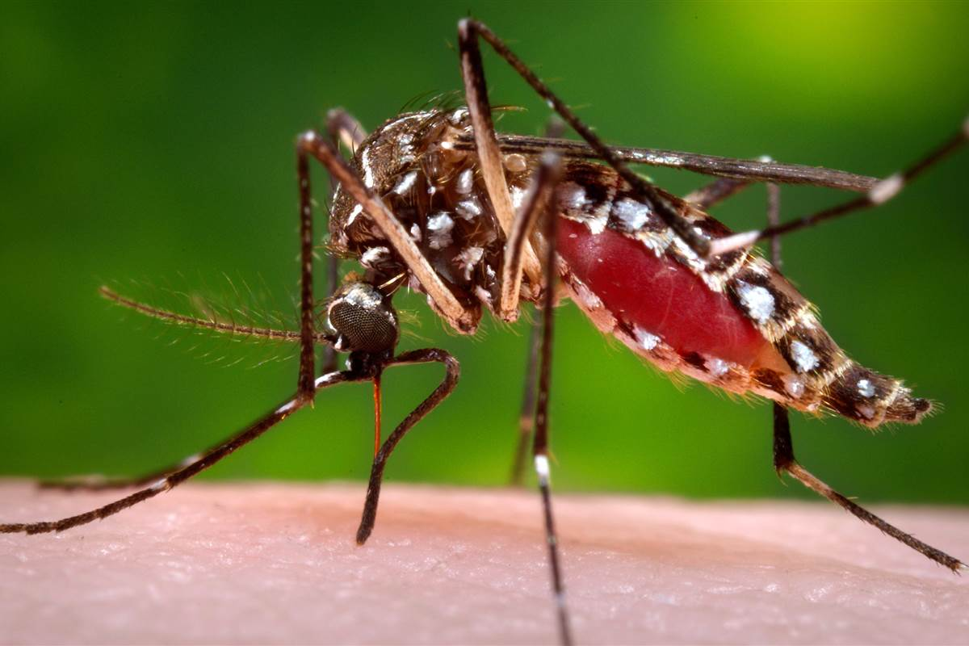
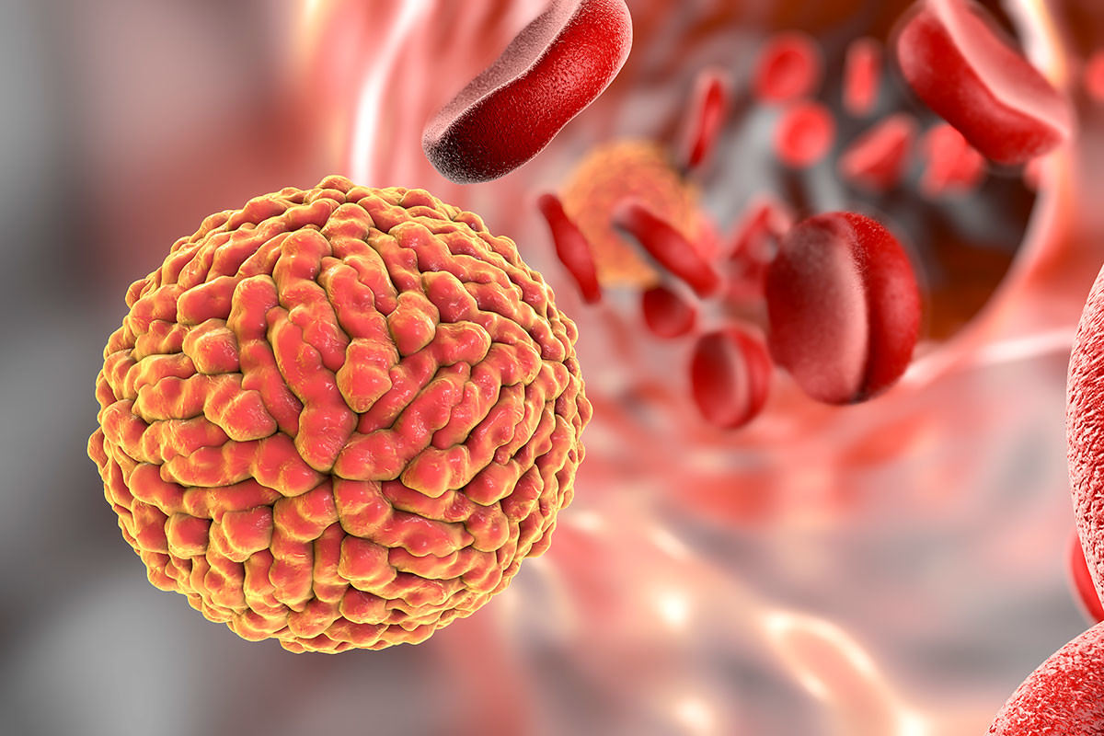
Zika Virus: What is it?
An Arbovirus
Genus flavivirus and family flaviviridae
Closely related to
Dengue virus
Yellow fever
Japanese encephalitis virus
West Nile Virus
Society for science and the public, 2017
Ragon Institute of MGH, MIT and Havard, 2017
Notes:
Information
ZIKV was first discovered among rhesus monkeys in Uganda some 70 years ago and the first ever recorded human case was in 1952
ZIKV is an arborvirus, belonging to the flaviviridae family, it is closely related to Dengue virus, yellow fever and Japanese encephalitis virus
ZIKV has two major geographical lineages, African (primates) and Asian (humans alone) lineages.
The African ZIKV is characterised by a life cycle that predominantly resides in apes with the occasional human host
The Asian ZIKV on the other hand almost exclusively resides in human host
Arbovirus is a term used to refer to any viruses that is transmitted by arthropod vectors
Summary: Zika virus was first discovered in Uganda around 70 years ago, first human case was in 1952. It is an arbovirus (meaning virus transferred by arthropod vectors) that belongs to the family flaviviridae. Closely related to dengue, yellow fever, japanese encephalitis, west nile. Two lineages, african which primarily affects primates and asian which primarily affects humans).

Slide 3
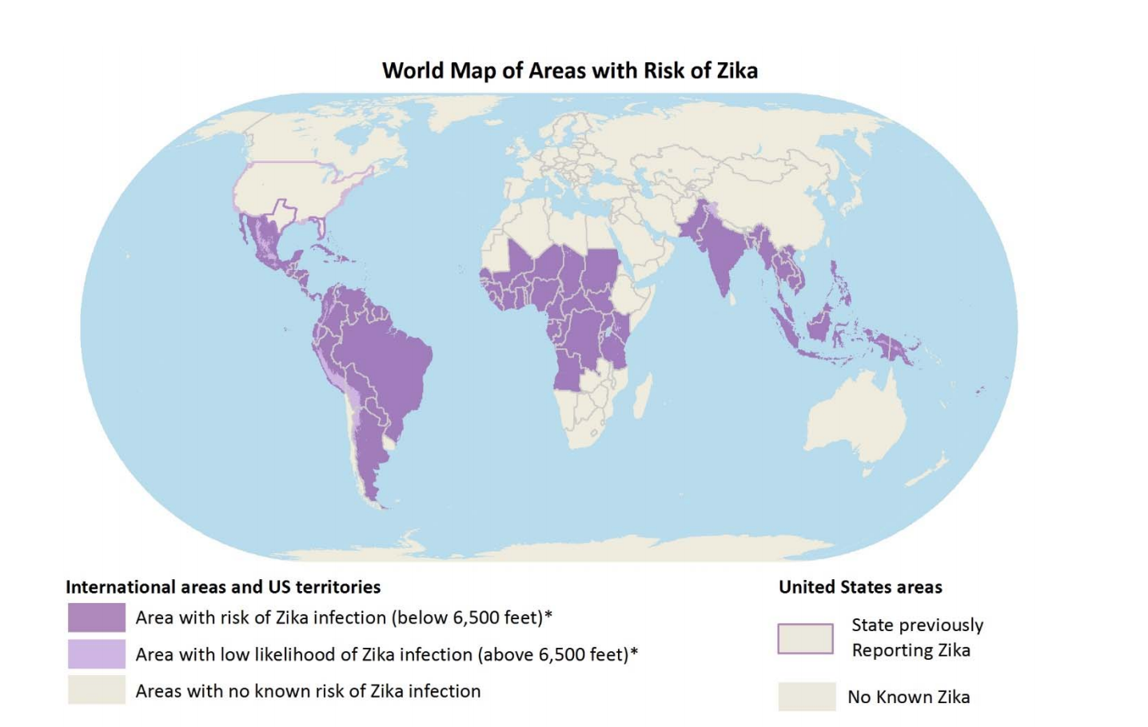
Risk Areas
Prior to 2015
Africa
Southeast Asia
The Pacific
Zika is now a global threat
CDC, 2018
Notes:
Prior to 2015. ZIKV outbreak occurred mostly in areas of Africa, Southeast Asia and the pacific Islands
However because the symptoms of ZIKV are similar to many other viral infections, many cases may have gone recognized and undocumented
The first major outbreak was reported in the Yap Islands of the Federated states of Micronesia with 185 confirmed individuals
The second outbreak occurred in 2013, French Polynesia suffered an outbreak with an estimated 32000 suspected cases
It was during this outbreak that the number of recorded Guillian Barre Syndrome rose by 20%
On May 7th 2015 the Pan American Health Organisation (PAHO) confirmed the first case of ZIKV infection
The 2015 outbreak of ZIKV in Brazil brought along with it a surge in neurological disorders
This quickly changed the perception of ZIKV as a harmless old disease
Molecular studies later showed that the ZIKV from French Polynesia and Brazil were the same strain and clearly from the Asian lineage.
It is believed that a traveller from French Polynesia was the source of the ZIKV outbreak in Brazil
Summary: Before 2015, Zika was primarily found in africa, south asia and pacific. However, the symptoms of zika are very similar to other viruses and thus the number of cases undocumented was very large. First outbreak was in yap islands with 185 cases. Second outbreak was in french polynesia in 2013 with 32000 cases and in this outbreak, guillian barre syndrome prevalence rose by 20%. In 2015, the PAHO confirmed first case of Zika in brazil. Finally changed perception of zika being harmless. Studies showed strains of zika in french polynesia and brazil were the same and asian lineage. Traveller from french polynesia caused outbreak in brazil.

Slide 4
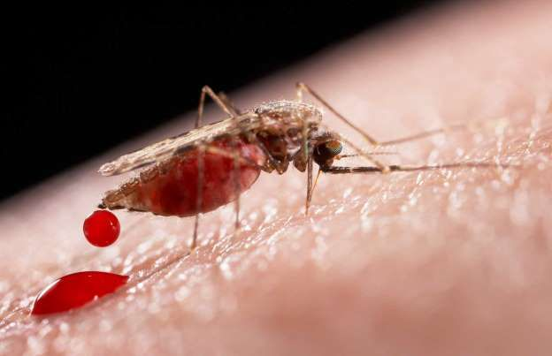
Transmission
Primarily through Aedes mosquitoes
Other modes of transmission includes
Sexual transmission
Laboratory exposure
Maternal to fetal
Periconceptional
Intrauterine
Perinatal
Modified from ICT & Health 2018
Notes:
Information
Primarily the mode of transmission of ZIKV is through the bite of infected Aedes mosquitoes
Other modes of transmission includes sexual transmission and maternal to fetal transmission during all stages of pregnancy
There has been no evidence of ZIKV infection through breastfeeding and as a result mothers are encouraged to continue breastfeeding in risk countries as the benefits outweigh the risks
The discovery of ZIKV RNA in most bodily fluids suggests the presence of other forms of transmission
To date, there have been male to male, female to male and male to female sexual transmission cases reported
There has only been one case of laboratory exposure in the united states
Although there have been no confirmed cases of ZIKV transmission through blood transfusion in the united states, there have been suspected cases in Brazil
Summary: primarily transmitted through the bite of infected aedes mosquito. Others are sexual transmission, lab exposure (one case in the US and in terms of blood transfusions, no confirmed cases but suspected in brazil) and maternal to fetal at all stages of pregnancy. No evidence that transmission occurs through breastfeeding so mothers still encouraged as benefits outweigh the risks. Because Zika is found in RNA of most body fluids, suggests many forms of transmission.

Slide 5
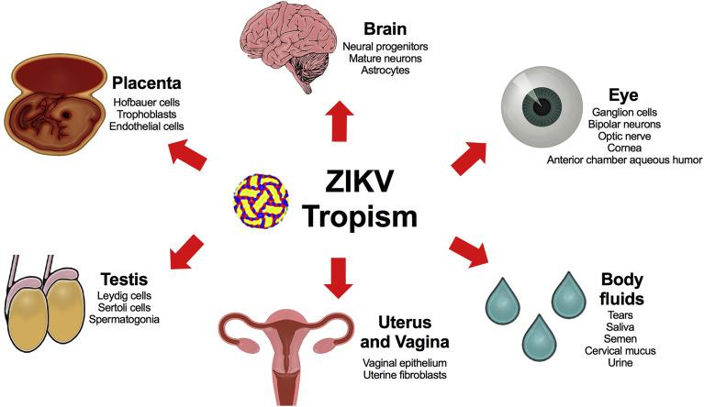
Pathogenesis
Blood meals
Replication in Aedes
Replication in host
Spread to Lymph node
Vireamia ensues
Modified from Miner and Diamond, 2017
Notes:
Little is known about the pathogenesis of ZIKV
Most of the information we have today of ZIKV is extrapolated from our knowledge of other closely related flavivirus
ZIKV is acquired by Aedes mosquito during a blood meal and undergoes replication in the body of the mosquito
Subsequently after replication, the virus reaches the salivary glands and is injected into the skin of the new host during a meal
The human skin thus becomes the first site of replication and the human epidermal cells have been experimentally proven to be permissive to ZIKV infection and replication
From the skin cells the virus spreads to the draining lymph node where it is amplified
Amplification of ZIKV in the lymph node gives rise to vireamia and dissemination to visceral organs and peripheral tissues of the body through the bloodstream
There are a few cell types for which ZIKV tropism has been proven so far two of which are neural and placental cells
In a recent ZIKV study both African and Asian lineage of ZIKV we shown to be highly efficient at infecting iPSC derived hNPCs and less efficient in differentiated immature neurons
Upon infection, the ZIKV behaves differently depending on the type of cell infected but ultimately induces a marked cytopathic effect and cell apoptosis via caspase-3 activation in all infected cells
This gives rise to ZIKV symptoms including reduced organoid size and thickness and enlarged lumen similar to those observed in microcephalic tissues
Summary: Little is known and most info is from other viruses. Once virus injected into skin of host, skin is first site of replication. From the skin, the virus spreads to the lymph nodes and is amplified. Causes viremia (virus in blood) and spread to organs and tissues in body, Upon infection, zika behaves differently depending on the type of cell infected but generally causes apoptosis via caspase 3 activation in infected cell. This causes symptoms associated with zika.

Slide 6
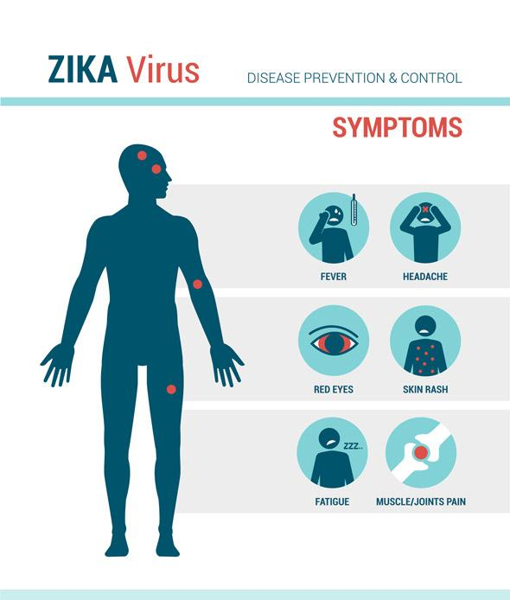
Symptoms
Modified from UWSWA, 2016
Notes:
Information
People usually aren't sick enough to go to hospital so don’t even know their infected … 1 in 4 people develop symptoms
Typical ones include ones on slide, also weakness and lack of energy (in other words fatigue)
Incubation period (exposure to symptoms) is 3 to 7 days
Symptoms last for 2-7 days
Symptoms similar to other mosquito spread viruses ie dengue virus and chikunguya
Picture from:
http://uwswa.org/zika/

Slide 7
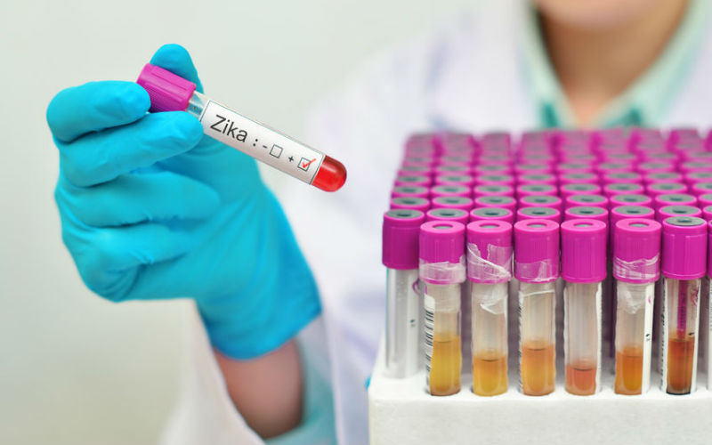
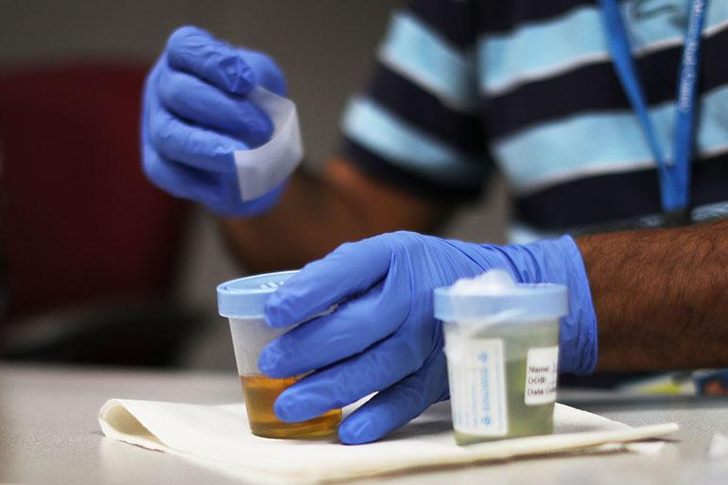
Testing
Most Common Tests:
Blood
Urine
Modified from GOS, 2017
Other Tests:
CSF
Semen
Amniotic Fluid
Modified from KHN, 2016
Notes:
Information:
Testing recommended if you develop systems, have traveled recently to a high risk area, sexual contact with someone who has zika
Zika is in blood of infected person for a roughly a week
Main tests on slide and other tests on slide
Optional info: to test blood & urine you do NAT (nucleic acid testing) via RT-PCR to identify targets on ZIKA virus if symptoms less than 7 days. If symptoms present longer than 7 days, do serology and look for IgM
Pictures from:
https://www.gov.sg/news/content/today-online-free-testing-for-pregnant-women-with-zika-symptoms
https://khn.org/news/reporters-notebook-pregnant-and-caught-in-zika-test-limbo/

Slide 8
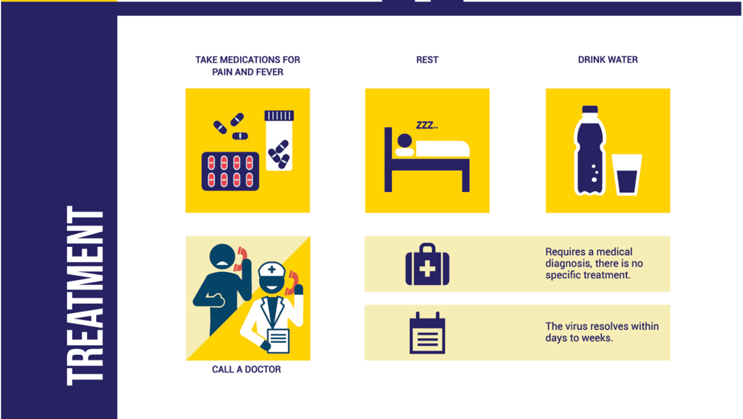
Treatment
Modified from the ZIKA Foundation, 2016
Notes:
Information:
No specific medicine or vaccine to treat ZIKA
Treatment instead involves addressing the symptoms
Rest & fluids for dehydration prevention
Tylenol (acetaminophen) for fever/pain
Can’t take non-steroidal anti-inflammatory meds eg. aspirin because person could have dengue (similar symptoms) which could cause bleeding
Once you’ve cleared infection, likely to be protected from future infections
Image from:
https://zikafoundation.org/symptoms-treatment/

Slide 9
Abbink et al., 2016 Study
n=8 Rhesus Monkeys
n=8 Rhesus Monkeys
Treatment: ZIKA PIV (0 & 4 weeks)
Control: Aluminum potassium sulfate (0 & 4 weeks)
n=4 of ZIKV-BR
n=4 of ZIKV-PR
n=4 of ZIKV-BR
n=4 of ZIKV-PR
Notes:
Immunized 8 rhesus monkeys with ZIKA PIV (Purified inactivated virus) and 8 with Aluminum potassium sulfate (control) at 0 and 4 weeks
All 8 getting the ZIKA PIV developed ZIKA specific binding antibodies according to ELISAs and microneutralization assays (MN50) and the other 8 did not develop the antibodies
Then infected or challenged both groups with viral particles of ZIKV-BR or ZIKV-PR n=4 per treatment

Slide 10
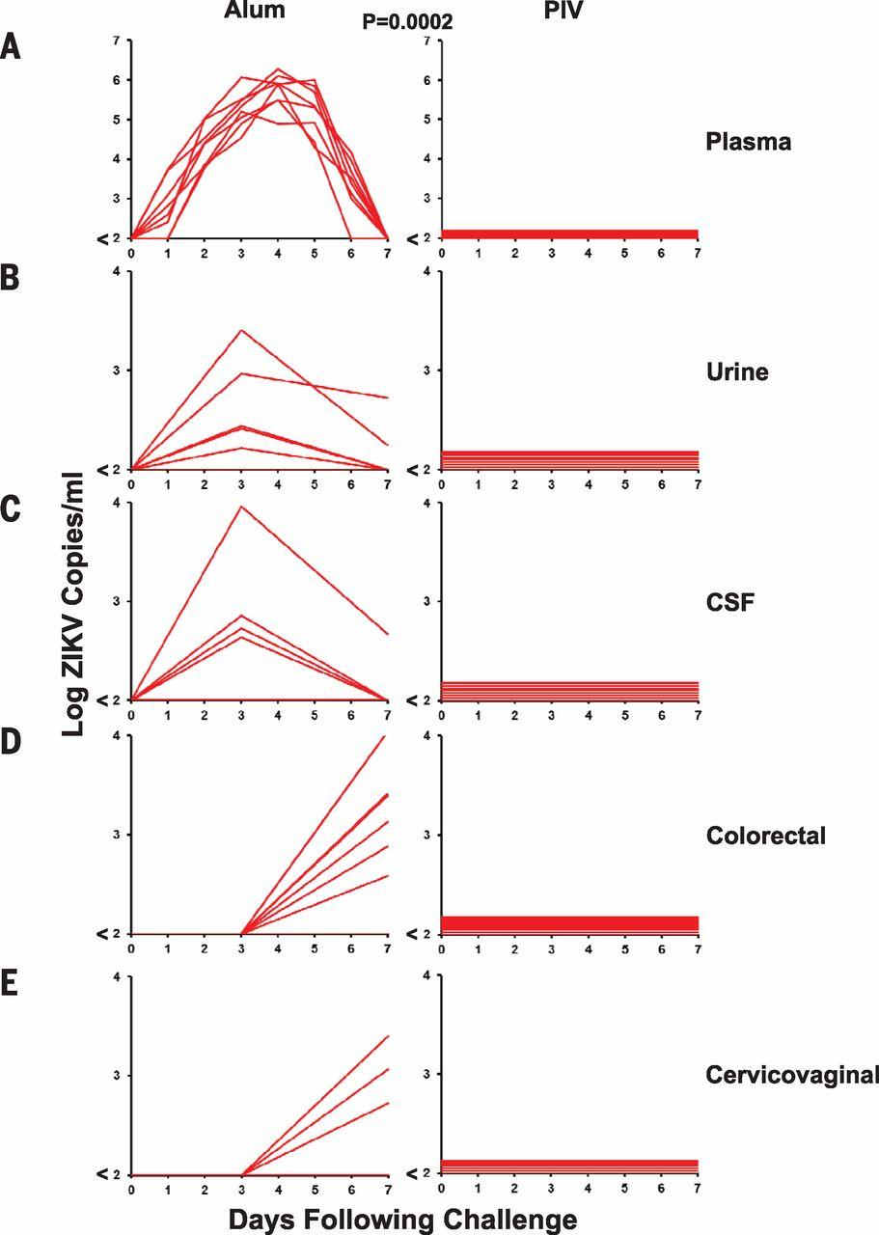
Abbink et al., 2016 Study
Controls showed an eventual increase in every collection method
PIV vaccinated monkeys demonstrated complete protection
No adverse side effects
Similar results seen in mice
Clinical trials being done on humans in the US & countries in South America
Modified from Abbink et al., 2016
Notes:
Control monkeys also showed 6 to 7 day viremia with peak loads on days 3 to 5
Virus detected in urine, CSF as well and later on colorectal secretions and cervico vaginal sceretions
In contrast, PIV vaccinated monekys showed complete protection agaisnt ZIKV challenge → no virus in any of detection methods
Good results which leads to next slide
Completed adoptive transfer studies (anitbodies) IgM and DNA based vaccines and saw similar results

Slide 11
Current Status of other ZIKA studies
NIAID - VRC 319
Phase 1 Clinical Trial - DNA based vaccine
St. Louis University SOM
Four Phase 1 Trials with PIV’s
2017
2018
2016
2017
NIAID - VRC 705
Phase 2 Clinical Trial - DNA based vaccine
NIAID
Clinical Trials of drug protecting against ZIKA and all four types of Dengue Virus
Notes:
This information is from here: https://www.niaid.nih.gov/diseases-conditions/zika-vaccines
2016 study -
https://www.niaid.nih.gov/news-events/nih-begins-testing-investigational-zika-vaccine-humans
Evaluating safety to generate an immune response
80 healthy volunteers 18-35 in the USA
Includes DNA plasmid that has genes coding for proteins of ZIKA
Body mounts a response to the proteins created → slightly better than PIVs for eg because not injecting a live version
4 groups of 20 people
All participants are vaccinated initially, half get another at 8 or 12 weeks, the remaining participants get two additional vaccines. One group of 20 gets 2nd vaccine at week 4 and third at week 8 and last group of 20 gets a 2nd vaccine at week 4 and 3rd a week 20.
All people followed up at 44 weeks → found to be safe and produce neutralizing anti body response.
2017 study →
https://www.niaid.nih.gov/news-events/phase-2-zika-vaccine-trial-begins-us-central-and-south-america
2490 healthy participants in areas of confirmed ZIKA infection ie south american countries to further evaluate safety and determine a dosing range and can it prevent disease caused by natural ZIKA infection
Also a DNA plasmid vaccine with genes coding for two genes on surface of zika vaccine which triggers a response
Part A → 90 men and women in affected areas and all will get vaccine 3 times 4 weeks apart and randomly assigned to standard or high dose aimed at determining safety, dosage and if can stimulate immune response
Part B→ double blinded 2400 men and women to determine if vaccine can protext agaisnt Zika if exposed to virus naturally
Randomly assigned to get vaccine or placebo 3 times 4 weeks apart
Followed for 2 years to track the effects
Will guide volunteers on preventative measures and then will compare zika rates in both groups

Slide 12
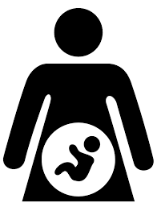
Risks and Health Effects
Risk
1 in 4
Risk for Fetus
Daylight and evening hours
People infected with Zika virus develop symptoms
Congenital Zika Syndrome
Characterized by:
Microcephaly
Decreased brain tissue
Damage to eyes
Club foot
Increased muscle tone
Ex. Guillain-Barre Syndrome
Elevations >2,000 metres
CDC, 2018.;Government of Canada, 2017.
Notes:
If you are travelling to countries or areas with reported mosquito-spread Zika virus, you are at risk of being infected
Mosquitoes that spread Zika bite during both daylight and evening hours however these mosquitoes generally do not live at elevations over 2,000 metres so there is lower risk at high altitudes
The risk to Canadians is low, as there are no reports of Zika-infected mosquitoes in Canada due to the cold climate
25% of people infected with Zika will actually show physical symptoms (i.e. fever, fatigue, skin rash, etc.)
A specific example is GBS, which has been shown in multiple studies to be associated with Zika infection. GBS is an autoimmune disorder that causes damage to nerve cells and eventual paralysis
Pregnant women who are exposed to the Zika virus or women who conceive a child whilst infected put their fetus at risk for severe birth defects.
Zika can remain in the blood for up to 1 week and in the semen up to 6 months
There is no evidence that the virus will cause infections in a baby after the virus has cleared from the blood of an infected mother or cause a risk for future pregnancies

Slide 13
Guillain-Barre Syndrome (GBS)
Notes:
Retrieved January 23 2018 from https://www.youtube.com/watch?v=4omfTbiB0kk
*Stop playing at 1:40
“Gee-on bar-eh”

Slide 14
GBS outbreak associated with Zika virus infection in French Polynesia: A case control study (Cao-Lormeau V et al., 2016)
Modified from Cao-Lormeau V et al., 2016
Notes:
Large Zika outbreak in the French Polynesia between 2013-2014 with 42 individuals presenting with GBS
These researchers state that this was one of the first direct associations of GBS with the Zika virus
They hypothesized that Zika virus infection is a risk factor for the development of GBS
Took blood samples from patients at a hospital in Polynesia at this time who were and were not diagnosed with GBS (control)
Used various techniques to detect antibodies against Zika virus in these patients
Found that previous occurrence of zika virus infection (as indicated by the presence of zika antibodies) was shown for 98% of patients in the GBS group compared to 36% in the control group (p<0.0001)
In addition, a neutralizing response (ie. protection against subsequent zika infection) against zika virus was seen in 100% of the GBS patients and 56% in the control group (p<0.0001)
The authors therefore exhibit a clear relationship between Zika and GBS

Slide 15
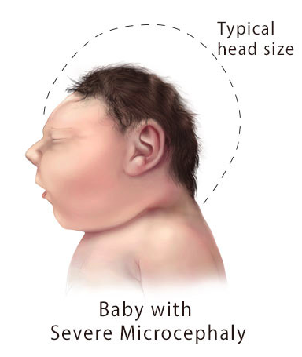
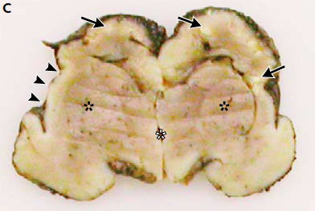
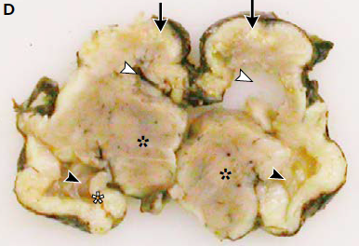
Zika Virus Associated with Microcephaly (Mlakar J et al., 2016)
Modified from CDC, 2018
Modified from Mlakar J et al., 2016
Notes:
A case study published in the New England Journal of Medicine described a case of a pregnant woman infected with Zika virus
The mother requested termination of the pregnancy after ultrasonography confirmed severe microcephaly with calcifications in the fetal brain and placenta
The fetus’ head circumference was 26cm (1st percentile) at 32 weeks when the pregnancy was terminated - microcephaly is anything less than the 3rd percentile (CDC)
This images are of an autopsy of the fetal brain
Panel C: Black whole arrows show white calcifications and almost complete loss of gyration of the cortex. Black arrowheads show open sylvian fissures. Asterix show poorly delineated basal ganglia
Panel D: White arrowheads show dilated lateral ventricles with the left one actual collapsed. Black Astrix shows thalami that are actually well developed. White astrix shows developed left hippocampus but you can see that the contralateral structure failed to develop on the other side

Slide 16
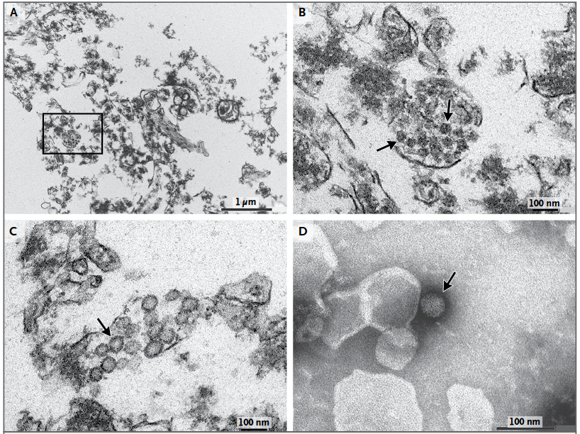
Zika Virus Associated with Microcephaly (Mlakar J et al., 2016)
Modified from Mlakar J et al., 2016
Notes:
Electron microscopy of ultrathin sections of the fetal brain and staining of the virus
Panel A shows damaged brain cells and cellular remains along with clusters of virions
Panel B is a magnified image of Panel A, you can clearly see the Zika virion clusters
Panel C is further showing the viral particles with arrows pointing to bright interiors that indicate viral replication
Panel D is a negative staining of the virion showing morphological features consistent with the zika virus
Stained with uranyl acetate and lead citrate
Negative staining is an established method, often used in diagnostic microscopy, for contrasting a thin specimen with an optically opaque fluid. In this technique, the background is stained, leaving the actual specimen untouched, and thus visible.

Slide 17
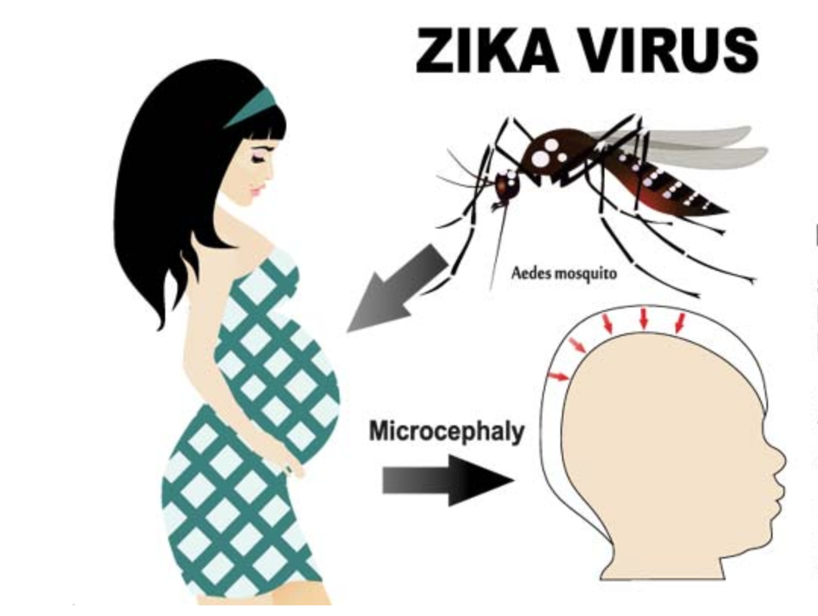
Planning for a Healthy Pregnancy
Avoid zika-infected areas.
Consumer Health Digest. (n.d.). [Modified image]. Why pregnant women should be cautious about zika virus?. Retrieved from https://www.consumerhealthdigest.com/pregnancy-center/zika-virus-and-pregnant-women.html
Notes:
The #1 precaution for women who are pregnant is not to travel to areas infected by zika virus (areas with documented or likely zika transmission)
If an individual does travel to an area or their partner travels to an area, they must take precautionary steps and use recommended prevention strategies.

Slide 18
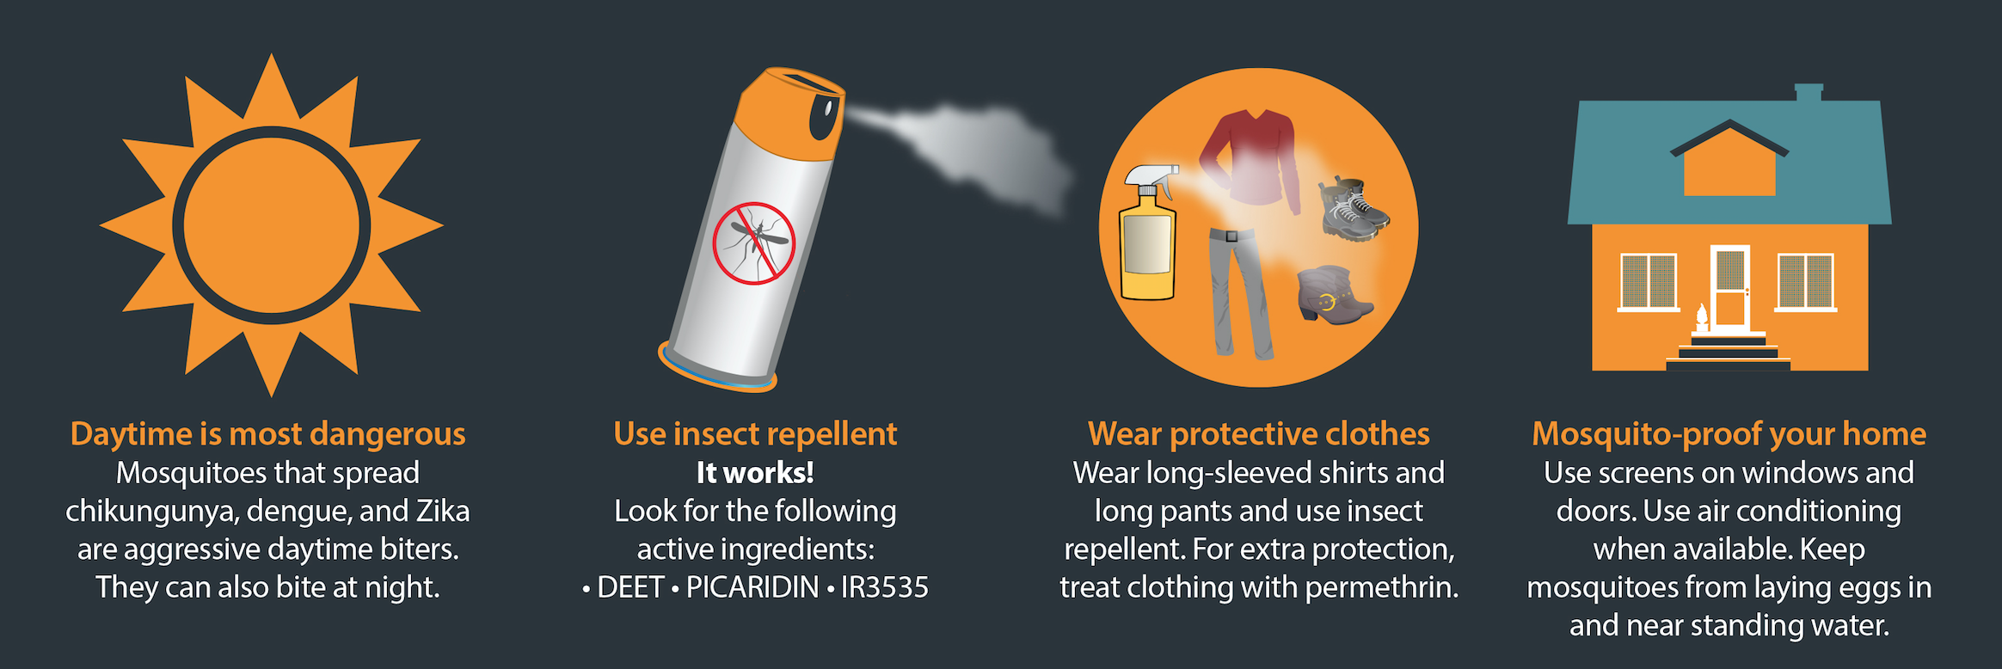
Prevention: Vector-borne Transmission
(CDC, 2017)
Notes:
No vaccine, so global health organizations and world governments have been advocating the implementation of several prevention methods to protect against Zika
To protect against mosquitoes:
Wear light coloured clothes that cover most of the body
Treat clothing with permethrin (medication, infesticide)
Continue to use insect repellent after returning from Zika active region
Try to find insect repellents with DEET, IR3535 or icaridin
Use physical barriers like mosquito nets and window screens
If doors and windows do not have screens, keep them closed as much as possible
Clean out potential breeding grounds for mosquitoes around the house (e.g. old tyres in garage, gutters, etc.)
Photo source: https://blogs.cdc.gov/publichealthmatters/2016/02/5-things-you-really-need-to-know-about-zika/

Slide 19
Prevention: Sexual Transmission
(CDC, 2018)
Notes:
Depends on the sex of the individual and whether they have been to a Zika active region
For women returning from active Zika region:
Wait 8 weeks before trying to conceive a child with your partner
Use condoms and other appropriate contraceptives or abstain from sex for 8 weeks
For men returning from active Zika region:
Wait 6 months before trying to conceive a child with your partner
Use condoms and implement other safe sex practices for 6 months
Photo source: https://www.cdc.gov/hiv/basics/prevention.html

Slide 20
Thank you!
Questions?

Slide 21
References
Abbink, P., Larocca, R. A., De La Barrera, R. A., Bricault, C. A., Moseley, E. T., Boyd, M., … Barouch, D. H. (2016).
Protective efficacy of multiple vaccine platforms against Zika virus challenge in rhesus monkeys. Science, 353(6304), 1129-32. doi:10.1126/science.aah6157
Baud, D., Gubler, D. J., Schaub, B., Lanteri, M. C., & Musso, D. (2017). An update on Zika virus infection. The Lancet.
Cao-Lormeau, V., Blake, A., Mons, S., Lastere, S., Roche, C., Vanhomwegen, J., Dub, T.,... Ghawche F. (2016).
Guillain-Barre Syndrome outbreak associated with Zika virus infection in French Polynesia: A case-control study. The Lancet, 387, 1531-1539. http://dx.doi.org/10.1016/S0140-6736(16)00562-6
Centers for Disease Control and Prevention (CDC). (2018, Jan 11). Zika Virus. Retrieved from https://www.cdc.gov/zika/
Index.html
Centers for Disease Control and Prevention (CDC). (2018, Jan 11). Zika Virus – Protect Yourself and Others. Retrieved from https://www.cdc.gov/zika/prevention/protect-yourself-and-others.html
Government of Canada. (2017, Mar 8). Risks of Zika Virus. Retrieved from
https://www.canada.ca/en/public-health/services/diseases/zika-virus/risks-zika-virus.html
Government of Canada. (2017, March 8). Prevention of Zika Virus. Retrieved from https://www.canada.ca/en/public-health/services/diseases/zika-virus/prevention-zika-virus.html
Mlakar, J., Korva, M., Tul, N., Popovic, M., Poljsak-Prijatelj, M., Mraz, J, Kolenc M.,... Zupanc, T.A. (2016). Zika virus
associated with microcephaly. New England Journal of Medicine, 374(10), 951-958.10.1056/NEJMoa1600651
National Institute of Allergy and Infectious Diseases. (2016, August 3). NIH Begins Testing Investigational Zika Vaccine in
Humans | NIH: National Institute of Allergy and Infectious Diseases. Retrieved from https://www.niaid.nih.gov/news-events/nih-begins-testing-investigational-zika-vaccine-humans
National Institute of Allergy and Infectious Diseases. (2017, March 3). Phase 2 Zika Vaccine Trial Begins in U.S., Central
and South America | NIH: National Institute of Allergy and Infectious Diseases. Retrieved from
https://www.niaid.nih.gov/news-events/phase-2-zika-vaccine-trial-begins-us-central-and-south-america
Public Health Agency of Canada. (2017, December 15). Zika virus. Retrieved from https://www.canada.ca/en/public-
health/services/diseases/zika-virus.html
World Health Organization. (2016, September 6). Zika virus. Retrieved from http://www.who.int/mediacentre/factsheets/zika/en/

Slide 22
Questions
How do clinicians typically test for the presence of Zika Virus?
Blood
CSF
Amniotic Fluid
Urine
Semen
More than one of the above
Paralysis and impairment of motor function in GBS are caused by:
Permanent closure of voltage-gated calcium channels on neuronal membranes
Failure of voltage-gated potassium channels to open
Damage to the myelin that surrounds axons
Inability of nerve cells to produce a strong enough action potential
None of the above

