Slide 1
Tay Sachs Disease
Group 5: Bhandari, M., Bhola, M., Desai, R., Joshi, D., & Shamim, A.

Slide 2
Table of Contents
Introduction
Signs & Symptoms
Epidemiology
Risk Factors
Inheritance
Pathophysiology
Diagnosis
Treatment
Conclusion

Slide 3
What is Tay Sachs?
Rare genetic disorder
Deletion of Hex A enzyme
Destroys the nervous system in a progressive manner
(GHR, 2012)

Slide 4
SIGNS & SYMPTOMS
What to look out for

Slide 5
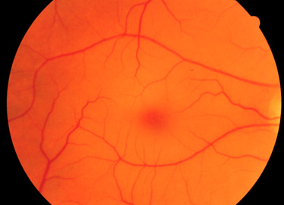
Early/Infantile Onset (~6 months)
Mild muscle weakness
Myoclonic jerks/twitches
Acoustic hypersensitivity
Easily startled in response to unexpected noises
Inability to hold eye contact
Gradual loss of vision
“Cherry red spots” → macular cell degeneration caused by choroid exposure
Apparent in ~90% of Tay Sachs cases
(NORD, 2016)

Slide 6
Childhood Onset (~2-10 years)
Lack of coordination and motor skills
Clumsiness
Unable to walk properly
Reduction in intellectual abilities
May develop retinitis pigmentosa
Degeneration of the retina
Loss of speech
(NORD, 2016)

Slide 7
Late Onset (Adolescence--)
Reduction in motor coordination
Muscle weakness
Involuntary muscle contractions
Tremors
Slurred speech
Changes in mood and mental health
Unable to complete daily tasks
(NORD, 2016)

Slide 8
EPIDEMIOLOGY
Distribution and determinants of Tay-Sachs disease

Slide 9
Genetic Risk Factors
Individuals of the following ethnicities are at a higher risk for being affected by Tay-Sachs or being heterozygous for the mutated allele:
Ashkenazi Jewish
French-Canadians of Quebec
Old Order Amish in Pennsylvania
Cajuns of Louisiana
Family history of condition
(Koeslag, 1984)

Slide 10
Tay-Sachs Map
French Canadians
Ashkenazi Jews
Pennsylvania Amish
Louisiana Cajuns

Slide 11
Theories
Heterozygote advantage
Being a carrier of mutated gene provides resistance against tuberculosis
Random genetic drift
Change in allele frequencies due to chance
Founder effect
Isolated populations
Small initial population: high genetic mutation frequency
Reproductive compensation
Parents who have children affected by Tay-Sachs may continue reproducing
(Withrock, 2015)(Chakravarti, 1978)

Slide 12
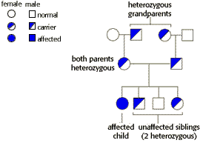
Case Study
A couple has a female child with Tay-Sachs disease, and three unaffected children. Neither parent nor any of the biological grandparents of the affected child has had this disease.
Dominant or recessive?
Autosomal or X-linked?
(The University of Arizona, 1998)

Slide 13
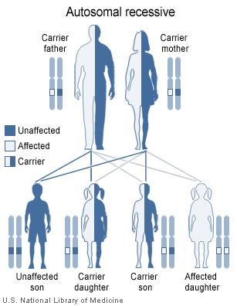
Genetic Inheritance
Notes:
http://www.biology.arizona.edu/human_bio/problem_sets/human_genetics/04t.html

Slide 14
PATHOPHYSIOLOGY
Underlying Mechanisms of Disease

Slide 15
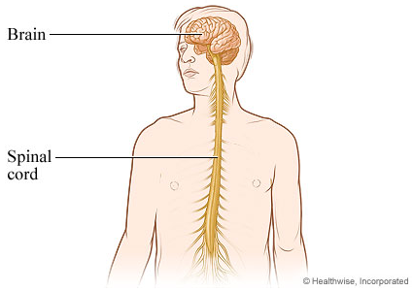
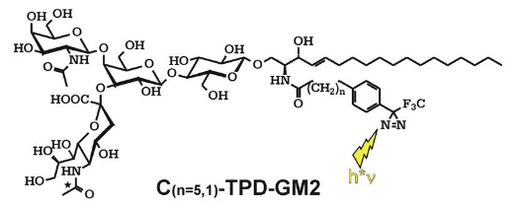
Neurophysiology
Central Nervous System
Brain & Spinal Cord
Gangliosides
Plasma Membrane
Cell-cell recognition, adhesion and signal transduction
GM2 gangliosides
(Yu, Tsai, Ariga, & Yanagisawa, 2013) (Sandhoff & Harzer, 2013)

Slide 16
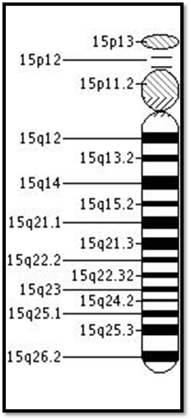
HEXA Gene
Chromosome 15
15q24.1
Encodes
β Hexosaminidase A
(Genetics Home Reference, 2017)
(Neudorfer et al., 2005)

Slide 17
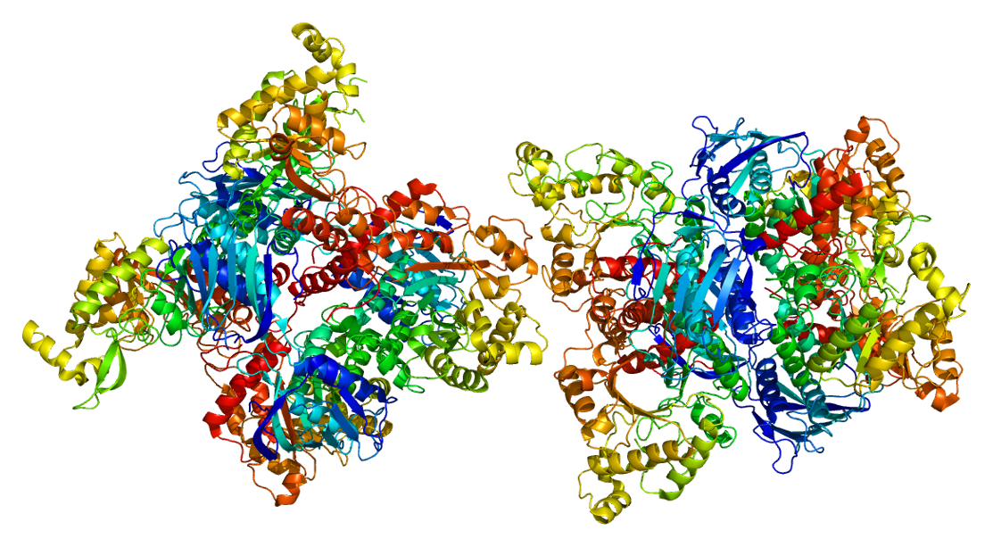
Beta Hexosaminidase A
Lysosomal Enzyme
Degrades GM2 gangliosides
Two subunits
α/β heterodimer
(Pymol, 2009)
(Sandhoff & Harzer, 2013) (Myerowitz, 1997)
Tay-Sachs Disease
α - subunit

Slide 18
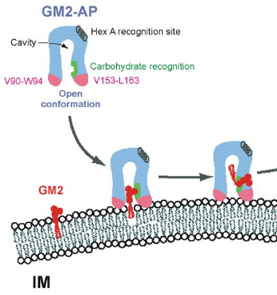
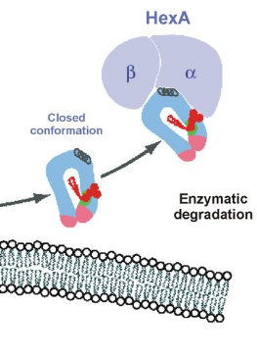
Cellular Pathway
(Sandhoff, 2013)

Slide 19
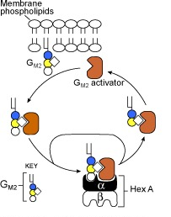
Mutation
Single Point Mutation
Affect Lysosomal Catalytic Activity
x
x
(Genetics Home Reference, 2017)
(Pymol, 2009)
(Myerowitz, 1997)
(Chavany & Jendoubi, 1998)

Slide 20
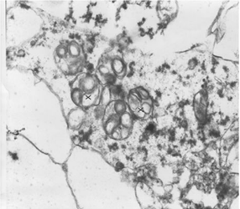
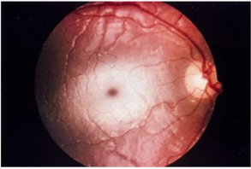
Result
GM2 Gangliosidosis
Neural Degeneration
(Sandhoff, 2013))
Red Macular Spot (Sandhoff, 2013))
(Sandhoff, 2013) (Sandhoff & Harzer, 2013)

Slide 21
DIAGNOSIS
Various screening methods

Slide 22
Diagnosis
Blood tests
Measures hexosaminidase A levels in the body
Reduced levels in people with Tay-Sachs
Molecular genetic testing
Detect mutation in HEXA gene
Testing prenatally
Chorionic villi sampling (CVS)
Amniocentesis
(NIH, 2011) (NORD, 2016)

Slide 23
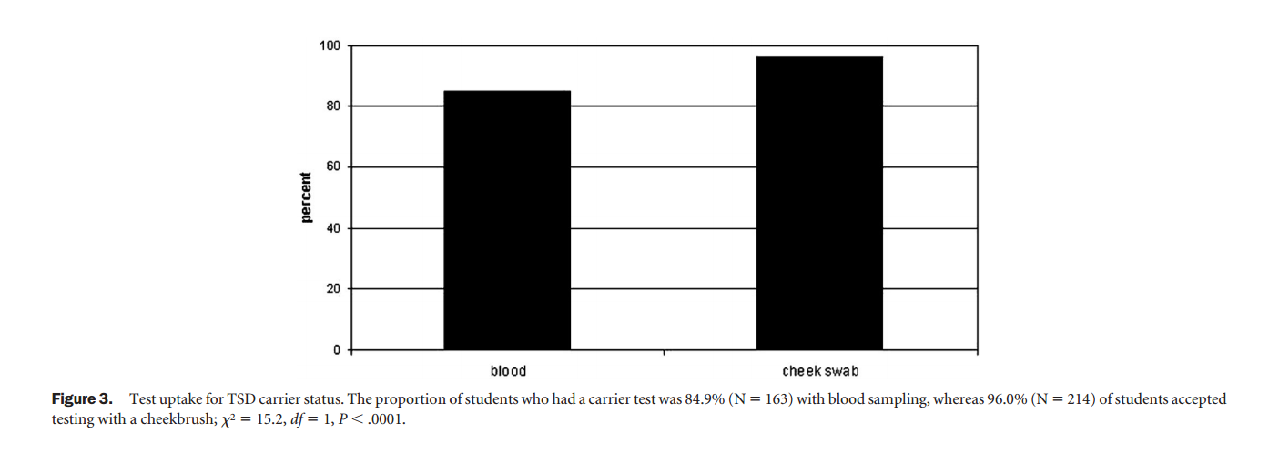
Carrier screening in schools
(Gason et al., 2005)

Slide 24
TREATMENT
Treatment aimed at relieving symptoms

Slide 25
Treatment Approach
Drug Treatment
Genetic Counselling
Psychosocial Support

Slide 26
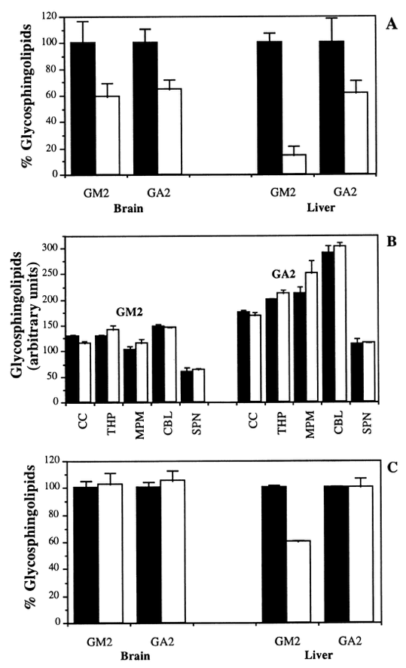
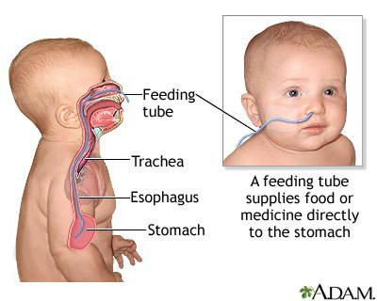
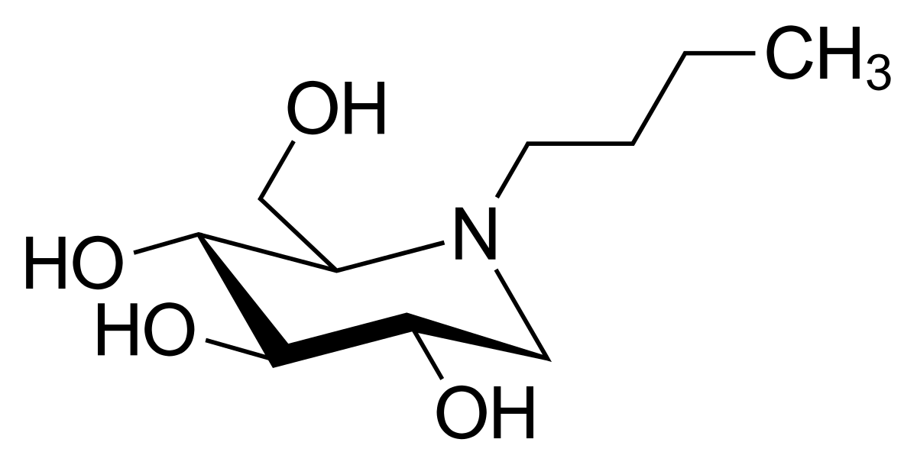
Current Therapeutic Options
Anticonvulsants
Anticonvulsants may be used to treat seizures
Miglustat (synthetic analogue of D-glucose)
Substrate Deprivation
N-butyldeoxynojirimycin (inhibitor of glycosphingolipid synthesis)
Nutritional Support
Infants monitored for proper nutrition and hydration
Feeding tube may be necessary
(Osher et al., 2011)

Slide 27
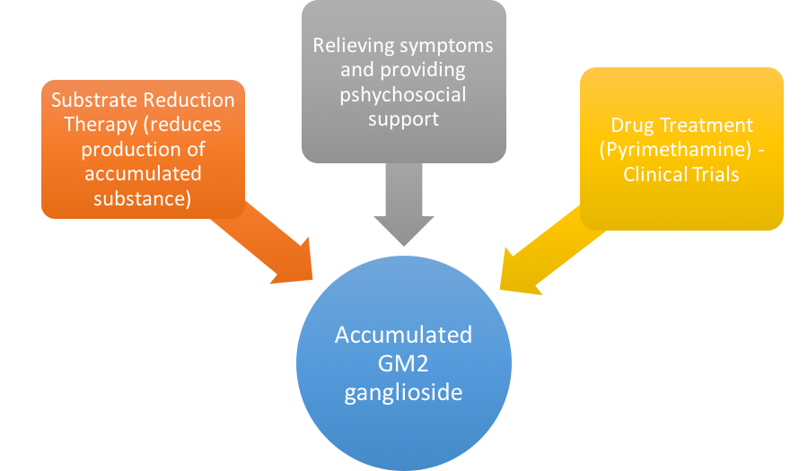
Investigational Therapies
(Cachón-González et al., 2006)

Slide 28
Investigational Therapies...cont’d
(Cachón-González et al., 2006)

Slide 29
Conclusion
What can we do moving forward?

Slide 30
Family Battles Tay-Sachs Disease
Notes:
End video at 1:38

Slide 31
National Tay-Sachs & Allied Diseases Association
4 key areas of focus:
Education
Advocacy
Research
Family Services
(NTSAD, n.a.)

Slide 32
Questions
How is this disease inherited?
Autosomal Dominant
Autosomal Recessive
X-linked Dominant
X-linked Recessive
2. What gene is mutated in Tay-Sachs Disease?
HEXA gene
HEXB gene
GM2 ganglioside
β Hexosaminidase A

Slide 33
Thanks!
Any questions?

Slide 34
References
About NTSAD. (n.d.). Retrieved from https://www.ntsad.org/index.php/about
Chakravarti, A. and Chakraborty R. (1978). Elevated frequency of Tay-Sachs disease among Ashkenazic Jews unlikely by genetic drift alone. Am J Hum Genet, 30(3): 256-261. https://www.ncbi.nlm.nih.gov/pmc/articles/PMC1685578/
Cachón-González, M. B., Wang, S. Z., Lynch, A., Ziegler, R., Cheng, S. H., & Cox, T. M. (2006). Effective gene therapy in an authentic model of Tay-Sachs-related diseases. Proceedings of the National Academy of Sciences, 103(27), 10373-10378.
Frisch, A. et. al. (2004). Origin and spread of the 1278insTATC mutation causing Tay-Sachs disease in Ashkenazi Jews: genetic drift as a robust and parsimonious hypothesis. Human Genetics, 114 (4): 366-376.Doi 10.1007/s00439-003-1072-8 http://link.springer.com/article/10.1007%2Fs00439-003-1072-8
Gason, A. A., Metcalfe, S. A., Delatycki, M. B., Petrou, V., Sheffield, E., Bankier, A., & Aitken, M. (2005). Tay Sachs disease carrier screening in schools: educational alternatives and cheekbrush sampling. Genetics in Medicine, 7(9), 626-632.
GHR. (2012). Tay-Sachs disease - Genetics Home Reference. Retrieved March 05, 2017, from https://ghr.nlm.nih.gov/condition/tay-sachs-disease#diagnosis
Jeyakumar, M., Butters, T. D., Cortina-Borja, M., Hunnam, V., Proia, R. L., Perry, V. H., ... & Platt, F. M. (1999). Delayed symptom onset and increased life expectancy in Sandhoff disease mice treated with N-butyldeoxynojirimycin. Proceedings of the National Academy of Sciences, 96(11), 6388-6393.
Koeslag, J. H. and Schach, S. R. (1984), Tay–Sachs disease and the role of reproductive compensation in the maintenance of ethnic variations in the incidence of autosomal recessive disease. Annals of Human Genetics, 48: 275–281. doi:10.1111/j.1469-1809.1984.tb01025.x
Learning About Tay-Sachs Disease. (2011, March 17). Retrieved from https://www.genome.gov/10001220/learning-about-taysachs-disease/
Lew, R. M., Burnett, L., Proos, A. L., Barlow‐Stewart, K., Delatycki, M. B., Bankier, A., … & Fietz, M. (2015). Ashkenazi Jewish population screening for Tay–Sachs disease: The International and Australian experience. Journal of paediatrics and child health, 51(3), 271-279.
NORD. (2016). Tay Sachs Disease. Retrieved March 05, 2017, from https://rarediseases.org/rare-diseases/tay-sachs-disease/
Osher, E., Fattal-Valevski, A., Sagie, L., Urshanski, N., Amir-Levi, Y., Katzburg, S., ... & Navon, R. (2011). Pyrimethamine increases β-hexosaminidase A activity in patients with Late Onset Tay Sachs. Molecular genetics and metabolism, 102(3), 356-363.
Tay Sachs disease (2017). Genetics Home Reference. https://ghr.nlm.nih.gov/condition/tay-sachs-disease
Tay Sachs Disease. (n.d.). Retrieved from https://rarediseases.org/rare-diseases/tay-sachs-disease/
Tay Sachs Disease. (n.d.). Retrieved from https://rarediseases.org/rare-diseases/tay-sachs-disease/
Withrock, I. C. et. al. (2015). Genetic diseases conferring resistance to infectious diseases. Genes & Diseases, 2(3): 247-254. doi: 10.1016/j.gendis.2015.02.008 http://www.sciencedirect.com/science/article/pii/S2352304215000239

