Slide 1
Investigating the Mental Disorder: Schizophrenia
Tiffane Anandarajan
Vaidehi Bhatt
Giulia Coletta
Kulsum Saeed
Michael Kwok

Slide 2
Schizophrenia Simulation
What are some things you noticed about the behaviour of the individual in the video?

Slide 3
Introduction
‘Splitting of the mind’
Rare in the population
Episodes of altered reality that is extremely debilitating - feel, act, behave
Positive / Negative Symptoms
A chronic condition with no cure
Not much is known - high variability
Notes:
Lionel Aldridge

Slide 4
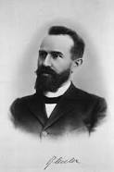
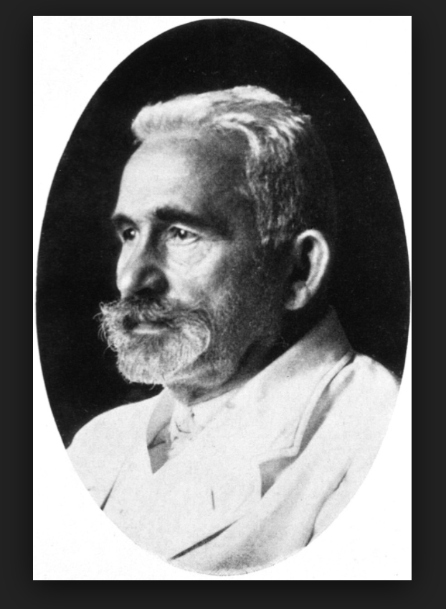
History
Emil Kraepelin first classified schizophrenia in 1887 as a mental disorder
‘Dementia Praecox’ early dementia
Eugen Bleular, a Swiss psychiatrist in 1911 created the term ‘Schizophrenia’ and classified it's positive and negative symptoms
Kraeplin’s terms was misleading as it did not always lead to mental deterioration
Greek Roots Schizo = split; Phrene = mind
Controversial term
DSM III grouped schizophrenia into 5 categories:
Disorganized
Catatonic
Paranoid
Residual
Undifferentiated
Notes:
Look into that

Slide 5
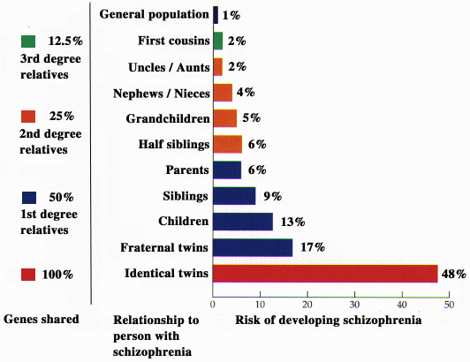
Epidemiology
Lifetime prevalence: 0.3-0.7% → 1 in 300
Lifetime incidence: 10.2-22.0 per 100 000 people/year
Young Adulthood 20-30 y o
Male-Female Ratio: 1.4 : 1
Symptomatic expression more severe in men
Earlier Onset

Slide 6
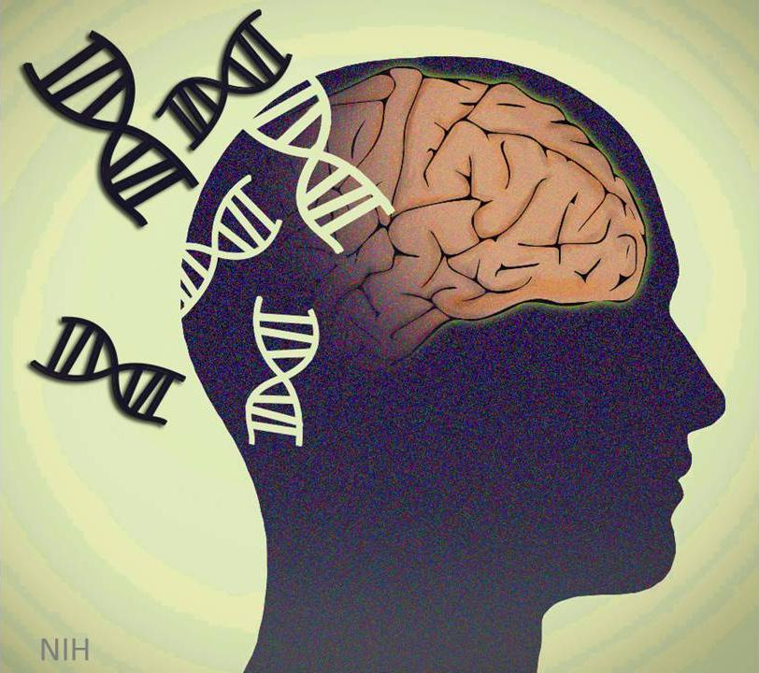
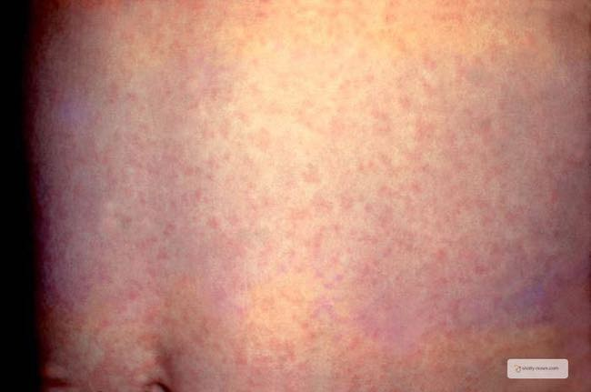
Etiology
Genetics
Multiple genes
Mutations
10% of patients have a 1st degree relative with the disorder
In the case of twins, the likelihood is in a range from 41%-65%
Autoimmune Diseases
Severe Infection
Rubella
Environmental and Developmental Factors
Prenatal brain damage / Premature birth
Isolation
Drugs
Stress

Slide 7
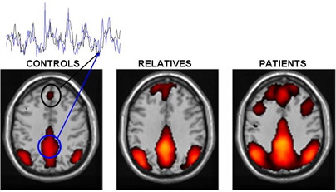
Diagnosis
Physician-based
Observing appearance, demeanour, mood, delusion and hallucination episodes, and family history
DSM-5
Functional Neuroimaging Techniques
Functional magnetic resonance imaging (fMRI)
Positron emission tomography (PET)
Magnetic resonance spectroscopy (MRS)
Schizophrenia varies from patient to patient

Slide 8
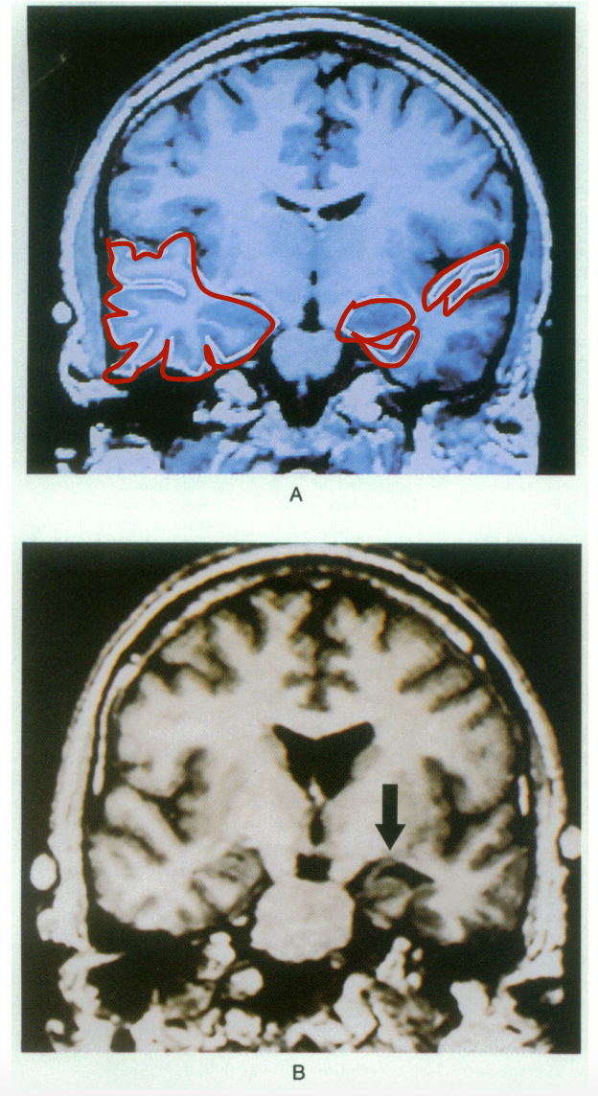
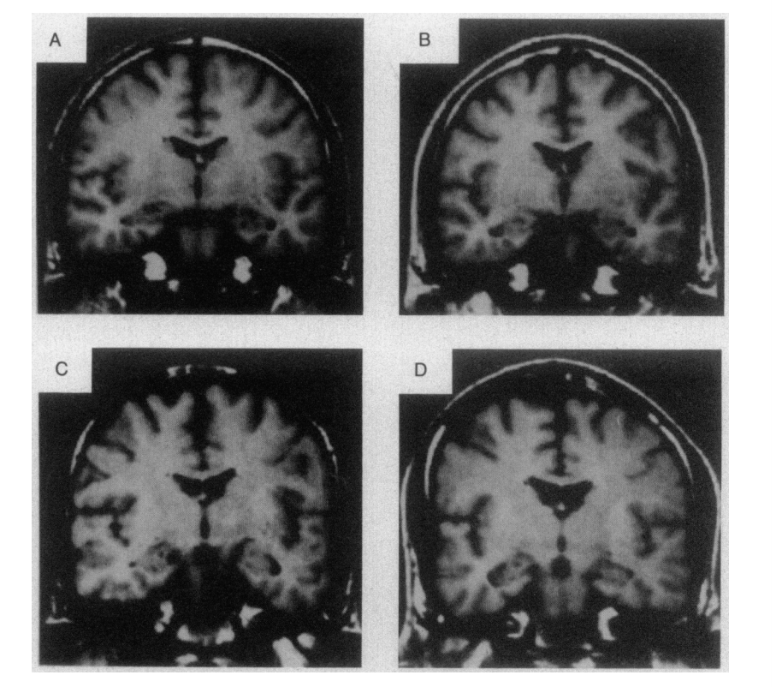
Pathophysiology
Anatomic Abnormalities
Prefrontal and medial temporal lobe and cortical regions affect
Larger ventricular volumes
Smaller hippocampus, thalamus, amygdala, nucleus accumbens, intercranial space
White and grey matter 5-6% smaller
Decrease in Default Mode Network activation and increase in Auditory Networks activation

Slide 9
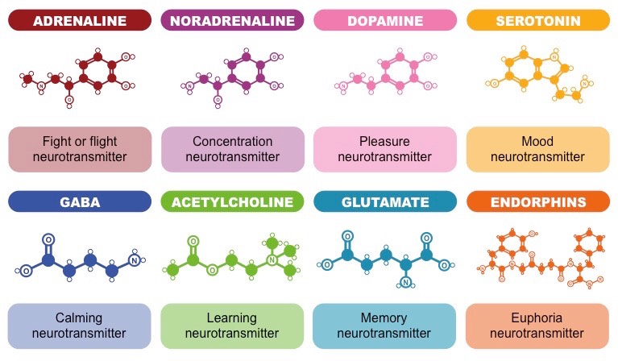
Pathophysiology
Neurotransmitter System Abnormalities
Dopamine, Serotonin, GABA, glutamate imbalances
Most symptoms are due to excess dopamine levels

Slide 10
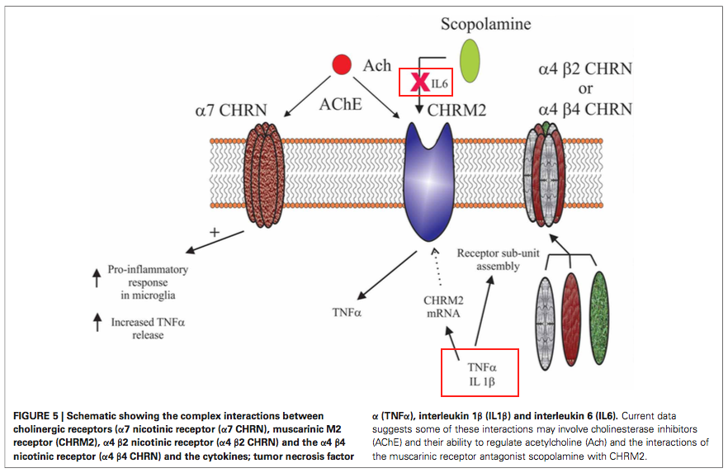
Pathophysiology
Immunology and Inflammation
Non-specific overactivation of immunological response of T-helper cells for inflammation
Cytokines imbalance leads to Th1 cell decrease and increase in Th2 secretion
Cytokines:
IL2
IL6
IL10
Tumor necrosis
Mitogen levels

Slide 11
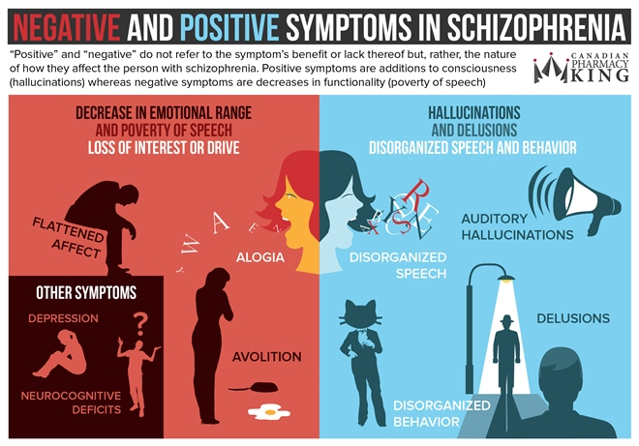
Symptoms
Positive - Symptoms not present in healthy individuals
Delusions
Hallucinations
Disorganized thinking and speech
Abnormal motor behaviour
Childhood silliness and agitation
Negative - Reduced functioning
Avolition/Apathy - No passion or emotion
Alogia - speech impairment
Anhedonia - reduced pleasure

Slide 12
Case Study - Atypical Musculoskeletal Pain
19 year old male university student has wrist pain after falling on it while skateboarding
Was originally viewed as a musculoskeletal dysfunction, over 22 months had pain all over and doctors could not diagnose him
Through an interview setting, he was questioned for a psychiatric disease
Later diagnosed with Schizophrenia
Redefined the way neuromusculoskeletal assessment and treatment are thought of
Reference
https://www.ncbi.nlm.nih.gov/pmc/articles/PMC2958076/

Slide 13
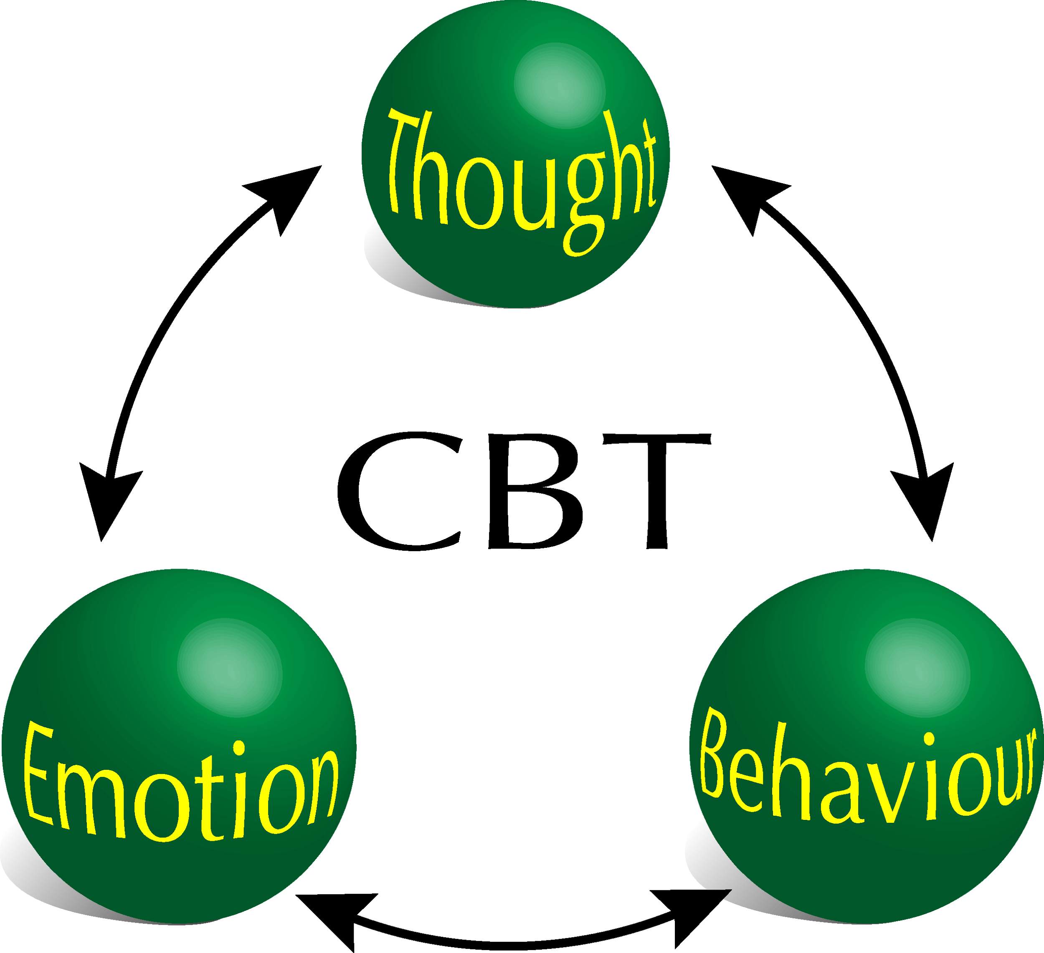
Treatments
No known cure currently
Initiate with the Care Program Approach
Develop a personal approach for treatment based off of each patient
Cognitive Behavioural Therapy
Pharmacological Drug Approach
Excess dopamine levels
First Generation antipsychotic
Clozapine
Second generation antipsychotic
Aripiprazole
Olanzapine
Paliperidone

Slide 14
Ending Off...

Slide 15
References
Burton, N. (2012). A Brief History of Schizophrenia. Retrieved January 24, 2018, from https://www.psychologytoday.com/blog/hide-and-seek/201209/brief-history-schizophrenia
Bromet, E. J., & Fennig, S. (1999). Epidemiology and natural history of schizophrenia. Biological psychiatry, 46(7), 871-881.
Cardno, A. G., & Gottesman, I. I. (2000). Twin studies of schizophrenia: from bow‐and‐arrow concordances to star wars Mx and functional genomics. American Journal of Medical Genetics Part A, 97(1), 12-17.
Deng, C., & Dean, B. (2013). Mapping the pathophysiology of schizophrenia: interactions between multiple cellular pathways. Frontiers in cellular neuroscience, 7.
Frankenburg, F. (2018). Schizophrenia: Practice Essentials, Background, Pathophysiology. Emedicine.medscape.com. Retrieved 23 January 2018, from https://emedicine.medscape.com/article/288259-overview#a3
Gao, X., Zhang, W., Yao, L., Xiao, Y., Liu, L., Liu, J., ... & Sweeney, J. A. (2017). Association between structural and functional brain alterations in drug-free patients with schizophrenia: a multimodal meta-analysis. Journal of psychiatry & neuroscience: JPN, 43(1), 160219-160219.
Gaughran, F., O'Neill, E., Cole, M., Collins, K., Daly, R. J., & Shanahan, F. (1998). Increased soluble interleukin 2 receptor levels in schizophrenia. Schizophrenia research, 29(3), 263-267.
Ginestet, D., Loo, H., & Zarifian, E. (1989). Aberrant T cell-mediated immunity in untreated schizophrenic patients: deficient interleukin-2 production. Am J Psychiatry, 1(46), 609.
Gong, Q., Lui, S., & Sweeney, J. A. (2015). A selective review of cerebral abnormalities in patients with first-episode schizophrenia before and after treatment. American Journal of Psychiatry, 173(3), 232-243.
Healthwise Staff (2011). Second-Generation Antipsychotics for Treating Schizophrenia. Michigan Medicine.
Karlsgodt, K. H., Sun, D., & Cannon, T. D. (2010). Structural and functional brain abnormalities in schizophrenia. Current directions in psychological science, 19(4), 226-231.
Kay, S., Fiszbein, A., & Opler, L. (1987). The positive and negative syndrome scale (PANSS) for schizophrenia. Schizophrenia Bulletin, 13(2), 261-276.
Jablensky, A. (2010). The diagnostic concept of schizophrenia: its history, evolution, and future prospects. Dialogues in clinical neuroscience, 12(3), 271.
Learn about what is schizophrenia and schizophrenia treatment options. (2018). Schizophrenia.ca. Retrieved 23 January 2018, from http://www.schizophrenia.ca/learn_more_about_schizophrenia.php
Lichtenstein, Paul, et al. "Common genetic determinants of schizophrenia and bipolar disorder in Swedish families: a population-based study." The Lancet 373.9659 (2009): 234-239.
McDonald, C., & Murray, R. (2000). Early and late environmental risk factors for schizophrenia. Brain Research Reviews, 31(2-3), 130-137.
McGuire, P., Howes, O., Stone, J., & Fusarpoli, P. (2008). Functional neuroimaging in schizophrenia: diagnosis and drug discovery. Trends In Pharmacological Sciences, 29(2), 91-98.
McGrath, J. J., & Sasser, E. S. (2009). New directions in the epidemiology of schizophrenia. Medical Journal of Australia, 190(4), S7.
McIntosh, A. M., Owens, D. C., Moorhead, W. J., Whalley, H. C., Stanfield, A. C., Hall, J., ... & Lawrie, S. M. (2011). Longitudinal volume reductions in people at high genetic risk of schizophrenia as they develop psychosis. Biological psychiatry, 69(10), 953-958
NIMH » Schizophrenia. (2018). Nimh.nih.gov. Retrieved 23 January 2018, from https://www.nimh.nih.gov/health/topics/schizophrenia/index.shtml
Muller, N., Riedel, M., Hadjamu, M., & Schwarz, M. J. (1999). Increase in expression of adhesion molecule receptors on T helper cells during antipsychotic treatment and relationship to blood-brain barrier permeability in schizophrenia. The American Journal of Psychiatry, 156(4), 634.
Patel, K. R., Cherian, J., Gohil, K., & Atkinson, D. (2014). Schizophrenia: overview and treatment options. Pharmacy and Therapeutics, 39(9), 638.
Potvin, S., Stip, E., Sepehry, A. A., Gendron, A., Bah, R., & Kouassi, E. (2008). Inflammatory cytokine alterations in schizophrenia: a systematic quantitative review. Biological psychiatry, 63(8), 801-808.
Reichenberg, A., Rieckmann, N., & Harvey, P. (2005). Stability in schizophrenia symptoms over time: Findings from the Mount Sinai Pilgrim Psychiatric Center Longitudinal Study. Journal Of Abnormal Psychology, 114(3), 363-372.
Schizophrenia - CMHA National. (2018). CMHA National. Retrieved 23 January 2018, from https://cmha.ca/mental-health/understanding-mental-illness/schizophrenia
Schizophrenia - Diagnosis and treatment - Mayo Clinic. (2018). Mayoclinic.org. Retrieved 21 January 2018, from https://www.mayoclinic.org/diseases-conditions/schizophrenia/diagnosis-treatment/drc-20354449
Sigmundsson, T., Suckling, J., Maier, M., Williams, S. C., Bullmore, E. T., Greenwood, K. E., ... & Toone, B. K. (2001). Structural abnormalities in frontal, temporal, and limbic regions and interconnecting white matter tracts in schizophrenic patients with prominent negative symptoms. American Journal of Psychiatry, 158(2), 234-243.
Snyder, S. (2018). What dopamine does in the brain. PNAS. Retrieved 23 January 2018, from http://www.pnas.org/content/108/47/18869.full
Spencer, E., & Campbell, M. (1994). Children with Schizophrenia: Diagnosis, phenomenology, and pharmacotherapy. Schizophrenia Bulletin, 20(4), 713-725.
Strous, R. D., & Shoenfeld, Y. (2006). Schizophrenia, autoimmunity and immune system dysregulation: a comprehensive model updated and revisited. Journal of autoimmunity, 27(2), 71-80.
van Os, J., & Kapur, S. (2018). Schizophrenia. ScienceDirect. Retrieved 23 January 2018, from http://www.sciencedirect.com/science/article/pii/S0140673609609958?via%3Dihub

