Slide 1
EPILEPSY
Childhood Absence Epilepsy

Slide 2
Overview
Case Study
Introduction
Epidemiology
Signs and Symptoms
Diagnosis
Aetiology
Pathophysiology
Prognosis
Treatment and Management
Notes:
Mention that we will be explaining epilepsy in general and Childhood Absence Epilepsy more specifically

Slide 3
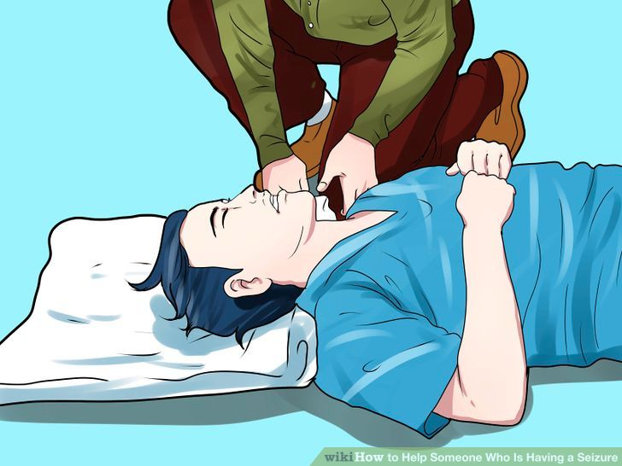
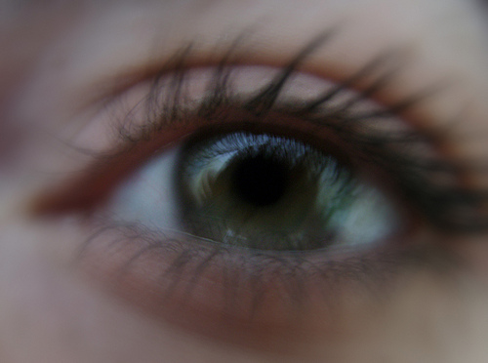
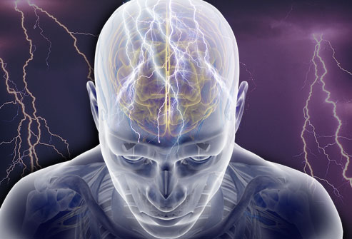
Case Study
Notes:
Imagine this: unprovoked seizures with uncontrollable jerking (image 1),
A loss of consciousness or awareness, and confusion (image 2)
And a temporary disruption of brain activity at the cell level (image 3).
This is what a young boy, growing up in Minneapolis in the 60s, faced daily. Along with this, he struggled to make friends and fit in at school, because despite his illness, his eccentric personality made him incredibly unique. He was teased relentlessly for his condition. Still, in lieu of this, the young boy’s family did what they could with the little money and resources they had, and managed his condition the best they could. His own resilience helped field the battle.
One day, he walked in to his mother and said, ‘Mom, I’m not going to be sick anymore,’ and she said ‘Why?’ and he said ‘Because an angel told me so.’
So the boy, determined, worked hard for his dreams, and eventually made a name for himself. Early in his career he tried to compensate for the apparent symptoms of his disorder by being as flashy and as noisy as he possibly could. And it worked. Before his untimely death, he was worth approximately 300 million dollars.

Slide 4
Case Study
“I’ve never spoken about this before but I was born epileptic… I used to have seizures when I was young. My mother and father didn’t know what to do or how to handle it but they did the best they could with what little they had.”
Notes:
This individual, who you most likely know, was quoted on his battle with epilepsy. He said: (Read quote).
We’ll let you think about this, and see if you can guess who it was. We will reveal our mystery individual at the end.

Slide 5
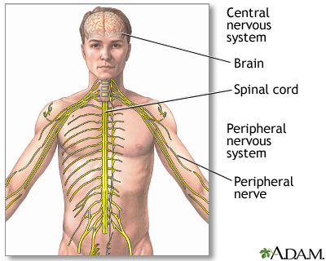
Introduction
Central nervous system (CNS) disorder → Nerve cell activity
Childhood Absence Epilepsy in school-aged children
Characterized mainly by seizures
In CAE: absence seizures
Non-convulsive, loss of consciousness
Upto hundreds per day
Recedes in adolescence
Notes:
Epilepsy is the fourth most common neurological disorder and affects the central nervous system. Seizures are the most characteristic symptom of this disorder, and are due mainly to the disruption of nerve cell activity, ranging from mild to severe.
In Childhood Absence Epilepsy (CAE) school-aged children are usually affected, with peak onset occurring at 6-7 years old. This specific form of epilepsy is characterized by daily absence seizures. These seizures are non-convulsive and accompanied by a brief loss of consciousness. Absence seizures can occur up to a few hundred times a day, and are generally unprovoked. CAE typically tends to recede in adolescence for most affected individuals.

Slide 6
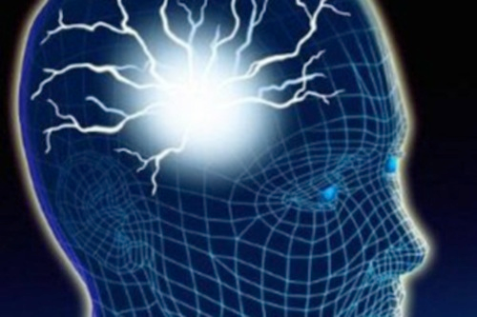
Nomenclature
Physiological states of seizures
Preictal state – before seizure
Ictal – during the seizure
Interictal – between two seizures – this is the state in which 99% of the entire seizure takes place
Postictal – after seizure event
Notes:
unedited

Slide 7
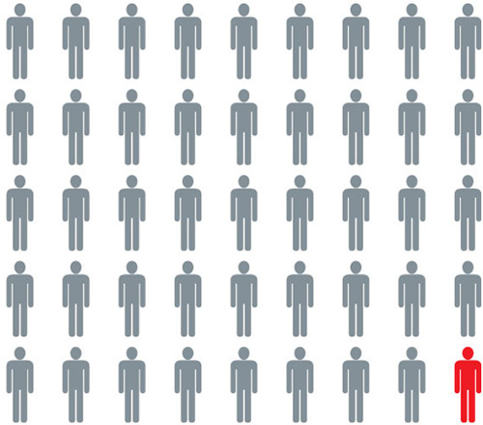
Epidemiology
Every 1 in 100 Canadians are afflicted by epilepsy → Globally, 50 million!
Yearly incidence:
50 cases per 100 000 individuals
150 cases per 100 000 individuals
Higher rates in lower income regions of the world
CAE: 2-10% per 100,000 children
Equal incidences in both sexes, but girls deemed at higher risk
Notes:
Approximately 1 in 100 Canadians currently live with epilepsy, and globally, that number sits at 50 million!
The yearly incidence of epilepsy is approximately 50 cases per 100 000 individuals in developed and industrialized countries. In areas of socioeconomic deprivation, these risks tend to be higher, around 150 cases per 100 000. This is because of the lack of medical facilities and improper diagnoses.
New diagnoses of epilepsy are approximated at 2.4 million annually.
In the case of Childhood Absence Epilepsy, the annual incidence has been reported to fall within the range of 2-10% per 100,000 children under the age of 16 years old. Girls are deemed to be at twice the risk of boys in developing Childhood Absence Epilepsy, however, equal incidences have thus far been reported.

Slide 8
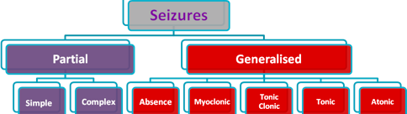
Signs and Symptoms
Seizures
Two broad seizure categories
Partial: seizure onset in one cortical region of the brain
Generalized: seizure onset in both cerebral hemispheres
Notes:
Image: http://www.enlightenhk.org/index.php/english-pages/about-epilepsy/what-is-a-seizure-types-of-seizures/

Slide 9
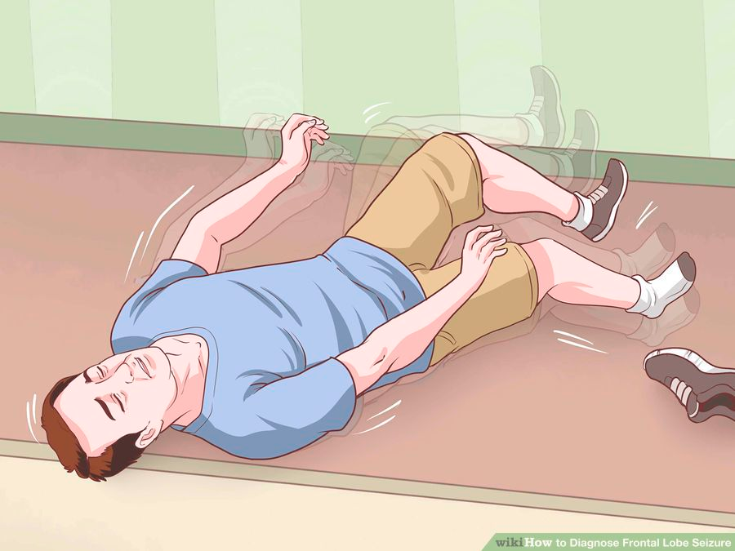
Signs and Symptoms
Partial Seizures
Simple
No loss in consciousness
Auras
Clonic movements
Complex
Loss in consciousness
Auras
Staring spells
Clonic movements
Notes:
Image: http://www.wikihow.com/Diagnose-Frontal-Lobe-Seizure

Slide 10
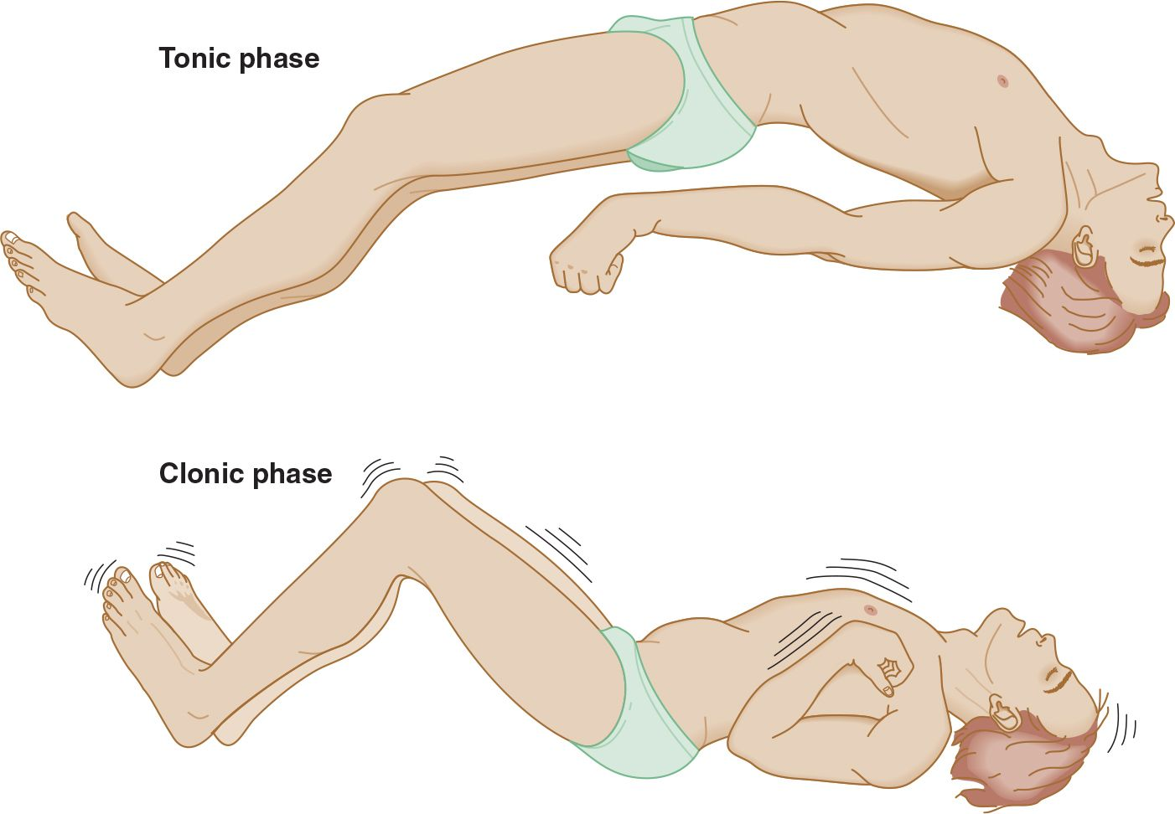
Signs and Symptoms (cont’d)
Generalized Seizures
Clonic seizures
Tonic seizures
Absence seizures
Atonic seizures
Myoclonic seizures
Tonic-clonic seizures
Notes:
Image: http://neupsykey.com/seizures-syncope/

Slide 11
Signs and Symptoms (cont’d)
Childhood Absence Epilepsy Absence seizures
10-20 second duration
Staring spells
Lack of consciousness
Automatisms
Notes:
Image: https://uk.pinterest.com/explore/absence-seizure/

Slide 12
Diagnosis
Diagnostic imaging
Electroencephalogram (EEG)
Computerized Tomography (CT)
Magnetic Resonance Imaging (MRI)
Positron Emission Tomography (PET)
Functional Magnetic Resonance Imaging (fMRI)
History check
Examination (Neurological & Neuropsychological)
Laboratory tests
Notes:
Image: http://www.parkinson.org/understanding-parkinsons/diagnosis

Slide 13
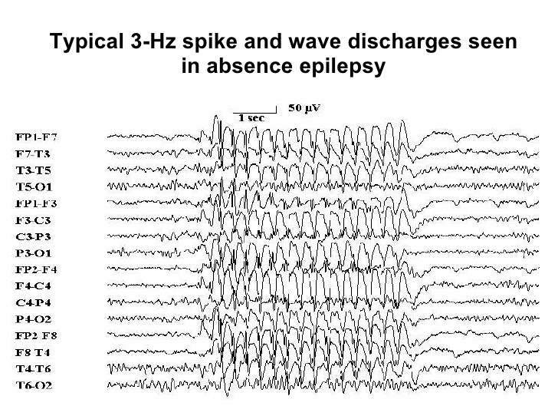
Diagnosis (cont’d)
CAE:
History check
EEG
Normal between seizures
3 Hz spike and wave discharge
Inducing a seizure through hyperventilation
CT and MRI scans
Notes:
Image: http://www.slideshare.net/Kouya71/epilepsy-4502939

Slide 14
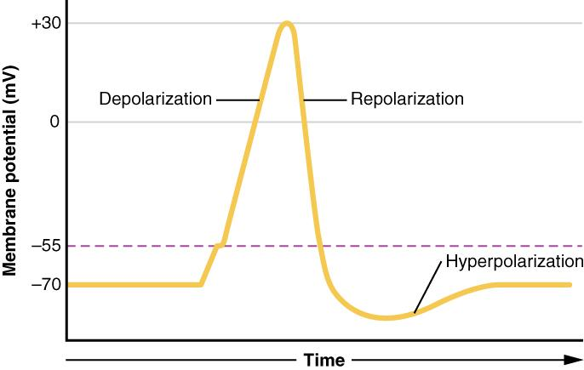
The Action Potential
At rest:
Na+ ions found outside
K+ ions found inside
Depolarization :
Na+ ions move into the cell
Repolarization:
K+ ions move out of the cell
Notes:
Image: https://opentextbc.ca/anatomyandphysiology/chapter/12-4-the-action-potential/

Slide 15
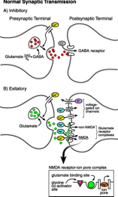
Synaptic Transmission
Electrical signals convert to neurotransmitters (NT)
Ca2+ enters the cell - releases NT into synapse
Two important NT:
Glutamate - excitatory
GABA - inhibitory
Notes:
Image: http://pedsinreview.aappublications.org/content/19/10/342

Slide 16
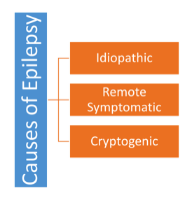
Aetiology
Idiopathic epilepsy
Underlying genetics – approximately 40% of patients
Unclear what type of gene because the disorder is polygenic
Remote symptomatic
Less common
Caused by environmental triggers of a seizure
Characterized by more than one unprovoked seizure
May be caused by kindling – abnormal decrease in resting threshold potential
Cryptogenic
No identifiable cause

Slide 17
Aetiology (CAE)
Biochemical changes:
Increased glutamate – leads to increased excitation
Decreased GABA – leads to decreased inhibition
Genetic alterations in calcium channels – increased flow of intracellular Ca2+

Slide 18
Pathophysiology
Hyperexcitability:
Neurons fire multiple discharges instead of one or two
Hypersynchrony:
Large number of neighbouring neurons fire abnormal number of charges at once

Slide 19
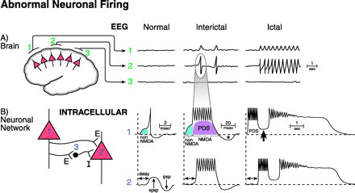
Pathophysiology
Normal state – desynchronized; low-voltage activity
Interictal state – EEG “spike”; hypersynchrony causes shift in depolarization state – known as Paroxysmal Depolarization Shift (PDS)
Ictal state – large number of repeating EEG spikes – characterized by hyperexcitability
Notes:
Image: http://pedsinreview.aappublications.org/content/19/10/342

Slide 20
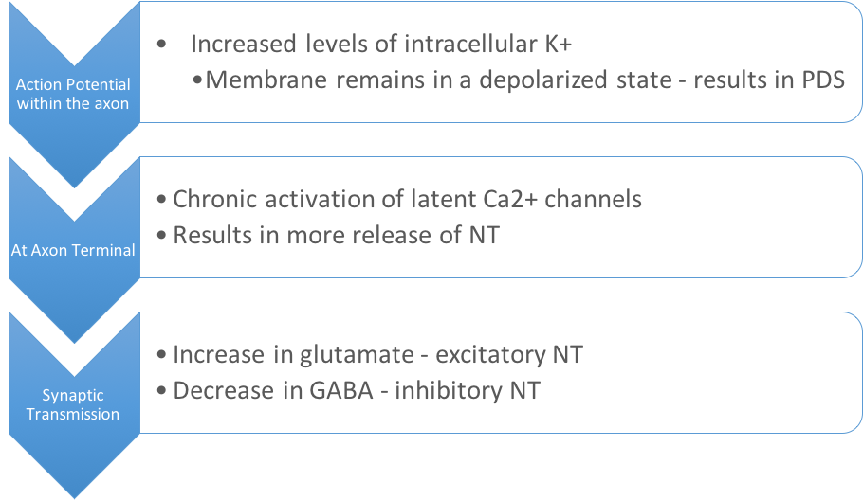
Ictogenesis
Hyperexcitability due to:
Notes:
Prolonged depolarization leads to a burst of several action potentials within one large depolarization event

Slide 21
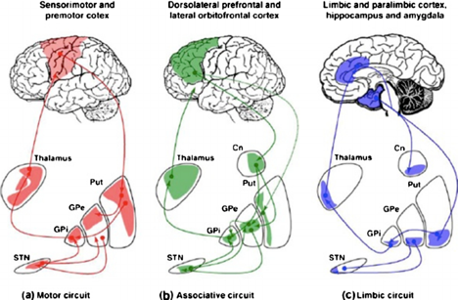
Pathophysiology (CAE)
These patterns of excitation and inhibition in an EEG are seen in the thalamocortical circuit
Notes:
Image: https://www.researchgate.net/figure/263584956_fig1_Fig-1-Neurocircuitry-cortico-striato-thalamocortical-loops-Pathways-in-motor

Slide 22
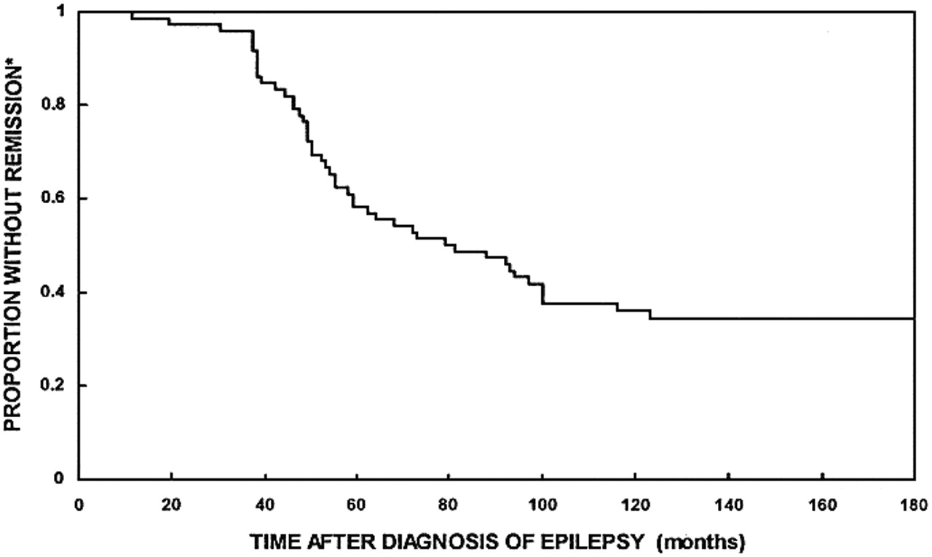
Prognosis
Overall remission rate for CAE is high: 80% of patients respond to medication
Remits by early puberty in most cases
Early treatment and response to the anti-epileptic drugs may contribute to the permanent disappearance of seizures

Slide 23
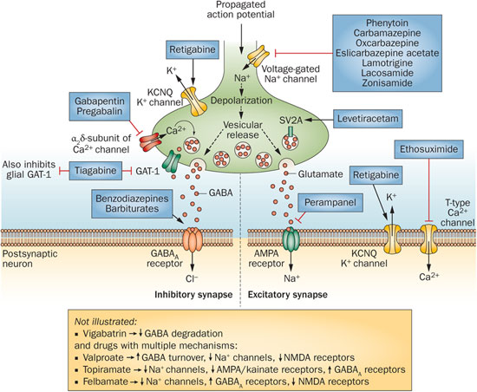
Treatment
Antiepileptic Drug Therapy:
Ethosuximide (Zarontin)
Valproate (Epilim)
Lamotrigine (Lamictal)
Ketogenic Diet

Slide 24
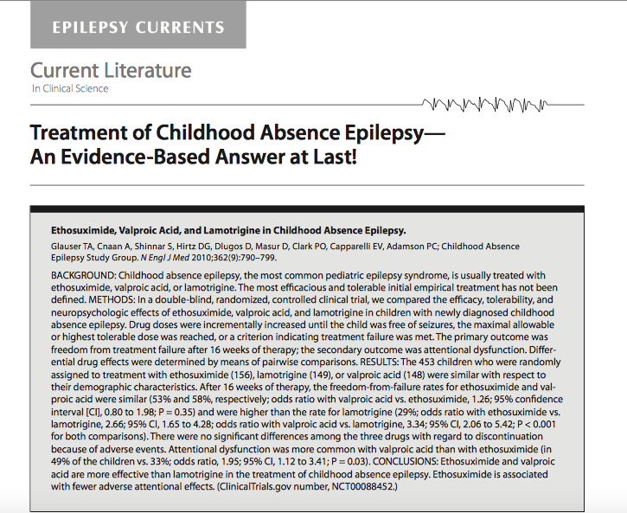
Ethosuximide
First-line therapy
Glauser et al. (2010)
Double blind, randomized control trial
453 children eligible
Ethosuximide (156)
Lamotrigine (149)
Valproic acid (148)
16 weeks of therapy
Outcomes: freedom from treatment & attentional dysfunction

Slide 25
Case Study Reveal
“I’ve never spoken about this before but I was born epileptic… I used to have seizures when I was young. My mother and father didn’t know what to do or how to handle it but they did the best they could with what little they had.”
http://people.com/celebrity/prince-talks-about-his-struggle-with-epilepsy/
Notes:
Back to our case study. Now that you’ve had the time to think about it, can you guess who it was?
This was Prince! (Click for image and click again for link) The quote above was taken from a People magazine interview in 2009.
Prince, and many other celebrities like Lil Wayne and Neil Young, as well as plenty of everyday individuals are afflicted by epilepsy. It is the fourth most common neurological disorder in the world. Someone you know may very well be afflicted by the condition.

Slide 26
References
Epilepsy. (2013, May 31). Mayo Clinic. Retrieved January 21, 2017, from http://www.mayoclinic.org/diseases-conditions/epilepsy/basics/definition/CON-20033721?p=1 What Is Epilepsy? (2014, January). Epilepsy Foundation. Retrieved January 21, 2017, http://www.epilepsy.com/learn/epilepsy-101/what-epilepsy What is Epilepsy? (2016). Epilepsy Ontario. Retrieved January 21, 2017, from http://epilepsyontario.org/about-epilepsy/what-is-epilepsy/ Sander, J. W. (2003). The epidemiology of epilepsy revisited. Current opinion in neurology, 16(2), 165-170. "Epilepsy". Fact Sheets. World Health Organization. October 2012. Retrieved January 21, 2017. Crunelli, V., & Leresche, N. (2002). Childhood absence epilepsy: genes, channels, neurons and networks. Nature Reviews Neuroscience, 3(5), 371-382. Loiseau, P., Panayiotopoulos, C. P., & Hirsch, E. (2002). Childhood absence epilepsy and related syndromes. Epileptic syndromes in infancy, childhood and adolescence, 3, 285-304.
Berg, A. T., Shinnar, S., Levy, S. R., & Testa, F. M. (1999). Newly diagnosed epilepsy in children: presentation at diagnosis. Epilepsia, 40(4), 445-452.
Engelborghs, S., D’hooge, R., & De Deyn, P. P. (2000). Pathophysiology of epilepsy. Acta neurologica belgica, 100(4), 201-213.
Stafstrom, C. E., Rho, J. M. (2016). Pathophysiology of seizures and epilepsy. URL: https://www.uptodate.com/contents/pathophysiology-of-seizures-and-epilepsy
Stafstrom, C. E. (1998). Back to Basics: The Pathophysiology of Epileptic Seizures: A Primer For Pediatricians. Pediatrics in Review, 19 (10).
McCormick, D. A., & Contreras D. (2001). On the Cellular and Network Bases of Epileptic Seizures. Annul. Rev. Physiol, 63: 815-846
McCandless, D. W. (2011). Epilepsy. Simple Partial Seizures (143-152) Chicago. IL: Springer Science+Business Media.
Holmes, G. L. & Fisher, R. S. (2013). Childhood Absence Epilepsy. Epilepsy Foundation. Retrieved January 24, 2017, from http://www.epilepsy.com/learn/types-epilepsy-syndromes/childhood-absence-epilepsy
Donner, E. J. (2010). Absence Seizures. aboutkid’shealth. Retrieved January 24, 2017 from, http://www.aboutkidshealth.ca/En/ResourceCentres/Epilepsy/UnderstandingEpilepsyDiagnosis/TypesofSeizures/Pages/Absence-Seizures.aspx
Gotman, J. (2008). Epileptic Networks studied with EEG-fMRI. Epilepsia. 49 (s3) 42-51.
Pillai, J. & Sperling, M. R. (2006). Interictal EEG and the Diagnosis of Epilepsy. Epilepsia. 47 (s1), 14-22.

Slide 27
Questions?

Slide 28
Multiple Choice Questions:
1. What is the main contrasting feature between simple partial seizures and complex partial seizures?
A) simple partial seizures involve a loss of consciousness, whereas complex partial seizures do not
B) simple partial seizures involve the presence of auras, whereas complex partial seizures do not
C) complex partial seizures involve a loss of consciousness, whereas simple partial seizures do not ##
D) There is no difference between simple and complex partial seizures
E) simple partial seizures may involve clonic movements, whereas complex seizures never involve clonic movements
2. According to recent research, what is currently the best treatment for children with Childhood Absence Epilepsy?
A) Valproic Acid
B) Ethosuximide ##
C) Insulin
D) Lamotrigine
E) Perchloric acid
3. ____________ refers to the process of permanently decreasing the threshold potential for normal neuronal transmission.
A) Coupling
B) Transmission
C) Kindling ##
D) Hyperpolarization
E) Deactivation

