Slide 1
Breast Cancer
Life Science 4M03
By: Isha Singh
Aman Gill
Harris Joseph
Sarah Cardozo
Vandevi Sookar

Slide 2
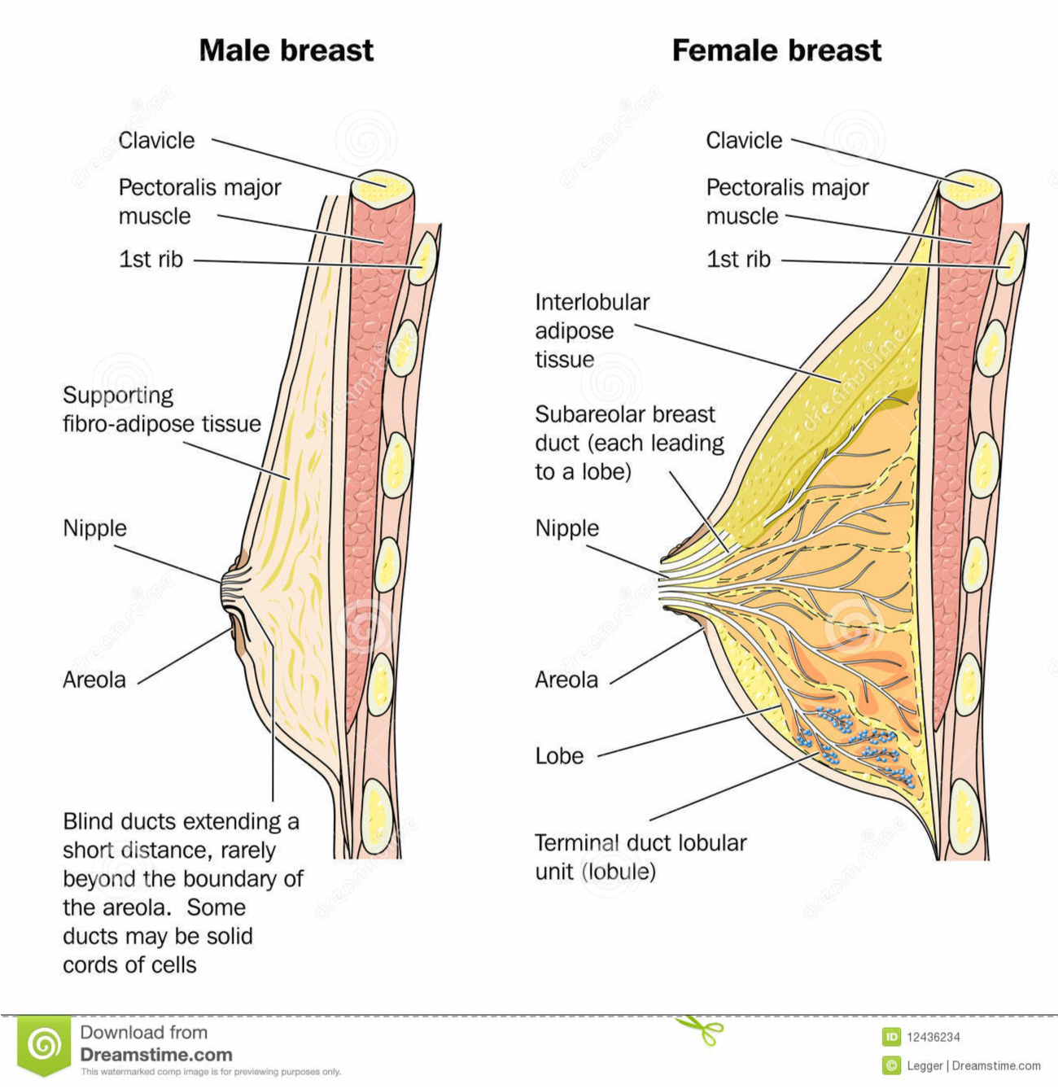
Introduction- Anatomy / Physiology
Primarily composed of adipose tissue
Situated right in front of the pectoralis major muscle
Specialized function is the production of milk for lactation
Epithelial component
the lobules where milk is made
Ductal component
connects the lobules to the external area of the nipple
(Intimate Health Help, 2012)

Slide 3
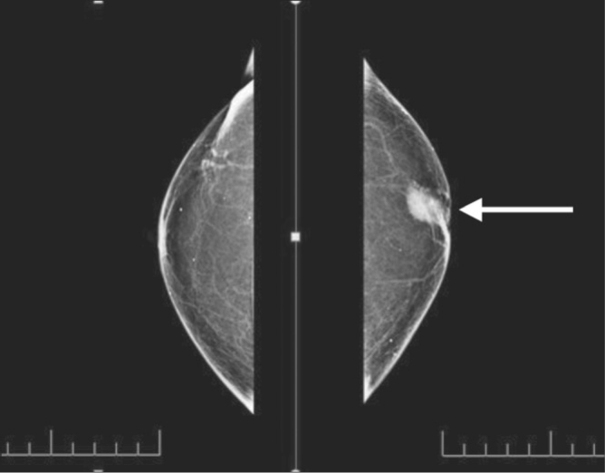
Introduction- Breast Cancer
The abnormal division of breast cells within the organ
can be an inherited or sporadic cancer
common type of genes involved are the BRCA1 and BRCA2 genes
Two types
ductal carcinomas
lobular carcinomas
High potency of metastasizing to other nearby tissues

Slide 4
Introduction - Breast Cancer Cont’d
24,400 women and 210 men in Canada diagnosed per year, with over 5,000 women and 60 men dying of disease
Accounts to 25% of all cancer cases worldwide (Boyle & Levin, 2008)
Most cases are not reported because patients
refuse to report it to doctors
feminizing syndrome
caught too late (da Silva, 2015)

Slide 5
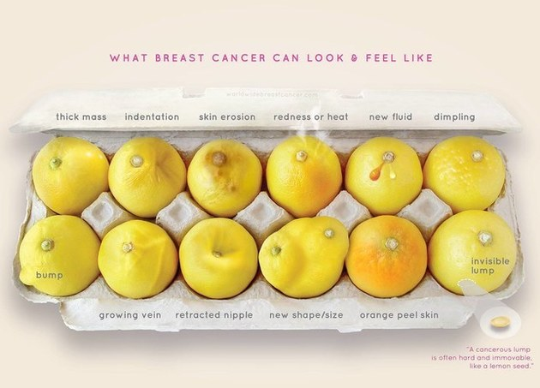
(KNOW YOUR LEMONS CAMPAIGN/WORLDWIDE BREAST CANCER ORGANIZATION, 2016)

Slide 6
Epidemiology
Estimated 1.4 million incidence cases of breast cancer are recorded globally per year. 460, 000 of these cases turning into mortality.
2050 - approx 3.2 million incidence cases
Middle age females are mostly impacted by the disease
(McPherson, 2000)
(Da Silva, 2015)

Slide 7
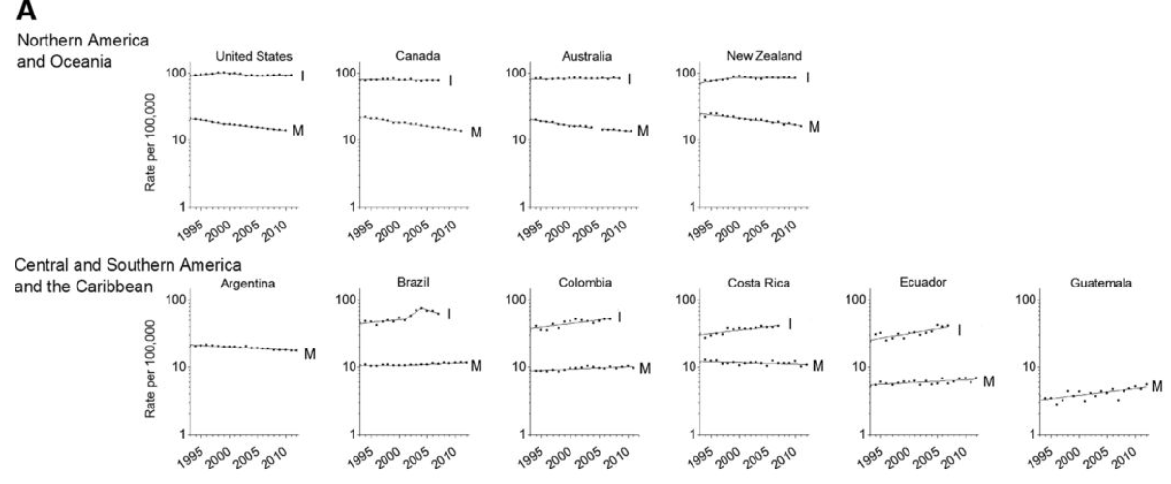
Epidemiology - Incident vs Mortality rates (Geographical Regions)
(DeSantis, 2015)

Slide 8
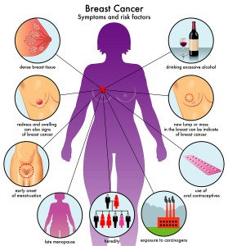
Etiology
Exact cause unknown
However there are certain risk factors; some can be controlled and others cannot
Controllable: diet, smoking, alcohol consumption, physical activity, obesity, hormone replacement therapy/using contraceptives
Uncontrollable: age, genetics, environment, breast density, family/personal health history, endogenous sex hormone levels
Net Health Book, 2015

Slide 9
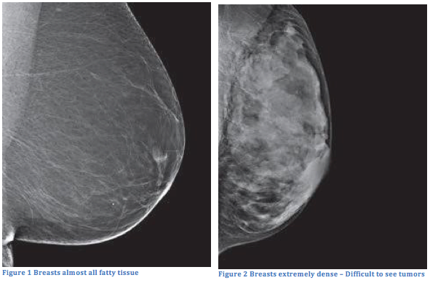
Etiology - Risk Factors
Genetics:
BRCA1 & BRCA2
Environmental Carcinogen Exposure
Lipophilic compounds accumulate in breast fat
Breast Density
Denser breasts harder to read on mammograms - difficult to detect tumours in tissue
National Breast Cancer, 2016
American Cancer Society, 2016

Slide 10
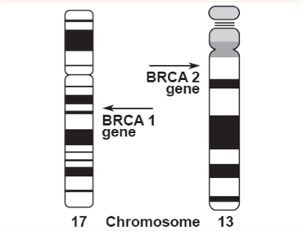
Diagnosis- Inherited Breast Cancer
BRCA1 and BRCA2
Inherited breast cancer is associated with mutations in the BRCA 1 and BRCA 2 genes
Two main methods of BRCA mutation DNA testing:
1. Testing for ALL possible BRCA gene mutations
2. Specifically looking for a mutation present in a close family member
(Cancer Center and Research Institute, 2004)

Slide 11
DIAGNOSIS- Mammography
Low dose X-ray imaging
•Breast is compressed with parallel plates to detect abnormal masses
•Can detect breast cancer in its early stages
Women 50-74 should get a mammography every 2 years
(Blausen gallery, 2014)

Slide 12
DIAGNOSIS- Breast Biopsy
1.Fine Needle Aspiration
Least common method
Used if lump is fluid-filled/ easily accessible
Thin needle extracts fluid/ drains lump
(MedicaLook, 2016)

Slide 13
2. Core Needle Biopsy
Using a larger hollow needle
Removes small amounts of suspicious tissue
(Diagnose Cancer, 2017)

Slide 14
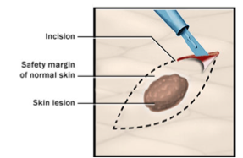
3. Surgical Biopsy
1-2 inch cut on the breast
Removes lump along with surrounding tissue
(Mayo Clinic, 2016)

Slide 15
Pathophysiology
Normal cell growth
Divide as necessary and have functioning signals that stop cell division
Programmed cell death
Cancer
Abnormal cell growth invades other areas of the body
(Berns et al., 2012)

Slide 16
Pathophysiology - P13K Pathway
Pathway protects cells by controlling functions such as cell growth, differentiation, motility, survival, proliferation
P13K heterodimer interacts with p85 - removing the inhibitory effect of p85 on p1110 rendering the P13K pathway active.
The activation leads to a cascade of events downstream of the pathway, resulting in cellular metabolism, proliferation, differentiation and survival.
Breast Cancer = Hyperactive

Slide 17
Pathophysiology - P13K in Breast Cancer
(Berns et al., 2012)

Slide 18
Pathophysiology - HER2 (ErbB)
In both P13K and Ras-Raf-MAPK pathway
Increased cell proliferation and inhibition of apoptosis (cell death).
Mutation in the HER2 gene leads to amplification of this oncogene and excessive ErbB signalling.
Aberrant cell proliferation and increased inhibition of cell apoptosis.

Slide 19
Pathophysiology - Types of Abnormalities
(Weaver, 2006)

Slide 20
Pathophysiology - Spreading of Malignant Tumours
(Weaver, 2006)

Slide 21
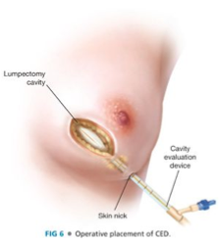
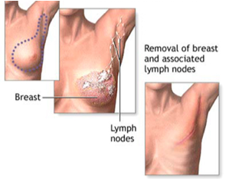
Treatments
1. Lumpectomy
Breast conserving surgery
Remove lump and surrounding healthy tissue
2. Mastectomy
Removal of all breast tissue
Pathologist examines tissue of surrounding regions (i.e. Axillary nodes)
(General Surgery, 2016)
(Gloria Gossard, 2017)

Slide 22
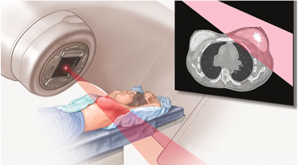
Treatments
3. Radiation Therapy
Uses targeted, high energy X-rays
Kills Cancer cells
Recommended after lumpectomy
Reduces recurrence by 50%
Reduces death by breast cancer by 20%
Can be used alone, or with other treatments i.e. chemotherapy
(Mayo Clinic, 2016)

Slide 23
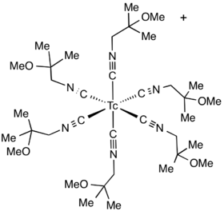
Future Treatments- Medical Imagery
Scintimammography
(Rhodes et al, 2005)
(American Cancer Society, 2016)

Slide 24
Future Treatments- Target Therapies
PARP Inhibitors
(American Cancer Society, 2016)

Slide 25
Future Treatments - Target Therapies
Anti-Angiogenesis Drugs
(American Cancer Society, 2016)

Slide 26
References
Mitri, Z., Constantine, T., & O'Regan, R. (2012). The HER2 receptor in breast cancer: pathophysiology, clinical use, and new advances in therapy. Chemotherapy research and practice, 2012.
Berns, K., Horlings, H. M., Hennessy, B. T., Madiredjo, M., Hijmans, E. M., Beelen, K., ... & Beijersbergen, R. L. (2007). A functional genetic approach identifies the PI3K pathway as a major determinant of trastuzumab resistance in breast cancer. Cancer cell, 12(4), 395-402.
Weaver, A. M. (2006). Invadopodia: specialized cell structures for cancer invasion. Clinical & experimental metastasis, 23(2), 97-105.
Li, D., Wang, M., Dhingra, K., & Hittelman, W. N. (1996). Aromatic DNA adducts in adjacent tissues of breast cancer patients: clues to breast cancer etiology. Cancer Research, 56(2), 287-293.
Newcomb, P. A., Kampman, E., Trentham-Dietz, A., Egan, K. M., Titus, L. J., Baron, J. A., ... & Willett, W. C. (2013). Alcohol consumption before and after breast cancer diagnosis: associations with survival from breast cancer, cardiovascular disease, and other causes. Journal of clinical oncology, 31(16), 1939-1946.
N. (n.d.). Causes of Breast Cancer :: The National Breast Cancer Foundation. Retrieved January 24, 2017, from http://www.nationalbreastcancer.org/causes-of-breast-cancer
Da Silva, R. (2015) Module 3 Lecture 2: Breast Cancer[PowerPoint Slides]. Retrieved from McMaster University Health and Disease.
Boyle, P., & Levin, B. (2008). World cancer report 2008. IARC Press, International Agency for Research on Cancer.
Cancer center and Research Institute. (2004). Medico Chirurgo. Retrieved January 26, 2017, from http://www.dr-ruggero-trevisan.it/ginecologia/marcatori-tumori-del-seno-e-dell-ovaio/
Blausen Gallery. (2014). Mammography. Retrieved January 26, 2017, from https://wsoonli15.wordpress.com/2016/03/26/mammography/
MedicaLook. (2016). Fine-Needle Aspiration - Definition, Purpose, Procedure, Results. Retrieved January 29, 2017, from http://www.medicalook.com/tests/Fine-Needle_Aspiration.html
Diagnose Cancer. (2017). Retrieved January 29, 2017, from http://www.cipherhealthcare.com/CancerDiagnosis.aspx
Mayo Clinic. (2016). Solving the Puzzle – Excisional vs Shave Biopsy. Retrieved January 29, 2017, from https://millerfamilydermatology.com/punch-vs-shave-biopsy/
McPherson, K. (2000). ABC of breast diseases: Breast cancer---epidemiology, risk factors, and genetics. BMJ, 321(7261), 624-628. http://dx.doi.org/10.1136/bmj.321.7261.624
DeSantis, C., Bray, F., Ferlay, J., Lortet-Tieulent, J., Anderson, B., & Jemal, A. (2015). International Variation in Female Breast Cancer Incidence and Mortality Rates. Cancer Epidemiology Biomarkers & Prevention, 24(10), 1495-1506. http://dx.doi.org/10.1158/1055-9965.epi-15-0535
Rhodes, D., O'Connor, M., Phillips, S., Smith, R., & Collins, D. (2005). Molecular Breast Imaging: A New Technique Using Technetium Tc 99m Scintimammography to Detect Small Tumors of the Breast. Mayo Clinic Proceedings, 80(1), 24-30. http://dx.doi.org/10.4065/80.1.24

