Slide 1
Postpartum Depression
Group 3: Angelica Dimita, Franklin Duru, Gabrielle Retta, Selina Casalino, CJ Lindo

Slide 2
What is Postpartum depression?
Depression that can happen during pregnancy or any time up to 1 year after birth
Can happen to mother and/or father, and parents who adopt a child
Affects the way that individual feels about themselves, their baby and about others
Can last a very long time
Photo source: https://www.psychbytes.com/postpartum-depression-
understanding-the-basics/
CMHA National, 2018

Slide 3
Symptoms
Sadness, worthlessness, guilt, hopelessness, anxiousness
Irritability or anger
Loss of interest in things they once enjoyed
Withdrawal from family, friends and/or the child
Changes in diet and sleep patterns
Thoughts about harming themselves or the baby
Frequent thoughts that they are a bad parent
Photo source: https://advancedbodydynamics.com/postpartum-depression/
CMHA National, 2018

Slide 4
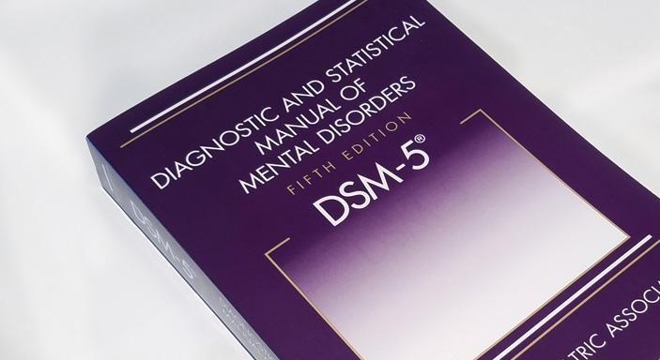
Diagnosis
Discussion of thoughts and feelings with a doctor to distinguish from postpartum blues
Depression-screening questionnaire
Blood tests → underactive thyroid
Diagnostic and Statistical Manual for Mental Disorders (DSM-5)
Photo source: https://www.psychiatry.org/psychiatrists/practice/dsm
Mayo Clinic, 2015

Slide 5
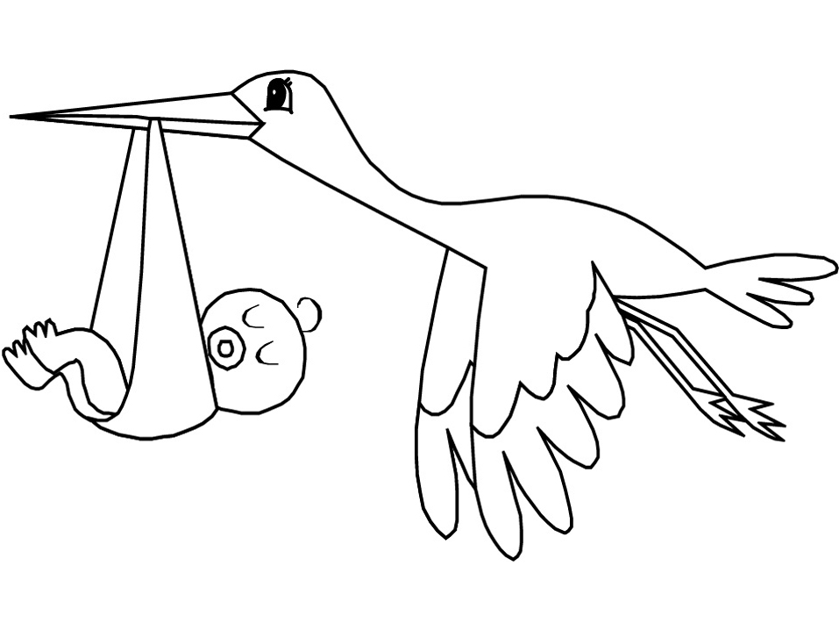
Risk Factors
Stress
Problems with partner
Delivery method
Other risk factors include: history of depression, PPD after previous pregnancy, health problems with baby, unwanted pregnancy, lower socioeconomic status
Notes:
On left
Some risk factors include a history of depression and also bipolar disorder during pregnancy or at any other time prior to pregnancy, PPD after previous pregnancy, family members who are depressed, health issues with baby and also trouble breastfeeding baby
History of depression during pregnancy
PPD after previous pregnancy
Family members with depression or mood stability issues
Health problems with baby
On right
Stressful life events eg. complications with pregnancy, illness, job, problems with SO eg. abuse, unstable relationship, lack of support, unwanted pregnancy and then remaining 2 on slide (transpelvic vs vaginal - less likely with vaginal)
Stressful life events
Problems with significant other
Pregnancy unplanned/unwanted
Lower socioeconomic status
Method of childbirth

Slide 6
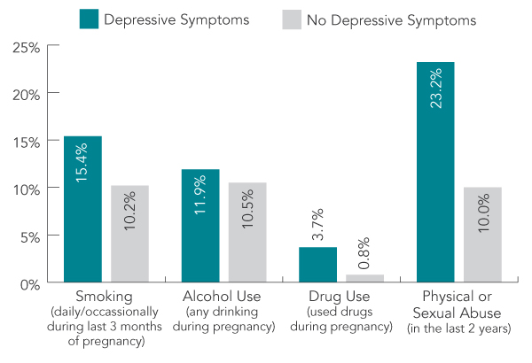
Risk Factors
Photo source: https://www.canada.ca/en/public-health/services/publications/healthy-living/pregnancy-women-mental-health-canada.html
Notes:
In addition to the risk factors previously discussed, The Government of Canada reported the results from the Canadian Maternity Experiences Survey and found that 7.5% of women overall reported experiencing depressive symptoms during the postpartum period. Of these 7.5%, 15.4% of women smoked in the last 3 months of pregnancy, 11.9% of women used alcohol at some point during pregnancy, 3.7% of women used drugs at anytime during pregnancy and 23.2% of women experienced physical/sexual abuse in the last 2 years.

Slide 7
Causes
Physical Changes
Variation in hormone levels
Estrogen
Progesterone
Thyroid gland hormones
Sleep deprivation increases vulnerability to factors causing PPD
Emotional Changes
Overwhelmed feeling
Anxious about caring abilities for newborn
Feel less attractive
Struggle with identity or control over life
Notes:
Ultimately, There is no single cause of depression and thus PPD. The approach clinicians take is the biopsychosocial model of depression → Physical (discuss slide), social, psychological and emotional (discuss slide) factors all play a role.

Slide 8
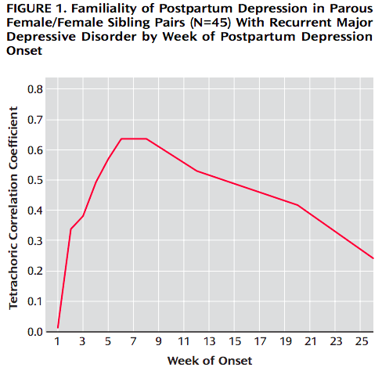
Genetic Causes (Forty et al., 2006)
Forty et al., 2006
Notes:
Recruited 45 sibling pairs with recurrent unipolar depression
29% of women with a sister with PPD, experienced PPD after delivery
Only 13% of women with no sister with PPD, experienced PPD after delivery
Part of the biopsychosocial model includes genetic factors leading to PPD. Study done in england recruited 45 pairs of sisters. Several exclusion factors which controlled for adoption, alcohol induced depression and others. Explain two definitions of PPD on slide. 31 women had narrowly defined PPD and 59 did not. Of the 31, 9 sisters developed PPD (29% overall but 42% on first pregnancy) and of the 59, 8 developed PPD (13% overall but 15% on first pregnancy).
Overall, significant effect of clustering within families was found if PPD onset occurred within 4 weeks of delivery and NOT broad.

Slide 9
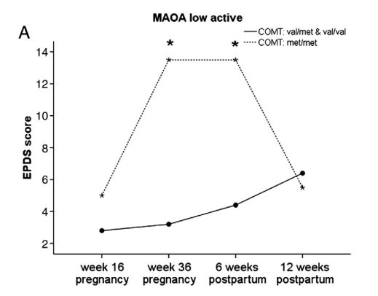
Genetic Causes (Doornbos et al., 2009)
89 women filled out two Edinburgh Postpartum Depression Scale (EPDS) questionnaires during pregnancy and two after pregnancy
Found polymorphisms in 5-HTT, MAO and COMT interact with development of depressive symptoms
Women with combination of low active MAO and COMT the met/met polymorphism showed greatest increase in EPDS Score
Doornbos et al., 2009
Notes:
Study involving 89 pregnant women who filled in two surveys during and after pregnancy and analyzed 5-HTT, MAO and COMT polymorphisms. Took blood samples and isolated DNA. Analysis was done using real time PCR. low activity MAO increased score, 5-HTT sl & ll polymphorism increased score, COMT met/met increased score. What was most significant was combining COMT met/met polymorphism and MAO low active to achieve greatest increase.
MAO and COMT regulate stress response and influences the onset of mood swings during normal, mild and stressful events such as those experienced postpartum. Shows support genetics contributing to environmental factors.

Slide 10
Levels of Postpartum Depression
Notes:
Postpartum Baby Blues
· Postpartum Baby Blues refers to a mild form of depression several days after childbirth when the mom can experience mood swings.
· They feel happy one minute and begin to cry in the very next. They may feel a bit depressed, have a hard time concentrating, lose their appetite or find they can’t sleep.
· These symptoms usually last for no more than the first 3 – 4 days after the birth of their child; up to 80% of mothers are affected by this level of depression.
· This is considered a normal part of the postpartum period and doesn’t resemble the more moderate or severe postpartum depression.
· During this period it is beneficial for the mother and father if there is outside help at home to help them get past this initial bump in the road.
Postpartum Depression
· Postpartum depression may initially appear as the more mild form of baby blues or may make an appearance in the weeks that follow the delivery. This is considered a more moderate form of depression.
· In addition to the symptoms of Baby blues women experiencing postpartum depression will complain about symptoms that interfere with their daily living.
· This includes lack of joy, a sense of emotional numbness or failure, insomnia and severe mood swings.
Postpartum Psychosis
· A more severe form of postpartum depression is postpartum psychosis.
· This is a very rare condition that develops within the first 6 weeks of childbirth
· Women with this condition experience a fear of harming themselves and their baby, hallucinations, delusions and paranoia.

Slide 11
Prevention Strategies and Interventions
Psychosocial and Psychological Interventions
Postnatal Psychological Debriefing
Traumatic events
Interpersonal psychotherapy
ROSE Program
Educational Programmes
Parenthood classes
Pharmacological and Biological Interventions
Estrogen
Calcium
Selenium
Notes:
Psychosocial and Psychological Interventions
· Psychological debriefing is a controversial treatment typically consisting of a single psychological interview during which the interviewer explores a person’s experience of a traumatic event with the aim of reducing psychological distress after trauma and preventing PTSD.
· This was a failure as both a treatment and prevention for PTSD. In fact some studies found it made subjects symptomatically worse.
o In the postnatal setting, debriefing most often takes the form of a discussion of labour and delivery experiences with an empathic listener soon after delivery.
o Five RCTs have studied the effects of postnatal psychological debriefing on the prevention of PPD. Two studies showed positive effects and three showed no difference.
o Lavender and Walkinshaw studied 120 British women in the general population.
o The session consisted of “an interactive interview in which they spent as much time as necessary discussing their labour, asking questions, and exploring their feelings.”
o All participants were mailed a questionnaire three weeks after discharge and were scored.
o Results showed that women who received the intervention were significantly less likely to have high depression, as well as high anxiety.
· Interpersonal Psychotherapy is a short-term psychotherapy focusing on the present and the context in which depressive symptoms occur.
o IPT originally was developed to treat Major Depressive Disorder in a general adult population, but has been adapted to treat women during the perinatal period
o Seven studies have evaluated IPT’s efficacy in preventing PPD. Three of them incorporated IPT into the ROSE program (Reach Out, Stay strong, Essentials for new mothers)
o The ROSE program is a group intervention designed by Zlotnick and colleagues to help pregnant women on public assistance to improve relationships; build social support networks, and manage the role transition to motherhood.
o The intervention comprises 4 weekly 60-minute group sessions during pregnancy.
o Session topics included identifying and managing role transitions, setting goals, developing social supports, and identifying and resolving interpersonal conflict.
o Within 3 months after childbirth, six (33%) of the control group had developed PPD (as measured by the major depression module of the SCID for DSM IV
Biological and Pharmacological Intervention
An open-label trial study of 11 women by Sichel et al found that high dosage oestrogen improved the rate of relapse amongst women with a history of PPD
A study of 166 mothers giving birth for the first time in Iran found that women given 100ug of selenium daily in the form of selenium yeast from first trimester to moment of delivery had a lower chance of developing PPD as measured within the first 8 weeks after delivery.
Another study closer to home in the USA found that women given 2000mg calcium daily during pregnancy and after childbirth had a significantly lower incidence of severe PPD

Slide 12
Prevalence of PPD
19% of women worldwide
(Gelaye B et al., 2016; Meta-analysis of 53 studies published between 1998-2015; 23 low-and-middle-income countries)
17% of Japanese men
(Suto M et al., 2016; n=215 between 2012-2013)
11.5% of US women
(Ko JY et al., 2017; 27 states in 2012)
17.15% of Canadian women
(Lanes A et al., 2011; n= 6,421)
6.3% of Swedish men
(Massoudi P et al., 2016; n=885)
Notes:
Slide is animated.
In a study conducted by Lanes et al. in 2011, 6,421 Canadian women who had a live birth between 2005-2006 and were analyzed for Postpartum Depressive Symptomatology (PPDS) measured based on EPSD. The overall prevalence of PPDS (minor/major & major) in Canada was found to be 17.15%, with the highest prevalence of PPDS in the Territories (29.95%), and the lowest prevalence in PEI (10.89%).
In a study conducted by Ko et al. in 2017, Self-reported Pregnancy Risk Assessment Monitoring System (PRAMS) data was used to estimate the overall incidence of PDS (Postpartum depressive symptoms) in 27 US States. The overall incidence in these States was estimated to be 11.5% in 2012, with a decline in PDS from 14.8% in 2004 to 9.8% in 2012 for 13 States. Finally, PDS was highest in mothers who had less than 12 years of education, were unmarried, smoked, had greater than 3 stressful life events, and had infants with a low birth weight or admitted to the ICU.
A study conducted by Massoudi et al. in 2016 found that 6.3% of Swedish fathers from a population-based sample of 885 partners reported symptoms of depression at 3 months postpartum. PPD symptoms significantly correlated with having problems in partner relationship, low education level, previous depression, stressful life events, and low partner support.
A study conducted by Suto et al. in 2016 found that 17% of Japanese men in a regional longitudinal study between 2012 and 2013 (n=215) reported symptoms of depression in the first 3 months after birth. PPD symptoms significantly correlated with a history of psychiatric treatment and depressive symptoms during pregnancy.
Finally, Gelaye et al. (2016) conducted a meta-analysis of 53 studies published between 1998-2015 that looked at the prevalence of PPD in low and middle income countries. PPD was predominantly determined using the Edinburgh Postnatal Depression Scale (EPDS) and the pooled prevalence estimate of PPD was estimated to be 19%.

Slide 13
Pharmacological Treatment of PPD
Antidepressant Medication
Medications used to treat major depression can be used to treat PPD (antidepressants, antipsychotics, mood stabilizers)
Estrogen Hormone Therapy
Studies found drop in estradiol and progesterone in women with PPD
Suggest estradiol as potential treatment
(Bloch et al., 2000; Moses-Kolko et al., 2009; Fitelson et al., 2010)
Notes:
There are several types of treatment methods currently used to treat postpartum depression.
One main course of treatment is the pharmacological treatment of PPD.
There are some suggestions that PPD can be treated using pharmaceutical drugs in a similar way one would treat major depression.
The use of antidepressants such as Zoloft and Prozac, antipsychotics such as Clozapine, and mood stabilizers such as lithium can all be used either independently or in conjunction with one another to treat PPD.
There is a dramatic drop in maternal levels of estrogen and progesterone at the time of delivery.
This change in hormone levels has been proposed as one trigger for the onset of PPD in some women.
It was determined that women with a prior history of PPD experienced mood symptoms when exposed to a decrease in estradiol and progesterone, and women without a history of PPD did not.
This led to the suggestion of hormonal intervention as a method for treating PPD.
Estradiol (an estrogen steroid hormone) seems to function similar to other psychotropic drugs, however, more research is needed to determine whether it would be suitable to treat PPD.
Photo taken from: http://casereports.alliedacademies.com/events-list/case-reports-on-pharmacology

Slide 14
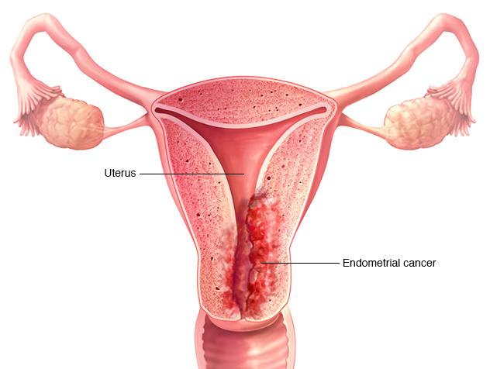
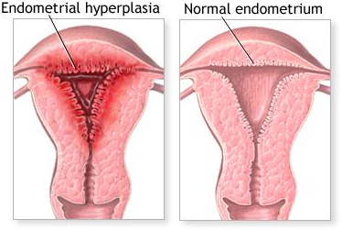
Concerns with Pharmacological Treatment
Antidepressant Medication:
Infant exposure to medications through breastfeeding
Hormone Therapy
Interference with lactation
Elevates risk of endometrial cancer
Can cause endometrial hyperplasia
(Mayo Clinic, 2017)
(New York Times, 2018)
Notes:
One main concern mothers have with regards to pharmacological intervention is the risk it poses to the newborn child.
The baby can be exposed to the medication of the mother through breast milk.
The amount of medication passed through the breast milk is very small and generally not considered by doctors to be a risk for the baby, especially when considering how the benefits of breastfeeding (reduced allergy risk, enhanced natural immunity, bonding with mother) outweigh this risk.
Some concerns with the hormone therapy are the risk of interfering with lactation, endometrial cancer, and endometrial hyperplasia (increase in the amount of tissue caused by cell proliferation in the endometrium)
For many women, the potential risk to the newborn child often associated with pharmaceutical interventions leads them to consider other treatment options like psychological treatment
Photo taken from: https://www.mayoclinic.org/diseases-conditions/endometrial-cancer/symptoms-causes/syc-20352461
https://archive.nytimes.com/www.nytimes.com/imagepages/2007/08/01/health/adam/17087Abnormalmenstrualperiods.html

Slide 15
Psychological Treatment of PPD
Cognitive Behavioural Therapy (CBT): focus on modifying patterns of negative thinking and behaviours to help cope and reduce stress
Interpersonal Therapy (ITP): based on addressing interpersonal problems and their effect on mood
Nondirective Counseling: focus on empathetic/nonjudgmental listening and support
Peer and Partner Support: focus on increasing social supports for new mothers
(Psychotherapy, 2012)
(Fitelson et al., 2010)
Notes:
Many mothers that are hesitant to take antidepressant medication due to the risk of infant exposure. Instead prefer psychological treatment of PPD
CBT:
Most common treatment for postpartum depression.
Normally the first treatment physicians recommend for mild or moderate symptoms.
Teaches you how your thoughts, feelings, and behaviours work together and can influence each other (CAMH, 2018)
Teaches important skills like problem-solving, realistic thinking, stress management, and relaxation
helps depressed patients to change patterns of negative thinking to enhance coping and reduce stress
ITP:
focuses on relationships and the connection between interpersonal problems and mood
can help people adjust to changing roles in their relationships and build better social supports
patient and clinician select one of four interpersonal problem areas (role transition, role dispute, grief, or interpersonal deficits) as a treatment focus
address problem areas relevant to postpartum depression such as the relationship between mother and infant, mother and partner, and transition back to work
Nondirective counselling
This type of counselling (also known as person-centred therapy) focuses on nonjudgmental and empathetic listening and support
Less structured form of therapy compared to CBT and ITP
Essentially provides a safe space for the patient to express their concerns relevant to motherhood and postpartum depression
Peer and partner support
Inadequate social support has often been identified as a risk factor for developing PPD
alleviates the symptoms associated with PPD, by increasing the social supports available to the mother
CBT teaches patients how their thoughts, behaviours and feelings work together to influence each other and it helps depressed patients overcome negative patterns of thinking
Interpersonal relationships on the other hand addresses problem areas relevant to postpartum depression such as relationships between mother and partner and helps new mothers adjust to their changing roles in their relationship.
Non directive counselling is a less structured form of therapy that focuses on empathic/nonjudgemental listening and support essentially providing a safe space for patients to express their concerns about motherhood and postpartum depression
Photo from: https://www.ai-therapy.com/blog/tag/psychotherapy/

Slide 16
Alternative Treatments
Electroconvulsive Therapy (ECT)
Pitfalls:
Under-researched
Research conducted shows mixed results
Research does not specifically target postpartum population (e.g. specifically targets major depressive disorder)
Bright Light Therapy
Omega-3 Fatty Acids
Exercise
Acupuncture and Massage
(Fitelson et al., 2010; Mayo Clinic, 2017)
Notes:
ECT:
only ever recommended in severe cases and when the patient does not respond to other treatments
During ECT, a small amount of electrical current is applied to your brain to produce brain waves similar to those that occur during a seizure. The chemical changes triggered by the electrical currents can reduce the symptoms of psychosis and depression
This treatment has also been used to treat major depressive disorder
Bright light therapy
originally for seasonal affective disorder, but can also be used for non-seasonal depression, like PPD
attractive option for the treatment since there are no known risks to the fetus or nursing infant, can be done at home, and is low cost
during light therapy, you sit or work near a device called a light therapy box. The box gives off bright light that mimics natural outdoor light
thought to affect brain chemicals linked to mood and sleep
Omega 3s
Aside from the known benefits of omega 3 fatty acids during pregnancy for the mother and the foetus, it has also been shown to positively affect mood
Acupuncture and massage
Acupuncture is the ancient Chinese tradition of the inserting and manipulating needles into various points on the body to treat pathologic processes and relieve pain
The use of acupuncture and massage mainly aims to alleviate stress
Exercise
Due to the release of endorphins that occurs during exercise, it is thought that this could help alleviate symptoms of PPD

Slide 17
What can you do to help?
Have realistic expectations
Offer help with daily responsibilities and child care
Accompany your loved one to appointments
Offer support, encouragement, and reassurance
Seek support for yourself if needed
“What’s the matter with me?”
“I thought this would be the happiest time in my life but I’m so sad”
“I feel like I’m going crazy”
APA, 2018; CMHA, 2018
Notes:
https://cmha.ca/documents/postpartum-depression
http://www.apa.org/pi/women/resources/reports/postpartum-depression.aspx
In conclusion, PPD is a difficult experience for everyone, including partners, friends, and family members. Most people expect the arrival of a child to be a happy and joyful time, and PPD can drastically change this. PPD is no one’s fault, but everyone plays a huge role in recovery.
If you have a loved one who is affected with PPD you can help by:
Having realistic expectations of your loved one’s day-to-day abilities and experiences
Offering help with daily responsibilities, chores, and child care (especially nighttime feedings) so that your loved one does not feel overwhelmed and has time to rest
Accompany your loved one to doctor’s appointments or support groups
Being supportive and encouraging of your loved one’s progress and letting them know you are there for them
Seek support for yourself if needed, in the form of support groups where you can meet individuals in similar situations who may be able to offer guidance and advice

Slide 18
References
American Psychological Association (APA). (2018). Postpartum Depression. Retrieved from http://www.apa.org/pi/women/resources/reports/postpartum-depression.aspx
Bloch, M., Schmidt, P. J., Danaceau, M., Murphy, J., Nieman, L., & Rubinow, D. R. (2000). Effects of gonadal steroids in women with a history of postpartum depression. The American Journal of Psychiatry, 157(6), 924–930. https://doi.org/10.1176/appi.ajp.157.6.924
Canadian Mental Health Association (CMHA). (2018). Postpartum Depression. Retrieved from https://cmha.ca/documents/postpartum-depression
Case reports on Pharmacology | Global Events | USA| Europe | Middle East| Asia Pacific. (n.d.). Retrieved from http://casereports.alliedacademies.com/events-list/case-reports-on-pharmacology
Centers for Disease Control and Prevention (CDC). (2018). PRAMS Questionnaires. Retrieved from https://www.cdc.gov/prams/questionnaire.htm
Couto, T. C. (2015). Postpartum depression: A systematic review of the genetics involved. World Journal of Psychiatry, 5(1), 103. doi:10.5498/wjp.v5.i1.103
Doornbos, B., Dijck-Brouwer, D. J., Kema, I. P., Tanke, M. A., Van Goor, S. A., Muskiet, F. A., & Korf, J. (2009). The development of peripartum depressive symptoms is associated with gene polymorphisms of MAOA, 5-HTT and COMT. Progress in Neuro-Psychopharmacology and Biological Psychiatry, 33(7), 1250-1254. doi:10.1016/j.pnpbp.2009.07.013
Fitelson, E., Kim, S., Baker, A. S., & Leight, K. (2010). Treatment of postpartum depression: clinical, psychological and pharmacological options. International Journal of Women’s Health, 3, 1–14. https://doi.org/10.2147/IJWH.S6938
Forty, L., Jones, L., Macgregor, S., Caesar, S., Cooper, C., Hough, A., … Jones, I. (2006). Familiality of Postpartum Depression in Unipolar Disorder: Results of a Family Study. American Journal of Psychiatry, 163(9), 1549-1553. doi:10.1176/ajp.2006.163.9.1549
Gelaye, B., Rondon, M., Araya, R. & Williams, M.A. (2016). Epidemiology of maternal depression, risk factors, and child outcomes in low-income and middle-income countries. Lancet Psychiatry, 3(10), 973-982. Doi: https://dx.doi.org/10.1016%2FS2215-0366(16)30284-X
Ko, J.Y., Rockhill, K.M., Tong, V.T., Morrow, B. & Farr, S.L. (2017). Trends in Postpartum Depressive Symptoms — 27 States, 2004, 2008, and 2012. Morbidity and Mortality Weekly Report (MMWR), 66(6), 153-158. Doi: http://dx.doi.org/10.15585/mmwr.mm6606a1
Lanes, A., Kuk, J.L. & Tamim, H. (2011). Prevalence and characteristics of Postpartum Depression symptomatology among Canadian women: a cross-sectional study. BMC Public Health, 11, 302. Doi: 10.1186/1471-2458-11-302
Massoudi, P., Hwang, C.P. & Wickberg, B. (2016). Fathers’ depressive symptoms in the postnatal period: Prevalence and correlates in a population-based Swedish study. Scandinavian Journal of Public Health, 44(7), 688-694. Doi: 10.1177/1403494816661652

Slide 19
References (cont.)
Mayo Clinic. (2015, August 11). Postpartum depression - Symptoms and causes. Retrieved from https://www.mayoclinic.org/diseases-conditions/postpartum-depression/symptoms-causes/syc-20376617
Mayo Clinic. (2017, August 9). Light therapy. Retrieved from https://www.mayoclinic.org/tests-procedures/light-therapy/about/pac-20384604
Mayo Clinic. (2017, August 9). Endometrial cancer - Symptoms and causes. Retrieved from http://www.mayoclinic.org/diseases-conditions/endometrial-cancer/symptoms-causes/syc-20352461
Moses-Kolko, E. L., Berga, S. L., Kalro, B., Sit, D. K. Y., & Wisner, K. L. (2009). Transdermal estradiol for postpartum depression: A promising treatment option. Clinical Obstetrics and Gynecology, 52(3), 516–529. https://doi.org/10.1097/GRF.0b013e3181b5a395
Psychotherapy. (2012). Retrieved from https://www.ai-therapy.com/blog/tag/psychotherapy/
Public Health Agency of Canada. (2014, October 9). Pregnancy and Women's Mental Health in Canada. Retrieved from https://www.canada.ca/en/public-health/services/publications/healthy-living/pregnancy-women-mental-health-canada.html
Suto, M., Isogai, E., Mizutani, F., Kakee, N., Misago, C. & Takehara, K. (2016). Prevalence and Factors Associated With Postpartum Depression in Fathers: A Regional, Longitudinal Study in Japan. Research in Nursing and Health, 39(4), 253-262. Doi: 10.1002/nur.21728
The New York Times: Abnormal Menstrual Periods. (2018). Retrieved from https://archive.nytimes.com/www.nytimes.com/imagepages/2007/08/01/health/adam/17087Abnormalmenstrualperiods.html

Slide 20
Multiple Choice Questions
What is a concern that comes with hormone therapy for postpartum depression?
Increased risk of endometrial cancer
Endometrial hyperplasia
Interference with lactation
Both a and b
All of the above ##
Which of the following is a treatment for postpartum depression?
Lithium
Prozac
Clozapine
All of the above ##
None of the above

