Slide 1
Parkinson’s Disease
Diving Deeper into the Disease
Prabhnoor Bhons
Jamyang Choetso
Inderpreet Gill
Ali Hamade
Rajvir Thind

Slide 2
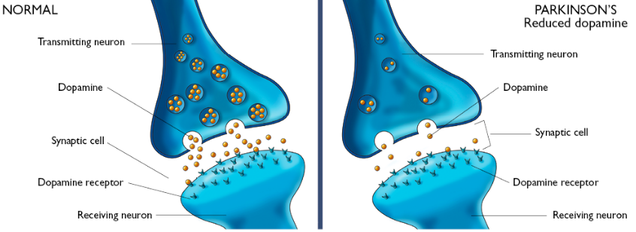
Parkinson’s disease is a neurodegenerative disorder which affects dopamine levels¹
Image: https://www.clinicaladvisor.com/features/link-between-pesticides-and-parkinsons-disease/article/492896/

Slide 3
History^{2,3,4}
1895
Richer and Beige
“Stages of the disease”
1817
James Parkinson
“Essay on the shaking palsy”
Jean-Martin Charcot
“Parkinson’s disease"

Slide 4
History^{2,3,4}
Brissaud
“PD and damage to the substantia nigra"
1953
Greenfield and Bosanquet
“Comprehensive analysis
Trétiakoff, Foix, and Nicolesco
“midbrain”
Babinski
“Irregular motor fluctuations”

Slide 5
Epidemiology^{3,5,6,7,8,9}
Most common movement disorder
2nd most common neurodegenerative disease
Affects 1-2 people for every 1000
In US: 572 per 100,000

Slide 6


Epidemiology⁹
1602 / 100,00
1602 / 100,00
646 / 100,00
1602 / 100,00

Slide 7
Causes^{10,11,12}
Neurons in substantia nigra deteriorate
Decrease in dopamine
Cause not known but believed to be genetic or environmental
  Genetic: LRRK2, PARK7, PINK1, PRKN, or SNCA
  Environmental: pesticide, tobacco smoke, head injury

Slide 8
Pathophysiology

Slide 9
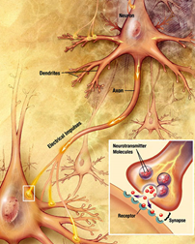
Pathophysiology^{13,14,15,16}
Substantia Nigra plays a role in movement
Moves through the brain via synaptic transmission
Seen in much lower levels in PD
Image:https://www.forbes.com/sites/daviddisalvo/2012/06/05/the-straight-dope-on-what-bath-salts-do-to-your-brain-and-why-theyre-dangerous/#3ce350f978ed

Slide 10
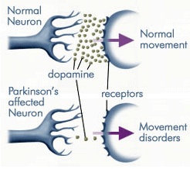
Pathophysiology^{17,18,19,20,21}
Substantia Nigra can inhibit or excite unwanted movement.
PD develops when at 80% of the neurons die
Lewy bodies
Image:https://sciensphere.wordpress.com/2015/08/15/how-are-parkinsons-disease-and-huntingtons-disease-different/

Slide 11
Symptoms

Slide 12
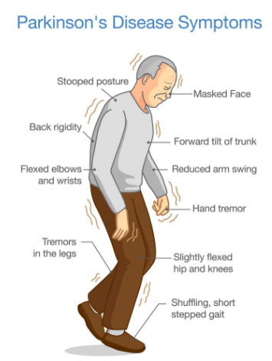
Motor Symptoms^{22,23}
Affect mobility
T: tremors
R: rigidity
A: akinesia
P: postural instability
Image: https://labiotech.eu/medical/axovant-parkinsons-disease-gene/

Slide 13
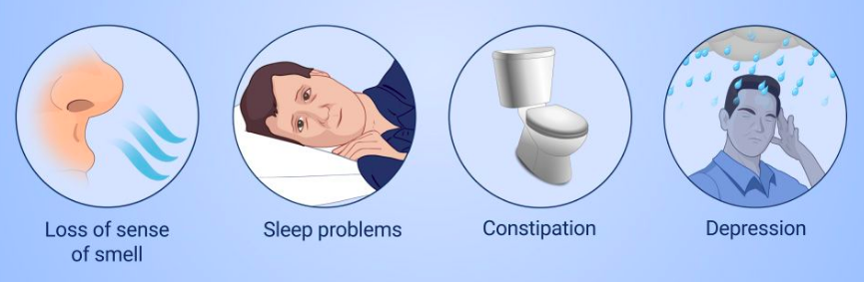
Non-Motor Symptoms²⁴
Not visible
Neuropsychiatric disorders
Sleep disorders
Sensory abnormalities
Autonomic dysfunction
Image: http://www.youandparkinsons.com/en-pk/view/m101-s01-understanding-parkinsons-disease-slide-show

Slide 14
Diagnosis

Slide 15
PD is commonly misdiagnosed, either missing it completely or telling someone they have it, even if they don’t²⁴

Slide 16
UK Brain Bank Criteria²⁶
3. Supportive Criteria
1. Diagnosis of Parkinsonian
2. Exclusion Criteria

Slide 17
MDS -UPDRS²⁵
Neuroimaging²³
Movement Disorders Society - Unified Parkinson’s Disease Rating Scale
  questionnaire
CT Scan
MRI
PET
SPECT

Slide 18
Drugs and Medications

Slide 19
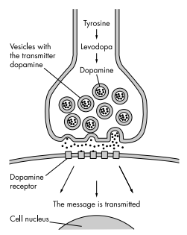
Levodopa (L-dopa)²⁷
One of the most prominent drugs
Amino acid that is involved in dopamine producing pathway
Side effects:
  Nausea
  Involuntary movement
  Mood swings

Slide 20
2. Dopamine Agonist (DA)^{27,28}
Discovered by Calne and colleagues in 1970’s
Bypass the degenerating dopaminergic pathway
Do not produce toxic metabolites or free radicals
Ropinirole
  Side effects:
    Vomiting
    Hypotension
    Hallucinations for PD patients with dementia

Slide 21
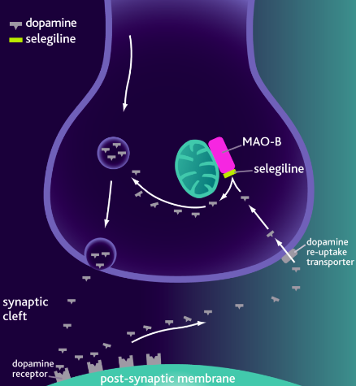
3. MAO-B Inhibitors²⁷
Blocks the metabolism of dopamine
Block the conversion of MPTP to its active metabolic MPP+
Selegiline was the first MAO-B
inhibitor
Side effects:
  Headache
  Loss of balance
  Nausea
Image: https://scienceofparkinsons.com/tag/mao-b-inhibitors/

Slide 22
Future Therapeutics

Slide 23
Future Therapeutics^{29,30,31,32}
A2A antagonists
Gene Therapy
  Neurturin
  GABA
Levodopa/carbidopa
AFQ056

Slide 24
References
Poewe W, Seppi K, Tanner CM, Halliday GM, Brundin P, Volkmann J, Schrag AE, Lang AE. Parkinson disease. Nature reviews Disease primers. 2017 Mar 23;3:17013.
Goetz CG. The history of Parkinson's disease: early clinical descriptions and neurological therapies. Cold Spring Harbor perspectives in medicine. 2011 Sep 1;1(1):a008862.
Tysnes OB, Storstein A. Epidemiology of Parkinson’s disease. Journal of Neural Transmission. 2017 Aug 1;124(8):901-5.
Gelb DJ, Oliver E, Gilman S. Diagnostic criteria for Parkinson disease. Archives of neurology. 1999 Jan 1;56(1):33-9.
von Campenhausen S, Bornschein B, Wick R, Bötzel K, Sampaio C, Poewe W, Oertel W, Siebert U, Berger K, Dodel R. Prevalence and incidence of Parkinson's disease in Europe. European Neuropsychopharmacology. 2005 Aug 1;15(4):473-90.
De Lau LM, Breteler MM. Epidemiology of Parkinson's disease. The Lancet Neurology. 2006 Jun 1;5(6):525-35.
De Rijk MC, Breteler MM, Graveland GA, Ott A, Grobbee DE, Van der Meche FG, Hofman A. Prevalence of Parkinson's disease in the elderly The Rotterdam Study. Neurology. 1995 Dec 1;45(12):2143-6.
Launer LJ, Berger K, Breteler MM, Dartigues JF, Baldereschi M, Fratiglioni L, Lobo A, Martinez-Lage J, Trenkwalder C, Hofman A. Prevalence of Parkinson's disease in Europe: A collaborative study of population-based cohorts. Neurologic Diseases in the Elderly Research Group. Neurology. 2000;54(11 Suppl 5):S21-3.
Marras C, Beck JC, Bower JH, Roberts E, Ritz B, Ross GW, Abbott RD, Savica R, Van Den Eeden SK, Willis AW, Tanner CM. Prevalence of Parkinson’s disease across North America. NPJ Parkinson's disease. 2018 Jul 10;4(1):21.
Schapira AH, Jenner P. Etiology and pathogenesis of Parkinson's disease. Movement disorders. 2011 May;26(6):1049-55.
Li JY, Englund E, Holton JL, Soulet D, Hagell P, Lees AJ, Lashley T, Quinn NP, Rehncrona S, Björklund A, Widner H. Lewy bodies in grafted neurons in subjects with Parkinson's disease suggest host-to-graft disease propagation. Nature medicine. 2008 May;14(5):501.
Camargos ST, Dornas LO, Momeni P, Lees A, Hardy J, Singleton A, Cardoso F. Familial Parkinsonism and early onset Parkinson's disease in a Brazilian movement disorders clinic: phenotypic characterization and frequency of SNCA, PRKN, PINK1, and LRRK2 mutations. Movement Disorders. 2009 Apr 15;24(5):662-6.
Filion M. Abnormal spontaneous activity of globus pallidus neurons in monkeys with MPTP-induced parkinsonism. Brain research. 1991 Apr 26;547(1):140-4.
DeLong MR. Primate models of movement disorders of basal ganglia origin. Trends in neurosciences. 1990 Jul 1;13(7):281-5.
Vallone D, Picetti R, Borrelli E. Structure and function of dopamine receptors. Neuroscience & biobehavioral reviews. 2000 Jan 1;24(1):125-32.

Slide 25
References
Ribrault C, Sekimoto K, Triller A. From the stochasticity of molecular processes to the variability of synaptic transmission. Nature Reviews Neuroscience. 2011 Jul;12(7):375.
Zarow C, Lyness SA, Mortimer JA, Chui HC. Neuronal loss is greater in the locus coeruleus than nucleus basalis and substantia nigra in Alzheimer and Parkinson diseases. Archives of neurology. 2003 Mar 1;60(3):337-41.
Deumens R, Blokland A, Prickaerts J. Modeling Parkinson's disease in rats: an evaluation of 6-OHDA lesions of the nigrostriatal pathway. Experimental neurology. 2002 Jun 1;175(2):303-17.
Greenwood CE, Tatton WG, Seniuk NA, Biddle FG. Increased dopamine synthesis in aging substantia nigra neurons. Neurobiology of aging. 1991 Sep 1;12(5):557-65.
Auluck PK, Chan HE, Trojanowski JQ, Lee VM, Bonini NM. Chaperone suppression of α-synuclein toxicity in a Drosophila model for Parkinson's disease. Science. 2002 Feb 1;295(5556):865-8.
Jankovic J. Parkinson’s disease: clinical features and diagnosis. Journal of neurology, neurosurgery & psychiatry. 2008 Apr 1;79(4):368-76.
Reichmann H. Clinical criteria for the diagnosis of Parkinson’s disease. Neurodegenerative diseases. 2010;7(5):284-90.
Weintraub D, Comella CL, Horn S. Parkinson's disease--Part 1: Pathophysiology, symptoms, burden, diagnosis, and assessment. Am J Manag Care. 2008 Mar 1;14(2 Suppl):S40-8.
Marsili L, Rizzo G, Colosimo C. Diagnostic Criteria for Parkinson’s Disease: From James Parkinson to the Concept of Prodromal Disease. Frontiers in neurology. 2018 Mar 23;9:156.
Davie CA. A review of Parkinson's disease. British medical bulletin. 2008 Apr 8;86(1):109-27.
Lang AE, Lees A. Management of Parkinson’s disease: an evidence-based review. Mov Disord. 2002 Jan 1;17(Suppl 4):S1-66.
Nutt JG, Wooten GF. Diagnosis and initial management of Parkinson's disease. New England Journal of Medicine. 2005 Sep 8;353(10):1021-7.
van Rensburg HJ, Legoabe L, Terre’Blanche G, Van der Walt M. 2–Benzylidene–1–Indanone Analogues as Dual Adenosine A1/A2a Receptor Antagonists for the Potential Treatment of Neurological Conditions. Drug research. 2019 Jan 7.
Palmer C, Coronel R, Bernabeu-Zornoza A, Liste I. Therapeutic Application of Stem Cell and Gene Therapy in Parkinson’s Disease. InPathology, Prevention and Therapeutics of Neurodegenerative Disease 2019 (pp. 159-171). Springer, Singapore.
Anang JB. Levodopa-Carbidopa-Related Rash in Parkinson’s Disease: A Case Series. Canadian Journal of Neurological Sciences. 2018 Sep;45(5):588-9.
Jones T, Murray R. Current research in and development of treatments for Parkinson’s disease. Pathophysiology. 2018 Dec 11;14:00.

