Slide 1
Obesity
Life Science 4M03
Charife Rabah, Christelle Ah Sen, Geetha Ramachandran,
Rosie Gill & Saakethiya Sriranjan

Slide 2
Table of Contents
What is Obesity?
Pathophysiology
Treatments and Management
Obesity
Notes:
In society, obese people are depicted as lazy individuals that have no respect for their bodies.
However, obesity is a disease, despite what some people might say. A disease that has become so prevalent in the world that it is called an epidemic.
This presentation will shed light on what obesity is from a clinical standpoint and argue the position of obesity as a disease.

Slide 3
What is Obesity?
Symptoms
Contributing factors
Epidemiology
Diagnosis

Slide 4
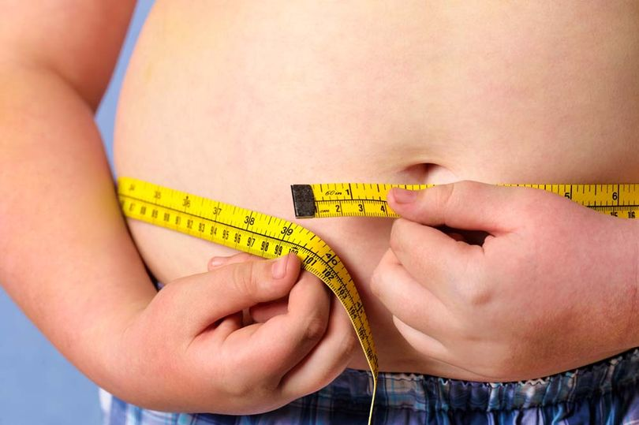
Definition of Obesity ¹
Obesity is the excessive accumulation of fat in adipose tissue to the extent that health may be impaired
http://www.mirror.co.uk/news/uk-news/poor-children-three-times-more-5342123
Notes:
Obesity is commonly defined as the excessive accumulation of fat in adipose tissue which can in turn impair one’s health. This definition can be applied to adults and children alike.

Slide 5
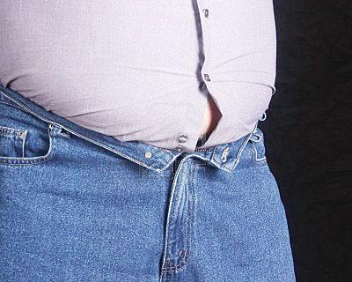
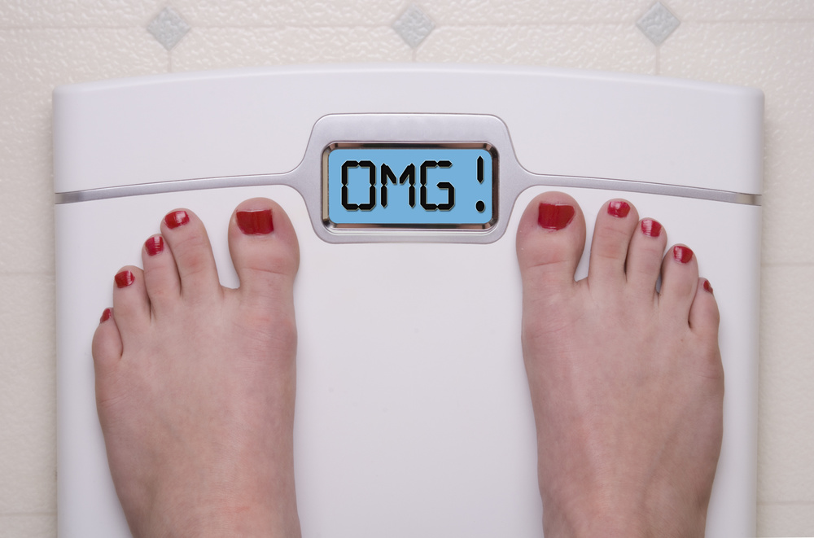
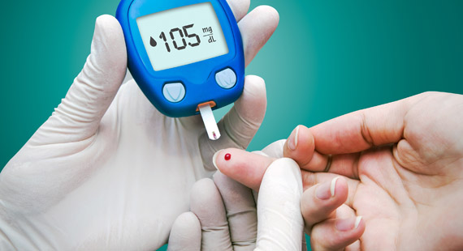
Symptoms ¹
http://www.newtimes.co.rw/section/article/2012-04-29/89410/
http://homegymr.com/are-digital-scales-accurate-for-measuring-weight/
http://eyogaguru.com/diabetes-symptom-yoga-control-cure-diabetes/
Symptoms of comorbid diseases (ex. Increase in glucose levels)
Increase in body fat
Increase in weight
Notes:
Unlike many other diseases, the symptoms are relatively simple. Most people that are obese know that they are overweight. They would have noticed a steady increase in body fat from changes in the way their clothing fit, an increasing number on the scale and perhaps even symptoms of other diseases, such as diabetes.
Symptoms of diseases associated with obesity can often lead patient into the doctor's office where they get an official diagnosis of obesity.

Slide 6
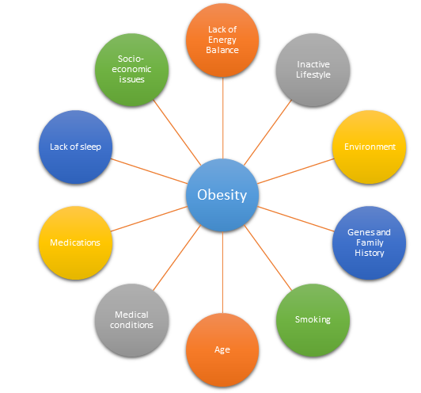
Contributing factors ¹
Lack of energy balance
Weight gain = ↑ energy in and ↓ energy out
Inactive lifestyle
↑ TV use and ↓ physical activity
Environment
↑ food portion sizes
Lack safe recreation places
Genes and family history
Medical conditions
Cushing’s Syndrome
Medicines
Psychiatric drugs
Socio-economic issues
Emotional factors
Cannot afford healthy alternatives
Notes:
Obesity isn’t something with a clear cause and effect. There are a plethora of contributing factors and they range from medical to social.
One important factor that contributes to obesity is one that is often assumed to be the cause, lack of energy balance. This simply means that the individual consumes more energy than they use.
This can be attributed to other factors like leading and inactive lifestyle or the environment. Perhaps the individual lives in an area where there are no safe recreation places so they have to resort to stationary activities. Maybe they live in a North American country where the portion sizes are distorted.
Genes and family history also play a large role and will be elaborated on in a couple slides.
Medical conditions like Cushing’s syndrome, a condition affecting the pituitary gland, can lead to obesity.
Medicines used for psychiatric conditions such anxiety and insomnia can cause rapid weight gain.
Socioeconomic factors such as binge eating when emotional or bored, perhaps someone can’t afford healthy alternatives so they resort to fast food.
The list really goes on but the key point here is that the cause of obesity is not one dimensional.
NOTE:
Cushings Syndrome - a disorder that occurs when your body has a high level of the hormone cortisol. The most common cause of Cushing syndrome is taking too much glucocorticosteroid medicine. Glucocorticoids mimic the action of the body's natural hormone cortisol. Other people develop Cushing syndrome because their body produces too much cortisol. This hormone is made in the adrenal glands. Weight gain with fat accumulation on the trunk, but fat loss from the arms, legs, and buttocks (central obesity)

Slide 7
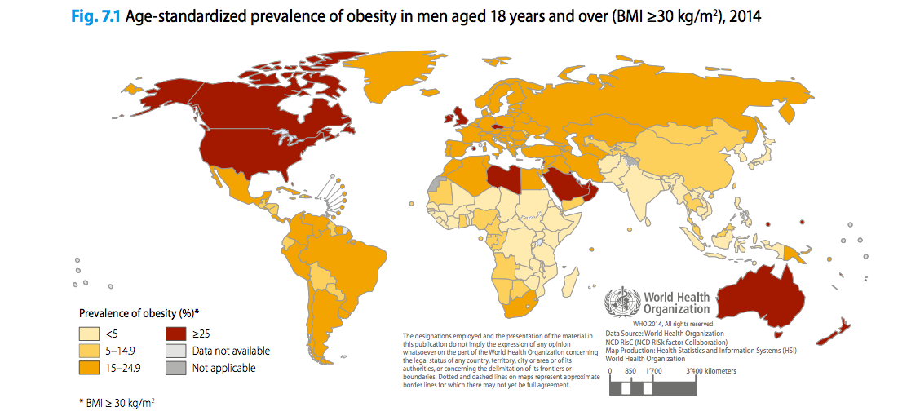
Epidemiology ²
http://www.bettycjung.net/BG2016/WHOMaleObesity.png
Notes:
After understanding the contributing factors, it’s easy to understand why the prevalence of obesity in certain countries is higher than others. Canada and the US are prime examples because they’re notorious for inactive lifestyles and fast food culture. Essentially, the developed countries in red are the ones with a big obesity problem and the ones in orange are the ones catching up to them. Although obesity used to be considered a “rich country problem”, it has spread all across the globe. Just look at parts of africa and the caribbean islands.

Slide 8
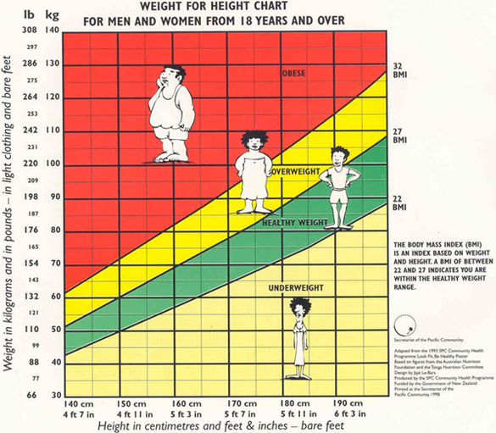
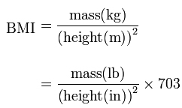
Diagnosis ³
Body Mass Index (Adults)
BMI | WEIGHT STATUS
30.0 – 34.9 | Obese (Class 1)
35.0 – 39.9 | Obese (Class 2)
40.0 and higher | Extremely Obese (Class 3)
https://www.pinterest.com/jerryprimus/bmi/
Notes:
Obesity can be diagnosed by calculating the patient’s body mass index (BMI). BMI estimates an individual’s level of body fat, and it's a good gauge of your risk for diseases that occur with more body fat.
It is calculated by dividing the patient’s weight in kilograms (kg) by their height in meters (m) squared. The numerical answer you get is then assessed based on what category it falls under on the BMI table or chart.
It’s important to remember that the charts are not definitive, they vary depending on age and sex. The chart here is a less specific one because it combines the sexes when it would probably be more accurate to look at the charts specific to each gender.
*image* As you can see, Height is included on the x-axis and the weight is on the y-axis. A BMI of less than 20 here indicates that the individual is underweight, the green section is normal/healthy weight and a bmi of about 32 and above is classified as obese. The category of obese can be further divided into subcategories that range from class 1 to 3.
*table with obesity classes* This chart has different numbers because it comes from an a chart specific to males, as you can see, the numbers are much more specific.

Slide 9
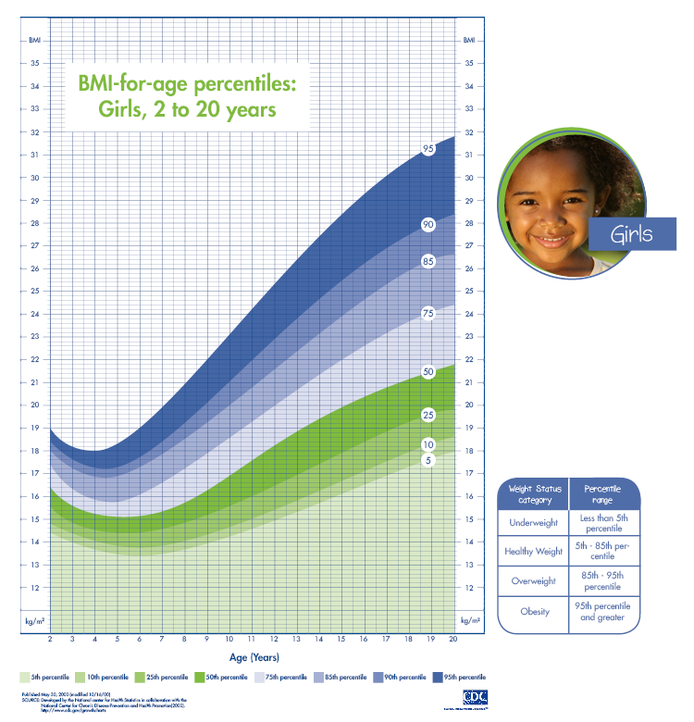
Body Mass Index (Children)
BMI calculation is slightly different for children
There are different BMI categories for specific age ranges
The sex of the child is important for the calculation of their BMI
Percentiles vary based on sex
http://www.obesityaction.org/wp-content/uploads/girls1.png
Notes:
In the case of children, you have the same concepts but they are applied a little differently. Children are still growing, and boys and girls mature at different rates.
BMIs for children/teens take height, weight, age and sex into account. Then they compare the child’s BMI with other boys and girls of their age. This is called BMI-for-age percentile.
For more accurate/specific calculations, the percentiles vary by sex, as seen in this image.
Sometimes clinicians will vary the percentiles based on age as well and look at different ranges for children between 2 - 5 and different ones for Children/Teens aged 5-19.

Slide 10
Pathophysiology
Adipocyte Development and Metabolic Activity
Hormone-Regulated Metabolism
Genetic Predisposition

Slide 11
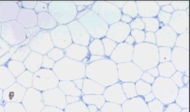
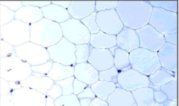
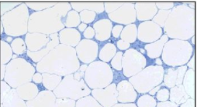
Adipocyte Development and Metabolism: Lipolysis ⁴
Normal Adipocytes
Obesity: excessive accumulation of adipocyte cells forming deposits of adipose tissue
Lipolysis: breakdown of lipids, which are made of fatty acids
Regulated by 𝜷₁ and 𝜷₂ adrenergic receptors (ARs) → Signal cAMP expression → Phosphorylation of perilipin and hormone-sensitive lipase
Adipocytes express elevated levels of α₂ adrenergic receptors → Inhibit the expression of cAMP → inhibits lipolysis
Hypertrophic Adipocytes
Inflammatory Adipocytes
α₂
𝜷₁ 𝜷₂
http://doku6rqv4sqv7.cloudfront.net/content/ppclinsci/130/18/1603/F1.large.jpg
Notes:
Obesity can be characterized by the excessive accumulation of adipocyte cells forming deposits of adipose tissue. On the right side, there are three microscopic images of adipocytes. The first image shows healthy differentiation of adipocytes. Hypertrophic adipocytes portray larger cell size, and inflammatory adipocytes occur as a result of cytokines.
Individuals with healthy metabolic activity and a normal BMI undergo the process of lipolysis, which is the breakdown of lipids made of fatty acids. Lipolysis is regulated in the process of 𝜷₁ and 𝜷₂ adrenergic receptors (ARs) which signal a cascade of effects of cAMP kinase. In individuals who are obese however, elevated levels of α₂ adrenergic receptors are present, which inhibit the expression of cAMP, thus preventing lipolysis. Essentially, an imbalance of 𝜷 and α receptors disrupts the process of lipolysis.

Slide 12
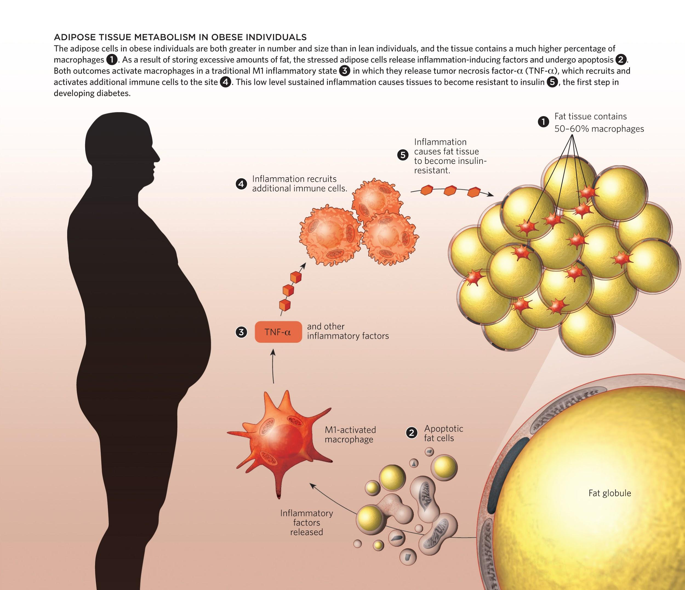
Adipocyte Development and
Metabolism:
Functional Analysis ⁵
Adipokines: inflammatory cytokines in adipocytes
http://www.the-scientist.com/images/December2012/Obese_Infograph.jpg
Notes:
The secretory activity of adipocytes plays a huge role in regards to hormonal and metabolic activity that takes place. Adipose cells are increased in size and number in obese conditions, which initiate an immune response. The fat cells release pro-inflammatory cytokines (adipokines) that recruit macrophages to the site. Following this, tumour necrosis Factor- alpha (TNF-α) is released and additional immune cells are brought to the site. This constant state of inflammation essentially causes insulin resistance. This is why diabetes is often comorbid with obesity.

Slide 13
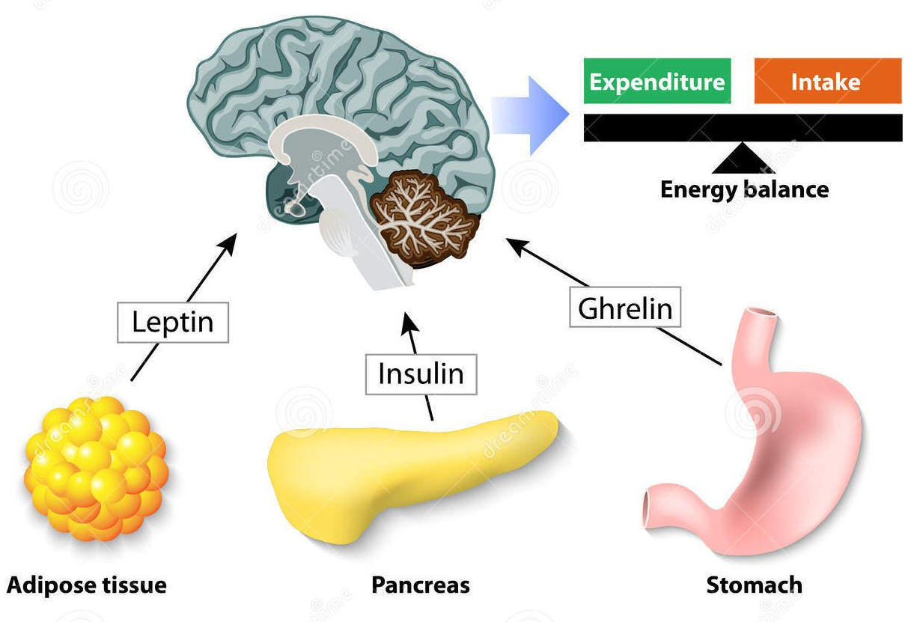
HORMONES
LEPTIN, INSULIN & GHRELIN
Notes:
There are three hormones-- leptin, insulin, and ghrelin-- that significantly contribute to the body’s energy balance.

Slide 14
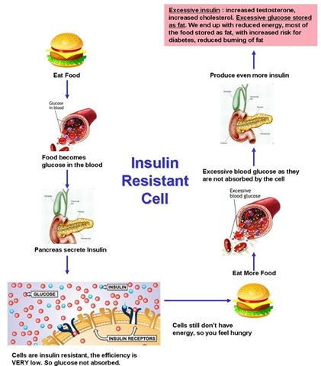
Hormone: Insulin ⁶
Secreted from pancreas
Regulates glucose levels
Obesity→ increased secretion → insulin resistance→ Type 2 Diabetes
Notes:
Insulin is a pancreatic hormone that assists in the body’s energy balance by regulating glucose. Insulin allows for the cells in the muscles, fat and liver to absorb glucose that is in the blood, thereby lowering the blood glucose level.
Obesity increases the likelihood that the body will have trouble responding to insulin (insulin resistance). Since the insulin is resistant, glucose cannot be taken up by the cells leading to less energy in the cells. The lower energy signals a need for food, eating then increases glucose levels again, more insulin is secreted and the process becomes cyclic. The build up of glucose in the blood is what also leads to Type 2 Diabetes.

Slide 15
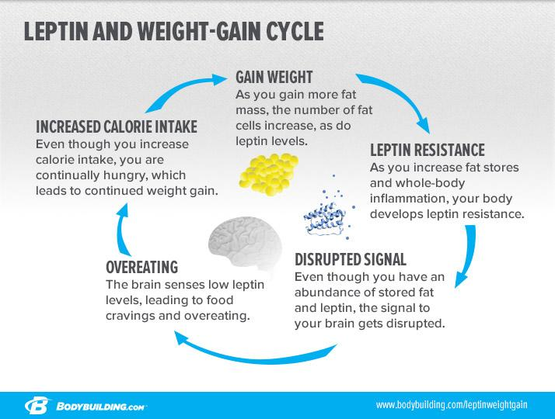
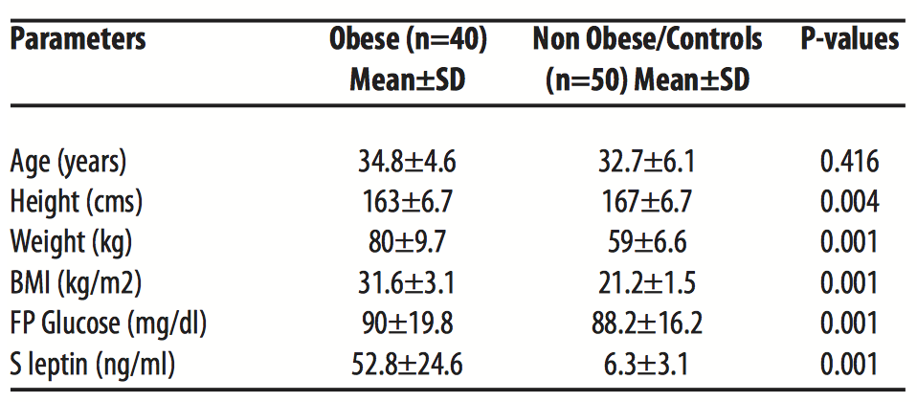
Hormone: Leptin ⁶
Appetite-suppressing
Secreted by fat cells
Obesity→ increased secretion→ leptin resistance
Kazmi et al.2013
Notes:
Leptin is an appetite-suppressing peptide hormone secreted by adipocytes (fat cells). So the more fat you have, the more leptin you produce, the less hungrier you’ll be, therefore the less you’ll eat. So theoretically, obese individuals, who have more fat and produce more leptin, should eat less. The findings from a study comparing leptin levels in obese vs. non obese individuals shows a concentration of 52.8 ng/mL in obese individuals and only 6.3 ng/mL in non obese. However, even with the high levels of leptin we do not see a reduction in appetite. This suggests that obesity is influenced by leptin resistance.
The weight gain results in the vicious Leptin and Weight-Gain Cycle(diagram to the right) where gaining weight causes leptin resistance which disrupts signals to the brain which results in overeating which increases calories intake,thus results in weight gain.
More information about Study
-to determine serum leptin concentrations from a sample of Rawalpindi population in relation to body mass index, age and gender

Slide 16
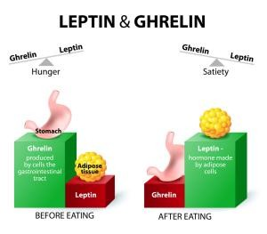
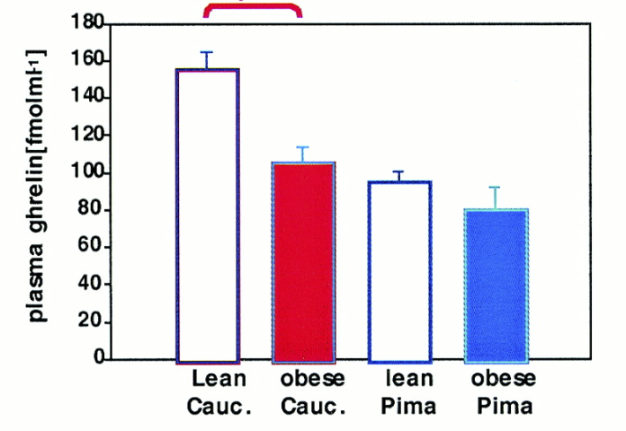
Hormone: Ghrelin ⁷
Appetite-stimulating
Secreted by stomach
Obesity→ Reduced secretion
Tschop et al. 2001
Notes:
Ghrelin is an appetite-stimulating hormone (antagonistic role of leptin) predominantly secreted by the stomach when it is empty. It increases food intake and promotes fat storage. In obesity we would expect ghrelin concentration to be higher, however when researchers measured the plasma ghrelin concentration in obese individuals they found that that the concentration was reduced compared to lean individuals (as shown in bar graph). Since leptin and ghrelin have an antagonistic role, the higher concentration of leptin could be influencing ghrelin’s concentration.
-physiological adaptation to obesity.
http://www.precisionnutrition.com/leptin-ghrelin-weight-loss
http://diabetes.diabetesjournals.org/content/50/4/707

Slide 17
Summary of Hormone Influences on Obesity
Insulin
(resistance)
Leptin
(resistance)
Ghrelin
(homeostasis)
Notes:
Here is a quick diagram that summarizes the concentration of hormones in obese individuals. So, the concentrations of Leptin and Insulin are increased due to resistance, while the concentration of Ghrelin is decreased primarily due to leptin resistance.

Slide 18
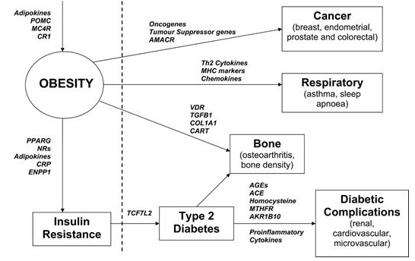
Genetic Predisposition ⁸
Highly heritable (heritability = 0.7)
Rare Familial Obesity
Common Polygenic Obesity
Biomarkers
https://academic.oup.com/hmg/article/15/suppl_2/R124/626082/Genetics-of-obesity-and-the-prediction-of-risk-for#10562151
Notes:
When assessing the heritability of obesity, it has a numerical association of 0.7, which is fairly high. In the case of rare familial obesity, gene defects occurs in appetite regulation. Variants in the leptin-melanocortin pathway results in about 5% of morbid human obesity. Common polygenic obesity is characterized by the human obesity gene map, which will be looked at in depth in the next slide.
Having the ability to detect the genetic bases for obesity provides therapeutic solutions that can combat symptoms of obesity. A variety of biomarkers have been identified as factors involved in obesity, as shown in the image to the right. These biomarkers are used to differentiate between types of obesity, provide insight on the associated comorbid diseases, genetic susceptibility and explain the implications of the interaction between two or more factors.

Slide 19
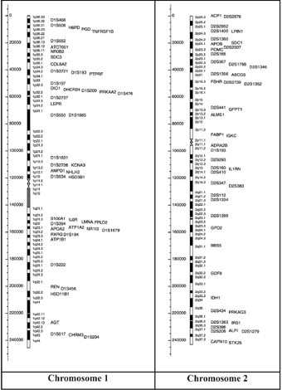
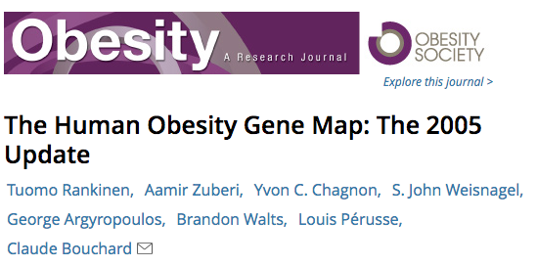
Genetic Predisposition: Human Obesity Gene Map ⁹
http://onlinelibrary.wiley.com.libaccess.lib.mcmaster.ca/doi/10.1038/oby.2006.71/full
Notes:
As of October 2005, 244 mutated genes or transgenes causing phenotypic changes in weight and adiposity were identified. The human obesity gene map indicates that 176 human obesity cases can be linked to 11 specific genes.
The gene map, shown on the right, includes all obesity-related genes and quantitative trait loci identified from the various lines of evidence reviewed in the paper. It is further explained and categorized into the 5 categories, where information pertaining to the mouse chromosome, mouse gene, human chromosome, human homolog, statistical analyses of variance, gene description, details pertaining to its role in obesity and more is provided. Areas of research pertaining to molecular genetics are expanding the scope of genetic predispositions involved in obesity.

Slide 20
Treatment &
Management
Dietary Therapy
Physical Activity
Cognitive Behaviour Therapy
Pharmacotherapy
Surgical Procedures

Slide 21
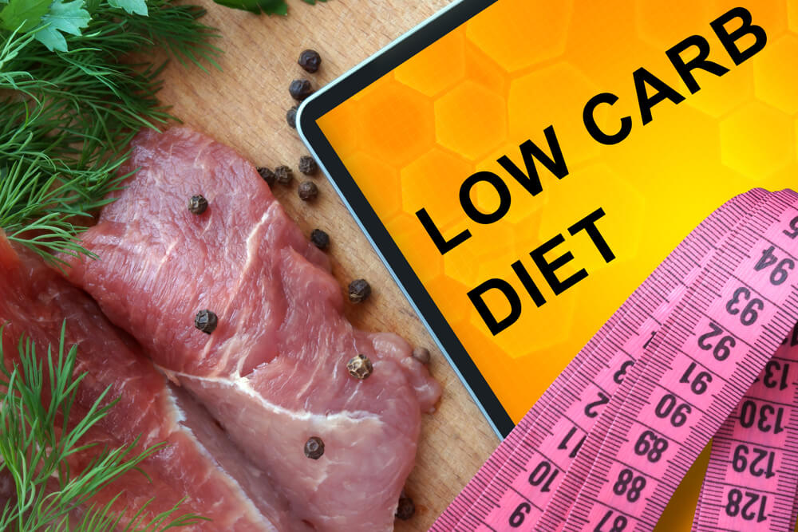
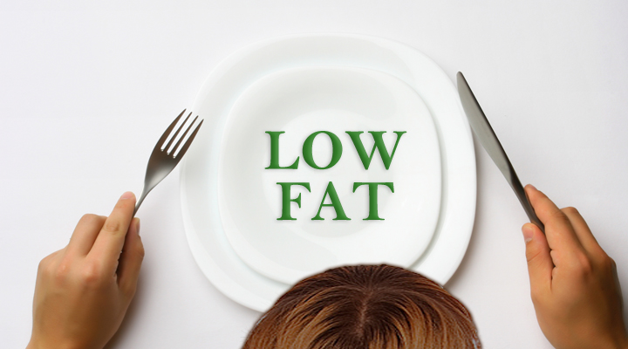
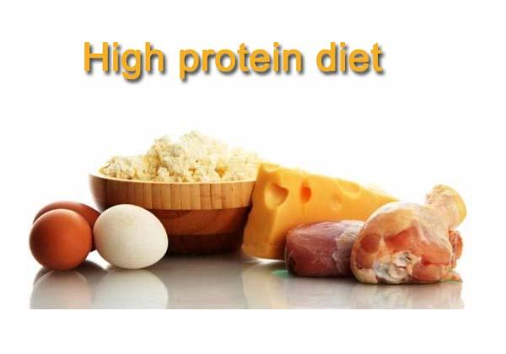
Diet ^{10,11,12}
Diets are subjective to each individual
Low Carb Diet 2. High Protein Diet 3. Low Fat Diet
https://gymjunkies.com/wp-content/uploads/2015/04/low-carb-diet-plan.jpg https://gymjunkies.com/wp-content/uploads/2015/04/low-carb-diet-plan.jpg http://arogyamasthu.com/wp-content/uploads/2015/05/low-fat-foods.jpg
Notes:
When discussing diet management in obese patients, we can state that weight reduction is dependant on energy intake compared to energy expenditure
Three popular diets that are often mentioned in many case control studies are: the low carbohydrate diets, the high protein diet and low fat diets
Low carb diets primarily require an individual to reduce the number of carbs they are intaking on a daily basis
The high protein diet encourages patients to increase the amount of protein they are eating and reduce the amount of foods rich in fat and sugars
Low carb diets and high protein diets are a great way to lose weight on a short term scale but not long term
Lastly, low fat diets are also a popular diets that many patients due tend to go on
Low fat diets have shown to produce a significant weight decrease up to about 3 years and then the results aren't as significant
Managing weight loss through dietary means can be difficult and can be made easier when incorporating physical activity into the daily routine.

Slide 22
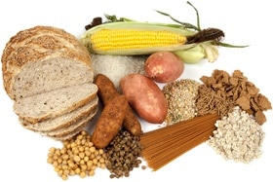
Weight Loss Programs ¹³
There are many weight loss programs available and each of these weight loss programs can have a different impact on various individuals
The Paleo Diet
The Vegan Diet
The Low Carb Diet
Ultra Low Fat Diet
The Zone Diet
Intermediate Fasting
https://authoritynutrition.com/9-weight-loss-diets-reviewed/
Notes:
These are just a few options of diets when trying to reduce weight loss
All the diets listed above do prove to have a positive impact on weight reduction, however, every diet has its pitfalls and negatives
Any time you restrict your body from having certain kinds of foods, you are limiting yourself from consuming good minerals and vitamins.
Again, it is important for you to visit your family physician and ask about what weight loss program would work best with your body type and health condition.
THIS IS JUST FOR YOUR PERSONAL UNDERSTANDING OF EACH DIET: DO NOT NEED TO MENTION IT FOR THE PRESENTATION**
The Paleo Diet: It works to incorporate whole foods, lean protein, veggies, fruits, nuts, and seeds and encourages to stay away from foods with sugars, dairy and grains.
The Vegan Diet: It’s an extreme vegetarian diet that works to eliminate dairy, eggs, and animal derived products like gelatin, honey, whey, and some kinds of vitamin D3.
The Low Carb Diet: Encourages to eat an unlimited amount of protein and fat, while either completely or almost eliminating carbs.
The Ultra Low-Fat Diet: Consists of a diet where 10% or less calories come from fat. This diet is almost made up completely off plant based food items, with a very limited intake in animal products.
The Zone Diet: This diet encourages participants to balance each meal with one third protein, two thirds fruits and veggies contain a small amount of fat that comes from natural and healthy sources like avocado, almonds, or olive oil.
Intermediate Fasting: This diet challenges its participants to fast during portions of the day, while restricting the calorie intake during the times you do choose to eat. This diet is most efficient when you aren’t overeating during the times where the fast has been broken.

Slide 23
Physical Activity ^{14,15,16,17}
The effect of physical activity on weight loss differs from person to person
Walking
Running
Biking
Swimming
https://15lqly1asnyxgrm42brusqb1j-wpengine.netdna-ssl.com/wp-content/uploads/2014/12/walk-bike-swim.jpg
Notes:
Maintaining physical activity is known to be the key to long term weight maintenance because it increases the energy expenditure through caloric deficit, which helps with weight loss
Many studies have concluded that thirty to forty-five minutes of moderately intensive physical activity done 3-5 times a week is recommended
Activities like walking, jogging and running are all good forms of aerobic activities which are the most efficient ways to burn calories
Not every kind of physical activity produces the same results among different individuals
Realistic goals need to be set with a clinician pertaining to weight loss and exercise because each individual is different and require different levels of physical activity in order to lose weight in a safe and healthy manner

Slide 24
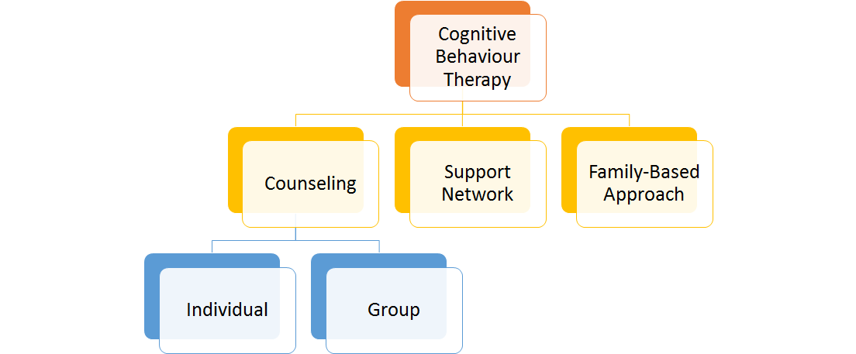
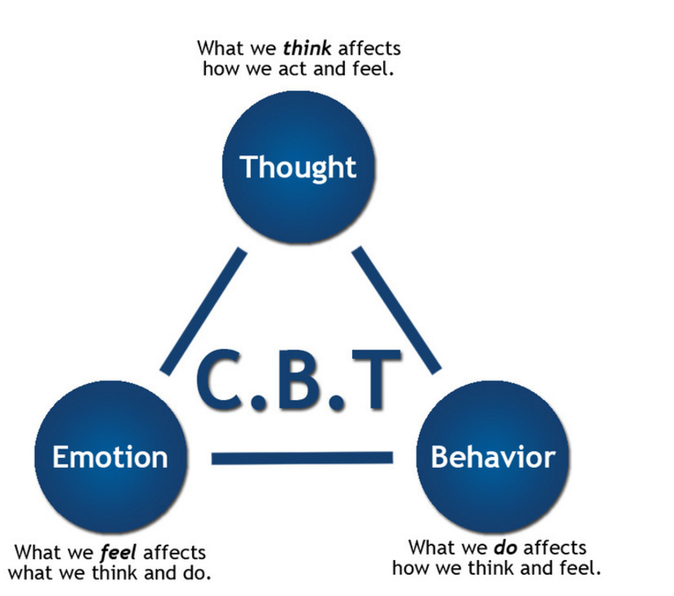
Cognitive Behaviour Therapy ^{18,19}
http://anxietynetwork.com/content/cognitive-behavioral-therapy-social-anxiety-makes-physical-changes-brain
Notes:
A behaviour modification program is highly recommended to make lifestyle changes that will enable the most sustainable weight loss and maintenance. It is important to undertake critical steps such as identifying factors, stresses or situations from current habits which may have contributed to one’s obesity.
Behaviour therapy includes many interventions such as having counseling, joining a support group(s). Seeing a trained mental health counselor (or other professionals) is really beneficial to understand why one person overeats and how to eat heathy again. Successful counselling programs, either on an individual basis or in a group setting, need to be typically a minimum of 12 sessions per year to achieve sustainable weight-loss goals.
It is also crucial to have a support system. There are support groups where others share similar challenges with obesity.
In addition, family-based therapy has been proven very effective and sustainable approach, especially when treating pediatric obesity. The role of family-based behavioural pediatric obesity treatment is to target eating and activity change in both child and parent. Programs using this approach teach parents behavioural skills to facilitate child behaviour change. Simultaneously, treating the parent and child is beneficial for both and creates positive relationships between child and parent weight change.
https://www.ncbi.nlm.nih.gov/pmc/articles/PMC2387251/pdf/nihms43557.pdf
Epstein, L. H., Paluch, R. A., Roemmich, J. N., & Beecher, M. D. (2007). Family-based obesity treatment, then and now: twenty-five years of pediatric obesity treatment. Health Psychology, 26(4), 381.

Slide 25
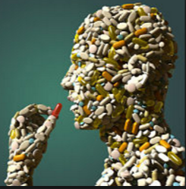
Pharmacotherapy ¹⁹
Use
If one is not successful at losing 10% of body weight after 6 months using lifestyle changes
Eligibility
BMI >> 30
BMI >> 27 with life-threatening diseases
Most effective
In conjunction with lifestyle modifications including dietary changes, physical activity and behavioural changes
http://hubpages.com/health/The-Prescription-Drug-Addiction-Epidemic-Pain-Killers-Addictions-Pain-Clinics-Pain-Pills-Pharmaceuticals
Notes:
Pharmacotherapy is usually suggested for patients who are not attaining or unable to maintain clinically important weight loss with dietary, exercise, and cognitive behaviour therapy within the first 6 months. Effectiveness of lifestyle modifications are assessed after 6 months, and if weight loss goal is not reached, health care practitioners would consider their patients’ eligibility for drugs. It’s important to note that highest rate of success is done in conjunction with lifestyle modifications including dietary changes, physical activity and behavioural changes.
http://www.cmaj.ca/content/suppl/2007/09/04/176.8.S1.DC1/obesity-lau-onlineNEW.pdf
Lau, D. C., Douketis, J. D., Morrison, K. M., Hramiak, I. M., Sharma, A. M., Ur, E., & members of the Obesity Canada Clinical Practice Guidelines Expert Panel. (2007). 2006 Canadian clinical practice guidelines on the management and prevention of obesity in adults and children [summary]. Canadian Medical Association Journal, 176(8), S1-S13.

Slide 26
Randomized Control Trials (RCTs) ¹⁹
Notes:
2 FDA-approved drugs are orlistat and silbutramine.
Orlistat is a gastrointestinal lipase inhibitor and reduces fat absorption by approximately 30%. Patients can use it for up to 2 years (Guerciiloni, 10).
On the other hand, Sibutramine functions as a serotonin and noradrenaline reuptake inhibitor which induces weight loss through enhanced satiety and increased basal energy expenditure. Sibutramine is approved for clinical use for up to 1 year (Finer, 2002).

Slide 27
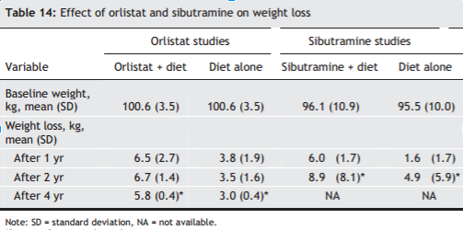
Combined Pharmacological-Diet Therapy RCT ¹⁹
Notes:
This table drawn from an RCT compared pharmacological-diet therapy and diet-only therapy. It was found that combination therapy was associated with a greater likelihood of attaining clinically important weight loss ratios (Rippe et al., 1998).
In addition, results from RCTs have showed that combined therapy using either orlistat or sibutramine, with diet therapy, is more effective than diet-only groups in maintaining weight loss in the long run. Treatment with orlistat or sibutramine, when combined with a reduced-energy diet, was associated with a weight loss. The long term weight loss was about 6-7 kg, compared to about 2-3 kg with diet-only therapy.
These RCTs assessed this for in patients who received therapy for at least 2 years and up to 5 years.
Therefore, the data reinforces the hypothesis that pharmacotherapy used in conjunction with dietary changes is more effective and sustainable, than dietary changes alone.
http://www.cmaj.ca/content/suppl/2007/09/04/176.8.S1.DC1/obesity-lau-onlineNEW.pdf

Slide 28
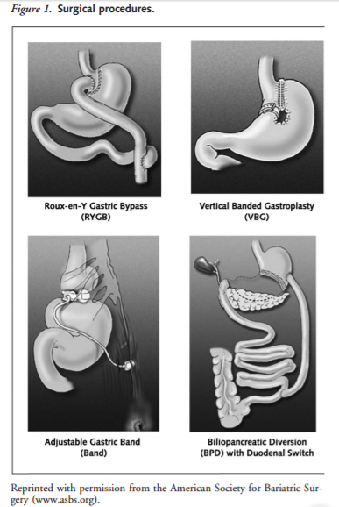
Bariatric Surgery ¹⁹
Undergo surgery when other non-surgical treatment options have failed
Eligibility
Extreme obesity (BMI of > 40)
Obesity (BMI> 35 but with life-threatening conditions)
Lifelong medical follow up needed
Notes:
Bariatric surgery is used when other non-surgical treatment options have failed.
The increasing numbers of obese individuals have led to intensified interest in surgical treatments to achieve weight loss, and a variety of surgical procedures have been used.
(cite- from meta-analysos-surgical treatment of obesity Maggard)
https://www.nhlbi.nih.gov/health/health-topics/topics/obe/treatment
Check out- http://www.cmaj.ca/content/suppl/2007/09/04/176.8.S1.DC1/obesity-lau-onlineNEW.pdf

Slide 29
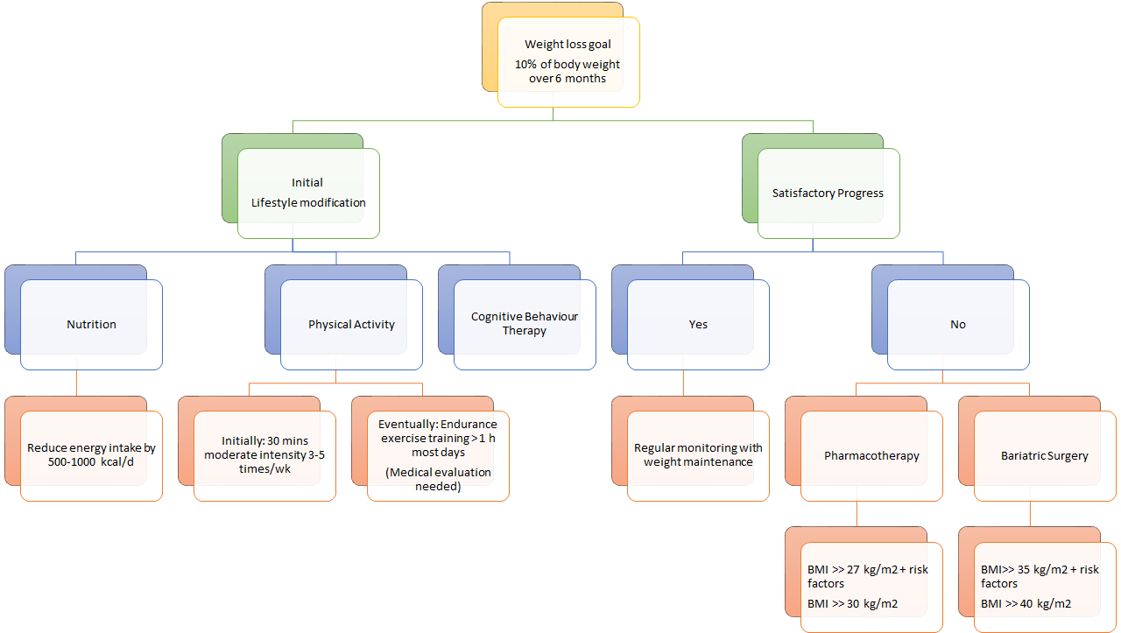
Notes:
http://www.cmaj.ca/content/suppl/2007/09/04/176.8.S1.DC1/obesity-lau-onlineNEW.pdf
In summary, here is a holistic approach to treating obesity. The initial goal of weight loss therapy is to reduce body weight by approximately 10% from baseline over 6 months.
First, it is important to adopt lifestyle modifications such as healthy eating, being physically active and undergoing cognitive behaviour therapy.
After 6 months of adopting lifestyle modifications, one can evaluate whether satisfactory progress or weight loss goal has been achieved.
If YES- regular monitoring needs to occur on a regular basis to assist with weight maintenance. It is important to reinforce healthy eating and physical activity.
If NO- an individual can either undergo pharmacotherapy or bariatric surgery. With these two treatment options, it is of utmost importance that they are used in conjunction with lifestyle modifications to see the most benefits.
Adults: Success if 10% of initial weight is loss and no more than 6-7 pounds are gained in 2 years
Important to adopt sustainable lifestyle changes

Slide 30
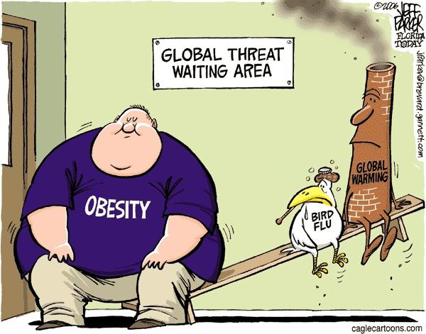
Conclusion
Notes:
Obesity certainly has clinical manifestations, pathophysiological mechanisms and treatments/managements that would be characteristic of any disease
We hope that we’ve provided you with enough insight to convince you that obesity is indeed a disease.

Slide 31
Questions?

Slide 32
Reference List
How Are Overweight and Obesity Diagnosed? - NHLBI, NIH. (2017). Nhlbi.nih.gov. Retrieved 28 January 2017, from https://www.nhlbi.nih.gov/health/health-topics/topics/obe/diagnosis
Obesity and overweight. (2017). World Health Organization. Retrieved 28 January 2017, from http://www.who.int/mediacentre/factsheets/fs311/en/
Obesity - Mayo Clinic. (2017). Mayo Clinic. Retrieved 28 January 2017, from http://www.mayoclinic.org/diseases-conditions/obesity/basics/definition/con-20014834
Gurevich-Panigrahi, T., Panigrahi, S., Wiechec, E., & Los, M. (2009). Obesity: pathophysiology and clinical management. Current Medical Chemistry, 16, 506-521. Retrieved 20 January 2017, from http://liu.diva-portal.org/smash/get/diva2:583167/FULLTEXT01.pdf
Odegaard, J., & Chawla, A. (2012). Adipose tissue metabolism in the obese. TheScientist. Retrieved 18 January 2017, from http://www.the-scientist.com/?articles.view/articleNo/33653/title/adipose-tissue-metabolism-in-the-obese/
Kaszmi, A., Sattar.A., Hashim, R., Khan., S.P.., Younus, M., Khan, F.A. (2013). Serum Leptin values in the healthy obese and non-obese subjects of Rawalpindi. J Pak Med Assoc. 63(2), 245-8.
Tschop, M., Weyer, C., Tataranni, P. A., Devanarayan, V., Ravussin, E., & Heiman, M. L. (2001). Circulating Ghrelin Levels Are Decreased in Human Obesity. Diabetes, 50(4), 707-709. doi:10.2337/diabetes.50.4.707
Walley, A.J., Blakemore, A.I.F. & Froguel, P. (2006). Genetics of obesity and the prediction of risk for health. Human Molecular Genetics. Retrieved 27 January, 2017, from https://academic.oup.com/hmg/article/15/suppl_2/R124/626082/Genetics-of-obesity-and-the-prediction-of-risk-for
Rankinen, T., Zuberi, A., Chagnon, Y.C., Weisnagel, S.J., Argyropoulos, G., Walts, B., Perusse, L., & Bouchard, C. (2006). The human obesity gene map: the 2005 update. Obesity, 14(4), 529-644.
Hey, H., Petersen, H. D., Andersen, T., & Quaade, F. (1987). Formula diet plus free additional food choice up to 1000 kcal (4.2 MJ) compared with an isoenergetic conventional diet in the treatment of obesity. A randomised clinical trial. Clinical Nutrition, 6(3), 195-199.
Lau, D. C., Douketis, J. D., Morrison, K. M., Hramiak, I. M., Sharma, A. M., Ur, E., & members of the Obesity Canada Clinical Practice Guidelines Expert Panel. (2007). 2006 Canadian clinical practice guidelines on the management and prevention of obesity in adults and children [summary]. Canadian Medical Association Journal, 176(8), S1-S13.
Toubro, S., & Astrup, A. (1997). Randomised comparison of diets for maintaining obese subjects' weight after major weight loss: ad lib, low fat, high carbohydrate diet fixed energy intake. Bmj, 314(7073), 29.
9 Popular Weight Loss Diets Reviewed by Science. (2016, October 04). Retrieved January 27, 2017, from https://authoritynutrition.com/9-weight-loss-diets-reviewed
Pate, R. R., Pratt, M., Blair, S. N., Haskell, W. L., Macera, C. A., Bouchard, C., ... & Kriska, A. (1995). Physical activity and public health: a recommendation from the Centers for Disease Control and Prevention and the American College of Sports Medicine. Jama, 273(5), 402-407.
Poirier, P., & Després, J. P. (2001). Exercise in weight management of obesity. Cardiology clinics, 19(3), 459-470.
Gwinup, G. (1987). Weight loss without dietary restriction: efficacy of different forms of aerobic exercise. The American journal of sports medicine, 15(3), 275-279.
Tremblay, A., Nadeau, A., Despres, J. P., St-Jean, L., Theriault, G., & Bouchard, C. (1990). Long-term exercise training with constant energy intake. 2: Effect on glucose metabolism and resting energy expenditure. International journal of obesity, 14(1), 75-84.
Epstein, L. H., Paluch, R. A., Roemmich, J. N., & Beecher, M. D. (2007). Family-based obesity treatment, then and now: twenty-five years of pediatric obesity treatment. Health Psychology, 26(4), 381.
Lau, D. C., Douketis, J. D., Morrison, K. M., Hramiak, I. M., Sharma, A. M., Ur, E., & members of the Obesity Canada Clinical Practice Guidelines Expert Panel. (2007). 2006 Canadian clinical practice guidelines on the management and prevention of obesity in adults and children [summary]. Canadian Medical Association Journal, 176(8), S1-S13.
Notes:
Quiz Questions:
Which hormone(s) is/are downregulated in individuals who are obese?
Leptin
Ghrelin ##
Obestatin
Insulin and Leptin
Insulin
What diet(s) produce(s) successful weight loss results at a short term rate?
A. Low fat diet
B. Low carb diet
C. The Paleo diet
D. High protein diet
E. Both B and D ##

