Slide 1
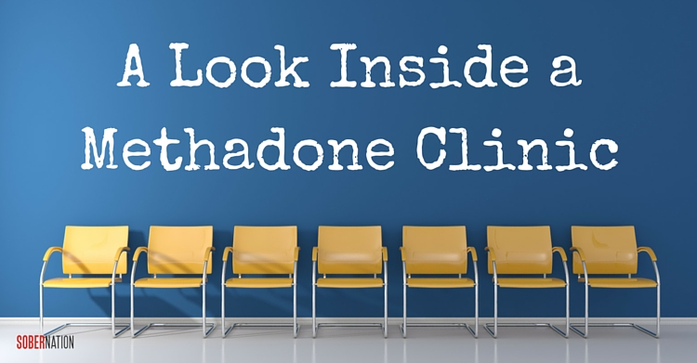
BY: AFRAAH, ABHINAYA(SAI), ZACHARY, JORAVAR & EDLYN

Slide 2
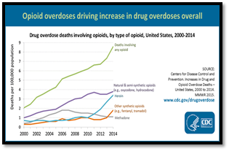
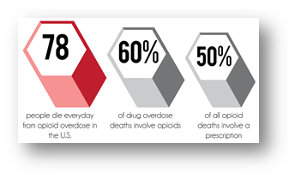
Opioid Crisis ⁸
❖Increase of opioid use in last decade
❖consumption of oxycodone increased 500%
❖OPR related death has quadrupled
❖435,000 people use heroin, 171 % increase
❖Doctor’s prescribe OPRs >50% in non surgeries
Addiction is hard to recover from
People switch to heroin after using OPRs
Large Increase in opioid related deaths

Slide 3
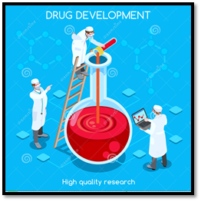
History ⁶
❖Methadone clinics were historically opened to be used as an opioid replacement therapy.
❖Substance called polamidon was developed in 1937
❖During World War II ¹⁸
morphine shortage, so production was increased
❖Pain relief medicine + narcotic addiction treatment drug after 1947
❖ The drug was researched + new regulations were added during 19th century
Delivery mechanisms and to prevent side effects
❖Methadone is an effective maintenance therapy

Slide 4
Mechanism
Opioids need to cross the blood brain barrier (BBB) to have an effect ¹⁷
P-gp binds to morphine both after it crosses and as it is crossing and removes it from inside the BBB¹⁷
Morphine that does not get effluxed binds to mu opioid receptors (MOR) on cell surfaces ^{1,2,17}
Notes:
Schaefer, C. P., Tome, M. E., & Davis, T. P. (2017). The opioid epidemic: a central role for the blood brain barrier in opioid analgesia and abuse. Fluids and barriers of the CNS, 14(1), 32. doi:10.1186/s12987-017-0080-3
Schaefer, C. P., Tome, M. E., & Davis, T. P. (2017). The opioid epidemic: a central role for the blood brain barrier in opioid analgesia and abuse. Fluids and barriers of the CNS, 14(1), 32. doi:10.1186/s12987-017-0080-3
Chahl, A. Loris. (1996) Opioids - mechanisms of action. Australian Prescriber, 19(3), doi: 10.18773/austprescr.1996.063
Akbarali, H. I., & Dewey, W. L. (2017). The gut–brain interaction in opioid tolerance. Current Opinion in Pharmacology, 37, 126–130. https://doi.org/https://doi.org/10.1016/j.coph.2017.10.012
Schaefer, C. P., Tome, M. E., & Davis, T. P. (2017). The opioid epidemic: a central role for the blood brain barrier in opioid analgesia and abuse. Fluids and barriers of the CNS, 14(1), 32. doi:10.1186/s12987-017-0080-3

Slide 5
Mechanism
MOR are coupled with voltage gated ion channels via G proteins²
Activation of receptor causes uncoupling of G proteins (alpha subunit) which binds to an effector²
Results in cellular response
Response in both presynaptic and postsynaptic neuron^{1,2}
Inhibitory effect
Notes:
Chahl, A. Loris. (1996) Opioids - mechanisms of action. Australian Prescriber, 19(3), doi: 10.18773/austprescr.1996.063
Chahl, A. Loris. (1996) Opioids - mechanisms of action. Australian Prescriber, 19(3), doi: 10.18773/austprescr.1996.063
Chahl, A. Loris. (1996) Opioids - mechanisms of action. Australian Prescriber, 19(3), doi: 10.18773/austprescr.1996.063
Akbarali, H. I., & Dewey, W. L. (2017). The gut–brain interaction in opioid tolerance. Current Opinion in Pharmacology, 37, 126–130. https://doi.org/https://doi.org/10.1016/j.coph.2017.10.012

Slide 6
Mechanism
3 mechanisms by which opioids inhibit signal ^{1,2}
Inhibition of Ca2+ channels
Activation of K+ voltage gated channels
Inhibition of adenylate cyclase
Methadone is a synthetic opioid that can induce same effects with lessened side effects ¹⁷
Notes:
Chahl, A. Loris. (1996) Opioids - mechanisms of action. Australian Prescriber, 19(3), doi: 10.18773/austprescr.1996.063
Akbarali, H. I., & Dewey, W. L. (2017). The gut–brain interaction in opioid tolerance. Current Opinion in Pharmacology, 37, 126–130. https://doi.org/https://doi.org/10.1016/j.coph.2017.10.012
Schaefer, C. P., Tome, M. E., & Davis, T. P. (2017). The opioid epidemic: a central role for the blood brain barrier in opioid analgesia and abuse. Fluids and barriers of the CNS, 14(1), 32. doi:10.1186/s12987-017-0080-3

Slide 7
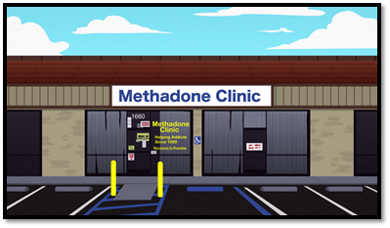
Methadone Clinic ⁴
Treatment prescribed by doctor
not a cure
2 types of clinic
Public (cheaper, longer waits, etc.)
Private(expensive, shorter waits, etc.)
Goals
Control opioid withdrawal
Decrease opioid cravings
Block effects of opioids
Control behaviour => functional day-to-day life

Slide 8
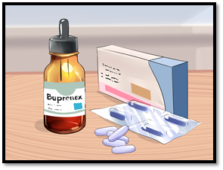
Treatments ¹⁰
Medication-assisted treatment
block opiate drug reward pathways → prevent craving
2. Cognitive Behavioral Therapy (CBT)¹³
Counseling → coping skills for substance cravings + stress factors
3. Medical detox
Withdrawal symptoms are treated → a week-month.

Slide 9
Effectiveness & Efficacy
Reducing Opioid Usage
1998 meta-analysis found statistically significant correlation between the methadone maintenance treatment and opioid use reduction ¹²
2007 meta-analysis came to supporting conclusions ³
Important to consider that reduction in opioid use depends on methadone dosage and timespan of treatment
Therefore, with proper dosage and consistency of the methadone treatment, addicts are able to overcome their opioid-abusive behaviour. ¹⁹

Slide 10
Effectiveness & Efficacy
Comparison to Alternatives ⁹
Higher effectiveness compared to other treatments
Double-blind Randomized Controlled Study comparing Buprenorphine and Methadone maintenance in treating opioid dependence
3 groups: 8 mg/d of buprenorphine, 30 mg/d of methadone, or 80 mg/d of methadone maintenance
Results: high dose methadone treatment showed significant improvements in retention, and opioid use and cravings
Important to note: lower doses of methadone may not be effective, and may cause the blockade effect ¹⁵

Slide 11
Effectiveness & Efficacy
Cost Effectiveness ¹⁹
Social cost of methadone use = cost of methadone treatment x 4
$1 spent on methadone treatment= $4 to $13 saved by community
In Toronto:
Untreated opioid addictions= $44,600 cost per year
Estimated cost of methadone treatment= $6,000 per year
Ultimately, when comparing the methadone maintenance treatment to other opioid dependency treatments, it is a cost-effective solution, considering its lower delivery cost and higher retention rates

Slide 12
Methadone Program in Canada⁴
As of May 19, 2018, practitioners no longer requires exemption from Health Canada to prescribe, sell, or administer methadone
Greater access to comprehensive treatment options
Pharmacists may sell and provide a narcotic to a person if there is a written prescription signed and dated from a practitioner
Patients under practitioner’s professional care can be administered methadone

Slide 13
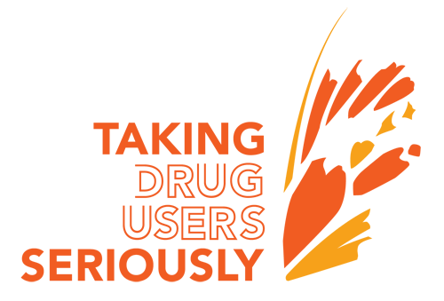
Harm Reduction Policy ¹¹
Aim to reduce the negative consequences of active drug use
Users no longer need to buy drugs on the black market
Respect for the rights of people who use drugs
Law enforcement agencies utilize this policy in high drug use areas
https://goo.gl/GG2rMJ
https://goo.gl/2nXAEY

Slide 14
Positive Effects
Reducing the incidents of blood borne sickness like hepatitis C and HIV
Provides a structured treatment
Quality of drug is pure and dosage is right
Opportunity for addicts to meet others with the same problem and intention to get better ¹⁹
Patients in the program cut back their use of drugs from 14 times to 4 times a month ¹⁶
80% retention rate, 20% switch to less sensitive treatments such as methadone pills after they stabilize ¹⁶

Slide 15
Negative Effects
Over concentrates poverty (effect on surroundings)²⁰
Creating a trap people struggle to escape from
Weight gain in users (often in short periods)⁷
Accidental dosage overdose causes huge sugar cravings
Client gained 50 pounds in 4 months
Loss of Sexual Drive (Erectile Dysfunction)⁴
40% of men over 40 on Methadone will experience it
Sometimes coupled with loss of libido

Slide 16
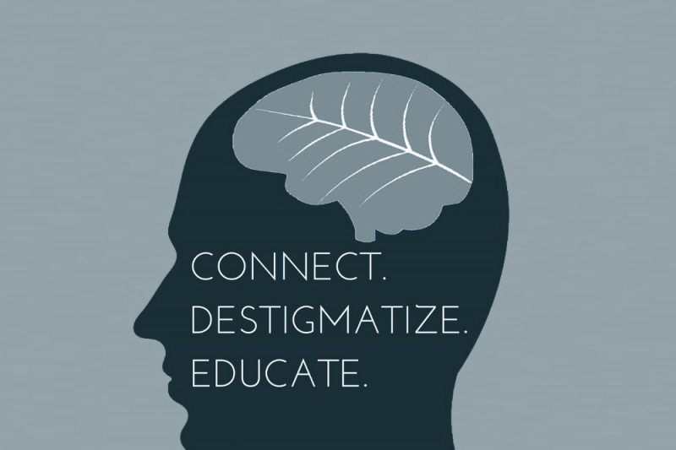
In Conclusion, in order to allow the methadone maintenance treatment to expand and be accepted socially, communities need to overcome the bias and stigma that currently exists. This can be done through increased education and awareness on the treatment and the benefits of it ⁶.
Notes:
https://www.google.ca/search?q=break+stigma&source=lnms&tbm=isch&sa=X&ved=0ahUKEwiTkvLd26_eAhVFwFkKHSWjCEwQ_AUIDigB&biw=1366&bih=626#imgrc=BYbjl6FxJdRjtM:v

Slide 17
References
Akbarali, H. I., & Dewey, W. L. (2017). The gut–brain interaction in opioid tolerance. Current Opinion in Pharmacology, 37, 126–130. https://doi.org/https://doi.org/10.1016/j.coph.2017.10.012
Chahl, A. Loris. (1996) Opioids - mechanisms of action. Australian Prescriber, 19(3), doi: 10.18773/austprescr.1996.063
Connock, M., Juarez-Garcia, A., Jowett, S., Frew, E., Liu, Z., Taylor, R. J., ... & Burls, A. (2007). Methadone and buprenorphine for the management of opioid dependence: a systematic review and economic evaluation.
Government of Canada. (2017). Methadone Program. Retrieved from https://www.canada.ca/en/health-canada/services/health-concerns/controlled-substances-precursor-chemicals/exemptions/methadone-program.html
Hosseini, S. H., Isapour, A., Tavakoli, M., Taghipour, M., & Rasuli, M. (2013). Erectile dysfunction in methadone maintenance patients: a cross sectional study in northern Iran. Iranian journal of psychiatry, 8(4), 172.
Joseph, H., Stancliff, S., & Langrod, J. (2000). Methadone maintenance treatment (MMT): a review of historical and clinical issues. The Mount Sinai Journal of Medicine, New York, 67(5-6), 347-364.
Kenny, P. J. (2013). The food addiction. Scientific American, 309(3), 44-49.
Kolodny, A., Courtwright, D. T., Hwang, C. S., Kreiner, P., Eadie, J. L., Clark, T. W., & Alexander, G. C. (2015). The prescription opioid and heroin crisis: a public health approach to an epidemic of addiction. Annual review of public health, 36, 559-574.
Ling, W., Wesson, D. R., Charuvastra, C., & Klett, C. J. (1996). A controlled trial comparing buprenorphine and methadone maintenance in opioid dependence. Archives of general psychiatry, 53(5), 401-407.
Lucas, G. M., Mullen, B. A., Weidle, P. J., Hader, S., McCaul, M. E., & Moore, R. D. (2006). Directly administered antiretroviral therapy in methadone clinics is associated with improved HIV treatment outcomes, compared with outcomes among concurrent comparison groups. Clinical Infectious Diseases, 42(11), 1628-1635.
Marden, D. (2016). Western NC Harm Reduction: A Look Inside a Methadone Clinic. Retrieved from https://sobernation.com/western-nc-harm-reduction-a-look-inside/
Marsch, L. A. (1998). The efficacy of methadone maintenance interventions in reducing illicit opiate use, HIV risk behavior and criminality: a meta‐analysis. Addiction, 93(4), 515-532
Mattick, R. P., Breen, C., Kimber, J., & Davoli, M. (2009). Methadone maintenance therapy versus no opioid replacement therapy for opioid dependence. Cochrane database of systematic reviews, (3).
Methadone Treatment Effectiveness. (2018, September 18). Retrieved from https://www.oatc.ca/news-articles-information/methadone-treatment-effectiveness/
Rettig, R. A., & Yarmolinsky, A. (1995). Pharmacology and Medical Aspects of Methadone Treatment.
Stolte, E. (2018). New opiod treatment clinic coming; core communities likely location. Retrieved from https://edmontonjournal.com/news/local-news/new-opioid-treatment-clinic-coming-core-communities-likely-location
Schaefer, C. P., Tome, M. E., & Davis, T. P. (2017). The opioid epidemic: a central role for the blood brain barrier in opioid analgesia and abuse. Fluids and barriers of the CNS, 14(1), 32. doi:10.1186/s12987-017-0080-3
Thorp, R. H., Walton, E., & Ofner, P. (1947). Analgesic activity in compounds related to amidone. Nature, 159(4046), 679.
Towards recovery. (2017). Methadone treatment pros and cons. Retrieved from http://www.towardsrecovery.com/methadone-treatment-pros-cons/
Tran, B. X., Nguyen, L. H., Tran, T. T., & Latkin, C. A. (2018). Social and structural barriers for adherence to methadone maintenance treatment among Vietnamese opioid dependence patients. PloS one, 13(1), e0190941.

Slide 18
Questions
What is NOT a negative side effect of the methadone maintenance treatment?
Over concentrates poverty
Weight gain
Increase in opioid use
Loss of sexual drive
Why are higher doses of methadone administered rather than lower ones?
Lower doses are less effective
Lower doses may cause the blockade effect
Both A & B
None of the above

