Slide 1
Melanoma
Wajiha, Ahmad, Nischal, Ellen & Kasthuri

Slide 2
Outline
Incidence & Distribution
Factors that Affect Incidence
Pathophysiology
Symptoms
Stages
Current & Future Treatments
Conclusions & Implications

Slide 3
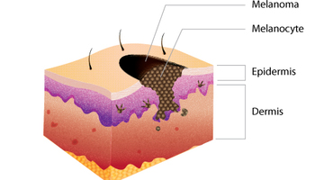
Introduction
Specific type of skin cancer
Melanocytes
Can spread to other organs
Develops as moles

Slide 4
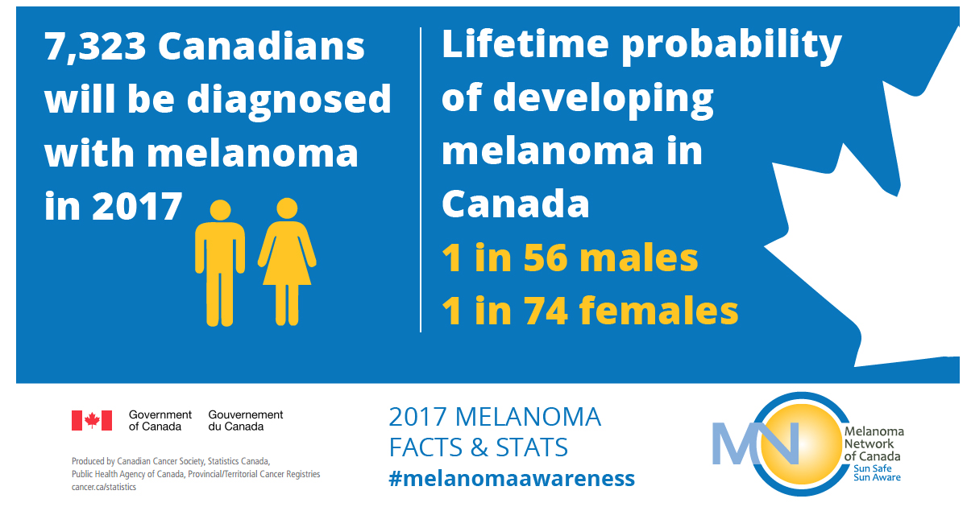
Incidence
7th most common cancer in Canada
Increasing incidence
In 2017:
7,300 people diagnosed
1,200 deaths

Slide 5
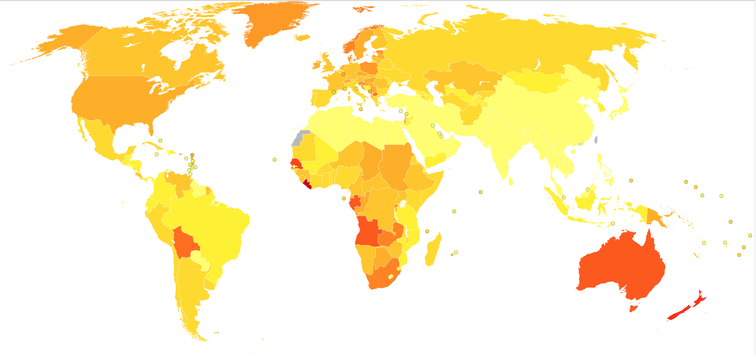
Distribution
1.7% of all cancers worldwide
More common in Australasian countries
European countries

Slide 6
Survival rates
One of the highest survival rates if caught early
Early stages: 97% survival
Late stages: 15-20% survival

Slide 7
Etiology— Predisposition
Inherited melanomas often have changes in tumour suppressor genes
CDKN2A→ encodes P16 & p14ARF
CDK4
Genetic changes prevent normal activity of cell growth control
Most gene changes are not inherited
Notes:
Sun-sensitive skin such as fair skin types more prone to sunburn as well as specific melanoma-related genes can be inherited. Most inherited melanomas often have changes in tumour suppressor genes. The major susceptibility gene is CDKN2A, which encode the P16 and p14ARF proteins. These proteins affect the p53 and retinoblastoma (Rb) cell cycle genes. CDK4 is another gene that is changed through inherited melanomas, preventing them from carrying out their normal activity of controlling cell growth (Long et al., 2011). However, it is important to note that most of the gene changes causing melanoma are not a result of inheritance. They are more likely caused by damage induced by environmental factors (“What Causes Melanoma Skin Cancer?,” n.d.).

Slide 8
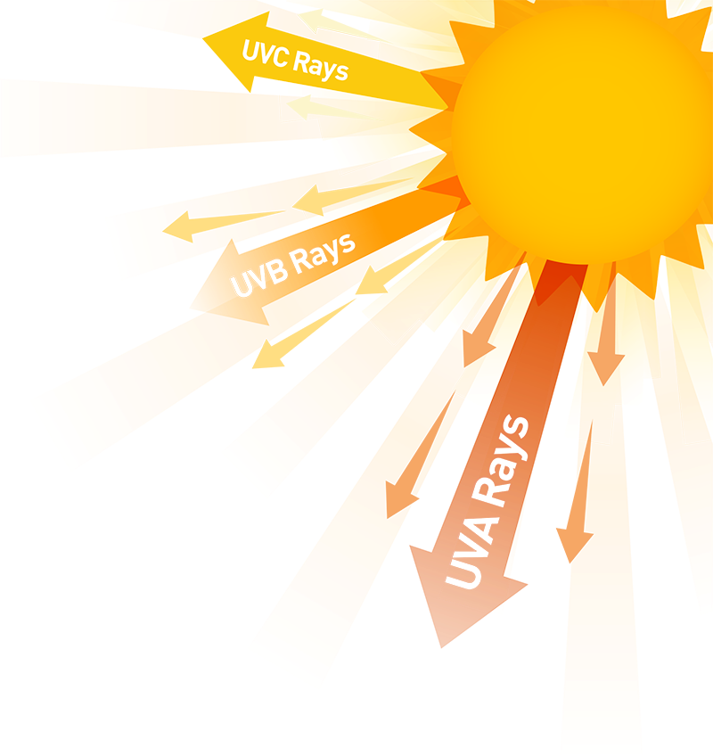
Etiology— Environmental Factors
Solar and artificial UV radiation
Sun
Tanning beds
History of sunburns and high-intensity sun exposure
Strong association with melanoma development
Notes:
Exactly what induces damage in skin cell DNA and how this causes melanoma is not fully understood. It is likely that a combination of factors that cause DNA changes. The most known factors are excessive exposure to solar and artificial UV radiation from the sun and tanning beds, respectively. UV ray damage on the DNA in skin cells affects various genes that control how skin cells grow and divide. If such genes stop working effectively, the affected cells become cancerous (“What Causes Melanoma Skin Cancer?,” n.d.). A history of sunburns and intermittent high-intensity sun exposure are more strongly associated with melanoma development compared to cumulative chronic sun exposure (Long et al., 2011).

Slide 9
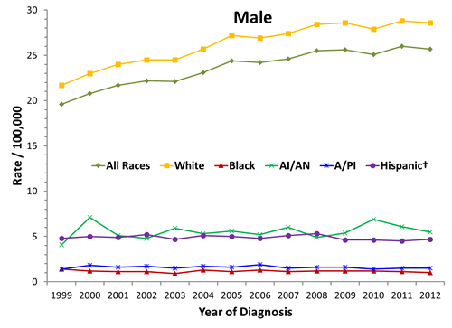
Risk Factors
Skin Colour
Darker skin tone has protective effect against UV light
Caucasians are 8-19 times more likely than blacks to develop melanoma
Notes:
Skin colour plays a protective role of melanoma against UV light. Melanoma is much more common in Caucasian with light skin compared to Blacks with darker skin. Darker skin has been found to protect against melanoma. In fact, in the United States, Caucasians are 8-19 times more likely than blacks to develop melanoma (Koh, Sinks, Geller, Miller, & Lew, 1993).
The graph is of melanoma incidence rates based on race/ethnicity in the United States from 1999-2013

Slide 10
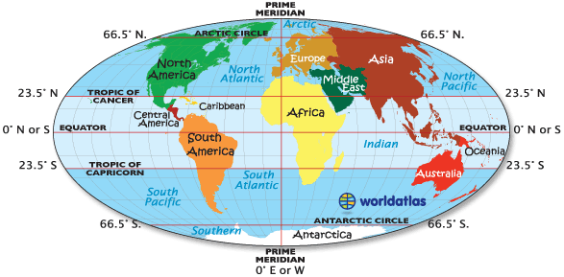
Risk Factors
Geographic location
Close to the equator or at higher elevation→ experience higher amounts of UV radiation
Age
Melanoma risk increases with age
Notes:
Individuals living closer to the earth’s equator tend to be more susceptible melanoma. The sun’s rays are more direct to this location resulting in this population experiences higher amounts of UV radiation compared to those living in higher latitudes. In the same way, those living at higher elevation tend to be exposed to more UV radiation resulting in higher risk (“What Causes Melanoma Skin Cancer?,” n.d.).
It has also been observed that melanoma risk increases by age. The increased risk has been attributed to greater cumulative exposure to environmental agents and UV light (Koh et al., 1993).

Slide 11
General Symptoms of Melanoma
Non-healing sores
Pigment (redness/swelling) that spread out of the border of the original spot
Itching, pain or tenderness
Novel changes to an existing mole
Spots in the iris or blurring of vision
Notes:
These are some of the symptoms. Basically any kind of abnormalities in the skin including non-healing skin sores, any sort of pigment or redness that spread out from the original spot, itching, pain, tenderness, any new changes to an existing mole or birthmark. Spots in the iris can also occur.

Slide 12
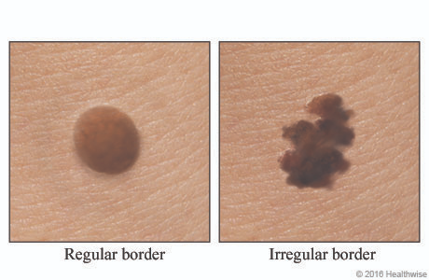
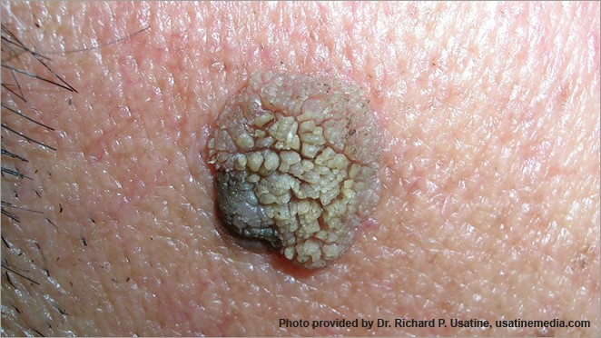
ABCDE Check
A | Asymmetry | One half does not match the other
B | Border | Irregular, crusted or notched
C | Colour | A change in colour – darker, lighter, varied
D | Diameter | 6mm or more, but can be smaller
E | Evolving | Changes in the mole over time
Notes:
ABCDE is a quick check that can be performed to help identify if a melanoma is developing (BAPRAS, 2015). It is recommended that you seek advice from a dermatologist if you suspect that you are developing melanoma because it is difficult to diagnose correctly even for doctors (BAPRAS, 2015).

Slide 13
Abnormal Nail (Subungual Melanoma)
A | Age
B | Brown to Black Band
C | Change in the Nail Band
D | Digit
E | Extension
F | Family History
Notes:
Brown colouration under a nail or at the base of a nail may represent a subungual melanoma (BAPRAS, 2015). Subungual melanoma is a rare type of melanoma that does not have many early diagnostic tools (Levit et al., 2000). One diagnostic tool that was created for early detection of subungual melanoma is called ABCDEF where each letter stands for something. This is a good tool to use to detect subungual melanoma early, but absolute diagnosis can only be determined through biopsy (Levit et al., 2000).

Slide 14
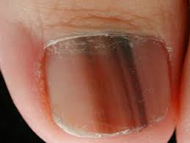
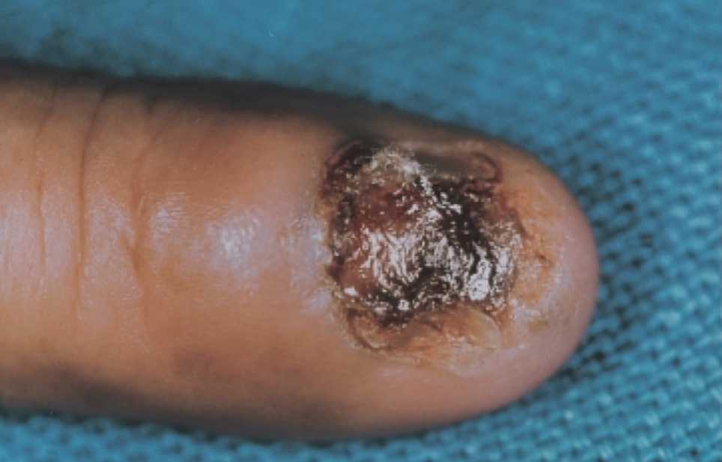
What Subungual Melanoma Looks Like
Notes:
The image on the left shows a patient’s nail who has melanoma. The melanoma can be seen by the brown and black bands running across the nail. The image on the right is of a 68 year old female’s nail who has had melanoma for 2 years.

Slide 15
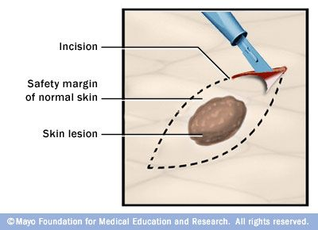
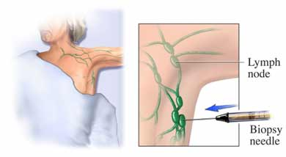
Excision Biopsy and Sentinel Lymph Node Biopsy (SNLB)
Notes:
Excision biopsy is another procedure that can be performed to detect for melanoma. This biopsy involves the removal of a mole along with about 2mm of normal skin (BAPRAS, 2015). The extra normal skin is necessary to see if the melanoma is spreading beyond the mole.
Sentinel Lymph Node Biopsy (SNLB) is another procedure that is performed on a patient with melanoma to detect whether the melanoma cells have travelled to the lymph nodes in the armpits, neck, or groin region (BAPRAS, 2015). This is a procedure that is usually conducted prior to any surgery so that affected lymph node areas can also be removed at the same time.

Slide 16
Other Screening Procedures for Melanoma
CT Scans
Blood Tests
Fine Needle Aspiration
Punch Biopsy
Notes:
CT Scans are requested if there is a risk that melanoma may have spread to other parts of the body (BAPRAS, 2015).
Blood tests are also requested to examine whether the liver is functioning normally (BAPRAS, 2015).
Fine Needle Aspiration involves inserting a thin needle into the lesion area
Punch Biopsy involves taking a small piece of skin in the shape of a circle

Slide 17
Pathophysiology
Genetic mutations alter cell proliferation and differentiation
impacts apoptosis programming.
impact susceptibility to carcinogenic effects of UV radiation.
Higher nevus (body marks, like birthmarks, etc) counts tend to predispose individuals for disease (based on strong correlations)
Notes:
Mutations that occur in the DNA greatly changes the cellular functions. Specifically, the cells divide and grow in an uncontrolled manner. The mutations to DNA also cause the cell to often ignore apoptosis or rather programmed cell death. They also make the skin and cells more susceptible to the harmful and cancer causing potential of UV radiation.
Interestingly, higher number of birth marks or spots on the body are a predisposing factor for the disease. This is however a strong correlation and causation has not been established.

Slide 18
Pathophysiology Continued...
Specific mutations occurring in the BRAF, NRAS and KIT oncogenes have been linked to melanoma
Intermittently sun exposed areas more likely to show mutations in BRAF area whereas frequently sun exposed areas more likely to display KIT mutations
Other mutations including disruptions to p16/Rb pathway as well as cyclin D1 (CCND1) and cyclin dependent kinase 4 (CDK4) genes alter senescence and cell-cycle progression
This combined with a gene for proliferation and activation of telomerase leads to melanoma
Notes:
The specific mutations are linked to the BRAF, NRAS and KIT oncogenes. Mutations in oncogenes increase the risk of cancer and these three in particular have been linked with melanoma. Sun exposed areas usually have mutations in the BRAF oncogene whereas areas which aren’t exposed to the sun as much show mutations in the KIT oncogene. Some other mutations have also been discovered which lead to disruptions to the p16/R pathway, cyclin D1 and cyclin dependent kinase 4 which all basically alter the cell cycle and cellular senescence. Proliferation and telomerase mutations also play a role in speeding up the progression of melanoma.

Slide 19
Stages of Melanoma
Stage 0 - Melanoma is in situ
Stage I - Primary melanoma stage; cancer cells are only in the skin
Stage IB: Depends on the thickness of melanoma and presence of ulceration
Stage II - Melanoma thicker, extends into dermis; higher chance of spreading
3 subgroups - A, B or C
Stage III - Spread of melanoma
Also divided into sub groups - A B, C or D
Stage IV - Melanoma has spread through the bloodstream
M1a: distant skin
M1b: lung
M1c: other location that does not involve central nervous system
M1d: central nervous system
Notes:
Stage 0 - at this stage melanoma is in situ, meaning that the melanoma cells are only found in the outer layer of the epidermis. In this stage, it is unlikely for melanoma to spread to other parts of the body
Stage I - This is the primary melanoma stage, where melanoma is still only in the skin
Stage IB - subgroup of stage I, depending on the thickness of melanoma and whether or not the pathologist is able to see ulceration under a microscope
Stage II - Melanoma is thicker than in stage I, and extends through the epidermis into the dermis (the inner layer of the skin). In this stage, there is a higher chance of spreading. The stage can be divided into 3 subgroups -- A, D, or C-- depending on the thickness of melanoma and whether there is ulceration.
Stage III - In this stage, melanoma has spread locally or through the lymphatic system, which is a part of the immune system and drains fluid from the body through tubes or vessels. This stage is also divided into subgroups -- A,B,C or D -- depending on size and number of lymph nodes impacted by melanoma, whether primary tumor has satellite lesion and ulceration appears under a microscope or not.
Stage IV - Melanoma has spread through the bloodstream to other parts of the body (distant locations on the skin, distant lymph nodes or other organs).
M1a: the cancer only spread to distant skin
M1b: the cancer spread to the lung
M1c: the cancer spread to any other location that does not involve central nervous system
M1d: The cancer has spread to the central nervous system (brain, spinal cord or cerebrospinal fluid)

Slide 20
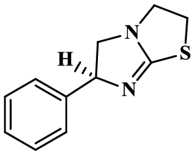
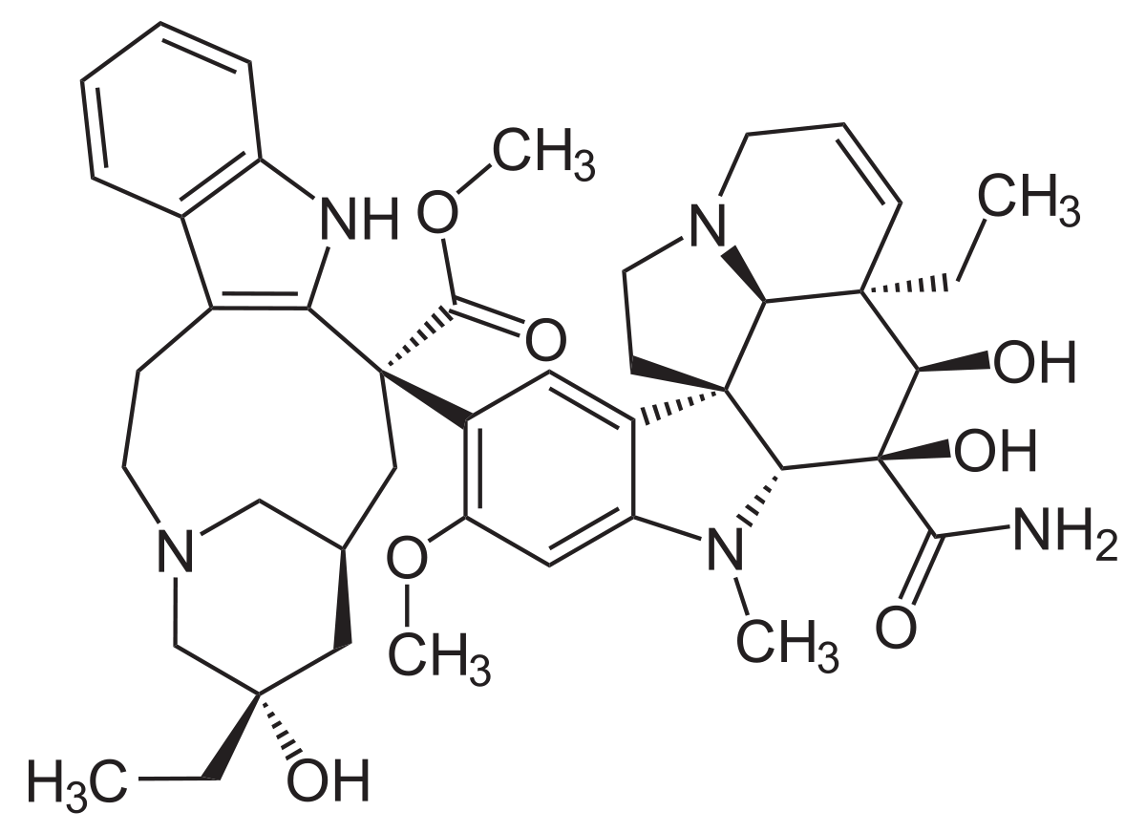
Treatments
Current treatment: Chemotherapy
Vindesine - significant improvement in disease-free and overall survival in patients
Levamisole - reductio of 29% in both the death rate, and the recurrence rate in patients who received adjuvant levamisole (National Cancer Institute of Canada)
Notes:
vindesine is an anti-mitotic vinca alkaloid, that has been evaluated in the adjuvant treatment of malignant melanoma. In a non randomised trial, researchers have found a highly significant improvement in disease-free and overall survival in patients treated with vindesine following resection of regional lymph nodes compared with patients followed by observation alone.
Levamisole has also been evaluated as an adjuvant treatment following excision of a primary melanoma. In a trial conducted by the National Cancer Institute of Canada, researchers were able to demonstrate a reduction of 29% in both the death rate (p = 0.08) and the recurrence rate (p = 0.09) in a cohort of patients who were randomised to receive adjuvant levamisole as opposed to observation alone.

Slide 21
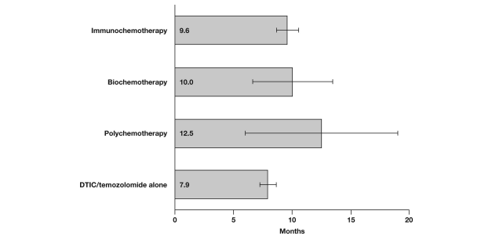
Graph showing the overall survival of patients treated with different types of therapy for melanoma
Notes:
Immunotherapies
There is emerging research on new types of immunotherapies such as tremelimumab and ipilimumab
Promising antitumor activity with manageable side effects
However, as shown in the graph, the most effective type of therapy for treating melanoma is polychemotherapy - chemotherapy involving several different drugs.

Slide 22
Gene Therapy
STATs = Signal Transducer and Activator of Transcription
Responsible for normal cell signaling, cell proliferation, differentiation and apoptosis
Increasing number of human cancer related to the activation of Stat3
Levels of activated Stat3 in N16 tumor cell line are low
Overexpression of Stat3 Induces cell death
Stat3 gene therapy via electroinjection
Notes:
STATs - latent cytoplasmic transcription factors that function as intracellular effectors of cytokine and growth factor signaling pathways - which means that it is responsible for normal cell signaling, cell proliferation, differentiation and apoptosis.
Most frequently activated STAT family members: Stat3, Stat 5 and Stat 1
Stat 3 most importantly is involved with cell transformation
Evidence implicates that abnormal activation of Stat3 signaling is involved in human cancers including melanoma
Increasing studies on Stat3 gene therapy via electrotroinjection
This therapy can induce killing of residual tumor cells by inducing cell apoptosis

Slide 23
References
British Association of Plastic Reconstructive and Aesthetic Surgeons. (2015). Malignant Melanoma. Retrieved November 27, 2018, from
http://www.bapras.org.uk/public/patient-information/surgery-guides/skin-cancer/malignant-melanoma
Cutaneous Melanoma. (2018, October 31). Retrieved from https://emedicine.medscape.com/article/1100753-overview
Karimkhani, C. Green, A.C. Nijsten, T. Weinstock, M.A. Dellavalle, R.P. Naghavi. Fitzmaurice, C. (2015). The global burden of melanoma: results from the Global Burden
of Disease Study 2015. Br J Dermatol. Retrieved from https://www.ncbi.nlm.nih.gov/pmc/articles/PMC5575560/pdf/BJD-177-134.pdf
Koh, H. K., Sinks, T. H., Geller, A. C., Miller, D. R., & Lew, R. A. (1993). Etiology of melanoma. In L. Nathanson (Ed.), Current Research and Clinical Management of Melanoma (pp. 1–28). Boston, MA: Springer US. https://doi.org/10.1007/978-1-4615-3080-0_1
Levit, E. K., Kagen, M. H., Scher, R. K., Grossman, M., & Altman, E. (2000). The ABC rule for clinical detection of subungual melanoma. Journal of the American Academy of Dermatology, 42(2), 269-274.
Long, G. V., Menzies, A. M., Nagrial, A. M., Haydu, L. E., Hamilton, A. L., Mann, G. J., … Kefford, R. F. (2011). Prognostic and Clinicopathologic Associations of Oncogenic in Metastatic Melanoma. Journal of Clinical Oncology, 29, 1239–1246. https://doi.org/10.1200/jco.2010.32.4327
Melanoma. (n.d.). Canadian Dermatology Association. Retrieved from https://dermatology.ca/public-patients/skin/melanoma/
Melanoma Research Foundation. (2017, June 26). Diagnosing Melanoma. Retrieved November 27, 2018, from
https://www.melanoma.org/understand-melanoma/diagnosing-melanoma
Metastatic Melanoma. (2018). Melanoma Research Foundation. Retrieved from https://www.melanoma.org/understand-melanoma/what-is-melanoma/metastatic-melanoma

Slide 24
References Continued
Skin Cancer, Melanoma. (n.d.). Health Link BC. Retrieved from https://www.healthlinkbc.ca/health-topics/hw206547
Skin Cancer Statistics. (2017). Canadian Cancer Society's Advisory Committee on Cancer Statistics. Retrieved from
http://www.cancer.ca/en/cancer-information/cancer-type/skin-melanoma/statistics/?region=on
Survival Rates for Melanoma Skin Cancer. (2018). American Cancer Society. Retrieved from
https://www.cancer.org/cancer/melanoma-skin-cancer/detection-diagnosis-staging/survival-rates-for-melanoma-skin-cancer-by-stage.html
Takata, M., Murata, H., & Saida, T. (2010). Molecular pathogenesis of malignant melanoma: a different perspective from the studies of melanocytic nevus and acral
melanoma. Pigment cell & melanoma research, 23(1), 64-71.
What Causes Melanoma Skin Cancer? (n.d.). Retrieved November 21, 2018, from
https://www.cancer.org/cancer/melanoma-skin-cancer/causes-risks-prevention/what-causes.html
What is melanoma skin cancer? (2018). Canadian Cancer Society. Retrieved from
http://www.cancer.ca/en/cancer-information/cancer-type/skin-melanoma/melanoma/?region=on
Why melanoma skin cancer is increasing and what we can do. (2017). SkinVision. Retrieved from
https://www.skinvision.com/articles/why-melanoma-skin-cancer-is-increasing-and-what-we-can-do

Slide 25
References Continued
World Health Organization (WHO). (2018). Skin cancers. Retrieved from https://www.who.int/uv/faq/skincancer/en/index1.html
Worldwide Cancer Data. (2018). World Cancer Research Fund. Retrieved from https://www.wcrf.org/dietandcancer/cancer-trends/worldwide-cancer-data

