Slide 1
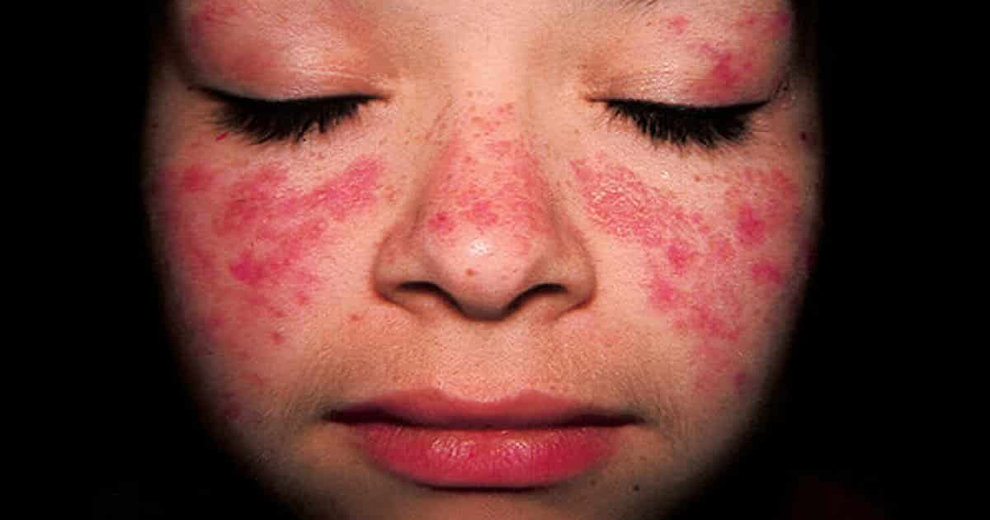
LUPUS
TREATMENT
CONCLUSION
DIAGNOSIS
INTRODUCTION
MECHANISM
SYMPTOMS
Afraah, Sai, Edlyn, Zachary, Joravar

Slide 2
INTRODUCTION
What is Lupus?
Clinical Name: Lupus Erythematosus
autoimmune chronic disease
immune system produces antibodies in abundance
body’s immune system attack healthy tissues (Askanase et al., 2012).
Lupus
derived from the rash people develop as a result of the disease and how it looks similar to a bite from a wolf.
First case was reported in 1874 (Adelman et al., 1986)
Usually not life-threatening
positively correlated with a shorter lifespan
severe cases directly leads to death.
CONCLUSION
TREATMENT
DIAGNOSIS
MECHANISM
SYMPTOMS
INTRODUCTION

Slide 3
INTRODUCTION
Types of Lupus(Walling, 2009)
Three subtypes of lupus that are common in clinical settings include:
Acute cutaneous lupus erythematosus (ACLE)
Local rash
Less severe
Subacute cutaneous lupus erythematosus (SCLE)
Affects multiple body systems simultaneously
Often affected by sun exposure
head, shoulders, neck, etc. with rashes
Chronic Cutaneous lupus erythematosus (CCLE)
less common forms like lupus timidus, lupus profundus and chilblain lupus
Depends on types of sensitivity to the sun
How lesions are formed etc.
CONCLUSION
TREATMENT
DIAGNOSIS
INTRODUCTION
MECHANISM
SYMPTOMS

Slide 4
INTRODUCTION
Risk Factors
Female sex hormones are linked with a higher prevalence
Twin studies
In dizygotic twins there is a 1-5% chance of the disease in both twins
In monozygotic twins a 29-57% chance of the disease in both twins
Genetic component
no specific gene contributes to getting the disease
Environment
twins that did not express the genes for the disease is linked to the differences in the environment (Askanase et al., 2012).
CONCLUSION
TREATMENT
DIAGNOSIS
INTRODUCTION
MECHANISM
SYMPTOMS

Slide 5
INTRODUCTION
Epidemiology
Women are more likely to be affected (9 women:1 man).
From 20-45 years old (15:1 compared to men) (Askanase et al., 2012).
linked to female sex hormones
Prevalence records of lupus around the world (2006)
Non-Caucasians are more likely to have the disease then Caucasians (Lau et al., 2006)
Indians, Afro-Americans, Chinese and Japanese had higher rates of prevalence than Caucasians from North America or England
may have less socio economic advantages making their rates inflated compared to Caucasians
CONCLUSION
TREATMENT
DIAGNOSIS
INTRODUCTION
MECHANISM
SYMPTOMS

Slide 6
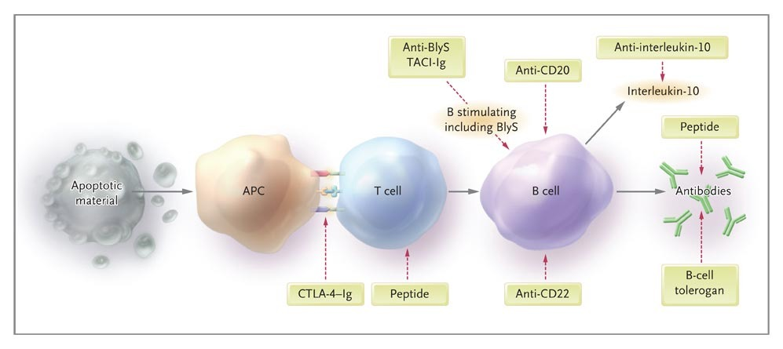
MECHANISM
Overview
Lupus is a chronic autoimmune disease causing the body to produce autoantibodies
Abnormal apoptosis leads to activation of immune system
Results in tissue inflammation and formation of a rash
Innate immunity versus adaptive immunity
CONCLUSION
TREATMENT
DIAGNOSIS
MECHANISM
SYMPTOMS
INTRODUCTION

Slide 7
MECHANISM
Overview
Dendritic Cells (DCs) process antigens and present them to T cells
Results in increase in autoreactive T and B cells
Neutrophils release NETs to kill microbes
NETosis seen in patients with Lupus
DNA serves as autoantigens for DCs
CONCLUSION
TREATMENT
DIAGNOSIS
INTRODUCTION
SYMPTOMS
MECHANISM

Slide 8
MECHANISM
Overview
Interaction between TCR and MHC-antigen complex on DC
Binding of other ligands between the cells results in activation or inhibition
CD28 - B7: Stimulation
CTLA4 - B7: Inhibition
Recruitment of B cells
CONCLUSION
TREATMENT
DIAGNOSIS
INTRODUCTION
SYMPTOMS
MECHANISM

Slide 9
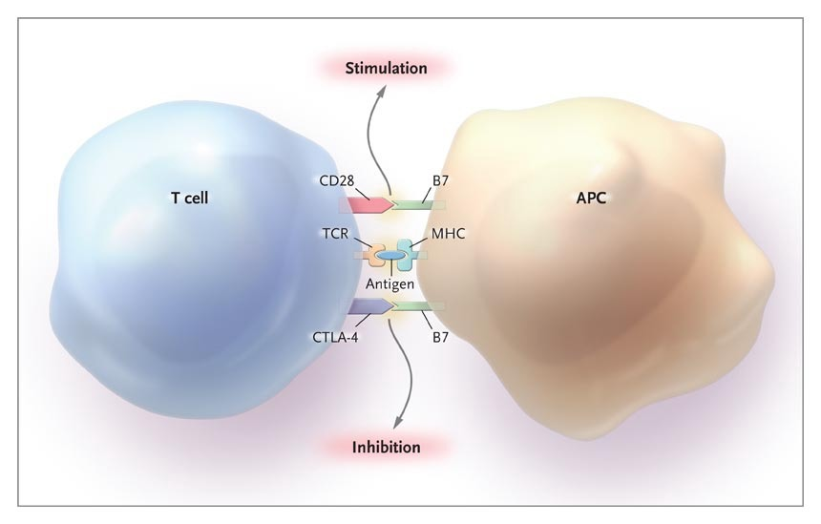

Slide 10
MECHANISM
Overview
B cell and T cell have positive interaction
complex of B cell activates T cell which stimulates B cell
T cells release cytokines which facilitate conversion of IgM antibodies to IgG
Increase in B cell division leading to more antibodies produced
CONCLUSION
TREATMENT
DIAGNOSIS
INTRODUCTION
SYMPTOMS
MECHANISM

Slide 11
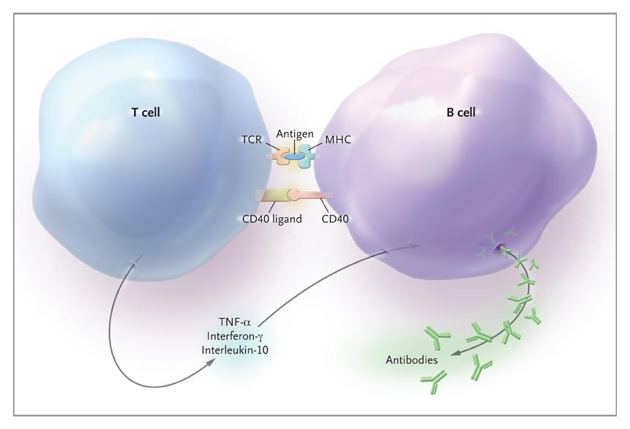

Slide 12
MECHANISM
Overview
CONCLUSION
TREATMENT
DIAGNOSIS
INTRODUCTION
SYMPTOMS
Main autoantibody in Lupus is against DNA from apoptotic cells
Antigen-antibody complex cause of symptoms
Complex migrates to basement glomerular membrane
Activates complement system (inflammation)
Antigen cross reacts with proteins in the kidney
⍺-actin critical in cells of the filtration barrier
MECHANISM

Slide 14
SYMPTOMS
very complex disease, with thousands of faces
can affect any of the body systems
greatly vary from person to person
severity of symptoms increases with progression of the disease
two types of symptoms:
non-specific symptoms: occur in other conditions too
lupus-specific symptoms
CONCLUSION
TREATMENT
DIAGNOSIS
MECHANISM
INTRODUCTION
SYMPTOMS

Slide 15
NON-SPECIFIC SYMPTOMS
Fatigue
Weight changes
Fever
Swollen glands
CONCLUSION
TREATMENT
DIAGNOSIS
INTRODUCTION
MECHANISM
SYMPTOMS
Notes:
https://www.google.ca/search?biw=1366&bih=626&tbm=isch&sa=1&ei=pOL9W8T_Gou_jwT234LQCg&q=symptoms&oq=symptoms&gs_l=img.3..0i67l4j0l4j0i67j0.42103.43582..43941...0.0..0.86.598.8......1....1..gws-wiz-img.Y2R3axIj8oM#imgrc=0_y2dxwhYIIYKM:

Slide 16
LUPUS-SPECIFIC SYMPTOMS
Criteria (must meet at least 4 out of the 11):
butterfly rash
photosensitivity
discoid lupus
mucosal ulcers
arthritis
pleuritis and pericarditis
kidney involvement
seizures and psychosis
blood cell disorders
immunologic disorders
antinuclear antibodies
CONCLUSION
TREATMENT
DIAGNOSIS
INTRODUCTION
MECHANISM
SYMPTOMS
Notes:
Mielczarek, L. (2017). Living-Symptoms of SLE. Retrieved from https://www.lupuscanada.org/living-symptoms-of-sle/

Slide 17
OTHER COMMON SYMPTOMS
Hair loss
Subacute cutaneous lupus erythematosus
Raynaud's phenomenon
Vasculitis
Headaches
Persistent high blood pressure
CONCLUSION
TREATMENT
DIAGNOSIS
INTRODUCTION
MECHANISM
SYMPTOMS

Slide 18
DIAGNOSIS
A Disease With Many Faces
Signs and symptoms are wide-ranging & vary from person to person
Symptoms resemble or overlap other diseases
It is not possible to diagnosis a person with lupus using just one test
Combination of blood tests, urine tests, tissue biopsies, and/or imaging test are used to diagnose lupus
CONCLUSION
TREATMENT
INTRODUCTION
MECHANISM
DIAGNOSIS
SYMPTOMS
Notes:
From this codebook we have identified a few themes, which are emerging patterns from our dataset using keywords or ideas based on the frequency of occurrence, vocabulary used and when certain occurrences are relevant for students. For our first theme….(add here).
Our next theme is Food Consumption which includes the codes of healthy and unhealthy food, nutritious meals as well as eating habits. In all this theme outlines the types of food McMaster students are consuming, in many cases transition into a more unhealthy diet has occurred since coming to University.

Slide 19
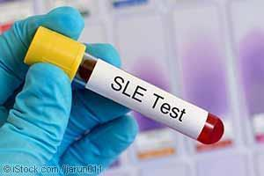
DIAGNOSIS
Blood Tests
One blood test confirming the presence of an auto-antibody cannot be conclusive
Anti-nuclear antibody (ANAs)
attacks nuclei of cells
most sensitive diagnostic test for confirming llupus
98% of people with lupus will have a positive result for ANA test
5-10% of healthy people will also have a positive ANA
Anti-phospholipid antibody (APLs)
attacks phospholipids
50% of people with lupus will test positive for APLs
indicates a higher risk of blood clots, stroke, and pulmonary hypertension
higher risk for pregnancy complications
CONCLUSION
TREATMENT
MECHANISM
DIAGNOSIS
INTRODUCTION
SYMPTOMS
Notes:
https://www.google.ca/search?biw=772&bih=762&tbm=isch&sa=1&ei=KcX8W93SIY2Z_QbA_INw&q=urine+test+for+lupus&oq=urine+test+for+lupus&gs_l=img.3..0i24l2.90932.92292..92449...0.0..0.152.900.8j2......1....1..gws-wiz-img.......0j0i67.KsbnuulbyFc#imgrc=U3pOWSXusWiIpM:
From this codebook we have identified a few themes, which are emerging patterns from our dataset using keywords or ideas based on the frequency of occurrence, vocabulary used and when certain occurrences are relevant for students. For our first theme….(add here).
Our next theme is Food Consumption which includes the codes of healthy and unhealthy food, nutritious meals as well as eating habits. In all this theme outlines the types of food McMaster students are consuming, in many cases transition into a more unhealthy diet has occurred since coming to University.

Slide 20
DIAGNOSIS
Anti-double-stranded DNA antibody (Anti-dsDNA)
attacks DNA
in 30% of people with lupus
indicates a more serious form of lupus, such as lupus nephritis
in <1% of people without lupus
the absence of this antibody doesn’t eliminate the possibility of lupus
Anti-smith antibody (Anti-Sm antibody)
attacks ribonucleoproteins, located in the nucleus of a cell
found ALMOST exclusively in people with lupus
20% of people with lupus
<1% of healthy people and other disorders
Anti-Ro/SSA and Anti-La/SSB antibodies
commonly found in people with lupus who have tested negative for ANA
in 30-40% of people with lupus
in 15% of people without lupus and other disorders
pregnant mother with lupus that has these antibodies have an increased chance that the baby will have neonatal lupus
CONCLUSION
TREATMENT
INTRODUCTION
MECHANISM
DIAGNOSIS
SYMPTOMS
Notes:
From this codebook we have identified a few themes, which are emerging patterns from our dataset using keywords or ideas based on the frequency of occurrence, vocabulary used and when certain occurrences are relevant for students. For our first theme….(add here).
Our next theme is Food Consumption which includes the codes of healthy and unhealthy food, nutritious meals as well as eating habits. In all this theme outlines the types of food McMaster students are consuming, in many cases transition into a more unhealthy diet has occurred since coming to University.

Slide 21
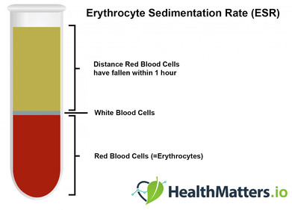
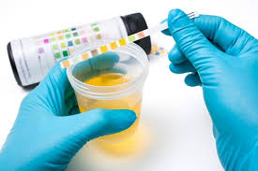
DIAGNOSIS
Other Clinical Tests
Erythrocyte sedimentation rate (ESR)
indicates the amount of inflammation in the body
measures the rate at which red blood cells settle to the bottom of a test tube
increase in ESR = more inflammation
not specific to lupus
Urine test
help to diagnose or monitor the effects of lupus on kidney
measures the amount of protein, red blood cells and white blood cells
CONCLUSION
TREATMENT
INTRODUCTION
MECHANISM
DIAGNOSIS
SYMPTOMS
Notes:
https://www.google.ca/search?q=erythrocyte+sedimentation+rate&source=lnms&tbm=isch&sa=X&ved=0ahUKEwj_0dme2_PeAhVNnlkKHWLeAs8Q_AUIDigB&biw=772&bih=762#imgrc=Xqn7CkyJSa6hhM:
https://www.google.ca/search?biw=772&bih=762&tbm=isch&sa=1&ei=h8X8W7jvBqSd_QagrYCYBg&q=urine+test+&oq=urine+test+&gs_l=img.3..0l10.203483.203483..203781...0.0..0.76.76.1......1....1..gws-wiz-img.M56GODFMpWw#imgrc=85bwzkkgCnVBDM:

Slide 22
TREATMENT
Non-Pharmaceutical
Lupus cannot be cured completely and thus, it can only be kept from reducing your quality of life.
A few lifestyle changes that can be implemented to curb the early onset of symptoms:
Eating a Balanced Diet
Getting a lot of rest
Exercising and keeping metabolism active
CONCLUSION
TREATMENT
MECHANISM
DIAGNOSIS
INTRODUCTION
SYMPTOMS

Slide 23
TREATMENT
Pharmaceutical
Anti-Inflammatory Drugs (ie. Ibuprofen)
helps with swelling of joints and sometimes, fever
very affordable as they are over the counter NSAIDS
overdose can cause organ damage and increase risk of heart attack
Anti-Malarial Drugs (ie. Malarone)
helps with skin rashes, mouth sores etc
since symptoms are similar to Malaria, drugs used can overlap
drugs can also help protector from harmful UV rays
these drugs can increase the risk for blood clotting
Corticosteroids (ie. Prednisone)
helps with pain in various organs such as liver, kidney etc
work by inhibiting the immune response that is often inflated in lupus patients
can be injected via IV or taken through a pill
side effects include muscle weakness, diabetes and cataracts
CONCLUSION
TREATMENT
INTRODUCTION
MECHANISM
DIAGNOSIS
SYMPTOMS

Slide 24
TREATMENT
Pharmaceutical
Immunosuppressive Drugs (ie. Cyclosporine)
helps with organ damage and related symptoms
reduces overall immune response within the body
work similarly to corticosteroids in the body
taken alongside corticosteroids because overall side effects can be reduced
side effects include potential increase in getting cancer
Anticoagulants and Monoclonal Antibodies (ie. Benlysta)
anticoagulants work by blood thinning and thus, reducing blood clots
Monoclonal antibodies are given through IV and target immune cells
these drugs reduce the need for direct steroid use
they haven't been tested by huge general populations yet (just recently FDA approved)
CONCLUSION
TREATMENT
INTRODUCTION
MECHANISM
DIAGNOSIS
SYMPTOMS

Slide 25
CONCLUSION
chronic autoimmune disorder that are more prevalent in women
causes diverse abnormalities in various body parts
general symptoms are not specific, vary from person to person
diagnosis of lupus requires many laboratory tests
there is no cure, treatments can only help to manage the disease
CONCLUSION
TREATMENT
MECHANISM
DIAGNOSIS
INTRODUCTION
SYMPTOMS

Slide 26
References
Adelman, D. C., Saltiel, E., & Klinenberg, J. R. (1986, February). The neuropsychiatric manifestations of systemic lupus erythematosus: an overview. In Seminars in arthritis and rheumatism (Vol. 15, No. 3, pp. 185-199). WB Saunders.
Askanase, A., Shum, K., & Mitnick, H. (2012). Systemic lupus erythematosus: an overview. Social work in health care, 51(7), 576-586.
Brazier, Y. (2018, November 12). What is lupus? Medical News Today. Retrieved from https://www.medicalnewstoday.com/articles/323653.php
Elkon, K., & Casali, P. (2008). Nature and functions of autoantibodies. Nature clinical practice. Rheumatology, 4(9), 491-8.
Fortuna, G., & Brennan, M. (2013). Systemic lupus erythematosus. Dental Clinics of North America, 57(4), 631-655. http://dx.doi.org/10.1016/j.cden.2013.06.003
John Hopkins Lupus Center. (2018). Lupus tests. Retrieved from https://www.hopkinslupus.org/lupus-tests/
Lau, C. S., Yin, G., & Mok, M. Y. (2006). Ethnic and geographical differences in systemic lupus erythematosus: an overview. Lupus, 15(11), 715-719.
Lupus Foundation of America. (2013). How lupus is diagnosed: an overview. Retrieved from https://www.lupus.org/resources/how-lupus-is-diagnosed-an-overview
Mielczarek, L. (2017). Living-Symptoms of SLE. Retrieved from https://www.lupuscanada.org/living-symptoms-of-sle
Rahman, A., & Isenberg, D. A. (2008). Systemic Lupus Erythematosus. New England Journal of Medicine, 358(9), 929–939. https://doi.org/10.1056/NEJMra071297
Suryanarayan, D. & Garcia, D. (2014). Anti-phospholipid antibodies and pregnancy. The Hematologist, 11(4).
Walling, H. W., & Sontheimer, R. D. (2009). Cutaneous lupus erythematosus. American journal of clinical dermatology, 10(6), 365-381.

