Slide 1
Global Burden of Disease: Lower Respiratory Infections
Group 1: Kritika Badhan, Hannah Kearney, Muhammad Mateen, Vyshnavi Mahendran, and Wardha Wardha

Slide 2
Table of Contents
What is the Global Burden of Disease?
Overview of lower respiratory infections (LRIs)
Epidemiology of LRI
Pathophysiology of LRIs
Risk Factors associated with LRIs
Diagnosing LRIs
Treatment Options for LRIs
Future Burden of LRIs

Slide 3
What is the Global Burden of Disease?
Notes:
Global Burden of Disease is a research study that is done every few years and it is the most comprehensive observational epidemiological study to date.
It describes mortality AND morbidity of major diseases around the world. One (there are many more) of the measures this study uses to describe mortality and morbidity of diseases is through the use of DALYs!

Slide 4
What are Disability Adjusted Life Years (DALYs)?
Notes:
DALYs stand for: Disability Adjusted Life Years.
Simply put, DALYs they take into account the years of life one lived in disability AND years of life one has lost due to premature death.

Slide 5
Visual Representation of DALYs
Normal Life Expectancy
0
80
Compromised Life Expectancy
DALYs = Red + Green
Notes:
To visually explain DALYs, imagine the normal life expectancy of an individual in a specific country is 80 years old. They live their entire life free of any serious diseases.
Now, let’s imagine someone has a particular disease that has shortened their life expectancy. More specifically - they are born, and they are relatively healthy, but at a certain time, they get sick and a spend a few years living in disability.
But then, they get healthy again, and all is good. But then the disease comes back, and they live in disability for a few years and then they unfortunately pass away.
DALYs look at the years they’ve lived in disability (RED) and the years they’ve lost to disease because of premature death (GREEN).

Slide 6
Lower Respiratory Infections (LRI)

Slide 7
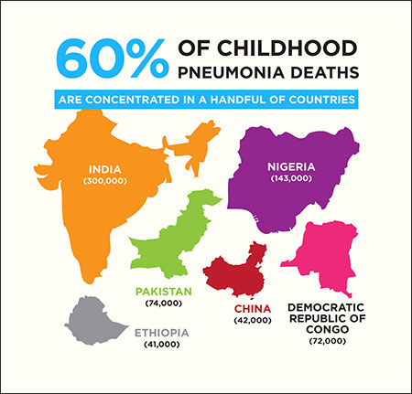
Overview: Why does this matter?
Lower Respiratory Infections (LRIs) have a significant global burden of disease
Most common type of LRIs is: Pneumonia
Childhood Pneumonia is the leading cause of childhood mortality in the world
(Rudan, Boschi-Pinto, Biloglav, Mulholland, & Campbell, 2008)
Retrieved from: https://www.askideas.com/media/86/60-Of-Childhood-Pneumonia-Deaths-Are-Concentrated-In-A-Handful-Of-Countries-World-Pneumonia-Day.jpg
Notes:
LRIs have a significant global burden! The most common type of LRI is Pneumonia.
LRIs affect all ages, but the age group that is most affected are children. In fact - IT IS THE LEADING CAUSE OF CHILDHOOD MORTALITY IN THE WORLD.
As you can see in this photo, developing nations such as: Pakistan, Nigeria, Congo, and etc carry the majority (60%) of the global burden of childhood pneumonia.

Slide 8
Epidemiology
Notes:
Now let’s further expand into the epidemiology of LRIs.

Slide 9
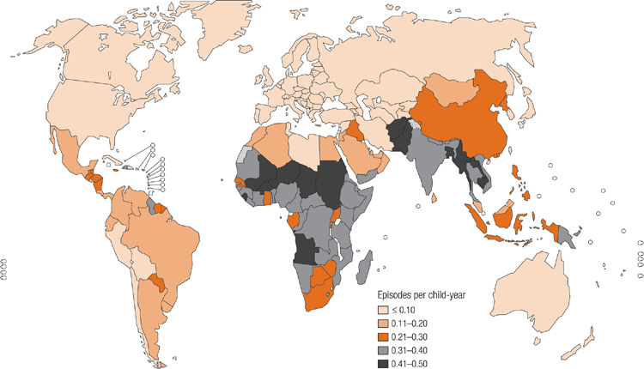
World Health Organization Statistics
Lower Respiratory Infections (LRIs) are the second leading cause of DALYs in the world
From 2000-2012, 30% decrease in DALYs associated with LRIs
LRIs affects individuals of all ages and ethnicities with children being the most negatively affected
Retrieved from: http://www.who.int/entity/bulletin/volumes/86/5/07-048769-F1.jpg
(WHO, n.d.), (Rudan, Boschi-Pinto, Biloglav, Mulholland, & Campbell, 2008)
Notes:
As per the World Health Organization statistics, LRIs are the second leading cause of DALYs in the entire world.
Thankfully, from 2000-2012, there has been a 30% decrease in the DALYs associated with LRIs. However, there is still plenty of work to be done in resolving this issue.
LRIs affect individuals of ALL ages, and ethnicities - but CHILDREN are the most negatively affected.
In the image, you can see the distribution of “Incidence of Childhood Clinical Pneumonia” around the world, with the darker regions meaning higher incidence rates.
More specifically, we mentioned before that Childhood Pneumonia (a type of LRI) is the #1 cause of Childhood Mortality, well 95% of these episodes of childhood clinical pneumonia occur in developing nations!

Slide 10
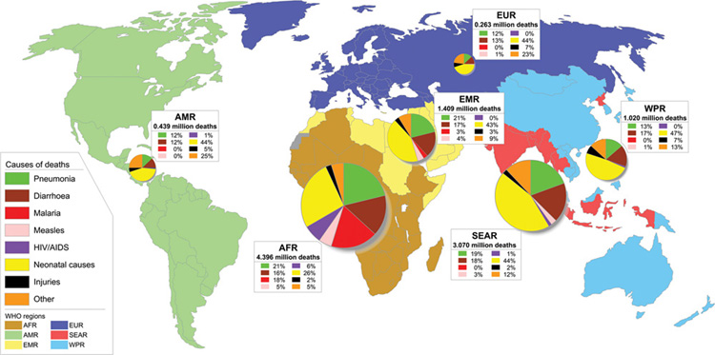
Causes of Childhood Mortality
Retrieved from: http://www.who.int/entity/bulletin/volumes/86/5/07-048769-F2.jpg
(Rudan, Boschi-Pinto, Biloglav, Mulholland, & Campbell, 2008), (Jehan et al., 2009)
Notes:
This image was pulled from a study posted on the World Health Organization and it outlines the major causes of Childhood Mortality around the world.
Green represents “Childhood Pneumonia” and as you can see, it has a significantly burden almost all over the world! Especially in developing regions.
On a Side note, Yellow Presents “Neonatal Causes” which mean deaths during birth, or the very early stages of life (less than 1 month old).
Major causes of death during Neonatal phase are: Infections (Pneumonia), Preterm Birth, and Birth Asphyxia
Jehan, I., Harris, H., Salat, S., Zeb, A., Mobeen, N., Pasha, O., … Goldenberg, R. L. (2009). Neonatal mortality, risk factors and causes: A prospective population-based cohort study in urban Pakistan. Bulletin of the World Health Organization, 87(2), 130–138. http://doi.org/10.2471/BLT.08.050963
Green = Deaths caused by Pneumonia in children under 5

Slide 11
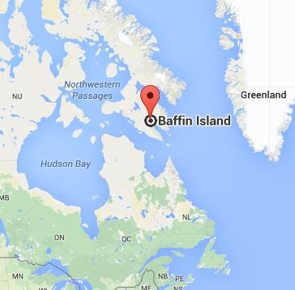
LRIs within Canada
Inuit Communities within Canada have some of the highest rates of LRIs in the entire world
Risk Factors: Indoor air pollution, reduced ventilation, and overcrowding
(Kovesi et al., 2007)
Retrieved from: https://encrypted-tbn3.gstatic.com/images?q=tbn:ANd9GcQ3VU-2zllZKj0gv4Ww9NXrTf7mXMTXZVvW7_G-yR5OElvwp_HSm-bes9Y
Notes:
Canada is not immune to the burden of LRIs, in fact, research indicates that Children living in Inuit Communities located in Northern Canada (more specifically on Baffin Island) have some of the highest rates of Childhood LRIs in the ENTIRE WORLD.
The reasons for such a high prevalence rates are due to fact that these Inuit Children are exposed to numerous risk factors including: Indoor Air Pollution, Reduced Ventilation, and Overcrowding which perpetuate their risk of developing LRIs!

Slide 12
Pathophysiology

Slide 13
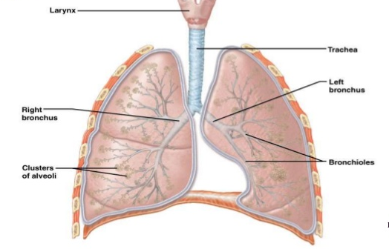
Lower Respiratory System Anatomy
Trachea
Left and Right Bronchus
Secondary and Tertiary Bronchi
Bronchioles
Alveoli
Retrieved from https://www.slideshare.net/albertpg01/respiratory-system-39466744
Notes:
The lower respiratory system consists of the larynx, trachea, the bronchi and bronchioles and the alveoli which make up the lungs.The trachea, branches off into two bronchial tubes known as bronchus. The tubes of the bronchi branch subdivide further into secondary and tertiary bronchi and then into bronchioles. The ends of the bronchioles give rise to microscopic air sacs known as alveoli.
The primary function of the respiratory system is to exchange oxygen and carbon dioxide between the body and environment and it takes place in the alveoli. the respiratory tract is constantly exposed to microorganisms such as bacteria, viruses and fungi

Slide 14
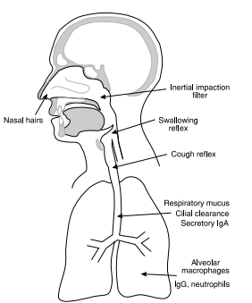
Defences of Respiratory Tract
Nasal hairs
Inertial impaction
Epiglottis
Swallowing reflex
Cough reflex
Cilia, Secretory IgA, mucus
Macrophages, neutrophils
(Inglis, 2007)
Notes:
The lower respiratory system has defences which help prevent microorganisms from getting into the respiratory system. The majority of particles are filtered out in the nasal hairs and by the inertial impaction. The inertial impaction filter which is found in the posterior nasopharynx is covered by mucus. Next, the epiglottis applies a closure and cough reflex to reduce the risk of microorganisms reaching the lower respiratory tract. However despite the defences already described, particles ranging from about 5-10 µm may be able to get further into the respiratory system into the alveolar air sacs. Once they reach the alveolar air sacs, the alveolar macrophages phagocytose the pathogens. Neutrophils may also be activated through the inflammatory response to eliminate the microorganisms .
However, if all these defences fail, the microorganisms may get through leading to respiratory infections such as pneumonia.

Slide 15
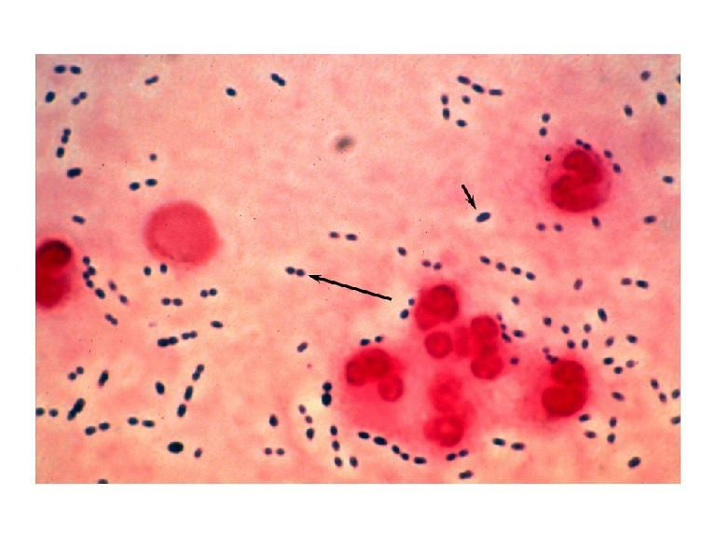
Mechanism of Action: Pathogens
Inhalation of microorganisms:
Bacteria
Streptococcus pneumoniae
Haemophilus influenzae
Viruses
Fungi
Retrieved from : http://www.gettyimages.ca/photos/streptococcus-pneumoniae?excludenudity=true&sort=mostpopular&mediatype=photography&phrase=streptococcus%20pneumoniae
Notes:
Pneumonia can develop after inhalation of microorganisms primarily bacteria ( such as Streptococcus pneumoniae, and Haemophilus influenzae, the 2 most common) , viruses and fungi or when bacteria from an infection elsewhere in the body spreads to the lungs, which overpower your immune system, thus infecting your lungs .
Side note --A cold or flu that gets worse can turn into pneumonia. That's because the cold or flu will irritate the lungs, creating an environment where it's easier for pneumonia germs to move in and start an infection.

Slide 16
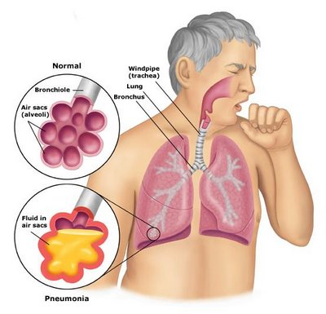
Pneumonia
Inflammation of the alveoli
Reduces the capacity of gas exchange within the Alveoli
Symptoms:
Similar to a cold
Shortness of Breath
Nausea
Retrieved from: http://medicalassessmentonline.com/terms.php?R=323&L=L
Notes:
inflammation of the air sacs or alveoli, which are microscopic sacs in the lungs that absorb oxygen. The inflammation causes the alveoli to fill with fluid reducing the amount of air space space in the lungs for air and so the air coming is unable to exchange.
Many of the symptoms of pneumonia are similar to that of a cold, some other symtoms include shortness of breath, nausea, and Chest pain -which gets worse when you cough or breath.

Slide 17
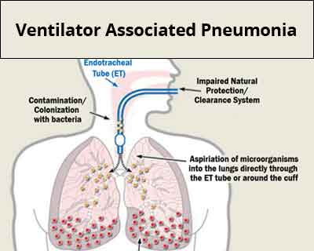
Community and Hospital Acquired Pneumonia
Community Acquired Pneumonia (CAP)
Hospital Associated Pneumonia (HAP)
Retrieved from: https://clipartfest.com/categories/view/b6bda3f04c326b200112f3fe0b36549ae0843563/peaceful-environment-clipart.html
Retrieved from:http://speciality.medicaldialogues.in/preventing-ventilator-associated-pneumonia-in-hospitals-goi-guidelines/
Notes:
Community acquired pneumonia (CAP) is the most common type of pneumonia, which occurs outside of the hospital setting. It is caused by bacteria, fungi and viruses.
Whereas, Hospital associated pneumonia (HAP) is when a patient gets pneumonia during a hospital stay for another illness. It is mostly caused by a bacteria. The bacteria causing the pneumonia, may become resistant to antibiotics, making it dangerous.
Ventilator-associated pneumonia is a type of HAP, which occurs in patients receiving mechanical ventilation through an endotracheal tube or tracheostomy. Thus, the mechanical ventilation increases the risk of developing bacterial pneumonia because it allows free passage of bacteria (so they get around the defences of the respiratory system , that we discussed previously ) , so they enter the lungs with each breath, as seen in the image.

Slide 18
Risk Factors

Slide 19
Physiological Risk Factors
Age
<1 years old
>65 years old
Recent viral respiratory infection
Chronic disease
Not limited to lung disease
Immunosuppressant use
(NHLBI, 2016; Mayo Clinic, 2016; Healthline, 2015)
Retrieved from: http://i.telegraph.co.uk/multimedia/archive/02781/Retirement-Home_2781309b.jpg, http://sesame-en.tokyo/wp-content/uploads/2015/10/carina-if-baby-e1443667613753.png
Notes:
Young = immune system still developing, Old = immune system weakens with normal aging
Recent cold/flu can cause bacterial pneumonia to spontaneously develop (Streptococcus pneumoniae bacteria)
Chronic diseases that restrict airways/make breathing hard can exacerbate pneumonia risk
Individuals w/ diseases like COPD or Cystic Fibrosis might be prescribed inhaled corticosteroids (immunosuppressants)

Slide 20
Lifestyle Factors
Smoking
Alcohol Abuse
Conditions that weaken the immune system:
HIV/AIDS
Chemotherapy
Steroids
Exposure to Chemicals
Exposure to Fungi
(NHLBI, 2016; WHO, 2016; Mayo Clinic, 2016)
Retrieved from:
http://www.usnews.com/cmsmedia/ca/2e/2224d66f4148ac4bc37cec847d8a/160421-anabolicsteroids-stock.jpg, http://www.weightlossresources.co.uk/img/a/alcohol-guidelines.jpg
Notes:
Smoking is self-explanatory
Long term alcohol use suppresses white blood cell production
Chronic conditions (also including blood/bone/organ transplant) weaken/suppress immune system
Indoor air pollution (asbestos, heating using biomass fuels like wood/dung, second hand smoke)
Fungal-pneumonia can be caused by exposure to fungi in animal excrement or soil

Slide 21
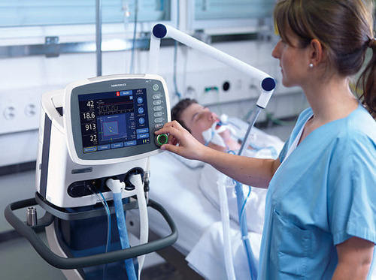
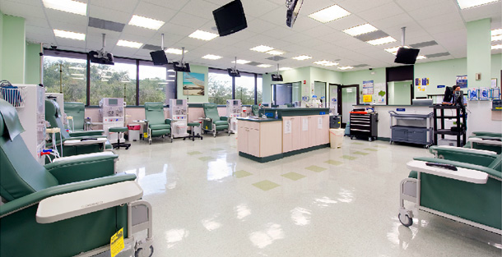
Healthcare Factors
Immunosuppressant Medication
Ventilators
Proximity to Others
(Mayo Clinic, 2016)
Retrieved from: http://medsunhealthcare.com/wp-content/uploads/2015/11/4.-ICU-Ventilator.jpg.
http://www.nkfi.org/images/made/uploads/education/Donor_Profiles/Transplant_slide_show_2_480_320_s_c1.jpg,
http://www.newstartdialysiscenter.com/images/slideshow/dialysis_room.jpg
Notes:
Immunosuppressant medications are often prescribed to patients who have received organ transplants, have an autoimmune condition (e.g. Lupus, Crohn’s, MS), these drugs weaken the immune system and make patients vulnerable to secondary infections
Ventilators are often used in intensive care units, where patients are already vulnerable. Ventilators can cause pneumonia because they tend to harbour antibiotic resistant bacteria, and because they are fairly invasive instruments.
Proximity to others in healthcare settings (e.g. ICU, kidney dialysis centers etc.) when immunosuppressed

Slide 22
Diagnostic Tests

Slide 23
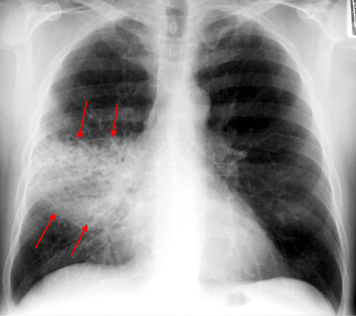
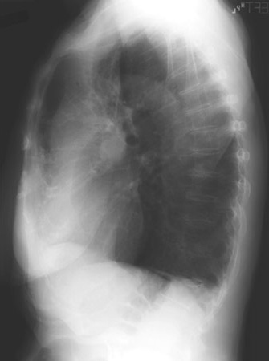
Diagnostic Tests
Patient history and physical examination
Chest X ray
Further test for specificity:
Blood test
Bacterial cell culture test
Retrieved from: https://www.med-ed.virginia.edu/courses/rad/cxr/pathology3chest.html
(Mayo Clinic, 2014), (Carrol, 2002)
Notes:
-the first indication of an LRI is due to a recurring cough and chest irritation which does not stop after a short period of time. Physicians will take the patient's history and perform a physical examination, by listening to the the lungs via a stethoscope.
-To confirm a diagnosis of pneumonia, and distinguish it from acute bronchitis and a mass in the lung, physicians will order a chest X ray. The image on the right depicts a patient with RML pneumonia. Take note of the indistinct borders and dispersed nature of the image, which distinguishes it from a mass which would be more compact.
-To test for specific bacteria causing the pneumonia and the right course of medication, blood tests and bacterial cell culture tests are prescribed.

Slide 24
Treatments

Slide 25
Treatment Options
Retrieved from: http://www.clipartpanda.com/categories/medication-clipart,
http://search.coolclips.com/m/vector/vc065197/doctors-in-surgery/,
http://www.clipartbest.com/clipart-dTrodpMpc
Notes:
The treatments for pneumonia can be categorized into lifestyle modifications, pharmacological options and medical procedures.

Slide 26
Lifestyle Modifications
Vaccinations
Pneumococcal pneumonia
Seasonal influenza
Quit smoking
Healthy eating
Regular Exercise
Retrieved from
http://womenpla.net/move-into-the-circle-of-the-winners/
(National Heart, Lung, and Blood Institute, 2016)
Notes:
-Lifestyle modifications are important in the prevention and treatment of pneumonia
-A vaccination against pneumococcal pneumonia, which is a common form of bacterial pneumonia can be administered
-It is also important to be vaccinated against the seasonal influenza as it can also cause pneumonia
-Quitting smoking is crucial as the tobacco damages the lung’s ability to fight off infection
-Healthy eating and regular exercise keeps a strong immune system to effectively fight infections

Slide 27
Pharmacological Treatments
Antibiotic drugs
Azithromycin
Clarithromycin
Erythromycin
Antiviral drugs
Oseltamivir
(National Heart, Lung, and Blood Institute, 2016), (DrugBank, 2005)
Retrieved from: http://discovermagazine.com/2014/oct/8-stop-taking-antibiotics-when-you-feel-better
Notes:
The type of pharmacological treatment depends on the type of pneumonia. The goal of medications is to cure the respiratory infection and manage symptoms.
Pneumonia caused by bacteria is treated with antibiotics like azithromycin, clarithromycin and erythromycin. These antibiotics interfere with translation, preventing regular bacterial growth. These antibiotics improve symptoms in one to three days. It is important to take antibiotics as prescribed by the doctor to completely eliminate the infection and prevent its reoccurrence.
Pneumonia caused by a virus is treated with antiviral drugs such as oseltamivir. It inhibits the ability of a virus to reproduce.

Slide 28
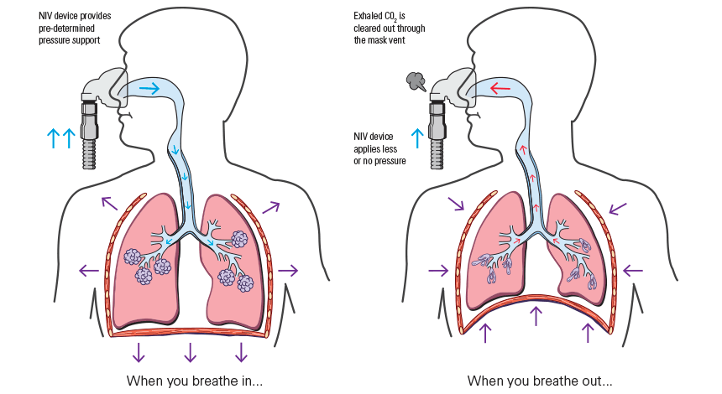
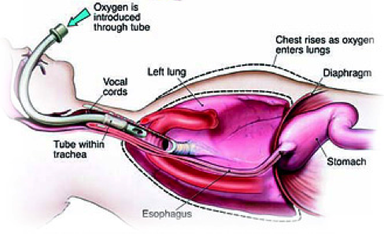
Medical Procedures: Oxygen Therapy
Non-Invasive Ventilation
Invasive Ventilation
Image retrieved from: http://careforyou.com.hk/en/the-role-of-non-invasive-ventilation-in-the-treatment-of-copd
Image Retrieved from: https://www.google.ca/search?q=oxygen+therapy&client=safari&rls=en&biw=562&bih=679&source=lnms&tbm=isch&sa=X&ved=0ahUKEwiSm-DP5YbSAhVE5SYKHd9WBsgQ_AUIBigB#tbm=isch&q=ventilator+in+pneumonia&imgrc=RI46QSkVwZ6XRM:
(Zhang et al., 2012)
Notes:
Some medical procedures include non-invasive and invasive ventilation to facilitate breathing via oxygen therapy. A non-invasive ventilation provides oxygen support through a tightly fitted facial or nasal mask. Whereas, invasive ventilation provides oxygen through a tube inserted into the trachea through the mouth or the nose. Both ventilation methods provide more oxygen with the same inspiratory effort, thus providing higher oxygen volume to alveoli which is then delivered to the blood. Oxygen therapy will be complemented with antibiotics and fluids delivered intravenously.

Slide 29
Future Global Burden

Slide 30
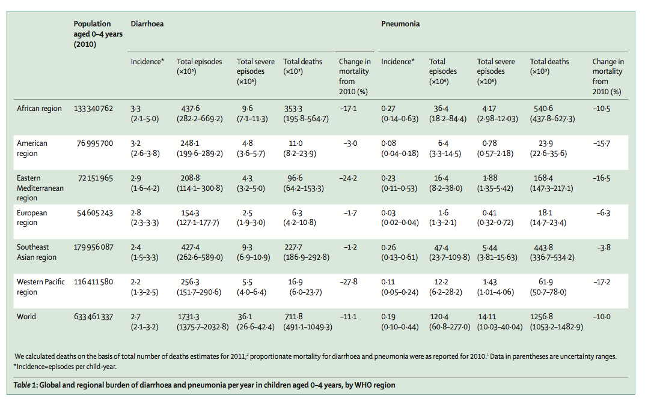
Future Burden
Global burden highest in Southeast Asia and Africa
Poor hygienic conditions, malnutrition, suboptimal breastfeeding
Nearly ⅓ severe diarrhoea and pneumonia cases are vaccine-preventable
(Walker et al., 2013)
Notes:
Poor hygiene conditions leads to enhanced exposure to pneumonia causing pathogens, malnutrition leads to a weakened immune system and suboptimal breastfeeding results in children not acquiring passive immunity from their mother at a susceptible age (0-24 months). This lack of passive immunity means that children exposed to pathogens early will quickly succumb to the disease.

Slide 31
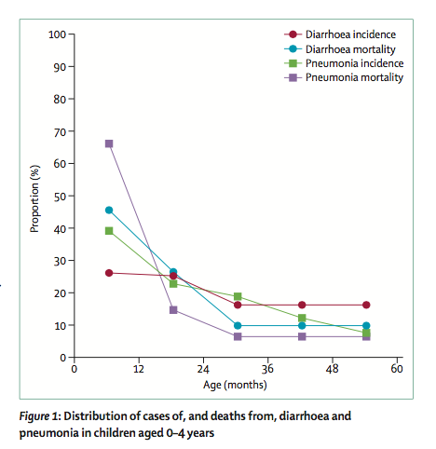
Case Study: Global Burden of childhood pneumonia and diarrhoea
Global and Regional Burden
Incidence and case-fatality ratios higher in low and middle income families
Highest in 15 major countries:
Afghanistan, Angola, Burkina Faso, China, Democratic Republic of the Congo, Ethiopia, India, Indonesia, Kenya, Mali, Niger, Nigeria, Pakistan, Tanzania, and Uganda
Burden by Age and Sex
Seen in younger age groups: 81% of death happen in children under 2 years
(Walker et al., 2013)
Notes:
-this was a large scale systematic, literature review on the epidemiology of childhood pneumonia and diarrhea
-the 15 countries combined contributed to 64% of total global cases of pneumonia
-Figure 1 - represents proportion of children with pneumonia vs the age of the children
-the study concluded that global morbidity and mortality from pneumonia and diarrhea are falling, but action is needed globally (due to increased awareness) and at an accelerated pace

Slide 32
Multiple Choice
What communities within Canada have the highest risk of developing Lower Respiratory Infections (LRIs)?
Hamilton Residents
Ontario Residents
Alberta Residents
Inuit Communities on Baffin Island
Which diagnostic method is the most favoured to confirm if an individual has pneumonia?
Blood Test
Patient History
Chest X Ray
Bacterial Cell Culture Test

Slide 33
Multiple Choice
What communities within Canada have the highest risk of developing Lower Respiratory Infections (LRIs)?
Hamilton Residents
Ontario Residents
Alberta Residents
Inuit Communities on Baffin Island (##)
Which diagnostic method is the most favoured to confirm if individual has pneumonia?
Blood Test
Patient History
Chest X Ray (##)
Bacterial Cell Culture Test

Slide 34
Questions?

Slide 35
References
Amanullah. (2015).Ventilator-Associated Pneumonia Overview of Nosocomial Pneumonias. Retrieved from http://emedicine.medscape.com/article/304836-overview
American Lung Association. (2016). Pneumonia symptoms, causes and Risk Factors. Retrieved from: http://www.lung.org/lung-health-and-diseases/lung-disease-lookup/pneumonia/symptoms-causes-and-risk.html?referrer=https://www.google.ca/
Anderson, W., & Winter, J. (2009). Managing LRTI in adults in the community. The Practitioner, 253(1723), 21-26.
Banerji, a, Bell, a, Mills, E.L., McDonald, J., Subbarao, K., Stark, G., Eynon, N., and Loo, V.G. (2001). Lower respiratory tract infections in Inuit infants on Baffin Island. CMAJ 164, 1847–1850
Carroll, K. C. (2002). Laboratory diagnosis of lower respiratory tract infections: controversy and conundrums. Journal of clinical microbiology, 40(9), 3115-3120.
Confalonieri, M., Potena, A., Carbone, G., Porta, R., Tolley, E., & Meduri, U. (1999). Acute Respiratory Failure in Patients with Severe Community-acquired Pneumonia. ATS Journals, 160(5), 1585-1591.
DrugBank. (2005, June 23). Pharmacology . Retrieved from https://www.drugbank.ca/drugs/DB01211
El-Azami-El-Idrissi, M., Lakhdar-Idrissi, M., Chaouki, S., Atmani, S., Bouharrou, A., & Hida, M. (2016). Pediatric recurrent respiratory tract infections: When and how to explore the immune system? (About 53 cases). Pan African Medical Journal, 24. http://doi.org/10.11604/pamj.2016.24.53.3481
Falagas, M. E., Mourtzoukou, E. G., & Vardakas, K. Z. (2007). Sex differences in the incidence and severity of respiratory tract infections. Respiratory Medicine. http://doi.org/10.1016/j.rmed.2007.04.011
Healthline. 2015. Bacterial Pneumonia: Risk Factors. Retrieved from: http://www.healthline.com/health/bacterial-pneumonia#Overview1.
Inglis, T. J. J. (2007). Microbiology and infection: a clinical core text for integrated curricula with self-assessment. Elsevier Health Sciences

Slide 36
References (2)
Kovesi, T., Gilbert, N. L., Stocco, C., Fugler, D., Dales, R. E., Guay, M., & Miller, J. D. (2007). Indoor air quality and the risk of lower respiratory tract infections in young Canadian Inuit children. CMAJ : Canadian Medical Association Journal = Journal de l’Association Medicale Canadienne, 177(2), 155–60. http://doi.org/10.1503/cmaj.061574
Mayo Clinic. (2016). Pneumonia. Retrieved from: http://www.mayoclinic.org/diseases-conditions/pneumonia/symptoms-causes/dxc-20204678
Mayo Clinic. (2014). Respiratory Syncytial virus (RSV) Test and Diagnosis. Retrieved from: http://www.mayoclinic.org/diseases-conditions/respiratory-syncytial-virus/basics/tests-diagnosis/con-20022497
Mayo Clinic. 2016. Symptoms and causes of Pneumonia. Retrieved from: http://www.mayoclinic.org/diseases-conditions/pneumonia/symptoms-causes/dxc-20204678
Medicine Plus. (2017).Lower respiratory tract. Retrieved from: https://medlineplus.gov/ency/imagepages/19379.htm
National Heart, Lung, and Blood Institute. (2016, October 12). Pneumonia. Retrieved from https://www.nhlbi.nih.gov/health/health-topics/topics/oxt
National Heart, Lung, and Blood Institute (NHLBI). 2016. Risk Factors: Pneumonia. Retrieved from: https://www.nhlbi.nih.gov/health/health-topics/topics/pnu/atrisk.
Rudan, I., Boschi-Pinto, C., Biloglav, Z., Mulholland, K., & Campbell, H. (2008). Epidemiology and etiology of childhood pneumonia. Bulletin of the World Health Organization. http://doi.org/10.2471/BLT.07.048769
Walker, C. L. F., Rudan, I., Liu, L., Nair, H., Theodoratou, E., Bhutta, Z. A., ... & Black, R. E. (2013). Global burden of childhood pneumonia and diarrhoea. The Lancet, 381(9875), 1405-1416.
World Health Organization. (n.d.). Estimates for 2000-2012: Disease Burden. Retrieved from: http://www.who.int/healthinfo/global_burden_disease/estimates/en/index2.html
World Health Organization (WHO). 2016. Pneumonia Fact Sheet. Retrieved from: http://www.who.int/mediacentre/factsheets/fs331/en/.
Zhang Y, Fang C, Dong BR, Wu T, Deng JL. (2012). Oxygen therapy for pneumonia in adults. Cochrane Database of Systematic Reviews, 3.

