Slide 1
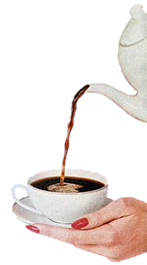
Physiological Effects of Caffeine
Presentation by: Abhay, Ankita, Karan, Reema & Sophia
Group 1
Notes:
Hello my name is Reema Ibrik and today I will be presenting the physiological effects of caffeine

Slide 2
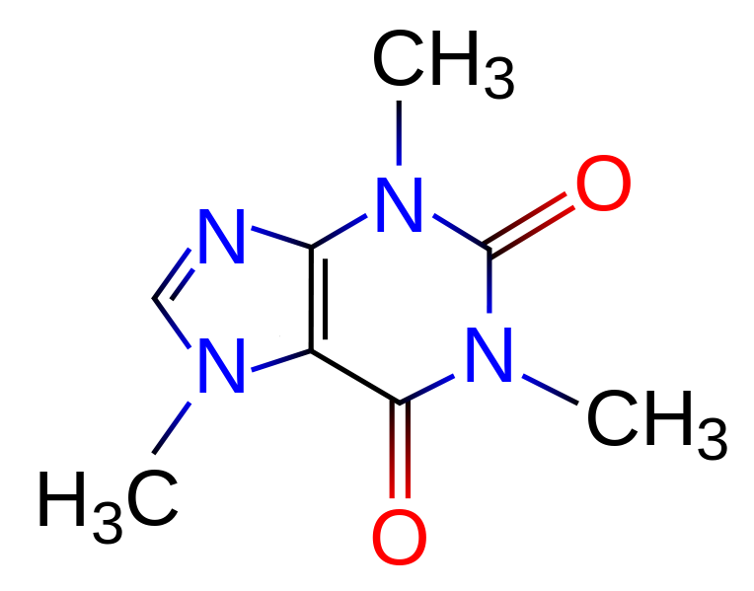
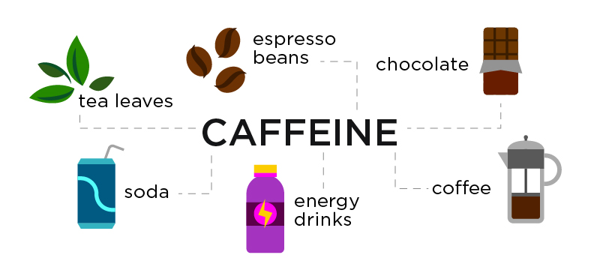
What is Caffeine?
World’s most widely consumed psychoactive “drug”
Central Nervous System stimulant
Increases alertness
Notes:
caffeine is a big part of many people’s daily lives. For those unaware of what it is, it is a legal central nervous system stimulant found in many widely-consumed goods. For example, this naturally occurring stimulant is found in coffee beans, tea leaves, chocolate, medications and even soft drinks! It is so popular that it is considered the world's most widely consumed psychoactive “drug”. It is a well-known fact that it can help individuals stay awake and keep alert! Most of you rely on coffee every day to help you get through the day. Many of you also might experience withdrawal symptoms if you don't get your daily intake of caffeine; you’ve developed tolerance and it is a part of your culture now. But you have to wonder, is it good for you? How much is too much? Should you drink coffee every day? and will it harm you in the long-term? We’re not sure either, but that’s what we wanted to examine through this project. Through this presentation, we hope to educate you on the effects of caffeine on your digestive system, cardiovascular system, mental health, and sleep and alertness. Additionally, we look at some of the positive outcomes of consuming caffeine in the short and long-term.

Slide 3
Half-life of Caffeine
Half-life of caffeine varies between 2-10 hrs
Factors determine how long caffeine stays in body
Age
Weight
Liver health
Susceptibility to caffeine
Notes:
But before we dig deeper let’s discuss the half-life of caffeine. The body quickly absorbs caffeine and it reaches its peak level just after 30 minutes. However, the half-life of caffeine varies among different individuals., making it range between 2 to 10 hours. Several different factors determine how long caffeine stays in the body and those include person’s age, weight, liver health and susceptibility to caffeine. In addition, people who regularly drink coffee build up a tolerance to its effects. Therefore, there is no surprise that that each individual could react differently to caffeine

Slide 4
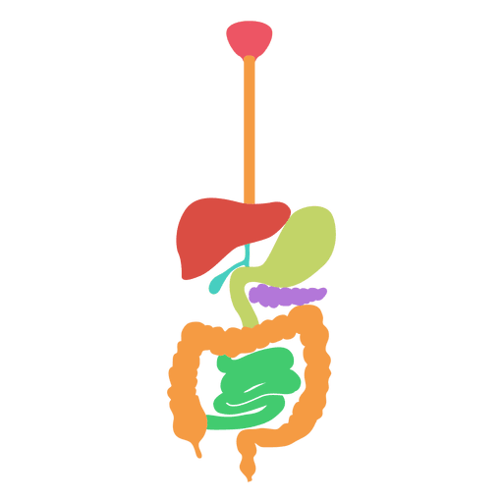
Caffeine & the Digestive System
Notes:
So the first topic we will be discussing is caffeine and the d

Slide 5
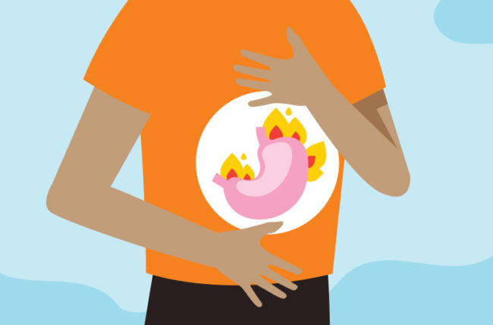
Caffeine and the Digestive System
Caffeine decreases risk of gastric cancer
99% of caffeine absorbed in the GI tract within 45 min (Romualdo et al., 2019)
Heartburn is the most common gastrointestinal symptom from caffeine
Notes:
Consuming caffeine, especially in high amounts, has significant impacts on the gastrointestinal tract, metabolism, urination tendencies and bowel movements. Caffeine is consumed more than any stimulant drug in the world. Coffee has also been linked to stimulating gallbladder contraction and colonic motor activity. Other studies have found that coffee consumption decreases the risk of digestive tract and liver cancer, especially gastric cancer. Drinking coffee daily significantly reduces the risk of gastric cancer by 7% when compared to non-coffee drinkers. Those who drank 3-4 cups of coffee a day had a 12% risk decrease.
Caffeine is rapidly and almost completely absorbed (99%) in the GI tract, within 45 minutes of consumption. Since the GI tract experiences caffeine at the highest concentration, it is impacted the most by it.
Coffee promotes gastro-oesophageal reflux which is when stomach acid leaks into the oesophagus and can cause heartburn. Heartburn is the most common gastrointestinal symptom that results from drinking coffee and is experienced by about 68% of patients who experience GI symptoms.
A study that focused on the effects of caffeine on gastro-oesophageal reflux after meals in healthy subjects, found that coffee stimulates gastric acid secretion and could possibly induce secretion as well.

Slide 6
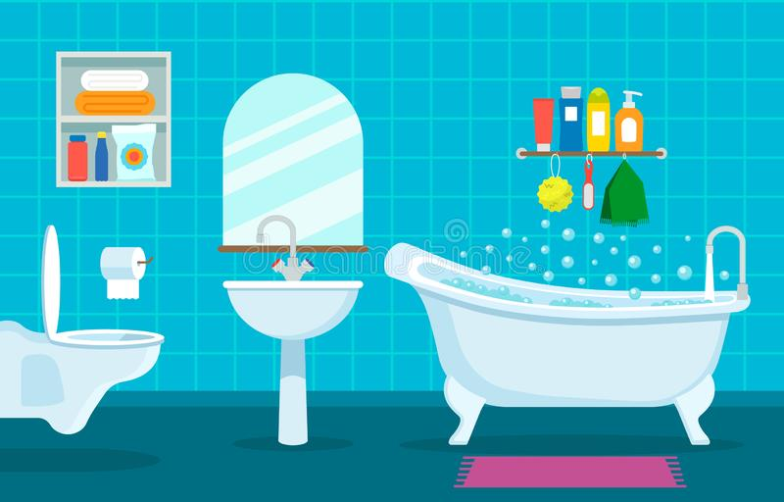
Frequent Urination due to Caffeine
Caffeine causes urinary incontinence
Regular coffee drinkers experience less symptoms
Frequency and urgency are dosage dependent
Notes:
Caffeine has a diuretic effect that affects the bladder by increasing pressure on the muscle wall of the bladder and promoting detrusor muscle excitability. A caffeine intake greater than 204 mg per day was linked to urinary incontinence (UI), even when controlling other UI risk factors like water and total liquid intake.
Study found that people who didn’t consume coffee regularly were more vulnerable to changes in urination patterns and that high-dosage coffee consumption can cause overactive bladder symptoms. Symptoms of urgency, frequency and urge incontinence are all dosage dependent , increasing at high dosage. Those who drank coffee regularly experienced little change in urination patterns and people who rarely consume caffeine experienced the most drastic urinary symptoms.

Slide 7
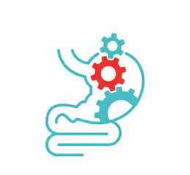
Laxative Effects of Caffeine
Caffeine causes 60% stronger colonic motor activity than water (Boekema et al., 1999)
Coffee can be used as a postoperative ileus prevention measure
Notes:
Next They studied how colonic motor activity was impacted by drinking regular coffee, decaffeinated coffee or water, paired with a 1000 calorie meal. The conclusion was that regular and decaf coffee caused more colonic activity than drinking water. Caffeinated coffee stimulates colonic motor activity the most and caused 60% stronger activity than water and 25% stronger than decaf. Thus, caffeine causes increased colonic motor activity, which is responsible for causing a laxative effect and increasing bowel movement.
Which is why coffee is administered as a prevention measure for postoperative ileus after major abdominal surgeries.
Postoperative ileus (POI) is a condition involving severe constipation and intolerance of oral intake caused by disruption of the propulsive motor activity of the GI tract. Typically, POI self-resolves, but extended hospital stays and morbidity caused by it has a big impact on health care costs. In fact, it costs hospitals an extra $750 million per year.
It was Found that caffeine reduced time to first defecation by almost 10 hours, when compared to drinking just water. Also, time to first flatus was reduced by 7 hours, time to first audible bowel sound by 4 hours, and decreased length of hospital stay by 0.75 days

Slide 8
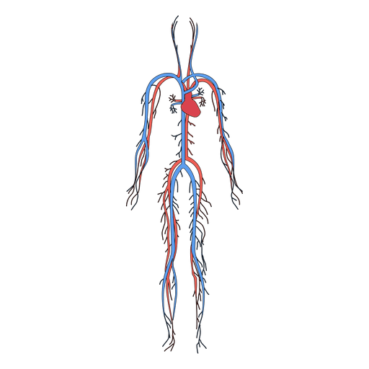
Caffeine & the Cardiovascular System

Slide 9
How Caffeine Impacts Blood Pressure
Drinking 1-2 cups of coffee daily:
Increases the systolic pressure by 8 mm Hg
Increases diastolic pressure by 6mm Hg (Chrysant et al., 2017)
These effects were only seen up to 3 hours after consumption
Notes:
Majority of medical doctors recommend people to avoid drinking coffee until they have their blood pressure checked. Studies have shown that drinking 1-2 cups of coffee per day, will increase the systolic pressure by 8mm Hg and diastolic pressure by 6mm Hg. However, these effects were only observed up to three hours after consumptions. In addition, these effects are not usually seen in regular coffee drinkers and this could be due to the fact that they develop caffeine tolerance. Other studies suggested that, coffee consumption could raise blood pressure for a short period of time. luckily, in long term no significant impact in blood pressure is observed. As with anything, overconsumption would have negative effects and same goes with coffee consumption. However, the American Heart Association as well as Mayo Clinic recommend that \ daily consumption of caffeine should not be more than 200 mg in order to avoid hypertension

Slide 10
How Caffeine Impacts Heart Rate
Surprisingly, a decline in heart rate!
Even in individuals with tolerance
Heart rate variability (HRV)
Significant increase in HRV
Notes:
affeine has the ability to help you stay awake through a variety of mechanisms, one of which involves pumping more blood, and subsequently oxygen, to your brain to help you stay awake and alert. But a habitual coffee drinker must wonder then, how is this affecting my heart? In the context of heart rate, Daniels and colleagues show that there is indeed no significant difference in acute heart rate. They tested the caffeine condition on 10 cyclists who do not consume caffeine. While there was a change in blood pressure and arterial pressure, there was no change in heart rate. From this study, we can see that caffeine can induce this alertness not by increasing the heart rate, but rather by increasing regional blood flow to the brain by increasing blood pressure and arterial pressure. Another study verifies this increase in blood pressure but also suggests that there is a decrease in heart rate for both coffee and caffeine consumption.
Even in coffee drinkers who have potentially developed tolerance, 24 hr abstinence of caffeine does not result in any changes to heart rate. It is hypothesized that this duration of abstinence is enough to negate tolerance of caffeine, further demonstrating that caffeine decreases one’s heart rate. The most consistent theme amongst these studies is that short-term/acute caffeine consumption will increase the consumer’s blood pressure and cause a slight decline in their heart rate , however long-term effects are minimal
Another important risk factor in determining cardiovascular health is heart rate variability (HRV). HRV is essentially the variation in time between consecutive heart beats. Similar to the first study discussed in this section, researchers examined the effects of caffeine on individuals pre- and post-exercise. Their results demonstrated no significant difference in heart rate pre- and post- exercise, as expected. Interestingly enough however, there was a significant increase in heart rate variability pre-exercise, suggesting that caffeine can induce changes to HRV
It is important to consider that this occurred pre-exercise too, meaning we cannot attribute these results to the exercise. However, research discussing the effects of caffeine on HRV are not conclusive, as HRV is a relatively recent marker being used. This is evident as a study Rauh et al shows that HRV does not actually change in response to caffeine ingestion. They suggest further research much be conducted to validate their results.

Slide 11
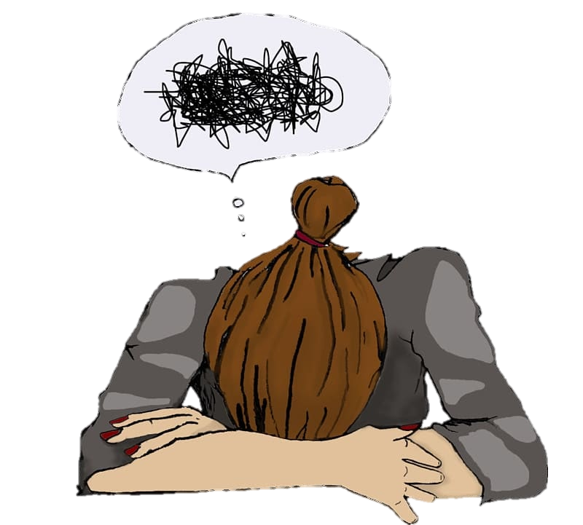
Caffeine & Anxiety

Slide 12
Caffeine and Anxiety
“Fight or Flight” response
Common symptoms:
Restlessness
Trembling or muscle twitching
Alertness
Insomnia
Notes:
Anxiety is our body’s natural way to respond to stress. This feeling of fear and discomfort varies in magnitude from one person to another and can be triggered by countless stimuli. Research has shown that high doses of caffeine can stimulate our body’s “fight or flight” response and generate symptoms that memic anxiety symptoms.
A study by Childs et al. (2008) studied the effect of variable caffeine exposure on different individuals. The study consisted a four-session, double-blind, placebo-controlled, within-subject design. Each subject received placebo, 50, 150, or 450 mg caffeine in random order during four test sessions conducted at least 72 h apart. Standardized questionnaires were used to assess the participant’s baseline mood states and anxiety levels and post-exposure levels. Some standardized tests included Profile of Mood States (POMS) to asses the state of anxiety and a visual-analog scale (VAS) to rate anxiety. Results showed significant increase in anxiety at high doses of caffeine, as shown in Figure ##. With these results, the researchers concluded, that the effect of caffeine on anxiety is dose-dependent.

Slide 13
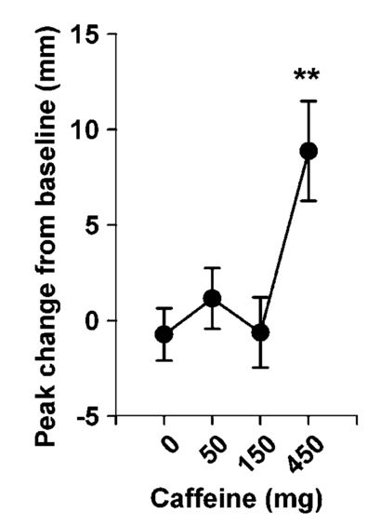
Can Caffeine Induce Anxiety?
Significant increase in self-reported anxiety after 450mg of Caffeine.
450mg =
(Childs et al., 2008)
Notes:
A study by Childs et al. (2008) looked at the effect of variable caffeine exposure on different individuals. Each subject received placebo, 50, 150, or 450 mg caffeine in random order during four test sessions conducted at least 72 h apart. Standardized questionnaires were used to assess the participant’s baseline mood states and anxiety levels and post-exposure levels. Some standardized tests included Profile of Mood States (POMS) to assess the state of anxiety and a visual-analog scale (VAS) to rate anxiety.as seen on the figure on the right Results showed significant increase in anxiety at high doses of caffeine, in this cases it was 450 mg which equivalent to approximately 4 and half cups of coffee
With these results, the researchers concluded, that the effect of caffeine on anxiety is dose-dependent.

Slide 14
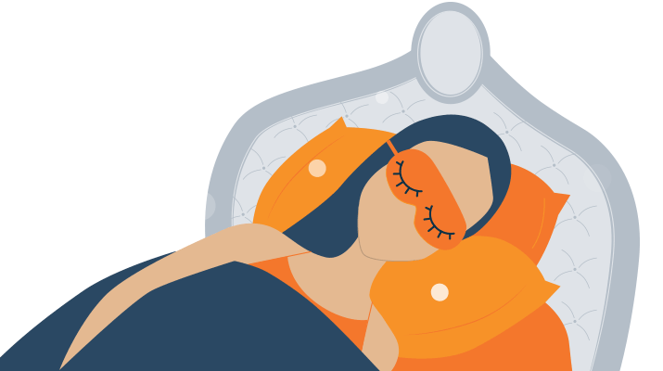
Caffeine & Sleep

Slide 15
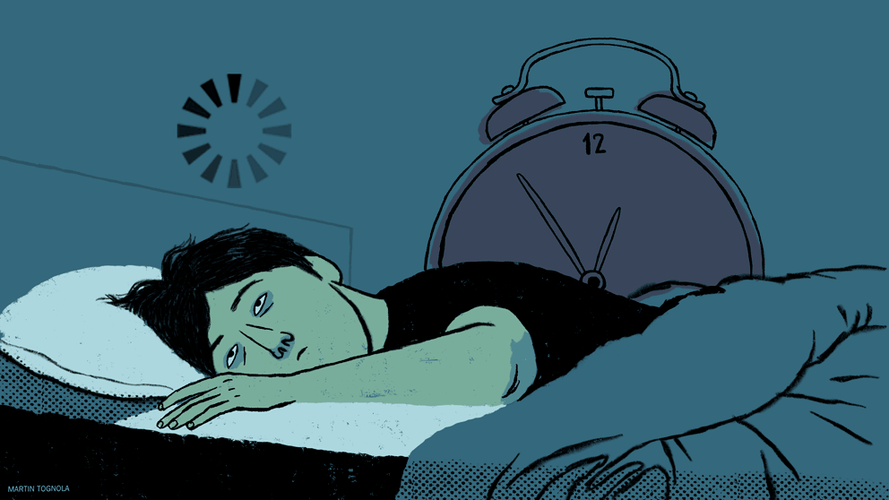
Impact of Caffeine on Sleep
Moderate intake of caffeine up to 6 hours before bedtime has disruptive effects on sleep by:
Time spent to fall asleep
Time spent awake at night
(Drake et al., 2013).
Notes:
Research had shown that great consumption of caffeine affects sleep and results in poor sleep quality. A study by drake te al. 2013 looked at the how timing of caffeine consumption would affect sleep. This study was done on 12 healthy adults with no history of insomnia and they were given 400 mg of caffeine either 3 hours before sleep, 6 hours before sleep or immediately prior to sleep. They found out that in all three cases, the time spent to fall asleep as well as the time they spent awake at night increased drastically. As a result, they concluded that the intake of caffeine upto 6 hours before bedtime could have disruptive effects on sleep

Slide 16
Caffeine and Jet Lags
Coffee consumption causes a shift in circadian rhythm
Delays a rise in melatonin (sleep hormone) level in body
How to cope moderate coffee consumption with short naps (Arendt et al., 2009).
Notes:
In addition, caffeine has been found to help people deal with jet lag. Jet lag occurs after long flights across different time zones and it could either cause severe sleepiness or wakefulness at inappropriate times. Coffee consumption has been seen to increase alertness thus control the sleepiness in those individuals suffering from jet lag. A review study showed that short naps combined with moderate coffee consumption during the times of appropriate wakefulness helped individuals suffering from jet lag , since coffee consumption causes a shift in our circadian rhythm by delaying a rise in melatonin level in our body.

Slide 17
Impact of Caffeine on Sleep and Alertness
Drivers greatly affected by fatigue
Approximately 43% of commercial drivers consume some sort of caffeinated drinks
63% reduced chance of crashing
(Sharwood et al., 2013).
Notes:
Another aspect of sleep that caffeine intervenes with is fatigue. Fatigue is a common problem that could affects everyone. In this case, we focused on lorry drivers. Fatigue could reduce their driving ability as well as their reaction time. Studies have shown that individuals who drive after being awake for 17 hours have a double risk of crashing. It was found out that consumption of strong coffee that contained 150-200 mg caffeine with a short nap was effective in reducing driver’s sleepiness
Approximately 43% of those drivers consume some sort of caffeinated drinks such as energy drinks, coffee and tea. Which resulted in as a 63% reduced chance of crashing.

Slide 18
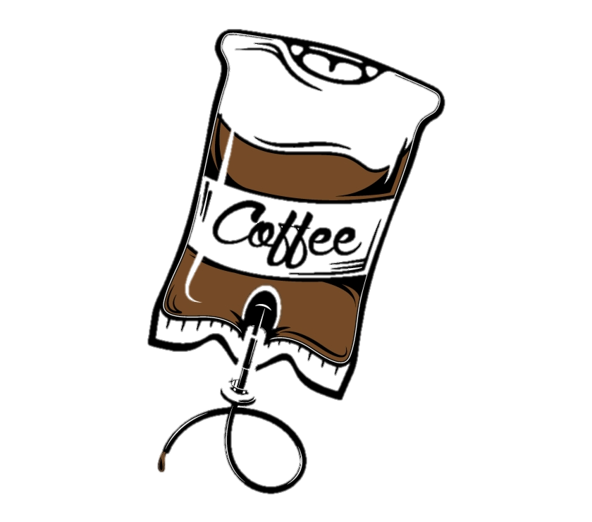
Caffeine Addiction
Clinical disorder
Most common psychoactive drug
90%+ adults use caffeine regularly (Meredith et al., 2013).
Average consumption of 200 mg/day (Meredith et al., 2013).
Notes:
Caffeine is the most commonly used psychoactive drug in the world. Whether it comes from coffee, tea, energy drinks or soda, many individuals feel the need for caffeine in the morning in order to increase alertness. In North America, more than 90% of adults use it regularly, with the average consumption being around 200 mg daily. Although low to moderate levels of caffeine consumption are safe, clinical studies show that caffeine users become dependent on it, and thus are unable to reduce caffeine consumption despite being aware of the detrimental effects. The World Health Organization and other healthcare professionals have recognized caffeine addiction as a clinical disorder.

Slide 19
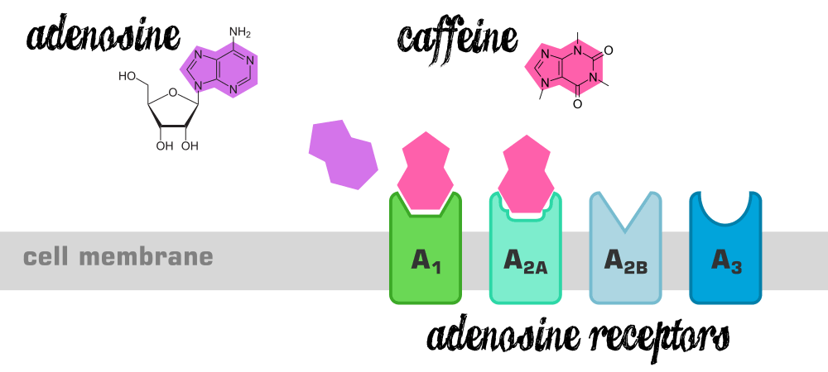
Mechanism Behind Caffeine Dependance
Competitive adenosine receptor antagonist
Greater amount of adenosine receptors to maintain equilibrium
Desired wake-up effect
Tolerance develops
(Sajadi-Ernazarova & Hamilton, 2019).
Notes:
Caffeine is strongly addictive, and studies have shown subjects exhibiting syndromes of intoxication, withdrawal, and dependence.
It is quite easy to develop a dependence on caffeine and the brain chemistry is altered overtime in those that drink caffeinated beverages. Caffeine has been shown to stimulate dopaminergic activity by removing the negative modulatory effects of adenosine at dopamine receptors. Caffeine is a competitive adenosine receptor antagonist, and ultimately blocks adenosine from binding to its receptor, thus preventing the onset of drowsiness. The brain cells grow more adenosine receptors in an attempt to maintain equilibrium. This is how tolerance develops, as the brain has more adenosine receptors and thus it takes a greater amount of caffeine to block a large portion of them in order to achieve the desired wakeup effect. Thus, up-regulation of the adenosine system after chronic caffeine administration appears to be a neurochemical mechanism which underlies the caffeine withdrawal syndrome.

Slide 20
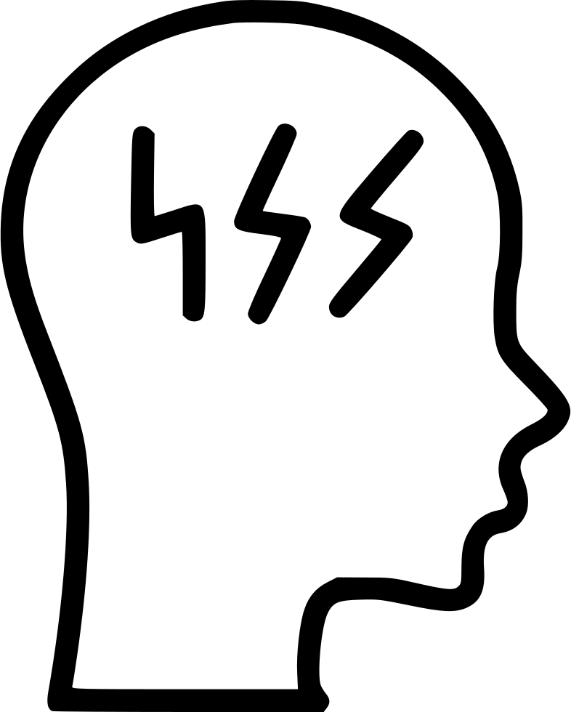
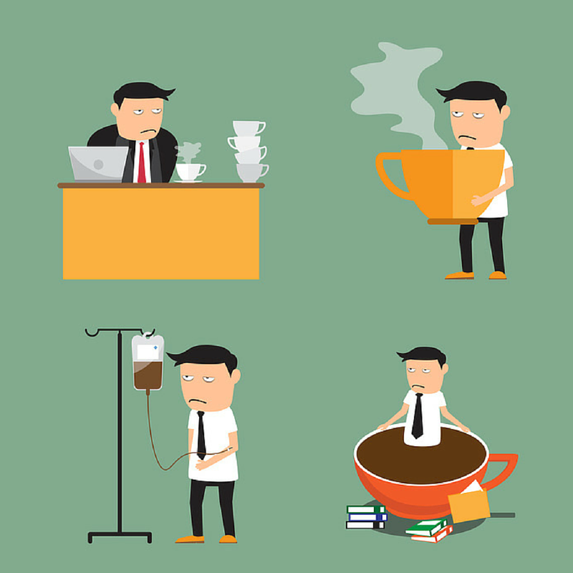
Caffeine Withdrawal Syndrome
Greater abstinence symptom severity increases
Symptoms
Begin within 12-24 hrs
Maximum intensity after 20-48 hrs
Headache, fatigue, uneasy feelings
(Schuh and Griffiths, 1997).
Notes:
Those that abruptly stop drinking caffeine after prolonged use will suffer from withdrawal symptoms and showcase strong cravings. Caffeine withdrawal refers to a time-limited syndrome that occurs after the termination of caffeine administration. Caffeine withdrawal syndrome can occur with abstinence from daily doses as low as 100 mg a day, however, the chances and severity of symptoms increase with higher amounts. Withdrawal from caffeine causes mild to clinically significant distress and impairment of daily functioning. Caffeine withdrawal symptoms begin around 12-24 hours after cessation of caffeine intake and reach maximum intensity 20-48 hours after abstinence. Common symptoms include headache, fatigue, decreased alertness and uneasy feelings. These symptoms are easily suppressed with low doses of caffeine.

Slide 21
Caffeine Withdrawal Mechanism
Changes in cerebral blood flow velocity and quantitative EEG
Abstinence increases blood flow
Headache
It also increases theta rhythm
Fatigue
(Sigmon et al., 2009).
Notes:
Researchers have sought to investigate the biological mechanisms of caffeine withdrawal. They have looked at brain electrical activity and blood flow during caffeine withdrawal in order to examine what was taking place physiologically during acute caffeine abstinence, including the likely mechanism underlying the common caffeine withdrawal headache. It has been concluded that stopping daily caffeine consumption produces changes in cerebral blood flow velocity and quantitative EEG that are likely related to the classic caffeine withdrawal symptoms of headache, drowsiness and decreased alertness. In specific, acute caffeine abstinence increases brain blood flow, which is what ultimately plays a factor in the reported withdrawal headaches. Further, it produces changes in EEG (increased theta rhythm), which has previously been associated to the common withdrawal symptom of fatigue.

Slide 22
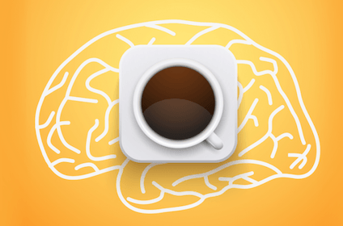
Positive Effects
Decreases fatigue, increases alertness
Enhances physical, cognitive and motor performance
Lowers risk of diabetes
Improves erectile dysfunction
(Glade, 2010)
Notes:
While studies primarily focus on the negative effects of caffeine, there is an extensive amount of scientific evidence that caffeine also has positive health benefits. As such, a literature review was conducted by (Glade, 2010) in order to showcase positive effects of human caffeine consumption. The main positive effects that were found included decreased fatigue, increased alertness, enhanced physical, cognitive and motor performance, enhanced cognitive functioning and thus a lower chance of dementia, a lower risk of diabetes and improved erectile dysfunction.

Slide 23
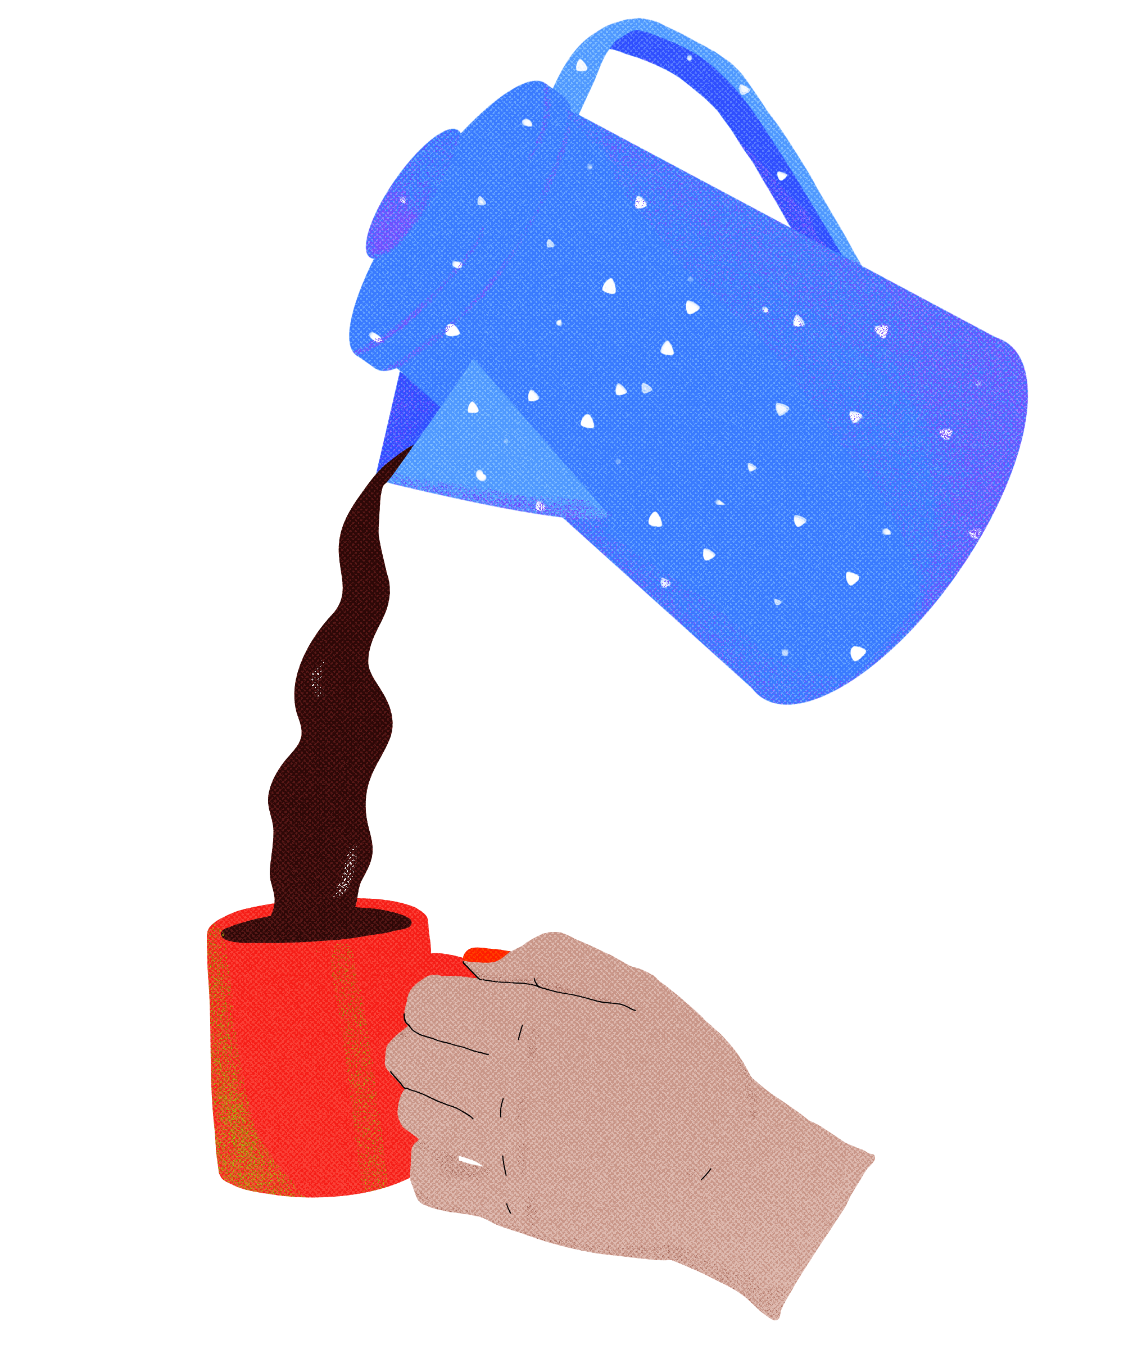
Conclusion
Caffeine exerts effects on many of our bodily systems and processes
Much of the research is inconclusive
Notes:
From what we’ve seen so far, there are so many processes affected by the consumption of caffeine. To put this into perspective, considering that this is the world’s most consumed stimulant, it is significantly impacting the lives of many on a daily basis! In terms of the digestive system, while it is a known laxative and diuretic, it has the potential to exert protective effects on the stomach from things like gastric cancer! Additionally, it aids on our body in glucose metabolism. However, due to its acidic nature and associated irritating effect on the mucosal layers of the esophagus and stomach, we see an increase in gastroesophageal reflux and heartburn. Essentially, we seem some pros and cons of caffeine in the context of our digestive system. Similarly, the cardiovascular system has potential to be impacted by caffeine consumption. Its acute effects involve an increase in blood pressure, but a decrease in heart rate. Intuitively speaking, that means chronic caffeine consumption can potentially result in hypertension. Aside from caffeine-induced anxiety, increased wakefulness when one is trying to sleep, and the withdrawal symptoms, we see that there can be positive effects of caffeine consumption. Despite all the information provided in this presentation, it is important to realise that much of the results are inconclusive, and more research needs to be conducted. As such, take everything with a grain of salt and try to remain informed when consuming caffeine!

Slide 24
Thank You for Listening!
Notes:
This concludes our presentation thank you so much for listening!

Slide 25
References
Alsene, K., Deckert, J., Sand, P., & de Wit, H. (2003). Association Between A2a Receptor Gene Polymorphisms and Caffeine-Induced Anxiety. Neuropsychopharmacology, 28(9), 1694-1702. doi: 10.1038/sj.npp.1300232
Arendt, J. (2009). Managing jet lag: Some of the problems and possible new solutions. Sleep Medicine Reviews, 13(4), 249–256. doi: 10.1016/j.smrv.2008.07.011
Benowitz, N. L. (1990). Clinical pharmacology of caffeine. Annual review of medicine, 41(1), 277-288.
Bichler, A., Swenson, A., & Harris, M. A. (2006). A combination of caffeine and taurine has no effect on short term memory but induces changes in heart rate and mean arterial blood pressure. Amino acids, 31(4), 471-476.
Boekema, J., Samsom, M., van Berge Henegouwen, G.P., Smout, P. (1999). Coffee and gastrointestinal function: facts and fiction: a review. Scandinavian Journal of Gastroenterology, 34(230), 35-39.
Burke, T. M., Markwald, R. R., Mchill, A. W., Chinoy, E. D., Snider, J. A., Bessman, S. C., … Wright, K. P. (2015). Effects of caffeine on the human circadian clock in vivo and in vitro. Science Translational Medicine, 7(305). doi: 10.1126/scitranslmed.aac5125
Childs, E., Hohoff, C., Deckert, J., Xu, K., Badner, J., & de Wit, H. (2008). Association between ADORA2A and DRD2 Polymorphisms and Caffeine-Induced Anxiety. Neuropsychopharmacology, 33(12), 2791-2800. doi: 10.1038/npp.2008.17
Chrysant, S. G. (2017). The impact of coffee consumption on blood pressure, cardiovascular disease and diabetes mellitus. Expert Review of Cardiovascular Therapy, 15(3), 151–156. doi: 10.1080/14779072.2017.1287563
Daniels, J. W., Molé, P. A., Shaffrath, J. D., & Stebbins, C. L. (1998). Effects of caffeine on blood pressure, heart rate, and forearm blood flow during dynamic leg exercise. Journal of applied physiology, 85(1), 154-159.
Dowell, M. (2018, November 1). Does Caffeine Cause High Blood Pressure? Retrieved from https://www.cheatsheet.com/health-fitness/does-caffeine-cause-high-blood-pressure.html/

Slide 26
References
Drake, C., Roehrs, T., Shambroom, J., & Roth, T. (2013). Caffeine Effects on Sleep Taken 0, 3, or 6 Hours before Going to Bed. Journal of Clinical Sleep Medicine, 09(11), 1195–1200. doi: 10.5664/jcsm.3170
Eamudomkarn, N., Kietpeerakool, C., Kaewrudee, S., Jampathong, N., Ngamjarus, C., & Lumbiganon, P. (2018). Effect of postoperative coffee consumption on gastrointestinal function after abdominal surgery: A systematic review and meta-analysis of randomized controlled trials. Scientific reports, 8(1), 1-9.
Fredholm, B., Arslan, G., Halldner, L., Kull, B., Schulte, G., & Wasserman, W. (2000). Structure and function of adenosine receptors and their genes. Naunyn-Schmiedeberg's Archives Of Pharmacology, 362(4-5), 364-374. doi: 10.1007/s002100000313
Gkegkes, I. D., Minis, E. E., & Iavazzo, C. (2020). Effect of Caffeine Intake on Postoperative Ileus: A Systematic Review and Meta-Analysis. Digestive surgery, 37(1), 22-31.
Gleason, J. L., Richter, H. E., Redden, D. T., Goode, P. S., Burgio, K. L., & Markland, A. D. (2013). Caffeine and urinary incontinence in US women. International urogynecology journal, 24(2), 295-302.
Green, P. J., Kirby, R., & Suls, J. (1996). The effects of caffeine on blood pressure and heart rate: a review. Annals of Behavioral Medicine, 18(3), 201-216.
Harvard Health Publishing. (n.d.). Coffee and your blood pressure. Retrieved from https://www.health.harvard.edu/heart-health/coffee_and_your_blood_pressure
Horne, J., & Reyner, L. (1999). Vehicle accidents related to sleep: a review. Occupational and Environmental Medicine, 56(5), 289–294. doi: 10.1136/oem.56.5.289
How Does Caffeine Really Affect Sleep? (2019, July 20). Retrieved from https://www.thesleepjudge.com/sleep-and-caffeine/
Hurd, R. (n.d.). Caffeine & Sleeping Pills. Retrieved from https://www.livestrong.com/article/289985-caffeine-sleeping-pills/

Slide 27
References
Lopez, D. S., Wang, R., Tsilidis, K. K., Zhu, H., Daniel, C. R., Sinha, A., & Canfield, S. (2015). Role of caffeine intake on erectile dysfunction in US men: results from NHANES 2001-2004. PloS one, 10(4).
Meredith, S. E., Juliano, L. M., Hughes, J. R., & Griffiths, R. R. (2013). Caffeine Use Disorder: A Comprehensive Review and Research Agenda. Journal of caffeine research, 3(3), 114–130.
Rauh, R., Burkert, M., Siepmann, M., & Mueck‐Weymann, M. (2006). Acute effects of caffeine on heart rate variability in habitual caffeine consumers. Clinical physiology and functional imaging, 26(3), 163-166.
Romualdo, G. R., Rocha, A. B., Vinken, M., Cogliati, B., Moreno, F. S., Chaves, M. A. G., & Barbisan, L. F. (2019). Drinking for protection? Epidemiological and experimental evidence on the beneficial effects of coffee or major coffee compounds against gastrointestinal and liver carcinogenesis. Food Research International. 123, 567-589.
Sajadi-Ernazarova, K. R., & Hamilton, R. J. (2019). Caffeine, Withdrawal.
Schuh, K. J., & Griffiths, R. R. (1997). Caffeine reinforcement: the role of withdrawal. Psychopharmacology, 130(4), 320-326.
Sharwood, L. N., Elkington, J., Meuleners, L., Ivers, R., Boufous, S., & Stevenson, M. (2013). Use of caffeinated substances and risk of crashes in long distance drivers of commercial vehicles: case-control study. Bmj, 346(mar18 3). doi: 10.1136/bmj.f1140
Shearer, J. (2014). Methodological and metabolic considerations in the study of caffeine-containing energy drinks. Nutrition reviews, 72(suppl_1), 137-145.
SHFAustralia. (n.d.). Caffeine and Sleep. Retrieved from https://www.sleephealthfoundation.org.au/caffeine-and-sleep.html
Sigmon, S. C., Herning, R. I., Better, W., Cadet, J. L., & Griffiths, R. R. (2009). Caffeine withdrawal, acute effects, tolerance, and absence of net beneficial effects of chronic administration: cerebral blood flow velocity, quantitative EEG, and subjective effects. Psychopharmacology, 204(4), 573-585.

Slide 28
References
Snyder, S. H., & Sklar, P. (1984). Behavioral and molecular actions of caffeine: focus on adenosine. Journal of Psychiatric Research, 18(2), 91-106.
Staack, A., Distelberg, B., Schlaifer, A., & Sabaté, J. (2017). Prospective study on the effects of regular and decaffeinated coffee on urinary symptoms in young and healthy volunteers. Neurourology and urodynamics, 36(2), 432-437.
Strachan, C. (2019, February 22). How caffeine and alcohol affect your blood pressure. Retrieved from http://sweetspotnutrition.ca/how-caffeine-alcohol-blood-pressure/
Watson, E., Coates, A., Kohler, M., & Banks, S. (2016). Caffeine Consumption and Sleep Quality in Australian Adults. Nutrients, 8(8), 479. doi: 10.3390/nu8080479
Willett, W. C. (1996). Coffee Consumption and Coronary Heart Disease in Women. Jama, 275(6), 458. doi: 10.1001/jama.1996.03530300042038
Whitsett, T. L., Manion, C. V., & Christensen, H. D. (1984). Cardiovascular effects of coffee and caffeine. The American journal of cardiology, 53(7), 918-922.
Yeragani, V. K., Krishnan, S., Engels, H. J., & Gretebeck, R. (2005). Effects of caffeine on linear and nonlinear measures of heart rate variability before and after exercise. Depression and anxiety, 21(3), 130-134.

