Slide 1
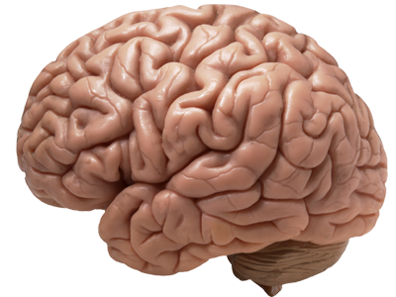
Effects of
Sleep Deprivation on the Brain
Group 3: Aaliya, Elena, Henry, Manvir, Supreet

Slide 2
Statistics on Sleep Deprivation
Who and how many are affected?

Slide 3
WHO IS SLEEP DEPRIVED?
60% of adults feel tired and report only sleeping on average of 6.9 hours/ night
40% of Canadian children sleep <6 hours/night
30% of Canadian adults sleep < 6 hours a night
Notes:
http://www.cbc.ca/news/health/lack-of-sleep-called-global-epidemic-1.991855

Slide 4
What is Sleep Deprivation?
What happens when we don’t sleep?

Slide 5
SLEEP DEPRIVATION
Partial Sleep Deprivation
Total Sleep Deprivation
Notes:
Sleep deprivation can occur in two ways. Total sleep deprivation is the complete lack of sleep while partial sleep deprivation is chronically having insufficient sleep or less than 6 hours of sleep a night.

Slide 6
NEGATIVE IMPACTS ON COGNITIVE PERFORMANCE
Alertness
Concentration
Attention
Vigilance
Impair memory
Impair executive functions
Impair psychomotor skills

Slide 7
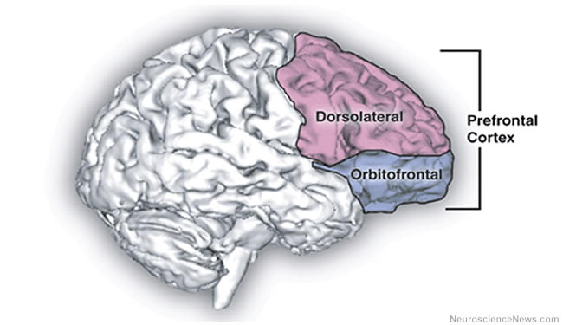
WHAT HAPPENS WHEN WE DON’T SLEEP?
First day: Mesolimbic system stimulated
Dopamine
Energy, mood & libido
Exhaustion exponentially increases
Inactivation of brain regions
Notes:
After the first sleepless night, mesolimbic system becomes stimulated and dopamine is overexpressed. This may result in a slight increase of energy, mood or sex drive. However, the portions of the brain that is responsible for planning and evaluating decisions shut down leading to impulsive behavior. In addition to impulsive behavior, reaction time, perception and cognitive functions are affected once exhaustion starts.

Slide 8
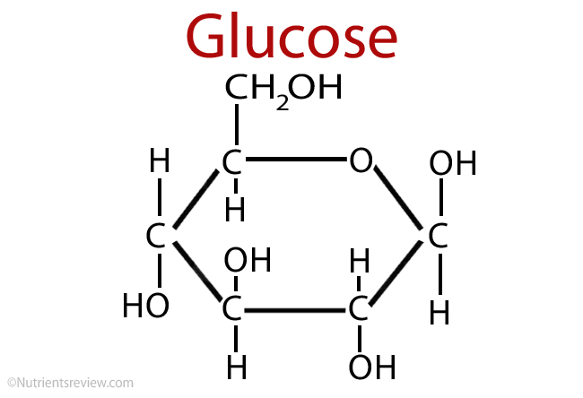
WHAT HAPPENS WHEN WE DON’T SLEEP?
Second day
Third day and onwards
http://www.shutterstock.com/s/psychedelic/search-vectors.html
http://www.chemicalformula.org/glucose
FACT: Longest documented time w/o sleep is 264 hours / 11 days
Notes:
After 2 days without sleep, the body’s ability to metabolize glucose is greatly reduced. Eventually, the continuing sleep deprivation whether it is total sleep deprivation or partial will lead to death. The research showed surprising results. The person who did not sleep for 11 days suffered numerous short term consequences regarding cognitive and physical function along with intense hallucinations however, the subject did not suffer any long term health consequences. But more studies were done and there is a correlation between diseases and insufficient sleep.

Slide 9
Why is Sleep Deprivation Detrimental?

Slide 10
CUMULATIVE EFFECTS OF SLEEP DEPRIVATION
Cells metabolize substrate to yield energy
Many byproducts are left behind
Accumulation of waste products
Increases sleep pressure - adenosine
Need to remove toxins to maintain brain function
How?
Notes:
Scientists believe that the accumulation of waste products in the brain is the cause for the detrimental effects of sleep deprivation. During the waking hours, the cells of the human body are constantly metabolizing substrate in order to provide sufficient energy for daily activities. The body breaks down substances into byproducts including adenosine. As adenosine builds up, it increases the body’s urge to sleep. This is also known as sleep pressure. There are other waste products that build up within the brain such as B-amyloid and metabolites of glucose.. The accumulation of the waste products during our waking hours is linked to the negative consequences of sleep deprivation. Sleep is necessary in the removal process of waste accumulation in the brain.

Slide 11
Glymphatic System

Slide 12
GLYMPHATIC SYSTEM
Macroscopic waste clearance system
System of perivascular tunnels (astrocytes)
Distribution system
Glucose, lipids, amino acids, neuromodulators, etc.
Cerebrospinal fluid and Interstitial fluid
Notes:
The glymphatic system is a macroscopic waste clearance system that utilizes a system of perivascular tunnels formed by astroglial cells in order to remove soluble proteins and metabolites from the CNS. In addition to waste eliminiation, the glympatic system also plays a role in the distribution of brain compounds such as glucose, lipids, amino acids, neuromodulators and growth hormones. In the glympatic system, cerebrospinal fluid (CSF) and interstitial fluid (ISF) continuously interchange.

Slide 13
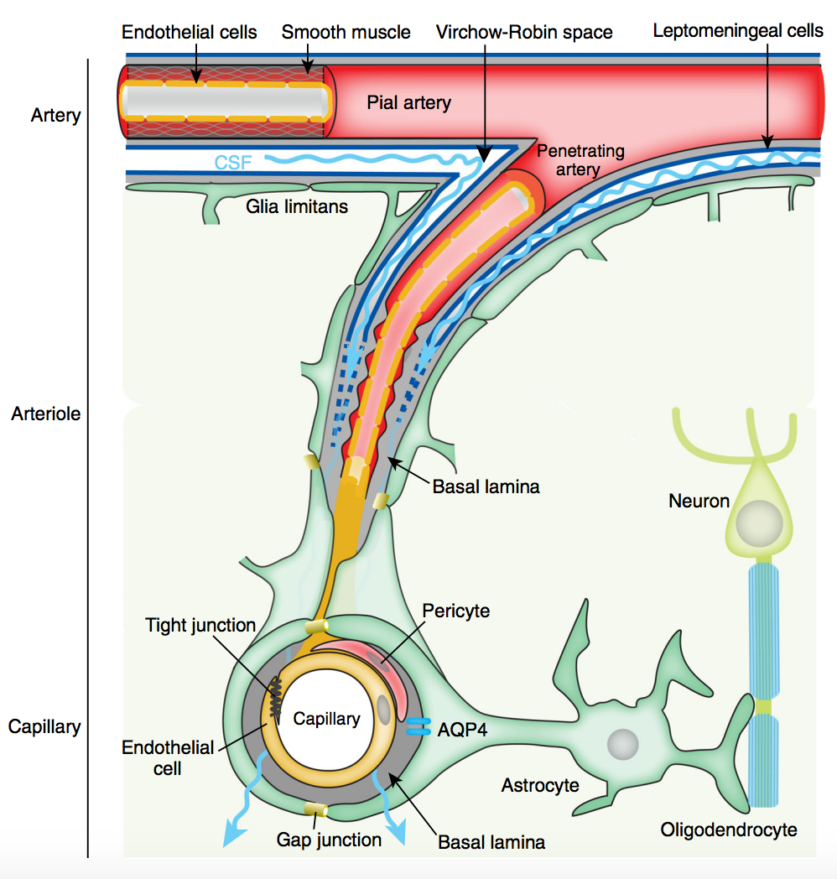
GLYMPHATIC SYSTEM PHYSIOLOGY
Subarachnoid space
CSF is the main fluid that travels throughout brain to remove toxins
Virchow-Robin spaces
Perivascular space (basal laminar)
AQP4 Water channels (Astrocyte end-feet)
Jessen et al., 2015.
Notes:
This is facilitated by convective influx of CSF along the periarterial space. CSF is driven from the subarachnoid space into the Virchow-Robin spaces by a combination of arterial pulsatility, respiration, slow vasomotion and CSF pressure gradients. The CSF is then transported into the dense and complex brain parenchyma through AQP4 water channels that is expressed in a highly polarized manner in astrocytic end-feet that surround the brain vasculature. This movement drives convective interstitial fluid fluxes in the tissue towards the perivenous surrounding the large deep veins. The ISF collects in this perivenous space and then drains out of the brain towards the cervical lymphatic system.
Jessen, N. A., Munk, A. S. F., Lundgaard, I., & Nedergaard, M. (2015). The glymphatic system: a beginner’s guide. Neurochemical research, 40(12), 2583-2599.

Slide 14
VIDEO: GLYMPHATIC SYSTEM PHYSIOLOGY
https://www.youtube.com/watch?v=3fb72F3n1xI
Notes:
As you can see in this video, after leaving the AQP4 membrane, this movement drives convective interstitial fluid fluxes in the tissue towards the perivenous surrounding the large deep veins. The ISF collects in this perivenous space and then drains out of the brain towards the cervical lymphatic system.

Slide 15
What Causes
Sleep Deprivation?

Slide 16
ALCOHOL/DRUG DEPENDENCE
Alcohol/Cocaine
Stage 3 Sleep
Slow Wave Sleep (SWS)
Slow (delta) waves + fast waves
REM Sleep

Slide 17
MENTAL DISORDERS
Schizophrenia
=
Severity
REM Sleep

Slide 18
NEURODEGENERATIVE DISEASES
Parkinson’s Disease
http://www.wired.com/
Neurons in basal ganglia
Stability of
REM Sleep
Pre-thalamic fibres in the brain stem
http://www.wired.com/

Slide 19
SLEEP DISORDERS
Zzzz
Obstructive Sleep Apnea
Sleep disturbances due to gasping and choking
5 obstructive sleep events/hour of sleep

Slide 20
SLEEP DISORDERS
Insomnia
Primary Insomnia
Difficulty falling asleep
Awakening during night
Secondary Insomnia
Associated with comorbidities
=
Functionality
Daytime
Sleepiness

Slide 21
Effects of Sleep Deprivation

Slide 22
DIFFERENT KINDS OF DISORDERS
Depression
Diabetes
Obesity
High Blood Pressure
Psychopathological
http://www.nontoxiclivingchoices.com/sleep-deprivation-lowers-testosterone.html

Slide 23
DEPRESSION
Hand and hand with SD
Shortened REM Sleep latency
TSD
Catalyst
Resistance probe
Psychotherapy unlikely
https://www.youtube.com/watch?v=dfXW0cTQYzU

Slide 24
DIABETES
Comfort food
Energy balance/weight gain
Insulin resistance gain
Glucose tolerance loss
Obesity
http://www.slideshare.net/myZeo/sleep-and-health

Slide 25
HEART DISEASE
2x Increased Risk
CVD and hypertension
Lack of Sleep
Higher BP
Decrease sympathetic
Increased risk of HD
http://7bigspoons.com/sleep/activities-bed-increase-risk-high-blood-pressure/

Slide 26
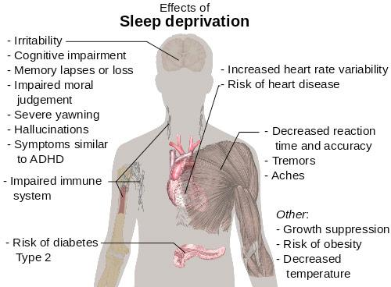
PSYCHOPATHOLOGICAL
Schizophrenic tendencies:
Irritability
Illusions
Visual Hallucinations
Paranoia
http://www.acediabetes.org/2013/06/diabetes-and-sleep/

Slide 27
Sleep Deprivation Research Studies
Notes:
Although scientists continue to debate the purposes and benefits of sleep, one thing is clear: sleep deprivation is really bad for brain function. The first known study about the negative effects of sleeplessness was published in 1896. Since then, hundreds of studies have established that sleep loss impairs various cognitive functions and behavior, including arousal, attention, cognitive speed, memory, emotional intelligence, and decision making. Let’s take a look at a few.

Slide 28
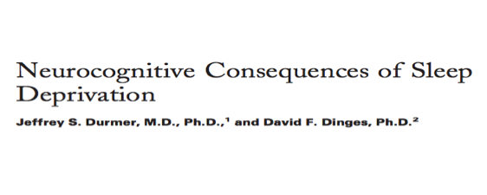
SLEEP DEPRIVATION IS BAD FOR YOU
Major Findings:
Microsleeps, sleep attacks, and lapses in cognition increase
Variable (negative) impact on mood, cognitive performance, and motor function
Executive attention, working memory, and divergent higher cognitive functions are particularly vulnerable to sleep loss
Chronic partial sleep deprivation: neuro-cognitive deficits accumulate over time
Notes:
Microsleeps, sleep attacks, and lapses in cognition increase with sleep loss. There is a variable (negative) impact on mood, cognitive performance, and motor function due to an increasing sleep propensity and destabilization of the wake state. Specific neurocognitive domains including executive attention, working memory, and divergent higher cognitive functions are particularly vulnerable to sleep loss. The neural systems involved in executive function (i.e., prefrontal cortex) are more susceptible to sleep deprivation in some individuals more than others.
Recent chronic partial sleep deprivation experiments, which more closely replicate sleep loss in society, demonstrate that profound neurocognitive deficits accumulate over time in the face of subjective adaptation to the sensation of sleepiness (due to continuously being sleep deprived, individuals start adapting to the feeling of sleepiness in different ways).

Slide 29
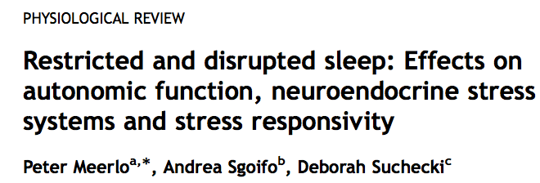
SLEEP DEPRIVATION IS BAD FOR YOU
Major Findings:
Raises activity of major neuroendocrine stress systems: autonomic sympatho-adrenal system, hypothalamic-pituitary- adrenal axis
Alters response of stress systems to new challenges and stressors
May gradually change brain systems involved in regulation of stress responses
Changes brain systems in direction similar to what is seen in mood disorders
Notes:
It is important to question how sleep loss affects the stress systems in our bodies because these systems enable us to deal with everyday challenges. Altered activity and reactivity of these systems following insufficient sleep might have serious repercussions for health and well-being. Studies on both humans and rodents have shown that sleep deprivation and sleep restriction are conditions often associated with mild, temporary increases in the activity of the major neuroendocrine stress systems, i.e., the autonomic sympatho-adrenal system and the hypothalamic-pituitary- adrenal axis. Sleep deprivation may not only have a direct activating effect by itself but, in the long run, it may also affect the reactivity of these systems to other stressors and challenges. The first sign of this change in the way people deal with challenges under conditions of restricted sleep appear to be on the level of emotional perception. Chronic sleep restriction may ultimately change the fundamental properties of neuroendocrine stress systems as well. E.g. reduction in the number or sensitivity of corticotropin-releasing hormone receptors and serotonin receptors

Slide 30
SLEEP DEPRIVATION: EFFECT ON ACADEMIC PERFORMANCE
Major Findings:
60% of students reported engaging in a single night of total sleep deprivation once or more
Associated with later self-reported bedtimes, evening preference, poorer academic achievement (measured by GPA)
Notes:
This study evaluated the self-reported patterns, motivations, and correlates of engagement in a single night of total sleep deprivation (SN-TSD) in a sample of 120 university students at a 4-year liberal arts college. They self-reported usual bedtime, rise time, and total sleep time. Students’ cumulative grade point averages (GPAs) were also obtained; these were reported from the university registrar. Sixty percent of students surveyed reported engaging in SN-TSD once or more since coming to college.
Engagement in SN-TSD was associated with later self-reported bedtimes, evening preference, and poorer academic achievement as measured by GPA.

Slide 31
SLEEP DEPRIVATION: EFFECT ON ACADEMIC PERFORMANCE
Major Findings:
Sleep quality and quantity effects on student’s life:
Increased daytime sleepiness
Impaired mood
Neurocognitive deficits
Behavioural changes
Possibility of improvement in neurocognitive function through use of healthy sleep schedules
Notes:
Sleep quality and quantity induce several effects on a student's life: increased daytime sleepiness, impaired mood, neurocognitive deficits and behavioural changes. Studies in which sleep was actively restricted or optimized showed, respectively, a worsening and an improvement in neurocognitive and academic performance: this raises the possibility of an improvement in neurocognitive functioning (and thus of learning capacity and academic performance) as a consequence of healthy sleep schedules.

Slide 32
Sleep deprivation is BAD for you.
GOOD?
Notes:
We’ve all heard about the detrimental impacts of sleep deprivation. But could sleep deprivation be beneficial?

Slide 33
SLEEP DEPRIVATION: AN UNCONVENTIONAL TREATMENT FOR DEPRESSION
Major Findings:
Therapeutic sleep deprivation (SD): fast-acting antidepressant intervention that leads to a rapid decrease of depressive symptoms in 50-60% of patients MDD
Effect is temporary
Improves clinical symptomatology that is related to impaired associative synaptic plasticity MDD
Underlying molecular mechanisms:
BDNF, adenosine, monoaminergic system, glutametergic system
Notes:
Therapeutic sleep deprivation (SD) is a fast-acting anti- depressant intervention that leads to a rapid decrease of depressive symptoms in 50-60% of patients with major depressive disorder (MDD). Improves clinical symptomatology that is related to impaired associative synaptic plasticity in MDD. This effect is temporary, only lasting until you fall asleep.
Neuronal plasticity or remodeling is a fundamental process by which the brain acquires information and makes the appropriate adaptive responses in future-related settings. Dysfunction of these fundamental processes could thereby contribute to the pathophysiology of mood disorders, and recovery could occur by induction of the appropriate plasticity or remodeling. These possibilities are supported by preclinical and clinical studies demonstrating that there are structural alterations that occur in response to stress and in patients with mood disorders, such as Major Depressive Disorder. In the case of this study, prolonged wakefulness shifts the initially deficient inducibility of associative synaptic long-term potentiation in patients with MDD in a more favorable window of associative plasticity (basically improves neuro plasticity in people with depression) (extra info: long-term potentiation (LTP) is a persistent strengthening of synapses based on recent patterns of activity. These are patterns of synaptic activity that produce a long-lasting increase in signal transmission between two neurons As memories are thought to be encoded by modification of synaptic strength LTP is widely considered one of the major cellular mechanisms that underlies learning and memory)
Potential underlying molecular mechanisms:
Brain Derived Neurotrophic Factor -- play a key role in synaptic plasticity in the adult brain. Decreased BDNF expression is associated with reduced synaptic plasticity and neuronal atrophy [69], while increased BDNF expression is associated with neuronal survival and differentiation
BDNF levels increase with prolonged periods of wakefulness, facilitate associative synaptic plasticity, and might provide a mo- lecular mechanism for the clinical improvement after therapeutic sleep deprivation in MDD.
Adenosine: Adenosine is important in sleep regulation, and its absence has also been implicated in a greater risk for depression. Adenosine release is increased the longer you're awake (to a point), making you feel less aroused and more tired, and acting as part of your normal sleep-wake cycle. A beneficial side effect of its release now also appears to be an alleviation of depressive symptoms. Several animal studies suggest that activation of adenosine A1 receptors in the brain has an antidepressant effect.
Monoaminergic: The therapeutic effects of SD are comparable to the rapid onset of mood changes after the treatment with psychostimulants. Psy- chostimulants increase the release of all monoamines or inhibit the reuptake of these neurotransmitters, leading to the net effect of increased synaptic dopamine, noradrenaline and serotonin.
Glutamatergic System: Under physiological conditions, glutamate has a prominent role in synaptic plasticity, learning and memory. Therapeutic sleep deprivation may have various effects on glutamate transmission.

Slide 34
Treatments

Slide 35
SLEEP
Chronic - occurring consistently for a period of time
Extend nightly sleep hours
Additional naps
Acute-Single occurrence
Ex. All-nighter
Single night of 8 hours sleep
https://www.psychologytoday.com/blog/shadows-in-the-sun/201404/the-healing-power-sleep

Slide 36
STAY ACTIVE
Effective during periods of minor sleep deprivation
Periods of activity help increase alertness based on multiple sleep latency testing (MSLT) results
Ex. 5 min walk improves excessive daytime sleepiness
http://www.eprojectconsult.com/casa/youth-in-action/past-youth-projects/

Slide 37
BRIGHT LIGHT
Time-specific exposure to bright light impacts circadian rhythm
Pattern of bodily functions timed to day-night cycle
Especially effective for seasonal affective disorder (SAD) and circadian rhythm sleep disorder
May increase awakeness if sleep deprived
http://www.dreamstime.com/illustration/light-bulb.html

Slide 38
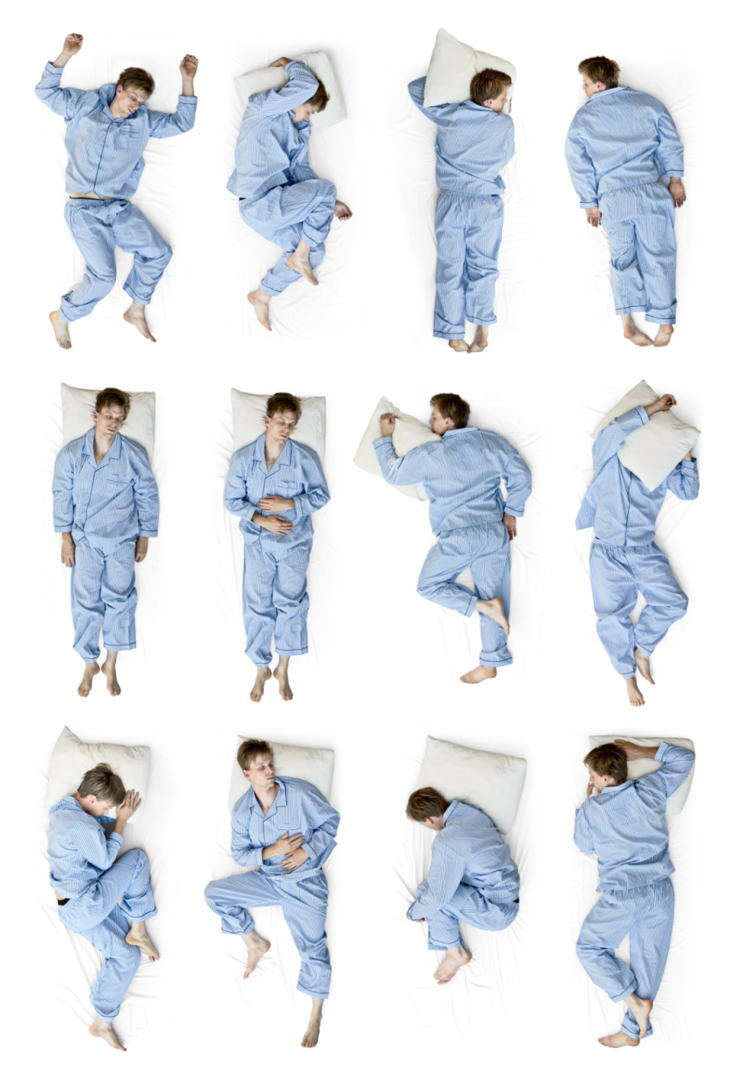
Novel Stimuli (Noise)
+
Improper Posture
=
Lack of Sleep
http://premierhealthchiropractic.com/

Slide 39
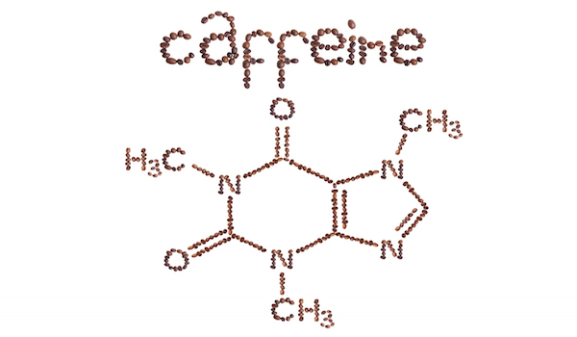
STIMULANTS
Caffeine = naturally occurring stimulant
Found in coffee, tea, chocolate
Increases alertness
Minor side effects (headache, tremor)
Prescription Drugs
Ex. methylphenidate, modafinal
Harmful side effects
Reserved for narcolepsy or ADHD
http://www.stuffyoushouldknow.com/podcasts/the-duality-of-caffeine/

Slide 40
SLEEP HYGIENE TIPS
DOs
DON’Ts
http://yourmedguide.com/2014/10/100-reasons-make-exercise-habit.html
https://www.unitedadlabel.com/no-caffeine-nutrition-communication-labels-1-1-4-x-5-16
http://www.2healthcare.net/tips-on-eating-healthy-good-health-starts-in-cooking/
https://www.sciencedaily.com/releases/2014/12/141222131348.htm

Slide 41
Get Some Zzzz’s

Slide 42
REFERENCES
Aguirre, C. (2015, November 15). What would happen if you didn’t sleep? – Claudia Aguirre [Video File]. Retrieved from
http://ed.ted.com/lessons/what-would-happen-if-you-didn-t-sleep-claudia-aguirre
Altevogt, B. M., & Colten, H. R. (Eds.). (2006). Sleep Disorders and Sleep Deprivation: An Unmet Public Health Problem. National Academies Press.
National Academies Press.
Christensen, J. A. E., Jennum, P., Koch, H., Frandsen, R., Zoetmulder, M., Arvastson, L., ... & Sorensen, H. B. D. (2016). Sleep stability and transitions in
patients with idiopathic REM sleep behavior disorder and patients with Parkinson’s disease. Clinical Neurophysiology, 127(1), 537-543.
Cohrs, S. (2008) Sleep disturbances in patients with schizophrenia: impact and effect of antipsychotics. CNS Drugs, 22, 939–962.
Curcio, G., Ferrara, M., & De Gennaro, L. (2006). Sleep loss, learning capacity and academic performance. Sleep Medicine Reviews, 10(5), 323-337.
Durmer, J. S., & Dinges, D. F. (2005). Neurocognitive Consequences of Sleep Deprivation. Seminars in Neurology, 25(01), 117-129.
Epstein, L. J., Kristo, D., Strollo Jr, P. J., Friedman, N., Malhotra, A., Patil, S. P., ... & Weinstein, M.D. (2009). Clinical guideline for the evaluation,
management and long-term care of obstructive sleep apnea in adults. Journal of Clinical Sleep Medicine, 5(3), 263-276.
Irwin, M. R., Bjurstrom, M. F., & Olmstead, R. (2016). Polysomnographic Measures of Sleep in Cocaine Dependence and Alcohol Dependence:
Implications for Age‐Related Loss of Slow Wave, Stage 3 Sleep. Addiction.
Jessen, N. A., Munk, A. S. F., Lundgaard, I., & Nedergaard, M. (2015). The glymphatic system: a beginner’s guide. Neurochemical Research, 40(12),
2583-2599.
Knutson, K. L., Spiegel, K., Penev, P., & Van Cauter, E. (2007). The metabolic consequences of sleep deprivation. Sleep Medicine Reviews, 11(3), 163-178.
Lee-Iannotti, J. K., & Parish, J. M. (2016). Suvorexant: a promising, novel treatment for insomnia. Neuropsychiatric Disease and Treatment, 12,
491–495.
Luby, E. D., Grisell, J. L., Frohman, C. E., Lees, H., Cohen, B. D., & Gottlieb, J. S. (1962). Biochemical, psychological, and behavioral responses to sleep deprivation. Annals of the New York Academy of Sciences, 96(1), 71-79.

Slide 43
REFERENCES
Feature, M. J. (2005, June 29). How to Sleep Better: Sleep Deprivation Solutions. Retrieved March 30, 2016, from http://www.webmd.com/sleep-disorders/features/sleep-hygiene
Lustberg, L., & Reynolds, C. F. (2000). Depression and insomnia: questions of cause and effect. Sleep medicine reviews, 4(3), 253-262.
McEwen, B. S., & Karatsoreos, I. N. (2015). Sleep deprivation and circadian disruption: stress, allostasis, and allostatic load. Sleep Medicine
Clinics, 10(1), 1-10.
Meerlo, P., Sgoifo, A., & Suchecki, D. (2008). Restricted and disrupted sleep: effects on autonomic function, neuroendocrine stress systems and
stress responsivity. Sleep Medicine Reviews, 12(3), 197-210.
Naitoh, P., Kelly, T. L., & Englund, C. (1990). Health effects of sleep deprivation (No. NHRC-89-46). NAVAL HEALTH RESEARCH CENTER SAN DIEGO CA.
Peters, B. (2016, January 27). What Is the Treatment for Sleep Deprivation? Retrieved March 30, 2016, from http://sleepdisorders.about.com/od/sleepdisorderstreatment/ss/What-Is-The-Treatment-For-Sleep-Deprivation.htm
Plog, B. A., Dashnaw, M. L., Hitomi, E., Peng, W., Liao, Y., Lou, N., ... & Nedergaard, M. (2015). Biomarkers of traumatic injury are transported
from brain to blood via the glymphatic system. The Journal of Neuroscience, 35(2), 518-526.
Taskar, V., & Hirshkowitz, M. (2003). Health effects of sleep deprivation. Clinical Pulmonary Medicine, 10(1), 47-52.
Thacher, P. V. (2008). University students and the “All Nighter”: Correlates and patterns of students' engagement in a single night of total sleep
deprivation. Behavioral Sleep Medicine, 6(1), 16-31.
Wolf, E., Kuhn, M., Norman, C., Mainberger, F., Maier, J. G., Maywald, S., ... & Riemann, D. (2016). Synaptic plasticity model of therapeutic sleep
deprivation in major depression. Sleep Medicine Reviews, 30, 53-62
Zepelin H, Siegel JM, Tobler I. Mammalian sleep. In: Kryger MH, Roth T, Dement WC, editors. Principles and Practice of Sleep Medicine. 4th ed.
Philadelphia: Elsevier/Saunders; 2005. pp. 91–100

