Slide 1
OBESITY
LIFE SCI 4M03
GROUP 1
FARUK ALAGIC
AYESHA ASAF
AISHA MOHAMED
MEGAN VIERHOUT
DAN ZAMFIR

Slide 2
Clinical Definition of Obesity
Obesity is the excessive or abnormal accumulation of fat in adipose tissue which leads to the impairment of health.
(Ofei, 2005)

Slide 3
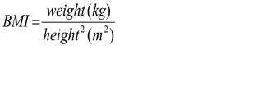
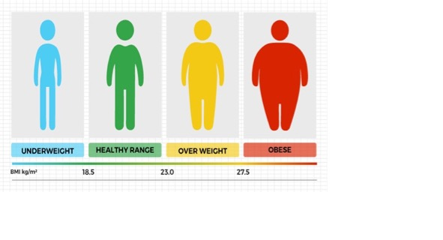
Body Mass Index (BMI)
https://2o42f91vxth73xagf92zhot2-wpengine.netdna-ssl.com/blog/wp-content/uploads/sites/4/2017/07/Chart.jpg
(Nuttall, 2015)

Slide 4
BMI
Pros
Cons
Simple
Inexpensive
Noninvasive
Unable to differentiate between lean and fat body mass
Overestimates health risks for some
(Nuttall, 2015)

Slide 5
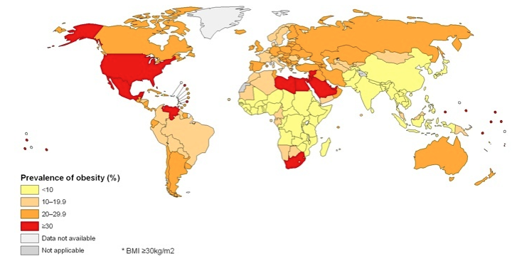
Epidemiology
25% of Canadians are obese
25% of Ontarians are obese
Hamilton is 5th most obese city in Canada
Affects 30% of world’s population
990 million obese individuals globally
Lower than 6% in Korea & Japan
Greater than 30% in USA & Mexico,
https://www.hsph.harvard.edu/obesity-prevention-source/map-of-global-obesity-trends/
(World Health Organization, 2017; Statistics Canada, 2017)

Slide 6
If obesity is a detrimental condition, then why is it still prevalent?

Slide 7
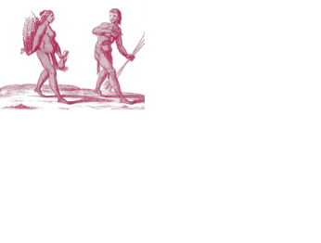
Food wasn’t always so abundant!
We are stone-age hunter/gatherers living in a modern world
Haven't adapted to modern conditions where food is abundant
https://www.thoughtco.com/complex-hunter-gatherers-170428
(Brown & Konner, 1987; Eaton, Konner & Shostak, 1988)

Slide 8
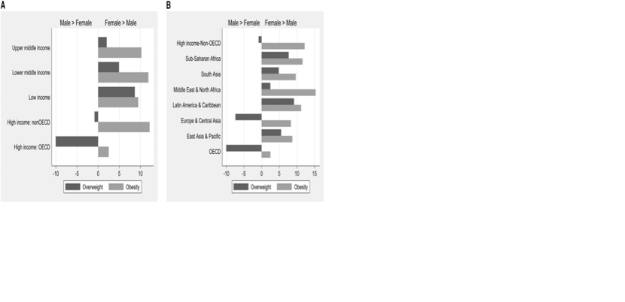
Obesity and Gender
WHY?
(Kanter & Caballero, 2012)

Slide 9
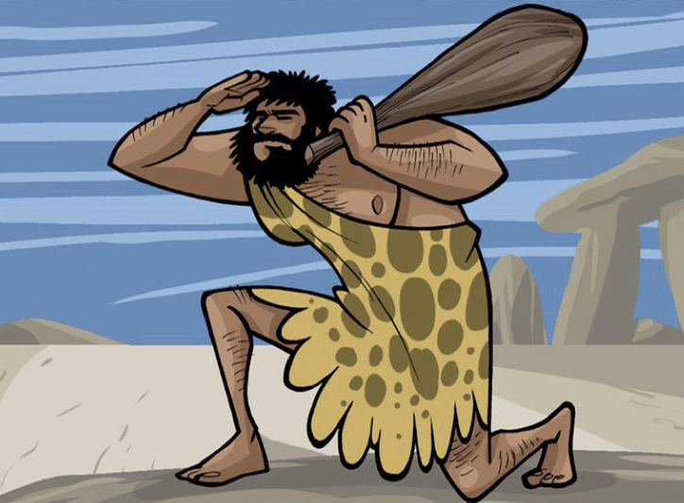

Obesity and Gender
Men
  Hunters
  Lead to a selection of greater muscle mass
Women
  Gatherers, primary caregiver
  Lead to selection for increased fat
http://www.cavemenworld.com/explore/the-life-of-a-hunter-gatherer/
http://historyofeating.umwblogs.org/files/2011/11/hunter-gatherer2.jpg
(Brown & Konner, 1987; Eaton, Konner & Shostak, 1988)

Slide 10
PATHOPHYSIOLOGY

Slide 11
Macronutrients vs Micronutrients
Energy providing nutrients
Needed in larger amounts
    Carbohydrate
    Fats
    Proteins
Allow for chemical reactions
Needed in smaller quantities
      Vitamins
      Minerals
IN OBESITY
(FAO, n.d.)

Slide 12
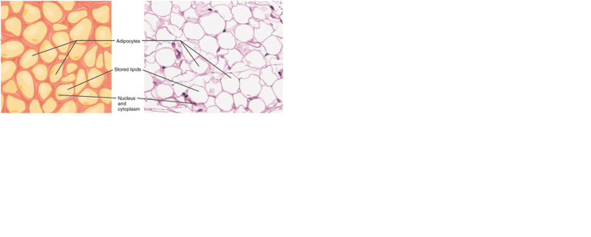
Adipose Tissue
Composed of adipocytes
Endocrine organ responsible for energy storage
https://www.lecturio.com/magazine/various-types-of-tissue/
(Balistreri, Caruso & Candore, 2010)

Slide 13
Adipogenesis
Involves differentiation of pre-adipocytes into mature adipocytes
Differentiation requires expression of specific transcription factors
Promote Adipogenesis | Inhibit Adipogenesis
AP-1 family PPARy STATs KLF family SREBP-1 C/EBP family | Pref-1 GATA Wnt
(Stephens, 2012)

Slide 14
Adipogenesis and Obesity
Pre-adipocytes can differentiate into mature adipocytes throughout lifetime
Mature adipocytes accommodate for increased storage needs and overnutrition, i.e. obesity
(Stephens, 2012)

Slide 15
Hormones
High calorie food → Brain releases endorphins and enkephalins
Fats and sugars trigger brain in the same way as addictive drugs (i.e. heroin)
Hormone Imbalances in Obesity
Insulin
Ghrelin
Sex hormones
Leptin
(Martindale, 2003; Victoria State Government, 2010; Ahima, 2008)

Slide 16
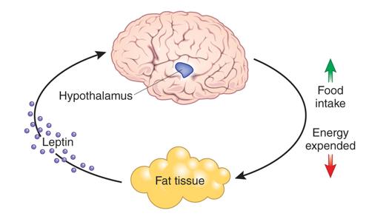
Leptin
https://www.peptideclinics.com.au/wp-content/uploads/2015/01/nm1010-1100-F3.jpg
(Ahima, 2008)

Slide 17
Environmental Factors
High-fat diets
Low levels of physical activity
Increase in food availability
Large portion sizes/“super-sizing”
Rise of fast-food restaurants
Poverty
“Food Desserts”
https://vignette.wikia.nocookie.net/ronaldmcdonald/images/6/60/Supersize.png/revision/latest?cb=20141010025338
(Faith & Kral, 2006)

Slide 18
Genetics
Non-syndromic monogenic obesity | Polygenic obesity
Rare, extreme Results from single gene mutation i.e. Frameshift homozygous mutation in leptin (LEP) gene | More common Small contribution from multiple genetic variations i.e. SNPs in fat mass and obesity-associated (FTO) gene strongly associated with increased BMI, hip circumference, weight gain and risk of childhood obesity
Obesity usually results from a combination of genetics and environmental factors
(Pigeyre et al., 2016)

Slide 19
TREATMENTS

Slide 20
Treatments
EXCERCISE
BEHAVIOUR
DIET
Combination therapy involving dietary, exercise and behavioural modifications is most effective

Slide 21
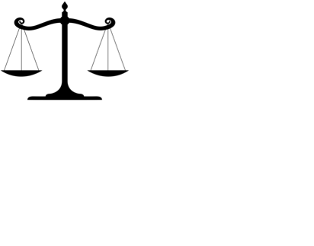
Dietary Modifications
Lower energy intake assists with weight loss
Substitute energy dense foods with nutrient dense foods
  Low Fat Diet
  Low Carb Diet
  High Protein Diet
http://weclipart.com/gimg/8A7FEEF7C4B61AC1/yiogR9j6T.jpeg
(Markis & Foster, 2011)

Slide 22
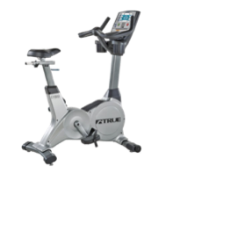
Exercise
Increased energy expenditure leads to a negative energy balance
Aerobic exercise: walking, jogging or rowing
https://www.durstcycle.com/merchant/3137/images/large/back_3_4_left_ues9002.jpg
Studies have proven the effectiveness of exercise for both weight loss as well as secondary effects associated with obesity like cardiovascular disease and high blood pressure
(Ka et al., 2009)

Slide 23
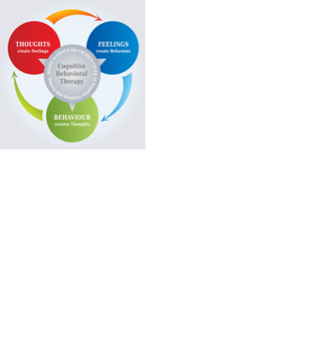
Behavioural Therapy
Maladaptive eating and exercise habits can be modified with specific interventions
Help individuals develop skills to achieve and maintain a healthy body weight
Self-monitoring
Stimulus control
Goal setting
Social support
http://stewartoncbt.co.uk/wp-content/uploads/2011/12/cbt.jpg
(Jacob & Issac, 2012)

Slide 24
Pharmaceuticals
Lipase inhibitors (Orlistat)
Decreases the amount of dietary fats absorbed in your intestines
Orlistat has been shown to result in weight loss of 3-9% of initial weight within a year, when compared to a control.
Appetite suppressant (Phentermine)
Most commonly prescribed
Psychostimulant
Only used for 3 months at a time due to adverse side effects
(Guerciolini, 1997; Yanovski & Yanovski, 2014; Ryder et al., 2017)

Slide 25
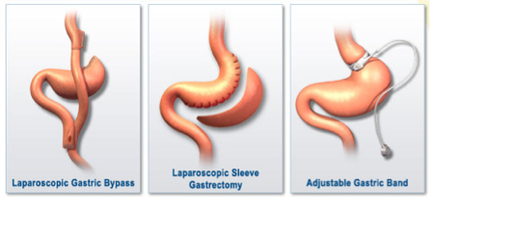
Bariatric Surgery
Decreases the amount of food available in the stomach
Only recommended for individuals with a BMI > 40
Proven results with intense weight loss, recovery from diabetes, CVD and reduction in mortality
http://asamed.net/wp-content/uploads/2017/02/bariatric-surgeries-2.jpg
(Tucker et al., 2018; Robinson, 2009; Colquitt et al., 2014)

Slide 26
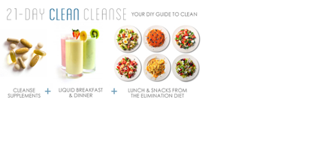

Fad Diets
A diet promising quick weight loss through unconventional techniques
Usually unhealthy and almost always no scientific basis to claims
https://wildroseproducts.com/
(Caulfield, 2015)

Slide 27

The Beverly Hills Diet
“As long as food is fully digested, fully processed through the body, you will not gain weight. It’s only undigested food, food that is “stuck” in your body, for whatever reason, that accumulates and becomes fat.”
“Most enzymes do not work simultaneously… Many cancel one another out in our digestive systems.”
“Enzymes presented in certain fruits make hard to digest foods less fattening.”
http://www.topendsports.com/weight-loss/images/book-beverly-hills.JPG
(Caulfield, 2015)

Slide 28

The Clean Cleanse
Created by Dr. Junger, endorsed by Gwyneth Paltrow on GOOP
21 day diet
Claims
Excessive toxin build up in the body leads to weight gain
Cleanse aims to reduce the digestive load to remove toxins resulting in weight loss
“Adrenal Fatigue”
https://goop.com/wellness/detox/the-beauty-wellness-detox-guide/
(Caulfield, 2015)

Slide 29
Why do people fall for these diets?
CELEBRITY ENDORSEMENT
LACK OF KNOWLEDGE
QUICK FIX
(Caulfield, 2015)

Slide 30
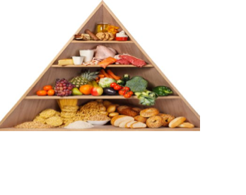
What does work?
Moderate consumption of fats and carbohydrates is best for health
McMaster University study analyzed >135,000 individuals across five continents
3-4 servings of fruits, vegetables and legumes a day with 35% fat consumption associated with lowest risk of early mortality
https://food.ndtv.com/food-drinks/the-ideal-balanced-diet-what-should-you-really-eat-1214286
What we’ve known for years… a balanced diet!
(Dehghan et al., 2017)

Slide 31
Multiple Choice Questions
Which of the following components are within the BMI calculation?
Lean muscle mass
Weight
Height
b and c
All of the above
Which of the following diets has been shown to be the most effective in weight loss?
High Protein
High Fat
High Carb
Balance between protein, fat, and carbs
Just don’t eat

Slide 32
References
Ahima, R. S. (2008). Revisiting leptin’s role in obesity and weight loss. Journal of Clinical Investigation. doi:10.1172/jci36284
Balistreri, C. R., Caruso, C., & Candore, G. (2010). The role of adipose tissue and adipokines in obesity-related inflammatory diseases. Mediators of inflammation, 2010.
Brown, P. J., & Konner, M. (1987). An anthropological perspective on obesity. Annals of the New York Academy of Sciences, 499(1), 29-46.
Caulfield, T. (2015). Is Gwyneth Paltrow Wrong about Everything?: when celebrity culture and science clash. Penguin Canada.
Colquitt, J. L., Pickett, K., Loveman, E., & Frampton, G. K. (2014). Surgery for weight loss in adults. The Cochrane Database of Systematic Reviews, 8(8), CD003641. http://doi.org/10.1002/14651858.CD003641.pub4
Dehghan, M., Mente, A., Zhang, X., Swaminathan, S., Li, W., Mohan, V., ... & Amma, L. I. (2017). Associations of fats and carbohydrate intake with cardiovascular disease and mortality in 18 countries from five continents (PURE): a prospective cohort study. The Lancet, 390(10107), 2050-2062.
Eaton, S. B., Konner, M., & Shostak, M. (1988). Stone agers in the fast lane: chronic degenerative diseases in evolutionary perspective. The American journal of medicine, 84(4), 739-749.
Faith, M. S., & Kral, T. V. (2006). Social environmental and genetic influences on obesity and obesity-promoting behaviors: fostering research integration.
FAO. (n.d.). Macronutrients and Micronutrients. Retrieved January 31, 2018, from http://www.fao.org/elearning/Course/NFSLBC/en/story_content/external_files/Essential_Nutrients.pdf
Guerciolini, R. (1997). Mode of action of orlistat. International Journal of Obesity and Related Metabolic Disorders : Journal of the International Association for the Study of Obesity, 21 Suppl 3, S12-23. Retrieved from http://www.ncbi.nlm.nih.gov/pubmed/9225172
Jacob, J. J., & Isaac, R. (2012). Behavioral therapy for management of obesity. Indian Journal of Endocrinology and Metabolism, 16(1), 28–32. http://doi.org/10.4103/2230-8210.91180
Ka, S., Hc, G., Rourke, O. P., & C, D. M. (2009). Exercise for overweight or obesity ( Review ). Library, 18(1), CD003817. http://doi.org/10.1002/14651858.CD003817.pub3
Kanter, R., & Caballero, B. (2012). Global gender disparities in obesity: a review. Advances in nutrition, 3(4), 491-498.
Lamberton, D. (2016, April 15). What 12 days on the Wild Rose cleanse is really like. Retrieved January 31, 2018, from http://www.chatelaine.com/health/detox-health/what-12-days-on-the-wild-rose-cleanse-is-really-like/
Makris, A., & Foster, G. D. (2011). Dietary approaches to the treatment of obesity. The Psychiatric Clinics of North America, 34(4), 813–27. http://doi.org/10.1016/j.psc.2011.08.004
Martindale, D. (2003, February 1). Burgers on the brain. Retrieved January 31, 2018, from http://scholar.googleusercontent.com/scholar?q=cache:djUYPHLDAgIJ:scholar.google.com/ burgers on the brain&hl=en&as_sdt=0,5
Nuttall, F. Q. (2015). Body mass index: obesity, BMI, and health: a critical review. Nutrition today, 50(3), 117.
Obesity and overweight. (n.d.). Retrieved January 31, 2018, from http://www.who.int/mediacentre/factsheets/fs311/en/
Ofei, F. (2005). Obesity-a preventable disease. Ghana medical journal, 39(3), 98.
Pigeyre, M., Yazdi, F. T., Kaur, Y., & Meyre, D. (2016). Recent progress in genetics, epigenetics and metagenomics unveils the pathophysiology of human obesity. Clinical science, 130(12), 943-986.
Robinson, M. K. (2009). Surgical Treatment of Obesity - Weighing the Facts. New England Journal of Medicine, 361(5), 520–521. http://doi.org/10.1056/NEJMe0904837
Ryder, J. R., Kaizer, A., Rudser, K. D., Gross, A., Kelly, A. S., & Fox, C. K. (2017). Effect of phentermine on weight reduction in a pediatric weight management clinic. International Journal of Obesity, 41(1), 90–93. http://doi.org/10.1038/ijo.2016.185
Statistics Canada. (2017, September 19). Obesity: Guide to the latest information. Retrieved January 31, 2018, from https://www.statcan.gc.ca/eng/help/bb/info/obesity
Stephens, J. M. (2012). The fat controller: adipocyte development. PLoS biology, 10(11), e1001436.
Tucker, O. N., Szomstein, S., & Rosenthal, R. J. (2018). Nutritional Consequences of Weight-Loss Surgery. Medical Clinics, 91(3), 499–514. http://doi.org/10.1016/j.mcna.2007.01.006
Victoria State Government. (2015, January 29). Obesity and hormones. Retrieved January 31, 2018, from https://www.betterhealth.vic.gov.au/health/healthyliving/obesity-and-hormones
Yanovski, S. Z., & Yanovski, J. a. (2014). Long-term drug treatment for obesity: a systematic and clinical review. JAMA : The Journal of the American Medical Association, 311(1), 74–86. http://doi.org/10.1001/jama.2013.281361

