Slide 1
Juvenile Idiopathic Arthritis
Life Science 4M03: Group 2

Slide 2
Overview
Types of Juvenile Arthritis
Symptoms
Risk Factors & Causes
Epidemiology
Pathophysiology
Treatment & Management
Juvenile Idiopathic Arthritis

Slide 3
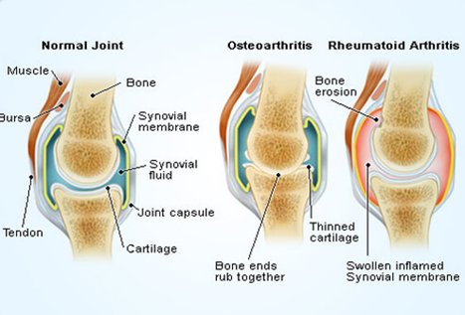
Juvenile Idiopathic Arthritis (JIA) ^{1,2}
http://www.onhealth.com/content/1/rheumatoid_arthritis_ra

Slide 4
Diagnosis

Slide 5
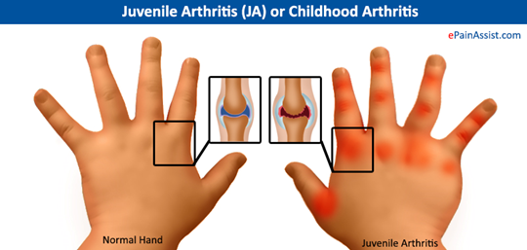
Diagnosis^{2,3,4}
https://www.epainassist.com/images/Juvenile-Arthritis.jpg

Slide 6
Types of Arthritis

Slide 7
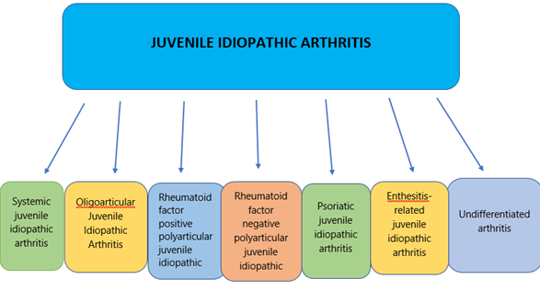
Types of JIA¹

Slide 8
Symptomology

Slide 9
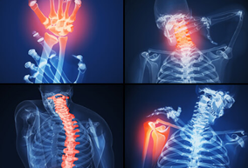
Flares²
http://www.onhealth.com/content/1/rheumatoid_arthritis_ra
Joint pain and inflammation
Lasting time ranges
Remission/ Relapse

Slide 10
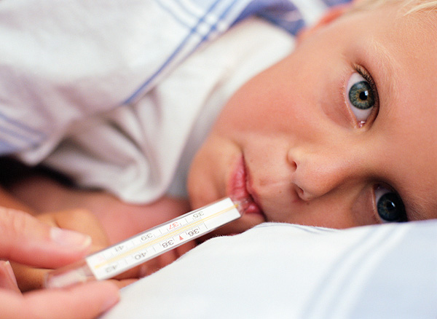
Fever⁴
Identified three ways:
Daily high spike, then returning back down to normal temperatures
Persistent elevation with occasional increase in temperature
Low grade fever with periodic elevation in temperature
https://survivorpediatrics.files.wordpress.com/2012/03/childfever.jpg

Slide 11
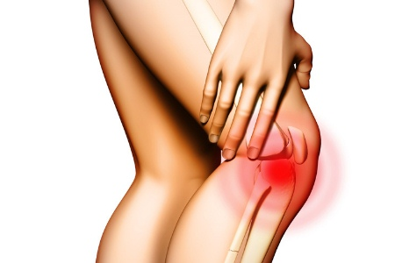
Morning Stiffness⁵
Occurs after night sleep, naps, long periods of sitting
Difficulty in moving muscles
With gradual activity, it fades
Varies in lasting time
Varies in severity
Specific to JIA patients
http://www.findarthritistreatment.com/wp-content/uploads/2013/01/stiffness-and-swelling.jpg

Slide 12
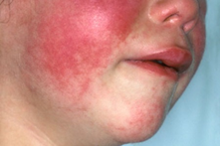
Rheumatoid Rash⁵
Redness in the skin
Spreads to the:
Trunk
Neck
Arms
Inner parts of the thighs
Buttocks
Face
Varies in severity and lasting time
http://www.findarthritistreatment.com/wp-content/uploads/2013/12/Skin-rash.jpg

Slide 13
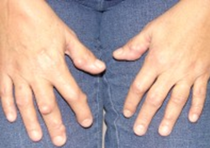
Subcutaneous Nodules⁵
In 10% of children diagnosed with JIA
Vary in size
Hard
Not attached to overlying skin
Found over:
metacarpophalangeal
proximal interphalangeal
distal interphalangeal joints
olecranon process of the elbow
over the anterior tibial surfaces
around the wrists
the tendons of the erector spinae group
over the aponeurosis of the scalp
http://c.ymcdn.com/sites/www.aocd.org/resource/resmgr/ddb/rheumatoid_nodules_1_low.jpg

Slide 14
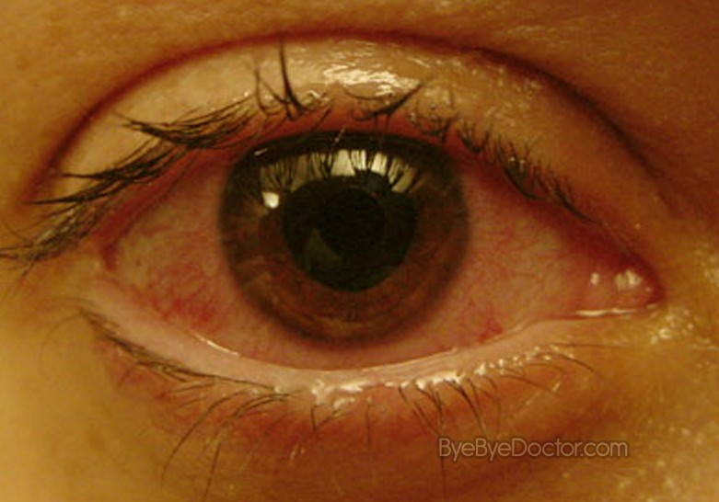
Uveitis⁶
Swelling or irritation of the uvea (middle layer of the eye)
Doesn't always occur with JIA
Symptoms that could arise due to uveitis are:
Red eyes
Eye pain
Vision changes
Sensitivity to light
http://byebyedoctor.com/wp-content/uploads/2011/02/uveitis-4.jpg

Slide 15
Etiology & Risk Factors

Slide 16
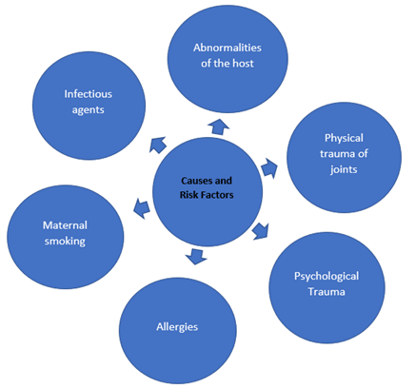
Causes and Risk Factors
Sporadic
Not considered to be a familial disease (except in the place in which there is an onset of pauciarticular arthritis)
Not transmissible

Slide 17
Epidemiology

Slide 18
Epidemiology^{1,9}
4-16 in 10,000 children in North America and Europe
1 in 1000 in the USA, approx 294, 000 children are affected
Females are more affected with JRA than males
In enthesitis-related JIA, males are more affected
ETHNICITY | CHANCES OF GETTING JIA
BLACK | LOW, BUT HIGH CHANCE OF GETTING POLYARTICULAR RHEUMATOID + JIA
INDIAN | LOW
NATIVE AMERICAN | HIGH CHANCE OF GETTING POLYARTICULAR RHEUMATOID + JIA
EUROPEAN | HIGH, EXCEPT FOR OLIGOARTHRITIS
ASIAN | LOW, BUT HIGH CHANCE OF GETTING ENTHESITIS-RELATED JIA
Notes:
Citations:
Juvenile idiopathic arthritis - Genetics Home Reference. (2015, February 14). Retrieved February 20, 2017, from https://ghr.nlm.nih.gov/condition/juvenile-idiopathic-arthritis#diagnosis
Saurenmann, R. K., Rose, J. B., Tyrrell, P., Feldman, B. M., Laxer, R. M., Schneider, R., & Silverman, E. D. (2007). Epidemiology of juvenile idiopathic arthritis in a multiethnic cohort: ethnicity as a risk factor. Arthritis & Rheumatism, 56(6), 1974-1984.

Slide 19
Pathophysiology
Genetic Predisposition
Environmental Risk Factors
Inflammation and Bone Destruction

Slide 20
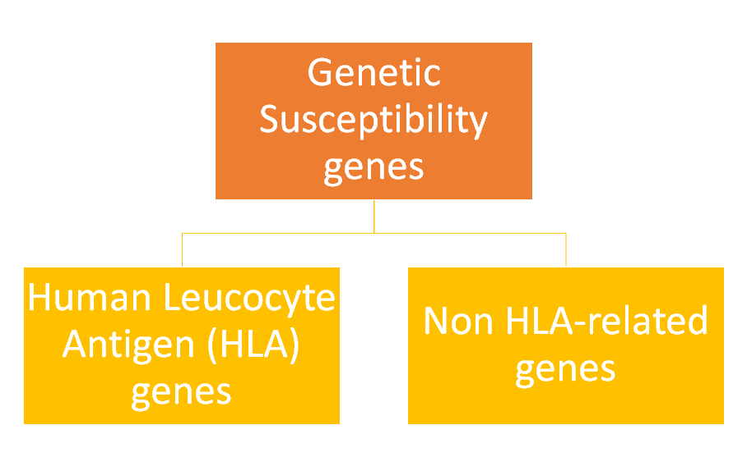
Genetic Susceptibility^{10,11}
Complex genetic trait
Prahalad and Glass, 2008

Slide 21
HLA and non-HLA Genetic Associations¹¹
Several associations between JIA subtypes and different HLA alleles
Non-HLA genes associated with JIA have been independently confirmed
Both tables retrieved from Prahalad and Glass, 2008

Slide 22
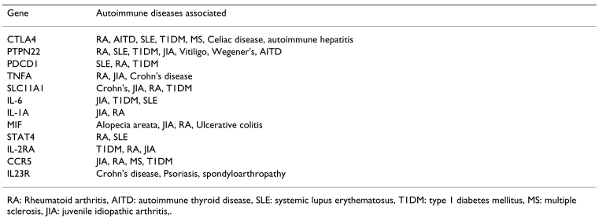
Genetic Variables Underlying Autoimmunity¹¹
Table shows different examples of genes associated with multiple autoimmune diseases (Prahalad and Glass, 2008)
Notes:
.

Slide 23
Twin Studies¹²
Twin and affected sibling pair (ASP) study (Prahalad et al., 2000)
12 monozygotic twins vs 104 non-affected sibling pairs from the National Institute for Arthritis and Musculoskeletal Skin Diseases
Classification | Average time difference for onset of JIA
Twins | 5.5 months
ASP | 37 months

Slide 24
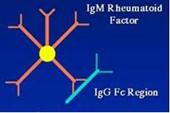
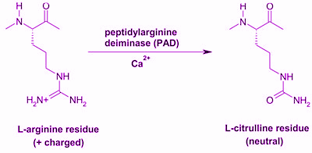
Auto-immunity^{13,14}
Antibodies to Citrullinated Protein Antigens (ACPAs)
Important for the diagnosis of JIA
Patient’s own antibodies are modified = body recognizes the antibodies are foreign
Rheumatoid Factor (RF)
Possible for patients to have JIA without this
Auto-antibody derived from IgM that forms immune complexes
https://www.hopkinsarthritis.org/wp-content/uploads/2012/08/round4-slide-12.jpg
http://www.ifcc.org/ifccfiles/images/e-blu.jpg

Slide 25
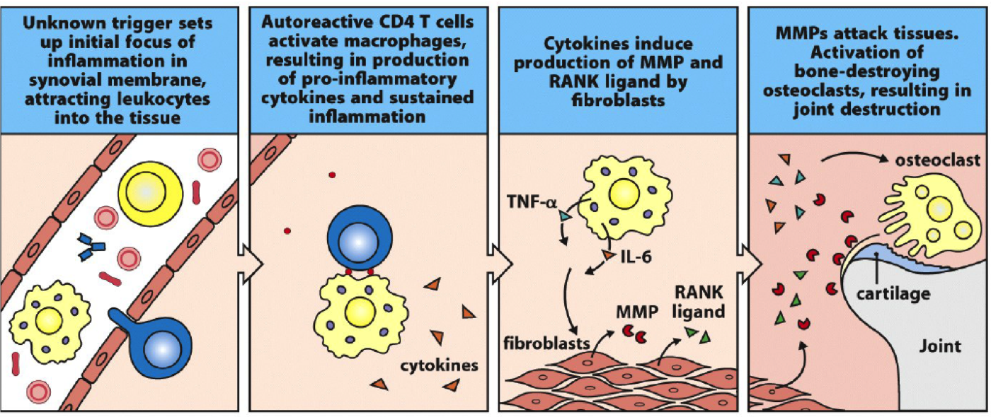
Inflammation and Bone Destruction¹⁵
Fig 15.11 Janeway 8th Ed

Slide 26
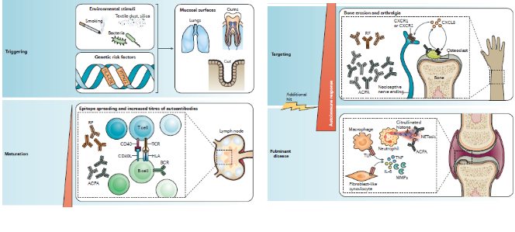
Pathophysiology Overview¹³

Slide 27
Treatments & Management
Drug Therapy
NSAIDs
DMARDs
BRMs
Corticosteroid Injections
Physical Therapy
Physiotherapy
Occupational Therapy
Surgical Procedures

Slide 28
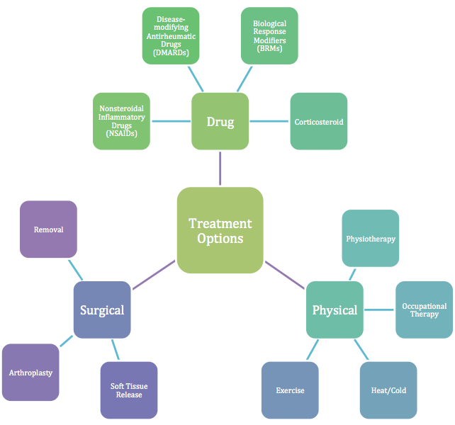
(Ravelli & Martini, 2007)

Slide 29
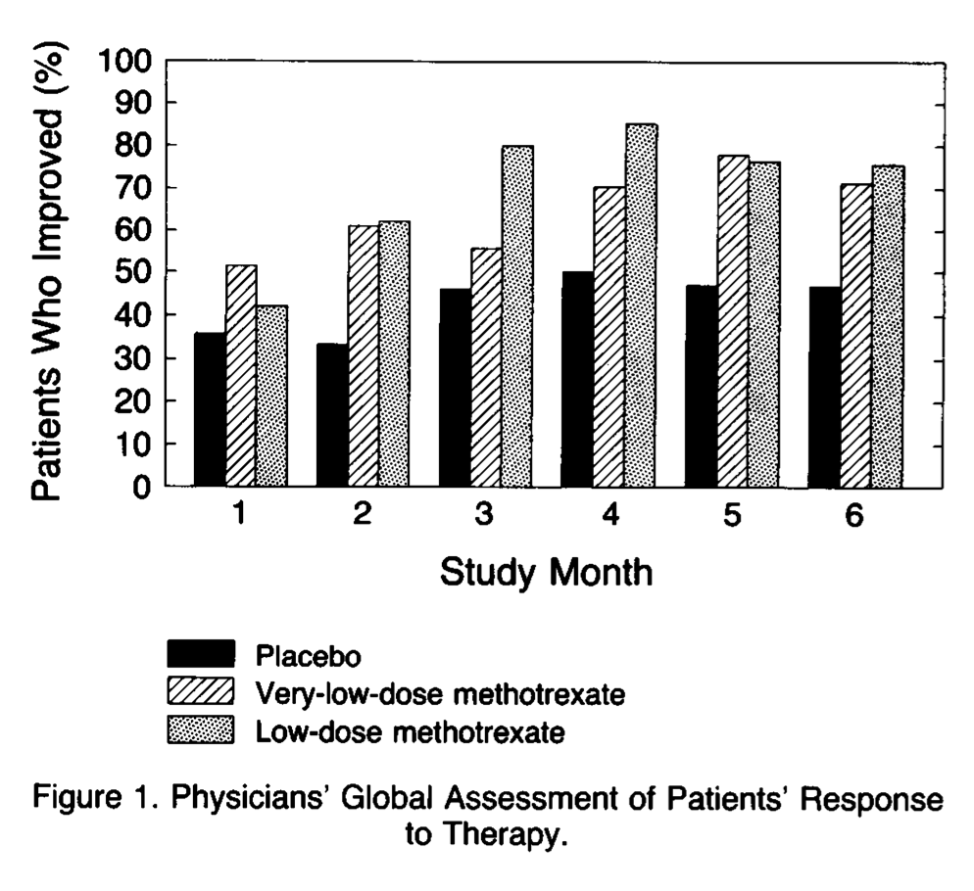
Drug Therapy: NSAIDs & DMARDs^{16,17,18}
Non-steroidal anti-inflammatory drugs (NSAIDs)
First-line drug therapy
Pain and inflammation relief
Ex. ibuprofen and naproxen
Disease-modifying antirheumatic drugs (DMARDs)
Second-line drug therapy
“slow-acting”
Slowing or stopping the immune system from causing inflammation
Ex. methotrexate and leflunomide

Slide 30
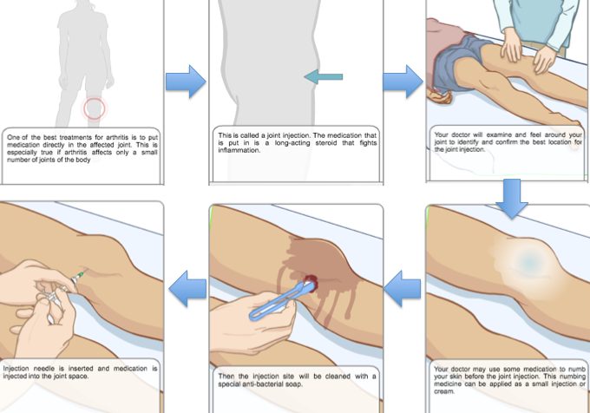
Drug Therapy: BRMs & Corticosteroid Joint Injections^{19,20}
Biological Response Modifiers (BRMs)
Etanercept
Infliximab
Adalimumab
Corticosteroid Joint Injections
http://www.aboutkidshealth.ca/En/ResourceCentres/JuvenileIdiopathicArthritis/TreatmentofJIA/MedicationsforJIA/Pages/CorticosteroidJointInjections.aspx

Slide 31
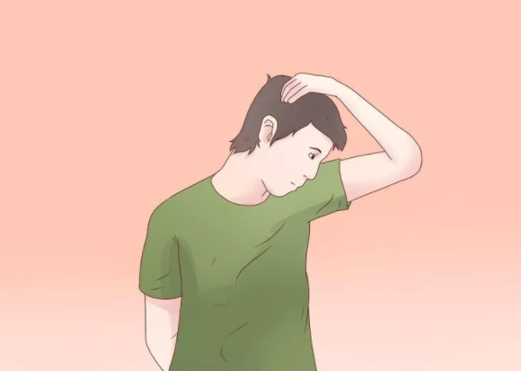
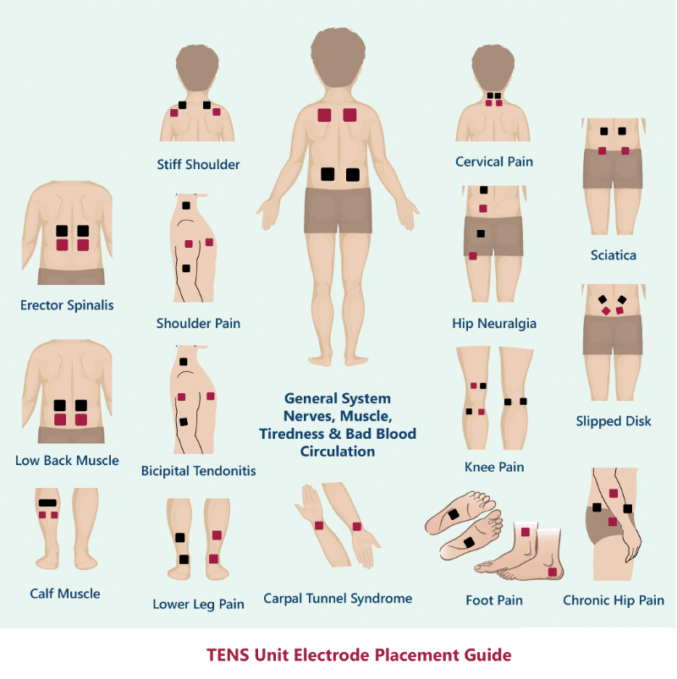
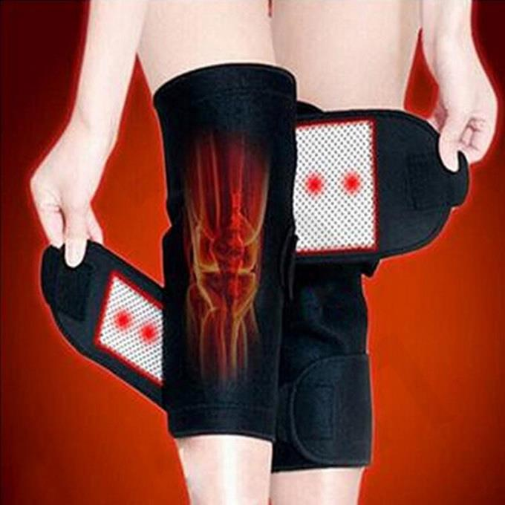
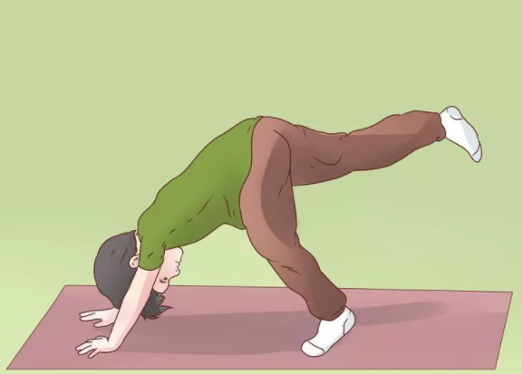
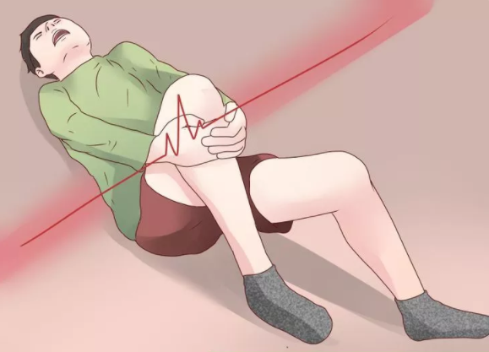
Physical Therapy²⁰
Heat/Cold Therapy Stretching/Exercises Physiotherapy
https://ae01.alicdn.com/kf/HTB17QgFNFXXXXarXpXXq6xXFXXXh/by-DHL-200-Pair-Tourmaline-Self-font-b-Heating-b-font-Kneepad-font-b-Arthritis-b.jpg
http://www.painawaydevices.com/wp-content/uploads/2015/03/How-to-place-your-electrode-pads-1.png
http://www.wikihow.com/Treat-Juvenile-Rheumatoid-Arthritis-with-Exercise

Slide 32
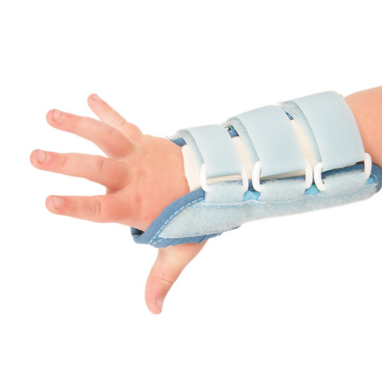
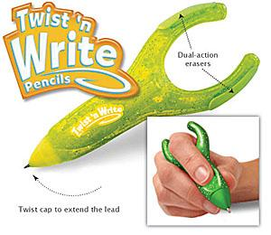
Physical Therapy: Occupational Therapy²⁰
Ergonomic Assistive Devices
Better grasp and control
Less pressure
Splints
Increased range of motion
Decreased contractures, swelling, pain
Ergonomic Pencil
Wrist Splint
http://www.arthritissupplies.com/assets/images/apw0071-twist-n-write-2.jpg
http://www.sportbraceadvies.nl/contents/media/fitzkidz%20polsspalk.jpg

Slide 33
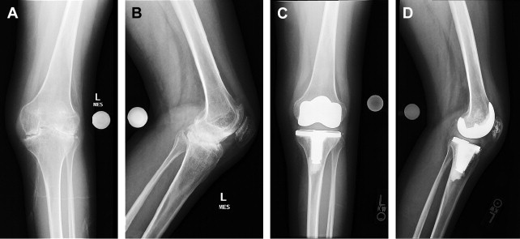
Surgical Treatments^{16,21}
Very Rare
Options:
Soft-tissue release of contractures
Total joint replacement/arthroplasty
Osteotomy
Epiphysiodesis
Synovectomy
Arthrodesis- bone fusion
Total Joint Replacement

Slide 34
Conclusion

Slide 35
Questions?

Slide 36
Reference List
Juvenile idiopathic arthritis - Genetics Home Reference. (2015, February 14). Retrieved February 20, 2017, from https://ghr.nlm.nih.gov/condition/juvenile-idiopathic-arthritis#diagnosis
William C. Shiel Jr., MD, FACP, FACR. (n.d.). Rheumatoid Arthritis (RA) Symptoms & Treatment. Retrieved February 20, 2017, from http://www.onhealth.com/content/1/rheumatoid_arthritis_ra
Nelson, W. E., & Kliegman, R. M. (2016). Nelson Textbook of pediatrics. Philadelphia: Elsevier.
Grossman, B. J., & Mukhopadhyay, D. (1975). Juvenile rheumatoid arthritis. Current problems in pediatrics, 5(12), CO11-65.
Miller, M. L. (1994). Juvenile rheumatoid arthritis. Current problems in pediatrics, 24(6), 190-198.
Goldstein, D. A., Horsley, M., & Ulanski, L. J. (2013). II, Tessler HH. Complications of uveitis and their management. Duane's Ophthalmology.
Schaller, J. G. (1997). Juvenile rheumatoid arthritis. Pediatrics in review, 18, 337-350.
Symmons, D. (2005). Commentary: Juvenile idiopathic arthritis—issues of definition and causation. International journal of epidemiology, 34(3), 671-672.
Saurenmann, R. K., Rose, J. B., Tyrrell, P., Feldman, B. M., Laxer, R. M., Schneider, R., & Silverman, E. D. (2007). Epidemiology of juvenile idiopathic arthritis in a multiethnic cohort: ethnicity as a risk factor. Arthritis & Rheumatism, 56(6), 1974-1984.
Glass, D. N., & Giannini, E. H. (1999). Juvenile rheumatoid arthritis as a complex genetic trait. Arthritis & Rheumatism, 42(11), 2261-2268.
Prahalad, S., & Glass, D. N. (2008). A comprehensive review of the genetics of juvenile idiopathic arthritis. Pediatric Rheumatology, 6(1), 11.
Prahalad, S., Ryan, M. H., Shear, E. S., Thompson, S. D., Glass, D. N., & Giannini, E. H. (2000). Twins concordant for juvenile rheumatoid arthritis. Arthritis & Rheumatism, 43(11), 2611-2612.
Malmström, V., Catrina, A., & Klareskog, L. (2016). The immunopathogenesis of seropositive rheumatoid arthritis: from triggering to targeting. Nature Reviews Immunology, 17(1), 60-75. doi:10.1038/nri.2016.124
Demoruelle, M. & Deane, K. (2011). Antibodies to Citrullinated Protein Antigens (ACPAs): Clinical and Pathophysiologic Significance. Current Rheumatology Reports, 13(5), 421-430. doi:10.1007/s11926-011-0193-7
Janeway, C. & Murphy, K. (2012). Janeway's immunobiology (1st ed.). London: Garland Science.
Juvenile Idiopathic Arthritis - Treatment Overview. (n.d.). Retrieved February 13, 2017, from http://www.webmd.com/rheumatoid-arthritis/tc/juvenile-rheumatoid-arthritis-treatment-overview#1
Brescia, A. C. (Ed.). (2016, April). Juvenile Idiopathic Arthritis. Retrieved February 19, 2017, from http://kidshealth.org/en/parents/jra.html#
Giannini, E. H., Brewer, E. J., & Kuzmina, N. (1990). Arthritis. Journal of Pediatric Orthopaedics, 10(5), 697. doi:10.1097/01241398-199009000-00034
Ungar, W.J., Costa, V., Burnett, H.F., Feldman, B.F., & Laxer, R.M. (2013). The use of biologic response modifiers in polyarticular-course juvenile idiopathic arthritis: A systematic review. Seminars in Arthritis and Rheumatism, 42(6), 597-618.
AboutKidsHealth -JIA Treatment of JIA. (2017). Retrieved February 20, 2017 from http://www.aboutkidshealth.ca/En/ResourceCentres/JuvenileIdiopathicArthritis/TreatmentofJIA/Pages/default.aspx
Abdel, M. P., & Figgie, M. P. (2014). Surgical Management of the Juvenile Idiopathic Arthritis Patient with Multiple Joint Involvement. Orthopedic Clinics of North America, 45(4), 435-442. doi:10.1016/j.ocl.2014.06.002

