Slide 1
Exploring Infertility
Prabhnoor Bhons | Jamyang Choetso | Inderpreet Gill | Ali Hamade | Rajvir Thind

Slide 2
Disease of the reproductive system defined by the failure to achieve a clinical pregnancy
World Health Organization (WHO)

Slide 3
50 - 80 Million
Developed Countries
Canada
People around the world have problems with having a complete integrated family
Infertility rates range from 3.5% to 16.7%
Less developed countries; range is from 6.9% to 9.3%
Prevalence of infertility in 2009-2010 was between 11.5% to 15.7%

Slide 4
Female Infertility

Slide 5
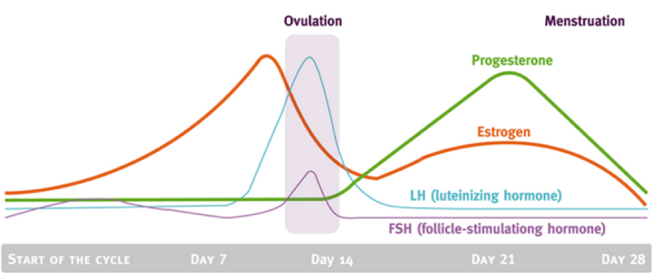
Ovulation
Tubal Obstruction
Disrupted ovulation and lack of menstruation
LH and FSH level imbalance
Fertilization Prevention
Unknown mechanisms for some diseases
Image: https://coconutsandkettlebells.com/training-with-your-menstrual-cycle/

Slide 6
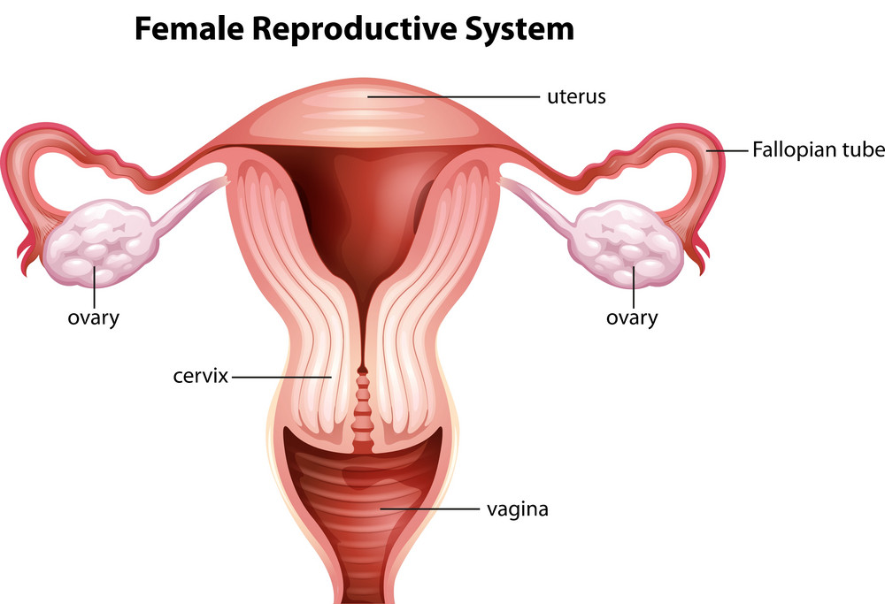
Female Infertility Causes
Ovarian
Tubal
Uterine
Lack of eggs or blockage of ovaries
Most common: PCOS
Hormone imbalance
Fallopian tube blockage or damage
Inhibits oocyte from being transported into the uterine cavity
Most common: endometriosis
Failure of egg implantation in the uterus
Tumors
Abnormal uterus shape
Image: https://www.vectorstock.com/royalty-free-vector/female-reproductive-system-vector-1858352

Slide 7
Male Infertility

Slide 8
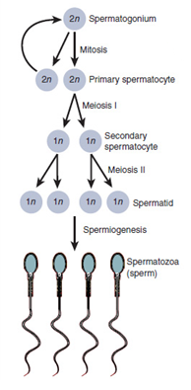
Sperm Formation
Spermatogenesis
Requires multiple organs
Development occurs in the testes
Germ cells
Sertoli Cells: environment, FSH
Leydig: testosterone, LH
Hormones
Follicular-stimulating hormone (FSH)
Testosterone
Image:
http://teachmephysiology.com/reproductive-system/embryology/gametogenesis/

Slide 9
Ejaculation
Movement of sperm
Epididymis →Urethra
Seminal plasma
Semen
Main causes
Growth & Maturation
Ejaculation issues
Low Concentration
Sperm Quality
Image: https://altorahealth.com/male-infertility-causes-and-treatment/

Slide 10
Causes - Medical Issues
Varicocele
Swelling of the veins
Low production
Low quality
Infection
Inflammation of the organs
Effects sperm health
Retrograde Ejaculation
Semen may end up the bladder

Slide 11
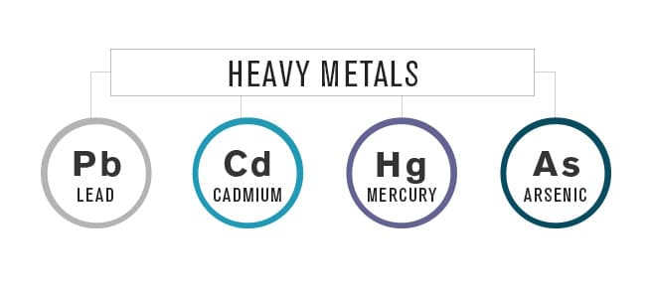
Causes- Environment
Chemicals
Constant exposure
Radiation
X-rays
Heavy Metals
Lead exposure
Image: https://ehsdailyadvisor.blr.com/2017/10/opp-issues-new-guidance-pesticide-resistance/
Image: https://trulyheal.com/how-to-test-for-heavy-metals/

Slide 12
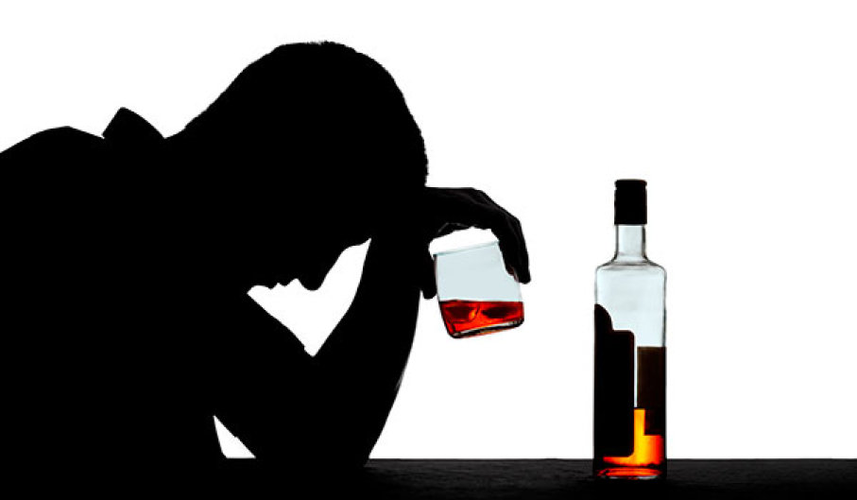
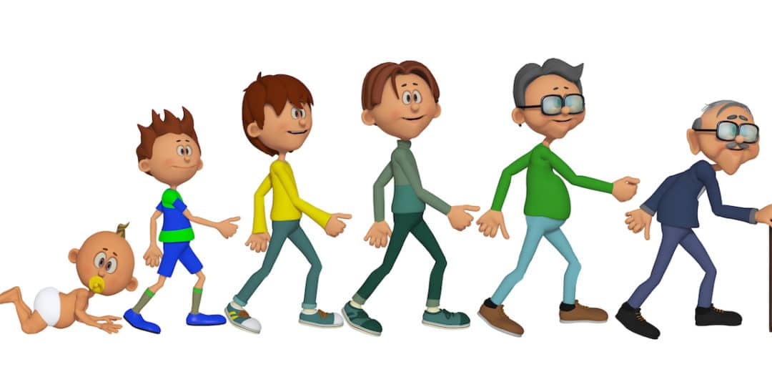
Lifestyle factors affecting both
males and females
Alcoholism
Smoking
Weight
Exercise
Age
Stress
STDs
Unknown
Image: https://www.stuffyoushouldknow.com/podcasts/how-alcoholism-works.htm
Image: https://www.frenchtoday.com/blog/french-grammar/expression-age-in-french-for-people-an-annee

Slide 13
Treatment

Slide 14
Treatment: Male Infertility
Surgical Procedure
Reverse vasectomy
Antibiotics
Bacterial infection
28% successful pregnancy
Hormone pills
Erectile dysfunction
Lack of testosterone
Positive rating of 66%
30% chance of pregnancy success

Slide 15
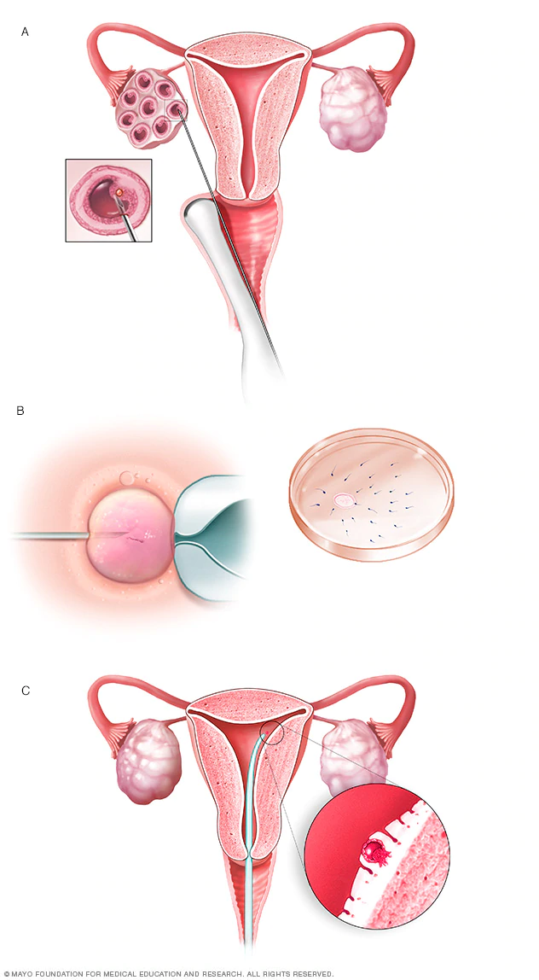
Treatment: Female Infertility
Hormone therapy
Clomiphene citrate: increase LH and FSH
Gonadotropins: increase egg production
Bromocriptine: excess prolactin
Metformin: insulin sensitivity
Surgery
Laparoscopic: remove obstructions
In Vitro Fertilization
Image: https://www.mayoclinic.org/tests-procedures/in-vitro-fertilization/about/pac-20384716

Slide 16
How it Affects People
Females
Males
Economic/Social
Losing “womanhood”
Feelings of pain, sadness, guilt, and loneliness
Face abuse
Stigma and hardships
Secrecy about infertility
Inaccurate media reports about infertility and impotence
Economic burden
Treatments
Losing jobs
Implications exacerbated due lack of support

Slide 17
Conclusion
Infertility affects both men and women.
Women: inability to get pregnant or carry a fetus to full term.
Men: inability to impregnate a fertile female.
Female infertility Factors:
Ovarian, tubal, uterine and lifestyle.
Male infertility Factors:
Medical issues, environmental factors and lifestyle choices
Modern medical science has developed various therapies.
Future therapy: use of stem cells.

Slide 18
Thanks for listening!
Any questions?

Slide 19
References
[1] Bedford, J. M. (1975). Maturation transport and fate of spermatozoa in the epididymis.
[2] Brinster, R. L., & Zimmermann, J. W. (1994). Spermatogenesis following male germ-cell transplantation. Proceedings of the National Academy of Sciences, 91(24), 11298-11302.
[3] Brugo-Olmedo, S., Chillik, C., & Kopelman, S. (2001). Definition and causes of infertility. Reproductive biomedicine online, 2(1), 173-185.
[4] Buchanan, J. F., & Davis, L. J. (1984). Drug-induced infertility. Drug intelligence & clinical pharmacy, 18(2), 122-132.
[5] Bushnik, T., Cook, J. L., Yuzpe, A. A., Tough, S., & Collins, J. (2012). Estimating the prevalence of infertility in Canada. Human reproduction, 27(3), 738-746.
[6] Carmignani, L., Gadda, F., Mancini, M., Gazzano, G., Nerva, F., Rocco, F., & Colpi, G. M. (2004). Detection of testicular ultrasonographic lesions in severe male infertility. The Journal of urology, 172(3), 1045-1047.
[7] Cousineau, T. M., & Domar, A. D. (2007). Psychological impact of infertility. Best Practice & Research Clinical Obstetrics & Gynaecology, 21(2), 293-308.
[8] Crich, J. P., & Jequier, A. M. (1978). Infertility in men with retrograde ejaculation: the action of urine on sperm motility, and a simple method for achieving antegrade ejaculation. Fertility and Sterility, 30(5), 572-576.
[9] De Kretser, D. M. (1997). Male infertility. The lancet, 349(9054), 787-790.
[10] Dierich, A., Sairam, M. R., Monaco, L., Fimia, G. M., Gansmuller, A., LeMeur, M., & Sassone-Corsi, P. (1998). Impairing follicle-stimulating hormone (FSH) signaling in vivo: targeted disruption of the FSH receptor leads to aberrant gametogenesis and hormonal imbalance. Proceedings of the National Academy of Sciences, 95(23), 13612-13617.
[11] Dyer SJ, Abrahams N, Hoffman M, van der Spuy ZM. Men leave me as I cannot have children': women's experiences with involuntary childlessness. Human Reproduction. 2002 Jun 1;17(6):1663-8.
[12] Government of Canada. (2013, February 08). Fertility. Retrieved February 27, 2019, from https://www.canada.ca/en/public-health/services/fertility/fertility.html

Slide 20
References
[13] Hammoud, A. O., Wilde, N., Gibson, M., Parks, A., Carrell, D. T., & Meikle, A. W. (2008). Male obesity and alteration in sperm parameters. Fertility and sterility, 90(6), 2222-2225.
[14] Infertility definitions and terminology.(n.d). Retrieved from https://www.who.int/reproductivehealth/topics/infertility/definitions/en/
[15] Jung, A., & Schill, W. B. (2000). Male infertility. Current life style could be responsible for infertility. MMW Fortschritte der Medizin, 142(37), 31-33.
[16] Khourdaji I, Lee H, Smith RP. Frontiers in hormone therapy for male infertility. Translational andrology and urology. 2018 Jul;7(Suppl 3):S353.
[17] Li, H. Y., & Zhang, H. (2013). Proteome analysis for profiling infertility markers in male mouse sperm after carbon ion radiation. Toxicology, 306, 85-92.
[18] Maduro, M. R., & Lamb, D. J. (2002). Understanding new genetics of male infertility. The Journal of urology, 168(5), 2197-2205.
[19] Manjunath, P., Bergeron, A., Lefebvre, J., & Fan, J. (2007). Seminal plasma proteins: functions and interaction with protective agents during semen preservation. Society of Reproduction and Fertility supplement, 65, 217.
[20] Marberger, H. (1974). The mechanisms of ejaculation. In Physiology and genetics of reproduction (pp. 99-110). Springer, Boston, MA.
[21] Mayo Clinic. (2018, March 08). Female infertility. Retrieved February 25, 2019, from https://www.mayoclinic.org/diseases-conditions/female-infertility/diagnosis-treatment/drc-20354313
[22] Nayernia, K., Li, M., Jaroszynski, L., Khusainov, R., Wulf, G., Schwandt, I., ... & Engel, W. (2004). Stem cell based therapeutical approach of male infertility by teratocarcinoma derived germ cells. Human molecular genetics, 13(14), 1451-1460.
[23] Pasqualotto, F. F., Lucon, A. M., Sobreiro, B. P., Pasqualotto, E. B., & Arap, S. (2004). Effects of medical therapy, alcohol, smoking, and endocrine disruptors on male infertility. Revista do Hospital das Clínicas, 59(6), 375-382.

Slide 21
References
[24] Patel, A. P., & Smith, R. P. (2016). Vasectomy reversal: a clinical update. Asian journal of andrology, 18(3), 365.
[25] Phillip, M., Arbelle, J. E., Segev, Y., & Parvari, R. (1998). Male hypogonadism due to a mutation in the gene for the β-subunit of follicle-stimulating hormone. New England Journal of Medicine, 338(24), 1729-1732.
[26] Practice Committee of the American Society for Reproductive Medicine. (2008). Report on varicocele and infertility. Fertility and sterility, 90(5), S247-S249.
[27] Rodriguez, R., Hernandez, R., Fuster, F., Torres, A., Prieto, P., & Alberto, J. (2001). Genital infection and infertility. Enfermedades infecciosas y microbiologia clinica, 19(6), 261-266.
[28] Rouchou B. Consequences of infertility in developing countries. Perspectives in public health. 2013 May;133(3):174-9.
[29] Roupa, Z., Polikandrioti, M., Sotiropoulou, P., Faros, E., Koulouri, A., Wozniak, G., & Gourni, M. (2009). Causes of infertility in women at reproductive age. Health Science Journal, 3(2).
[30] Saez, J. M. (1994). Leydig cells: endocrine, paracrine, and autocrine regulation. Endocrine reviews, 15(5), 574-626.
[31] Van Waeleghem, K., De Clercq, N., Vermeulen, L., Schoonjans, F. R. A. N. K., & Comhaire, F. (1996). Deterioration of sperm quality in young healthy Belgian men. Human Reproduction, 11(2), 325-329.
[32] Wall, J., & Jayasena, C. N. (2018). Diagnosing male infertility. BMJ, k3202. https://doi.org/10.1136/bmj.k3202
[33] Wallach, E. E., Bronson, R., Cooper, G., & Rosenfeld, D. (1984). Sperm antibodies: their role in infertility. Fertility and Sterility, 42(2), 171-183.
[34] Wischmann T, Thorn P. (Male) infertility: what does it mean to men? New evidence from quantitative and qualitative studies. Reproductive biomedicine online. 2013 Sep 1;27(3):236-43.

