Slide 1
Human Immunodeficiency Virus (HIV)
Prabhnoor Bhons | Jamyang Choetso | Inderpreet Gill | Ali Hamade | Rajvir Thind

Slide 2
History
Origin: Chimps (SIV) through hunting
Patient “zero”: Southeast Cameroon
Oldest case: 1959
HIV-1:
M, N, O
HIV-2:
Less severe
Notes:
HIV is classified into two different groups, HIV-1 and HIV-2. HIV-1 is most commonly found around the world, while HIV-2 is less severe and targets a smaller population.
HIV-1 is found mostly in Africa, but it is present is almost every country. HIV-1 is thought to be transmitted through a Simian immunodeficiency virus (SIV) found in chimpanzees. While the exact origins of HIV are still unknown, one widely accepted theory is that it was passed to humans through hunting. When hunters killed an animal with SIV, it was transmitted to humans through the blood of the chimpanzee. SIV was then mutated to form HIV through multiple cross-species transmissions.
Patient zero is believed to have lived in Western Africa in southeast Cameroon. HIV-1 is classified into three groups, M, N, and O, with group M being found all across the globe. The oldest case of HIV is from 1959, a blood sample was found to have HIV-1 group M.
Recently, most countries have been seeing a decline in HIV rates. Most people with HIV belong low or middle-income families, with lack of access to treatment or are unable to afford it. There is now a World AIDS day on December 1st, created by WHO in 1988, to help raise awareness for HIV/AIDS.

Slide 3
Epidemiology
1981
1982
1986
1987
1994
2017
HIV
AZT
Oral test
ART
First Case of AIDS
AIDS in Canada
AIDS first discovered in USA
Found in 5 gay men in LA
First case of AIDS reported in Canada
Cause behind AIDS is named ‘HIV”
FDA approves first antiretroviral therapy (AZT)
WHO confirms mother-to-infant transmission
Blood test to detect HIV
First oral test for HIV
59% are on ART
1.8 million newly infected
Notes:
The first case of AIDS was in the US in 1981, found in five gay men in Los Angeles.
In Canada, AIDS was first reported in 1982. Initially, HIV was associated with gay men and drug users, however, it is spread through unprotected hetereosexual intercourse in many countries. Through international travel and intercourse, HIV has spread all across the globe.
HIV was first named “HIV” in 1986, and in 1987, FDA approved of the first antiretroviral therapy, zidovudine (AZT), for HIV. In that same year, WHO confirmed mother-to-infant transmission for HIV and a blood test to detect for HIV was also introduced.
In 1994, the first oral test for HIV was introduced.
As of 2017, 59% of people with HIV are now on antiretroviral therapy. Approximately, 37 million people across the globe have HIV - of them, 9 million don’t know that they are infected. It has killed around 35 million people globally, and 1.8 million people become newly infected by HIV in 2017.

Slide 4
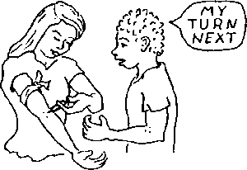
Causes
How is it transmitted?
Unprotected sex
Sharing needles
Mothers to babies
Entering into bloodstream: passage through lining of anus, genitals, mouth, eye, or sores and cuts
Notes:
HIV is a sexually transmitted infection that is caused by unprotected sex. It can also be passed on to babies from their mothers before or during birth and it may also be transmitted during breastfeeding. Although less common, HIV can also be transmitted by sharing needles either syringes or other injecting equipment. Unlike other viruses which spread through the air, HIV is not easily passed from one person to the next. Instead, for HIV transmission there needs to be fluid exchange between someone who has HIV and another person who does not have it.
Some targeted ways for the virus to enter the bloodstream include: direct injection through needles, passage through the lining of the anus, and/or genitals. It may also pass through the lining of the mouth and eyes or from cuts and sores in the skin.

Slide 5
Pathophysiology
Binding and Entry
Gp140 and GP120 bind to CD4+ receptors
CCR5 and CXCR4
Reverse Transcription
Single DNA strand produced
Integration
DNA can enter into the nucleus

Slide 6
Pathophysiology
4. Replication
mRNA synthesizes proteins
5. Budding
Accumulation of proteins
Push through membrane
6. Maturation
HIV protease enzyme splits up mature protein
Reassembles to form mature virus

Slide 7
Pathophysiology
3 principal genes, which are gag, pol, and env
gag: Will help to encode the core proteins
env: Used for the structural components of HIV
Pol: Encode Protease
After 5 days they will infiltrate the lymph nodes
10 million to 10 billion virions produced each day

Slide 8
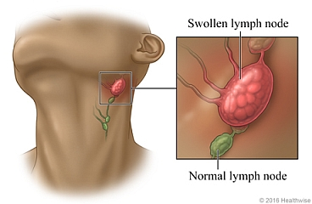
Signs and Symptoms
Acute HIV
Develop a flu-like symptoms within a month or two
Symptoms include:
Fever
Nausea and vomiting
Aching muscles
Sore throat
Chronic HIV
Flu-like symptoms disappear
No specific signs and symptoms at this stage
Some people develop persistent swelling of lymph nodes
This stage of HIV infection generally lasts around 10 years
Notes:
Acute HIV:
Most people infected by HIV develop a flu-like symptoms within a month or two after the virus enters the body (1). This is known as primary or acute HIV infection, which can last for a few weeks.
Possible signs and symptoms include:
Fever
Nausea and Vomiting
Aching muscles
Sore throat
These symptoms can be so mild that you might not even notice them. However, the amount of virus in your bloodstream is quite high at this time (1). As a result, the infection spreads more easily during primary infection than during the next stage.
Chronic HIV:
. After your immune system is unable to battle with HIV, the flu-like symptoms disappear, therefore there are no specific signs and symptoms at this stage. HIV remains in the body and in infected white blood cells (1). During this stage, some people develop persistent swelling of lymph nodes, untreated HIV will be killing CD4 T-cells and destroying the immune system. This stage of HIV infection generally lasts around 10 years if you're not receiving antiretroviral therapy (1). But sometimes, even with this treatment, it lasts for decades.

Slide 9
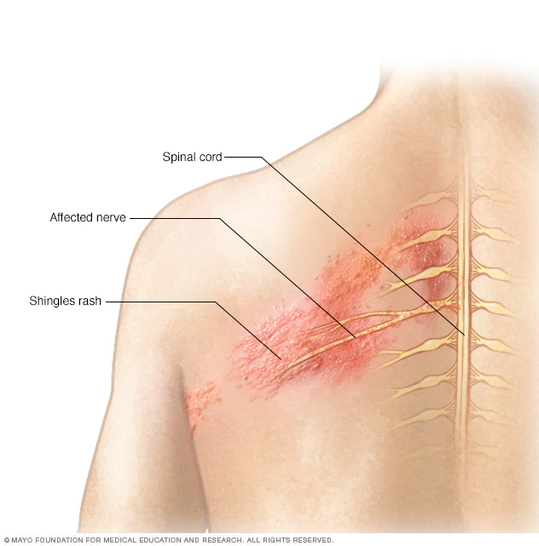
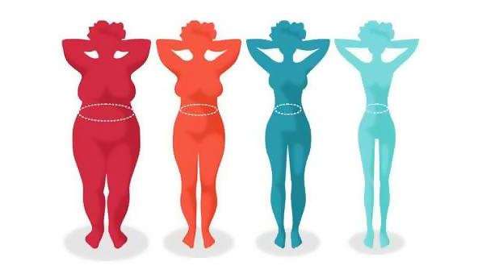
Signs and Symptoms
Symptomatic HIV
As the virus continues to multiply and destroy immune cells, the cells in your body that help fight off germs may develop chronic symptoms such as:
Fever
Swollen lymph nodes
Weight Loss
Oral yeast infection
Shingles
Notes:
As the virus continues to multiply and destroy immune cells, the cells in your body that help fight off germs may develop chronic symptoms such as:
Fever
Swollen lymph nodes — often one of the first signs of HIV infection
Weight loss
Oral yeast infection
Shingles

Slide 10
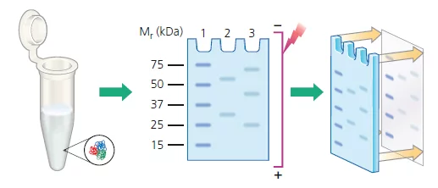
Diagnosis
Enzyme immunoassay (EIA)
common technique that has been adapted for the detection of HIV antibodies
screen large numbers of specimens
two hours
require sophisticated equipment
Rapid Test Devices
qualitative immunoassays
helpful in resource-limited settings
Kit with reagents
Cost-effective
Results in 10-30 minutes
Western Blotting
Multilayer process
HIV antibodies bind to HIV antigens
Changes colour when in contact with the antibody-enzyme layer
Notes:
1. Enzyme immunoassay (EIA)
Enzyme immunoassay is a common immunological technique that has been adapted for the detection of HIV antibodies. EIAs have a high sensitivity and specificity and are able to detect all subtypes of HIV. EIAs screen large numbers of specimens (about 90 or more at a time). An EIA procedure takes around two hours. EIAs require sophisticated equipment, and are technically demanding; automatic pipettes, incubators and a constant electricity supply must be available.
2. Rapid antibody tests are qualitative immunoassays that should be used in combination with the clinical status, history, and risk factors of the person being tested. These assays are helpful to use in resource-limited settings since they can be performed in clinic or community settings and little equipment is required. Most rapid tests are presented as a kit incorporating the reagents. Rapid HIV assays are quick and easy to perform, making them more cost-effective than EIAs. Test results become available within 10–30 minutes.
3. Western Blotting
The WB assay consists of a multilayer process similar to an EIA. HIV antigens are laid out on a strip from the highest in molecular weight to the lowest. When a specimen is incubated with the strip, any existing HIV antibodies bind to these HIV antigens. An antibody–enzyme complex is formed with the addition of the enzyme. Then a chemical is added that changes colour when it comes into contact with the protein–antibody–enzyme layers.

Slide 11
Drugs & Medication
Antiretroviral Therapy (ART)
No cure available
Treatments are very effective
Combination of multiple drugs
WHO
At least 2 or more types of drugs
Taken after diagnosis
Viral load decreases to negligible amounts
Taken for life
Headaches and Mild Dizziness
Liver Damage
Antiviral Resistance
Notes:
There is no cure available for HIV, however the current treatments available allow patients of HIV to live relatively normal lives, relieving the majority of the symptoms. The world health organization recommends Antiretroviral Therapy to treat HIV. Antiretroviral Therapy is not one drug but multiple, consists of 2 or more types of drugs. Once patients receive the diagnosis, it is recommended that patients take Antiretroviral Therapy as soon as possible. It will reduce the Viral load of HIV to undetectable amounts using any of the diagnostic machinery mentioned before and will reduce the risk of spreading the diseases to a a HIV-negative patient by 96%. Unfortunately, the effects of Antiretroviral Therapy is only temporary so it must be taken for life after diagnosis. The side effects of Antiretroviral therapy are very minor usually symptoms include headaches and mild dizziness, however in some cases causes throat swelling or liver damage.
In some cases, the virus can mutate making the current cocktail of drugs the patient is taking uneffective as it develops antibiotic resistance. So patients would need to take a different combination of drugs to maintain the suppression of the symptoms.

Slide 12
Classes of ART medication
Prevents Duplication
NRTI
Blocks RTase
NNRTI
Alters RTase
Protease Inhibitors
Integrase Inhibitors
Protects the Immune system
Fusion Inhibitors
CD4
CCR5 Antagonists
Post attachment inhibitors
Blocks the CD4 receptor
Drug Enhancer
Pharmacokinetic Enhancer
Notes:
There are 8 types of drugs that are part of a ART regime, and they can be classified into 3 classes:
Nucleoside Reverse Transcriptase Inhibitors (NRTI): blocks the reverse transcriptase of the HIV molecule, not allowing the virus to multiply. (National Library of Medicine)
Non-Nucleoside Reverse Transcriptase Inhibitors (NNRTI): binds and then Alters the reverse transcriptase of HIV, preventing the spread of the virus. (National Library of Medicine)
Protease Inhibitors (PI): Blocks the protease of the HIV molecule, preventing the disease to make copies of itself. (National Library of Medicine)
Fusion inhibitors: prevents HIV from infecting CD4 cells of the immune system. (National Library of Medicine)
CCR5 antagonists blocks the receptors of the immune system that HIV needs to bind to in order to infect the immune cells. (National Library of Medicine)
Post attachment inhibitors: blocks CD4 receptors on the surface of certain immune cells stopping HIV from entering the cell. (National Library of Medicine)
integrase Inhibitors: Block the Integrase enzyme needed to replicate the HIV molecule. (National Library of Medicine)
Pharmacokinetic enhancers: Increases the efficacy of the HIV drugs that are part of ART. (National Library of Medicine)

Slide 13
Future Therapeutics
Shock-and-Kill
Reactivating latent virus
Hopes to trigger cell death
Limited research on it
Gene Therapy
Gene editing through CRISPR
Express proteins to modify HIV receptors
immunotherapy
Broadly Neutralizing Antibodies
Maintain viral suppression
Eliminate latently infected cells
Notes:
There are a few new therapies that are being explored. The first therapy is the “shock and kill therapy” which reactivates the latent virus to in hopes to trigger cell death through virus-induced cytolysis or immune-mediated clearance. This has been tested through clinical trials however the number of agents being tested has remained limited. And thus, more research needs to be put into this method before it can be used.
Another therapy is gene therapy through three different strategies. First it targets the proviral genome directly through CRISPR, which is a gene editing technology or through transcriptional silencing. It also targets future HIV infections by expressing proteins that block HIV entry or provided HIV resistance due to modifications on HIV receptors. Lastly it uses immunotherapy-based approaches that are able to bind to specific cells and kill them. A similar approach is currently being being used in cancer clinical trials successfully.
Finally the last approach involves broadly neutralizing antibodies which includes promising agents for the prevention, treatment, and eradication of HIV-1 infection. This is done by maintaining viral suppression or eliminating infected cells. Improvements of this antibody includes increased potency, breadth, plasma half-life and effector function.

Slide 14
References
Ahlenstiel CL, Turville SG. Delivery of gene therapy to resting immune cells for an HIV cure. Current Opinion in HIV and AIDS. 2019 Mar 1;14(2):129-36.
Archin NM, Liberty AL, Kashuba AD, Choudhary SK, Kuruc JD, Crooks AM, Parker DC, Anderson EM, Kearney MF, Strain MC, Richman DD. Administration of vorinostat disrupts HIV-1 latency in patients on
antiretroviral therapy. Nature. 2012 Jul;487(7408):482.
Archin NM, Kirchherr JL, Sung JA, Clutton G, Sholtis K, Xu Y, Allard B, Stuelke E, Kashuba AD, Kuruc JD, Eron J. Interval dosing with the HDAC inhibitor vorinostat effectively reverses HIV latency. The Journal of clinical
investigation. 2017 Aug 1;127(8):3126-35.
Burke BP, Levin BR, Zhang J, Sahakyan A, Boyer J, Carroll MV, Colón JC, Keech N, Rezek V, Bristol G, Eggers E. Engineering cellular resistance to HIV-1 infection in vivo using a dual therapeutic lentiviral vector.
Molecular Therapy-Nucleic Acids. 2015 Jan 1;4:e236.
Causes HIV and AIDS [Internet]. NHS Choices. NHS; 2018 [cited 2019Mar24]. Available from: https://www.nhs.uk/conditions/hiv-and-aids/causes/
Effros RB, Fletcher CV, Gebo K, Halter JB, Hazzard WR, Horne FM, Huebner RE, Janoff EN, Justice AC, Kuritzkes D, Nayfield SG. Workshop on HIV infection and aging: what is
known and future research directions. Clinical infectious diseases: an official publication of the Infectious Diseases Society of America. 2008 Aug 15;47(4):542.
Elliott JH, McMahon JH, Chang CC, Lee SA, Hartogensis W, Bumpus N, Savic R, Roney J, Hoh R, Solomon A, Piatak M. Short-term administration of disulfiram for reversal of latent HIV infection: a phase 2
dose-escalation study. The lancet HIV. 2015 Dec 1;2(12):e520-9.
Elliott JH, Wightman F, Solomon A, Ghneim K, Ahlers J, Cameron MJ, Smith MZ, Spelman T, McMahon J, Velayudham P, Brown G. Activation of HIV transcription with short-course vorinostat in HIV-infected patients
on suppressive antiretroviral therapy. PLoS pathogens. 2014 Nov 13;10(11):e1004473.
Gama L, Koup RA. New-generation high-potency and designer antibodies: role in HIV-1 treatment. Annual review of medicine. 2018 Jan 29;69:409-19.
HIV and AIDS History. (n.d.). Retrieved from https://canfar.com/hiv-and-aids/history-of-hiv/
Ho DD, Neumann AU, Perelson AS, Chen W, Leonard JM, Markowitz M. Rapid turnover of plasma virions and CD4 lymphocytes in HIV-1 infection. Nature. 1995 Jan;373(6510):123.
Kim Y, Anderson JL, Lewin SR. Getting the “kill” into “shock and kill”: strategies to eliminate latent HIV. Cell host & microbe. 2018 Jan 10;23(1):14-26.
Kourtis AP, Bulterys M, Nesheim SR, Lee FK. Understanding the timing of HIV transmission from mother to infant. Jama. 2001 Feb 14;285(6):709-12.
Loussert-Ajaka I, Brun-Vézinet F, Simon F, Ly TD, Chaix ML, Saragosti S, Couroucé AM, Ingrand D. HIV-1/HIV-2 seronegativity in HIV-1 subtype 0 infected patients. The Lancet.
1994 Jun 4;343(8910):1393-4.
Mayo Clinic. (2019, March 30). https://www.mayoclinic.org/diseases-conditions/hiv-aids/symptoms-causes/syc-20373524.
Office of the Commissioner. (2018, May 1). HIV/AIDS History of Approvals - HIV/AIDS Historical TimeLine 1995-1999. Retrieved from https://www.fda.gov/ForPatients/Illness/HIVAIDS/History/ucm151079.htm
Pépin, J. (2013). The origins of AIDS: from patient zero to ground zero. Journal of Epidemiology and Community Health, 67(6), 473–475. https://doi.org/10.1136/jech-2012-201423

Slide 15
References
Rasmussen TA, Tolstrup M, Brinkmann CR, Olesen R, Erikstrup C, Solomon A, Winckelmann A, Palmer S, Dinarello C, Buzon M, Lichterfeld M. Panobinostat, a histone deacetylase inhibitor, for latent-virus reactivation
in HIV-infected patients on suppressive antiretroviral therapy: a phase 1/2, single group, clinical trial. The lancet HIV. 2014 Oct 1;1(1):e13-21.
Seibert SA, Howell CY, Hughes MK, Hughes AL. Natural selection on the gag, pol, and env genes of human immunodeficiency virus 1 (HIV-1). Molecular biology and evolution.
1995 Sep 1;12(5):803-13.
Sharp, P. M., & Hahn, B. H. (2011). Origins of HIV and the AIDS pandemic. Cold Spring Harbor perspectives in medicine, 1(1), a006841. doi:10.1101/cshperspect.a006841
Shaw GM, Hunter E. HIV transmission. Cold Spring Harbor perspectives in medicine. 2012 Nov 1;2(11):a006965.
Simon V, Ho DD, Karim QA. HIV/AIDS epidemiology, pathogenesis, prevention, and treatment. The Lancet. 2006 Aug 5;368(9534):489-504.
Søgaard OS, Graversen ME, Leth S, Olesen R, Brinkmann CR, Nissen SK, Kjaer AS, Schleimann MH, Denton PW, Hey-Cunningham WJ, Koelsch KK. The depsipeptide romidepsin reverses HIV-1 latency in vivo. PLoS
pathogens. 2015 Sep 17;11(9):e1005142.
Spivak AM, Andrade A, Eisele E, Hoh R, Bacchetti P, Bumpus NN, Emad F, Buckheit III R, McCance-Katz EF, Lai J, Kennedy M. A pilot study assessing the safety and latency-reversing activity of disulfiram in
HIV-1–infected adults on antiretroviral therapy. Clinical infectious diseases. 2013 Dec 12;58(6):883-90.
Suzuki K, Hattori S, Marks K, Ahlenstiel C, Maeda Y, Ishida T, Millington M, Boyd M, Symonds G, Cooper DA, Okada S. Promoter targeting shRNA suppresses HIV-1 infection in vivo through transcriptional gene
silencing. Molecular Therapy-Nucleic Acids. 2013 Jan 1;2:e137.
Turville SG, Cameron PU, Handley A, Lin G, Pöhlmann S, Doms RW, Cunningham AL. Diversity of receptors binding HIV on dendritic cell subsets. Nature immunology. 2002
Oct;3(10):975.
U.S. National Library of Medicine. (2019, March 04). FDA-Approved HIV Medicines Understanding HIV/AIDS. Retrieved March 30, 2019, from
https://aidsinfo.nih.gov/understanding-hiv-aids/fact-sheets/21/58/fda-approved-hiv-medicines
Vibholm L, Schleimann MH, Højen JF, Benfield T, Offersen R, Rasmussen K, Olesen R, Dige A, Agnholt J, Grau J, Buzon M. Short-course toll-like receptor 9 agonist treatment impacts innate immunity and plasma
viremia in individuals with human immunodeficiency virus infection. Clinical Infectious Diseases. 2017 Jun 15;64(12):1686-95.
Watanabe, M. E. (2006). Origins of HIV: The Interrelationship between Nonhuman Primates and the Virus. BioScience, 54(9), 810. https://doi.org/10.1641/0006-3568(2004)054[0810:oohtib]2.0.co;2
WebMD. (2019, February 2). HIV: Antiretroviral Therapy (ART) - Types, Brand Names, How They Work. Retrieved March 30, 2019, from
https://www.webmd.com/hiv-aids/aids-hiv-medication#1
World Health Organization. (2019, March 18). Treatment and care. Retrieved March 30, 2019, from https://www.who.int/hiv/topics/treatment/en
Xing S, Bullen CK, Shroff NS, Shan L, Yang HC, Manucci JL, Bhat S, Zhang H, Margolick JB, Quinn TC, Margolis DM. Disulfiram reactivates latent HIV-1 in a Bcl-2-transduced primary CD4+ T cell model without inducing global T cell activation. Journal of virology. 2011 Jun 15;85(12):6060-4.

