Slide 1
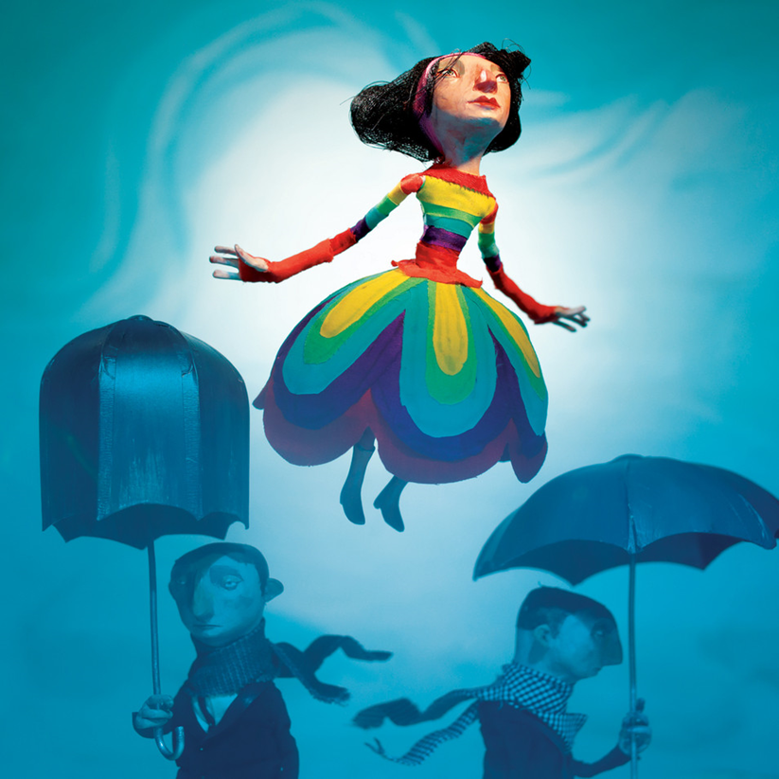
Shining Some Light On
Seasonal Affective Disorder
Group 5: Manika Bhandari, Malika Bhola, Rucha Desai, Dhruvika Joshi, Abir Shamim

Slide 2
Overview
Introduction
Signs & Symptoms
Epidemiology & Risk Factors
Pathophysiology
Diagnosis
Treatment
Conclusion & Future Directions

Slide 3
Introduction
1

Slide 4
Notes:
https://www.youtube.com/watch?v=7z3jXX81WA8

Slide 5
What is SAD?
Subtype of Major Depressive Disorder related to changes in seasons
Typically occurs at the same time of the year
Occurs due to disruption of body’s internal biological clock
Related to changes in Serotonin and Melatonin levels in the body
(Winkler et al., 2006)
(Mayoclinic, 2017)

Slide 6
Signs & Symptoms
2

Slide 7
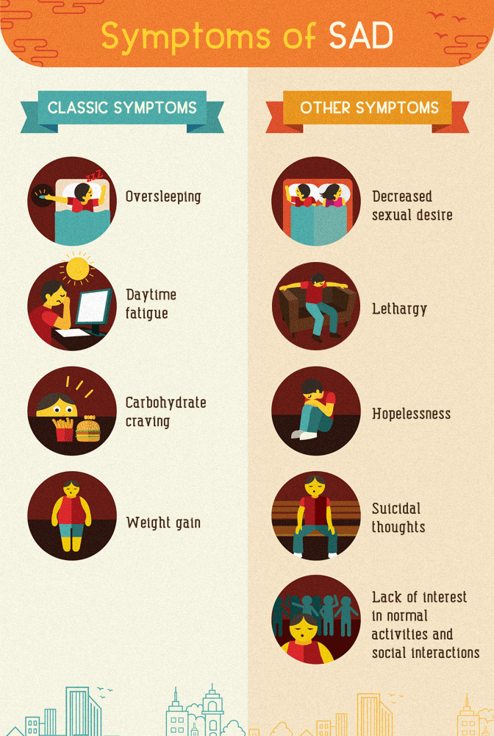
Nearly 10 hours of sleep during winter
Greater tendency for nodding off at work and less energy
Strong craving for carbs causes rise in tryptophan levels
Biological response to a seasonal drop in serotonin
(Burgo, 2014)
(Winkler et al., 2006)

Slide 8
Epidemiology & Risk Factors
3

Slide 9
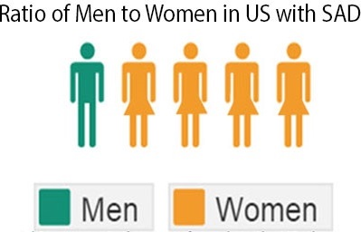
Epidemiology
Community based studies estimate SAD prevalence to be around 10 % in northern latitudes
Following DSM-IV–TR criteria SAD prevalence is:
1-2% in the United States
Around 2% in Canada
Higher incidence among women, especially during childbearing years
female-to-male ratio of 4:1
(Miller, 2005)
(Kurlansik, 2012)

Slide 10
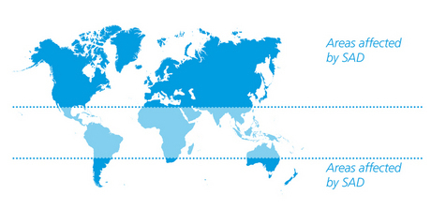
(Scientific American Mind, 2005)
Notes:
-The map shows that between the 30th parallels (areas in blue), there is really no winter depression. Beyond these parallels, there are increase in rates towards the poles. There is a 1% rate in Northern Florida and increases up to 10% in Alaska (Scientific American Mind, Vol16, No.3, 2005).

Slide 11
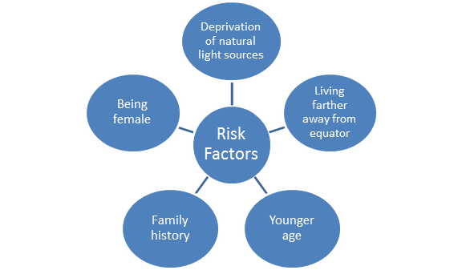
Risk Factors
(Byrne, 2008)

Slide 12
Pathophysiology
4

Slide 13
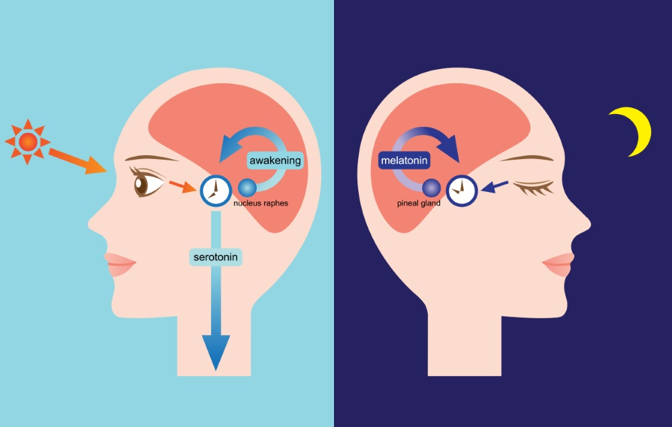
The body clock
Circadian Rhythms
(Puniewskla, 2016) (Lam & Levietan, 2000)

Slide 14
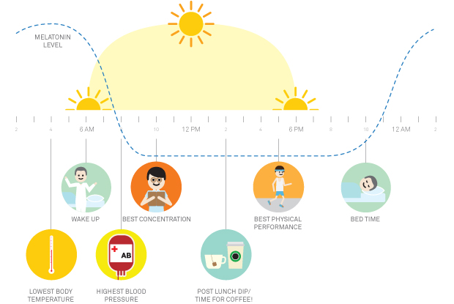
Photoperiod and Melatonin
Melatonin
Light suppresses melatonin secretion
Melatonin secretion abnormal in SAD patients
Undetermined causal process
(Lam & Levietan, 2000)

Slide 15
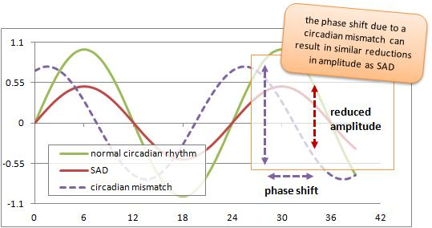
Circadian Phase Shift
Mismatch in circadian rhythm due to external factors
Shift in natural and social clocks of individuals
Shortened time length of overall circadian cycle
(Moussa, 2012) (Lam & Levietan, 2000)

Slide 16
Neurotransmitters
Serotonin (5-HT)
Fluctuate with seasons
Lowest in winter months
Low baseline level in SAD patients
Norepinephrine
Depressive SAD symptoms
Hypersomnia and increased eating
Low baseline level in SAD patients
Dopamine
Low functional activity in SAD patients
Levels stable year round
Decreased eye-blink rates
(Lam & Levietan, 2000)

Slide 17
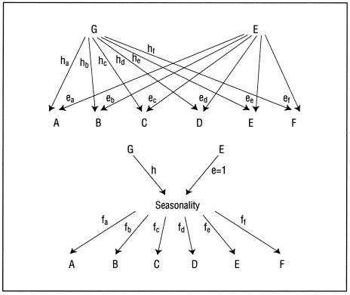
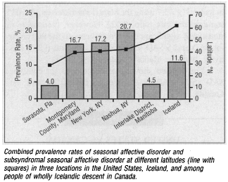
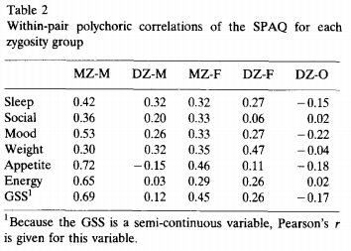
Genetics
Genetic Basis of SAD rates
Genetic Basis of Sex Factors
Modified from (Madden et al., 1996)
Genetic Basis with Twin Study
(Jang et al., 1997)
(Magnusson & Axelsson, 1993)

Slide 18
Diagnosis
5

Slide 19
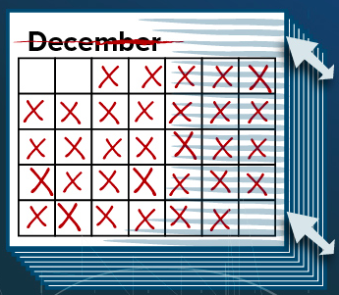
Diagnosis
The first ever diagnosis criteria in the DSM was made by Rosenthal et al.
No unique criteria in the DSM-IV
SAD is known as a specifier of recurrent major depressive episodes
Important to determine the time of onset and offset of depressive episodes / rule out any other conditions
(Westrin & Lam, 2007)
(Rosenthal et al, 1984)
Notes:
Non-seasonal depression (e.g. MDD) can worsen during the winter but can be differentiated from SAD patients because they will still be symptomatic in the summer

Slide 20
Criteria for Seasonal Pattern Specifier
(A) Regular temporal relationship between the onset of major depressive episodes and a particular time of the year
(B) Full remissions (or a change from depression to mania or hypomania) also occur at a characteristic time of the year
(C) Two major depressive episodes meeting criteria (A) and (B) in last two years and no non-seasonal episodes in the same period
(D) Seasonal major depressive episodes substantially outnumber the nonseasonal episodes
(Reid & Wise, 1995)

Slide 21
Treatments
6

Slide 22
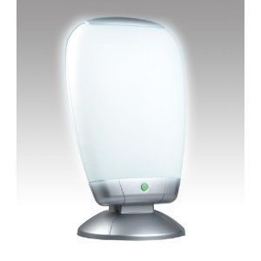
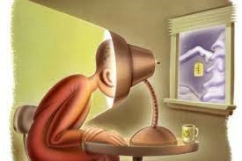
Phototherapy
Bright light therapy in the winter
Exposure to natural or artificial light suppresses brain’s secretion of melatonin
2500 lx of artificial light in the morning
High intensity visible light emitted through light boxes
Patients generally show response to treatment within the first week but exposure maintained for duration of winter
Side effects: eyestrain, headache
(Partonen, 1998)
(Terman et al., 1989)

Slide 23
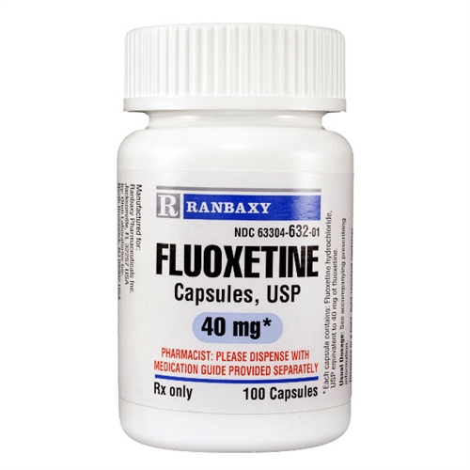
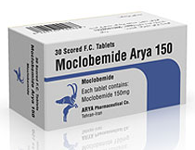
Drug Therapies
Antidepressants (serotonin-reuptake inhibitors)
Sertraline
Fluoxetine
Moclobemide
(Rodin and Thompson, 1997)

Slide 24
Psychotherapy - CBT
Preliminary studies
Talk therapy
Change patient’s automatic thoughts, dysfunctional attitudes, withdrawal and rumination
Effective in preventing relapse
(Rohan et al., 2004)

Slide 25
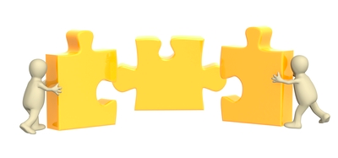
Combined Treatment
Combine phototherapy, psychotherapy and drug therapies
Ideal for patients who have no response to phototherapy, psychotherapy or drug therapy alone
Risk: overarousal
Psychotherapy
Drug Therapy
Phototherapy
(Rodin, 1997)

Slide 26
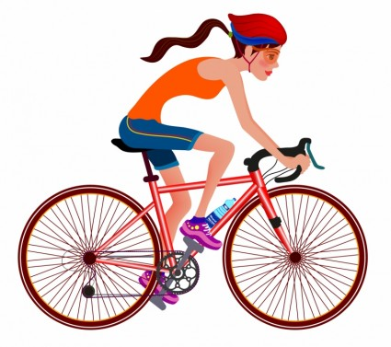
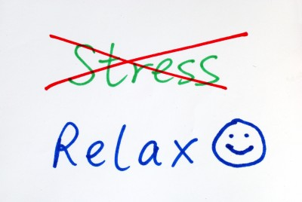
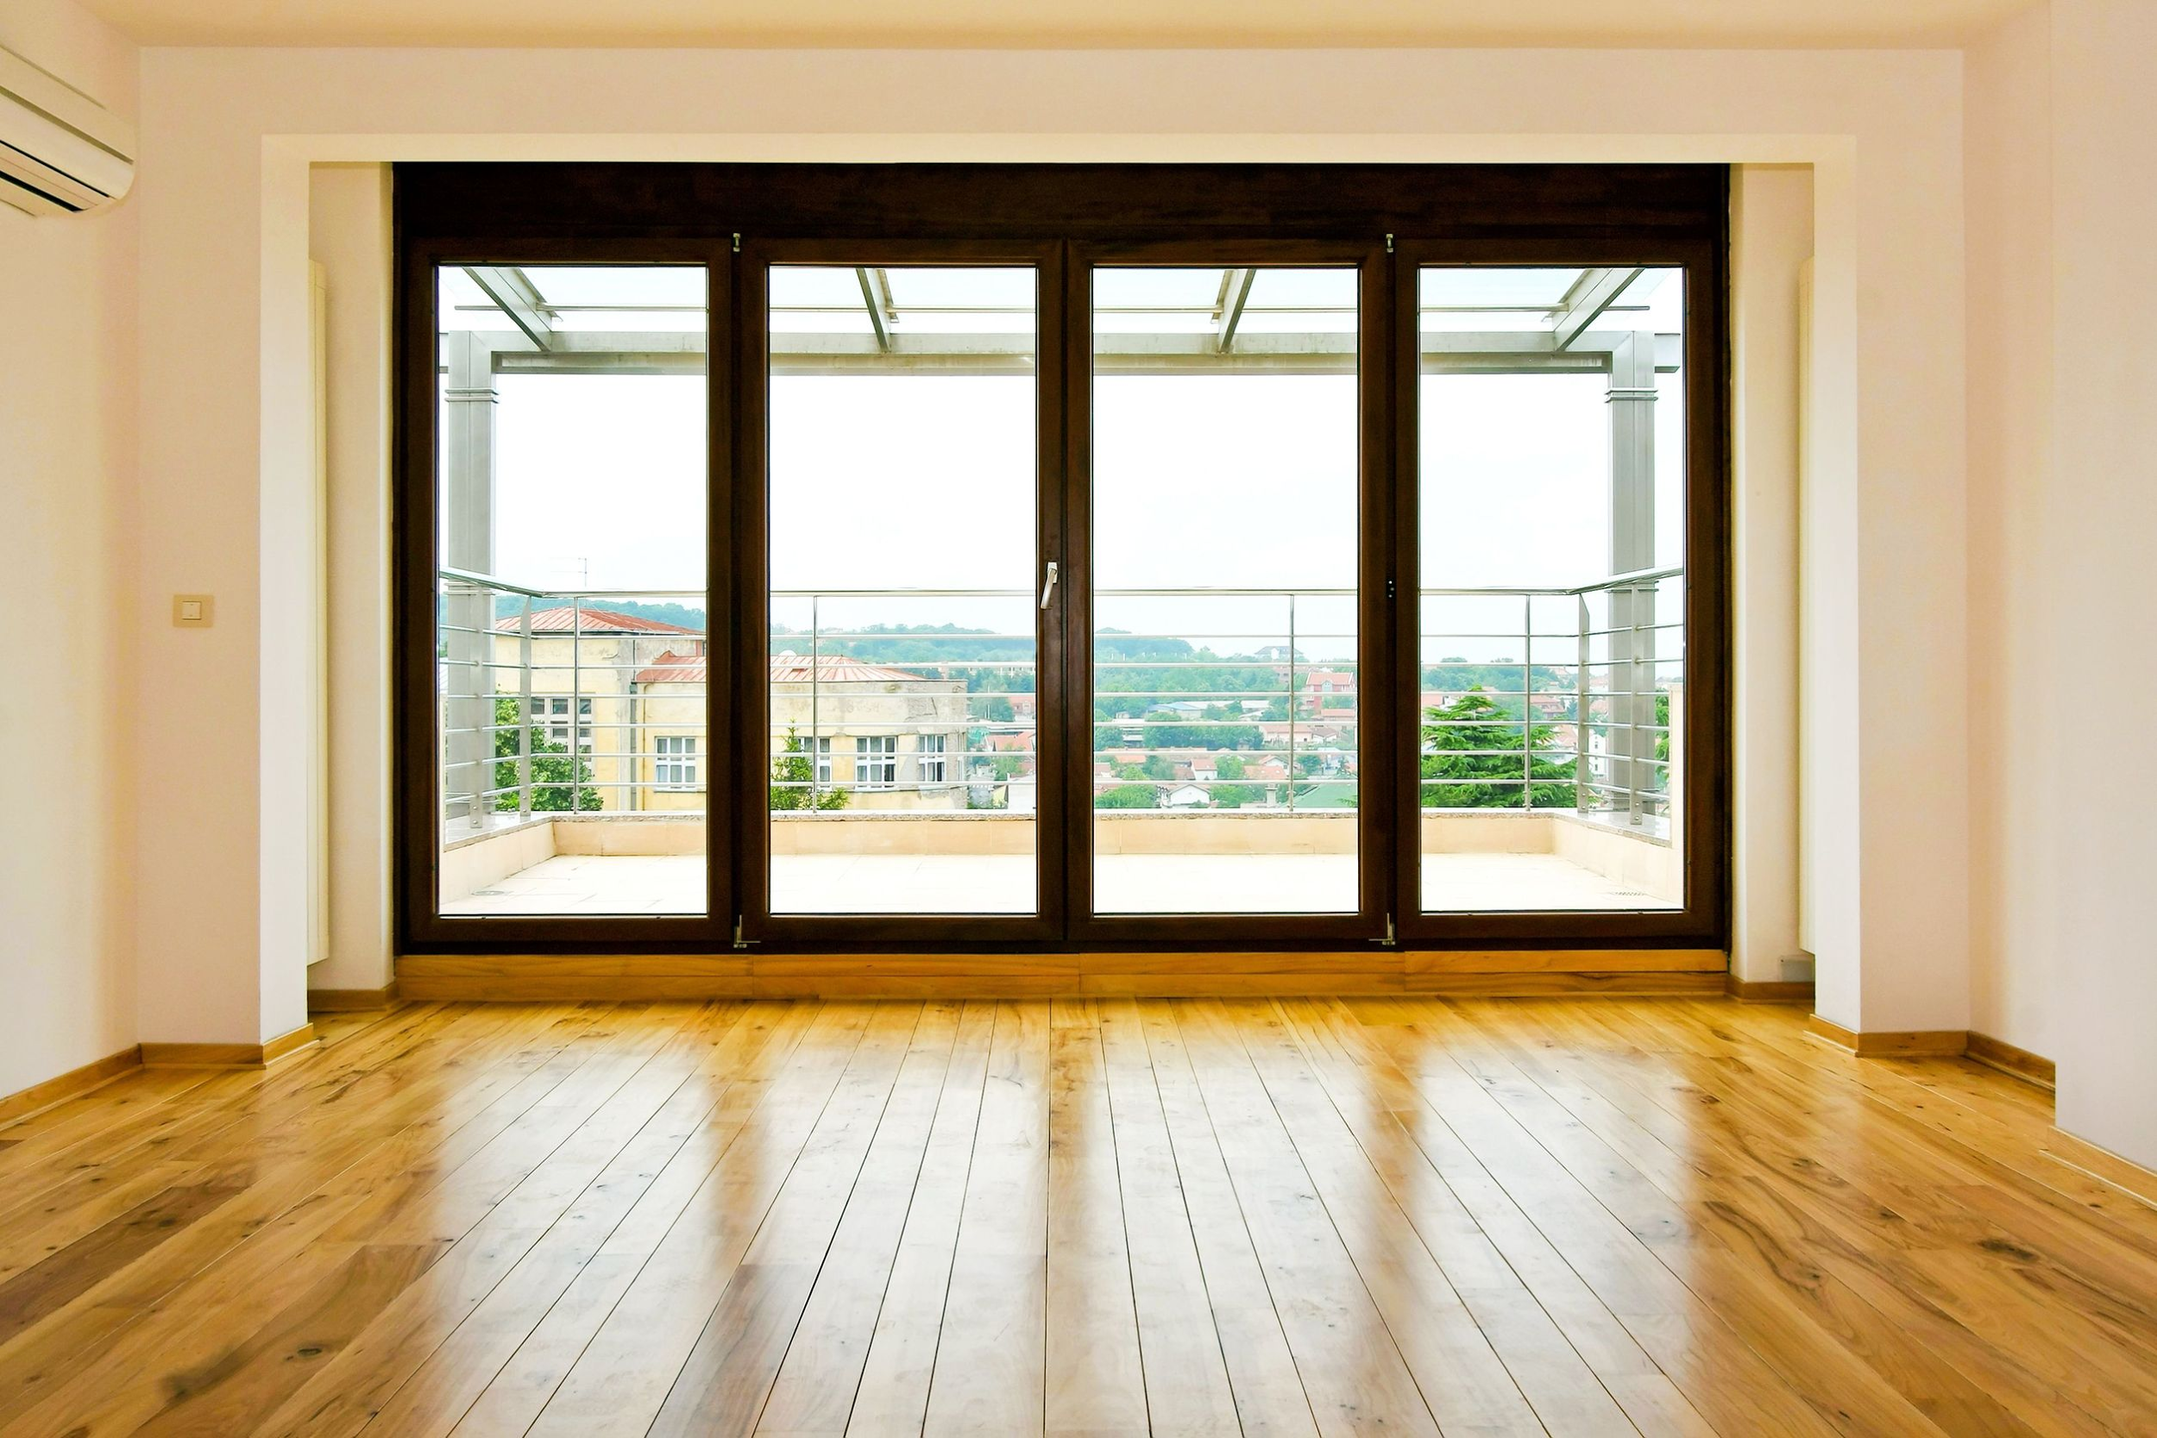
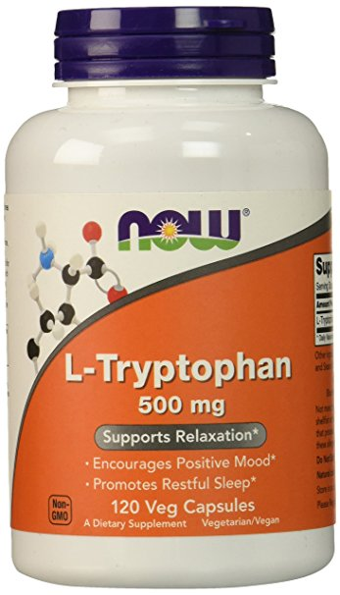
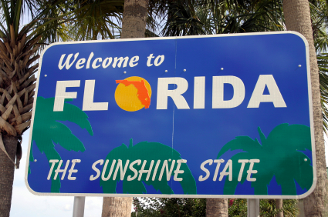
Other Therapies / Prevention
(Rodin, 1997)

Slide 27
Conclusion & Future Directions
7

Slide 28
Conclusion & Future Directions
Using Virtual Reality light therapy
Emulate the summer months through VR during the winter to help alleviate SAD symptoms
(Medeiros, 2017)
Notes:
We now know that there’s light therapy and antidepressants as the main lines of treatment but is there more than we can do? One of the best ways to deal with seasonal affective disorder is through prevention by implementing therapies (such as light therapy) before the onset of symptoms.

Slide 29
References
Burgo, J. (2014). Treating Seasonal Affective Disorder: How to Face Winter with a Smile. After Psychotherapy and Psychology Today. Retrieved from https://www.fix.com/blog/treating-seasonal-affective-disorder/
Byrne, B., & Brainard, G. C. (2008). Seasonal affective disorder and light therapy. Sleep Medicine Clinics, 3(2), 307-315.
Jang, K.L., Lam, R.W., Livesley, W.J., & Vernon, P.A. (1997). Gender differences in the heritability of seasonal mood change. Psychiatry Research, 70(3), 145-154. https://www.ncbi.nlm.nih.gov/pubmed/9211576.
Kurlansik, S. L., & Ibay, A. D. (2013). Seasonal affective disorder. Indian Jour. of Clinical Practice, 24.
Lam, R.W. & Levitan, R.D. (2000). Pathophysiology of seasonal affective disorder: A review. Journal of Psychiatry & Neuroscience, 25(5), 469-480. https://www.ncbi.nlm.nih.gov/pmc/articles/PMC1408021/pdf/jpn00088-0055.pdf.
Madden, P.A., Heath, A.C., Rosenthal, N.E., & Martin, N.G. (1996). Seasonal changes in mood and behavior. The role of genetic factors. Archives of General Psychiatry, 53(1), 47-55. https://www.ncbi.nlm.nih.gov/pubmed/8540777.
Magnusson, A. & Axelsson, J. (1993). The prevalence of seasonal affective disorder is low among descendants of Icelandic emigrants in Canada. Archives of General Psychiatry, 50(12), 941-946. https://www.ncbi.nlm.nih.gov/pubmed/8250680.
Mayoclinic. (2017). Seasonal Affective Disorder. Mayoclinic Health Newsletter. Retrieved from http://www.mayoclinic.org/diseases-conditions/seasonal-affective-disorder/basics/definition/con-20021047
Medeiros, D.M. (2017) Your VR Health Report. VR Fitness Insider. Retrieved from http://www.vrfitnessinsider.com/your-vr-health-report/
Miller, A. L. (2005). Epidemiology, etiology, and natural treatment of seasonal affective disorder. Alternative Medicine Review, 10(1), 5-14.
Moussa, A. (2012, Aug 12). Circadian Rhythmicity. Retrieved from http://suppversity.blogspot.ca/2012/08/circadian-rhythmicity-sunlight-la-carte.html.

Slide 30
References
Partonen, T. (1998) Seasonal affective disorder. The Lancet, 352(9137): 1369-1374.
Puniewska, M. (2016, Nov 4). 10 Things you didn’t know about your circadian rhythm. Retrieved from http://www.prevention.com/health/10-things-you-didnt-know-about-your-circadian-rhythm.
Reid, W. H., & Wise, M. G. (1995). DSM-IV training guide. Psychology Press.
Rodin, I. and Thompson, C. (1997) Seasonal Affective Disorder. Advances in Psychiatric Treatment, 3: 352-359.
Rohan et al. (2004). Cognitive-behavioral therapy, light therapy, and their combination in treating seasonal affective disorder. Journal of Affective Disorders, 80: 273-283.
Rosenthal, N. E., Sack, D. A., Gillin, J. C., Lewy, A. J., Goodwin, F. K., Davenport, Y., ... & Wehr, T. A. (1984). Seasonal affective disorder: a description of the syndrome and preliminary findings with light therapy. Archives of general psychiatry, 41(1), 72-80.
Terman et al. (1989). Light Therapy for Seasonal Affective Disorder: A Review of Efficacy. Neuropsychopharmacology, 2(1): 1-22.
Westrin, Å., & Lam, R. W. (2007). Seasonal affective disorder: a clinical update. Annals of Clinical Psychiatry, 19(4), 239-246.
Winkler, D., Pjrek, E., Iwaki, R., & Kasper, S. (2006). Treatment of seasonal affective disorder. Expert review of neurotherapeutics, 6(7), 1039-1048.

Slide 31
Thanks!
Any questions?

