Slide 1
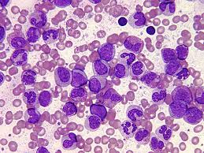
Chronic Myeloid Leukemia
Nerissa D’Mello, Ahmed Khan, Fadi Hana, Rohan Minhas & Mathushan Sukumar

Slide 2
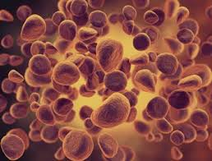
Table of Contents
Introduction
Leukemia
Chronic Myeloid Leukemia
Signs and Symptoms
Diagnosis
Pathophysiology
Pathogenesis
Therapeutics
Conclusion

Slide 3
Video: Chronic Myeloid Leukemia (CML)
https://www.youtube.com/watch?v=3tu3CWKbb4M

Slide 4
Introduction: Leukemia
Non-tumorous cancer of the blood that develops in the bone marrow
11th most prevalent cancer in the world
350,000 cases diagnosed annually
Classifications of Leukemia
Myelogenous vs Lymphocytic
Acute vs Chronic

Slide 5
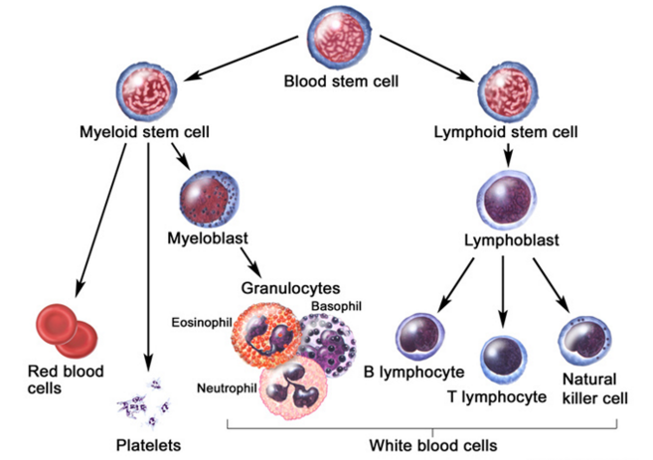
Introduction: Chronic Myeloid Leukemia (CML)
Characteristics Include
Rapid unregulated growth of myeloid cells in bone marrow
Accumulation of undifferentiated myeloid cells in blood
Associated Risk Factors
Age
Average case approx. 65 years
Gender
Higher genetic predisposition in males
Exposure to radiation
High-dose radiation (HDR)

Slide 6
Signs and Symptoms
Unique to CML
Onset of symptoms are not observed in early stages
Gradual development
Often discovered after blood tests reveal elevated white blood cell count
Contrasts with Acute Leukemia which display symptoms within days/weeks
Low red blood cell (RBC) count results in:
Anemia
Fatigue
Low platelet count results in:
Bleeding/bruising
Frequent infections
Loss of appetite/weight loss
Bone pain

Slide 7
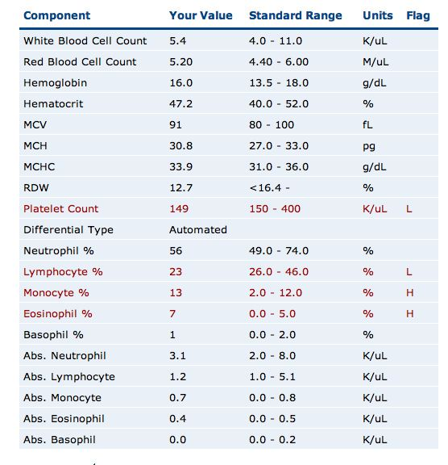
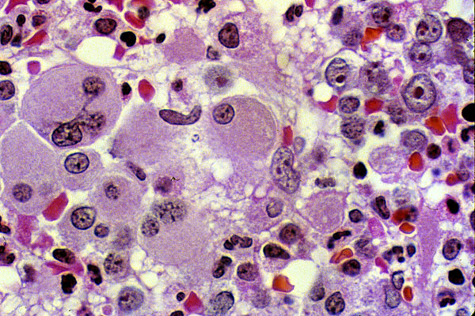
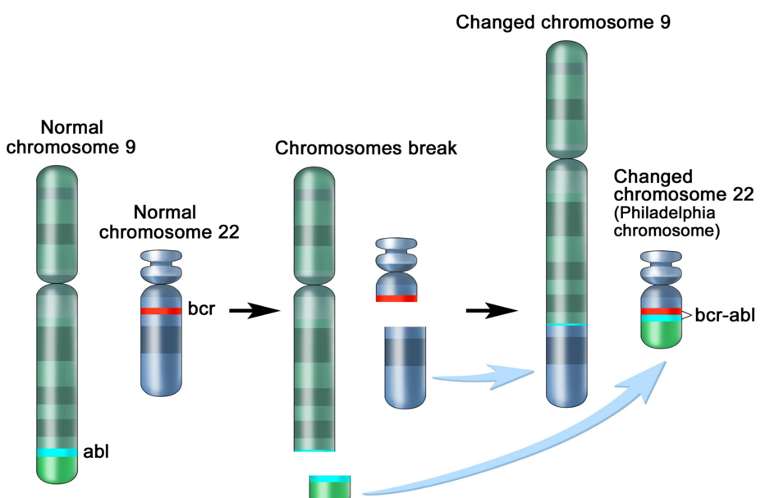
Diagnosis: Methods
Complete blood count (observe an increase of granulocytes)
Bone marrow biopsy
Genetic screening

Slide 8
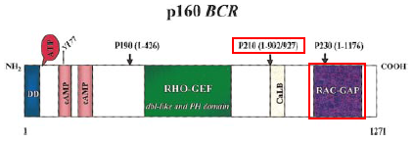
Pathogenesis: Introduction to the Bcr gene
Bcr genes: Breakpoint Cluster Region
Different breakpoints at the site for transcription
Located on Chromosome 22
3 different breakpoint regions: m-bcr, M-bcr, and µ-bcr
Serine/Threonine Tyrosine kinase → activates RAC1 and CDC42 GTPases

Slide 9
Pathogenesis: Introduction to the Abl gene
Abl gene: Abelson Murine Leukemia
v-abl oncogene human homologue
Located on chromosome 9
Non-receptor tyrosine kinase
3 SRC homology domains found on Abl: SH1 (carries out tyrosine kinase function), SH2 & SH3 (allows Abl to interact with other proteins)

Slide 10
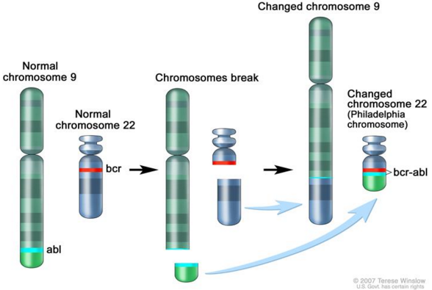
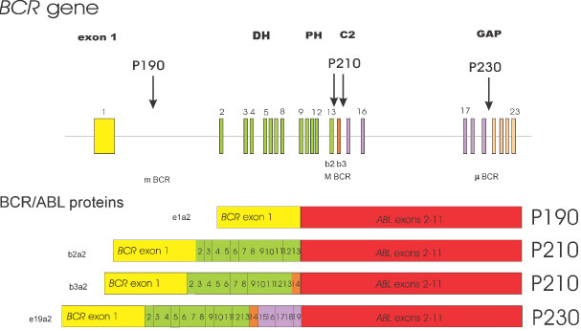
Pathophysiology: Bcr-Abl Protein
Reciprocal translocation between chromosome 9 and chromosome 22
Chromosome 22 is known as the “Philadelphia chromosome (Ph)”
The fusion of partial genes Abl and Bcr generates a Bcr-Abl protein
Involved in the activation of tyrosine kinase, without the need for cytokine signalling
Excessive proliferation of leukemia cells
Inhibition of apoptosis of HSC or progenitors
There are two types of Bcr-Abl mRNA: b2a2 and b3a2

Slide 11
Pathophysiology: Abl tyrosine kinase and oncogenes
Ways in deregulating the Abl tyrosine kinase
Deletion or the change in position of the SH3 domain (Regulatory function of the SH3 domain: to turn off tyrosine kinase activity )
Exposure to ionizing stress such as ionizing radiation leads to the oxidization of a protein called Pag/Msp23 → dissociation of Pag/Msp23 from Abl
Two different forms of Abl gene:
Form | Proto-oncogene ☺ | Oncogene ☹
Description | Normal gene | Viral gene
Activity Level | Weakly active Tyrosine Kinase | Constitutively active tyrosine kinase
Function | regulating the cell cycle, responding to genotoxic stress, and using integrin signals to influence decisions regarding cell cycle and apoptosis | excessive proliferation of leukemia cells, adhesion and the inhibition of apoptosis of HSC or progenitors

Slide 12
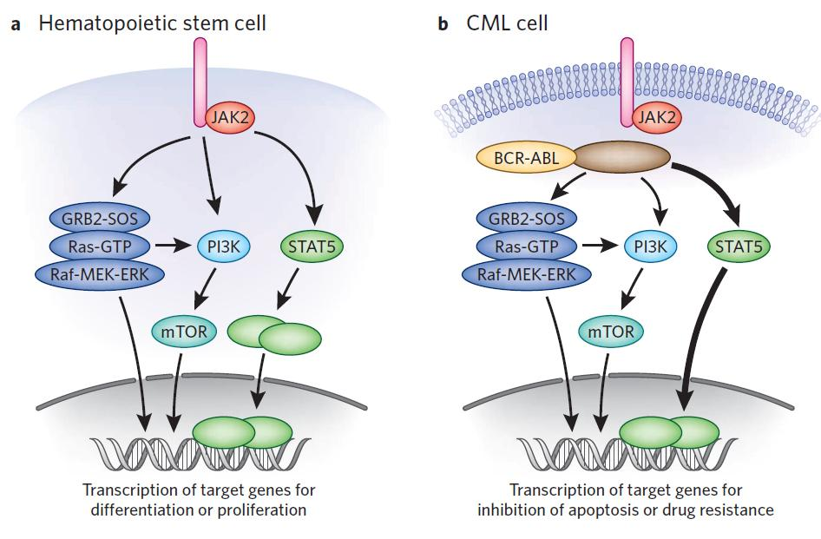
Pathogenesis: Jak-Stat Pathway
Numerous pathways and substrates are influenced by Bcr-Abl
Bcr-Abl phosphorylates STAT5 leading to transcription of target genes for CML cell proliferation and reduced apoptosis
Figure: In the above pathway, STAT5 can also be inhibited as another possible CML treatment

Slide 13
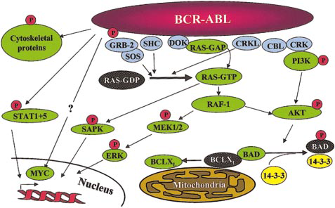
Pathogenesis: RAS and MAP kinase pathway
RAS and Map Kinase
Substrates (Grb-2, as well as, SHc on SH2 domain and Crkl on SH3 domain) bind to Abl-Bcr and are tyrosine phosphorylated. Grb-2 binds to Sos
RAS (GDP → GTP) gets activated
Path 1
RAS → RAF (serine/threonine kinase) recruited to cell membrane → MEK1/2 and ERK (Serine/threonine kinases) transcripts the genes
Path 2 RAC may relay RAS signalling
RAS → germinal center kinase (Gckr) → SAPK transcripts the genes

Slide 14
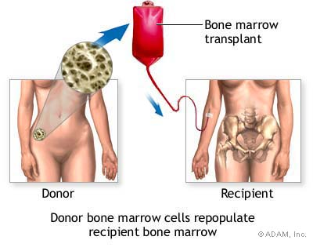
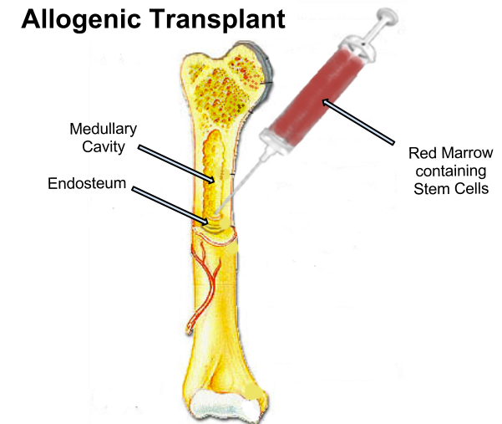
Therapeutics: Options
Only truly curative treatment is bone marrow transplant or allogeneic stem cell transplant
Other treatment: Tyrosine kinase inhibitors

Slide 15
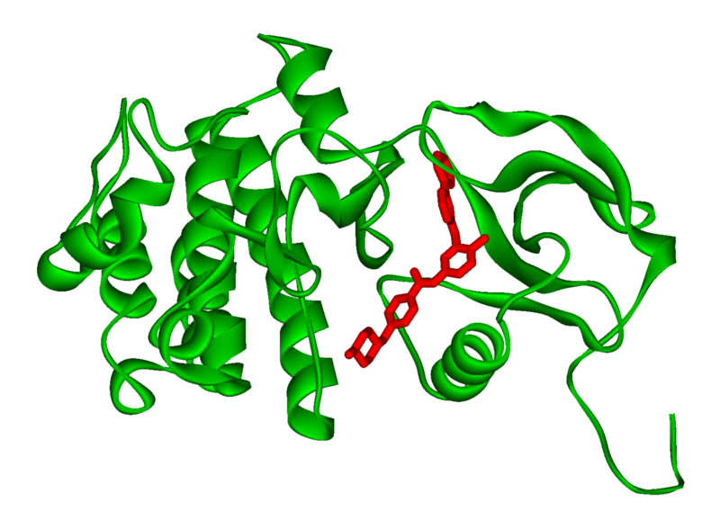
Therapeutics: Inhibiting Bcr-Abl
Inhibiting Bcr-Abl is a potential drug target
BCR-ABL is found in CML cells and thus has desired specificity of a therapeutic and minimizes systemic toxicity
Easy to target BCR-ABL’s well defined ATP pocket than other protein-protein interactions
Figure: Bcr-Abl kinase being inhibited by a compound, imatinib, in red

Slide 16
Therapeutics: Inhibiting Bcr-Abl
Two BCR-ABL conformations:
Open/Active Conformation of BCR-ABL
Active tyrosine kinase
Kinase uses ATP to activate downstream proteins via phosphorylation
Possible inhibitor could be an ATP mimetic
Closed/Inactive Conformation of BCR-ABL
Inactive tyrosine kinase
ATP cannot bind, hence no phosphorylation

Slide 17
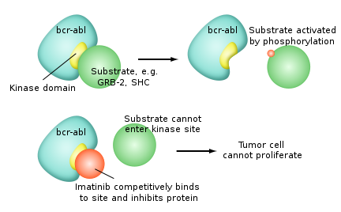
Therapeutics: Gleevec
Gleevec (imatinib mesylate)
FDA approved for treating CML
Doesn’t compete with ATP, instead it keeps kinase in closed/inactive conformation preventing ATP from binding
It is a tyrosine kinase inhibitor
Inhibits downstream effects of BCR-ABL (increased proliferation or decreased apoptosis of HSCs or progenitor cells)
Figure: Pharmacodynamics of imatinib, Gleevec

Slide 18
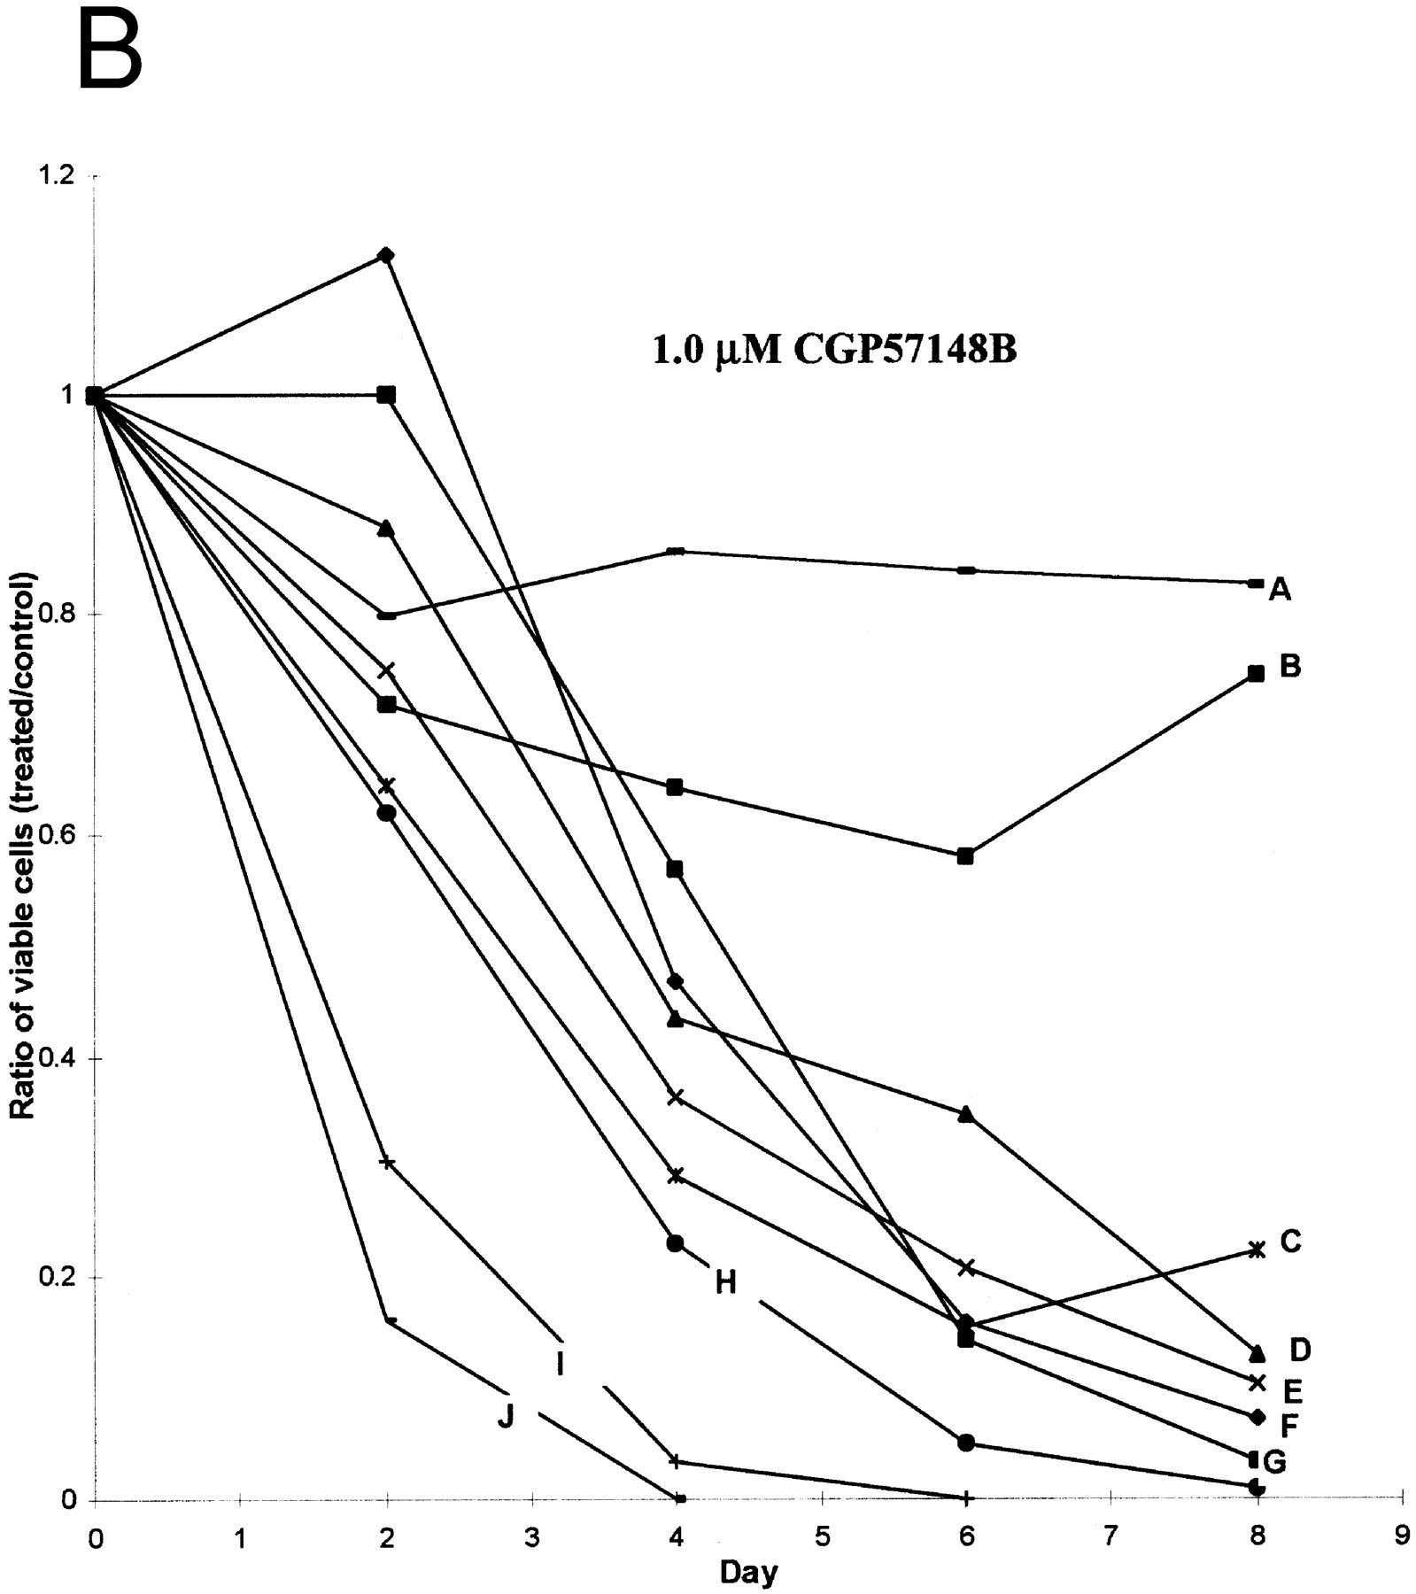
Therapeutics: Results
Results of Gleevec treatment:
Cells examined were Bcr-Abl positive cells
CML cell growth reduced drastically after exposure to CGP57148B, a tyrosine kinase inhibitor
Cell lines A and B were resistant to 1.0uM but not 10uM

Slide 19
Therapeutics: Future Implications
Possibility of acquired drug resistance
Some CML cells survive due to genetic mutation in Bcr-Abl at Thr315Ile that removes Gleevec from its pocket
This gives rise a new population of Bcr-Abl CML cells that are resistant to Gleevec
Other inhibitors of Bcr-Abl include:
Dasatinib which inhibits most Bcr-Abl mutants except Thr315Ile
Ponatinib which inhibits Thr315Ile mutation
Inhibiting the STAT5 pathway can be another possible target for CML treatment

Slide 20
Conclusion
Leukemia is a non-tumorous cancer of the blood, that develops exclusively in the bone marrow of an individual
CML is the rapid, unregulated growth of myeloid cells which can be observed in the bone marrow
CML can be attributed to the translocation of BCR (on Chromosome 22) and ABL (on Chromosome 9) genes.
Bcr-Abl protein leads to upregulated tyrosine kinase activity, causing an excessive proliferation of leukemia cells, and the inhibition of apoptosis of HSC or progenitors
Gleevec has been FDA approved for CML treatment → studies have shown a great improvement in CML patient survival

Slide 21
References
Apperley, J. (2015). Chronic myeloid leukaemia. The Lancet. 385:9976, 1447–1459
CML Society of Canada. (2010, March 18). CML Animation. Retrieved from https://www.youtube.com/watch?v=3tu3CWKbb4M
Corey, S., Cortes, J. (2010). Chronic Myeloid Leukemia: Pathophysiology and Therapeutics.
Deniniger, M., Goldman, J., Melo, J. (2000). The Molecular Biology of Chronic Myeloid Leukemia. Blood, 96(10), 3343 - 3356.
Druker, B. (2008). Translation of the Philadelphia chromosome into therapy for CML. Blood, 12(13), 4808 - 4817.
Druker, B. J., Talpaz, M., Resta, D. J., Peng, B., Buchdunger, E., Ford, J. M., ... & Sawyers, C. L. (2001). Efficacy and safety of a specific inhibitor of the BCR-ABL tyrosine kinase in chronic myeloid leukemia. New England Journal of Medicine, 344(14), 1031-1037.
Fabbro, D. (2012). BCR-ABL signaling: A new STATus in CML. Nature Chemical Biology, 8, 228-229.
Goldman, J. M., & Melo, J. V. (2003). Chronic myeloid leukemia—advances in biology and new approaches to treatment. New England Journal of Medicine, 349(15), 1451-1464.
Hurtado et al. (2007). Chronic Myeloid Leukemia Current Concepts in Physiopathology and Treatment. Cancerología, 2, 137-147.
Sawyers, C. L. (1999). Chronic myeloid leukemia. New England Journal of Medicine, 340(17), 1330-1340.

