Slide 1
Osteoporosis
Life Science 4M03
Group 5:
Jasmine, Henry, Sachin, Negar, Ebuka
Notes:
PRESENTATION/ORAL RUBRIC: - NO READING FROM NOTES !!!!!!!!!!!!!! (15-20 min)
RELEVANT TO TOPIC
LOGICAL FLOW OF IDEAS
USE OF ILLUSTRATION/NOT TOO CLUTTERED
PRIMARY OBSERVATIONS (speculation vs. actual measurement/observations → use GRAPHS)
REFERENCES (APA, IN-TEXT)
CONCLUSION/OPINION/APPLICATION/IMPLICATION

Slide 2
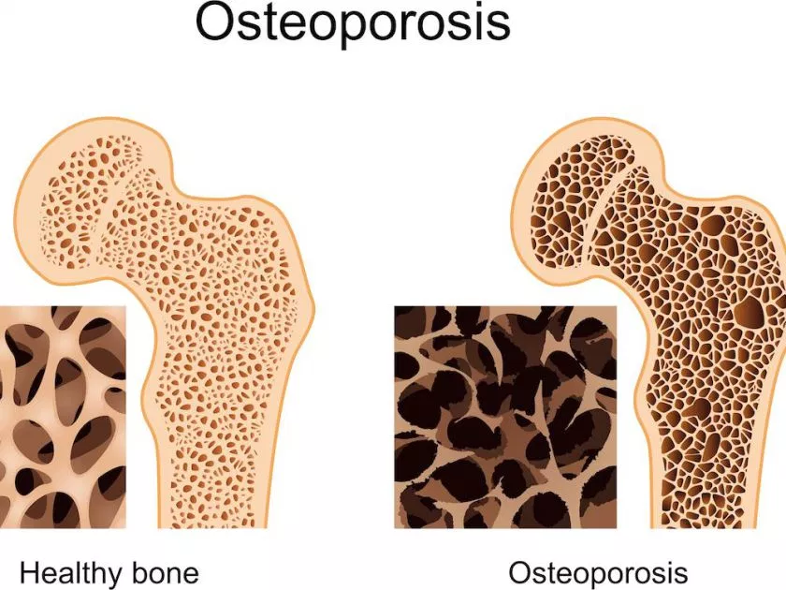
What is Osteoporosis?
Osteoporosis: “porous bone”
Most common bone disease in humans
Characterized by a deterioration of bone tissue and low bone density
Leads to an increasing prevalence
of breaks and fractures
https://dev.rodpub.com/images/148/817_main.jpg
Notes:
Osteoporosis, which literally means porous bone, is a disease in which the density and quality of bone are reduced.
Most common bone disease → characterized by a deterioration of bone tissue and low bone density which results in the weakening of bones
As become more fragile, the risk of fracture is greatly increased.

Slide 3
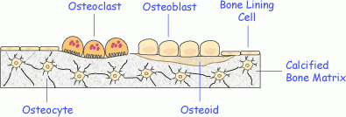
Bone Biology
Osteoblasts: production and secretion of bone matrix proteins for bone synthesis and remodelling
Osteoclasts: bone breakdown through the reabsorption
https://www.iofbonehealth.org/introduction-bone-biology-all-about-our-bones
Notes:
The major functions of bones are to:
Provide structural support for the body
Protection of vital organs
Act as a storage area for minerals (such as calcium)
Bone loss occurs when this balance is altered, resulting in greater bone removal than replacement.
When the activity of osteoclasts surpasses the bone formation by osteoblasts, the bones become brittle and porous leaving them susceptible to fractures

Slide 4
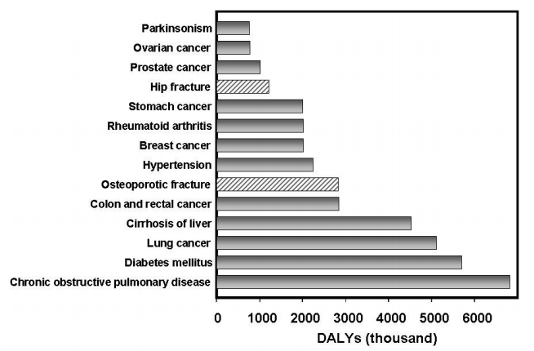
Epidemiology
1 in every 3 women
1 in every 5 men
Effects more than 2 million Canadians
Figure 1. DALYs per thousand for various diseases in Europe and Americas.
https://www.who.int/chp/topics/Osteoporosis.pdf
Notes:
More than heart attack, stroke and breast cancer combined.
Cost over $456 million directly in 2008 in terms of treatment (Canada)
DALY stand for disability adjusted life year ( yrs of disability + (difference between life expectancy - actual life span))
How much diseases burden a person’s life in terms of decreasing your life expectancy

Slide 5
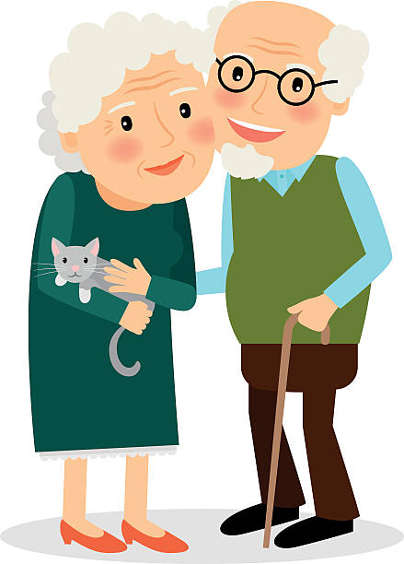
Who’s at risk?
Young (<50 yrs)
Use of glucocorticoids
Reduced hormone secretion
Experience of fracture
Old (>50yrs)
> 65 year old
Smoking
High alcohol intake
https://mbtskoudsalg.com/explore/old-clipart/
Notes:
Younger adults (age < 50 years):
Experience with bone fracture
Use of glucocorticoids (steroid hormones)
Lack of hormone production
Older adults (age > 50 years):
Older than 65 years old
Smoking
Long term intake of large quantity of alcohol
Underweight or rapid weight loss
Having diseases that have complications leading to bone loss

Slide 6
Signs & Symptoms
http://www.return2health.net/articles/osteoporosis-how-dense-are-you/
Notes:
Some individuals may not even realize that they have osteoporosis until a fracture of a bone occurs, as this is the most common sign that someone has osteoporosis. The most common signs include a decrease in height overtime, a hunched or stooped posture, back pain, as well as if they notice a fracture that occured easily.
If there is an excessive outward of the curve, it can be more difficult for individuals to breathe or eat since there is reduced space in the internal organs.
The most common area that people fracture the most is the spine and the hips. As individuals age, it is more prone in fracture and occurs for people in their late 70s to 80s. Those who have fractures in general are at a higher risk to develop fractures in other areas.

Slide 7
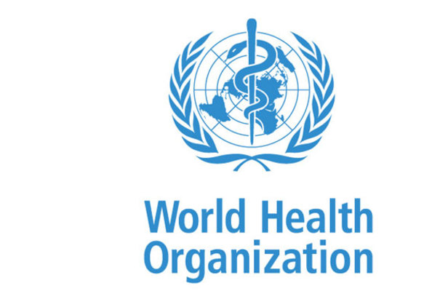
Diagnosis & Clinical Presentation
Bone mineral density is the primary test to determine bone strength
Osteoporosis is determined when an individual has 2.5 standard deviation below the average by WHO
Lower BMD number indicates a higher risk of a fracture
https://www.newvision.co.ug/new_vision/news/1426908/world-health-organization
Notes:
The bone mineral density, also known as BMD is the primary test that is used to determine the bone density using a dual X-ray absorptiometry (known as DEXA).
This method requires a scanning of the area such as the lumbar spine and proximal femur. DEXA is low in radiation and is effective which is why it is the primary test that is used today. The world health organization categorizes someone having osteoporosis when they have 2.5 standard deviation that is below the average.

Slide 8
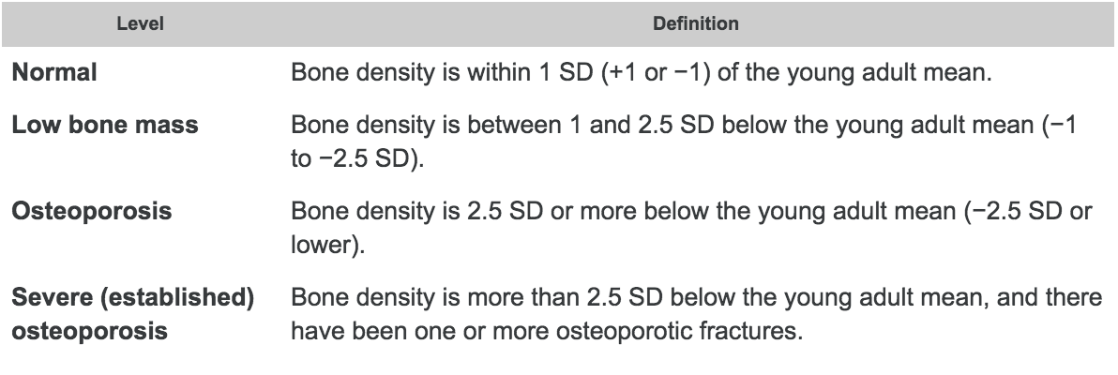
Diagnosis & Clinical Presentation
https://www.bones.nih.gov/health-info/bone/bone-health/bone-mass-measurement-what-numbers-mean
Notes:
This table shows how osteoporosis is indicated as well as if someone is at risk for osteoporosis.
Most commonly, your BMD test results are compared to the ideal or peak bone mineral density of a healthy 30-year-old adult, and you are given a T-score. A score of 0 means your BMD is equal to the norm for a healthy young adult. Differences between your BMD and that of the healthy young adult norm are measured in units called standard deviations (SDs). The more standard deviations below 0, indicated as negative numbers, the lower your BMD and the higher your risk of fracture.
As shown in the table, a T-score between +1 and −1 is considered normal or healthy. A T-score between −1 and −2.5 indicates that you have low bone mass, although not low enough to be diagnosed with osteoporosis. A T-score of −2.5 or lower indicates that you have osteoporosis. The greater the negative number, the more severe the osteoporosis.

Slide 9
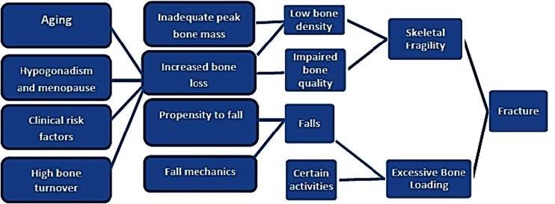
Pathophysiology
Pathogenesis of osteoporosis-related fractures, from Cooper and Melton, with modification
Notes:
Figure shows the factors associated with an increased risk of osteoporosis-related fractures. These include general factors that relate to aging and sex steroid deficiency, as well as specific risk factors, such as use of glucocorticoids, which cause decreased bone formation and bone loss, reduced bone quality, and disruption of microarchitectural integrity. Fractures result when weakened bone is overloaded, often by falls or certain activities of daily living.
Cosman, F., De Beur, S. J., LeBoff, M. S., Lewiecki, E. M., Tanner, B., Randall, S., & Lindsay, R. (2014). Clinician’s guide to prevention and treatment of osteoporosis. Osteoporosis international, 25(10), 2359-2381

Slide 10
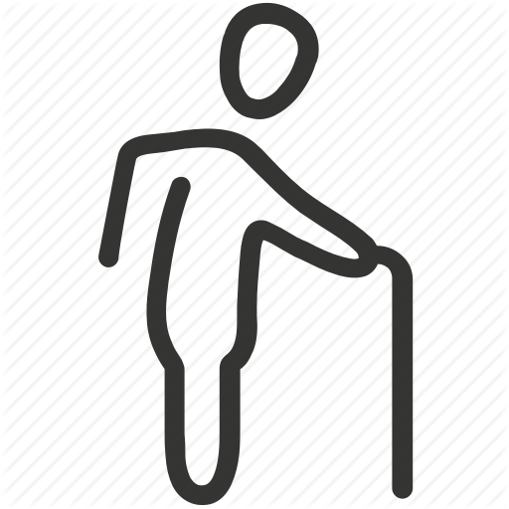
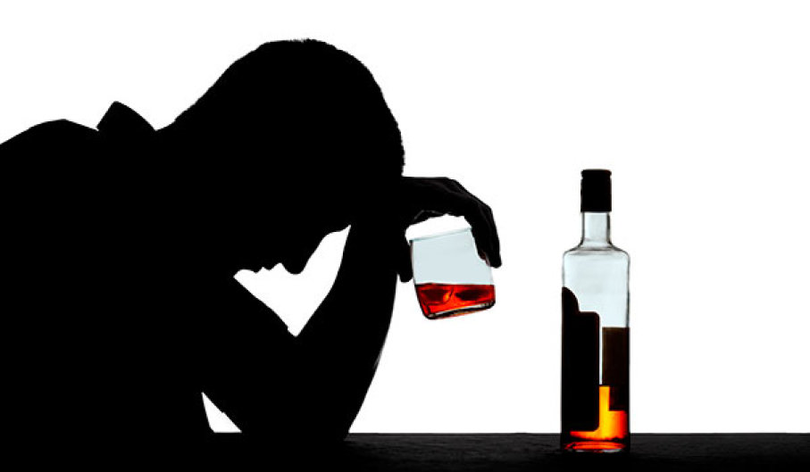
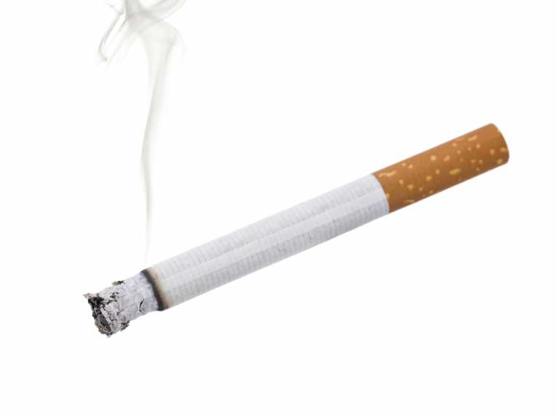
Primary vs. Secondary Osteoporosis
https://www.stuffyoushouldknow.com/podcasts/how-alcoholism-works.html
http://www.earthtimes.org/newsimage/smoking-50-years-progress-worldwide_10312.jpg
http://reclaimyourlongevity.com/articles/reduce-disease-risk/sarcopenia-is-only-for-the-weak/
Notes:
There are two main types of osteoporosis; primary and secondary. Primary osteoporosis is caused by an age-related bone loss, typically occurring to men and women that are above the age of 70.
Secondary osteoporosis is when bone mass is lost due to onset of certain diseases, bad lifestyle, etc. Some common causes of secondary osteoporosis include cigarette smoking, alcoholism, and low estrogen levels found in both men and women.
http://www.earthtimes.org/newsimage/smoking-50-years-progress-worldwide_10312.jpg
https://www.stuffyoushouldknow.com/podcasts/how-alcoholism-works.htm
http://reclaimyourlongevity.com/articles/reduce-disease-risk/sarcopenia-is-only-for-the-weak/

Slide 11
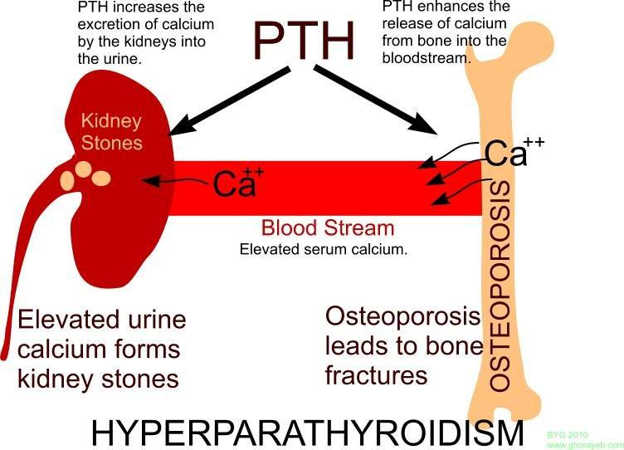
http://everesting.weebly.com/uploads/5/4/9/7/54979229/2098655_orig.jpg
Notes:
This calcium deficiency leads to secondary hyperparathyroidism; elevated PTH levels in the blood. This stimulates osteoclast activity within the bone resulting in more bone resorption than normal.
http://everesting.weebly.com/uploads/5/4/9/7/54979229/2098655_orig.jpg

Slide 12
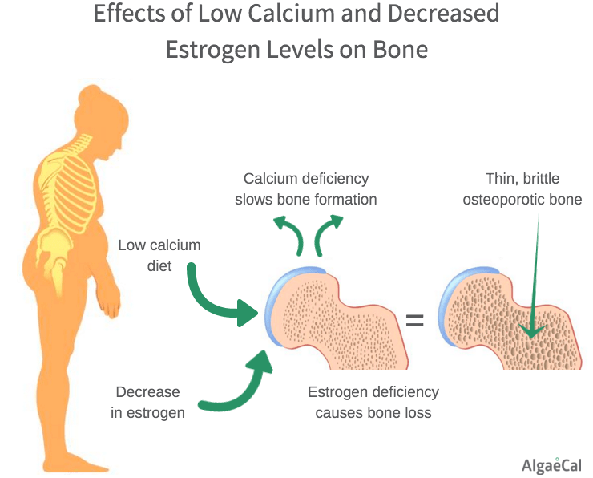
https://www.algaecal.com/expert-insights/everything-need-know-postmenopausal-osteoporosis/
Notes:
The likelihood of obtaining osteoporosis usually increases with age. The mechanism and rate for which older individuals lose bone, positively correlates with calcium deficiency.
In females, menopause usually leads to the loss of bone mass. When menopause occurs, the hormone progesterone is deficient. Some supporting data from 1990 suggests that progesterone plays the role of being a bone formation-stimulating hormone. Although supported, nothing is concrete as this hormone regulated by estrogen, thereby including multiple confounding variables.
https://www.algaecal.com/expert-insights/everything-need-know-postmenopausal-osteoporosis/

Slide 13
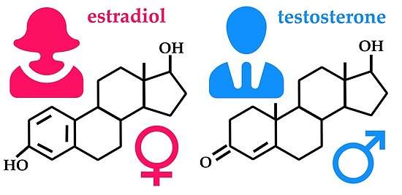
https://www.redbubble.com/people/orvalrochefort/works/26265113-man-woman-hormones-estradiol-testosterone?p=poster
Notes:
In males, studies have been done linking bone mineral densities to testosterone levels. When comparing the estrogen level of males, the group of males with the highest levels had the highest bone mineral density, while the group of males with the lowest estrogen levels had the highest risk of a hip fracture.
In contrast, when measuring levels of testosterone, there was no significant difference in hip fracture risk when looking at men with low levels of testosterone versus men with normal levels of testosterone. This supports the fact that the hormone estrogen plays more of a role in bone health in comparison to testosterone.
https://www.redbubble.com/people/orvalrochefort/works/26265113-man-woman-hormones-estradiol-testosterone?p=poster

Slide 14
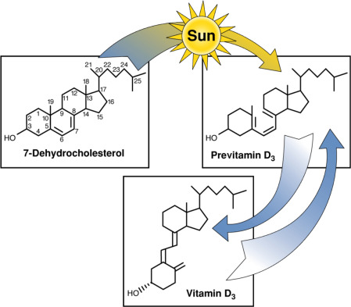
https://www.sciencedirect.com/science/article/pii/S0083672915000655
Notes:
The reason for why osteoporosis is usually seen in older individuals is due to a couple of factors. Aging skin along with decreased sun exposure, reduces the conversion of a precursor of vitamin D to Vitamin D3. Ultimately, this causes Vitamin D insufficiency which reduces the amount of calcium being absorbed.

Slide 15
Case Study
A Global Study of Vitamin D Status and Parathyroid Function in Postmenopausal Women with Osteoporosis: Baseline Data from the Multiple Outcomes of Raloxifene Evaluation (Lips et al., 2001)
Notes:
This study was done to compare vitamin d status and parathyroid function in postmenopausal women across the globe
Approximately 7500 women were in the study from 25 countries in 5 continents
It was confirmed first that all women in the study all had osteoporosis
In this longitudinal study, 3 things were measured specifically:
Vitamin D via a Radioimmunoassay
PTH levels via immunoradiometric assay
Bone mineral density measured by dual x-ray absorption

Slide 16
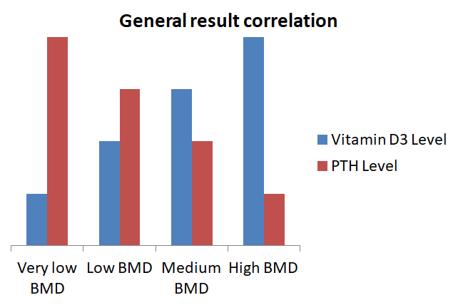
Method & Result
Variables:
Bone Mineral Density, Vitamin D, Parathyroid hormone
Before and after Vitamin D3 supplement
Findings:
Correlation and change for supplement
Notes:
Results:
Low, medium, and high ranges of Vitamin D levels were tracked
The PTH levels had a negative correlation with serum Vitamin D levels observed among all regions of the globe included in the study
When looking at how BMD levels compare to Vitamin D levels, results were only significant when looking at part of the femur on the leg
Based on these findings, women were then treated for 6 months with vitamin D3 and calcium supplements
After treatment, vitamin D levels increased significantly and PTH levels decreased significantly; with the highest effect on individuals categorized in the low range of vitamin d levels

Slide 17
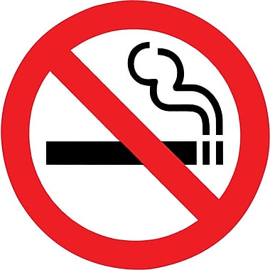
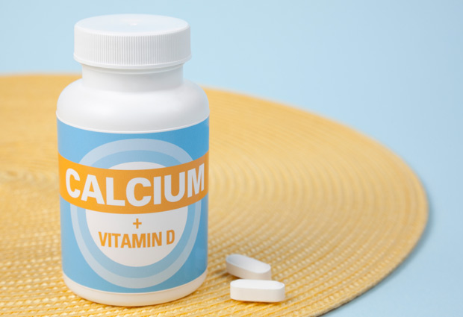
Prevention & Management
No current cure
Lifestyle Changes
Exercise
Smoking
Supplements/diet
https://www.staples.ca/en/International-No-Smoking-Signs/product_SS2000148_1-CA_1_20001
https://philmaffetone.com/walking-right/
https://americanbonehealth.org/nutrition/the-right-way-to-take-calcium-supplements/
Notes:
There are no true cures for osteoporosis, so the goal of treatments of the disease is the prevention of bone fractures, minimizing bone loss, or increasing bone strength. It is very difficult to rebuild bone that is affected by the disease, and so prevention is just as important as treatments.
There are 3 main ways to treat and prevent osteoporosis; lifestyle changes, drugs that minimize bone loss and increase bone strength, and drugs that increase bone formation. Many lifestyle changes can be put into effect in order prevent and manage osteoporosis.
Exercise is an example of a lifestyle change that can be very beneficial. The benefit does not significantly increase bone density, but rather decreases the chance of falls and related injuries, most likely due to improved balance and muscle strength. Researchers have not determined the most effective types of exercise and so recommendations include weight bearing exercise such as walking.
Smoking is another lifestyle choice that can worsen the effects of osteoporosis. one pack of cigarettes per day can lead to a loss of 5-10% of bone mass. They also decrease estrogen levels and can lead to early bone loss in women before menopause, along with an earlier onset of menopause.
Supplements can be useful for treatment of osteoporosis. Building strong bones requires a certain amount of calcium intake. The amount of calcium intake recommended does increase with age, and is highest for postmenopausal women. Vitamin D is another important molecule that is needed for healthy bone density and strength. It is able to increase absorption of dietary calcium. Similar to calcium, vitamin D alone is not enough for osteoporosis treatment, and should be used alongside other treatments.

Slide 18
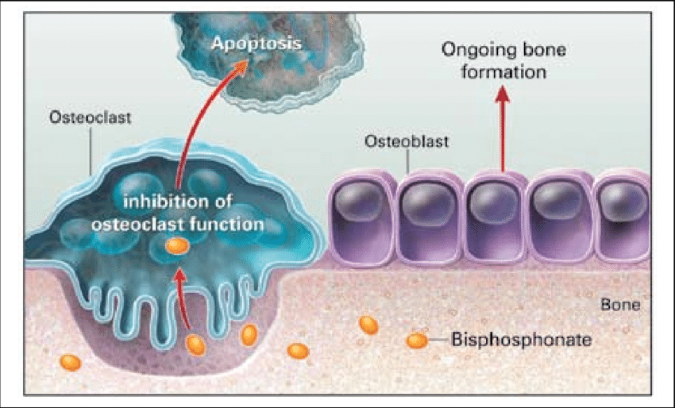
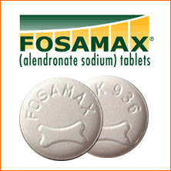
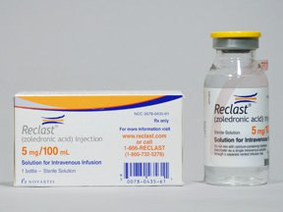
Pharmacological Intervention
Antiresorptive Drugs
Bisphosphonates
-Alendronate (Fosamax)
-Zoledronate (Reclast)
https://www.researchgate.net/figure/Proposed-mechanism-of-action-of-bisphosphonates-Reprinted-with-permission-from-Solomon_fig1_44643481
https://www.oshmanlaw.com/pharmaceutical-litigation/fosamax/fosmax/
https://www.webmd.com/drugs/2/drug-148235/reclast-intravenous/details
Notes:
As of now, the most effective drugs for osteoporosis are antiresorptive agents, meaning they decrease the amount of calcium removed from bones. Since bones are dynamic and constantly being remodelled, and osteoporosis results when bone resorption is higher than bone rebuilding, these medications inhibit the removal of bone so bone rebuilding is favoured.
Many antiresorptive agents are available including alendronate (fosamax), zoledronate (reclast), and others. Bisphosphonates are a class of antiresorptive drugs that are used to decreases risks of fractures of hip, wrist, and spine. These class of drugs are all administered orally to reduce adverse side effects, and to enhance the absorption of the medicine. Alendronate (Fosamax) is an example of a bisphosphonate drug. It is effective treatment for postmenopausal osteoporosis as well as with glucocorticoid induced osteoporosis. This drug, similar to other bisphosphonates increases bone density and reduces various possible fractures. This drug as all others does have a few side effects. This includes irritation of the esophagus or even inflammation of the esophagus.
Differences in the chemical makeups of the other bisphosphonate drugs is what allows for certain side effects to be avoided. Zoledronate (Reclast) is an intravenous administered bisphosphonate that is given once a year. It is able to effectively strengthen bones along with preventing both spinal and non-spinal fractures. Side effects of this drug may result in muscle and joint aches, and so mild painkillers are given following treatment. This drug is used mainly to prevent postmenopausal osteoporosis and to increase bone mass in males suffering the disease.

Slide 19
The Future of Osteoporosis
Can become an increasing problem as population ages
New research in human stem cells that help bone & cartilage grow
New genetic screening methods can help predict the risk of future fractures
Notes:
Osteoporosis is set to become a major health concern with an ageing population.
Scientists identified human stem cells that develop into the bone, cartilage, and other tissues that make up the body’s skeleton
This will one day help doctors repair or replace joint cartilage, heal broken bones more quickly, and build up bone in osteoporosis patients
A new genetic screen may predict a person’s future risk of osteoporosis and bone fracture, according to a study done at Stanford University School of Medicine

Slide 20
References
Cosman, F., De Beur, S. J., LeBoff, M. S., Lewiecki, E. M., Tanner, B., Randall, S., & Lindsay, R. (2014). Clinician’s guide to prevention and treatment of osteoporosis. Osteoporosis international, 25(10), 2359-2381.
Gardner, M., Demetrakopoulos, D., Shindle, M., Griffith, M. and Lane, J. (2006). Osteoporosis and Skeletal Fractures. HSS Journal, 2(1), pp.62-69.
Government of Canada. (2016, September 16). Osteoporosis Awareness Month – Exposing The Bone Thief. Retrieved from https://infobase.phac-aspc.gc.ca/datalab/osteo-blog-en.html?=undefined&wbdisable=true
Grob, G. N. (2014). Aging Bones: A Short History of Osteoporosis. JHU Press.
Hip Fractures. (n.d.). Retrieved from https://osteoporosis.ca/bone-health-osteoporosis/living-with-the-disease/after-the-fracture/what-to-expect-from-some-specific-types-of-fracture/hip-fractures/
Osteoporosis - Canadian Cancer Society. [online] Available at: http://www.cancer.ca/en/cancer-information/diagnosis-and-treatment/managing-side-effects/osteoporosis/?region=on#ixzz5QdWol1aw [Accessed 24 Sep. 2018].
National Osteoporosis Foundation. (2018). Osteoporosis and Your Spine - National Osteoporosis Foundation. [online] Available at: https://www.nof.org/patients/fracturesfall-prevention/exercisesafe-movement/osteoporosis-and-your-spine/ [Accessed 24 Sep. 2018].
Spine Fractures. (n.d.). Retrieved from https://osteoporosis.ca/bone-health-osteoporosis/living-with-the-disease/after-the-fracture/what-to-expect-from-some-specific-types-of-fracture/spine-fractures/
Lorente-Ramos, R., Azpeitia-Armán, J., Muñoz-Hernández, A., García-Gómez, J., Díez-Martínez, P. and Grande-Bárez, M. (2011). Dual-Energy X-Ray Absorptiometry in the Diagnosis of Osteoporosis: A Practical Guide. American Journal of Roentgenology, 196(4), pp.897-904.
Metcalfe, D. (2008). The pathophysiology of osteoporotic hip fracture. McGill Journal of Medicine : MJM, 11(1), 51–57.
Sozen, T., Ozisik, L. and Calik Basaran, N. (2017). An overview and management of osteoporosis. European Journal of Rheumatology, 4(1), pp.46-56.
Bones.nih.gov. (2018). Bone Mass Measurement: What the Numbers Mean | NIH Osteoporosis and Related Bone Diseases National Resource Center.

Slide 21
References
Osteoporosis Canada. (2018, September). KNOW YOUR RISK. Retrieved from https://osteoporosis.ca/
Osteoporosis in Men. (n.d.). Retrieved from https://www.bones.nih.gov/health-info/bone/osteoporosis/men#b
PubMed Health. (2018). Understanding tests used to detect bone problems. [online] Available at: https://www.ncbi.nlm.nih.gov/pubmedhealth/PMH0072597/ [Accessed 16 Sep. 2018]
Kling, J. M., Clarke, B. L., & Sandhu, N. P. (2014). Osteoporosis prevention, screening, and treatment: a review. Journal of women's health, 23(7), 563-572.
Sözen, T., Özışık, L., & Başaran, N. Ç. (2017). An overview and management of osteoporosis. European journal of rheumatology, 4(1), 46.
Gronholz, M. J. (2008). Prevention, diagnosis, and management of osteoporosis-related fracture: a multifactoral osteopathic approach. The Journal of the American Osteopathic Association, 108(10), 575-585.
Lewiecki, E. M. (2004). Management of osteoporosis. Clinical and Molecular Allergy, 2(1), 9.
Jr, W. C. (n.d.). Osteoporosis Causes, Symptoms, Treatment & Diet. Retrieved from https://www.medicinenet.com/osteoporosis/article.htm#what_is_the_treatment_for_osteoporosis_and_can_osteoporosis_be_prevented
Paul Lips, Tu Duong, Anna Oleksik, Dennis Black, Steven Cummings, David Cox, Thomas Nickelsen; A Global Study of Vitamin D Status and Parathyroid Function in Postmenopausal Women with Osteoporosis: Baseline Data from the Multiple Outcomes of Raloxifene Evaluation Clinical Trial, The Journal of Clinical Endocrinology & Metabolism, Volume 86, Issue 3, 1 March 2001, Pages 1212–1221, https://doi.org/10.1210/jcem.86.3.7327
Rachner, T. D., Khosla, S., & Hofbauer, L. C. (2011). Osteoporosis: now and the future. The Lancet, 377(9773), 1276-1287.
Kenny, A. M., & Prestwood, K. M. (2000). Osteoporosis: pathogenesis, diagnosis, and treatment in older adults. Rheumatic Disease Clinics of North America, 26(3), 569-591.
Wark, J. D. (1993). 8 Osteoporosis: pathogenesis, diagnosis, prevention and management. Baillière's clinical endocrinology and metabolism, 7(1), 151-181.

Slide 22
Questions
#1 What two types of bone cells are primarily involved in the development of osteoporosis?
a) osteocytes
b) osteoblasts
c) osteoclasts
d) a and c
e) b and c##

Slide 23
Questions
#2 What sort of relationship do PTH and Vitamin D have when talking about healthy bone? (ie. inversely proportional, proportional, exponential, no relationship)
inversely proportional ##
proportional
exponential
d) no relationship
e) quadratic

