Slide 1
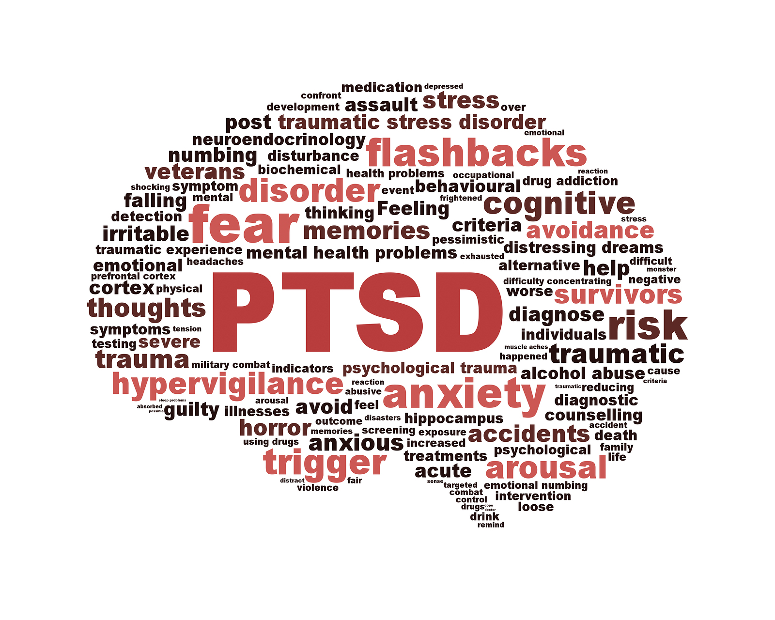
Post-Traumatic Stress Disorder
Prepared By: Julia, Josh, Anna, Rebecca & Melanie
Notes:
Font: ONLY USE Arial
Size: Title (36 and needs to be in blue), text on slide (18 and text colour is black)
Bullet Style: Round Gray
PLEASE add a smalll in text citation for IMAGES/STUDIES. Format (Author/Website Name (NOT URL), Year) underneath the image/study

Slide 2
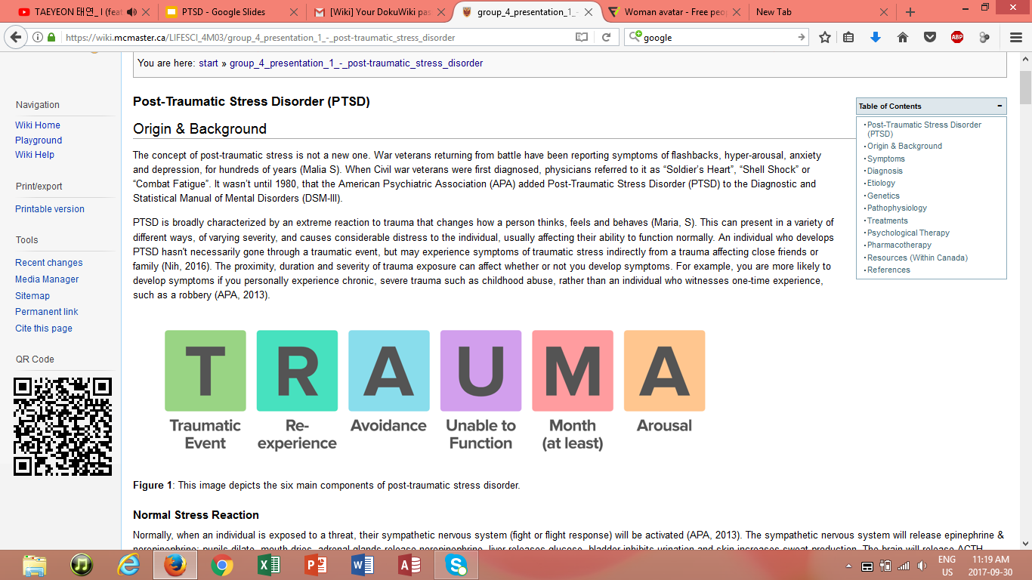
Introduction to Patient X
Notes:
(J) For our presentation we decided to come up with our own example of an individual experiencing PTSD. Here I will give you some background information on the patient and later on we will discuss the patient further.
Jim is a 40 year old military parent that recently retired from active duty. He has a wife Jennifer, and two kids David and Sera. After a few months of being home, the annual neighbourhood BBQ took place. Everyone from the neighbourhood came together for dinner, games and the annual fireworks display. This year it was held at Jim’s house. The night was going perfectly, everyone was stuffed, tired and just waiting for the fireworks. Unfortunately, once the fireworks began to go off Jim suddenly went inside, which seemed odd because this was usually his favourite part of the evening. Jennifer asked if anything was wrong, but Jim just said he was fine and needed to go lay down. In the following weeks, Jim started to be more anxious and edgy around the family. Jennifer wanted to understand what was happening with him because this wasn’t the usual Jim, so she set out to find help. Eventually she came across a wiki page created by McMaster University students on PTSD.

Slide 3
Living with PTSD
“It’s constantly looking over your shoulder and having difficulty trusting people… It’s not just something you can walk away from.”
“Triggers can come from anywhere at any time… a smell, a look/ glance, a vibe, a dream… how someone treats you. You are unable, as hard as you try, to turn it off.”
Notes:
R) 1nd
(J) 2st
(Read them out)
One quote each

Slide 4
What is PTSD?
Trauma & stress-related disorder
Exposure to a traumatic event
Extreme reaction: changes thoughts, feelings & behaviour
Notes:
Rebecca
PTSD is presented in many forms, with varying severity, causing considerable distress to the individual and affecting function normally.
Individual who develop PTSD haven’t necessarily gone through a traumatic event, but may experience symptoms of traumatic stress indirectly from a trauma affecting close friends or family.
The proximity, duration and severity of trauma exposure can affect whether or not you develop symptoms. Typically, the closer you are involved in the trauma, and the longer the trauma is occurring will result in more severe PTSD
An individual is more likely to develop symptoms if they personally experience a chronic, severe trauma over time (e.g. childhood abuse) rather than an individual who witnesses or experiences a one-time traumatic event such as a car accident or a robbery
Image- Good summary about DSM criterion which we will talk about in later on

Slide 5
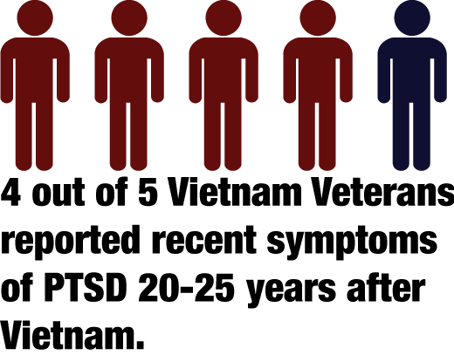
Background
War Veterans
Soldier’s Heart, Shell Shock, Combat Fatigue
Women > Men
30% of Canadians
75% > early years
Notes:
Josh
Script:
The concept of PTSD is not a new one...war veterans have been reporting symptoms for hundreds of years, including:
Flashbacks, hyperarousal, anxiety and depression, etc.
Civil war veterans were first diagnosed using terms such as
Soldier’s heart, shell shock & combat fatigue
Since then, it has become commonly known as Post-Traumatic Stress Disorder (PTSD) and in 1980, the American Psychiatric Association added PTSD to the Diagnostic and Statistical Manual of Mental Disorders (DSM-III)
PTSD is a very pervasive disorder - affecting roughly 30% of Canadians, and therefore it is very important for everyone to understand what it is, how it affects the body, and what are some ways in which you can help someone experiencing PTSD, or even yourself.

Slide 6
Etiology
Peritraumatic Risk factors
Type of response that follow a traumatic experience
Increase blood pressure
Dissociation
Disorientation
Notes:
(J)
Now let’s look into the etiology (causes) of PTSD
There are many different factors involved, here we have a list of the common causes but there are others
- If a person witnesses the traumatic event taking place, and the event is on a large scale like instances of war and genocide, this can lead to a greater likelihood of PTSD development
- Repeated exposure to traumatic stressors, known as “retraumatization”, has proven to increase PTSD risk in individuals; still being debated as the criteria for retraumatization has not been formalized as of yet
-PTSD is not triggered exclusively by traumatic experiences; 80-90% of people exposed to traumatic events do not develop PTSD
- If the traumatic event occurs during one’s developmental years, the risk of developing PTSD is greater by 75% or more
Females and ethnic-racial minorities are also more susceptible to developing PTSD, the latter being a result of socioeconomic factors (racial stigma, discrimination, and poverty)
Peritraumatic risk factors

Slide 7
Genetics
Studies around genetics are few with inconclusive results
FKBP5
Stress-related gene
Presence of 1 polymorphisms on the gene linked to PTSD in victims of child abuse
Without history of child abuse, did not exhibit increased risk of PTSD
FKBP5 genotype associated with peritraumatic dissociation
Common risk factor for PTSD development
Notes:
Rebecca

Slide 8
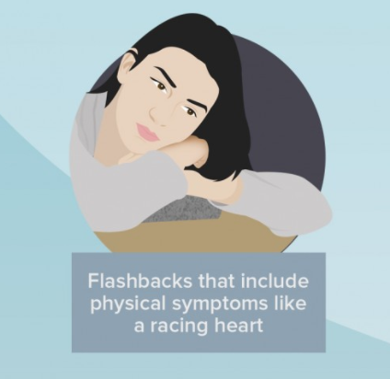
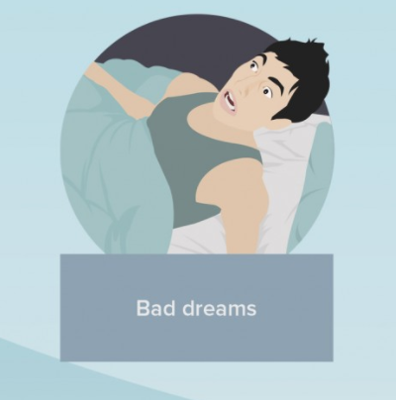
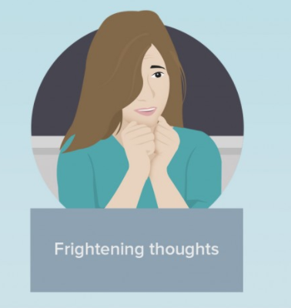
Symptoms
Intrusive Memories
Notes:
(J) There are 4 main symptoms associated with PTSD, one or more of these symptoms must last a least 1 month before leading to a diagnosis. The first symptom is…
Reliving the event - repeatedly experiencing the trauma by nightmares or dreams, flashbacks or uncontrollable thoughts (body reactivating fight or flight)

Slide 9
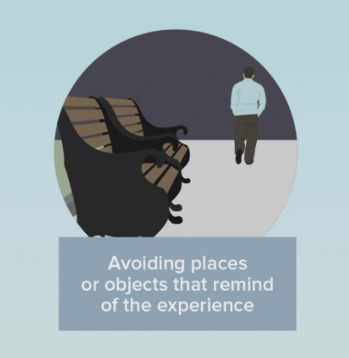
Symptoms
Avoidance
Notes:
(J) The second is..
Avoidance - anything related to trauma, trigger situations, avoiding places/people and activities that remind them or what happened
Thinking or talking
Places, activities, people

Slide 10
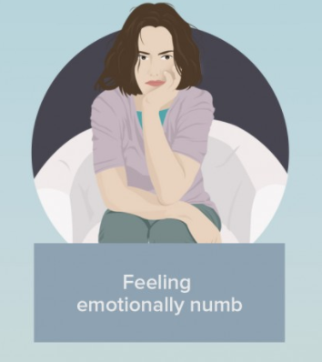
Symptoms
Thinking & Mood Changes
Notes:
(J) Third...
Changes in thoughts, feelings & beliefs
Sad, anxious, afraid most of the time, emotionally numb, losing interest in activities, feeling bad or guilty, believing the world is scary, dangerous and can’t be trusted

Slide 11
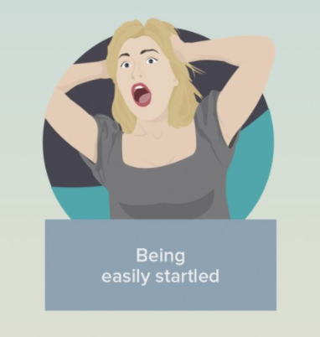
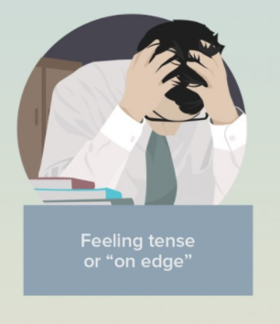
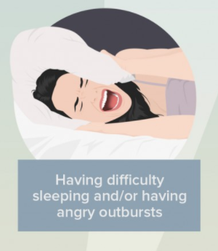
Symptoms
Physical & Emotional Reactions
Notes:
(J) Lastly...
Hyperarousal - heightened physiological arousal and increased reactivity to stress/trauma - jittery, startled easily, irritability, trouble sleeping

Slide 12
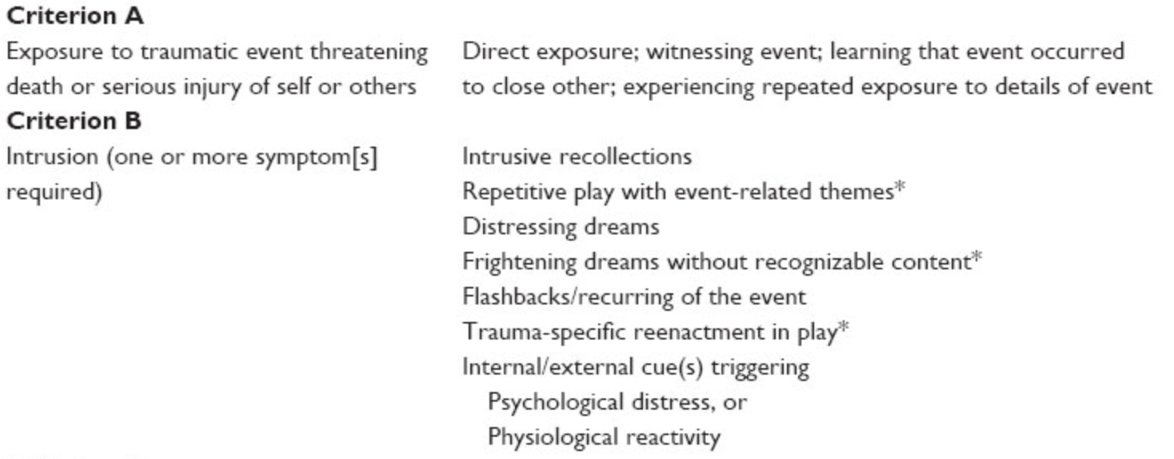
Diagnosis
Notes:
https://www.dovepress.com/a-narrative-review-of-the-occurrence-of-posttraumatic-stress-responses-peer-reviewed-fulltext-article-COAYA
Rebecca
DSM5 is used by clinicians and researchers to diagnose and classify mental disorders. There are a total of 8 criteron that
A/B/C-one is required
D/E-two is required
F/G/H-Required

Slide 13
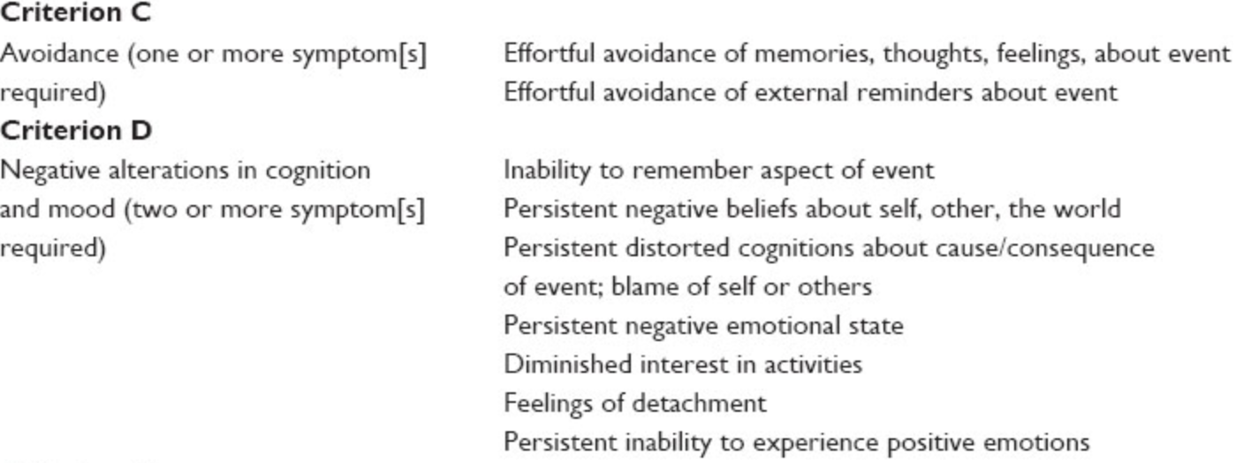
Diagnosis

Slide 14
Diagnosis

Slide 15
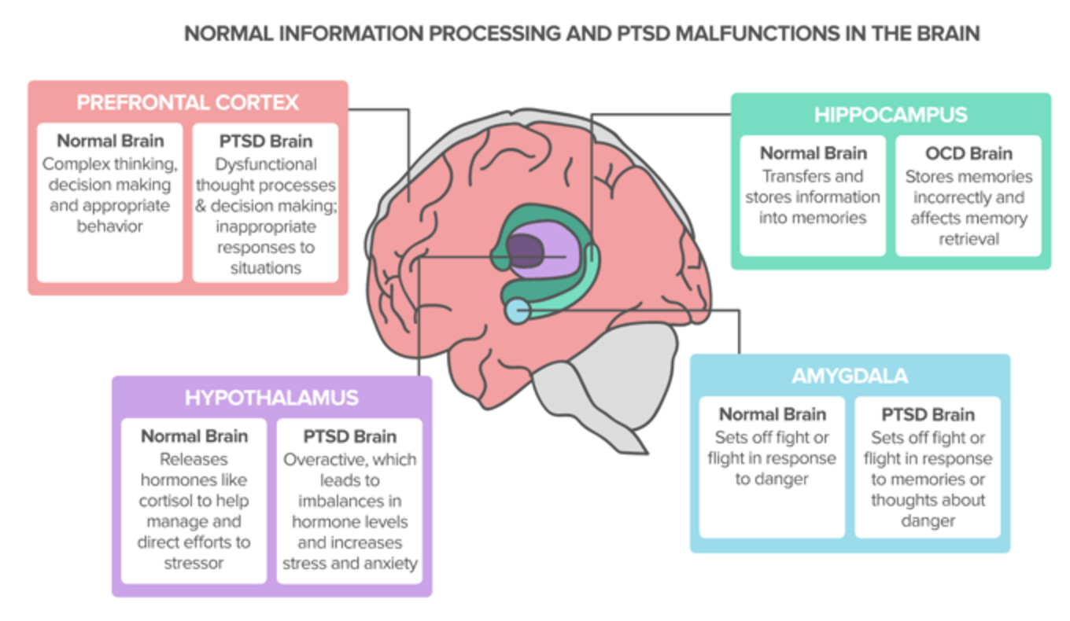
Pathophysiology
Sadock, B.J., Sadock, V.A., & Ruiz, P. (2015). Kaplan & Sadock's synopsis of psychiatry: Behavioral sciences/clinical psychiatry. Philadelphia, PA: Wolters Kluwer.
Notes:
(J) So lets look into the physiological processes associated with PTSD. In order to give you a better understanding I will describe a normal response before the PTSD response.
Person Unaffected by PTSD:
Individual is exposed to a threat, their sympathetic NS (fight or flight) response is activated
Release norepinephrine & epinephrine, pupils dilate, mouth dries, adrenal glands release norepinephrine, liver releases glucose, bladder inhibits urination, and skin increases sweat production
Brain releases ACTH, cortisol and adrenaline and HR will increase
When you are no longer exposed to the threat → parasympathetic NS will kick in and processes will reverse
PTSD Reaction:
Chronic stress, the brain overestimates danger - the sympathetic NS is in over-drive, chronically activated and your stress system malfunctions, remaining on high alert with continual release of hormones such as ACTH, cortisol and adrenaline
Brain will make mistakes interpreting the environment around you and different structures will begin to function differently
Here are the four structures association (point at diagram)Amygdala, Prefrontal cortex and the hypothalmus
The hippocampus is a comorbidity with PTSD meaning it is a symptom in the brain the is sometimes also associated

Slide 16
Neuroanatomy
AMYGDALA
Trigger initial reaction to threat
Reduced volume
Increased activity
PREFRONTAL CORTEX
Cognitive understanding of the event
Decreased response during threat
HIPPOCAMPUS
Reduced volume
Allow brain to learn/create memories to specific threats
Notes:
(J)
Amygdala:
-amygdala is responsible for stimulating the hippocampus to allow the brain to learn and create memories pertaining to specific threats
-The initial reaction to a traumatic stressor is triggered by the amygdala
Prefrontal Cortex:
- The prefrontal cortex is responsible for maintaining a cognitive understanding of the stimulus, including the event itself and the biopsychosocial responses of the traumatic event in the short and long-term
Hippocampus
Read off slide for this

Slide 17
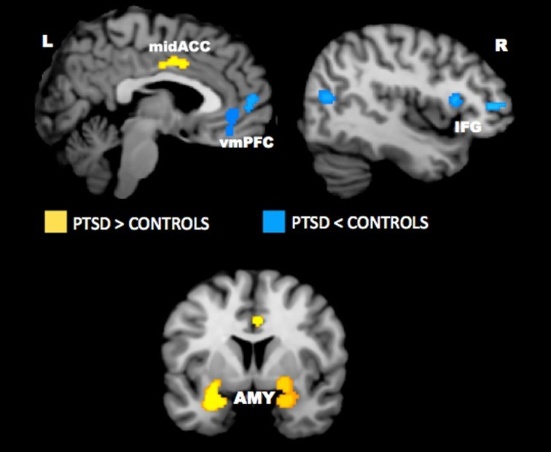
Research
Negative stimuli
Amygdala and ACC→ hyperactive
Lateral and medial prefrontal cortex→ hypoactive
Neurocircuitry model
Abnormality in the vmPFC causes overactivation in the amygdala
inflated fear response and weakened fear extinction learning
“Salience Network”
Hayes, J. P., Vanelzakker, M. B., & Shin, L. M. (2012). Emotion and cognition interactions in PTSD: a review of neurocognitive and neuroimaging studies. Frontiers in Integrative Neuroscience,6(89).
Notes:
(J) There was a study that took a meta-analysis of imaging studies in PTSD
-observations found that the amygdala and mid-anterior cingulate cortex was hyperactive, and the lateral and medial prefrontal cortex was hypoactive in PTSD for negative stimuli (threat not decrease) as opposed to neutral and positive stimuli
-abnormality in the ventromedial prefrontal cortex causes overactivation of the amygdala
- progresses to an inflated fear response and weakened fear extinction learning.
-The dorsal anterior cingulate cortex, anterior insula, and amygdala contain a salience network that manages information of personal significance and is hyperresponsive in persons with anxiety

Slide 18
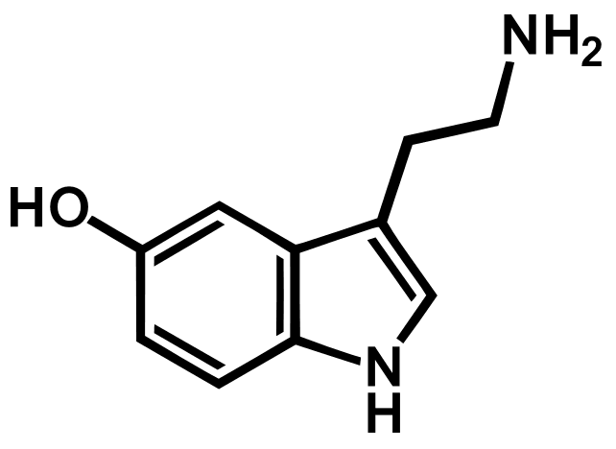
Neurobiology
Many neurochemicals that are not regulated the stress and fear response properly
Include catecholamine, serotonin, amino acid, peptide, and opioid neurotransmitters
Focus on Serotonin
NT derived from Tryptophan
14 different types of receptors
Notes:
(J)
In PTSD there are many neurochemical that are involved in stress and fear response that unfortunately are not properly regulated in the brain
These include amino acid regulation, peptide, opioid NT, and many others
We will focus on the 5HT pathway that Seratonin is involved in. We going to discuss the normal mechanism of 5HT and how that pathway is different individuals with PTSD

Slide 19
Serotonin
5HT Pathway
Interacts with NS to coordinate stress response, impulsivity, depression, aggression etc.
Anxiogenic Effect
Produces anxiety
Anxiolytic Effect
Inhibits anxiety
5HT 2 Receptor
Triggers excitatory
Upregulated during stress
5HT 1 Receptor (A&B subunits)
Triggers Inhibitory
Activation decrease firing of cells
Notes:
(R) Serotonin or 5-hydroxytryptamine is a monoamine neurotransmitter. THe 5HT pathway is involved with the nervous system to co-ordinate stress response and other behaviour such as impulsivity, depression, aggression and other task like sleep as well. Serotonin can have an anxiogenic or anxiety producing effect as well as an anxiolytic effect which inhibits anxiety.
Which does it produce? It depends on which area of the brain is impacted and how much. The 5HT 2 receptor is involved in the excitatory pathway to produce anxiety. The 5HT 1 receptor triggers the inhibitory pathway and stops anxiety

Slide 20
Studies on Serotonin & PTSD
Mice that had knockout 5HT 1A receptors showed increased anxiety and fear response compared to the control (Ramboz et al., 1998)
Mice models exposed to stress exhibit a downregulation of 5HT 1A receptors (McKittrick et al., 1995)
Changes to the density of 5HT 1B receptors in the brain links to clinical symptoms of PTSD (Pietrzak et al., 2013)
Notes:
(R) Previous research have suggested that the Serotonin receptors are involved in PTSD. In one study, mice that had the 5-HT receptor knockout showed increased anxiety and fear response. In another study using mice, researcher found that mice exposed to stress had a downregulation of 5-HT receptors. Lastly, in a more current study, researchers found that the density of the 5-HT receptors correlates clinical symptoms of PTSD

Slide 21
Treatment: Pharmacotherapy
Selective serotonin reuptake inhibitor (SSRIs)
Function by blocking the presynaptic receptors that uptake serotonin into the neurons
Blocks the uptake into neurons thus allowing an increase in serotonin into the synaptic cleft
2 Approved SSRIs drugs by FDA for PTSD:
Sertraline
Paroxetine
Notes:
(R)The most common type of medication given to PTSD patients is SSRIs. The function of SSRI is to block the pre-synaptic receptors therefore neurons cannot uptake any serotonin. Therefore, Serotonin cannot activate the excitatory pathway in patients. Previous studies have suggested that SSRIs are more effective in decreasing PTSD symptoms compared to other drugs like MAOs. There are only 2 types of SSRI that is approved by FDA

Slide 22
Treatment: Psychological Therapy
Cognitive Behavioural Therapy
GOAL: teach PTSD patients how to reduce their PTSD symptoms cognitive process
5 Main Steps:
Interview
Re-experience
Experience Negative Effect
Relaxation Exercise
Application outside session
Notes:
R) Goal- teach PTSD patients how to reduce their PTSD symptoms cognitive process (aka the way the patient thinks and act ). There are five main steps
1. therapist + patient goes through an interview to better understand the problem that the patients is facing
2. patient is asked about their symptoms and asked to re-call their traumatic experience.
3. series of sessions where their traumatic event is described and imagine again
4. Patient will focus on the negative effect which will increase their arousal then is given relaxation exercise
5. Patient is asked to try to use the techniques outside of the session and confront triggers that produces anxiety
CBT aims to help ppt chnage the way thei think about their experience therefor must evoke the experience through re-experiencing it

Slide 23
Treatment: Other Factors
1. Lifestyle Choices
Healthy diet
Socializing with family and friends
Refraining from alcohol
2. Support Groups with other PTSD patients
Notes:
Typically, PTSD are recommended to take medication and participate in therapy as part of their treatment. Additionally, other factors can help the individual with coping. Some of these include
Making good lifestyle and Self Care choices. Example, proper exercise, social life with friends and family, refrain from drugs and alcohol
Support Groups (Either with friends or friend or when a professional support group)

Slide 24
Back to Patient X...
Origin
Symptoms
Pathophysiology
Neuroanatomy
Treatment
Notes:
Rebeca probably best if you do this slide since I will be closing with the resources
Looking back at patient X
He was war veteran
He has anxiety and re-experiencing symptoms
4 areas in the brain that were affected
Symptoms are chronic because he left months ago
Treatment-has different options choose from
His wife is looking to some further resources

Slide 25
Resources
Notes:
(J) There are a lot of mental health resources that are related to people struggling with PTSD. Although some of these organizations don’t specialize specifically in PTSD, there are treatments or programs that they may provide. A lot of these organizations work together as opposed to separate and different organizations may handle different illnesses depending on the community that they are located in. If some can’t find what they are looking for at one of these organizations they will have connections to others that do. These five organizations are not the only five that deal with PTSD. There are a variety of them out there, the common ones were selected that were located in Canada.
Post-traumatic Stress Disorder Association of Canada (PTSDAC)
This is a not for profit organization that provides general information to aid individuals with PTSD, that may be susceptible to PTSD, caretakers, families, friends and co-workers. They provide you with a self-assessment tool that may help you understand the level of PTSD the individual has and if they should seek professional advice. Many of the symptoms of PTSD overlap with other illnesses and this checklist can help doctors create a more accurate diagnosis (PTSDAC, 2016).
Veterans Transition Network (VTN): Veterans Transition Network looks to help people in the military with PTSD when they come back home from war torn countries around the world. VTN wants to help bridge the gap to let the individuals with PTSD know that there are others going through similar experiences that can help them through what they are dealing with. They also help them acquire the tools needed to transition back into society in a way that is healthy for them and their families. This way the military vets can maintain themselves when they attempt a different career once they leave the military (VTN, 2017).
(J)
Canadian Mental Health Association (CMHA):
CMHA wants to help people of all ages that are dealing with a mental illness. Each province in Canada has a provincial branch along with others in many cities. Each branch provides mental health services and programs that are most beneficial to community that it is located in. Among all of the programs and services, there are counselling sessions and groups that are provided to people struggling with PTSD (CMHA, 2017). Centre for Addictions and Mental Health (CAMH):
CAMH like CMHA has a wide variety of mental health services. What makes them different from CMHA is they also provide services for people with addictions related to drugs, alcohol, gambling, etc. They have treatment for people with PTSD as long as they have proper medical documentation. Also CAMH gives people connection to various helplines that people with PTSD can call and have someone listen/talk to them. Not only does CAMH have support for people with PTSD, but also for the families of the individuals struggling with the illness. At CAMH they can they can better understand what their loved one is going through and find the resources that they may need (CAMH, 2012).
Canadian Association for Suicide Prevention (CASP):
It has been said that people with PTSD may be at risk of suicide. Fortunately, CASP is an organization that looks to reduce the number of suicides in Canada along with the unfortunate consequences that come about them. If you need help they can connect you with resources like 24/7 help lines and crisis centres that may be located near the individual with PTSD. They also have support for the families that have lost loved ones to suicide. It is in these support groups that the loved ones try to understand that it is not how their loved one left this world that is to be remembered, but how they lived. CASP also gives resources to anyone in Canada, so that people can be more aware of people at risk of suicide so we can get them help (CASP, 2016).
This concludes our presentation, thank you!

Slide 26
References
American Psychiatric Association. (2013). Diagnostic and statistical manual of mental disorders (5th ed.). Arlington, VA: American Psychiatric Publishing.
Canadian Mental Health Association. (2017). Mental Health: CMHA Ontario. Retrieved September 22, 2017, from CMHA Ontario Web site: http://ontario.cmha.ca/
Centre for Addiction and Mental Health. (2012). Who We Are: CAMH. Retrieved September 22, 2017, from CAMH Web site: http://www.camh.ca/en/hospital/about_camh/who_we_are/Pages/who_we_are.aspx
Cognitive Behavioral Therapy (CBT) for Treatment of PTSD. (2017). http://www.apa.org. Retrieved 16 September 2017, from http://www.apa.org/ptsd-guideline/treatments/cognitive-behavioral-therapy.aspx
Davidson, J., Pearlstein, T., Londborg, P., Brady, K., Rothbaum, B., & Bell, J. et al. (2003). Efficacy of Sertraline in Preventing Relapse of Posttraumatic Stress Disorder. FOCUS, 1(3), 273-281. http://dx.doi.org/10.1176/foc.1.3.273
Dryden-Edwards, M. R. (n.d.). Posttraumatic Stress Disorder: Read Up on PTSD Symptoms. Retrieved September 27, 2017, from http://www.medicinenet.com/posttraumatic_stress_disorder/article.htm
Eye Movement Desensitization and Reprocessing Therapy | Psychology Today. (2017). Psychologytoday.com. Retrieved 27 September 2017, from https://www.psychologytoday.com/therapy-types/eye-movement-desensitization-and-reprocessing-therapy
Equine Therapy for (PTSD) Post Traumatic Stress Disorder. (2017). Calico Junction New Beginnings Ranch, Inc. Retrieved 26 September 2017, from http://www.calicojunctionnewbeginningsranch.org/ptsd.html
Ford, J. D., Grasso, D. J., Elhai, J. D., & Courtois, C. A. (2015). Posttraumatic stress disorder: scientific and professional dimensions. Amsterdam: Academic Press. Retrieved September 23, 2017, from http://scitechconnect.elsevier.com/wp-content/uploads/2016/05/PTSD.pdf
Friedman, M. J. (2007, January 31). PTSD: National Center for PTSD. Retrieved September 27, 2017, from https://www.ptsd.va.gov/professional/ptsd-overview/ptsd-overview.asp

Slide 27
Questions?

Slide 28
Question 1
What group of brain structures are associated with the neurobiology of PTSD?
i) Prefrontal cortex, amygdala, cerebellum, hypothalamus
ii) Hypothalamus, amygdala, prefrontal cortex, motor cortex
iii) Prefrontal cortex, hypothalamus, hippocampus, amygdala
iv) Sensory cortex, amygdala, cerebellum, hippocampus
v) Hippocampus, amygdala, prefrontal cortex, occipital lobe

Slide 29
Question 1
What group of brain structures are associated with the neurobiology of PTSD?
i) Prefrontal cortex, amygdala, cerebellum, hypothalamus
ii) Hypothalamus, amygdala, prefrontal cortex, motor cortex
iii) Prefrontal cortex, hypothalamus, hippocampus, amygdala##
iv) Sensory cortex, amygdala, cerebellum, hippocampus
v) Hippocampus, amygdala, prefrontal cortex, occipital lobe

Slide 30
Question 2
What is the function of selective serotonin reuptake inhibitors (SSRI’s) in the nervous system?
i) Blocking the postsynaptic receptors that uptake serotonin
ii) Breaking down serotonin to decrease serotonin concentration in the synaptic cleft
iii) Blocking the presynaptic receptors that uptake serotonin
iv) Decrease action potential firing activity in the postsynaptic neurons
v) Producing 5-hydroxytryptophan (a serotonin precursor), to increase serotonin in the cleft

Slide 31
Question 2
What is the function of selective serotonin reuptake inhibitors (SSRI’s) in the nervous system?
i) Blocking the postsynaptic receptors that uptake serotonin
ii) Breaking down serotonin to decrease serotonin concentration in the synaptic cleft
iii) Blocking the presynaptic receptors that uptake serotonin##
iv) Decrease action potential firing activity in the postsynaptic neurons
v) Producing 5-hydroxytryptophan (a serotonin precursor), to increase serotonin in the cleft

Slide 32
Thank You!

