Slide 1
Snake Venom

Slide 2
Snake Venom and its Effects on The Body
2017 – 11 – 29
Bosco Xu and Aravind Rajendran
Life Science 4M03
Supporting Cast: Curtis M., Harleen K., and Yhameen H.
1 of 26

Slide 3
Outline
History and Evolution
Interesting Snake/Venom Facts
How To Identify Venomous Snakes
Fang Structures
Classification of Snake Venom
Injection Tactics
Chemical Make-Up of Venom
Factors Determining Venom Quantity
Mechanisms of Action (Normal)
Mechanisms of Action (Toxins)
Determining Venom Toxicity
Physiological Effects
Use of Snake Venom to Treat Disease
Snake Bite Venom Management
Snake Venom Immunity
Venom Treatment
Current and Future Studies
Conclusion
2 of 26

Slide 4
History and Evolution
Culturally significant
Egyptians – Atoum | Greek – Acheloos
Hinduism – Kaleyeni | Christianity – Devil
Venom genetically ancestral to snakes
https://www.pinterest.fr/sbastienquercy/pith%C3%B4m-pi-atoum-tjekou/
(Boquet, 1979; Fry, 2005; Fry 2012)
3 of 26

Slide 5
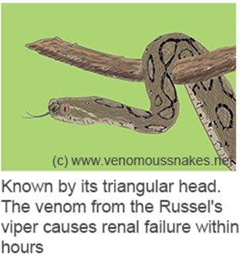
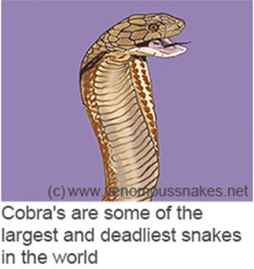
Interesting Venom/Snake Facts
8000 venomous snake bites are reported in USA every year (Copperhead Most)
India - most affected (35000-50000 deaths/year)
Prey includes fish, frogs, snails, lizards, chickens, mice, other snakes
Venom is primary offensive weapon
Belcher’s Sea Snake Bite = Can Kill 1000 Humans
(Nielson, n.d; Kang et al., 2011)
4 of 26

Slide 6
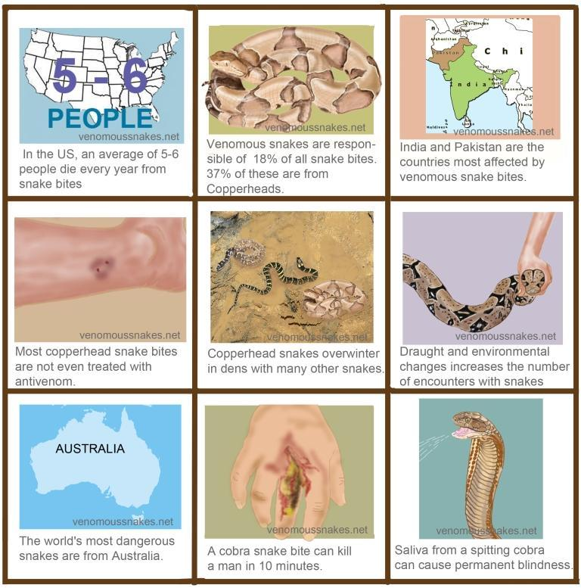
More Interesting Venom/Snake Facts
(Nielson, n.d; Kang et al., 2011)
5 of 26

Slide 7
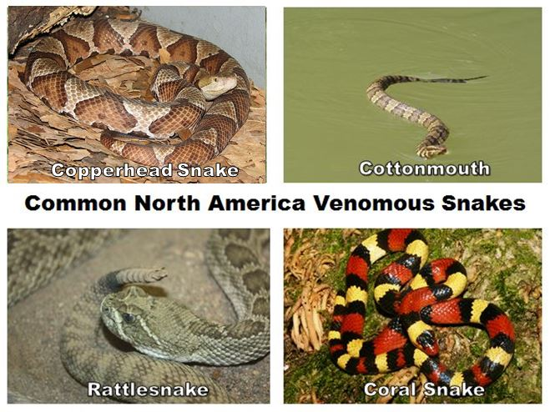
How to Identify Venomous Snakes
Three families of venomous snakes
Atractaspidids
Colubridae family
Lightly toxic venom
tissue necrosis
Elapids
Neurotoxin (central nervous systems/respiration)
Viperids
Hematoxic venom (tissue or blood)
Based on colours, triangular head, elliptical pupils, rattles, skin pattern etc.
https://1.bp.blogspot.com/-w2PccrKd2xk/WS1i_wEkBXI/AAAAAAAAPDI/_G2buHWOxc9g0QLU6pck8bGt77LLvbFACLcB/s1600/Common%2BVenomous%2BSnakes.JPG
(Underwood, 1979; Savage & Slowinski, 1992 and Reed, 2003 )
6 of 26

Slide 8
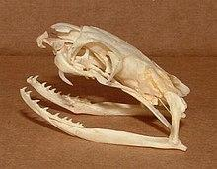
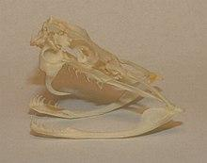
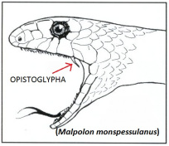
Fang Structures
https://upload.wikimedia.org/wikipedia/commons/thumb/8/87/Ophiophagus_hannah_skull.jpg/220px-Ophiophagus_hannah_skull.jpg
Three fang structures
Proteroglyphous
Elapid Family
Fixed to the jaw and cannot fold up
Solenoglyphous
Viper family
Attached to the jaw by a hinge and can be folded up against the roof of the mouth
Longest
Opisthoglyphous
Colubrid family
At the back of the mouth
https://upload.wikimedia.org/wikipedia/commons/thumb/f/ff/Crotalus_skull.jpg/220px-Crotalus_skull.jpg
https://allyouneedisbiology.files.wordpress.com/2015/02/malpolon-bo.jpg?w=204&h=176
(Vonk et al, 2008 and Warrell, 2010)
7 of 26

Slide 9
Classification of Snake Venom
Five different types of snake venom:
Hemotoxic Venom
RBCs or other tissue
Hemolysis, disrupts blood clotting etc.
Tissue Damage are permanent
Myotoxic Venom
Muscle tissues or kidney
Paralysis, loss muscle contraction etc.
Benefits for the snakes to eat and leave the prey flaccid
Neurotoxic Venom
Nervous system, respiration
Vomiting, droopy eyelids etc.
Cytotoxic Venom
Destroy and attacks the living cells of all sorts
Bleeding, swelling etc.
Haemorrhagic Envenoming
Bleeding in multiple organs
(Chang, 1979; Karlssoni, 1979; Ohsaka, 1979 and Russell, 1980 )
8 of 26

Slide 10
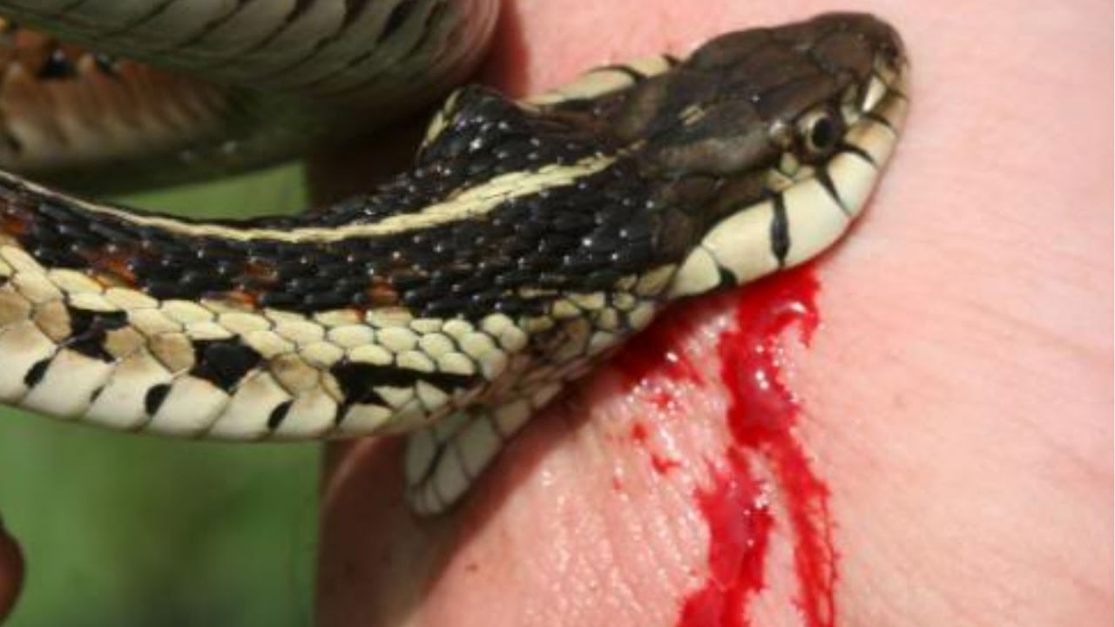
Injection Tactics
Purposes of bite
Inject the venom into their prey (immobilize and or kill)
Defend against attack by potential predators and antagonists
Fang Contact
Viperid snakes
Strike and release targets for both predatory and defensive bites
Elapid snakes
more inclined to hold after biting
more chance to delivery of more venom
more sophisticated delivery system
spit small fractions of venom for defensive purposes repeatedly
https://www.youtube.com/watch?v=srZmEsidcDE
(Malasit et al., 1986 )
9 of 26

Slide 11
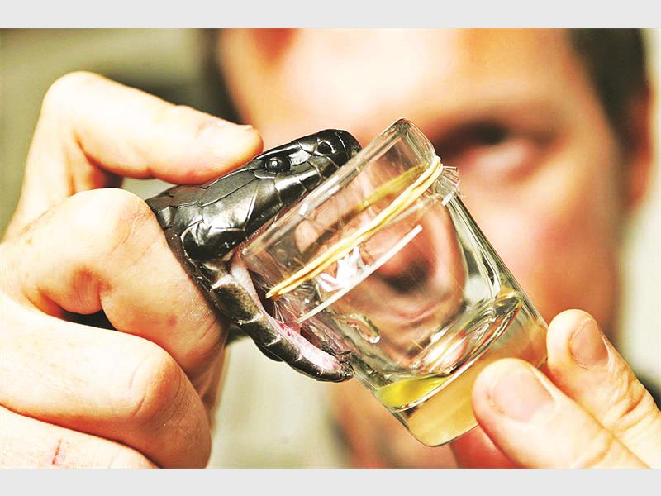
Chemical Make-up of Venom
Venom gland = modified version of salivary gland
Different toxin encoding genes = different venom
Primary constituents: proteins and peptides (aka toxins)
Contains 30 to >100 protein toxins
Common enzymes
Phospholipase A2s (PLA2s)
Serine proteinases
Metalloproteinases
Acetylcholinesterases (AChEs)
l-amino acid oxidases
http://www.sundayguardianlive.com/sites/sundayguardianlive.com/files/styles/article_page_image_895x550/public/
(Johnson, 2012; Casewell et al., 2014; Kang et al., 2011)
10 of 26

Slide 12
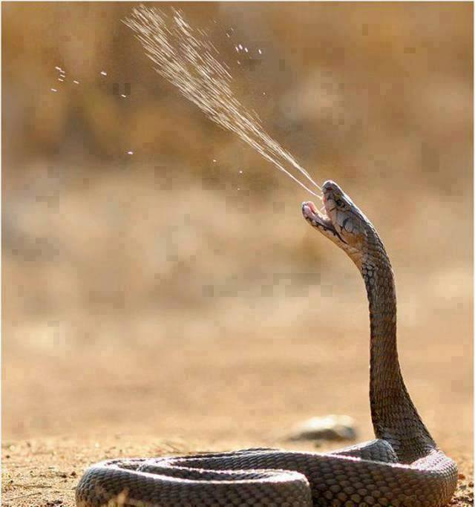
Factors Determining Venom Quantity
Correlates to snake’s size
Increases exponentially with snake size
Ranges from 1 mg to 850 mg
Accurate assessment of prey before venom injection
Situation + (Size/Type of Target)
Uses chemosensory, visual and thermal cues
Rattlesnakes increase venom quantity based on target size
https://www.youtube.com/watch?v=GYmU_wyQxyw
(Johnson, 2012; Young, Lee, & Daley, 2002)
11 of 26

Slide 13
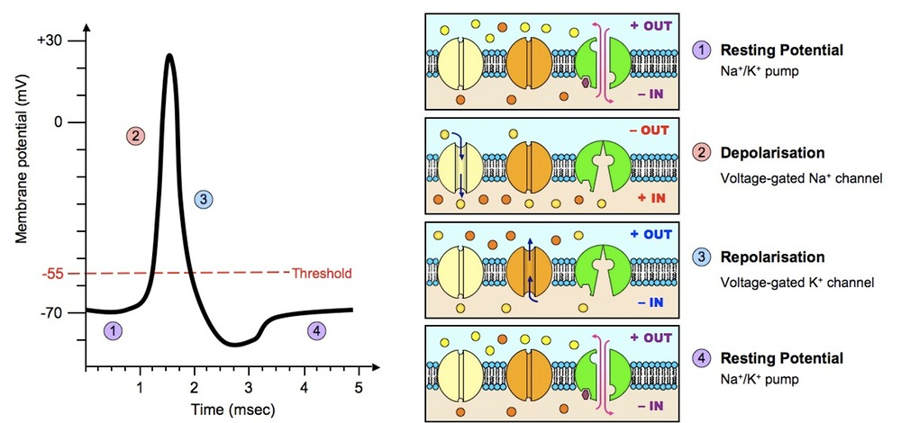
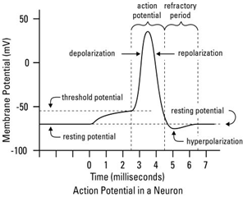
Toxins (Mechanism of Action) - Normal
http://www.dummies.com/education/science/understanding-the-transmission-of-nerve-impulses/
(Gong et al., 2008)
12 of 26

Slide 14
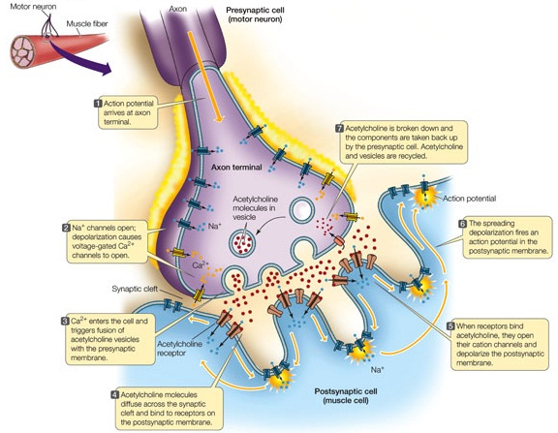
Toxins (Mechanism of Action) - Normal
https://universe-review.ca/I10-88-connSynapse.jpg
(Rossetto et al., 2008)
13 of 26

Slide 15
Toxins (Mechanism of Action) - Neurotoxins (Fasciculins)
NORMAL FASCICULIN
Target is Acetylcholinesterase
Acetylcholine NOT broken down
Overstimulation of postsynaptic neuron
Causes tetany (involuntary muscle contraction)
https://sites.google.com/a/macalester.edu/nerve-agents/home/acetylcholine-and-vx
(Lauridsen et al, 2016)
14 of 26

Slide 16
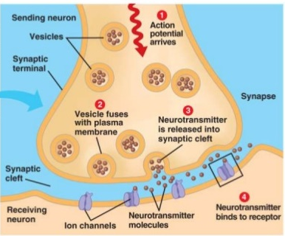
Toxins (Mechanism of Action) - Neurotoxins (Dendrotoxins/α-neurotoxins)
Dendrotoxins
α-neurotoxins
Target is K+ channels
Action Potentials NOT completed
No relay of message
Causes paralysis of nerves
Target is nicotinic acetylcholine receptors
Antagonistic
Acetylcholine cannot bind
Causes paralysis of nerves
https://www.epilepsyresearch.org.uk/about-epilepsy/background-to-seizures/
(Laustsen et al, 2015; Lauridsen et al, 2017)
15 of 26

Slide 17
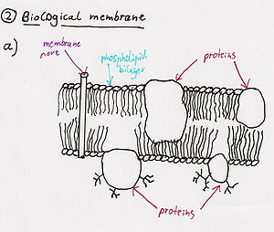
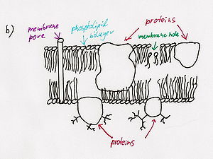
Toxins (Mechanism of Action) - Cytotoxins (Phospholipases)
Hydrolyze phospholipids
Several physiological systems affected
Integrity of the membrane lost
Cell membrane ruptures
https://en.wikipedia.org/wiki/Snake_venom#Neurotoxins
(Valdez-Cruz et al, 2007)
16 of 26

Slide 18
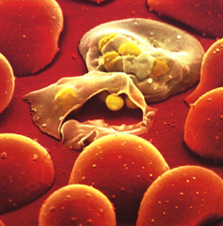
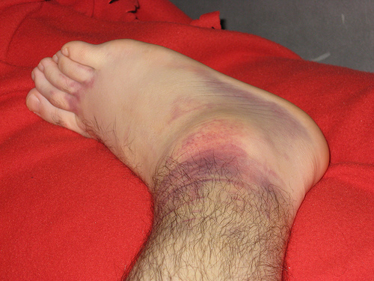
Toxins (Mechanism of Action) - Cytotoxins (Hemotoxins)
Causes hemolysis
Induce excess blood coagulation
Result is vast internal bleeding
Death (Most Deadly Snake Toxin)
http://www.zo.utexas.edu/faculty/sjasper/images/malariaRBC.jpg
http://www.newhealthguide.org/Internal-Bleeding-Symptoms.html
(Tang et al, 2016)
17 of 26

Slide 19
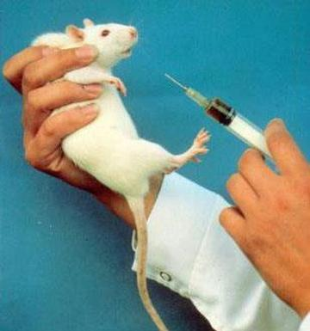
Determining Venom Toxicity
LD-50 test
Find the required dose that will kill half of the population of species
Not considered a biological constant
(Zbinden & Flury-Roversi 1981).
http://www.occupyforanimals.net/uploads/7/7/3/5/7735203/1065327.jpg?362
http://trinities.org/blog/wp-content/uploads/1-Person-in-2-natures.png
(Elli, 2017; Kini & Evans, 1990)
18 of 26

Slide 20
Physiological Effects
Different species, different symptoms
Common Symptoms:
Swelling and redness
Pain around the area
Difficulty breathing
Nausea
Blurred vision
Sweating
Salivating
Numbness
Interference in platelet aggregation
https://www.mesotheliomalawyercenter.org/site/wp-content/uploads/2013/05/symptoms.jpg
(Elli, 2017; Kini & Evans, 1990)
19 of 26

Slide 21
Use of Snake Venoms to Treat Disease
Venoms consist of:
Complex proteins, peptides, enzymes, etc.
Use in cancer
Inhibit cell proliferation and promote cell death
Occur because of increased/decreased expression of proteins that control the cell cycle, apoptosis induced cancer cells, etc.
Create drugs involved with:
Thrombin inhibition, blood thin, etc.
http://news.mit.edu/sites/mit.edu.newsoffice/files/images/2012/20121003154740-0_0.jpg
(Elli, 2017; Kini & Evans, 1990)
20 of 26

Slide 22
Snake Bite Venom Management
https://www.offgridweb.com/preparation/infographic-snake-bite-first-aid/
Common hazard in some places of the world
Snake bite venom management:
1. First aid
2. Hospital emergency care
3. History and physical examination
4. Laboratory tests
5. Targeted therapy (anti-snake venom)
(Ahmed et al., 2008)
21 of 26

Slide 23
Snake Venom Immunity
Immunoglobulins from immunizing horses with snake venom
Antivenom created from horse serum
Sole effective antidote
Steve Ludwin…snake venom immunity? (www.cnn.com/.../snake-venom-self-immunization-steve-ludwin-...)
http://uk.businessinsider.com/a-man-who-injects-himself-with-snake-venom-says-it-is-keeping-him-young-and-could-save-thousands-of-lives-2016-7
(Ahmed et al., 2008; Froissart, 2017)
22 of 26

Slide 24
Venom Treatment (1868 case)
Man bitten by venomous snake in 1868
Surgeon ties ligature & cuts site of bite
Pours ammonia on wound site
Meanwhile, patient drinks brandy
Applies mustard poultice to abdomen, hand, feet
Injects ammonia into vein of bitten arm
Patient (somehow) survives
(Hobbins, 2017)
23 of 26

Slide 25
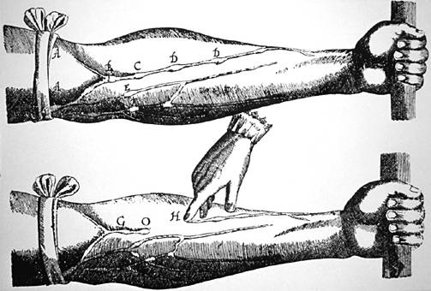
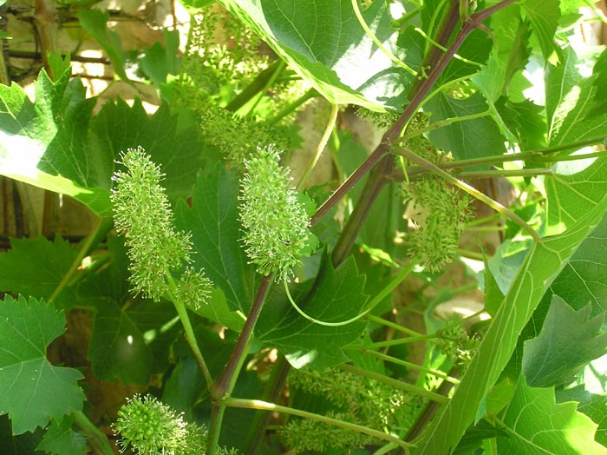
Other Traditional Venom Treatments
http://www.iflscience.com/editors-blog/10-survival-myths-that-might-get-you-killed/
http://web.ecs.baylor.edu/faculty/newberry/myweb/gtx%20os%20files/f05%20student%20pages/morehouse-basinger/Harvey%207.htm
http://www.uniprot.org/taxonomy/29760
Suction
Ligature
Medicinal plants (Vitis vinifera L)
(Hobbins, 2017; Gupta & Peshin, 2012
24 of 26

Slide 26
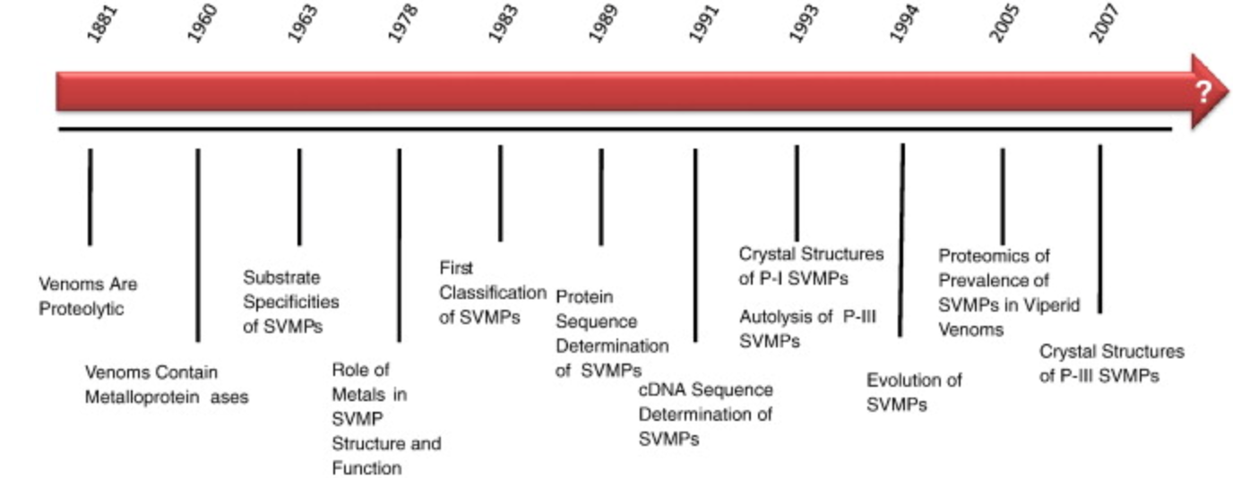
Current and Future Studies
Venom used in pharmaceutical research
(Fox and Serrano, 2007)
25 of 26

Slide 27
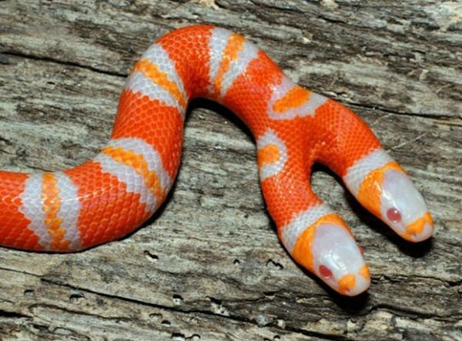
Conclusion
https://www.factslides.com/s-Snake
Venom is a defence mechanism/offensive weapon
Venom quantity increases with snake's size + prey size/type
Different Toxin, target different body components/processes (action potentials, red blood cells, etc.)
Different snake bites = different physiological effects
Venom as cancer treatment (inhibit cell proliferation/promote)cell death
Snake bite can be treated:
First aid
Emergent Care
Targeted Therapy
Anti-venom Treatment
26 of 26

Slide 28
References
Boquet, P. (1979). History of snake venom research. In Snake venoms (pp. 3-14). Springer, Berlin, Heidelberg.
Casewell, N. R., Wagstaff, S. C., Wüster, W., Cook, D. A. N., Bolton, F. M. S., King, S. I., … Harrison, R. A. (2014). Medically important differences in snake venom composition are dictated by distinct postgenomic mechanisms. Proceedings of the National Academy of Sciences, 111(25), 9205–9210. https://doi.org/10.1073/pnas.1405484111
Chang, C. C. (1979). The action of snake venoms on nerve and muscle. In Snake venoms (pp. 309-376). Springer Berlin Heidelberg.
Fox, J. W., & Serrano, S. M. (2007). Approaching the golden age of natural product pharmaceuticals from venom libraries: an overview of toxins and toxin-derivatives currently involved in therapeutic or diagnostic applications. Current pharmaceutical design, 13(28), 2927-2934.
Fox, J. W., & Serrano, S. M. (2009). Timeline of key events in snake venom metalloproteinase research. Journal of PROTEOMICS, 72(2), 200-209.
Gupta, Y. K., & Peshin, S. S. (2012). Do Herbal Medicines Have Potential for Managing Snake Bite Envenomation? Toxicology International, 19(2), 89–99. https://doi.org/10.4103/0971-6580.97194
Gong, B., Liu, M., & Qi, Z. (2008). Membrane potential dependent duration of action potentials in cultured rat hippocampal neurons. Cellular and Molecular Neurobiology, 28(1), 49-56. doi:10.1007/s10571-007-9230-5
Hobbins,P. (n.d.). Hissstory: how the science of snake bite treatments has changed. Retrieved November 25, 2017, from http://theconversation.com/hissstory-how-the-science-of-snake-bite-treatments-has-changed-71408
Jackson, K. (2007). The evolution of venom-conducting fangs: insights from developmental biology. Toxicon, 49(7),975-981.
Johnson,s. (2012). Venomous Snake FAQs. Ufwildlife.ifas.ufl.edu. Retrieved 25 November 2017, from http://ufwildlife.ifas.ufl.edu/venomous_snake_faqs.shtml
Kang, T. S., Georgieva, D., Genov, N., Murakami, M. T., Sinha, M., Kumar, R. P., …Kini, R. M. (2011). Enzymatic toxins from snake venom: structural characterization and mechanism of catalysis. FEBS Journal, 278(23),4544–4576. https://doi.org/10.1111/j.1742-4658.2011.08115.x
Karlsson, E. (1979). Chemistry of protein toxins in snake venoms. In Snake venoms (pp. 159-212). Springer Berlin Heidelberg.
Lauridsen, L. P., Laustsen, A. H., Lomonte, B., & Gutiérrez, J. M. (2017). Exploring the venom of the forest cobra snake: Toxicovenomics and antivenom profiling of naja melanoleuca. Journal of Proteomics, 150(Complete),98-108. doi:10.1016/j.jprot.2016.08.024
Lauridsen, L. P., Laustsen, A. H., Lomonte, B., & Gutiérrez, J. M. (2016). Toxicovenomics and antivenom profiling of the eastern green mamba snake (dendroaspis angusticeps). Journal of Proteomics, 136(Complete),248-261. doi:10.1016/j.jprot.2016.02.003
Laustsen, A. H., Lomonte, B., Lohse, B., Fernández, J.,& Gutiérrez, J. M. (2015). Unveiling the nature of black mamba (dendroaspis polylepis) venom through venomics and antivenom immunoprofiling: Identification of key toxin targets for antivenom development. Journal of Proteomics, 119(Complete), 126-142. doi:10.1016/j.jprot.2015.02.002
Malasit, P., Warrell, D. A., Chanthavanich, P.,Viravan, C., Mongkolsapaya, J., Singhthong, B., & Supich, C. (1986).Prediction, prevention, and mechanism of early (anaphylactic) antivenom reactions in victims of snake bites. Br Med J (Clin Res Ed), 292(6512), 17-20.
Nielsen, A. Venomous Snakes - facts, species, bites and natural history. Venomoussnakes.net. Retrieved 24 November 2017, from http://www.venomoussnakes.net/
Ohsaka, A. (1979). Hemorrhagic, necrotizing and edema-forming effects of snake venoms. In Snake venoms (pp. 480-546). Springer Berlin Heidelberg.

Slide 29
References
Reed, R. N. (2003). Interspecific patterns of species richness, geographic range size, and body size among New World venomous snakes. Ecography, 26(1), 107-117.
Rossetto, O.,Morbiato, L., Caccin, P., Rigoni, M., Carli, L., Paoli, M., . . . Montecucco,C. (2008). Tetanus, botulinum and snake presynaptic neurotoxins. RENDICONTI LINCEI, 19(2), 173-188. doi:10.1007/s12210-008-0010-z
Russell, F. E.(1980). Snake venom poisoning. Philadelphia, 18, 139-234.
Savage, J. M.,& Slowinski, J. B. (1992). The colouration of the venomous coral snakes (family Elapidae) and their mimics (families Aniliidae and Colubridae). Biological Journal of the Linnean Society, 45(3), 235-254.
Tang, E. L. H.,Tan, C. H., Fung, S. Y., & Tan, N. H. (2016). Venomics of calloselasma rhodostoma, the malayan pit viper: A complex toxin arsenal unraveled. Journal of Proteomics, 148(Complete), 44-56. doi:10.1016/j.jprot.2016.07.006
Underwood, G.(1979). Classification and distribution of venomous snakes in the world. In Snake venoms (pp. 15-40). Springer Berlin Heidelberg.
Valdez-Cruz, N. A.,Segovia, L., Corona, M., & Possani, L. D. (2007). Sequence analysis and phylogenetic relationship of genes encoding heterodimeric phospholipases A2 from the venom of the scorpion anuroctonus phaiodactylus. Gene, 396(1), 149-158. doi:10.1016/j.gene.2007.03.007
Vonk, F. J., Admiraal, J. F., Jackson, K., Reshef, R., de Bakker, M. A., Vanderschoot, K.,... & Mirtschin, P. J. (2008). Evolutionary origin and development of snake fangs. Nature, 454(7204), 630-633.
Warrell, D. A.(2010). Snake bite. The Lancet, 375(9708), 77-88.
Young, B. A., Lee, C. E., & Daley, K. M.(2002). Do Snakes Meter Venom? BioScience, 52(12), 1121–1126. https://doi.org/10.1641/0006-3568(2002)052[1121:DSMV]2.0.CO;2

