Slide 1
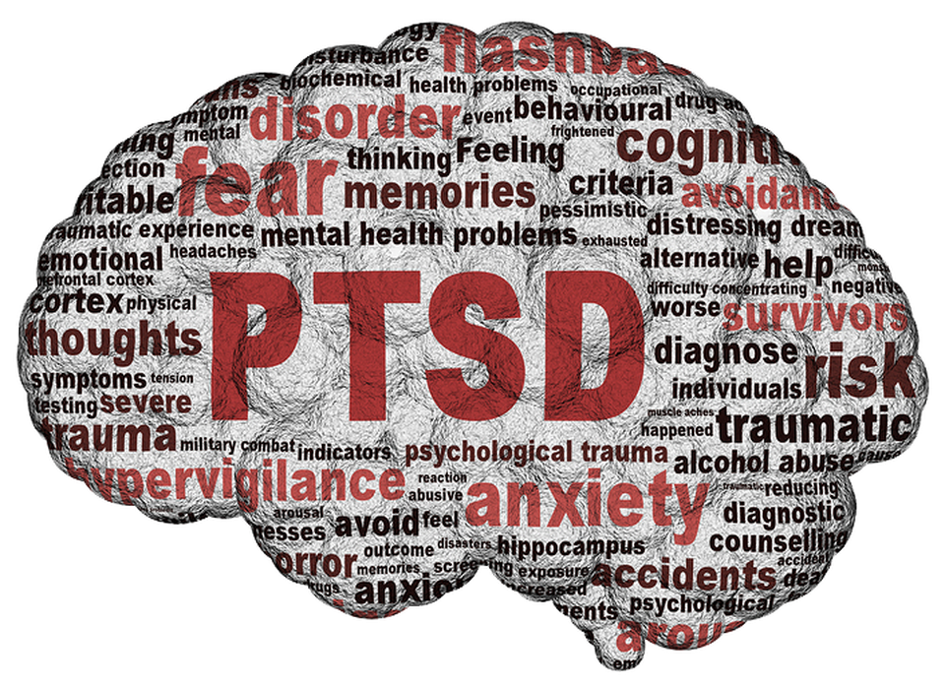
Post-Traumatic
Stress Disorder (PTSD)
(Essig, 2015)
Group 3 - Christina, Ahmad, Lucas, Roham, Sukhanwar

Slide 2
Outline
1. Introduction: Trauma, Diagnosis, Symptoms, Risk Factors
2. Pathophysiology
3. Treatment/Prevention
4. Case Study
5. Conclusion/Closing Remarks
(Cleaveland Clinic, 2018)

Slide 3
Introduction
PTSD: A mental disorder that develops after experiencing or witnessing a traumatic event.
PTSD was first coined after the Vietnam War.
Previously diagnosed as “shell shock” or “soldier’s heart”
American Psychiatric Association coined PTSD in 1980
First introduced into the Diagnostic and Statistical Manual of Mental Disorders, third edition (DSM-III)
Unlike many conditions, PTSD can affect ANYONE, even you!
(Khan Academy, n.d.)

Slide 4
70%
Of adults experience or witness at least one traumatic event in their lifetime.
10%
Of people who experience a traumatic event will develop PTSD.
(Recovery Village, 2019)

Slide 5
Trauma
Combat exposure (i.e. War)
Childhood (e.g. Neglect, Domestic violence, Sexual abuse, Bullying, Physical and Emotional abuse)
Sexual harassment or Sexual violence
Natural Disasters
Accidents, kidnapping, victim of a crime
Unexpected death of a loved one
Medical trauma (Injury, illness, procedures)
(Smith, Robinson, & Segal, 2019)
(Frontiers Science News, 2017)

Slide 6
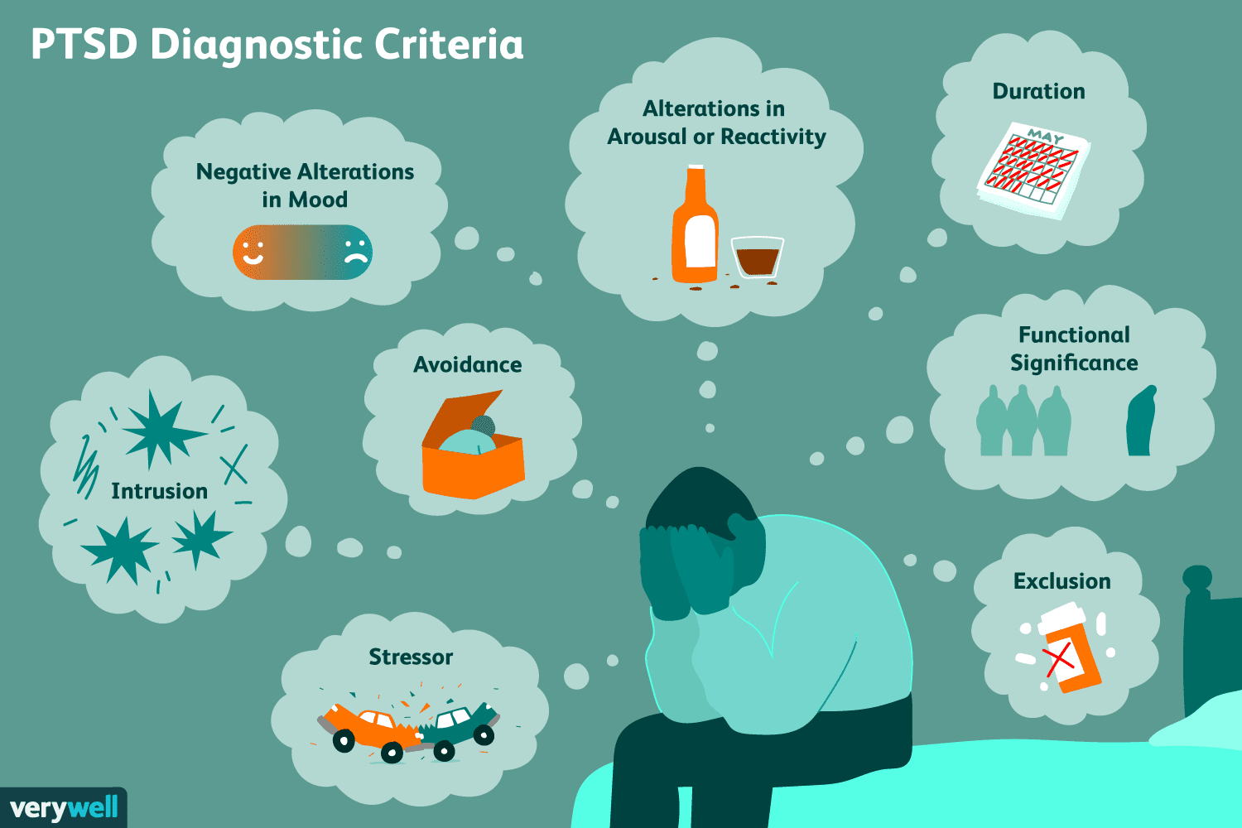
Diagnosis
DSM-5 contains the most up-to-date diagnosis method for PTSD
Involves a set of 20 questions that assesses your actions and thinking after a particular event
Responses are scored from 0-4
A minimum score of 31-33 from the 20 responses indicates potential PTSD
(Tull, 2019)

Slide 7
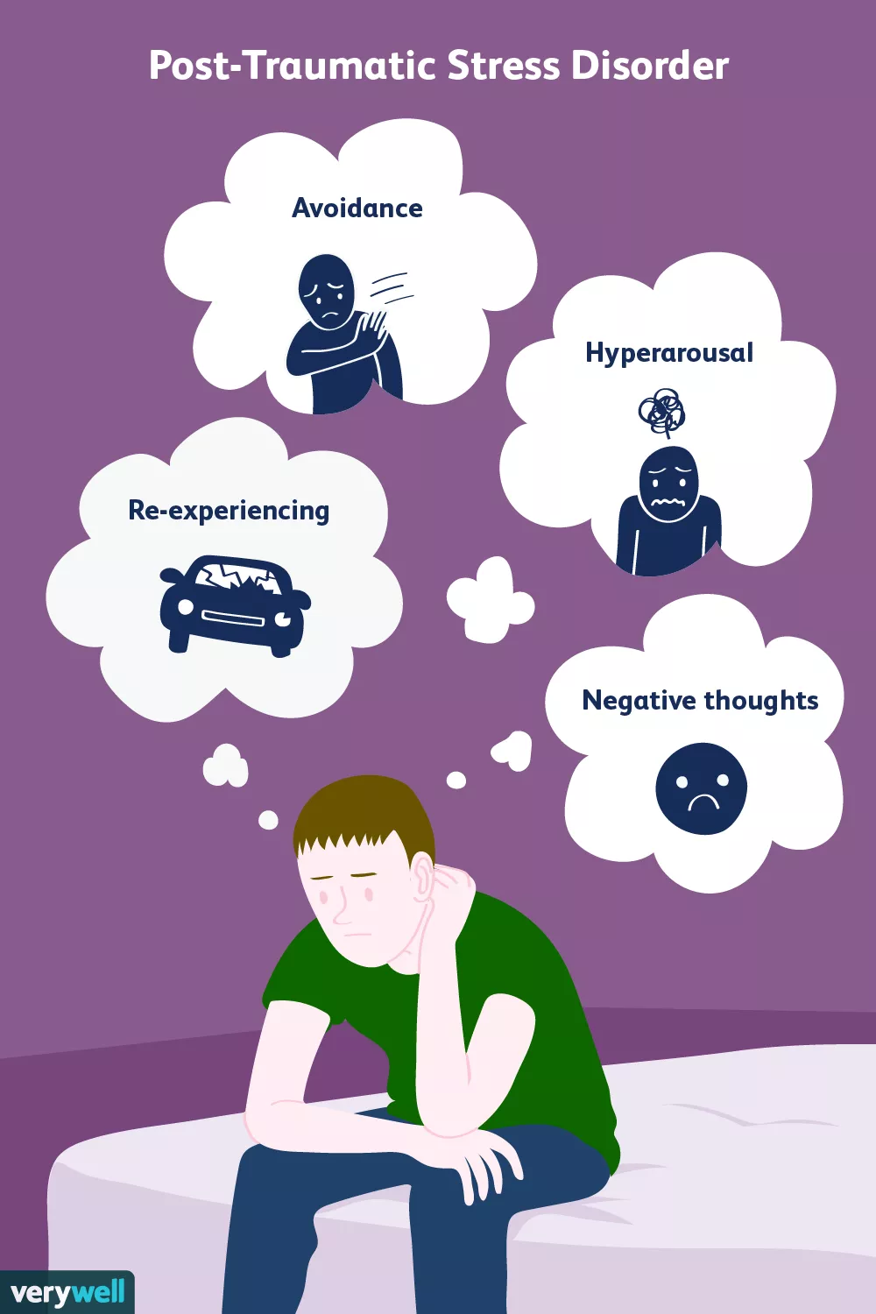
Symptoms
Symptoms categorized in four categories:
Reexperiencing symptoms
Reminders of traumatic event trigger symptoms such as flashbacks
Avoidance and numbing symptoms
Avoiding reminders of traumatic event. E.g. after car accident, a person avoids driving
Hyperarousal symptoms
These are constant and cause increased feeling of stress and anger
Cognition and mood symptoms
Persistent negative mood, loss of interest in people and activities, and feelings of detachment
(Tull, 2020)

Slide 8
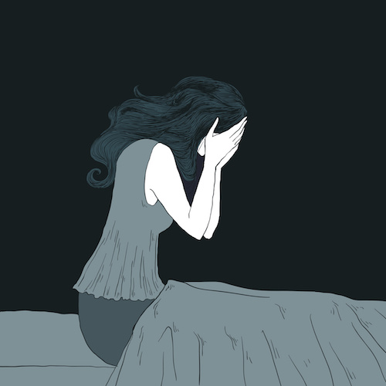
Risk Factors
Gender: Females are more likely to have PTSD.
The duration of the trauma: Long-lasting or repetitive
The age of exposure: Early age
Living through dangerous events or traumas (e.g. Jobs)
History / familial background of mental illness (e.g. Anxiety, depression)
Negative coping mechanisms / substance abuse
Lack of good support system
Dealing with extra stress after the event
(Vernor, 2019)
(Jones, 2018)
Notes:
Next, I would like to highlight some risk factors that increase one’s chance of getting PTSD. First, gender plays a critical role as females are twice more likely to have PTSD than males. Another risk factor is the duration of the trauma. If the trauma lasted for a long period of time or repeated several times, the individual is less likely to forget the experience and develop adverse reactions to it. Next, is the age of exposure. Children are the most susceptible group, as they are still in development. Due to their young age, the impact of the trauma is much greater in the developing brain. There are also studies in the literature that show that children experience much greater shock and … the trauma will continue to impact them later in life. Another risk factor is when an individual has to live through events or situations that remind them of the trauma. An example of this would be when a war veteran serves in the military personnel or first responder team. Also, if the affected individual has a mental disorder or if their family members have a mental illness, they are more likely to have PTSD.
Another risk factor is when an individual has negative coping mechanisms, such as substance abuse. Other risk factors are a lack of good support system, and dealing with extra stress after the event.

Slide 9
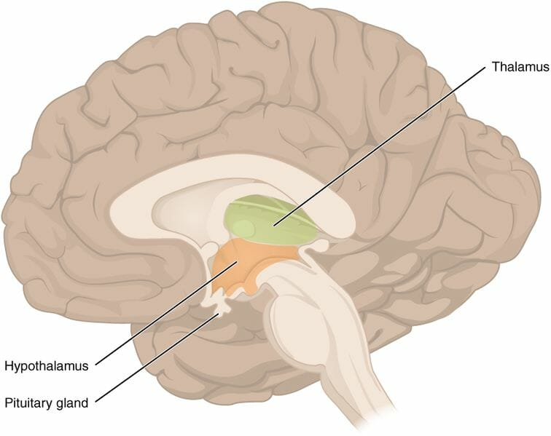
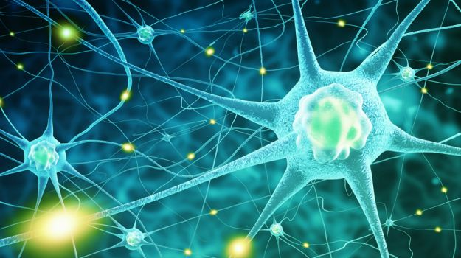
Pathophysiology
Genetics | Endocrine Factors
Neurochemical Factors | Brain Circuitry
(Carfagno, 2019)
(Biologydictionary, 2018)
(NeuroTracker, 2017)
(Paddock, 2018)
Notes:
Next, I will be talking about the factors that contribute to the pathophysiology of PTSD. So I will be covering genetic factors, endocrine factors, neurochemical factors and the brain circuitry.

Slide 10
Genetic Factors
Can PTSD be inherited?
Examined key candidate genes in major genotypes in connection with PTSD.
No general consensus in the literature.
(Risingchildren, 2018)
Notes:
So, the first factor is GENETICS -- studies have examined key candidate genes in major genotypes in connection with PTSD, to determine whether PTSD is an inheritable condition. As studies have not reached a consensus in the literature, more pieces of evidence are required to say that PTSD can be inherited.

Slide 11
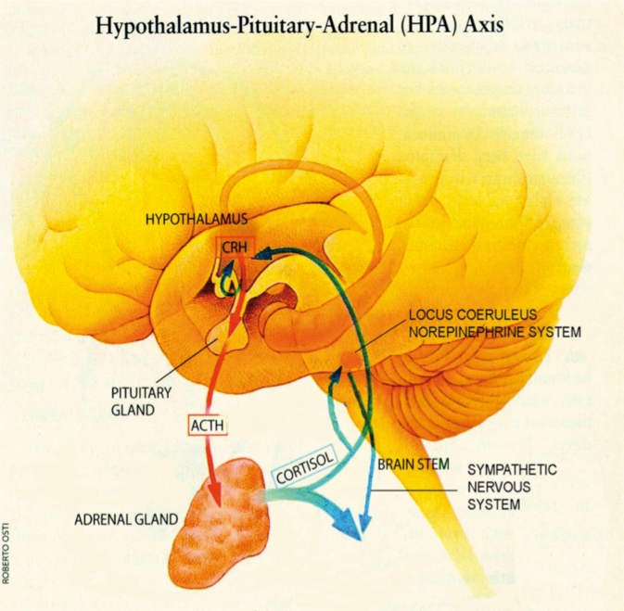
Endocrine Factors
Hypothalamic-pituitary-adrenal (HPA) axis is the body's major response system for stress.
The decreased availability of Cortisol results in abnormal regulation of HPA axis, which may promote abnormal stress reactivity and fear processing.
(Sherin & Nemeroff, 2011)
Notes:
With endocrine factors, the hypothalamic-pituitary-adrenal (HPA) axis in our body is the system that responds to stress. Studies have shown that individuals with PTSD have a decreased availability of cortisol, which is our main stress hormone. A decreased availability of cortisol likely promotes abnormal stress reactivity and fear processing.

Slide 12
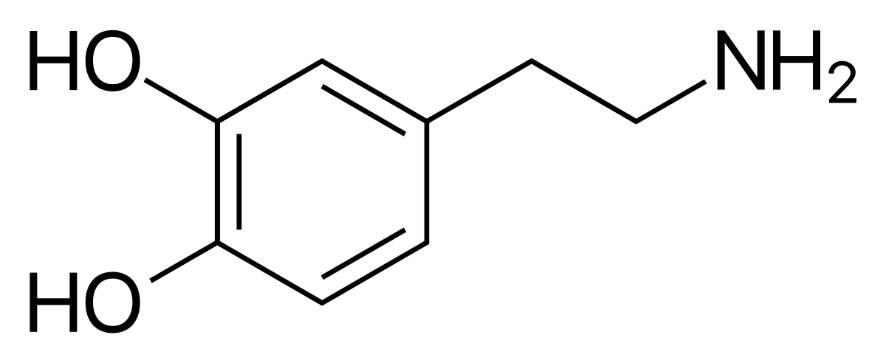
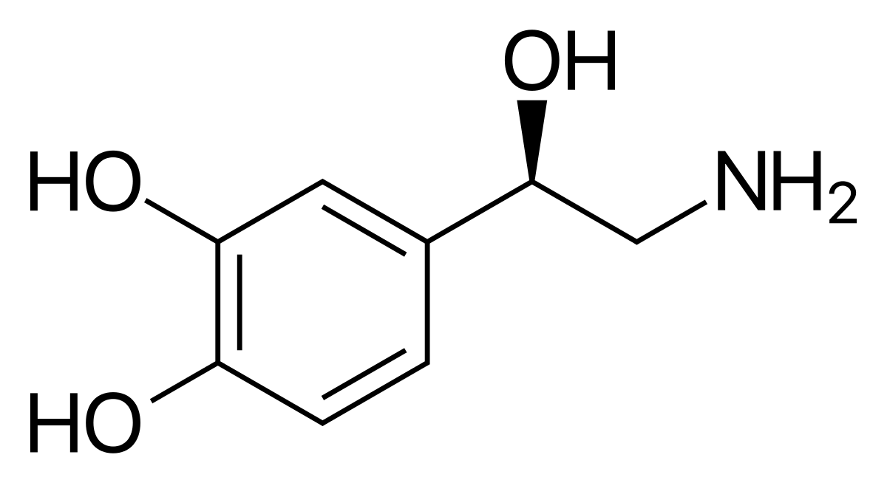
Neurochemical Factors
Increased dopamine levels in mesolimbic system may interfere with the fear conditioning process, which may explain the overgeneralization of fear in PTSD.
Hyperactivity of norepinephrine appears to associate with several PTSD symptomatology, including hyperarousal, heightened startle, and increased encoding of fear memories.
(Wikipedia, 2020)
(Wikipedia, 2020)
Notes:
There are also some neurochemical factors that play a role. Individuals with PTSD have excessive dopamine levels that interfere with the fear conditioning process. This explains why people with PTSD are easily provoked by fear. Also, individuals with PTSD have excessive levels of norepinephrine, which are associated with symptoms of hyper arousal, being easily startled or easily angered.

Slide 13
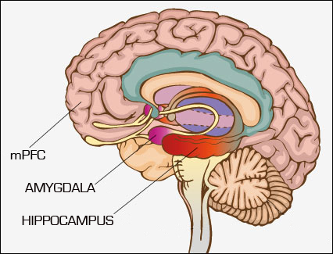
Brain Circuitry
Reduction in hippocampal volume
Associated with the severity of trauma and memory impairments
Hyper-responsiveness in amygdala
Associated with emotional memory and fear conditioning
(Equine ATI, n.d.)
Notes:
Lastly, in terms of brain circuitry there are two biological factors that increase the risk of developing PTSD– studies have shown that one common feature in most people with PTSD is that they have a reduced volume of the hippocampus, which is the part of the brain that stores memory. Also, studies have shown that most people with PTSD have a hyper-active amygdala, which is the part of the brain that provokes fear and emotions.

Slide 14
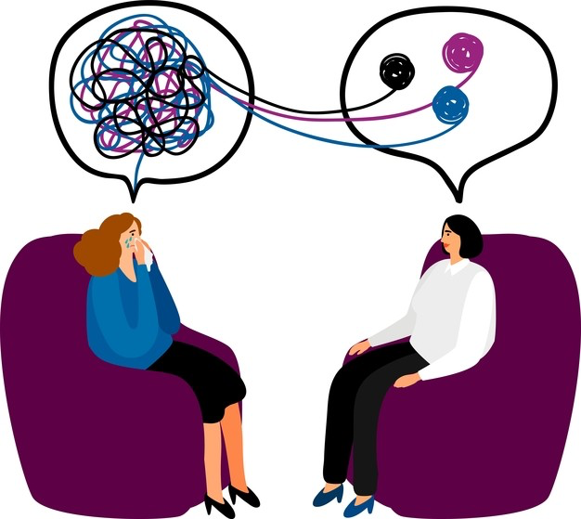
Treatment
Cognitive Processing Therapy
Prolonged Exposure Therapy
Eye Movement Desensitization
Stress Inoculation Therapy
(Dr. Diane, n.d.)
Notes:
So we learned about what PTSD is (diagnosis and symptoms, pathophysiology). Are there ant reatment options avilalbe?
One of the most common treatments for ptsd are
Cognitive Processing Therapy
Cognitive Processing Therapy (CPT). CPT is a 12-week psychotherapy course consisting of 60-90 minute weekly sessions. CPT is a very effective treatment that teaches an individual how to evaluate and change their negative thoughts towards their trauma. By changing their thoughts, they can change how they feel.
Prolonged Exposure Therapy
Another treatment is prolonged exposure therapy. This is specifically for individuals who avoid any potential reminders of their traumatic event, Prolonged Exposure Therapy (PE) involves constructing a list of things one has been avoiding and learning to face them one by one.
Eye Movement Desensitization
Another treatment that is less commonly used than the other two is the Eye movement desensitization and reprocessing. This is a way of associating positive things with the trauma by concentrating on the experience as they are doing another task that they enjoy.
Stress Inoculation Training
Lastly, Stress Inoculation Training (SIT) can be done alone or in a group, and is more focused on how to deal with the stress that was raised from the event. It incorporates breathing techniques to stop negative thoughts through relaxation of the body.

Slide 15
Prevention
Continuous communication with loved ones
Identify as a survivor as opposed to a victim
Practice the use of positive language and emotion
(DentistryIQ, 2020)
Notes:
Fortunately, there are protective measures that one can take to prevent PTSD from developing. Some of the measures one can take to prevent PTSD and reduce long-term suffering are:
Continuous communication with important people in your life-- this could involve discussing the trauma with loved ones or people who you know will listen to you.
Identify oneself as a survivor as opposed to a victim of the event. Setting the right attitude and the mindset regarding the trauma is very important.
Practicing positive language and emotion. This can include identifying positive meaning and lessons to be learned with the trauma experience.

Slide 16
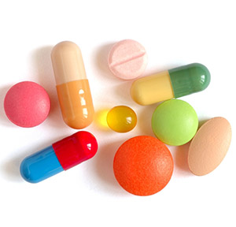
Medication
Medications can be used to better manage PTSD symptoms.
Medications target the neurotransmitters in our brain circuitry.
A lot of the medications for PTSD are anti-depressants and anti-anxiety drugs.
(Drugs.com, n.d.)
(Leafly, 2019.)
Notes:
You might ask – are there any biological treatments available besides therapy and training? Some individuals take medications to treat PTSD and better manage their symptoms. Medications primarily target the neurotransmitters in our brain to help them better deal with fear and anxiety. some examples of these medications are fluoxetine, sertraline, paroxetine (which you may have heard of them being used for depression and anxiety. As patients with PTSD develop depression and anxiety symptoms as a result of their trauma, these types of medication can help.

Slide 17
Case Study: War Veteran
Tom, a 23 year-old, white male who served in the Iraq war.
War: Witnessed suicide bombers, his fellow soldiers killed & injured.
Most distressing event: Having to kill a pregnant woman with a child.
“I killed an innocent family. I am a murderer.”
Symptoms: Night terrors, Insomnia, Anxiety, Flashbacks
Developed a severe drinking problem.
Diagnosed with PTSD in 2015.
(Lamplugh, 2017)
(Lamplugh, 2017)

Slide 18
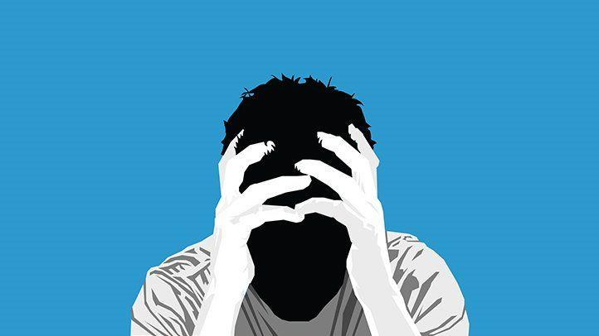
Conclusion
PTSD can affect anyone!
Broad symptoms which can differ depending on severity
Are assessed in the questionnaire for PTSD diagnosis
Many different treatments and medications are available
Preventative methods should be practiced, not just for PTSD!
(Lewis, 2018)
Notes:
In summary, the main takeaway of PTSD is that it can affect anyone, regardless of age or gender. It can be diagnosed through a questionnaire which analyzes thinking and behaviour after a traumatic event. Symptoms of PTSD are broad, and can differ depending on the severity of the PTSD, but they generally interfere with daily activities. Treatments for PTSD are available, and include Cognitive Processing Therapy, AND Prolonged Exposure Therapy. Preventative methods exist and should be practiced not just to avoid PTSD itself, but to maintain a healthier and more positive lifestyle. Even with preventative methods, sometimes PTSD is just inevitable depending on the severity of the event, but being able to know your options is essential when such instances occur.

Slide 19
References
Assessing and addressing the impact of childhood trauma. (2017). Frontiers Science News. https://blog.frontiersin.org/2017/06/20/frontiers-in-psychiatry-assessing-and-addressing-the-impact-of-childhood-trauma/
Biology Dictionary. (2018). How Does the Endocrine System Maintain Homeostasis. Retrieved from https://biologydictionary.net/how-does-the-endocrine-system-maintain-homeostasis/
Carfagno, J. (2019). Latest Research and Innovations in Genetics: Summer 2019. Retrieved from https://www.docwirenews.com/docwire-pick/future-of-medicine-picks/summer-2019-latest-research-and-innovations-in-genetics/
Drug Use in the Permian: Substance Abuse Advocates Look to Help Oil Workers. (n.d.). Retrieved March 25, 2020, from https://www.rigzone.com/news/drug_use_in_the_permian_substance_abuse_advocates_look_to_help_oil_workers-26-jul-2018-156417-article/
Equine ATI. (n.d.). Retrieved from http://equine-ati.com/neurobiology.html
Fraternal twins, identical twins and other types of twins. (2018). Raisingchildren. Retrieved from https://raisingchildren.net.au/pregnancy/health-wellbeing/twin-pregnancy/twins
Khan Academy. (n.d.). What is post traumatic stress disorder? Retrieved March 24, 2020, from https://www.khanacademy.org/science/health-and-medicine/mental-health/anxiety/a/post-traumatic-stress-disorder-article
Lamplugh, M.W. (2017). The Veteran Firefighter and Post Traumatic Stress Disorder. Retrieved from https://community.fireengineering.com/profiles/blog/show?id=1219672%3ABlogPost%3A635541
Lewis, L.L. (2018). When PTSD Accompanies a Concussion. Retrieved from https://www.everydayhealth.com/concussion/get-facts-about-concussion-ptsd/
Neurotracker. (2018).. Neuroscientists Discover the Hidden Powerhouse of Your Brain. Retrieved from https://neurotracker.net/2017/03/20/brain-hidden-powerhouse/
New year, new attitude: The power of positivity! (2020). DentistryIQ. Retrieved from https://www.dentistryiq.com/dental-assisting/staff-relations/article/14168128/new-year-new-attitude-the-power-of-positivity

Slide 20
References
Paddock, C. (2018). Schizophrenia: 'Resyncing' brain circuits could halt symptoms. Retrieved from https://www.medicalnewstoday.com/articles/323094
Psychotherapy. (n.d.). Dr. Diane Brain Health. Retrieved March 25, 2020, from https://www.drdiane.com/therapies/psychotherapy/
PTSD Statistics. (2019). The Recovery Village. Retrieved from https://www.therecoveryvillage.com/mental-health/ptsd/related/ptsd-statistics/
Sherin, J. E., & Nemeroff, C. B. (2011). Post-traumatic stress disorder: the neurobiological impact of psychological trauma. Dialogues in Clinical Neuroscience, 13(3), 263–278.
Smith, M., Robinson, L., & Segal, J. (2019). PTSD in Military Veterans—HelpGuide.org. Retrieved from https://www.helpguide.org/articles/ptsd-trauma/ptsd-in-military-veterans.htm
Top 10 Ways to Save Money on Your Medication Costs. (n.d.). Drugs.Com. Retrieved March 25, 2020, from https://www.drugs.com/slideshow/save-money-medication-costs-1027
Tull, M. (2019). Symptoms and Diagnosis of PTSD. Verywell Mind. Retrieved from
https://www.verywellmind.com/requirements-for-ptsd-diagnosis-2797637
Tull, M. (2020). What Is Post-Traumatic Stress Disorder (PTSD)? Verywell Mind. Retrieved March 25, 2020, from https://www.verywellmind.com/an-overview-of-ptsd-2797638
Vernor, D. (2019). PTSD is More Likely in Women Than Men. NAMI: National Alliance on Mental Illness. Retrieved March 25, 2020, from https://www.nami.org/Blogs/NAMI-Blog/October-2019/PTSD-is-More-Likely-in-Women-Than-Men
Wikipedia. (2020). Adrenaline. Retrieved March 25, 2020, from https://en.wikipedia.org/wiki/Adrenaline
Wikipedia. (2020). Norepinephrine. Retrieved March 25, 2020, from https://en.wikipedia.org/wiki/Norepinephrine

