Slide 1
The Effects of Caffeine
Group 2: Claudia Yousif, Melika Babadi, Noor Al-Alawi, Suhani Darji, Jenna Price

Slide 2
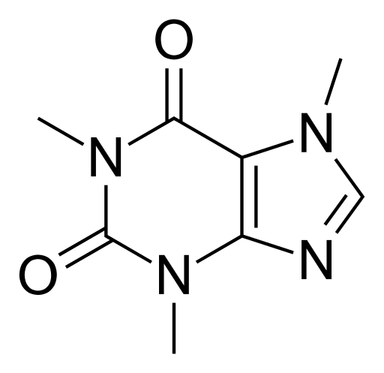
Caffeine Structure
From the methylxanthines class
Contains a purine base
Legal psychoactive drug
Most popularly consumed in coffee, tea and cola drinks
Drayer, L. (2017, October 20). The caffeine 'detox': How and why to cut back. Retrieved February 28, 2018, from https://www.cnn.com/2017/10/20/health/caffeine-fix-food-drayer/index.html
https://en.wikipedia.org/wiki/Caffeine#/media/File:Caffeine_structure.svg
Notes:
Noor

Slide 3
Frequent Users
73.6%
16%
44%
Of Canadians aged 12-24 consume beverages that contain caffeine
Of self reported caffeine consumers report exceeding two or more caffeinated drinks per day
Of the coffee consumed in the United States is by millennials aged 19-34
Canadian’s drink 152.1 L of coffee per person annually
Canada is the third country in the world to drink the most coffee
These beverages include coffee, tea, soda, and energy drinks
Drinking coffee has become a cultural and social activity
Notes:
Noor

Slide 4
How long is caffeine in your body for?
Concentration of caffeine in the bloodstream peaks
Most of the caffeine is diminished from the bloodstream
30-60 Minutes
12 hours
4-6 hours
Half life of caffeine
Notes:
Noor

Slide 5
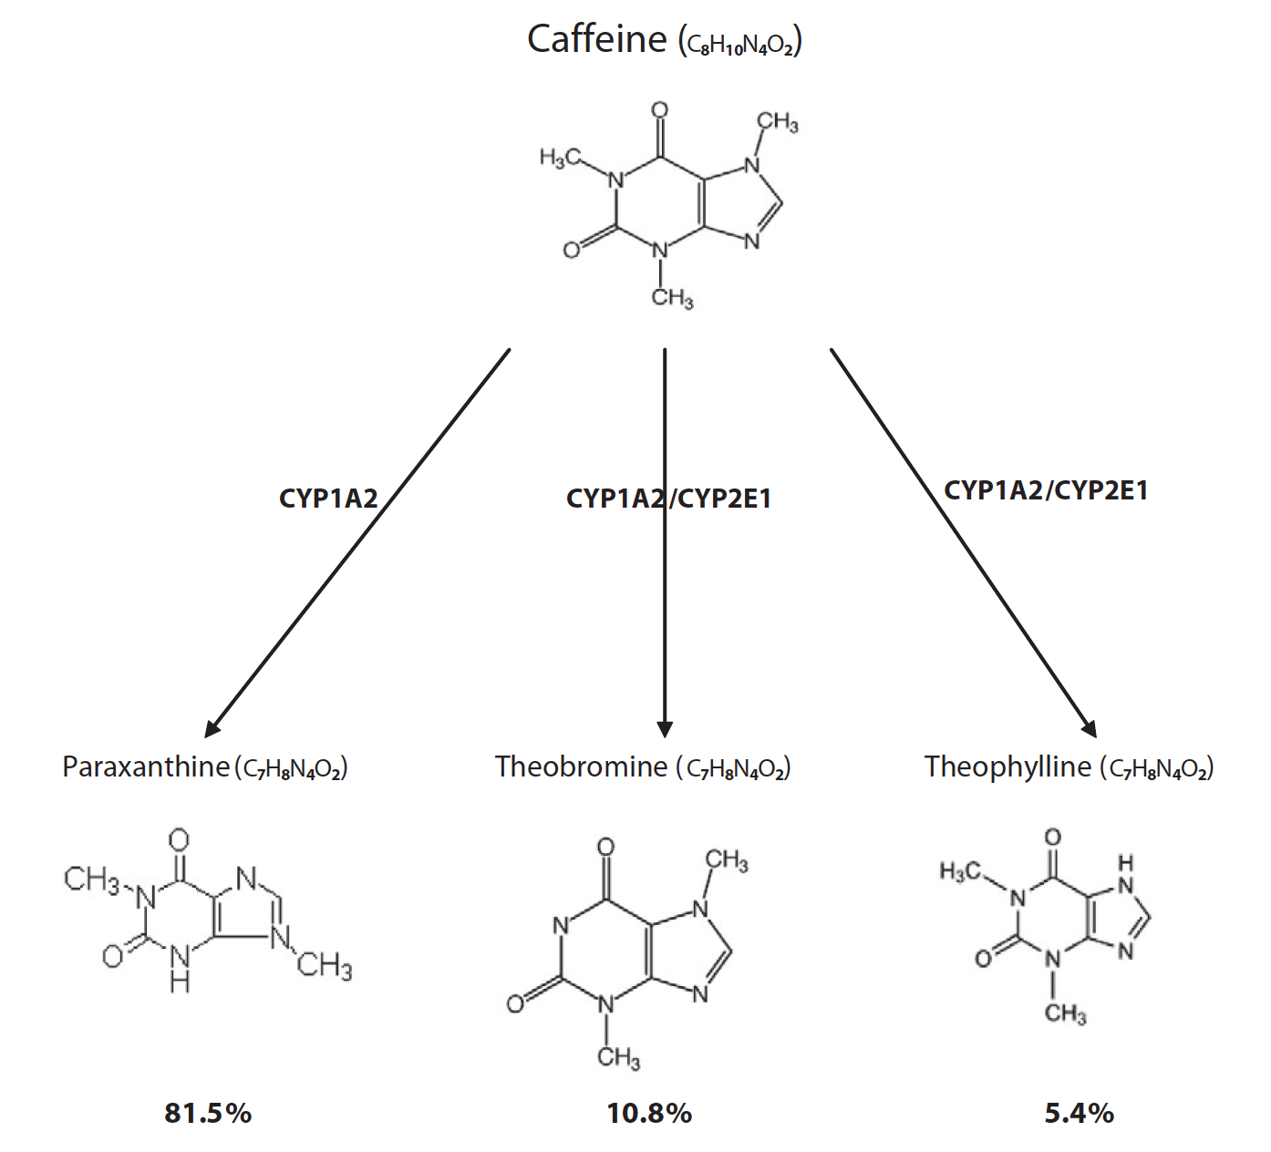
Absorption of Caffeine
99% of caffeine is absorbed in humans within 45 minutes of ingestion
Caffeine is metabolized in to liver to:
Paraxanthine
Theobromine
Theophylline
Caffeine can pass through:
Blood-brain barrier
Placental barrier
Perera, V., Gross, A. S., & McLachlan, A. J. (2010). Caffeine and paraxanthine HPLC assay for CYP1A2 phenotype assessment using saliva and plasma. Biomedical Chromatography, 24(10), 1136-1144.
Notes:
Suhani

Slide 6
Caffeine’s Mechanism of Action
Caffeine
Adenosine
A1 & A2 Adenosine Receptor
When Adenosine is bound to A1 and A2 receptors, it can cause:
Depression of spontaneous electrical activity of the neurons,
Inhibition of synaptic transmission
Inhibit the release of: acetylcholine, norepinephrine, dopamine, gamma amino butyric acid, and serotonin
Slow-wave sleep and reduced vigilance in animal studies
Notes:
Suhani

Slide 7
General Side Effects
1g of caffeine (6 cups of coffee):
Ringing in the ears
Tremors
Confusion
Cardiac arrhythmias
Vomiting
Diarrhea
Aggravation
Improved performance of tasks
Improved athletic performance
Increased concentration
Insomnia
Suppresses appetite
Restlessness
Increased attentiveness & alertness
1g of caffeine
=
Notes:
Transition on this slide be aware
Click twice for second blurb on the right
Noor

Slide 8
Positive Effects
Glade (2010)
Enhance motor performance
Increase concentration and focus attention
Increase daily energy expenditure
Decrease fatigue
Increase alertness and reactions
Increase energy availability
Enhance cognitive performance
Decrease the sense of effort associated with physical activity
Decrease mental fatigue
Enhance physical performance
Increase alertness, wakefulness, and feelings of “energy”
Enhance short term memory
Increase ability to solve problems requiring reasoning
Enhance cognitive functioning capabilities and neuromuscular coordination
Increase ability to make correct decisions
Glade, M.J. (2010). Caffeine-Not just a stimulant. Nutrition, 26(10), 932-938.
Notes:
Noor

Slide 9
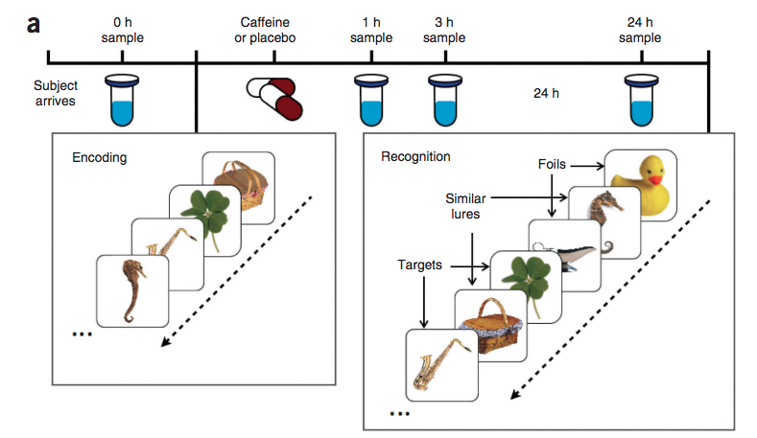
Enhancing Memory - Borota et al.
160 participants aged 18-30
Non-habitual caffeine drinkers
Double-blind placebo-controlled study
Studied images - encoding
Post-study: 200 mg of caffeine
Completed recognition task
Borota et al. (2014). Post-study caffeine administration enhances memory consolidation in humans. Nature Neuroscience, 17, 201-203.
Notes:
Noor

Slide 10
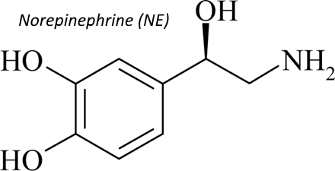
Enhancing Short-term Memory - Borota et al.
Those who received caffeine were able to recognize “similar” images as opposed to confusing them for “old” images
Study repeated with 100 mg and 300 mg
300 mg was more beneficial than 100 mg, but not any better than 200 mg
May be due to norepinephrine (amygdala)
Larne, S.G. (2015). Norepinephrine. Retrieved from http://psychiatricdrugs.com/neurology/norepinephrine/
Borota et al. (2014). Post-study caffeine administration enhances memory consolidation in humans. Nature Neuroscience, 17, 201-203.
Notes:
Noor

Slide 11
Enhancing Short-term Memory - Soar et al.
43 participants
Regular caffeine drinkers
Double-blind placebo controlled study
Pre-study: instant coffee (50 mg of caffeine) or decaffeinated coffee (1.8 mg)
Virtual setting - event-based and time-based prospective memory
Caffeine vs decaffeinated
Event-based (87%; 80%)
Time-based (72%; 69%)
Soar, K., Chapman, E., Lavan, N., Jansari, A.S., & Turner, J.J.D. (2016). Investigating the effects of caffeine on executive functions using traditional Stroop and a new ecologically-valid virtual reality task, the Jansari assessment of Executive Functions (JEF©). Appetite, 105, 156-163.
Notes:
Noor

Slide 12
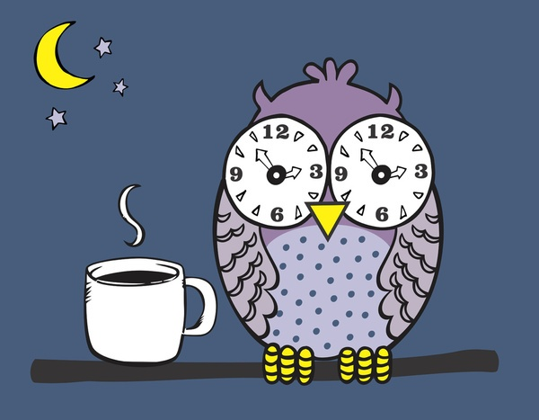
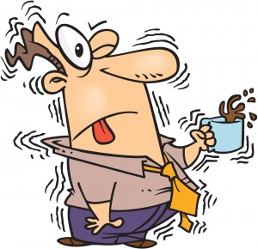
NEGATIVE Effects of Caffeine (on higher doses)
Insomnia
Nervousness
Restlessness
Irritability
Faster heartbeat
Muscle tremors
Frequency of urination
Eckstein, Charlene. “Confessions Of An Insomniac...No Cure, But A Plan.” Charley's Blog Life, Charlene , 23 Dec. 1970, www.charleneeckstein.com/blog/2016/10/20/my-miserable-week-of-insomnia-fs8pg
Puente, Lori. “The Whole Green Tea Thing!” Riding the Wave- Multiple Myeloma, 2011, www.loripuente.com/the-whole-green-tea-thing/.
Notes:
Noor

Slide 13
In the following studies the focus will be on…
Frequency of urination
Increased
risk of cardiovascular events
Changes in mood

Slide 14
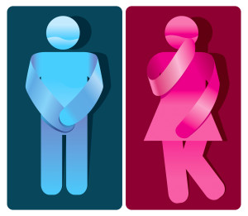
Frequency of Urination - Lohsiriwat, 2011
Studied effects of caffeine on bladder function in patients with overactive bladder symptoms
Specifically, a dose of caffeine at 4.5mg/kg on bladder in overactive bladder adults
Decreased threshold of sensation at filling phase, increase in flow rate and voided volume
Urgency and frequency of urination
“Overactive Bladder Study.” Vasectomy - Urology Group of New Mexico. PC, ugnm.com/clinical-trials-available/current-clinical-trials/overactive-bladder-study/.
Notes:
http://ugnm.com/clinical-trials-available/current-clinical-trials/overactive-bladder-study/

Slide 15
Mood Changes - Moawad, 2017
Enhanced alertness, on unimportant stimuli, resulting in irritation and anxiousness
On higher doses, enhanced irritability and anxiety
Nichols, Hannah. “How Social Media Reflects Our Daily Mood Changes.” Medical News Today, MediLexicon International, 29 Dec. 2017, www.medicalnewstoday.com/articles/320381.php.
Notes:
https://www.medicalnewstoday.com/articles/320381.php

Slide 16
Risk of Cardiovascular Events - Mos, 2015
Evaluated effects of coffee drinking in more than 1200 patients
Purpose: to see if drinking coffee had an effect on the risk of cardiovascular events
Results: Heavy coffee drinkers had a four-fold increased risk of mild hypertension, mild coffee drinkers, tripled their risk
Latika, Sharma. “Heavy Coffee Drinkers at Higher Risk for Early Death: Study.” Heavy Coffee Drinkers at Higher Risk of Early Death: Study | TopNews Arab Emirates, 2013, topnews.ae/content/217984-heavy-coffee-drinkers-higher-risk-early-death-study.
Notes:
Heavy Coffee Drinking Image: http://topnews.ae/content/217984-heavy-coffee-drinkers-higher-risk-early-death-study

Slide 17
Cont’d...
Ages 18-45, non-diabetic patients untreated with stage 1 hypertension
Non-drinkers, moderate drinkers, heavy drinkers (26.3%, 62.7%, 10% respectively)
Linear relationship between consumption of coffee and risk of hypertension
Statistical significant for heavy drinkers
Linear relationship between long term coffee drinking and risk of developing prediabetes
Cardiovascular events
Fig: European Society of Cardiology (2015). This image shows the risk of hypertension development according to level of coffee drinking. Retrieved from: https://www.sciencedaily.com/releases/2015/08/150829123701.htm

Slide 18
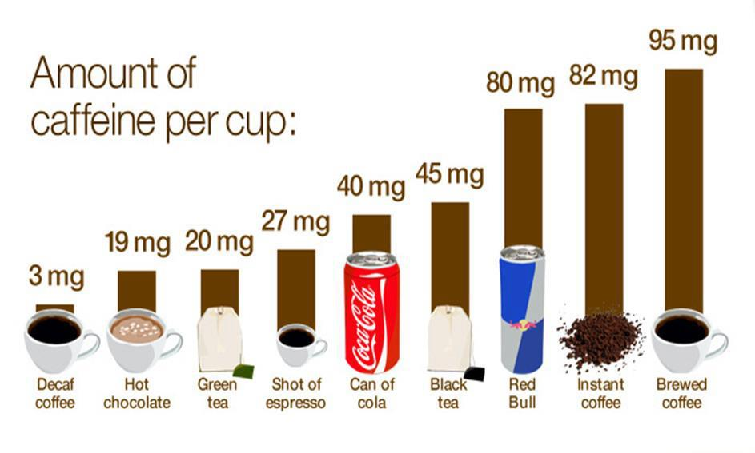
Amount of Caffeine per Cup:
Gromadzki, Slawomir. “Caffeine Addiction.” Full Health Secrets, 2016, www.fullhealthsecrets.com/diseases/caffeine-addiction/.
This image demonstrates how much caffeine is contained in typical drinks a consumer uses.

Slide 19
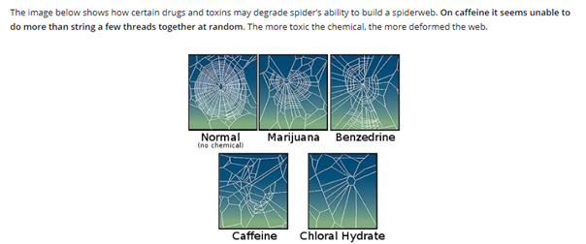
Gromadzki, Slawomir. “Caffeine Addiction.” Full Health Secrets, 2016, www.fullhealthsecrets.com/diseases/caffeine-addiction/.
This image shows how certain drugs and toxins may affect the ability of a spider to build a spiderweb. Particularly, on caffeine, the spider is unable to make an intricate design of a web, fewer threads together and randomly done.
Notes:
Found an interesting image that I thought we could share
Do u think we could make these images more clear?? - I tried to make them clear but couldn’t get them to :(

Slide 20
Coffee in Canada
Canadian chain founded in 1964 by Miles Gilbert “Tim Hortons”
4000 stores all around the globe
Revenue of 3.225 Billion US Dollar annually
Founded in 1971 by Jerry Baldwin, Zev Siegel, and Gordon Bowker in United States of America
21000 shops worldwide
Revenue of over 16 billion US Dollar annually

Slide 21
Coffee in Canada
Officially joined Mcdonald chains in 2002
300 stores worldwide
Estimated revenue of 1.86 Billion US Dollar
Most popular in North America

Slide 22
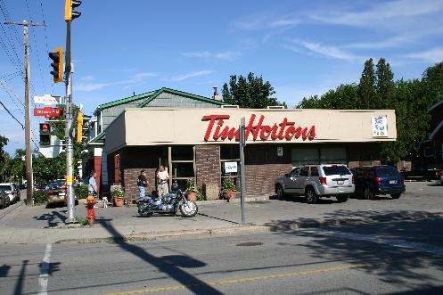
Fun Facts
The first Tim Hortons store was founded close to Downtown Hamilton in 1964
80% of the world's population consume caffeinated products as their wakeup boost
This image shows the first Tim Hortons store in Hamilton, Ontario (Forgotten Buffalo, 2014).
Notes:
We already say this earlier in the presentation (last bolded point)

Slide 23
…. Can Coffee Kill You?

Slide 24
What a Caffeine Overdose looks like...

Slide 25
Questions
Which one of the following is the primary metabolite of caffeine?
Paraxanthine
Theobromine
Theophylline
Caffeine is metabolized into all the metabolites in the same rate

Slide 26
Questions
Which one of the following is the primary metabolite of caffeine?
Paraxanthine
Theobromine
Theophylline
Caffeine is metabolized into all the metabolites in the same rate

Slide 27
Questions
What is the range of the amount of caffeine that, after being ingested, may cause the following symptoms: insomnia, restlessness, nervousness, muscle tremors, irritability, and faster heartbeat?
125mg-325mg
95mg-125mg
500mg-600mg
325mg-425mg

Slide 28
Questions
What is the range of the amount of caffeine that, after being ingested, may cause the following symptoms: insomnia, restlessness, nervousness, muscle tremors, irritability, and faster heartbeat?
125mg - 325mg
95mg - 125mg
500mg - 600mg
325mg - 425mg

Slide 29
References
Bellet, S., Roman, L., DeCastro, O., Kim, K. E., & Kershbaum, A. (1969). Effect of coffee ingestion on catecholamine release. Metabolism-Clinical and Experimental, 18(4), 288-291.
Benowitz, N. L. (1990). Clinical pharmacology of caffeine. Annual review of medicine, 41(1), 277-288.
Borota et al. (2014). Post-study caffeine administration enhances memory consolidation in humans. Nature Neuroscience, 17, 201-203.
Castle, E.P. (2017). Urinary Incontinence. Mayo Clinic. Retrieved from www.mayoclinic.org/diseases-conditions/urinary-incontinence/symptoms-causes/syc-20352808
Claypool, S. (2016). What are the benefits of drinking coffee? Quora. Retrieved from https://www.quora.com/What-are-the-benefits-of-drinking-coffee
Cappelletti, S., Daria, P., Sani, G., & Aromatario, M. (2015). Caffeine: cognitive and physical performance enhancer or psychoactive drug? Current neuropharmacology, 13(1), 71-88.
MedicineNet. (2016). Medical Definition of Nocturia. MedicineNet. Retrieved from www.medicinenet.com/script/main/art.asp?articlekey=4571.
European Society of Cardiology. (2015). Coffee linked with increased cardiovascular risk in young adults with mild hypertension. ScienceDaily. Retrieved from www.sciencedaily.com/releases/2015/08/150829123701.htm
Glade, M.J. (2010). Caffeine-Not just a stimulant. Nutrition, 26(10), 932-938.
Greden et al. Anxiety and Depression Associated with Caffeinism Among Psychiatric Inpatients. American Journal of Psychiatry, 133:8, Aug 1978.
Greden, J. F., Fontaine, P., Lubetsky, M., & Chamberlin, K. (1978). Anxiety and depression associated with caffeinism among psychiatric inpatients. The American journal of psychiatry, 135(8):963-6.
Greden, J. F. (1974). Anxiety or caffeinism: a diagnostic dilemma. American Journal of Psychiatry, 131(10), 1089-1092.

Slide 30
References
Harris, S. (2016). Why Canadians drink more coffee than most people in the world. CBC. Retrieved from: http://www.cbc.ca/news/business/canada-coffee-tim-hortons-1.3745971
Heath, T. (2016). Look how much coffee millennials are drinking. Washington Post. Retrieved from: https://www.washingtonpost.com/news/business/wp/2016/10/31/look-how-much-coffee-millennials-are-drinking/?utm_term=.35099b8ce2cf
Hensrud, D., Nelson, J.K., & Zeratsky K. (2017). Caffeine: How Much Is Too Much? Mayo Clinic. Retrieved from: www.mayoclinic.org/healthy-lifestyle/nutrition-and-healthy-eating/in-depth/caffeine/art-20045678?reDate=14022018
Fisone, G., Borgkvist, A., & Usiello, A. (2004). Caffeine as a psychomotor stimulant: mechanism of action. Cellular and Molecular Life Sciences CMLS, 61(7-8), 857-872.
Fredholm, B. B., Bättig, K., Holmén, J., Nehlig, A., & Zvartau, E. E. (1999). Actions of caffeine in the brain with special reference to factors that contribute to its widespread use. Pharmacological reviews, 51(1), 83-133.
Larne, S.G. (2015). Norepinephrine. PsychiatricDrugs. Retrieved from http://psychiatricdrugs.com/neurology/norepinephrine/
Lohsiriwat, S., Hirunsai, M., & Chaiyaprasithi, B. (2011). Effect of caffeine on bladder function in patients with overactive bladder symptoms. Urology annals, 3(1), 14.
Mandel, H. G. (2002). Update on caffeine consumption, disposition and action. Food and Chemical Toxicology, 40(9), 1231-1234.
McGaugh, J.L. (2000). Memory--a Century of Consolidation. Science, 287(5451), 248-251.
Moawad, H. (2017). Why Coffee Causes Irritability and Anxiety. Livestrong. Retrieved from: www.livestrong.com/article/368997-why-coffee-causes-irritability-anxiety/
Nehlig, A., Daval, J. L., & Debry, G. (1992). Caffeine and the central nervous system: mechanisms of action, biochemical, metabolic and psychostimulant effects. Brain Research Reviews, 17(2), 139-170.

Slide 31
References
Sherman, S.M., Buckley, T.P., Baena, E., & Ryan, L. (2016). Caffeine Enhances Memory Performance in Young Adults during Their Non-optimal Time of Day. Frontiers in Psychology, 7:1764.
Smith, A. (2002). Effects of caffeine on human behavior. Food and chemical toxicology, 40(9), 1243-1255.
Weinberg, B. A., & Bealer, B. K. (2001). The world of caffeine: the science and culture of the world's most popular drug. Psychology Press. Retrieved from https://books.google.ca/books/about/The_World_of_Caffeine.html?id=YdpL2YCGLVYC
Institute of Medicine (US) Committee on Military Nutrition Research. Caffeine for the Sustainment of Mental Task Performance: Formulations for Military Operations. Washington (DC): National Academies Press (US); 2001. 2, Pharmacology of Caffeine. Retrieved from: https://www.ncbi.nlm.nih.gov/books/NBK223808/
Roehrs, T., & Roth, T. (2008). Caffeine: sleep and daytime sleepiness. Sleep medicine reviews, 12(2), 153-162.
Soar, K., Chapman, E., Lavan, N., Jansari, A.S., & Turner, J.J.D. (2016). Investigating the effects of caffeine on executive functions using traditional Stroop and a new ecologically-valid virtual reality task, the Jansari assessment of Executive Functions (JEF©). Appetite, 105, 156-163.
Jahanfar, S., & Jaafar, S. H. (2013). Effects of restricted caffeine intake by mother on fetal, neonatal and pregnancy outcome. Cochrane Database Syst Rev, 2.
Perera, V., Gross, A. S., & McLachlan, A. J. (2010). Caffeine and paraxanthine HPLC assay for CYP1A2 phenotype assessment using saliva and plasma. Biomedical Chromatography, 24(10), 1136-1144.
Winstead, D. K. (1976). Coffee consumption among psychiatric inpatients. The American Journal of Psychiatry, 133(12), 1447-1450.
Zeratsky K. (2017). The Myth about Caffeine and Dehydration. Mayo Clinic. Retrieved from www.mayoclinic.org/healthy-lifestyle/nutrition-and-healthy-eating/expert-answers/caffeinated-drinks/faq-20057965

