Slide 1
AL Amyloidosis
Aravind Rajendran Harleen Kaura Bosco Xu
Curtis Menon Yhameen Hamid
LIFESCI 4M03 Group 3

Slide 2
Outline
What is AL Amyloidosis?
History
Classification
Epidemiology
Signs and Symptoms
Prognosis, Targeted Organs, and Diagnosis
Pathophysiology
Prevention
Treatment/Management
Social Implications
Further Research
Conclusion

Slide 3
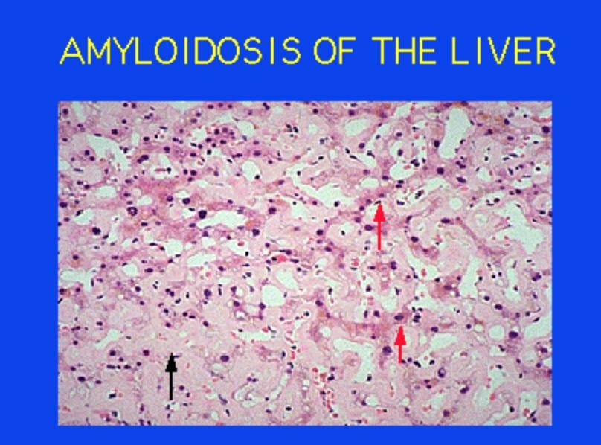
What is AL Amyloidosis?
Bone marrow disorder
Abnormal antibody (immunoglobulin) protein
Formation of amyloid
Amyloid = Aggregates of proteins allowing matching copies to stick
https://www.pathology.med.umich.edu/greensonlab/AM YLOID-HE.GIF
(Nienhuis, Bijzet & Hazenberg, 2016)

Slide 4
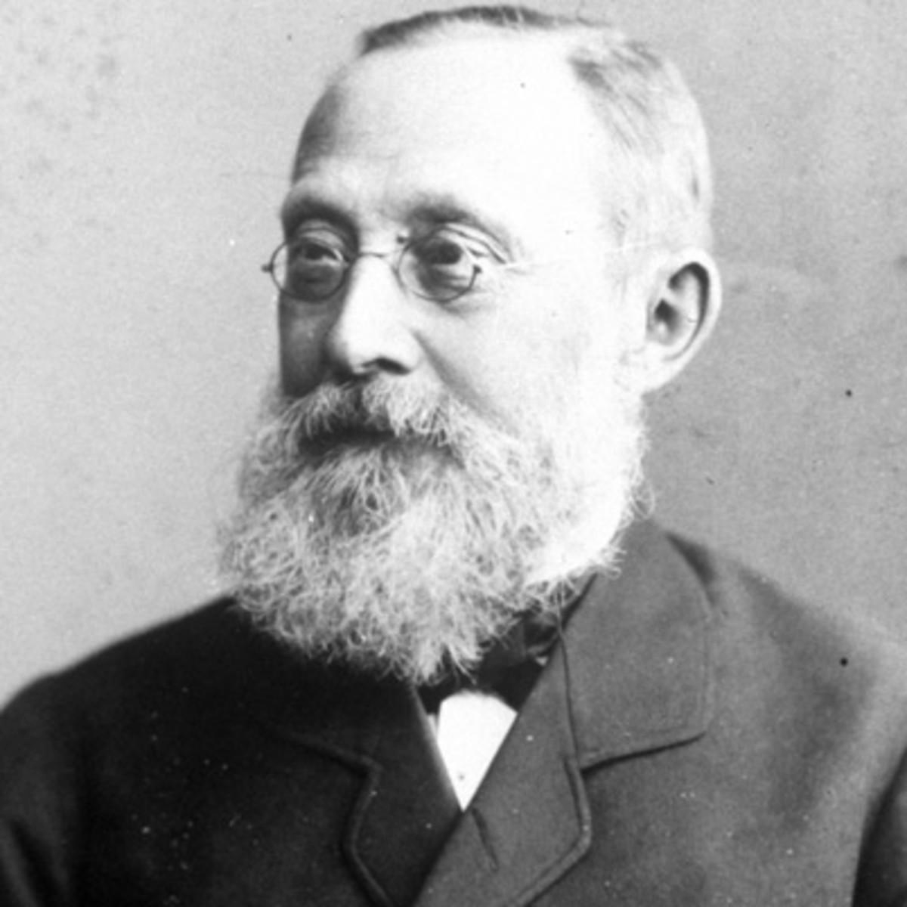
History
1854: Virchow uses term “amyloid” to refer to extracellular buildup in the liver (Nyirady, 2016)
1927: Divry and associates discover a test for identifying amyloid tissues (Congo red dye viewed under polarized light) (Beckerman, 2015)
1959: Cohen and Calkins discovered that amyloidosis demonstrates a fibril structure
(Nyirady, 2016)
https://www.biography.com/.image/t_share/MTI wNjA4NjMzOTk5MzYxNTQ4/rudolf-virchow-95 19219-1-402.jpg

Slide 5
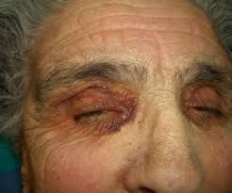
Classification
Systemic amyloidosis can be classified into:
Primary systemic amyloidosis
Amyloidosis associated with multiple myeloma
Secondary systemic amyloidosis
http://www.actasdermo.org/en/cutaneous-alerts-in-systemic
-malignancy/articulo/S1578219013000619/
(Nyirady, 2016)

Slide 6
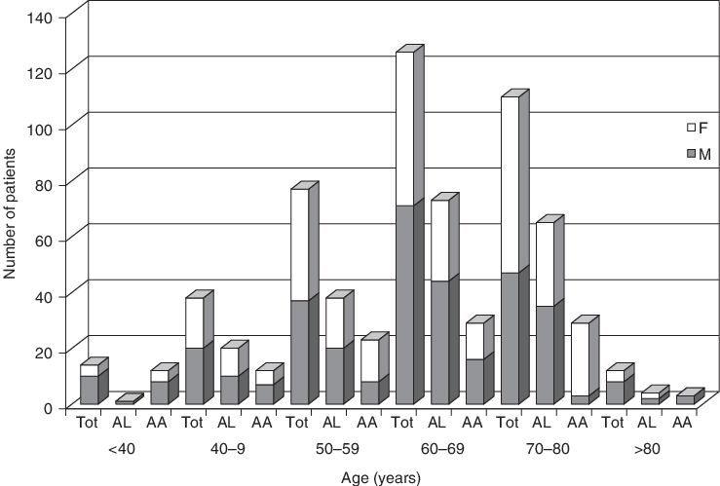
Epidemiology
Incidence Rates
ALA most common type of systemic amyloidosis (56%)
9 cases per-million inhabitants each year
Highest amongst adults aged 60 – 80 years old
Trends
(Real de Asúa et al., 2014)
Two-thirds of all patients are male
No racial predilection (Africans marginal higher rates)
Not a hereditary disease
(Nienhuis, Bijzet & Hazenberg, 2016) and (Desport et al., 2012)
https://www.researchgate.net/figure/51378997_fig2_Fig-2-Freque ncy-of-different-types-of-amyloidosis-according-to-age-and-gend er

Slide 7
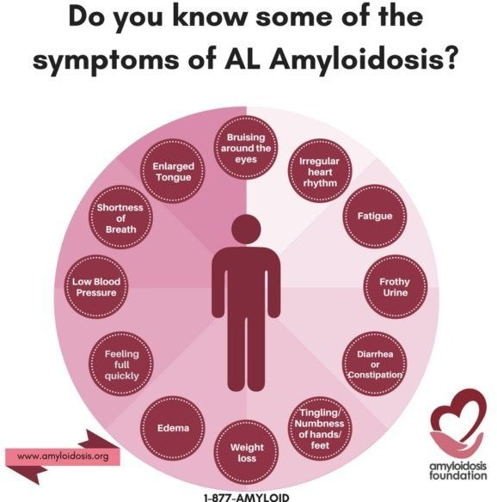
Signs and Symptoms
“An enlarged liver
An enlarged tongue (macroglossia)
An irregular heartbeat
Diarrhea alternating with constipation
Loss of weight
Numbness or tingling in the hands or feet
Severe fatigue
Shortness of breath
Skin changes
Swelling of the ankles and legs
Weakness” (Cedars-Sinai Cancer Institute, 2017)
http://www.amyloidosis.org/

Slide 8
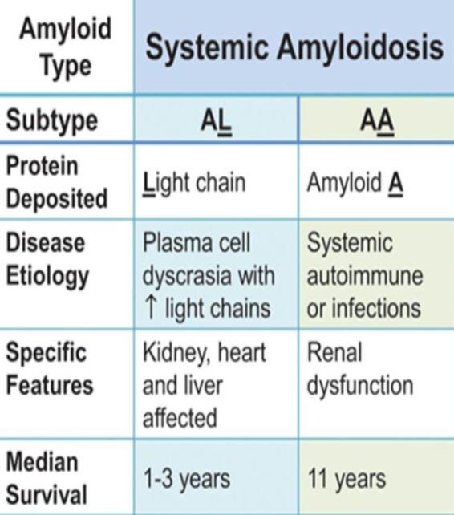



Prognosis
●
○
(Ma & Ra, 1994; Papadakis & McPhee, 2017)
●
(Shiel, & Balentine, 2017; Papadakis &
McPhee, 2017)
○
○
http://circ.ahajournals.org/content/133/3/245

Slide 9
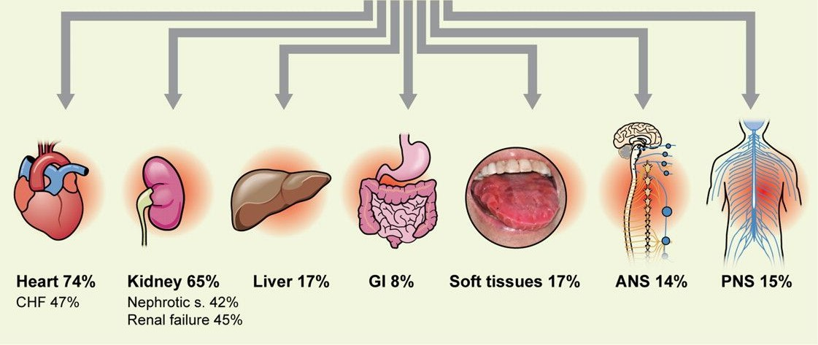
Targeted Organs - Mortality
Figure 1: Percentages referring to mortality rate (death within 3 years) upon development of AL Amyloidosis
http://www.bloodjournal.org/co ntent/119/19/4343?sso-check ed=true

Slide 10
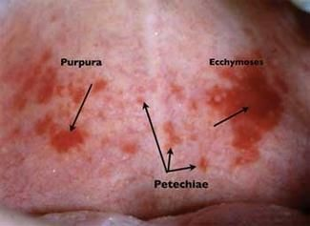
Diagnosis
Considered in patients with (Sanchorawala, 2006):
Proteinuria
Cardiomyopathy
Neuropathy
Hepatomegaly
Myeloma
Diagnosis requires two criteria (Sanchorawala, 2006):
Amyloid in the tissue
Plasma Cell Dyscrasia
http://www.rdhmag.com/articles/print/volume-29/issue-4/col umns/oral-exams/petechiae-ecchymoses-or-purpura.html
Skin signs (Nyirady, 2016)

Slide 11
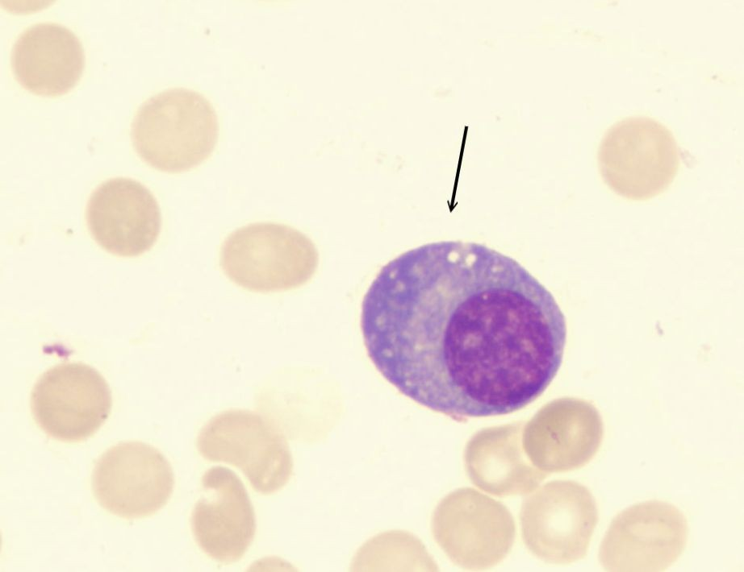
Pathophysiology
BRIEF OVERVIEW
Plasma cell dyscrasia (Zhang, Huang & Li, 2017)
Abnormal, over-proliferative plasma cells (PC) mass produce Ig antibodies (Ramirez-Alvarado, 2013; ,Zhang, Huang &
Li, 2017)
Once in blood circulation, Ig light
chains unfold, bind to other light chains, and deposit as insoluble amyloid fibrils in ECM of tissues & organs (Ramirez-Alvarado, 2013)
https://theadventuresofbecky.files.wordpress.com/2010/03/plas ma-cell-100x-website-arrow.jpg
https://www.youtube.com/watch?v=bTcWtVpBcgA

Slide 12
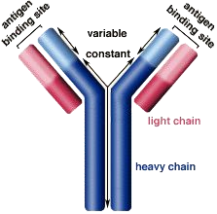
Ig Antibodies
Composed of
Two light chains
Kappa (k)
Lambda (λ)
Two heavy chains (Ramirez-Alvarado, 2013)
Tendency to develop fibrillogenesis depends on primary structure of light chains (Zhang, Huang & Li, 2017)
Normally, k:λ = 2:1
AL amyloidosis, k:λ = 1:4 (Weiss, Wong & Comenzo, 2016;
.Zhang, Huang & Li, 2017)
Variable regions of light chains are highly mutated (Perfetti et al., 1998)
http://www.biology.arizona.edu/immunology/tutorials/antibody/ structure.html

Slide 13
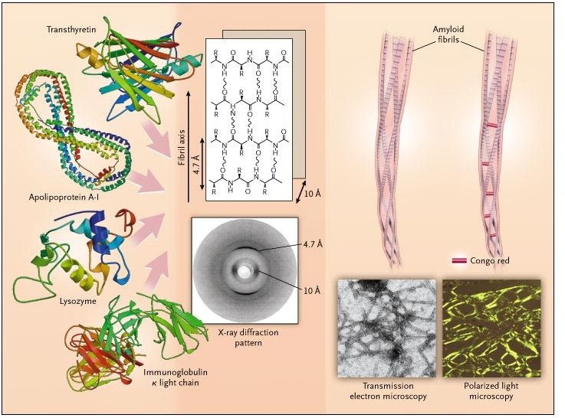
Amyloid Fibrils
Matrix components + Ig light chains form β-
super-secondary structure
(Perfetti et al., 1998)
Protofilaments wind around each other, forming fibrils
(Merlini & Belloti, 2003)
http://www.nejm.org/doi/full/10.1056/NEJMra023144

Slide 14
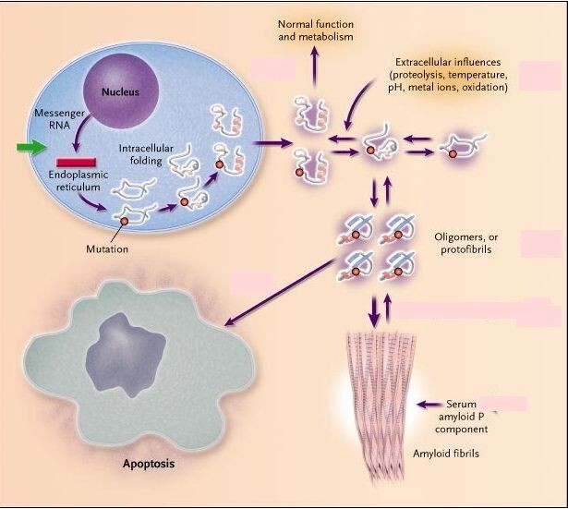
How Do Fibrils Form?
Amyloid precursors are secreted as native proteins but escape intracellular quality control system (Merlini & Bellotti, 2003)
Reach eqbm between fully folded and partially folded state (Merlini & Bellotti, 2003)
Low pH
Oxidation
rise in temperature
Limited proteolysis
Shift eqbm to partially folded state
Oligomers or protofibrils cause cellular toxicity by activating apoptosis (Merlini & Bellotti, 2003)
http://www.nejm.org/doi/full/10.1056/NEJMra023144

Slide 15


Factors Influencing Fibrillogenesis
Plasma cells
Cytogenetic abnormalities
translocation of chromosome 14q32, monosomy 13, trisomies 9, 15, 11 and 3
(Warsame et al., 2015; Zhang, Huang & Li, 2017,18)
Post translational modifications
Glycosylation: alters protein solvation energy, increases binding strength at certain regions and protects some sites from protease degradation
(Schachter, 1984; Petukhov et al., 1999; Zhang, Huang & Li, 2017)

Slide 16


Factors Influencing Fibrillogenesis
Extracellular Matrix Components
Serum amyloid P: protects amyloid fibrils from proteolytic degradation (Tennent, Lovat & Pepys, 1995; Zhang, Huang & Li, 2017)
Heparan Sulfate proteoglycans (HSPG): interact with ligands and promote protofilament assembly into mature fibrils (McLaurin, Franklin, Zhang, Deng & Fraser, 1999; Ren et al., 2010; Zhang, Huang & Li,
2017)
Extracellular Chaperones
Bind to amyloid fibrils and protect them from protease degradation (Zhang, Huang & Li, 2017)

Slide 17
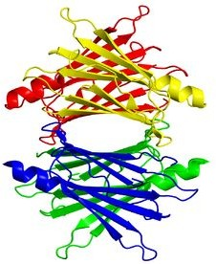
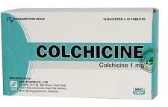
Prevention
Alzheimers: Transthyretin prevents amyloid formation (Schwarzman et al., 1994)
Familial Mediterranean fever: Colchicine (Zemer et al., 1986)
http://www.davipharm.info/dv/en/product/musculo- skeletal-system/colchicine.html
https://en.wikipedia.org/wiki/Transthyretin

Slide 18
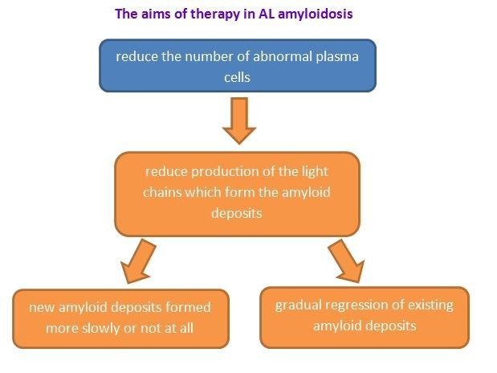
Treatment/Management
1. High-dose chemotherapy medicines with autologous stem
cell transplantation (Palladini et al., 2004; Derrer, 2015; Shiel, & Balentine, 2017; Papadakis, & McPhee, 2017)
Common chemotherapy medication is melphalan
Not all the patients can do autologous stem cell transplantation due to high toxicity
http://www.amyloidosis.org.uk/al-amyloidosis/treatment/

Slide 19
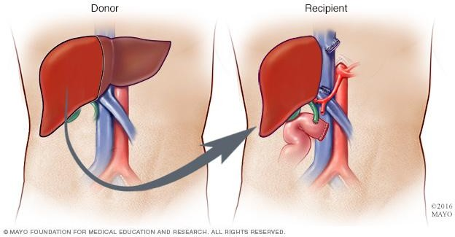
Treatment/Management
Liver, Kidney or Heart transplant
The vital organs failure
Diuretic medicines (kidney problem
Remove excess water from the body
http://www.mayoclinic.org/tests-procedures/liver-transplant/d etails/what-you-can-expect/rec-20211848
(Derrer, 2015; Shiel, & Balentine, 2017; Papadakis, & McPhee, 2017)

Slide 20


Social Implications
Amyloidosis Not Well Known by Society
Misconceptions and wrongful information
Difficult disease to understand
Ongoing research
The Amyloidosis Foundation
Raising money (Yearly Runs)
Spreading Awareness
Providing grants for research
http://www.amyloidosis.org/
http://www.amyloidosis.org/
(Amyloidosis Foundation, 2017)

Slide 21
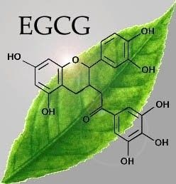
Further Research/Applications/Implications
Study of Gene Expression Changes/Mutations (Zhou et al., 2012)
Studying proteins, mutations and gene expressions
Large scale characterization currently being conducted
Identify structures used to diagnose patients earlier and/or target as treatment
Epigallocatechin-3-Gallate (EGCG) (Andrich et al., 2016)
Most abundant catechin in tea
Suggested that EGCG specifically inhibits the aggregation phase
http://toptestosteronesupplements.com/epigall ocatechin-gallate-egcg-ingredient-breakdown/

Slide 22
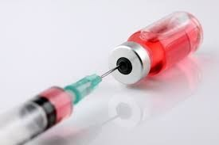

Further Research/ Applications/ Implications
Clear Amyloid Protein Deposits (Immunotherapy / Physical) (Rosenzweig et al., 2017)
Clearing amyloid protein deposits directly was before seen as impossible
Scavenger cells recognize and engulf amyloid deposits
New immunotherapy treatments accelerate functionality of scavenger cells
http://www.iran-daily.com/News/129235.html
Other (Gertz et al., 2016; Wechaleka et al., 2016; Sanchorawala et al., 2017)
Antibiotics = Interfere with amyloid deposit formation
Targeting of SAP Protein = Potential new treatment target
Vaccines = Protect vital organs from amyloid
formation
https://www.swan.wa.gov.au/files/assets/public/image
-resources/lists/people/children/ph_immunisation.jpg? w=480

Slide 23

Conclusion
Bone marrow disorder
Abnormal antibody light-chains
Formation of lethal amyloid
Disrupt tissues and organs
https://tctechcrunch2011.files.wordpress.com/2016/08/thats-a
AL amyloidosis is still rather lethal - be aware and stay educated
ll-folks.png?w=1279&h=727&crop=1
(Nienhuis, Bijzet & Hazenberg, 2016)
The ALA foundation website is a great source for more
information
Researchers believe ALA will no longer be a threat in 10 years!

Slide 24
Multiple Choice #1:
Which of the following statements is INCORRECT.
AL Amyloidosis incidence rate is highest for adults age 50 to 60.
Epigallocatechin-3-Gallate (EGCG) is a potential future treatment for AL Amyloidosis.
Amyloid formation is most lethal when formed in the heart.
Misfolded Light Chains is the cause of amyloid formation in AL Amyloidosis .
56% of all Systemic Amyloidosis cases are of AL variety

Slide 25
Multiple Choice #1: (Answer)
Which of the following statement is INCORRECT.
AL Amyloidosis incidence rate is highest for adults age 50 to 60. ##
Epigallocatechin-3-Gallate (EGCG) is a potential future treatment for AL Amyloidosis.
Amyloid formation is most lethal when formed in the heart.
Misfolded Light Chains is the cause of amyloid formation in AL Amyloidosis .
56% of all Systemic Amyloidosis cases are of AL variety

Slide 26
Multiple Choice #2:
Which of the following does NOT influence fibrillogenesis?
Plasma cells
Intracellular Matrix Components
Extracellular Chaperones
Post translational Modifications
Extracellular Matrix Components

Slide 27
Multiple Choice #2: (Answer)
Which of the following does NOT influence fibrillogenesis?
a) Plasma cells b)
c)
d)
e)
Intracellular Matrix Components ##
Extracellular Chaperones
Post translational Modifications Extracellular Matrix Components

Slide 28
References
Amyloidosis. (2017). Cedars-sinai.edu. Retrieved 4 October 2017, from https://www.cedars-sinai.edu/Patients/Health-Conditions/Amyloidosis.aspx Amyloidosis Foundation. (n.d.). Retrieved October 02, 2017, from http://www.amyloidosis.org/
Andrich, K., Hegenbart, U., Kimmich, C., Kedia, N., Bergen III, C.R., Schonland, S., Wanker, E.E., & Bieschke, J. (2016). Aggregation of Full Length Immunoglobulin Light Chains from AL Amyloidosis Patients Is Remodeled by Epigallocatechin-3-gallate. Journal of Biological Chemistry, 292, 2328-2344. https://doi.org/10.1074/jbc.M116.750323
BECKERMAN, M. (2015). FUNDAMENTALS OF NEURODEGENERATION AND PROTEIN MISFOLDING DISORDERS (p. 5). [S.l.]: SPRINGER INTERNATIONAL PU.
Bernard et al. (2015). Efficacy, toxicity and mortality of autologous SCT in multiple myeloma patients with dialysis-dependent renal failure. Bone Marrow Transplantation. 50: 95-99
Child et al. (2003). High-Dose Chemotherapy with Hematopoietic Stem-Cell Rescue for Multiple Myeloma. N Engl J Med. 348:1875-1883
Derrer, T.D. (2015). Amyloidosis. WebMD. Retrieved from: http://www.webmd.com/cancer/lymphoma/amyloidosis-symptoms-causes-treatments#1
Desport, E., Bridoux, F., Sirac,C., Delbes,S., Bender, S., Fernandez, B., … Jaccard, A. (2012). AL Amyloidosis. Orphanet Journal of Rare Diseases, 7, 54. https://doi.org/10.1186/1750-1172-7-54
Ebert, E. C., & Nagar, M. (2008). Gastrointestinal Manifestations of Amyloidosis. The American Journal of Gastroenterology. 103 (3): 776–787.
Gertz, M.A., Landau, H., Comenzo, R.L., Seldin, D., Weiss, B., & Zonder, J. (2016). First-in-Human Phase I/II Study of NEOD001 in Patients With Light Chain Amyloidosis and Persistent Organ Dysfunction. Journal of Clinical Oncology, 34, 1097-1103. https://doi.org/10.1200/JCO.2015.63.6530
Jantunen et al. (2006). High-dose melphalan (200 mg/m2) supported by autologous stem cell transplantation is safe and effective in elderly (greater than or equal to65 years) myeloma patients: comparison with younger patients treated on the same protocol. Bone Marrow Transplantation. 37:917-922
Liu, P.P., & Smyth, D. (2015). Wild-Type Transthyretin Amyloid Cardiomyopathy A Missed Cause of Heart Failure With Preserved Ejection Fraction With Evolving Treatment Implications. Circulation. 133:245-247

Slide 29
References
Ma, G., & Ra, K. (1994). Amyloidosis: prognosis and treatment. Semin Arthitis Rheum. 24(2): 124-138.
McLaurin, J., Franklin, T., Zhang, X., Deng, J., & Fraser, P. E. (1999). Interactions of Alzheimer amyloid-beta peptides with glycosaminoglycans effects on fibril nucleation and growth. European Journal of Biochemistry, 266(3), 1101–1110.
Merlini, G., & Bellotti, V. (2003). Molecular Mechanisms of Amyloidosis. New England Journal of Medicine, 349(6), 583–596. https://doi.org/10.1056/NEJMra023144
Nienhuis H, L., A, Bijzet J., & Hazenberg B, P, C. (2016). The Prevalence and Management of Systemic Amyloidosis in Western Countries. Kidney Dis, 2, 10-19. https://doi.org/10.1159/000444206
Nyirady, J. (2016). Primary Systemic Amyloidosis. MedScape. Retrieved 19 September 2017, from http://emedicine.medscape.com/article/1093258-overview Papadakis, M.A., & McPhee, S.J. (2017) CURRENT: MEDICAL DIAGNOSIS & TREATMENT. USA: McGraw-Hill Education
Palladini et al. (2004). Association of melphalan and high-dose dexamethasone is effective and well tolerated in patients with AL (primary) amyloidosis who are ineligible for stem cell transplantation. Blood. 103:2936-2938
Paiva, B., Almeida, J., Pérez-Andrés, M., Mateo, G., López, A., Rasillo, A., … Orfao, A. (2010). Utility of flow cytometry immunophenotyping in multiple myeloma and other clonal plasma cell-related disorders. Cytometry. Part B, Clinical Cytometry, 78(4), 239–252. https://doi.org/10.1002/cyto.b.20512
Perfetti, V., Ubbiali, P., Vignarelli, M. C., Diegoli, M., Fasani, R., Stoppini, M.,Merlini, G. (1998). Evidence that amyloidogenic light chains undergo antigen-driven selection. Blood, 91(8), 2948–2954.
Real de Asúa, D., Costa, R., Galván, J. M., Filigheddu, M. T., Trujillo, D., & Cadiñanos, J. (2014). Systemic AA amyloidosis: epidemiology, diagnosis, and management. Clinical Epidemiology, 6, 369–377. http://doi.org/10.2147/CLEP.S39981
Ramirez-Alvarado, M. (2012). Amyloid formation in light chain amyloidosis. Current Topics in Medicinal Chemistry, 12(22), 2523–2533.
Rosenzweig, M., Urak R., Walter, M., Lim, L., Sanchez, J.F., Krishnan, A., Forman, S., & Wang, X. (2017). Preclinical data support leveraging CS1 chimeric antigen receptor T-cell therapy for systemic light chain amyloidosis. Cytotherapy, 19(7), 861-866. https://doi.org/10.1016/j.jcyt.2017.03.077

Slide 30
References
Sanchorawala, V. (2006). Light-Chain (AL) Amyloidosis: Diagnosis and Treatment. Clinical Journal Of The American Society Of Nephrology, 1(6), 1331-1341. http://dx.doi.org/10.2215/cjn.02740806
Shiel, C.W., & Balentine, R. J. (2017). Amyloidosis. MedicineNet. Retrieved from: http://www.medicinenet.com/amyloidosis/article.htm#what_is_the_treatment_for_amyloidosis Wechalekar, A. (2017). Treatment of AL Amyloidosis. NAC. Retrieved from: http://www.amyloidosis.org.uk/al-amyloidosis/treatment/
Schachter, H. (1984). Glycoproteins: their structure, biosynthesis and possible clinical implications. Clinical Biochemistry, 17(1), 3–14.
Schwarzman, A., Gregori, L., Vitek, M., Lyubski, S., Strittmatter, W., & Enghilde, J. et al. (1994). Transthyretin sequesters amyloid beta protein and prevents amyloid formation. Proceedings Of The National Academy Of Sciences, 91(18), 8368-8372. Retrieved from https://www.ncbi.nlm.nih.gov/pmc/articles/PMC44607/
Tennent, G. A., Lovat, L. B., & Pepys, M. B. (1995). Serum amyloid P component prevents proteolysis of the amyloid fibrils of Alzheimer disease and systemic amyloidosis. Proceedings of the National Academy of Sciences of the United States of America, 92(10), 4299–4303.
Warsame, R., Kumar, S. K., Gertz, M. A., Lacy, M. Q., Buadi, F. K., Hayman, S. R., … Dispenzieri, A. (2015). Abnormal FISH in patients with immunoglobulin light chain amyloidosis is a risk factor for cardiac involvement and for death. Blood Cancer Journal, 5, e310. https://doi.org/10.1038/bcj.2015.34
Weiss, B. M., Wong, S. W., & Comenzo, R. L. (2016). Beyond the plasma cell: emerging therapies for immunoglobulin light chain amyloidosis. Blood, 127(19), 2275–2280. https://doi.org/10.1182/blood-2015-11-681650
Zemer, D., Pras, M., Sohar, E., Modan, M., Cabili, S., & Gafni, J. (1986). Colchicine in the Prevention and Treatment of the Amyloidosis of Familial Mediterranean Fever. New England Journal Of Medicine, 314(16), 1001-1005. http://dx.doi.org/10.1056/nejm198604173141601
Zhang, C., Huang, X., & Li, J. (2017a). Light chain amyloidosis: Where are the light chains from and how they play their pathogenic role? Blood Reviews, 31(4), 261–270. https://doi.org/10.1016/j.blre.2017.03.002
Zhou, P., Hoffman, J., Landau, H., Hassoun, H., Lyer, L., & Comenzo, R.L. (2012). Clonal Plasma Cell Pathophysiology and Clinical Features of Disease Are Linked to Clonal Plasma Cell Expression of Cyclin D1 in Systemic Light-Chain Amyloidosis. Clinical Lymphoma Myeloma and Leukemia, 12, 49-58. https://doi.org/10.1016/j.clml.2011.09.217

