Slide 1
An Overview of Migraine Headaches
My head doth ake
O Sappho! Take
Thy fillit,
And bind the paine;
Or bring some bane
To kill it.
Robert Herrick (1591–1674)
The Head-ake
Notes:
Migraine is a disabling neurovascular disorder characterized by mostly unilateral throbbing head pain and a host of neurological symptoms including nausea, change in appetite, decreased cognitive ability, visual disturbances and lightheadedness. These symptoms may last anywhere from 4-72 hours.

Slide 2
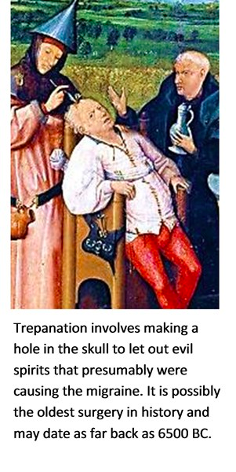
History
Migraines described by Egyptians as early as 1200 BCE
Aretaeus of Cappadocia credited with discovery around 200 AD
Historic Treatments include:
hot irons
bloodletting
inserting garlic into temple incisions
applying opium and vinegar to skull
Ergotamines (1930s)
Triptans (1990s)
still the only class of drugs developed exclusively for migraines
(American Migraine Foundation, 2016)
Notes:
Migraines are one of the oldest documented illness being described as early as 1200 BCE by the Egyptians. Arataeus of Cappadocia is however the one credited with the discovery of migraines after having extensively described unilateral headaches with aura. Migraines have plagued humans throughout our history with little progress made in the area of treatment and cures. Several treatments have been tried with no avail, including hot irons, bloodletting, inserting garlic into incisions made in the temple and applying opium and vinegar solutions directly to the skull. Some have even gone as far as to perform surgeries such as lobotomies on migraine sufferers.
The first known use of medication that has shown some success is use of ergotamine in the 1930s. Ergotamine constricts blood vessels in the brain and has been shown to provide pain relief in some individuals. Many drugs have been researched and experimented with since with little success. The first and currently only class of drugs developed and used solely for the treatment of migraines are Triptans, which were developed in the early 1990s (American Migraine Foundation, 2016).

Slide 3
RISK FACTORS
Family History
Age
Sex
Hormonal Changes
Notes:
Family history. Up to 90 percent of people with migraines have a family history of migraine attacks. If one or both of your parents have migraines, then you have a good chance of having migraines too.
Age. Migraines can begin at any age, though most people experience their first migraine during adolescence. By age 40, most people who have migraines have had their first attack.
Sex. Women are three times more likely to have migraines. Headaches tend to affect boys more than girls during childhood, but by the time of puberty and beyond, more girls are affected.
Hormonal changes. If you're a woman who has migraines, you may find that your headaches begin just before or shortly after onset of menstruation.
They may also change during pregnancy or menopause. Generally migraines improve after menopause.
Some women report that migraine attacks begin during pregnancy, or the attacks may get worse. However, for many, the attacks improved or didn't occur during later stages in the pregnancy.

Slide 4
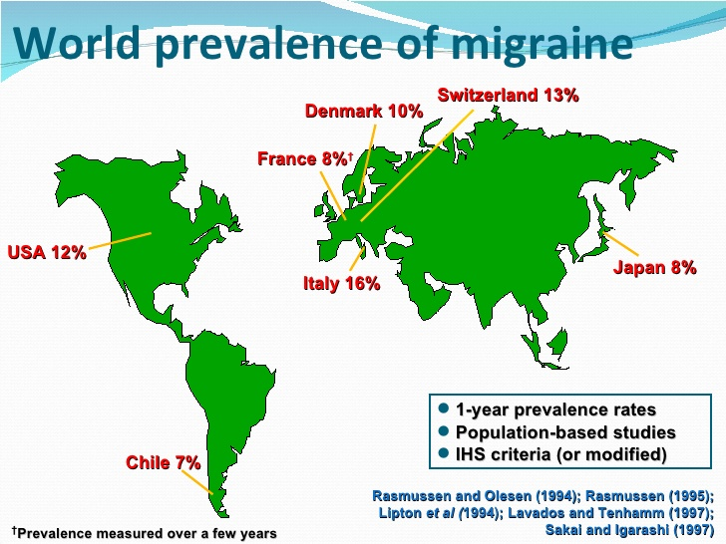
Epidemiology
19% of women and 11% of men worldwide with migraines
Commonly begin between ages 15-24
Highest prevalence in ages 35-45
Prevalence lower in Africa and Asia but may be due to lack of diagnostic resources
Chronic Migraines in about 1.4 to 2.2% of population
Worldwide incidence of migraines of 15%
Notes:
Migraines are more common in males before puberty and in females after puberty with 19% of adult women and 11% of adult males being affected (Vos, 2010). Migraines commonly begin between the ages of 15 and 24 and have an increased incidence in adults aged 35 to 45 (Bartleson, 2010). The incidence of migraines are slightly lower in Asian and African countries, but this may be partially due to lack of diagnostic resources in these areas (Wang, 2003). In the United States, 18% of men and 43% of women will experience migraines at some point in their lives with about 6% of men and 18% of women experiencing migraines in a given year. Europeans have a lifetime risk of migraine between 12 and 28%. Chronic migraines occur in about 1.4 to 2.2% of the population. Worldwide, migraines affect about 15% of the population (Vos, 2010).

Slide 5
Signs and symptoms
The Prodrome Phase
Few days to few hours before headache
60% of migraine patients
Symptoms:
change in mood and behaviour
irritability
depression
change in appetite and craving for certain food
changes in fluid balance in the body.
Notes:
Signs and symptoms of migraines can vary from one individual to another. The symptoms are represented in four different phases
This is the phase that occurs from a few days to a few hours before a headache. The prodromal phase occurs to about 60% of migraine patients. Its symptoms include a wide variety of phenomena including change in mood and behaviour, irritability, depression, change in appetite and craving for certain food, and changes in fluid balance in the body.

Slide 6
Signs and symptoms
The Aura Phase
30 to 60 minutes before the headache
13-18% of migraine patients
Visual Symptoms:
99% of aura cases
vision disturbance
partial alteration in the field of vision
Sensory Symptoms:
30-40% of aura cases
pain, numbness, and tingling feeling
https://upload.wikimedia.org/wikipedia/commons/1/1d/Negatives_Skotom_%28Brandenburger_Tor_Blaue_Stunde%29_1.jpg
Notes:
The phase that occurs right before a headache. The aura is a neurological phenomenon that usually lasts between 30 to 60 minutes. 13-18% of migraine patients experience aura in every single migraine they have, and 13 -18% of migraine patients experience aura in some of the migraines they have. Symptoms can be visual or sensory. The visual symptoms occur in 99% of the aura cases and include vision disturbance with partial alteration in the field of vision. The sensory symptoms occur in 30-40% of aura cases, and include pain, numbness, and tingling feeling in the hand and arm of one side, and the nose and mouth on the same side

Slide 8
Signs and symptoms
The Pain Phase
4 to 72 hours for adults
Unilateral vs Bilateral headache
Neck pain
intensifies during physical activity
Notes:
Also known as the attack, and is the headache phase. The pain lasts between 4 and 72 hours for adults and can be less than 4 hours for children. During the pain phase most people experience unilateral headache, with some people experience bilateral headache. The headache comes with different intensities and usually get more intense during physical activity. The headache is also usually associated with neck pain.

Slide 9
Signs and symptoms
The Postdrome Phase
Final Phase
Soreness
Some Patients
Cognitive difficulties
Mood changes
Weakness
Notes:
The final phase, which occurs after the migraine attack. During the postdromal phase one experiences soreness in the same area of the migraine. Some patients also experience cognitive difficulties, mood changes, and weakness.

Slide 10
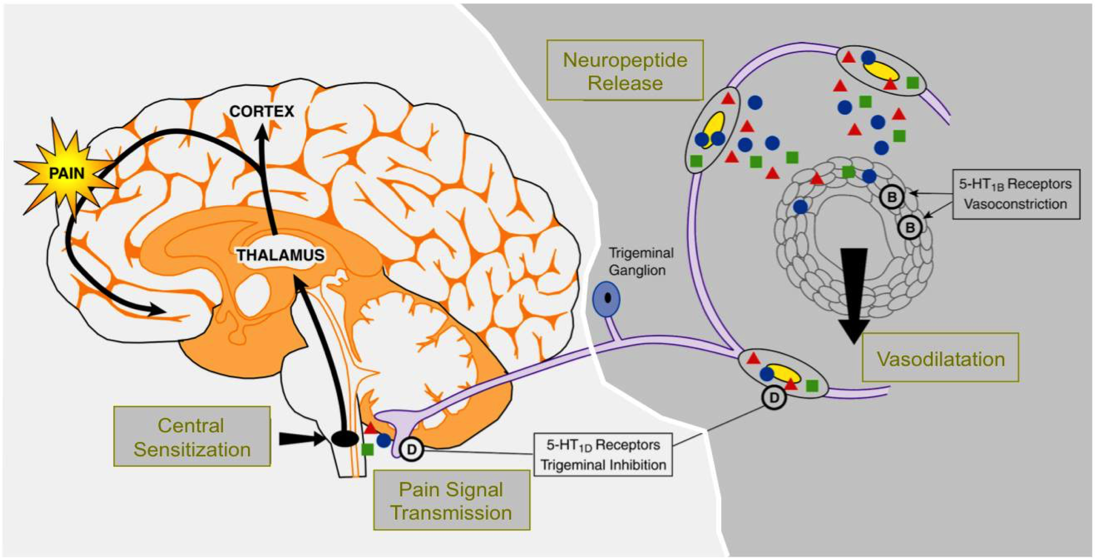
Pathophysiology
Notes:
The pathophysiology of migraine is fairly well understood, and evidence supports contributory roles of both neural and vascular mechanisms. It is a multifactorial disease whose progression is a result of the interaction of genes and environment. Researchers have identified a linkage to chromosome 19 and the biological basis for this is mutations involving the Cav2.1 (P/Q) type voltage-gated calcium channel CACNA1A gene.
The manifestation of headache in migraineurs is due to the activation of the trigeminovascular system, which is the major pain signaling system in the brain
It is thought that the migraine begins with this reversible, transient cortical event known as cortical spreading depression (CSD). It is a slow moving wave of depolarization that starts in the occipital lobe and moves forward and is followed by a prolonged inhibition of cortical activity. First identified by Leão in the rabbit, this distinctive electrophysiological phenomenon has been correlated with the visual aura that precedes the onset of headache in migraine. Although it is not clear how CSD begins in the human brain, genetic factors are likely to play a role in individual CSD susceptibility.
This cortical spreading depression is what initiates the activation of the trigeminovascular system. It begins through antidromic activation at distal trigeminal nerve terminals, which release neurotransmitters including substance P, neurokinin A and calcitonin gene related peptide (CGRP). Calcitonin gene-related peptide is the most potent vasodilator neurotransmitter of the trigeminal system.
These substances then bind to receptors on intracranial blood vessels and cause vasodilation, plasma protein extravasation and ultimately sterile inflammation. This results in the reactivation of the trigeminal nerve but now in an orthodromic fashion. The signal is relayed to the trigeminal nucleus caudalis which is a central structure in the brain stem that forwards pain impulses to the thalamus and ultimately the sensory cortex. This atypical, stimulus induced activation of the brain stem during and between migraine attacks, leads to the lack of normal habituation to repetitive stimuli and ultimately sensitization. Sensitization is the idea that repeated administration of a stimulus results in progressive amplification of a response. Once the first order trigeminal neurons become sensitized, normally innocuous, intracranial stimuli, such as a pulsating artery, become painful and result in a throbbing pain made worse with activity. If the pain is unsuccessfully treated, second order and third order neurons extending through the midbrain, thalamus and cortex are continuously activated. This can ultimately lead to central sensitization caused by pain from stimuli that are normally not painful.
Extra note: Second order neuron – carries the information from the central nervous system to the thalamus. Third order neuron – carries sensory information from the thalamus to the cerebral cortex.
CORTICAL INHIBITION: "Cortical inhibition can limit everything from the way a person moves to how they feel, see, and hear."
What is CORTICAL INHIBITION? can limit everything from the way a person moves to how they feel, see and hear

Slide 11
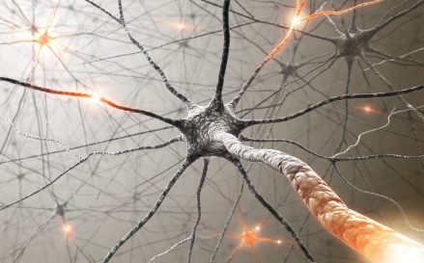
Treatment

Slide 12
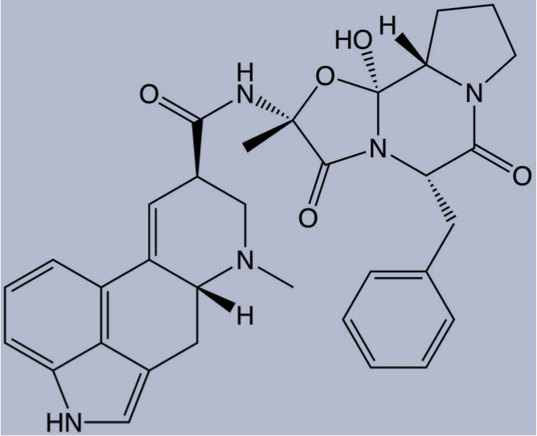
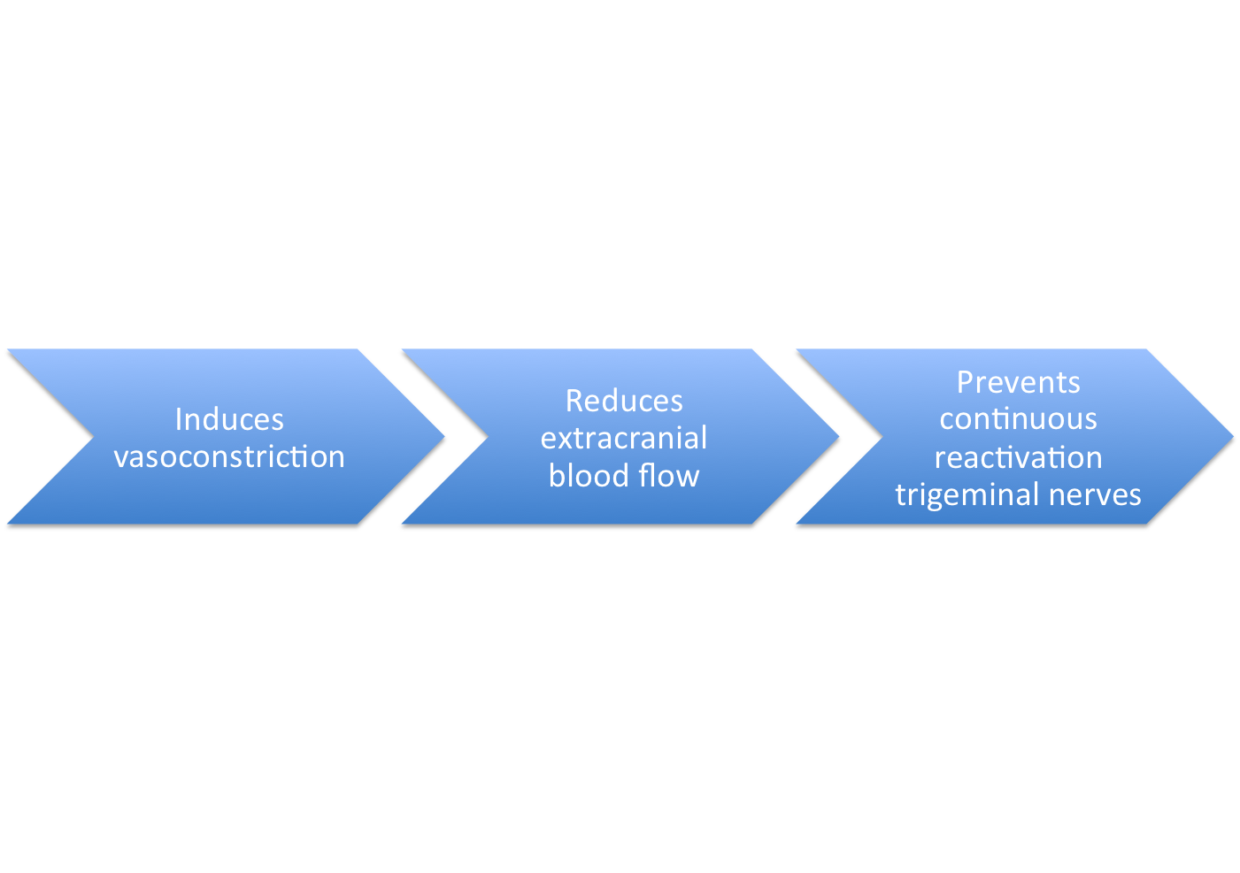
First drug therapeutic: Ergotamines
History:
First isolated Arthur Stole 1918
First used as treatment option for migraines in 1925
Rationale:
Notes:
Its chemical structure is similar to that of amines, serotonin, norepinephrine and dopamine. They have a complex mode of action that involves interaction with a variety of receptors which include 5-HT, dopamine and noradrenaline.The mode of action of ergotamine in migraine may be by means of selective arterial vasoconstriction on certain cranial vessel beds or, alternatively, by depression of central serotonergic neurons mediating pain transmission or circulatory regulation.
(go back to picture on previous slide)
2 modes of action:
1.Direct activation of 5-HT_{1B} receptors located on intracranial blood vessels, leads to vasoconstriction of blood vessels
2. Direct activation of 5-HT_{1D} receptors on sensory nerve endings of trigeminal system, inhibits pro-inflammatory neuropeptide release

Slide 13
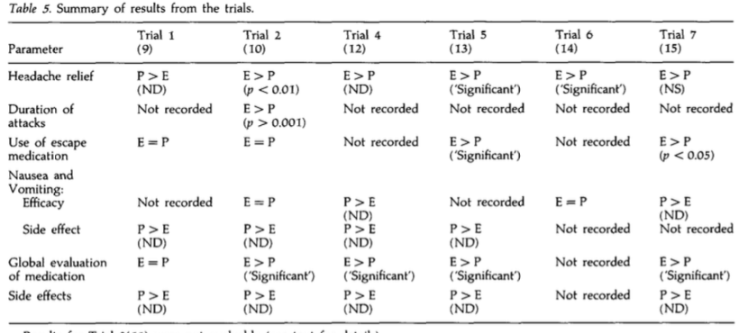
Placebo controlled trial with ergotamine:
(Dahlof, 1993)
Side effects:
-Nausea -Extreme muscle pain
-Vomiting -Diarrhea
-Abdominal pain -Chest tightness -General weakness
-Paresthesia
Notes:
The study conducted looked at the effect of ergotamines on headache relief in people presenting with symptoms of migraines. In comparison to the placebo treatment, ergotamines were found to be more effective in the relief of headache in 5 out of the 6 trials. In three of the trials, there was a statistically significant difference
the combination ergotamine and caffeine was used in three of the studies (12,13,15). include caffeine to improve absorption and efficacyIn the other trial,ergotamine was given together with caffeine, belladonna alkaloids and a barbiturate (11).This combination of drugs is significantly more effective than ergotamine alone in relieving migraine headache and other symptoms ( 12)
Nausea and vomiting: All ergotamine trials evaluated had some analysis of nausea and/or vomiting. In the four trials where efficacy assessments were made, nausea and/or vomiting either increased in severity after treatment with ergotamine, and more patients were affected than was observed with placebo or there was little difference between the two treatments (10, 12, 14, 15). In all trials where the symptoms were assessed as side effects, more patients were affected following ergotamine than following placebo (9, 10, 12, 13).
Global evaluation of medication: Five of the ergotamine trials evaluated presented results for patients’ preference for ergotamine or placebo. In four trials, significantly more patients preferred ergotamine to placebo (10, 12, 13, 15). In the fifth trial, similar numbers of patients clinically diagnosed as having migraine preferred placebo to ergotamine as preferred ergotamine to placebo (13)
Side effects : The side effect profile of ergotamine and placebo was reported in five of the six trials evaluated (9, 10, 12, 13, 15). In all these trials more patients reported side effects with ergotamine than with placebo. Side effects associated with ergotamine included nausea/ vomiting, dizziness/vertigo, drowsiness/tiredness, numbness, nervousness, trembling, dyspnoea and dry mouth.

Slide 14
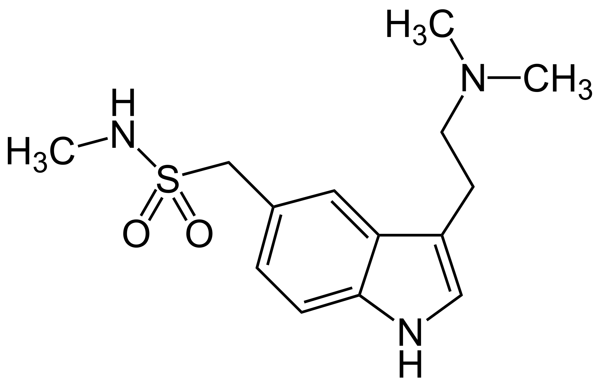
Triptans
Sumatriptan (Imitrex) is the most common
Developed in early 1990s to treat migraine
Can provide relief in approximately 75% of patients
oral tablets, injections and nasal sprays
Sumatriptan
Notes:
Triptans like Sumatriptan were developed to treat migraines in the early 1990s. They effectively relieve pain and nausea in approximately 75% of people. They are administered as oral tablets, injections and nasal sprays.

Slide 15
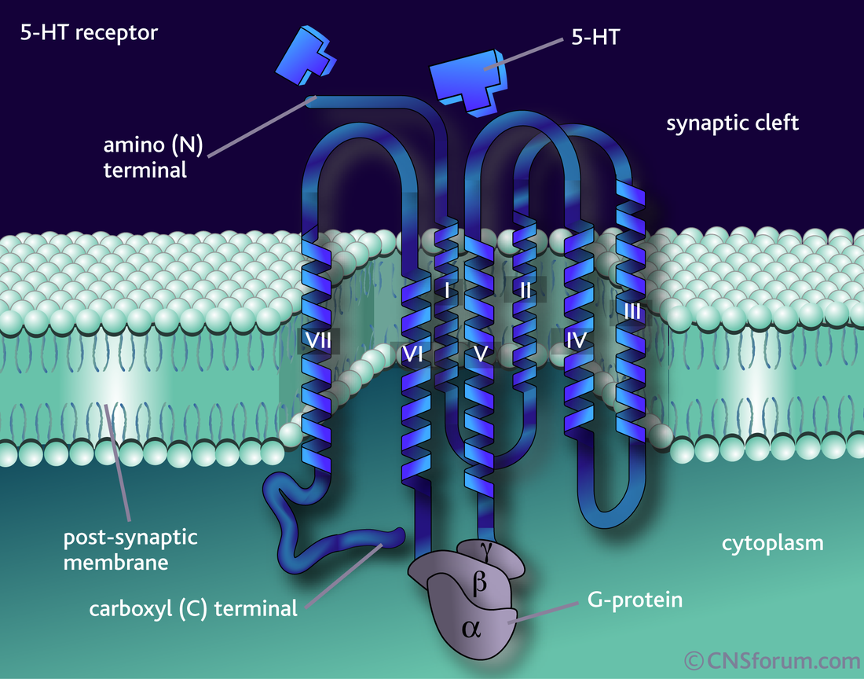
Triptan Biochemistry
5-hydroxytryptamine (5-HT) receptor agonists
5-HT receptors constrict blood vessels in brain when activated
Migraines thought to be caused by vessel dilation
Notes:
Triptans are selective 5-hydroxytryptamine (5-HT) receptor agonists with high affinity for 5-HT1B and 5-HT1D receptors. These receptors when activated, constrict blood vessels in the brain to provide relief (Bartleson, 2010).

Slide 16
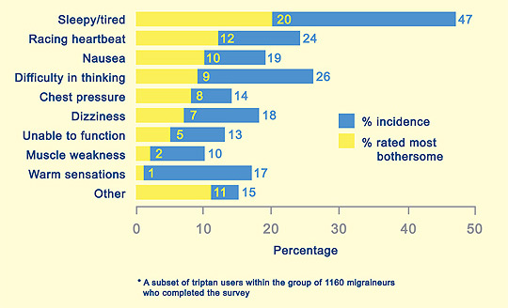
Triptan Side Effects
Triptans reserved for analgesic non-responders
Tingling, pain, tightness in chest/throat, fatigue, nausea, dizziness
Notes:
Triptans are often reserved for use in those with moderate to severe pain and for those who do not respond to analgesics (Johnston, 2010). Side effects include tingling, pain and tightness in the chest or throat, vomiting, dry mouth, flushing, dizziness and fatigue. In rare cases they can lead to cardiac ischemia (Gilmore, 2011).

Slide 17
Triptans and Cardiovascular Health
In rare cases cardiac ischemia may occur
Avoided in patients with history of CV disease or stroke
Serotonin like response (increased HR and BP)
Patients should be evaluated for vascular disease risk before triptans are prescribed
Notes:
Rare side effect of cardiac ischemia. Triptans are often avoided in patients who have cardiovascular disease, a history of stroke or have migraines accompanied by neurological problems. Patients should be evaluated for their risk of developing vascular disease before prescription for triptans is given. 5-HT receptor is a serotonin receptor

Slide 18
NSAIDs and Analgesics
The first line of treatment for migraines are common analgesic drugs known as Non-steroidal Anti inflammatory Drugs (NSAIDS)
Advil, Aleve, Motrin
They are a non specific treatment: They only treat symptoms, not underlying causes

Slide 19
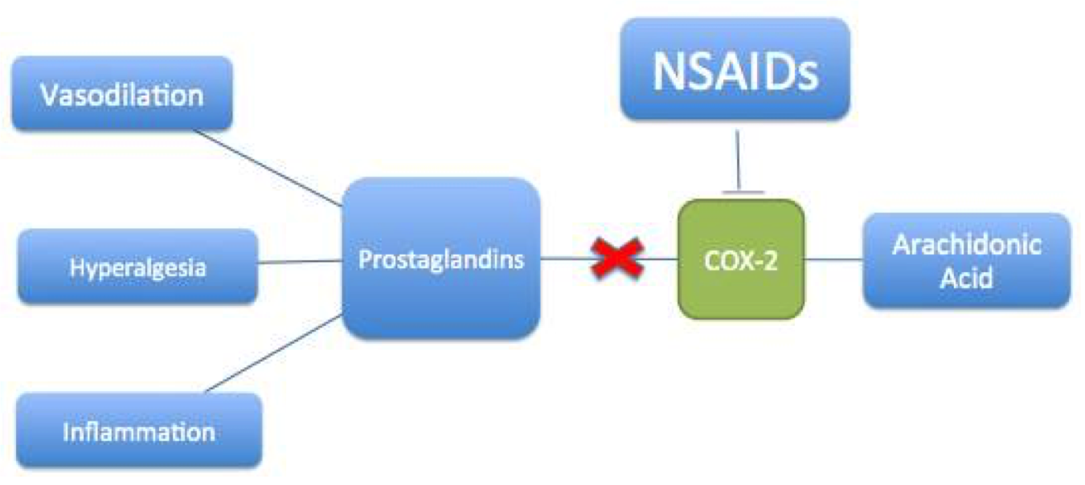
NSAIDs Pharmacokinetics
Notes:
NSAIDs work by inhibiting the production of Prostaglandins
Prostaglandins have a major role in modulating pain, inflammation, and fever.
One way they do this is by increasing sensitivity in the nerves that send the pain response to the brain, thus establishing the pain threshold.
-NSAIDs inhibit COX-2 to decrease synthesis of prostaglandins
-Reduction of prostaglandins = reduction of inflammation
Normally, arachidonic acid is converted to prostaglandins by COX-2 enzymatic activity. This results in vasodilation, inflammation and increased sensitivity to pain. NSAIDs inhibit COX-2 function and thus prevent these biological responses from occurring. Limiting these activities helps alleviate pain experienced from migraine.

Slide 20
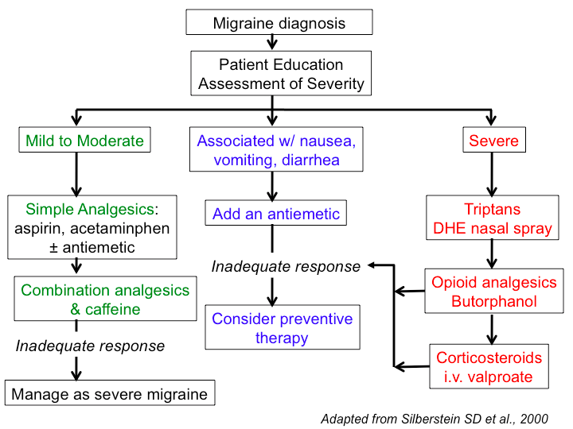
Notes:
antiemetic= effective against vomiting and nausea

Slide 21
Alternative Treatments for Migraine
Recently Plastic surgeons have advertised nerve decompression surgery as an innovative new treatment of migraine headaches.
The Surgical Migraine Procedure is the removal of the corrugator muscles (small muscles associated with the eyebrows).
Hotly debated in the medical community, published research shows both clinical effectiveness, and placebo
Notes:
This operation involves the removal of a muscle in an area of the forehead where patients experience migraine pain. The idea for surgery began with patients reporting that their headaches were disappearing after forehead rejuvenation plastic surgery . Combined, these observations led to a theory that migraine headache pain can be triggered by compression of superficial nerves by surrounding tissues, such as muscle, fascia, and bone. During nerve-decompression migraine surgery, nerves at one or multiple common migraine headache trigger sites are released from surrounding structures such as bone, muscle, fascia, and vessels

Slide 22
Neurostimulation
Neurostimulation is the practice of applying gentle stimulation to nerves that have been identified as sending strong, frequent pain signals
The Cefaly is a headband designed to deliver electrical impulses to nerves that transmit migraine pain and thereby theoretically suppress this trigger mechanism.
Notes:
An adhesive electrode is positioned on the forehead and Cefaly connects to this. Through the electrode, Cefaly generates precise micro-impulses in order to stimulate the nerve endings of the trigeminal nerve.
Neurostimulation of the trigeminal nerve with Cefaly produces a relaxing effect by triggering part of trigeminal nerve that releases endorphins. Regular repetition of this relaxing effect helps reduce the number of attacks of headache and migraine.
Cefaly is the first external trigeminal neurostimulator. Cefaly works by stimulating the trigeminal nerve utilizing an electrode that is applied to the forehead. This is where the two essential branches of the trigeminal nerve (supratrochlear and supraorbital) extend furthest to the surface of the skin.

Slide 23
Case study

Slide 24
References
American Migraine Foundation. (n.d.). Retrieved February 27, 2016, from http://www.americanmigrainefoundation.org/resources-and-links/a-brief-sad-history-of-treatments-for-migraine/
Aminoff, Roger P. Simon, David A. Greenberg, Michael J. (2009). Clinical neurology (7 ed.). New York, N.Y: Lange Medical Books/McGraw-Hill. pp. 85–88.
Bartleson JD, Cutrer FM (May 2010). "Migraine update. Diagnosis and treatment". Minn Med 93 (5): 36–41. PMID 20572569.
Bigal, ME; Lipton, RB (June 2008). "The prognosis of migraine". Current Opinion in Neurology 21 (3): 301–8.doi:10.1097/WCO.0b013e328300c6f5. PMID 18451714.
Blau, J. N. (1980). Migraine prodromes separated from the aura: complete migraine. Br Med J, 281(6241), 658-660.
Dahlof, C. (1993). Placebo-controlled clinical trials with ergotamine in the acute treatment of migraine. Cephalalgia, 13(3), 166-171.
Diseases and Conditions: Migraines. (2013, June 04). Retrieved March 08, 2016, from http://www.mayoclinic.org/diseases-conditions/migraine-headache/basics/risk-factors/con-20026358
Didier HA, Di fiore P, Marchetti C, et al. Electromyography data in chronic migraine patients by using neurostimulation with the Cefaly® device. Neurol Sci. 2015;36 Suppl 1:115-9.
Doggrell SA. 2004. New drugs for the prevention and treatment of migraine: topiramate and BIBN 4096 BS. Expert Opin Pharmacother,5:1837–40.
European Neurological Review, 2011;6(4):265–9
Hansen, J. M., Lipton, R. B., Dodick, D. W., Silberstein, S. D., Saper, J. R., Aurora, S. K., ... & Charles, A. (2012). Migraine headache is present in the aura phase A prospective study. Neurology, 79(20), 2044-2049.
Hougaard, A; Amin, FM; Ashina, M (June 2014). "Migraine and structural abnormalities in the brain.".Current opinion in neurology 27 (3): 309–14.doi:10.1097/wco.0000000000000086. PMID 24751961.
Iovino M, Feifel U, Yong C-L, et al. 2004. Safety, tolerability and pharmacokinetics of BIBN4096 BS, the first selective small molecule calcitonin gene-related peptide receptor antagonist, following single intravenous administration in healthy volunteers. Cephalalgia, 24:645–56.
International Headache Society abstracts. Cephalalgia. 2015;35(6 Suppl):1-296.
Jes Olesen, (2006). The headaches. (3 ed.). Philadelphia: Lippincott Williams & Wilkins. p. 238.
Johnson, E.S, Ratcliffe, D.M & Wilkinson, M. (1985). Naproxen sodium in the treatment of migraine . Cephalalgia, 5(1), 5-10.
Johnston MM, Rapoport AM (August 2010). "Triptans for the management of migraine". Drugs 70 (12): 1505–18. doi:10.2165/11537990-000000000-00000.PMID 20687618.
Kalra, A. & Elliott, D. (2007). Acute migraine: current treatment and emerging therapies . Therapeutics and clinical risk management , 3(3), 449-459.
Kelman L., (2006). " The postdrome of the acute migraine attack". Cephalalgia 26 (2): 214–20.
Noseda, R & Burstein, R. (2013). Migraine pathophysiology: Anatomy of the trigeminovascular pathway and associated neurological symptoms, cortical spreading depression, sensitization, and modulation of pain. Pain , 154(1), S44-S53.
Pfaffenrath V, Scherzer S. Analgesics and NSAlDs in the treatment of the acute migraine attack. Cephalalgia 1995; Suppl 15:14-20.
Rizzoli P. Preventive pharmacotherapy in migraine. Headache. 2014;54(2):364-9.
Schürks, M; Rist, PM; Bigal, ME; Buring, JE; Lipton, RB; Kurth, T (2009-10-27). "Migraine and cardiovascular disease: systematic review and meta-analysis". BMJ (Clinical research ed.) 339: b3914.doi:10.1136/bmj.b3914. PMC 2768778. PMID 19861375.
Tfelt-hansen et al.. (2000). Ergotamine in the acute treatment of migraine: A review and European consensus . Brain, 123(1), 9-18.
Vos, T; Flaxman, AD; Naghavi, M; Lozano, R; Michaud, C; Ezzati, M; Shibuya, K; Salomon, JA; et al. (Dec 15, 2012). "Years lived with disability (YLDs) for 1160 sequelae of 289 diseases and injuries 1990–2010: a systematic analysis for the Global Burden of Disease Study 2010". Lancet 380 (9859): 2163–96.doi:10.1016/S0140-6736(12)61729-2. PMID 23245607.
Wang SJ (2003). "Epidemiology of migraine and other types of headache in Asia". Curr Neurol Neurosci Rep3 (2): 104–8. doi:10.1007/s11910-003-0060-7.PMID 12583837.
Weinberger, J (March 2007). "Stroke and migraine".Current cardiology reports 9 (1): 13–9.doi:10.1007/s11886-007-0004-y. PMID 17362679.
Whalen, K., Finkel, R., & Panavelil, T. A. (n.d.). Pharmacology (6th ed.).

