Slide 1
Dissociative Identity Disorder (DID)
Ahmad Kiani, Nischal Praveen, Kasthuri Selvarajah, Wajiha Sabrani, Ellen Choi

Slide 2
Outline
Introduction
Diagnosis
Cause
Effects & Symptoms
Mechanism
Treatments
Legal implications

Slide 3
Introduction- What is DID?
Complex disorder
Coexistence of multiple personalities
Loss of memory
Childhood trauma
Symptoms grow worse with age
(Kluft, 1996)
Notes:
Dissociative Identity Disorder (DID), is also commonly referred to as multiple personality disorder. It is a very complex disorder characterized by the coexistence of multiple separate identities (Kluft, 1996). DID commonly develops after the occurrence of some form of trauma in childhood. However, as a person with DID grows older, the multiple personalities may grow more complex, as the individual affected may combine posttraumatic events with fantasy to create more intricate personalities (Kluft, 1996).
http://thewestsidestory.net/wp-content/uploads/2014/11/Trans-fat-consumption-linked-to-loss-of-memory-among-adults.jpg
(Name, Year)

Slide 4
Prevalence
Occurs in 1-3% of population
Underdiagnosis
Misdiagnosis- borderline personality disorder, schizophrenia, psychosis
(Johnson, 2011)
(Foote, 2006)
Notes:
A study conducted by the International Society for the Study of Trauma and Dissociation found the rate of DID to be about 1-3% in the general population (Johnson, 2011). However, this study may have underrepresented the cases of DID, as it is often misdiagnosed or undiagnosed. For example, in a prevalence study conducted by Foote, 5% of his sample size was diagnosed with DID, however in reality 29% actually had DID (Foote, 2006). Furthermore DID may be misdiagnosed as other disorders such as borderline personality disorder, schizophrenia, or psychosis. One reason that DID is often misdiagnosed and underdiagnosed is because it shares many different symptoms with other disorders, and thus psychiatrists may attribute the symptoms to another disorder (Johnson, 2011).

Slide 5
Demographics
Most commonly affected people range from 22.8 to 34.5 years old
Median age: 31.3 years old
89% people affected were women
11% people affected were men
(Foote, 2018)
Notes:
The most common age range for those suffering from DID is between 22.8 years to 34.5 years, with the median age being approximately 31.3 years (Foote, 2018). Through the conduction of eleven different studies, it was found that 89% of those suffering from DID were women, while only 11% were men (Foote, 2018). However, this statistic may show an over-representation of women, because these studies were conducted in psychiatric facilities, and women are more likely than men to seek psychiatric help.

Slide 6
Diagnosis Process
Rule out physical disease or physiological effects of a substances causing symptoms
Assess observed or reported symptoms and life history
Repeat psychotherapy assessments
Notes:
Physicians must rule out possible physical disease or physiological effects of a substance (e.g.: head injury or intoxication) that may be causing symptoms of memory loss and a sense of unreality (Nurcombe, 2008). Once physical conditions are ruled out, a psychiatrist can diagnose dissociative disorders by assessing observed or reported symptoms and life history. Often, repeat psychotherapy assessments are conducted to see how a patient is progressing (Nurcombe, 2008).

Slide 7
Defining Feature
Disruption of identity caused by two or more distinct personality states or an experience of possession.
(American Psychiatric Association, 2013)
Notes:
Physicians must rule out possible physical disease or physiological effects of a substance (e.g.: head injury or intoxication) that may be causing symptoms of memory loss and a sense of unreality (Nurcombe, 2008). Once physical conditions are ruled out, a psychiatrist can diagnose dissociative disorders by assessing observed or reported symptoms and life history. Often, repeat psychotherapy assessments are conducted to see how a patient is progressing (Nurcombe, 2008).

Slide 8
Diagnostic Criteria DSM-5
B. Recurrent gaps in memory
C. Symptoms cause significant distress
D. Disturbance is beyond cultural or religious practice
E. Symptoms not attributable to physiological effects of a substance or medical condition
Notes:
A. Disruption of identity characterized by 2 or more distinct personality states, which may be described in some cultures as an experience of possession. The disruption in identity involves marked discontinuity in sense of self and sense of agency, accompanied by related alterations in affect, behaviour, conciousness, memory, perception, cognition, and/or sensory-motor functioning. These signs and symptoms may be observed by others or reported by the individual.
B. Recurrent gaps in the recall of everyday events, important personal information, and/or traumatic events that are inconsistent with ordinary forgetting.
C. The symptoms cause clinically significant distress or impairment in social, occupational, or other important areas of functioning.
D. The disturbance is not a normal part of a broadly accepted cultural or religious practice. Note: In children, the symptoms are not better explained by imaginary playmated or other fantasy play.
E. The symptoms are not attributable to the physiological effects of a substance (e.g., blackouts or chaotic behaviour during alcohol intoxication) or another medical condition (e.g., complex partial seizures).
(American Psychiatric Association, 2013)

Slide 9
Associated Features
Dissociative flashbacks
Comorbid mental health issues
Substance abuse, self-harm, non-epileptic seizures
Notes:
Individuals with DID tend to report dissociative flashbacks. During dissociative flashbacks, the individual experiences a previous event as if it were occurring in the present. The experience is relived with a change of identity, disorientation, or a partial or complete loss of contact with current reality. The flashback is followed with amnesia about the content of the flashback. Individuals diagnosed with DID tend to have comorbid depression, anxiety, sleeping disorders and eating disorders. Substance abuse, self-harm and non-epileptic seizures are common in DID patients (American Psychiatric Association, 2013).

Slide 10
Genetic Causes
Evidence of personality disorders being genetically influenced
Natural, inborn capacity to dissociate
Genetic factors contributing to smaller hippocampal and amygdalar volumes
Notes:
Many types of personality disorders are influenced genetically, in particular the schizotypal and antisocial personality disorder. This raises the genetic possibility of DID
One of the predisposing factors of DID is a natural, inborn capacity to dissociate
Has biological determinant, although no twin studies have yet been undertaken, there is evidence that multiple personality disorder may be transgenerational
Some evidence of dissociative phenomenal reported and/or observed in the family histories of 18 multiple personality disorder cases
However, it is difficult to conclude that this is the case because there are factors that preclude a clear interpretation of the genetic mechanism.
First of all, selective sample chosen only based on availability of information on the patient's' family histories. Second, many multiple personality disorder patients come from families that deny anything problematic has ever occurred and unwilling to share data
It is hard to measure the genetic factor behind DID without extensive, well controlled studies
There is evidence of smaller hippocampal and amygdalar volumes in DID patients and genetic factors that could contribute to this could increase the risk for the development of the disorder

Slide 11
Environmental Causes
Detachment from attachment figure in infancy
Child trauma (physical and sexual abuse) from early childhood
Unpredictable, alternating abuse and love
Notes:
The second predisposing factor is exposure to severe, overwhelming trauma (ex. Frequent, unpredictable, and inconsistently alternating abuse and love especially during childhood)
Many studies have hypothesized that the maladaptive ability to dissociate is the integral cause of multiple personality disorder.
Child trauma, physical and sexual abuse in early childhood, latency and adolescence were shown as significant predictors of self-mutilation and suicidality.

Slide 12
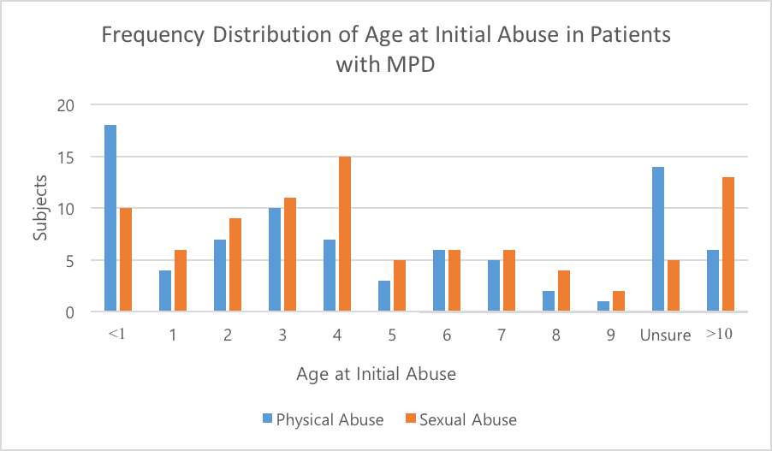
Notes:
Graph made by Ellen based on data from the study by Collin Ross and colleagues.
Interviewd 102 individual with clinical diagnoses MDP from Winnipeg, Utah, California and Ottawa using DDIS (Dissociative Disorders Interview Schedule)
Result: Consistent findings of high rates of childhood trauma such as physical and sexual abuse
In a larger pool of 388 cases, 91.2% of the patients had been physically or sexually abused or both prior to age 18
For the majority of subjects, the abuse started before the age of 5 (as shown in graph, highest number of physical ab.use before the age of 1, and sexual abuse at age 4)

Slide 13
Common Symptoms
Amnesia
Anxiety
Auditory hallucinations
Depression
Fugue episodes
Insomnia & nightmares
Blackouts
Low self-esteem
Mood swings
Numbness
Self-harm
Somatoform symptoms
Suicide attempts
Notes:
- Amnesia- Amnesia is typically around a period in childhood with a focus on traumatic events. The host and alters have no memory of other alters due to amnesic barriers separating alters. Amnesia follows dissociative flashbacks.
- Anxiety
- Auditory hallucinations- Hallucinations include crying, muttering, self-depracatory remarks.
- Depression
- Fugue episodes- May find themselves at some destination with no knowledge of journey.
- Insomnia and nightmares- Alters may keep host and other alters awake.
- Lost time “blackouts”- The host loses time when the alter(s) take over.
- Low self-esteem
- Mood swings- May have several mood changes in a day.
- Numbness- Individual may feel distant or detached from self.
- Self-harm- May be inflicted to prevent switching, have sense of control, or return to a feeling of reality.
- Somatoform symptoms
- Suicide attempts- Attempts are often in rapid succession and may be without the host’s awareness (Ringrose, 2018).

Slide 14
Effects on Life
Can function normally but extreme emotion may trigger a switch
Avoid things reminiscent of childhood trauma
Cope with comorbid mental health issues and symptoms
Effects on marital, family and professional relationships
Notes:
- Generally, people with DID can function normally. However, an experience of extreme emotion especially associated with childhood trauma can trigger a switch. When there is a perceived threat, patients tend to switch to an alter who is more competent to handle the situation. DID patients tend to avoid situations, people and environments that may remind them of a childhood trauma linked to their disorder. Coping with comorbid mental health disorders and symptoms of DID is important to maintaining the individual’s quality of life. Long-term supportive treatment helps individuals manage their symptoms and minimize strain on relational, marital, family, parenting, occupational and professional life (American Psychiatric Association, 2013).

Slide 15
Anatomic Abnormalities
3 distinct hypothesis that are all supported but not integrated
Orbitofrontal hypothesis
Cortico-limbic hypothesis
Temporal hypothesis

Slide 16
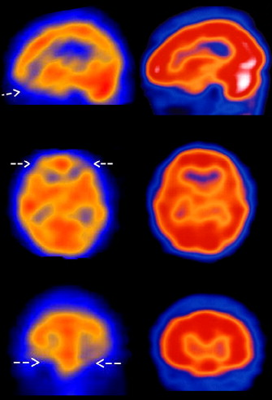
Reduced perfusion of orbitofrontal cortex revealed by SPECT imaging
Sourced from: Sar et al. (2007)
Notes:
Development of the orbitofrontal cortex is hypothesized to be correlated with emotional regulation and attachment to the sense of self. Additionally, the orbitofrontal cortex is also believed to serve inhibitory roles in the prevention of the formation of distinct identity states. The DID patients have reduced perfusion to this region which leads to their emotional instability and development of multiple personalities.
perfusion=blood flow

Slide 17
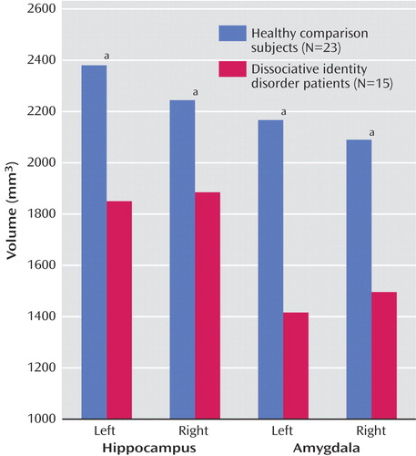
Reduced volumes of hippocampus and amygdala in female DID patients
Sourced from: Vermetten et al. (2006)
Notes:
The hippocampus and amygdala are particular features of the cortico-limbic system which have been shown to be impacted in female DID patients. The hippocampus is involved in long term memory storage whereas the amygdala is involved in fear and anxiety responses. Larger volumes have been shown to serve protective roles against early life trauma. Smaller volumes of these structures essentially predispose individuals to disorders like DID.

Slide 18
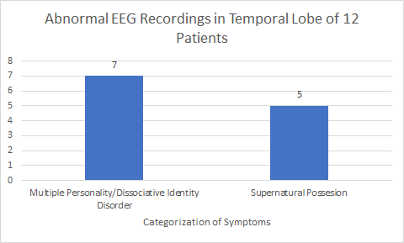
Case Study Analysis of 12 Patients with Electrical Disturbances in Temporal Lobe
Sourced from: Mesulam MM (1981)
Notes:
A case study analysis of 12 patients was conducted of patients who had varying degrees of abnormal electrical activity predominantly in the temporal lobe. This study predicts that the temporal lobe has a function of integrating affective tone (state of mind, how something affects the individual) with sensory information and perception. Sometimes, it can lead to abnormal characters traits. Other times, more dramatic effects arise like dissociative states of identity. 7 out of 12 patients presented with defining symptoms of DID while the other 5 believed to possessed by some sort of supernatural power.

Slide 19
Treatment
Two standard therapy approach
First: Restoration
Second: Integration
Triphasic Therapy Model (Judith Herman)
Stage 1: Safety and Stability
Stage 2: Maintaining Stability and resolving trauma related emotions
Stage 3: Integrating Multiple Identities
Notes:
The treatment process for DID is usually in the form of therapies rather than pharmaceuticals. Once treatment therapy used is called that two standard therapy approach which includes the restoration and integration stage. The restoration stage involves selecting a single identity and transforming it into the host identity. Most often this is the identity that the individual had prior to the diagnosis of DID. The integration stage involves combining multiple personalities into one which may be beneficial if those personalities overlap well with each other (ex. Some people with DID have alternate personalities that can communicate between each other).
Another treatment model that was first proposed by Judith Herman who is an American psychiatrist is the triphasic therapy model consisting of three stages:
Stage 1:
• Establishing bodily safety: e.g. abstinence from self-injury.
• Establishment of a safe environment: e.g., a secure living situation, non-abusive relationships, a job and/or regular income, adequate supports.
• Establishment of emotional stability: e.g., ability to calm the body, regulate impulses, self-soothe, manage post-traumatic symptoms triggered by mundane events
Stage 2:
Overcoming fear of traumatic events
Controlling emotions
Stage 3:
Decreasing shame and alienation
Establishing yourself in society once again
Some DID experts also recommended adding interventions to these three stages such as providing psychoeducation, increasing awareness and tolerance of emotion, and managing stressors and relationships

Slide 20
International Longitudinal Study
Consisted of 292 therapists and 280 patients from 19 countries
Study was run over a 30-month period
Results - Significant reduction in:
Dissociation
Distress
Depression
Suicide attempts
Aggressive behaviour
Younger patients showed a more rapid reduction

Slide 21
Pharmacotherapy
Drugs administered in severe DID along with therapy
Antipsychotic drugs that block dopamine and serotonin receptors
Are not sufficient alone to treat dissociation

Slide 22
Difficulties in Treatment
Each individual develops unique identities
Severity of DID varies among patients
Require individualized therapies

Slide 23
Legal Implications
Not common, but has been brought up in court cases
Used as a defense for:
Drunk driving
Kidnapping
Theft
Murder
Courts must decide whether or not DID is a valid defense for committing the crime
Notes:
Although DID is believed to be uncommon, there have been some cases of DID brought up in court rooms. It has been used as a defence in cases ranging from drunk driving, kidnapping, theft and even murder, in extreme cases.

Slide 24
Juanita Maxwell
While working as a maid she killed a hotel guest
During trial she claimed that her alternate personality “Wanda” had committed the crime
Ruling was “not guilty due to insanity”
Placed at Florida State Hospital
Haloperidol as medication
(James, 2008)
Notes:
Juanita Maxwell worked as a maid in a Florida Hotel. In 1979 she was accused of murdering a hotel guest using a lamp. However, when during the trial her lawyer accused her alternate personality Wanda, of committing the murder (James, 2008). Juanita claimed that the guest had refused to return a pen that she had borrowed, and thus Juanita had barged into her hotel room killing her. She also claimed that she had 7 alternate personalities. It was an interesting case for the court who had to consider whether or not DID was a viable explanation for the murder. Ultimately they sided with Juanita, and she was declared “not guilty due to insanity”. She was placed in care at Florida State Hospital, where she was prescribed Haloperidol as a medication (James, 2008). This was an important legal case because it was one first court cases in which the jury had to consider the consequences of DID.

Slide 25
References
Bayne, T. J. (2002). Moral Status and the Treatment of Dissociative Identity Disorder1. The Journal of medicine and philosophy, 27(1),
87-105.
Brand, B. L., Armstrong, J. G., Loewenstein, R. J., & McNary, S. W. (2009). Personality differences on the Rorschach of dissociative
identity disorder, borderline personality disorder, and psychotic inpatients. Psychological Trauma: Theory, Research, Practice,
and Policy, 1(3), 188.
Brand, B. L., Classen, C. C., McNary, S. W., & Zaveri, P. (2009). A review of dissociative disorders treatment studies. The Journal of
nervous and mental disease, 197(9), 646-654.
Dorahy, M. J., Brand, B. L., Şar, V., Krüger, C., Stavropoulos, P., Martínez-Taboas, A., ... & Middleton, W. (2014). Dissociative
identity disorder: an empirical overview. Australian & New Zealand Journal of Psychiatry, 48(5), 402-417.

Slide 26
References Continued...
Foote, B. (2018). Dissociative identity disorder: Epidemiology, pathogenesis, clinical manifestations, course, assessment, and
diagnosis. Up to Date. Retrieved from https://www.uptodate.com/contents/dissociative-identity-disorder-epidemiology-pathoge
nesis-clinical-manifestations-course-assessment-and-diagnosis
Foote, B, Smolin, Y, Kaplan, M, Legatt, M.E., Lipschitz, D. (2006). Prevalence of dissociative disorders in psychiatric outpatients. Am
J Psychiatry. 163(4):623-9.Retrieved from https://www.ncbi.nlm.nih.gov/pubmed/16585436
Forrest, K. A. (2001). Toward an etiology of dissociative identity disorder: A
neurodevelopmental approach. Consciousness and Cognition, 10(3), 259-293.
Gentile, J. P., Dillon, K. S., & Gillig, P. M. (2013). Psychotherapy and pharmacotherapy for patients with dissociative identity disorder.
Innovations in clinical neuroscience, 10(2), 22.

Slide 27
References Continued...
James, D. (1998). Multiple personality disorder in the courts: A review of the North American experience, The Journal of Forensic
Psychiatry, 9:2, 339-361, DOI: 10.1080/09585189808402201
Johnson, K. (2011). The Problem of Prevalence- How common is DID? Positive Outcomes for Dissociative Survivors. Retrieved from
https://information.pods-online.org.uk/the-problem-of-prevalence-how-common-is-did/
Kluft, R. P. (1987). Childhood antecedents of multiple personality. Washington, D.C.: American Psychiatric.
Mesulam, M. M. (1981). Dissociative states with abnormal temporal lobe EEG: Multiple personality and the illusion of possession.
Archives of Neurology, 38(3), 176-181.
Myrick, A. C., Brand, B. L., McNary, S. W., Classen, C. C., Lanius, R., Loewenstein, R. J., ... & Putnam, F. W. (2012). An exploration
of young adults' progress in treatment for dissociative disorder. Journal of Trauma & Dissociation, 13(5), 582-595.

Slide 28
References Continued...
Nurcombe, B. (2008). Chapter 24. Dissociative Disorders. In M. H. Ebert, P. T. Loosen, B. Nurcombe, & J. F. Leckman (Eds.),
CURRENT Diagnosis & Treatment: Psychiatry (2nd ed.). New York, NY: The McGraw-Hill Companies. Retrieved from
accessmedicine.mhmedical.com/content.aspx?aid=3287667
Ringrose, J. L. (2018). Understanding and Treating Dissociative Identity Disorder (or Multiple Personality Disorder). Routledge.
Ross, C. A., Miller, S. D., Bjornson, L., Reagor, P., Fraser, G. A., & Anderson, G. (1991). Abuse Histories in 102 Cases of Multiple
Personality Disorder. The Canadian Journal of Psychiatry,36(2), 97-101. doi:10.1177/070674379103600204
Sar, V., Unal, S. N., & Ozturk, E. (2007). Frontal and occipital perfusion changes in dissociative identity disorder. Psychiatry Research:
Neuroimaging, 156(3), 217-223.
Vermetten, E., Schmahl, C., Lindner, S., Loewenstein, R. J., & Bremner, J. D. (2006). Hippocampal and amygdalar volumes in
dissociative identity disorder. American Journal of Psychiatry, 163(4), 630-636. Association, A. P. (2013). Diagnostic and
Statistical Manual of Mental Disorders (DSM-5®). American Psychiatric Pub.

