Slide 1
Diabetes
By: Farah Al Faraj, Aliza Barua, Robert Kim, Filip Markovic, Najih Shabir

Slide 2
What is diabetes?
Proper name: Diabetes Mellitus
Group of metabolic disorders involving insulin secretion
Four major groups:
Type 1 diabetes
Type 2 diabetes
Gestational diabetes
Special diabetes

Slide 3
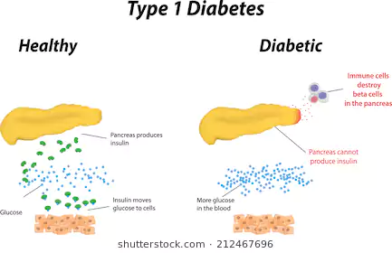
Type 1 Diabetes
Characterized by destruction of pancreatic β-cells, interfering with insulin production
https://www.shutterstock.com/search/type+1+diabetes

Slide 4
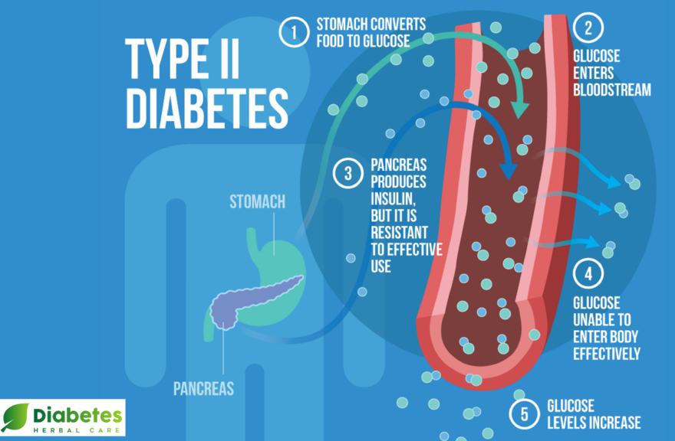
Type 2 Diabetes
Characterized by by insulin resistance
Caused by dysfunctional pancreatic β-cells
Most common form of diabetes
https://diabetesherbalcare.com/pages/type-2-diabetes

Slide 5
Gestational Diabetes
Onset of diabetes during pregnancy
High blood glucose levels in the mother's blood
Must not have any prior history of diabetes
Generally resolved once the baby is born
http://www.cihr-irsc.gc.ca/e/49943.html

Slide 6
Special Class
Any form of diabetes that does not belong to any other class
Maturity-onset diabetes of the young (MODY)
Inherited
Mutation in hepatic genes
Disrupts insulin production
One of most prevalent in this category
https://utswmed.org/medblog/teens-type-2-diabetes/

Slide 7
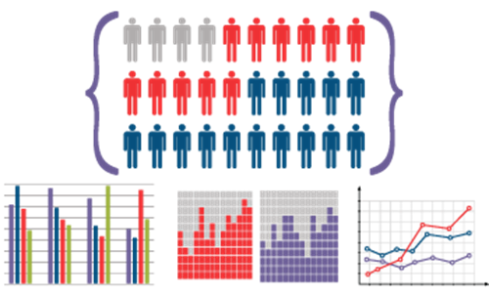
Epidemiology
https://toxtutor.nlm.nih.gov/05-003.html

Slide 8
Epidemiology
Prevalence of diabetes has been globally on the rise, raising a big concern
Based on previous data and assumptions, the number of adults with diabetes globally has been projected to increase from 382 million to 592 million by 2035 (Forouhi & Wareham, 2014).
The epidemiology of diabetes varies depending on different factors such as:
Sex
Age
Geography
Genetics

Slide 9
Type 1 Diabetes
The highest incidence is between birth and 14 year-old children
Highest incidence:
Europe & North America
Finland as the highest
Lowest incidence:
South America & Asia
Venezuela is the lowest
Males are slightly more prevalent to Type 1 diabetes than women
(Forouhi & Wareham, 2014)

Slide 10
Type 2 Diabetes
Accounts for the majority of the total cases of diabetes (>85%)
Highest prevalence is in western countries (USA) & ethnic groups that have developed a western diet (China & India)
China is projected to increase from 98.4 million to 142.7 million by 2035.
Developing countries have the lowest prevalence, specifically in rural areas
e.g. Mapuche Indian region in Chile
Prevalence increases sharply with age in both genders
(Forouhi & Wareham, 2014)

Slide 11
Etiology

Slide 12
Etiology for Type 1 Diabetes
Environmental factors:
Co-related viruses e.g. enterovirus infections
Dietary factors & chemical/cytotoxin factors in early life
Genetic factors:
18 related regions of the genome including the IDDM1 region & HLA region of genes
Affects coding of the proteins

Slide 13
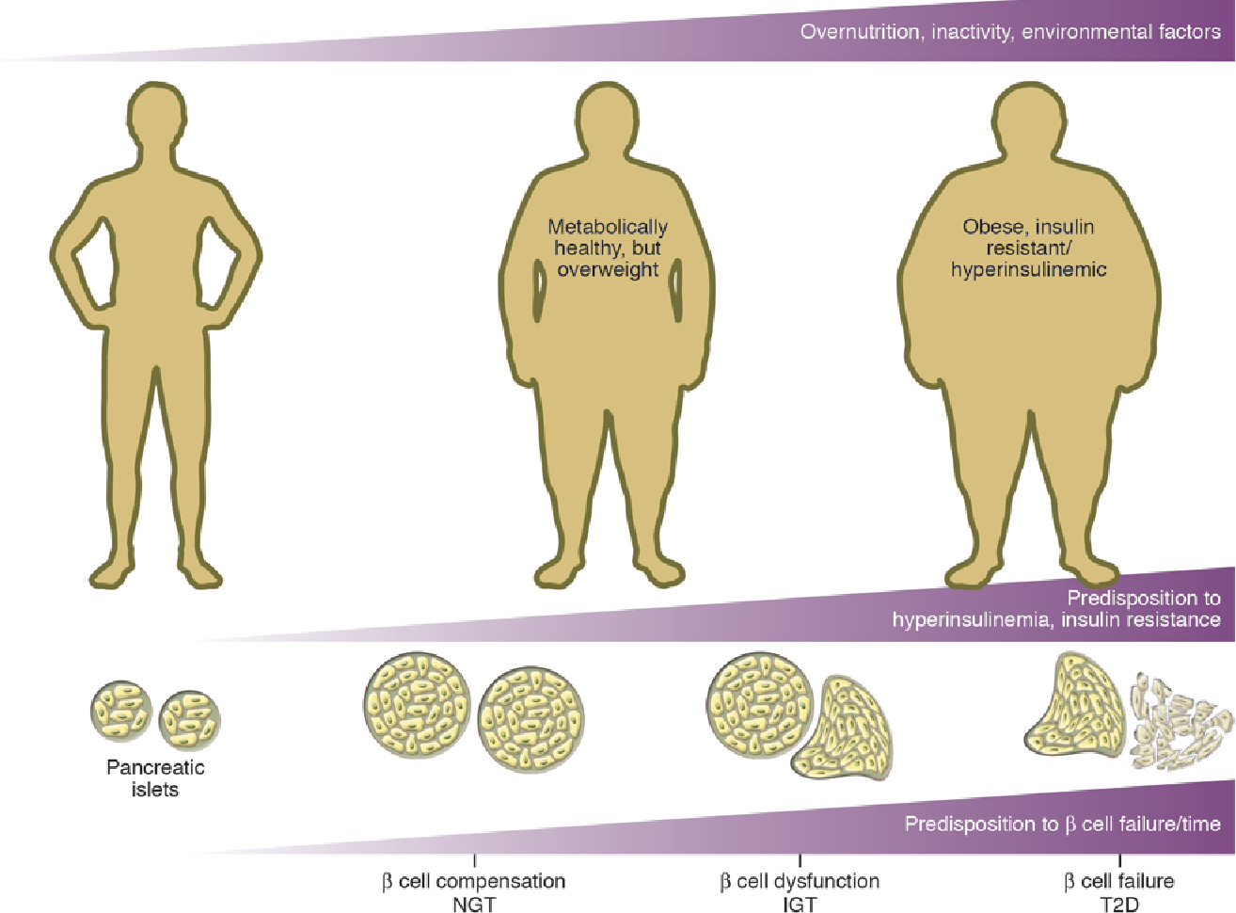
Etiology for Type 2 Diabetes
Certain gene variants increase susceptibility of Type 2
Other causes
Obesity/overweight factor
Leads to insulin resistance
due to inflammation
Metabolic syndrome
Impact of age
Inactive lifestyle
https://www.semanticscholar.org/paper/Digging-deeper-into-obesity.-Ahima/74451ec8409aa9300ef6f43a50ea473c498d7cfe

Slide 14
Risk Factors
Signs & Symptoms
&

Slide 15
Risk Factors
Type 1 | Type 2
Potential familial link | High Sugar diet Genetics Glucocorticoid medications High blood pressure High cholesterol Overweight Lower socioeconomic class

Slide 16
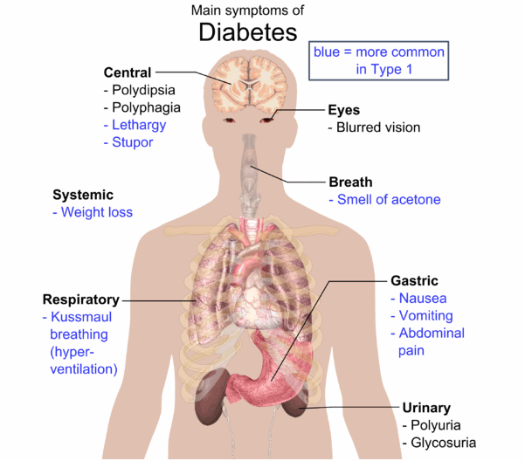
Signs and Symptoms
Typical symptom of DM include hyperglycemia which leads to the 3 P’s:
Polyphagia, Polyuria, Polydipsia
Lethargy, blurred vision, slow healing, sudden weight loss & numbness in the hands/feet
Symptoms for T2DM are so mild it can go unnoticed
https://www.medicalnewstoday.com/info/diabetes/diabetessymptoms.php
Notes:
Image: https://www.medicalnewstoday.com/info/diabetes/diabetessymptoms.php

Slide 17
Diagnosis
http://lifestagesholistics.com/pre-diabetic-diagnosis-action-plan/

Slide 18
Diagnosis
To screen for diabetes, multiple blood tests can be done
Blood tests are used to measure high blood glucose levels which is known to be a an indication of diabetes
A total of two abnormal blood tests are required for an official diagnosis for diabetes.

Slide 19
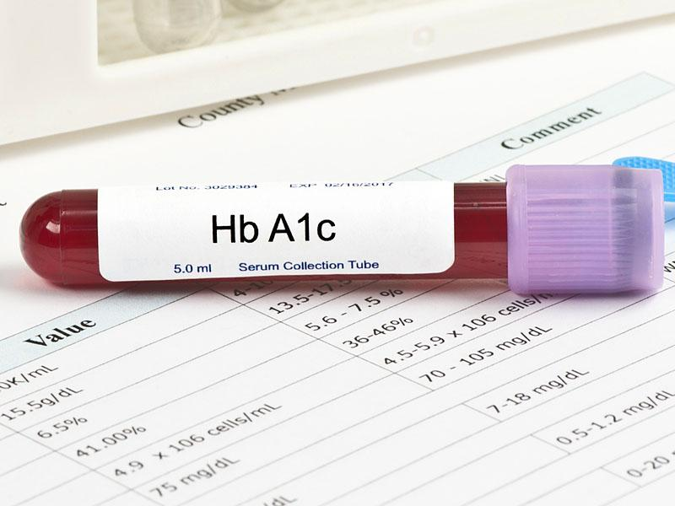
A1C Test (Glycated hemoglobin test)
Measures blood glucose attached to hemoglobin
The more blood glucose attached to hemoglobin, the higher the level of plasma glucose
In general, an A1C range of 7.5-6.4% indicates prediabetes
A measure of 6.5% or higher on TWO A1C tests is an indication of diabetes
https://www.medscape.com/viewarticle/870497
(2. Classification and Diagnosis of Diabetes, 2014)

Slide 20
Testing (continued)
Some patients may not be able to get A1C test done for various reasons
Normal blood glucose test can be completed for diagnosis

Slide 21
Fasting Blood Test
Measures the fasting blood glucose levels
Fasting blood glucose range of 100-125 mg/dL is considered as prediabetes
A result of 126 mg/dL or higher of fasting blood glucose levels is an indication of diabetes
http://chittagongit.com/icon/blood-sugar-icon-7.html
(Diagnosis and Classification of Diabetes Mellitus, 2009)

Slide 22
Non-Fasting Blood Test
Random blood glucose test
Measures the blood glucose levels at any random time
Random blood glucose levels of 200 mg/dL or higher suggests diabetes
https://pharmeasy.in/diagnostic-test/blood-sugar-random/amp/
(Diagnosis and Classification of Diabetes Mellitus, 2009)

Slide 23
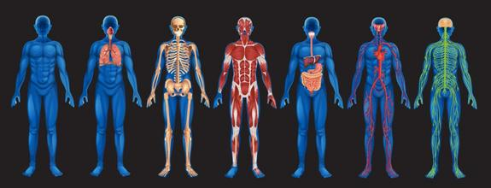
Pathophysiology

Slide 24
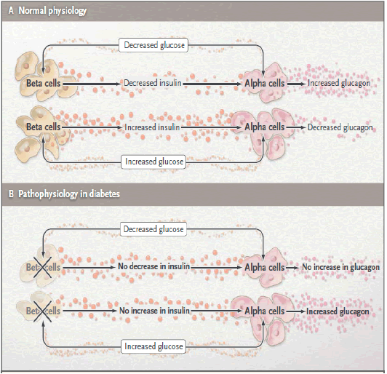
Pathophysiology (Type 1 Diabetes)
Characterized by autoimmune destruction of pancreatic β-cells which leads to the deficiency of insulin secretion
Excessive secretion of glucagon due to the abnormal function of pancreatic α-cells.
Insulitis with gradual β-cell destruction leads to pre-diabetes with symptoms of hyperglycemia and finally to overt DM
https://www.omicsonline.org/open-access/classification-pathophysiology-diagnosis-and-management-of-diabetesmellitus-2155-6156-1000541.php?aid=53137
Notes:
Image: https://www.omicsonline.org/open-access/classification-pathophysiology-diagnosis-and-management-of-diabetesmellitus-2155-6156-1000541.php?aid=53137

Slide 25
Type 1 diabetes (patho continued)
Insulin insufficiency leads to uncontrollable lipolysis → levels of free fatty acids increases in the plasma which suppresses glucose breakdown
This impairs glucose utilization and causes insulin insufficiency to reduce the expression of important genes

Slide 26
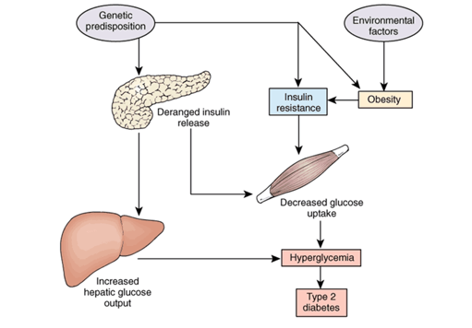
Pathophysiology (Type 2 Diabetes)
Characterized by 2 main pathological defects: impaired insulin action and impaired insulin secretion.
Susceptible individuals
Chronic food oversupply is the primary reason for pancreatic β-cell failure
Unsusceptible chronically over-nourished individuals
Remain resistant to T2DM by disposing excess calories to SAT
https://nurseslabs.com/diabetes-mellitus/
Notes:
Image: https://nurseslabs.com/diabetes-mellitus/

Slide 27
Type 2 diabetes (patho continued)
Susceptible over-nourished individuals
Fail to dispose excess calories safely to the SAT & instead to the VAT which cause severe tissue damage
There is increased glucagon secretion and reduced incretin response; inflammation of adipose tissue and development of peripheral insulin resistance

Slide 28
Mechanisms
https://www.iconfinder.com/icons/1726224/engine_gears_mechanism_icon

Slide 29
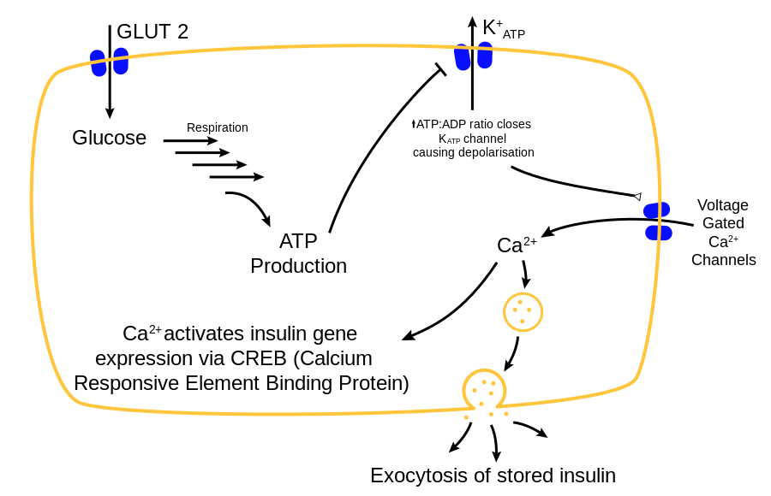
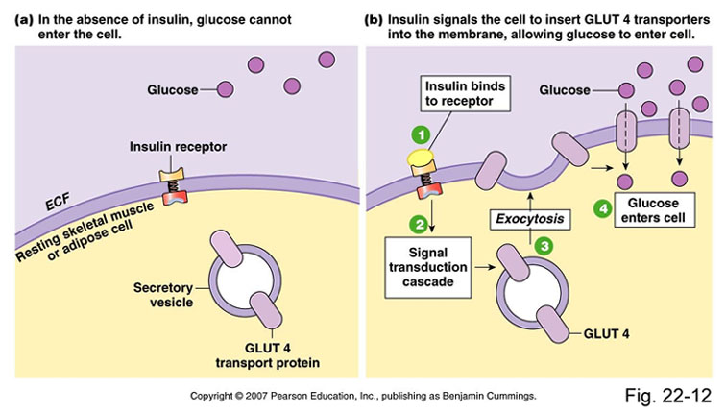
Mechanisms
Insulin pathway in β-cells
Insulin pathway on target cell
https://en.wikipedia.org/wiki/Diabetes_mellitus#/media/File:Glucose-insulin-release.svg
http://www.webmd.com/diabetes/ss/slideshow-type-2-diabetes-overview
Copyright 2007 Pearson Education Inc Benjamin Cummings Fig 22-12

Slide 30
Treatments

Slide 31
Treatment
Chronic illness, no known cure
Major lifestyle changes required
Revolved around controlling blood sugar
Done through medication, insulin injection
Weight loss surgery in obese patients
Pancreas transplants may be implemented
https://www.everydayhealth.com/hs/managing-type-2-diabetes/treatment-options/

Slide 32
Research for Future Treatments
Vanadium salts
Observed benefits:
Replicates effects of insulin on target tissues in vitro
Decreases blood glucose levels in insulin-deficient diabetic rats
Helps glucose homeostasis in insulin-resistant & obese diabetic rodents

Slide 33
Conclusion
The global prevalence of Type 1 and Type 2 diabetes has risen at an astronomical level
Implement more preventative programs encouraging healthy lifestyles
Requires more study to find more efficient methods to ease lifestyle changes
Hopefully will lead to a cure or method to significantly diminish side effects

Slide 34
Multiple Choice Questions
What is the most common type of diabetes?
Type 1
Type 2
Gestational
Special
Insipidus
Which of the following is NOT a risk factor for Type 2 diabetes?
Diet
Socioeconomic status
Race
Taking glucocorticoid medications
Enterovirus infection

Slide 35
References
“Are You at Risk?” Canadian Diabetes Association, Canadian Diabetes Association, 1 Jan. 2018, www.diabetes.ca/about-diabetes/risk-factors/are-you-at-risk.
Baynest, H. W. (2015). Classification, Pathophysiology, Diagnosis and Management of Diabetes Mellitus. Journal of Diabetes & Metabolism, 06(05). doi:10.4172/2155-6156.1000541
Centers for Disease Control and Prevention. (2017). National diabetes statistics report, 2017. Atlanta, GA: Centers for Disease Control and Prevention.
Classification and Diagnosis of Diabetes. (2014). Diabetes Care, 38(Supplement_1), S8-S16. doi: 10.2337/dc15-s005
Dean L, McEntyre J. (2004). The Genetic Landscape of Diabetes. Retrieved April 5, 2011 from NCBI.
Diabetes Association, A. (2017, August 28). Diabetes Symptoms. Retrieved September 25, 2018, from http://www.diabetes.org/diabetes-basics/symptoms/
Diagnosis and Classification of Diabetes Mellitus. (2009). Diabetes Care, 33(Supplement_1), S62-S69. doi: 10.2337/dc10-s062
Eckel RH. Metabolic syndrome. In: Fauci AS, Braunwald E, Kasper DL, Hauser SL, Longo DL, Jameson JL, Loscalzo J, eds. Harrisons Principles of Internal Medicine. 17th ed. New York, New York. McGraw-Hill;2008:1509-1514.
Egan, A. M., & Dinneen, S. F. (2014). What is diabetes?. Medicine, 42(12), 679-681.
Forouhi, N., & Wareham, N. (2014). Epidemiology of diabetes. Medicine, 42(12), 698-702. doi: 10.1016/j.mpmed.2014.09.007
McCarthy MI. (2010). Genomics, type 2 diabetes, and obesity. New England Journal of Medicine, 363(24), 2339-2350.
MNT Editorial, T. (2016, January 05). Diabetes Symptoms: Common Symptoms of Diabetes. Retrieved September 25, 2018, from https://www.medicalnewstoday.com/info/diabetes/diabetessymptoms.php

Slide 36
References
Pathophysiology Research. (2017). Retrieved September 25, 2018, from https://www.diabetes.ca/research/research-funding/pathophysiology-research
Ramachandran, A. (2014). Know the signs and symptoms of diabetes. The Indian Journal of Medical Research, 140(5), 579–581.
Shechter, Y., & Shisheva, A. (1993). Vanadium salts and the future treatment of diabetes. Endeavour, 17(1), 27-31.
Siddiqui, A. A., Siddiqui, S. A., Ahmad, S., Siddiqui, S., Ahsan, I., & Sahu, K. (2004). Diabetes: Mechanism, Pathophysiology and Management. International Journal of Drug Development and Research, 21-43. doi:10.1016/b978-012732350-3/50003-x
Siddiqui A, Siddiqui S, Ahmad S, Siddiqui S, Ahsan I, Sahu k. “Diabetes: Mechanism, Pathophysiology and Management-A Review” Int. J. Drug Dev. & Res., April-June 2013, 5(2): 1-23.
Symptoms & Causes of Diabetes. (2016, November 01). Retrieved from https://www.niddk.nih.gov/health-information/diabetes/overview/symptoms-causes
TEDDY Study Group. (2008). The environmental determinants of diabetes in the young (TEDDY) study. Annals of the New York Academy of Science, 1150, 1-13.
"The top 10 causes of death Fact sheet N°310". World Health Organization. May 24, 2018.
World Health Organization. Global report on diabetes. World Health Organization, 2016.
Yeung WC, Rawlinson WD, Craid ME. (2011). Enterovirus infection and type1 diabetes mellitus: systematic review and meta-analysis of observational studies. BMJ, 3, 342, d35.

