Slide 1
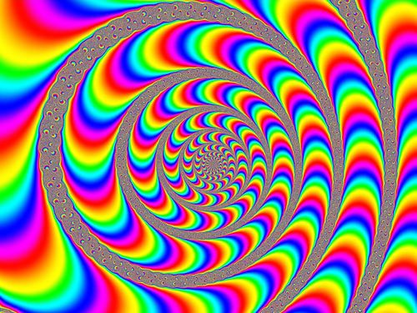

Slide 2
The Effects of D-Lysergic Acid Diethylamide (LSD) On The Brain
Curtis Menon, Yhameen Hamid, Harleen Kaura, Bosco Xu, Aravind Rajendran
LIFESCI 4M03

Slide 3
Outline
History of LSD
LSD Users and Classification
Demographics
Biochemical Properties and Mechanism of Action
Effects on the Brain
Uses and Potential as a Therapeutic Agent
Short Term Effects/Overdosing
Long Term Effects
Current Research
Social Implications/Conclusion
1 of 22
Notes:
medicinal plant squill and the fungus ergot as part of a program to purify and synthesize active constituents for use as pharmaceuticals
researching lysergic acid derivatives

Slide 4
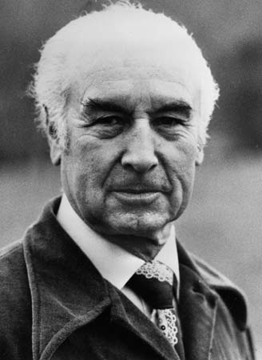
History
Albert Hofmann ingests experimental drug LSD-25 in 1938
Retook the drug intentionally again and bicycled home while undergoing its effects
Origin of ‘Bicycle Day’
Usage of LSD began in 1960s
(“Hallucinogenic Effects of LSD Discovered”, n,d., Horgan, 2014)
https://www.britannica.com/biography/Albert-Hofmann
2 of 22
Notes:
ERGOT

Slide 5
“Last Friday, April 16, 1943, I was forced to interrupt my work in the laboratory in the middle of the afternoon and proceed home, being affected by a remarkable restlessness, combined with a slight dizziness. At home I lay down and sank into a not unpleasant, intoxicated-like condition characterized by an extremely stimulated imagination. In a dreamlike state, with eyes closed (I found the daylight to be unpleasantly glaring), I perceived an uninterrupted stream of fantastic pictures, extraordinary shapes with intense, kaleidoscopic play of colors. After some two hours this condition faded away.” --- Albert Hofmann
(“Hallucinogenic Effects of LSD Discovered”, n,d.)
3 of 22

Slide 6
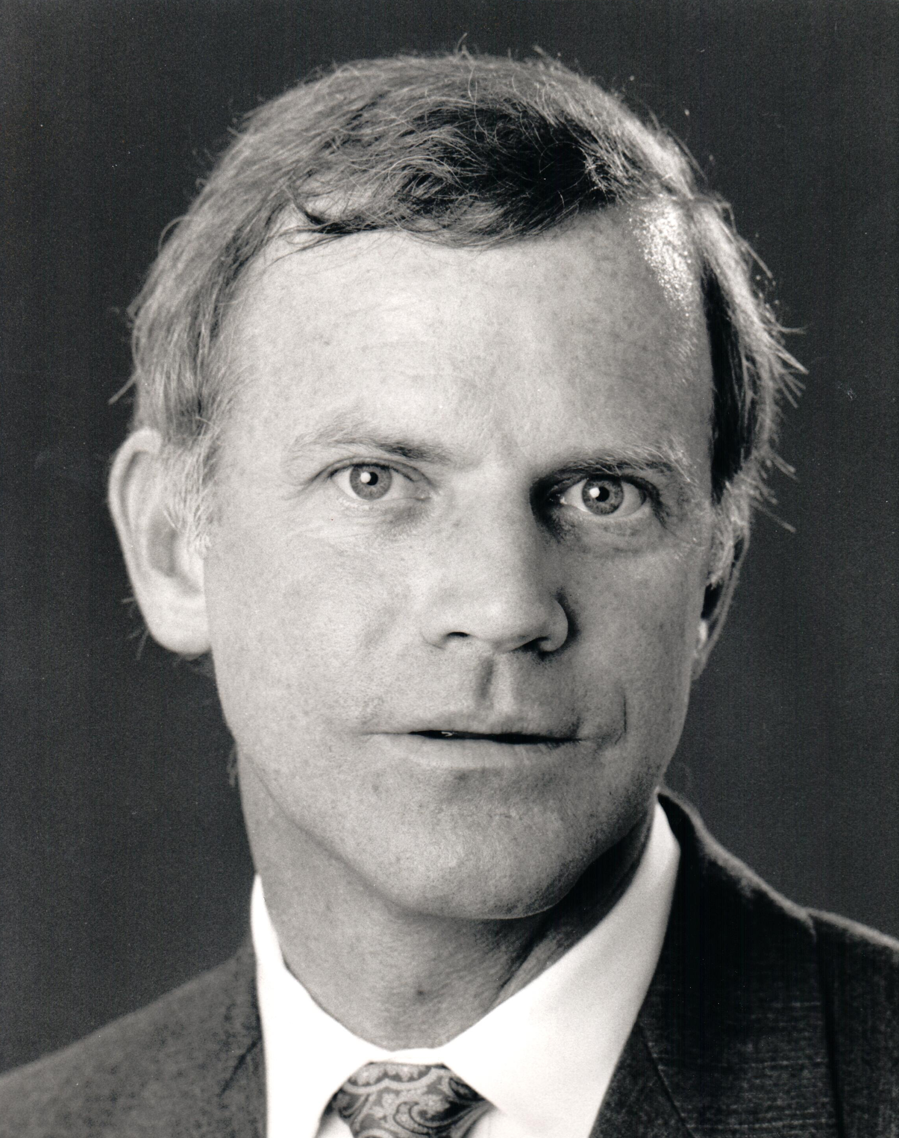
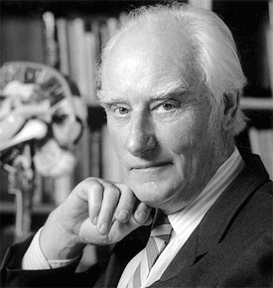
Famous LSD Users
http://gairdner.org/award_winners/kary-b-mullis/
http://www.sciography.com/francis-crick.htm
Bill Gates
Steve Jobs
The Beatles
Francis Crick
Kary Mullis
(Smith, 2017)
https://www.quora.com/Did-Steve-Jobs-hate-Bill-Gates-What-happened-when-two-of-the-biggest-names-in-the-field-of-technology-met
4 of 22
Notes:
medicinal plant squill and the fungus ergot as part of a program to purify and synthesize active constituents for use as pharmaceuticals
researching lysergic acid derivatives

Slide 7
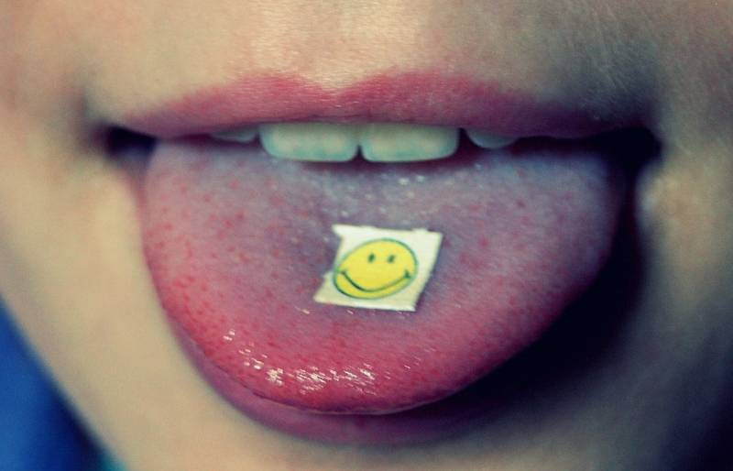
Classification
A psychedelic drug (psychological effects)
Hallucinogenic
Recreational
Over 40 Street Names
Tolerance Building
(Blachford & Krapp, 2010)
http://brokeassstuart.com/blog/2015/09/25/30-days-micro-dosing-with-lsd/
5 of 22
Notes:
medicinal plant squill and the fungus ergot as part of a program to purify and synthesize active constituents for use as pharmaceuticals
researching lysergic acid derivatives

Slide 8
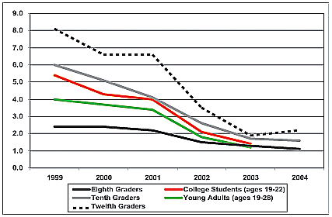
Demographics
Middle/Upper-Middle Class Whites
Men Use More Often
Rarely Taken Beyond Age 28
Declining Usage Rates
One Time Use Common
https://www.justice.gov/archive/ndic/pubs11/12620/odd.htm
(Krebs & Johansen, 2013)
6 of 22
Notes:
medicinal plant squill and the fungus ergot as part of a program to purify and synthesize active constituents for use as pharmaceuticals
researching lysergic acid derivatives

Slide 9
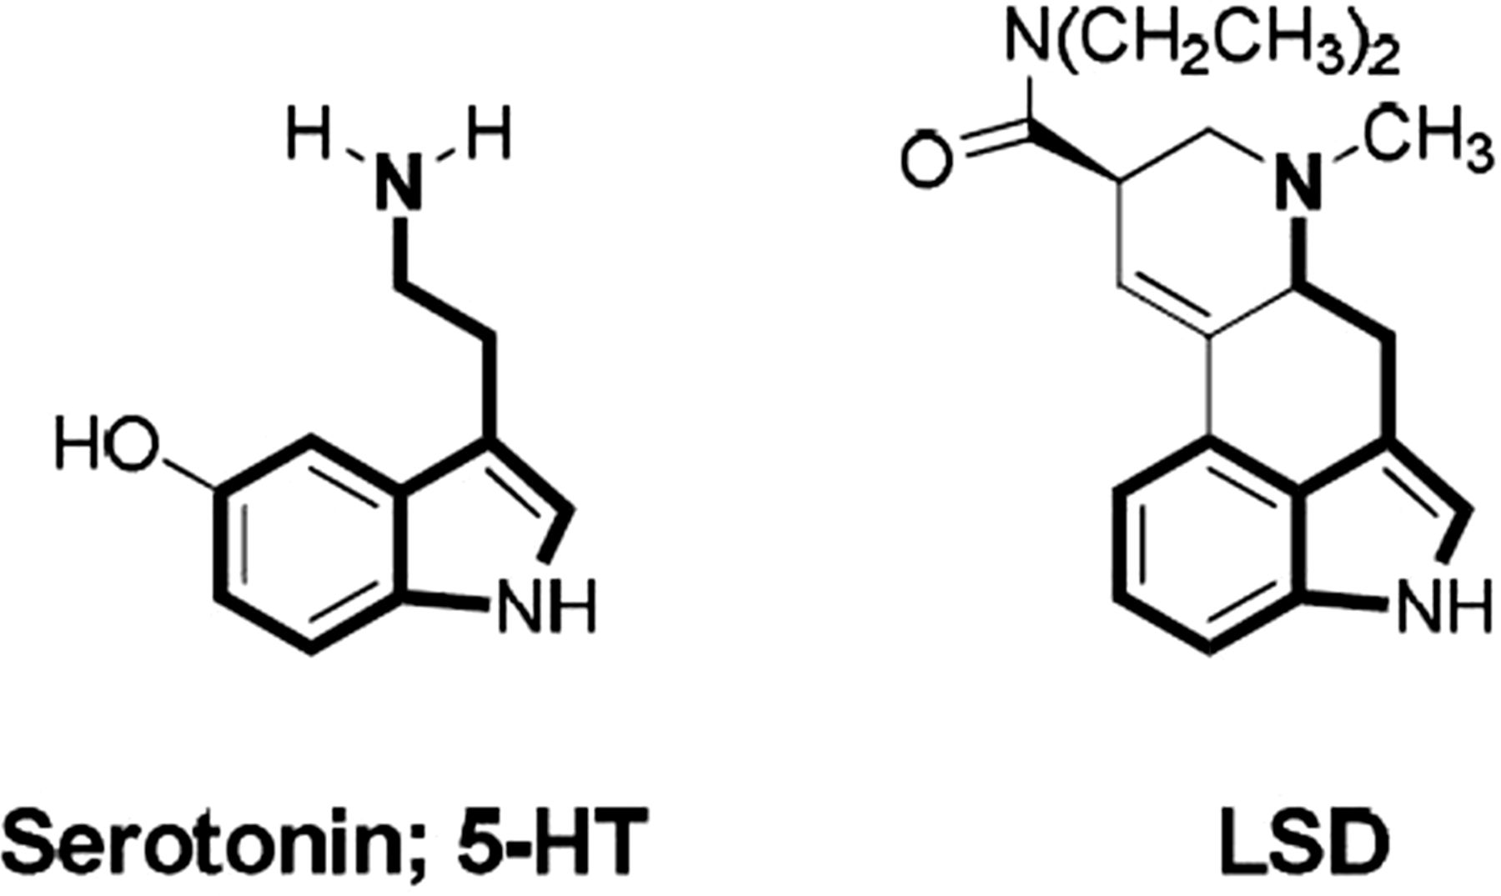
Biochemical Properties
Tasteless odorless and colorless
Water Soluble
Decomposes in light and high temperature
Similar structure to serotonin
http://www.themindcentre.com.au/microdosing-lsd-psychedelic-drugs-treatment-future/
(DrugBank, 2017; EMCDDA, 2011; Haddad, 1990; HSDB, 2017; Lewis, 2007; Li & Wang, 1998; PubChem, 2017.)
7 of 22
Notes:
medicinal plant squill and the fungus ergot as part of a program to purify and synthesize active constituents for use as pharmaceuticals
researching lysergic acid derivatives

Slide 10
Mechanism of Action
Step 1
Step 2
Step 3
Interaction with the 5-HT receptors results in an agonist or partial antagonist on serotonin activity
Glutamate release in thalamocortical terminals
LSD interacts with 5-HT receptors
(Schiff, 2006)
8 of 22
Notes:
LSD and serotonin share similar structures
5-HT1A and 5-HT1B are presynaptic receptors
5-HT2 is a post synaptic receptor

Slide 11
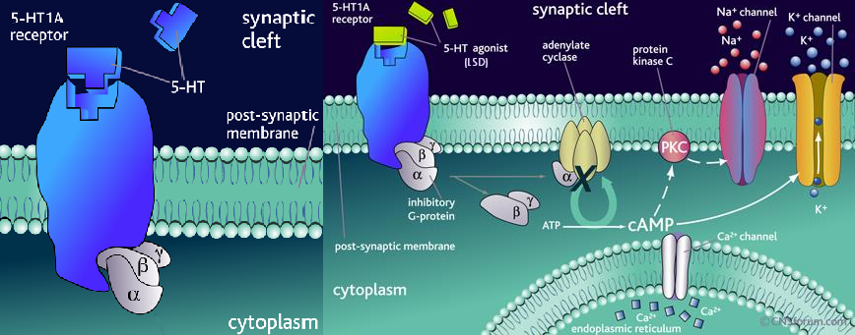
http://flipper.diff.org/apprulesitems/items/4051
9 of 22
Notes:
LSD (right) as you can see shares a similar structure to 5-HT (left), this allows it to bind to the 5-HT1A receptor causing suppression of Ca++ ions and interference of the conduction of K+ ions, this suppression plays a role in the hallucinogenic effect

Slide 12
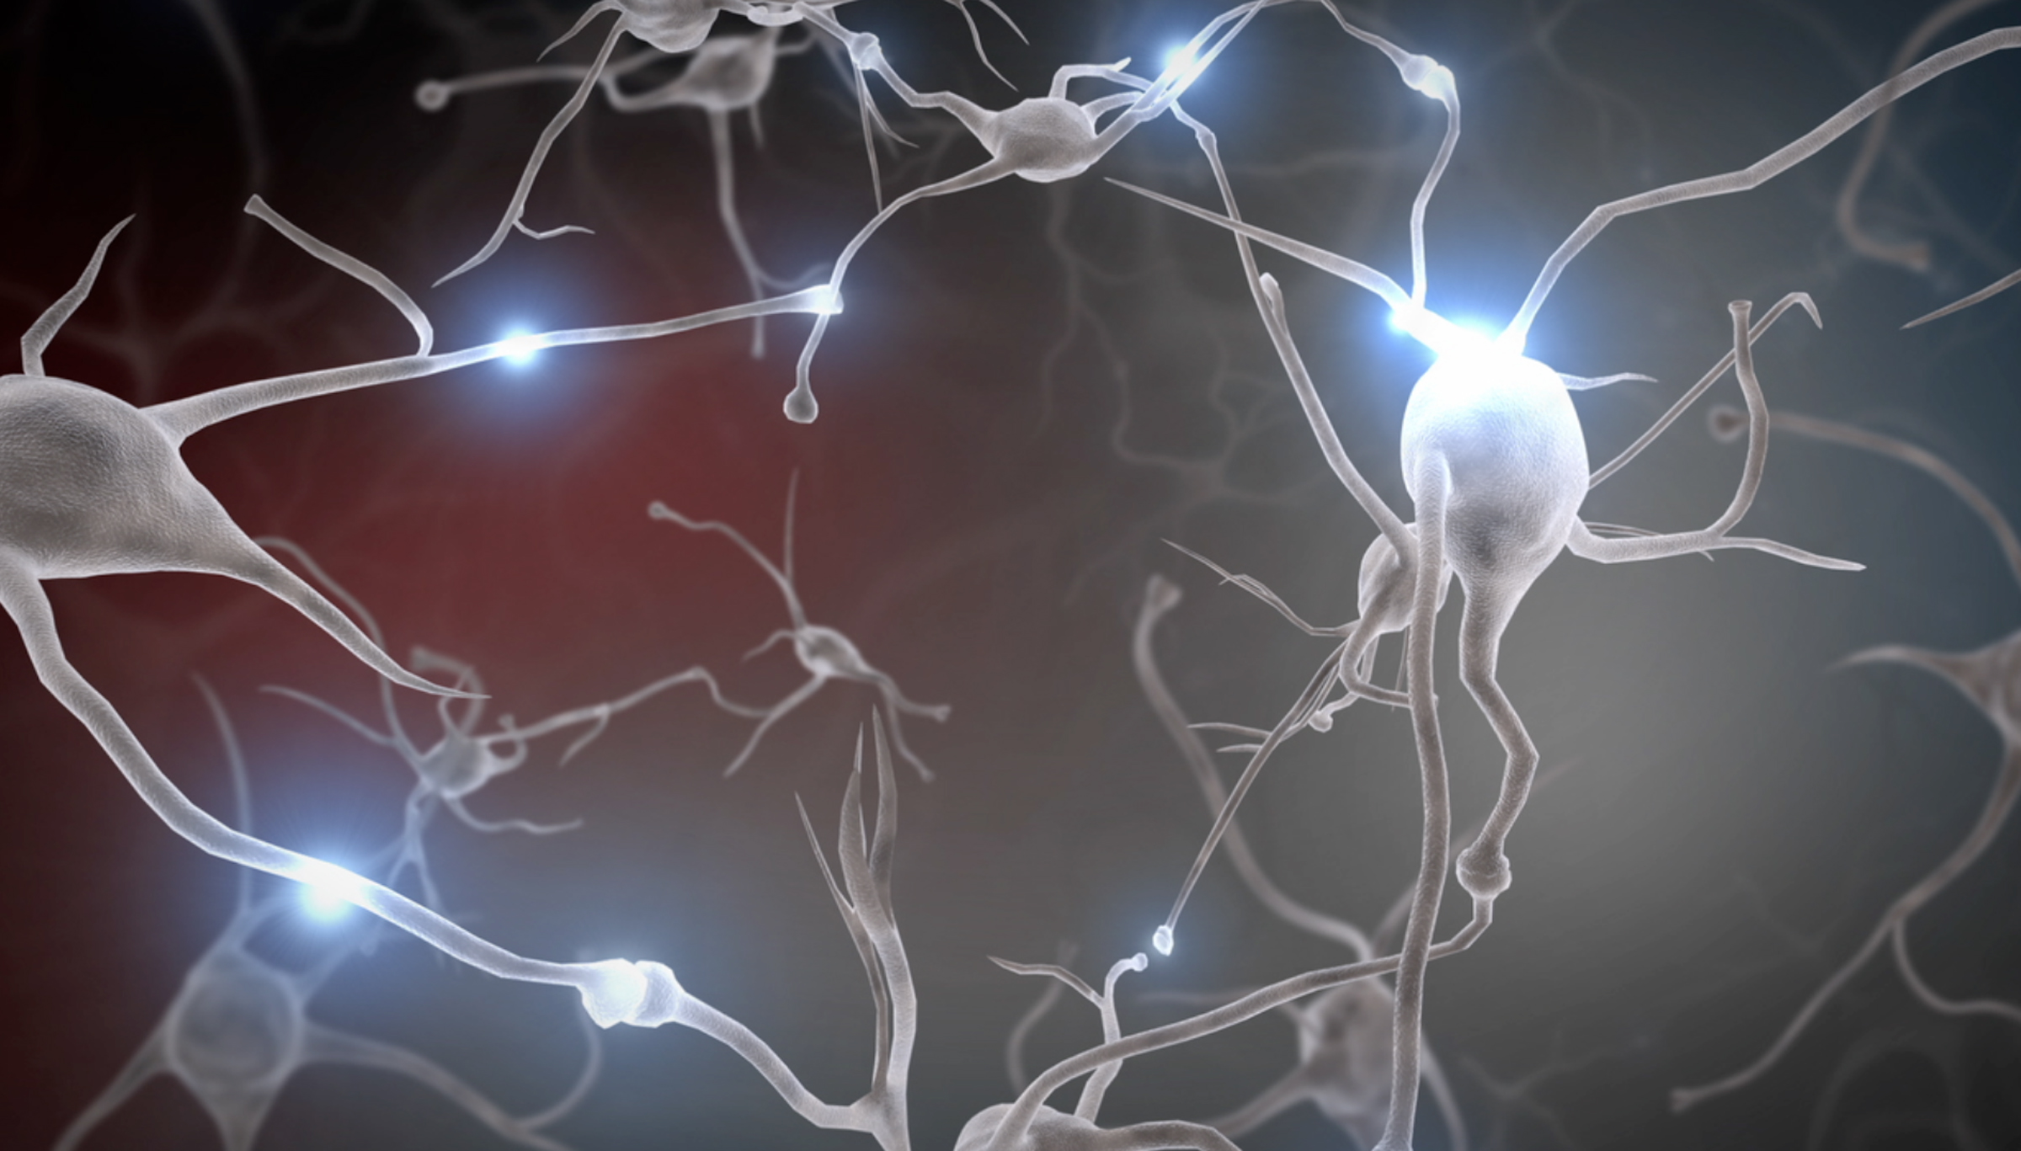
Effects on the Brain
More “unified” brain
Network(s) break down leading the activity to become entropic
Disconnections between the parahippocampus and retrosplenial complex
Feeling of “ego dissolution”
Psychologically addictive not physically
https://developingchild.harvard.edu/science/key-concepts/brain-architecture/
(Carhart-Harris et al., 2016; Cormier, 2016; Das et al., 2016)
10 of 22
Notes:
medicinal plant squill and the fungus ergot as part of a program to purify and synthesize active constituents for use as pharmaceuticals
researching lysergic acid derivatives

Slide 13
Uses of LSD
Recreational Purposes
Mood-changing
Delusions
Hallucinations
Boosts creativity
Spiritual Purposes
Enhances religious experiences
Cleansing
Display love for God
https://thethirdwave.co/lsd-myths/
( Das et al, 2016; NIDA, 2016)
11 of 22
Notes:
medicinal plant squill and the fungus ergot as part of a program to purify and synthesize active constituents for use as pharmaceuticals
researching lysergic acid derivatives

Slide 14
Therapeutic Agent?
LSD + counseling → reduced anxiety, depression and pain in patients with advanced cancer
Research potential in psychiatry, psychology & psychotherapy
Antianxiety agent
Helped with
Addictions
Obsessive-compulsive disorders
Severe depression
http://curioustendency.blogspot.ca/2012/05/psychoanalysis-part-i-transference-and.html#.WfPyxdenHIU
(Das et al., 2016; Kast & Collins, 1964)
12 of 22
Notes:
medicinal plant squill and the fungus ergot as part of a program to purify and synthesize active constituents for use as pharmaceuticals
researching lysergic acid derivatives

Slide 15
LSD Dosage Effects
Moderate effects: 0.5 mg
Lethal dose: 20 mg
Effects First Observed Peak Dissipate
( Das et al., 2016; Erowid LSD (Acid) Vault: fatalities/deaths , 2010)
Image source: https://depositphotos.com/19273659/stock-illustration-12-hours-clock-set.html
13 of 22
Notes:
Image: https://depositphotos.com/19273659/stock-illustration-12-hours-clock-set.html
A dosage of 0.5mg produces moderate effects for recreational purposes but 20 mg is considered a lethal dose, producing toxicity in the body
LSD’s effects can be observed within 30-60 minutes of ingesting and can peak over 1-6 hours and dissipates in 8-12 hours

Slide 16
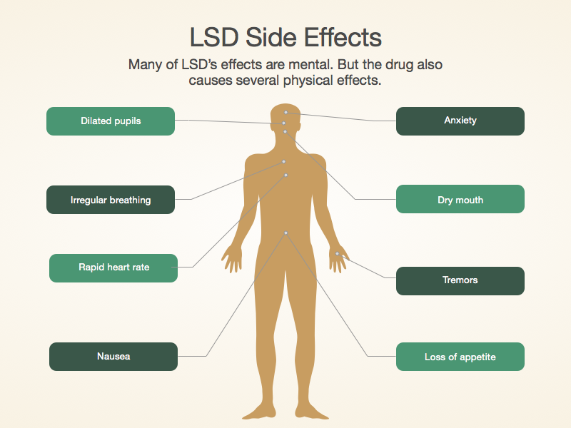
Acute Toxicity Effects
Upset GI system
Causes chills
Hypothermia
Palpitation
Hypertension
Hyperglycemia
Tachycardia
Panic
Rapidly changing emotions
Muscle incoordination
(NIDA, 2016; Das et al., 2016; NIDA, 2009)
Source: https://www.recovery.org/topics/lsd-facts/
14 of 22
Notes:
Image: https://www.recovery.org/topics/lsd-facts/
This image shows some of the side effects associated with LSD.
Toxic dosage of LSD can also upset the gastrointestinal system and cause chills while also stimulating the sympathetic nervous system resulting in hypothermia, palpitation, hypertension, hyperglycemia, tachycardia and panic
They have dramatic changes in their feelings and sensations such as rapidly changing emotions

Slide 17
Effects of Overdosing
Delusions and visual hallucinations
Altered sense of self
Cross-over of senses
Feelings of despair, insanity, death etc.
Impaired perception of depth, time, size, movements, etc.
Sudden or delayed flashbacks (HPPD)
“Bad trips”
https://b.passagesmalibu.com/tag/side-effects-of-lsd/
(NIDA, 2009; Das et al., 2016; NIDA, 2016 )
15 of 22
Notes:
Images 1 and 2: https://b.passagesmalibu.com/tag/side-effects-of-lsd/
Image 3: http://psychedelics.com/lsd/short-and-long-term-effects-of-lsd/
Large doses of LSD can cause delusions and visual hallucinations with altered sense of time and self along with cross-over of senses such as hearing colours and seeing sounds
In some cases, users experience terrifying thoughts and feelings of despair, insanity, death and losing control
Some other mental effects include impaired perception of depth, time, size, shape of objects, movements, touch, body image as well as artificial sense of certainty
They may also experience sudden or delayed flashbacks which may persist, causing distress, impairment in everyday occupational and social functioning
An overdose of LSD leads to “bad trips” which include intense anxiety, combat-behaviour, panic, confusion and a simply touch and normal sensations seem strange and bizarre

Slide 18
Current Research
LSD Effect on Brain
LSD to Treat Alcoholism
Studies on LSD Effects on Thoughts
LSD as Treatment for End-of-Life Anxiety/Pain
LSD as Treatment for Cluster Headaches
16 of 22

Slide 19
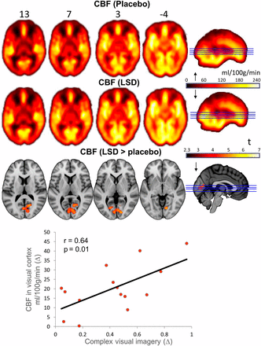
LSD Effects on Brain
Cerebral Blood Flow (CBF) Tracking
Positron Emission Tomography (PET) and Functional Magnetic Resonance Imaging (fMRI)
Complex Imagery in Altered State of Consciousness (ASC)
http://www.pnas.org/content/113/17/4853.full
(Carhart-Harris et al., 2016)
17 of 22

Slide 20
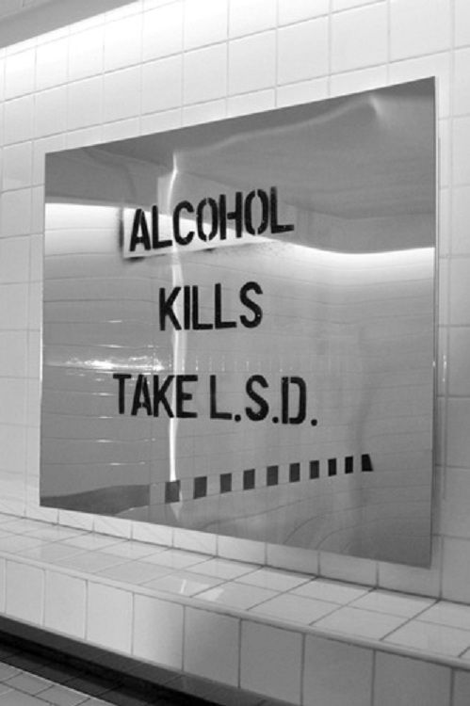
LSD to Treat Alcoholism
https://www.pinterest.ca/explore/psychedelic-drugs/
Meta-Analysis
Significant Decrease in Short-Term
No Success in Long-Term
Similar With Other Addictions
(Krebs et al., 2012)
18 of 22

Slide 21
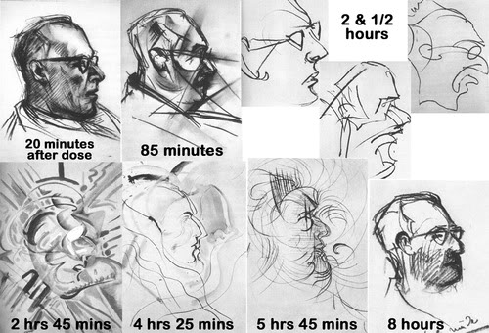
LSD Effects on Thoughts
Only required 1/10 dosage
Increased:
Optimism
Openness
Creativity
Imagination
http://www.openculture.com/2013/10/artist-draws-nine-portraits-on-lsd-during-1950s-research-experiment.html
(Lebedev et al., 2014)
19 of 22

Slide 22
LSD Treatment for End-of-Life Anxiety & Pain
Reduction in Anxiety
Rise in Their Quality of Life
Decreased Blood Pressure and Heart Rate
https://www.ncbi.nlm.nih.gov/pmc/articles/PMC4086777/
(Gasser et al., 2014)
20 of 22

Slide 23
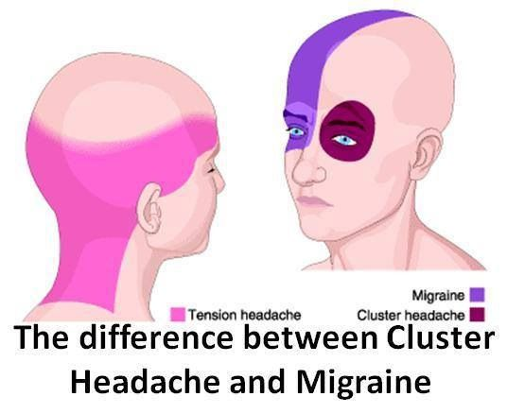
LSD Treatment for Cluster Headaches
Reduce Cluster Pain
Interrupt the Cluster-Headache Cycle
Micro-Dosage (Sub-Psychedelic)
https://www.pinterest.ca/louise3816/headaches-and-migraine/
(Passie et al., 2008)
21 of 22

Slide 24
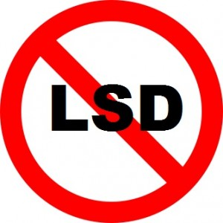
Conclusion/Social Implications
LSD is a hallucinogenic drug
Recreational usage prevalent
Potential for ‘more’…
Don’t Do Drugs!
http://www.nomeatathlete.com/long-run-bad/
http://www.maps.org/
(MAPS, n.d.)
22 of 22

Slide 25
Multiple Choice #1:
LSD (Lysergic Acid Diethylamide) has a similar structure to which neurotransmitter?
Serotonin
Histamine
Dopamine
Epinephrine
Norepinephrine

Slide 26
Multiple Choice #1 (Answer):
LSD (Lysergic Acid Diethylamide) has a similar structure to which neurotransmitter?
Serotonin ##
Histamine
Dopamine
Epinephrine
Norepinephrine

Slide 27
Multiple Choice #2:
Which of the following statements is incorrect?
Dustin Hoffman was credited with being the first to synthesize LSD
LSD is a classified as an Hallucinogenic drug
LSD interacts with 5-HT receptors
Ego Dissolution is an effect LSD has on the brain
LCD is psychologically addictive

Slide 28
Multiple Choice #2 (Answer):
Which of the following statements is incorrect?
Dustin Hoffman was credited with being the first to synthesize LSD ##
LSD is a classified as an Hallucinogenic drug
LSD interacts with 5-HT receptors
Ego Dissolution is an effect LSD has on the brain
LCD is Psychologically addictive

Slide 29
References
Blachford, S.L., & Krapp, K. (2010). LSD (lysergic acid diethylamide). Drugs and Controlled Substances: Information for Students. Detroit: Gale. Retrieved from http://sproxy.glenbrook225.org/login?url=http://link.galegroup.com/apps/doc/CV2645000028/SCIC?u=gotitans&xid=8a0a151
Carhart-Harris, R.L., Muthukumaraswamy, S., Roseman, L., Kaelen, M., Droog, W., Murphy, K., . . . Nutt, D.J. (2016). Neural correlates of the LSD experience revealed by multimodal neuroimaging. PNAS, 113(17), 4853-4858. https://doi.org/10.1073/pnas.1518377113
Cormier, Z. (2016). Brain scans reveal how LSD affects consciousness. Nature. http://dx.doi.org/10.1038/nature.2016.19727
Das, S., Barnwal, P., Ramasamy, A., Sen, S., & Mondal, S. (2016). Lysergic acid diethylamide: a drug of ‘use’?. Therapeutic Advances In Psychopharmacology, 6(3), 214-228. http://dx.doi.org/10.1177/2045125316640440
Davis, K. (2017). LSD: Effects and hazards. [online] Medical News Today. Available at: https://www.medicalnewstoday.com/articles/295966.php [Accessed 1 Nov. 2017].
Erowid LSD (Acid) Vault : Fatalities / Deaths. (2010). Erowid.org. Retrieved 1 November 2017, from https://erowid.org/chemicals/lsd/lsd_death.shtml
European Monitoring Centre for Drugs and Drug Addiction (EMCDDA) (2011). Drug Profiles: Lysergide (LSD).
Gasser, P., Holstein, D., Michel, Y., Doblin, R., Yazar-Klosinski, B., Passie, T., . . . Brenneisen, R. (2014). Safety and efficacy of lysergic acid diethylamide-assisted psychotherapy for anxiety associated with life-threatening diseases. The Journal of Nervous and Mental Disease, 202(7), 513–520. https://doi.org/10.1097/NMD.0000000000000113

Slide 30
References
Haddad, L.M. (1990). Clinical Management of Poisoning and Drug Overdose. 2nd ed. Philadelphia, PA: W.B. Saunders Co., p. 759
Lewis, R.J. (2004). Sax's Dangerous Properties of Industrial Materials. 11th Edition. Wiley-Interscience, Wiley & Sons, Inc. Hoboken, NJ. p. 1277
Hawkins, J. D., Catalano, R. F., & Miller, J. Y. (1992). Risk and protective factors for alcohol and other drug problems in adolescence and early adulthood: implications for substance abuse prevention. Psychological bulletin, 112(1), 64.
HISTORY.com. (n.d.). Hallucinogenic effects of LSD discovered - Apr 16, 1943 - HISTORY.com. [online] Available at: http://www.history.com/this-day-in-history/hallucinogenic-effects-of-lsd-discovered [Accessed 1 Nov. 2017].
Horgan, J. (2014). Tripping in LSD's Birthplace: A Story for "Bicycle Day". [online] Scientific American Blog Network. Available at: https://blogs.scientificamerican.com/cross-check/tripping-in-lsds-birthplace-a-story-for-e2809cbicycle-daye2809d/ [Accessed 1 Nov. 2017].
Kast, E. C., & Collins, V. J. (1964). STUDY OF LYSERGIC ACID DIETHYLAMIDE AS AN ANALGESIC AGENT. Anesthesia and Analgesia, 43, 285–291.
Krebs, T.S. & Johansen, P.O. (2012). Lysergic acid diethylamide (LSD) for alcoholism: meta-analysis of randomized controlled trials. Journal of Psychopharmacology, 26(7), 994-1002. https://doi.org/10.1177/0269881112439253
Krebs, T. S., & Johansen, P.-Ø. (2013). Over 30 million psychedelic users in the United States. F1000Research, 2, 98. http://doi.org/10.12688/f1000research.2-98.v1
Lebedev, A.V., Kaelen, M., Lövdén, M., Nilsson, J., Feilding, A., Nutt, D.J., . . . Carhart-Harris R.L. (2016) LSD-induced entropic brain activity predicts subsequent personality change. Human Brain Mapping, 37(9), 3203–3213. https://doi.org/10.1002/hbm.23234

Slide 31
References
Lewis, R.J. (2007). Hawley's Condensed Chemical Dictionary 15th Edition. John Wiley & Sons, Inc. New York, NY., p. 773
MAPS (n.d.). What Is MAPS? Retrieved from http://www.maps.org/
National Institute on Drug Abuse (NIDA). (2009). Hallucinogens: LSD, Peyote, Psilocybin, and PCP. Drugabuse.gov. Retrieved 28 October 2017, from https://www.drugabuse.gov/sites/default/files/hallucinogens09.pdf
NIDA. (2015). Hallucinogens and Dissociative Drugs. Retrieved from https://www.drugabuse.gov/publications/research-reports/hallucinogens-dissociative-drugs on 2017, October 30
Passie, T., Halpern, J.H., Stichtenoth, D.O., Emrich, H.M., & Hintzen, A. (2008). The pharmacology of lysergic acid diethylamide. CNS Neuroscience & Therapeutics. 14 (4), 295–314. https://doi.org/ 10.1111/j.1755-5949.2008.00059.x
PubChem. (2017). Lysergide. Retrieved from https://pubchem.ncbi.nlm.nih.gov/compound/5761 on 2017, October 30
Samhsa.gov. (2015). Substance Use Disorders | SAMHSA - Substance Abuse and Mental Health Services Administration. [online] Available at: https://www.samhsa.gov/disorders/substance-use [Accessed 1 Nov. 2017].
Schiff, P. (2006). Ergot and Its Alkaloids. American Journal Of Pharmaceutical Education, 70(5), 98. http://dx.doi.org/10.5688/aj700598
Smith, P. (2015). 7 People Who Say They Owe Their Huge Success to Psychedelics. Alternet. Retrieved from https://www.alternet.org/drugs/seven-high-achievers-credit-psychedelics-their-success
Zhuyin Li, A.J. McNally, Haiying Wang, S.J. Salamone; Stability Study of LSD Under Various Storage Conditions, Journal of Analytical Toxicology, Volume 22, Issue 6, 1 October 1998, Pages 520–525, https://doi.org/10.1093/jat/22.6.520

