Slide 1
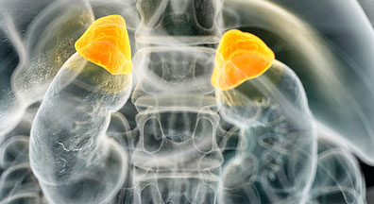
Adrenal Glucocorticoid Hyperfunction (Cushing’s Syndrome)

Slide 2
What is Cushing’s Syndrome?

Slide 3
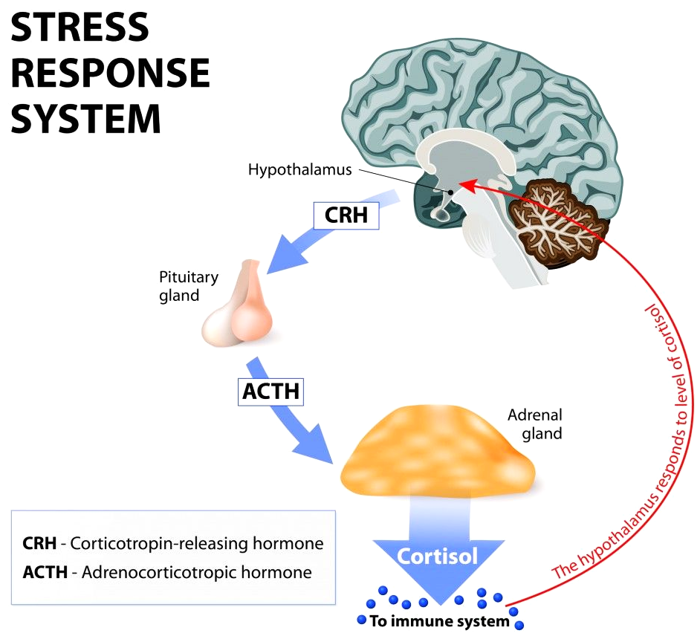
Excessive, long term exposure to glucocorticoids
endogenous, exogenous or iatrogenic
Cushing’s disease
excessive ACTH secreting pituitary tumor
Notes:
BRIEF SCRIPT: Cushing’s syndrome is an umbrella term used to describe excessive, long term exposure to glucocorticoids, such as cortisol, in the blood. Glucocorticoids are steroid hormones that help mediate the body’s stress response. The activation of the hypothalamus pituitary-adrenal axis by several stimuli will lead to the secretion of cortisol from the adrenal cortex. Stress, for example, stimulates secretion of corticotrophin releasing hormone (CRH) from the hypothalamus which acts on the anterior pituitary to release adrenocorticotrophin releasing hormone (ACTH). This hormone is a key regulator of glucocorticoid activity in the body because high levels of ACTH will stimulate the adrenal cortex to secrete cortisol into the blood and restore the imbalance in homeostasis.
Cushing’s disease is the most common endogenous type of cushing’s syndrome. It is a result of a pituitary tumour over secreting ACTH leading to high levels of cortisol being secreted from the adrenal cortex.
Glucocorticoids:
Steroid hormone
Cortisol being most important
Mediate body’s stress response
Anti-inflammatory actions
HPA axis:
Hypothalamus (CRH) → Pituitary (ACTH) → Adrenal glands (Cortisol)
Cushing’s disease
Excessive ACTH release due to pituitary tumor → Adrenals release excess cortisol

Slide 4
History of Cushing’s Syndrome

Slide 5
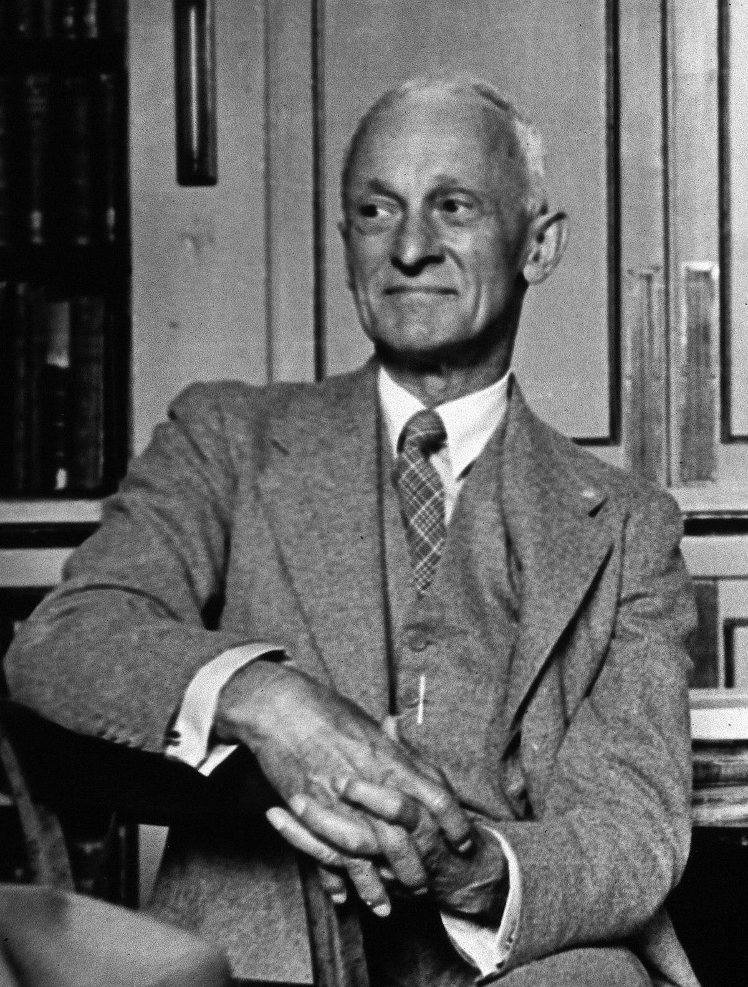
“The basophilic adenomas of the pituitary body and their clinical manifestations” published in 1931
Patient: Minnie
Symptoms: amenorrhea and abnormal hair growth
Acidophil hyperpituitarism vs basophil hyperpituitarism
Notes:
BRIEF SCRIPT: Harvey Cushing was a neurosurgeon who was born in Ohio. He was a professor of surgery at Harvard Medical school and was the surgeon in chief at Brigham hospital. In his paper, “the basophilic adenomas of the pituitary body and their clinical manifestations”, he mentioned a patient with the name of Minnie. Her symptoms of amenorrhea (abnormal periods) and hirsutism (abnormal hair growth) led him to believe that she may have an adrenal tumor due to dysfunction of the pituitary glands. He hypothesizes that if excess acidophil cells cause acromegaly, then excess basophil cells involves a pituitary disorder that involves sexual function. In 1932, he published “A Case of Basophil Adenoma of the Anterior Lobe of the Pituitary: Cushing’s Syndrome” which led to the introduction of the disease.

Slide 6
Epidemiology

Slide 7
Iatrogenic causes > Endogenous causes
1.2 - 2.4 new cases/million/year of Cushing’s disease (CD)
CD comorbidity = 38% Diabetes Mellitus; 55% Hypertension
Adrenal adenomas twice as prevalent as adrenal carcinomas
Average Diagnosis Age = 36-46 years; ~ 85% tend to be women
Mortality rate with Cushing’s disease vs General population ~ 2:1
Mortality rate with Cushing’s disease vs Cushing’s in remission ~ 1:1
Notes:
Brief Script:
Iatrogenic Cushing’s syndrome is induced by the exogenous overconsumption of glucocorticoid medication, and it is much more common than endogenous Cushing’s syndrome. Most of the endogenous cases consist of Cushing’s disease, which is actually the most researched epidemiologically.
The rate of new cases of Cushing’s disease found across a few studies is 1.2-2.4 cases per million people per year. They also found diabetes mellitus and hypertension to be significantly comorbid.
Adrenal adenomas are reported to be twice as common as adrenal carcinomas, which is good, seeing as adenomas are benign and carcinomas are malignant and more life-threatening.
The average age range reported for Cushing’s Disease is from mid-30s to mid-40s, although many can be diagnosed much earlier and much later. Women do make up the majority of the diagnosed population.
The mortalitiy rate of those with active Cushing’s disease is 2x as much as the general population or those in remission from the disease.
The epidemiological studies for Cushing’s syndrome are still very scattered, so more research must be done in this area.

Slide 8
Signs and Symptoms
Notes:
BRIEF SCRIPT: but we do know some of the signs and symptoms that patients with cushing’s generally present with.

Slide 9
Most Common Symptoms:
High Blood Pressure
Weight Gain
Joint Pain & muscle weakness
Recurrent Infections
Moon Face
Fatigue
Poor Concentration
Irritability
Least Common Symptoms:
Insomnia
Acne
Edema of the Extremities
Excessive Body Hair Growth (Women)
Erectile Dysfunction (Men)
Notes:
BRIEF SCRIPT: Patients who are suspected to have Cushing’s will normally present with a multitude of symptoms as illustrated on the slide. The most common ones being (read off the common list). Patients may also present with less common symptoms such as (read off the least common list). Since these symptoms are so diverse and present in many other cases as well, a definitive diagnosis can only be made through a series of bloodwork and lab tests which we will get into a bit later on.

Slide 10
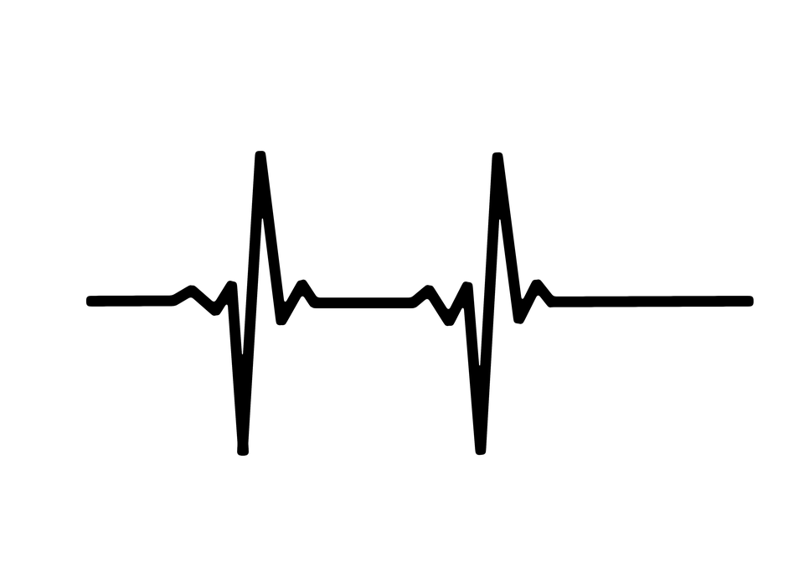
Physiology of
Cortisol
Notes:
BRIEF SCRIPT: Now Sandra previously mentioned that cushing’s syndrome is due to excess production of glucocorticoids. The most important glucocorticoid hormone in the body is cortisol.

Slide 11
Glucocorticoids...
Anti-inflammatory effects
Catabolic (breaking down) effects
Maintain blood pressure
Increase blood glucose levels
Notes:
BRIEF SCRIPT: Some of the actions of glucocorticoids include anti-inflammatory effects by inhibiting the immune response, catabolic effects such as breaking down bones and using the amino acids as a source for gluconeogenesis, maintaining blood pressure by sensitizing the arterioles to norepinephrine (a hormone involved in our fight or flight response), and increasing hepatic gluconeogenesis which increases the amount of glucose in our blood. Cortisol, as we are all familiar with, is the hormone that is released in response to stress.

Slide 12
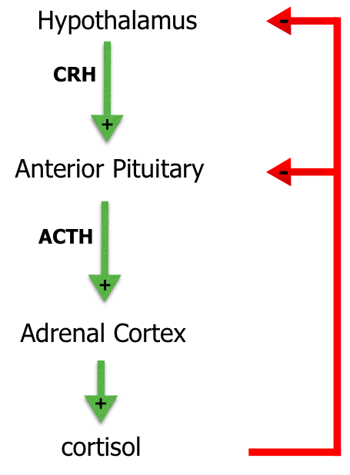
Hypothalamic Pituitary Adrenal Axis
Cortisol = end product of activation
Negative feedback control
Dysregulation = disorder
Notes:
BRIEF SCRIPT: Cortisol is the end product of the activation of the hypothalamic-pituitary adrenal (HPA) axis. The HPA axis consists of excitatory signals and negative feedback loops to regulate its activity. Our body's stress system coordinates the adaptive responses of organisms to different types of stressors resulting in changes that improve our ability to adjust homeostasis and increase chances of survival. Based on this diagram, we can see that cortisol exerts negative feedback control on ACTH release through the inhibition of CRH as well as inhibiting CRH itself. Regulation of the HPA axis is critical, otherwise disorders of the adrenal cortex can arise and present life-threatening conditions.

Slide 13
Pathophysiology of
Excess Cortisol
Notes:
BRIEF SCRIPT: Recalling the actions of glucocorticoids, excess production of cortisol can have many different and serious effects on the body. But where is this abnormal amount of cortisol coming from.

Slide 14
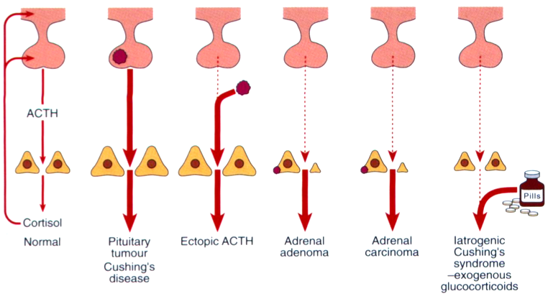
NORMAL
Notes:
BRIEF SCRIPT: In patient’s presenting with Cushing’s, there are a variety of causes that may lead to overproduction of glucocorticoids. Earlier it was mentioned that cushing’s disease is the most common endogenous form of Cushing’s due to a pituitary tumor over-secreting ACTH. Over secretion of ACTH stimulates our adrenal gland to release cortisol from the adrenal cortex. Other endogenous forms of the syndrome include an adrenal adenoma, which is a tumor of the adrenal gland over secreting cortisol, an ectopic ACTH producing tumor, that could originate from the lungs, pancreas or thymus, and iatrogenic cushing’s which is exogenous consumption of cortisol.

Slide 15
Cushing’s Disease
Notes:
BRIEF SCRIPT: Focusing on Cushing’s disease, we just learned that the increased levels of cortisol is a result of a pituitary tumor over secreting ACTH.

Slide 16
Recall...
Focus of Cushing’s
Disease
Notes:
BRIEF SCRIPT: Now you may be thinking, if we have circulating excess ACTH in the blood stimulating cortisol secretion from the adrenal cortex, why isn’t cortisol feeding back and downregulating secretion of ACTH from the pituitary? After all cortisol does exert negative feedback control. And you are 50% right, however, negative feedback mechanisms here are all messed up and the pituitary becomes less sensitive to glucocorticoid effects. As a result, we will need even more cortisol to suppress ACTH secretion due to the faulty negative feedback mechanisms. Remember, these faulty negative feedback mechanisms occurs in patients who are diagnosed with Cushing’s Disease.

Slide 17
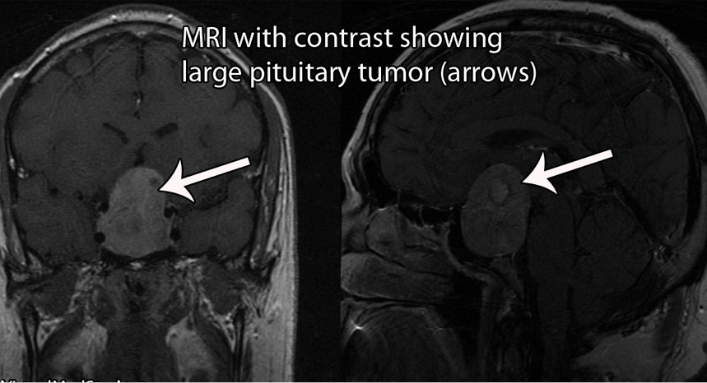
Notes:
BRIEF SCRIPT: The pituitary tumors are usually microadenomas, which are 10 mm or less in diameter. These tumors are often discovered by doing tests for other reasons, since these microadenomas do not have mass effects. Just as a reminder, these pituitary tumors are the secondary cause of Cushing’s Syndrome, called Cushing’s disease. It accounts for about 2/3rds of the endogenous cases of this syndrome.

Slide 18
Presentation of
Clinical Features
Notes:
BRIEF SCRIPT: Taking into account the diverse actions of glucocorticoids, patients with cushing’s will present with distinct clinical features such as:

Slide 19
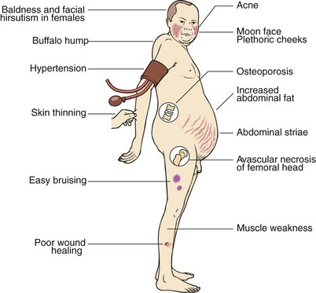
Notes:
BRIEF SCRIPT: Buffalo hump, truncal obesity (abdomen), poor wound healing and easy bruising due to the anti-inflammatory effects of cortisol, osteporosis due to the catabolic effects of cortisol. Interestingly, glucocorticoids also have mineralcorticoid activity. This means that cortisol can also act as aldosterone, an important mineralcorticoid, and present some of the clinical features characteristic of a patient with high levels of aldosterone in their bloodstream. This explains why patients present with high blood pressure (hypertension) due to the sodium retention, and metabolic alkalosis due to potassium wasting. Metabolic alkalosis is an increase in serum bicarbonate concentrations due to loss of hydrogen ions in the body, or a gain in bicarbonate ions.
(Can elaborate a little on the other features based on the actions of glucocorticoids if necessary)

Slide 20
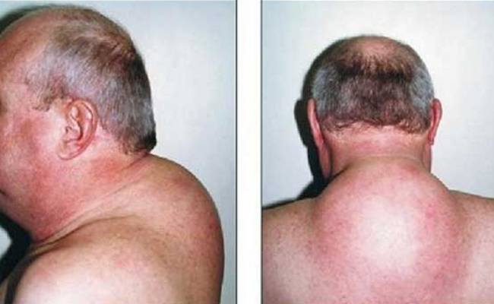
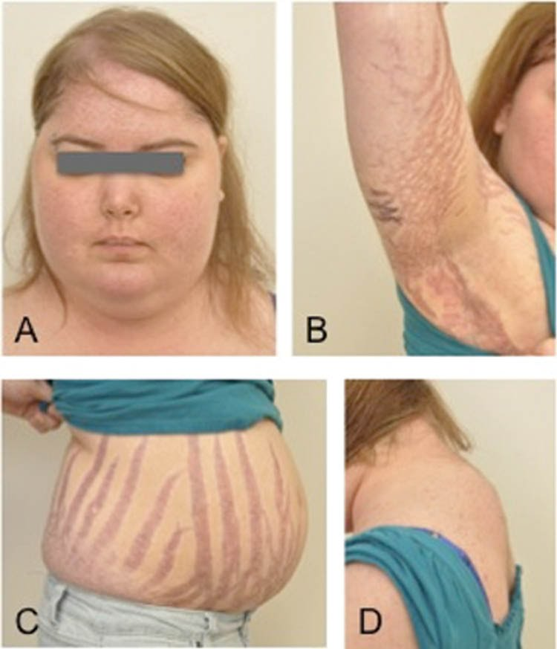
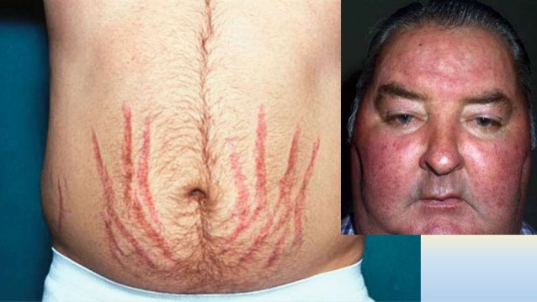
http://diseasespictures.com/wp-content/uploads/2015/02/Cushing-Syndrome-9.jpg
https://i.ytimg.com/vi/8wL82MDJQTc/maxresdefault.jpg
https://image.slidesharecdn.com/cushingssyndrome-160827080057/95/cushings-syndrome-15-638.jpg?cb=1472284877
Notes:
Some more pictures of the clinical manifestations of cushing’s syndrome

Slide 21
Diagnosis

Slide 22
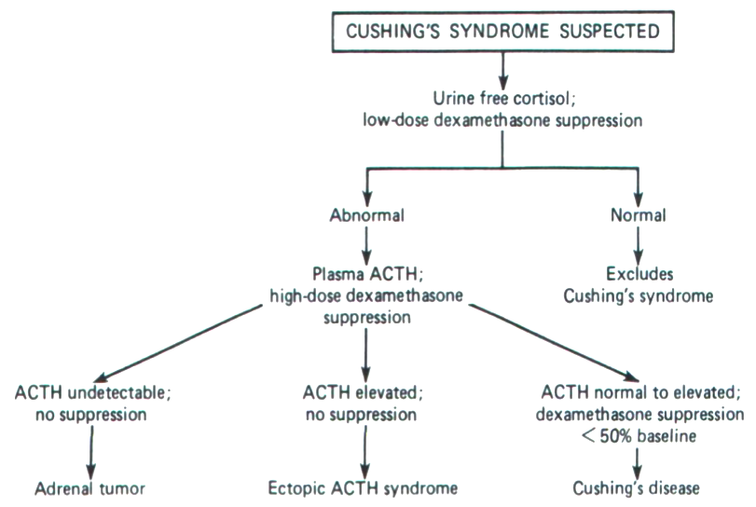
Cushing’s
Algorithm
Notes:
If a physician suspects Cushing’s Syndrome to be the underlying cause for the presentation of symptoms, the best screening test is a basic 24-hour urine test. In which urine free cortisol is measured (Urinary Cortisol concentration is roughly equal to plasma concentrations of cortisol). A diagnosis of Cushing’s can be made when 24 hour urinary free cortisol levels exceed 300 nmol.
A low Dexamethasone Suppression Test is also done, often in combination with urinary tests to confirm the diagnosis. Dexamethasone is a synthetically manufactured cortisol that binds to cortisol receptors in the pituitary and suppresses ACTH release. In healthy individuals this will ultimately suppress the secretion of cortisol. A 1mg dosage is administered at night and a blood test is taken the next morning. Individuals with Cushing’s will be unable to suppress ACTH levels, and will have values in the plasma exceeding 50 nmol/L..
A failure to suppress ACTH levels and thus cortisol require a high dose test to be performed. It involves a 2mg dosage over the course of 48 hours. Plasma cortisol levels are measured the next morning. Patients with Cushing's Disease would have their cortisol concentration levels drop by at least 50% of pre-treatment value. This indicates that high cortisol concentrations due to a pituitary tumour over-secreting ACTH is because of faulty negative feedback mechanisms. As a result, a higher dose is required to counteract the faulty negative feedback mechanisms. On the other hand, failure to suppress ACTH levels is suggestive of an ectopic ACTH secreting tumour that will continue to stimulate the adrenal cortex to release cortisol regardless of the negative feedback loops.

Slide 23
Cushing’s
Algorithm
Notes:
If a physician suspects Cushing’s Syndrome to be the underlying cause for the presentation of symptoms, the best screening test is a basic 24-hour urine test. In which urine free cortisol is measured (Urinary Cortisol concentration is roughly equal to plasma concentrations of cortisol). A diagnosis of Cushing’s can be made when 24 hour urinary free cortisol levels exceed 300 nmol.
A low Dexamethasone Suppression Test is also done, often in combination with urinary tests to confirm the diagnosis. Dexamethasone is a synthetically manufactured cortisol that binds to cortisol receptors in the pituitary and suppresses ACTH release. In healthy individuals this will ultimately suppress the secretion of cortisol. A 1mg dosage is administered at night and a blood test is taken the next morning. Individuals with Cushing’s will be unable to suppress ACTH levels, and will have values in the plasma exceeding 50 nmol/L..
A failure to suppress ACTH levels and thus cortisol require a high dose test to be performed. It involves a 2mg dosage over the course of 48 hours. Plasma cortisol levels are measured the next morning. Patients with Cushing's Disease would have their cortisol concentration levels drop by at least 50% of pre-treatment value. This indicates that high cortisol concentrations due to a pituitary tumour over-secreting ACTH is because of faulty negative feedback mechanisms. As a result, a higher dose is required to counteract the faulty negative feedback mechanisms. On the other hand, failure to suppress ACTH levels is suggestive of an ectopic ACTH secreting tumour that will continue to stimulate the adrenal cortex to release cortisol regardless of the negative feedback loops.

Slide 24
Additional
Diagnostic Tests

Slide 25
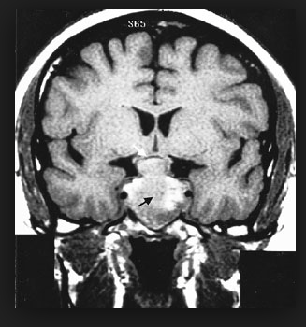
CRH Testing
MRI Scans
CT Scans
Notes:
Dynamic testing is used to distinguish pituitary adenomas from ectopic ACTH secreting tumours or adrenal secreting tumours. Corticotropin Releasing Hormone (CRH), which is released by the hypothalamus in response to stress, stimulates the entire cortisol release cascade. Providing CRH and measuring the ACTH levels helps to further diagnose the type of Cushing's. An exaggerated elevated response of excessive ACTH levels suggest a pituitary tumour (secondary class diagnosis) while no response after the administration of CRH indicates a primary class disorder.
If a brain tumor is suspected to be the cause of excessive secretions. Visualizing tests such as a CT and MRI are often performed in addition, to confirm and verify the location of the tumour.

Slide 26
Lab Abnormalities

Slide 27
Increased Levels of….
Cortisol
Bone Turnover Markers
Glucose
Decreased Levels of….
Potassium
Eosinophils and Lymphocytes
Notes:
Increased glucose levels are a result of increased hepatic gluconeogenesis that occurs with high amounts of glucose, causing the liver to produce glucose from proteins, lipids, and other metabolic sources.
Increased bone turnover markers are a result of triggering bone resorption of amino acids in order to be used as an energy source in gluconeogenesis. This is achieved indirectly through cortisol by blocking calcium absorption in order to decrease bone growth.
Decreased levels of Potassium are explained by increased sodium absorption in the small intestine, while at the same time acting to excrete potassium in the urine.
Decreased Eosinophils and Lymphocytes are decreased because excess cortisol is an immunosuppressant (weakens the immune system). Cortisol blocks the proliferation of T-cells by preventing them from recognizing interleukin signals. This explains why individuals with Cushing’s experience recurrent infections and may also need to be treated for these secondary infections as well.

Slide 28
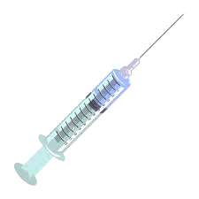
Treatment

Slide 29
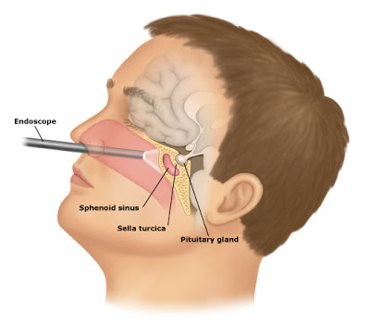
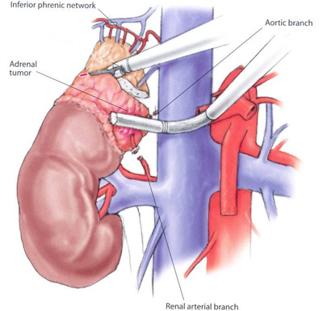
Common Surgeries
Trans-Sphenoidal Hypophysectomy
Bilateral Adrenalectomy
Notes:
Brief Script:
In cases of iatrogenic Cushing’s syndrome, the safest and most preferred method of treatment is the gradual weaning off of glucocorticoid medication along with alternative ways of treating the originally medicated condition. This is often not feasible or sufficient.
Currently the most common way of treating Cushing’s involves surgery on the pituitary to eliminate the adenomas; this is called trans-sphenoidal hypophysectomy. This procedure is fairly successful when the pituitary adenomas are identifiable, and if they are not, surgeons may cut out a big part of the pituitary, but this comes with more side effects.
Another procedure sometimes done is the bilateral adrenalectomy, which is the cutting out of the adrenal glands. The aim is to stop cortisol production, which is the main problem of Cushing’s syndrome.
Hormone therapy is necessary after either operation for the patient’s lifetime to avoid other life-threatening syndromes.

Slide 30
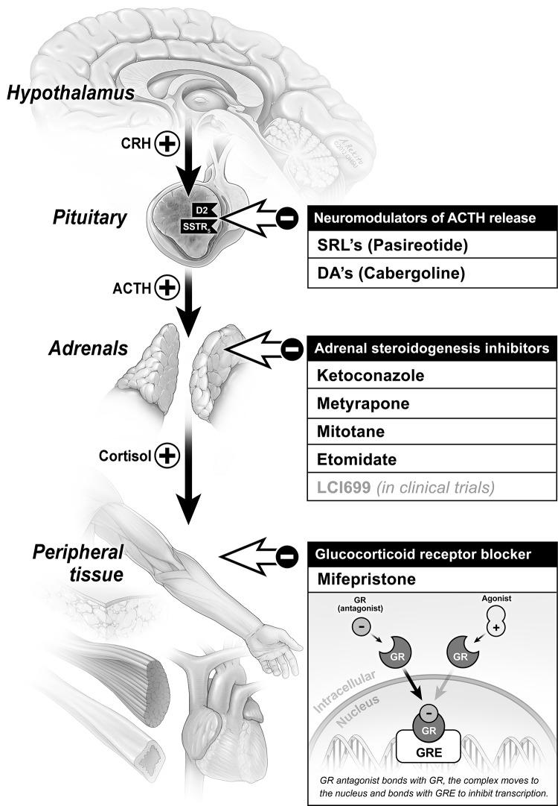
Targeted
Mechanisms
Inhibit release of ACTH
Inhibit steroidogenesis
Receptor antagonist
Notes:
In terms of medication that is out there for treating Cushing’s disease, there 3 main types that they can be categorized into based on where in the system they have an effect on.
Medications that inhibit the release of ACTH
Medications that inhibit steroidogenesis (process of creating steroids such as cortisol)
Medication that acts as a receptor blocker for glucocortisol

Slide 31
Pasireotide Mifepristone
Mitotane
release
ACTH
GlucoCR
Streoidogensis
Notes:
Pasireotide is a drug that inhibits the release of ACTH
It acts as an analog to somatostatin, which is known as a growth hormone-inhibiting hormone. (bc there are somatostatin receptors in the pituitary that are involved in tumor growth)
The drug inhibits corticotropin (acth) secretion from the pituitary gland
Corticotrophin is acth, and ACTH is what eventually leads to the secretion of cortisol
Mitotane is a drug that inhbits the process of steriodogensis
It limits cortisol production by inhibiting cholesterol side-chain cleavage and 11 β-hydroxylase, which is used in the final phase of cortisol synthesis as a catalyst
Mifepristone is a drug that acts as a glucocorticoid receptor blocker
The drug is a glucocorticoid receptor antagonist and this inhibits cortisol’s mechanism of action

Slide 32
Future Research

Slide 33
Combinational Drug Therapy
Notes:
The future of treating Cushing’s syndrome seems like it may lie within a combination of different drug therapy rather than a single drug
A study done by Feelders and Hofland looked at 17 patients that were diagnosed with Cushing’s disease and were given pasireotide as a treatment
After some time, five of those patients showed normalized UFC levels
The addition of cabergoline to the treatment normalized UFC levels in four further patients
Furthermore the addition of ketoconazole normalized six more patients
At the end of the trials, only 2 out of 17 patients had elevated UFC levels
Another study by Vilar et al looked at a combination of cabergoline and ketoconazole for treating Cushing’s disease
Initially, 12 patients were prescribed cabergoline for 6 months and 9 of these patients did not respond well to the treatment
However the addition of the ketoconazole to the treatment led to six of the nine patients having normalized UFC levels and the remaining patients showed a reduction in UFC levels of 44-52%

Slide 35
Question 1

Slide 36
A 45 year-old man presents to his family physician complaining of muscle weakness, high blood pressure, sore joints, excessive weight gain especially in the abdomen, and a moon face. Abnormalities in his lab results show:
The patient’s lab tests also show decreased WBC counts and after administering a high dose dexamethasone suppression test, cortisol levels decreased to <50% of pre-clinical treatment.
What is the most likely explanation for this patient?
Plasma Cortisol | 980 nmol/L (<300 nmol/L)
Plasma ACTH | 194 ng/L (10-50 ng/L)
Fasting Plasma Glucose (FPG) | 7.0 mmol/L (<6.1 mmol/L)
A) a tumour of the adrenal cortex secreting excess cortisol
B) an ectopic ACTH tumor operating outside of the HPA axis
C) a tumour in the pituitary gland over secreting ACTH (Cushing’s Disease)
D) type II diabetes mellitus due to hyperglycemia
E) he’s all good and his lab tests are normal

Slide 37
A 45 year-old man presents to his family physician complaining of muscle weakness, high blood pressure, sore joints, excessive weight gain especially in the abdomen, and a moon face. Abnormalities in his lab results show:
The patient’s lab tests also show decreased WBC counts and after administering a high dose dexamethasone suppression test, cortisol levels decreased to <50% of pre-clinical treatment.
What is the most likely explanation for this patient?
Plasma Cortisol | 980 nmol/L (<300 nmol/L)
Plasma ACTH | 194 ng/L (10-50 ng/L)
Fasting Plasma Glucose (FPG) | 7.0 mmol/L (<6.1 mmol/L)
A) a tumour of the adrenal cortex secreting excess cortisol
B) an ectopic ACTH tumor operating outside of the HPA axis
C) a tumour in the pituitary gland over secreting ACTH (Cushing’s Disease) ##
D) type II diabetes mellitus due to hyperglycemia
E) he’s all good and his lab tests are normal
Notes:
Answer: C

Slide 38
Question 2

Slide 39
Excess of which of the following hormones gives rise to the symptoms in Cushing's Disease?
A) Cortisol
B) Testosterone
C) Growth Hormone
D) Calcitonin
E) Aldosterone

Slide 40
Excess of which of the following hormones gives rise to the symptoms in Cushing's Disease?
A) Cortisol ##
B) Testosterone
C) Growth Hormone
D) Calcitonin
E) Aldosterone
Notes:
Answer: A

Slide 41
Thank You!

