Slide 1
Coronary Heart Disease
Zil Nasir, Allan Tran, Kunal Mehta, Noor Tariq, Arani Muthurajah

Slide 2
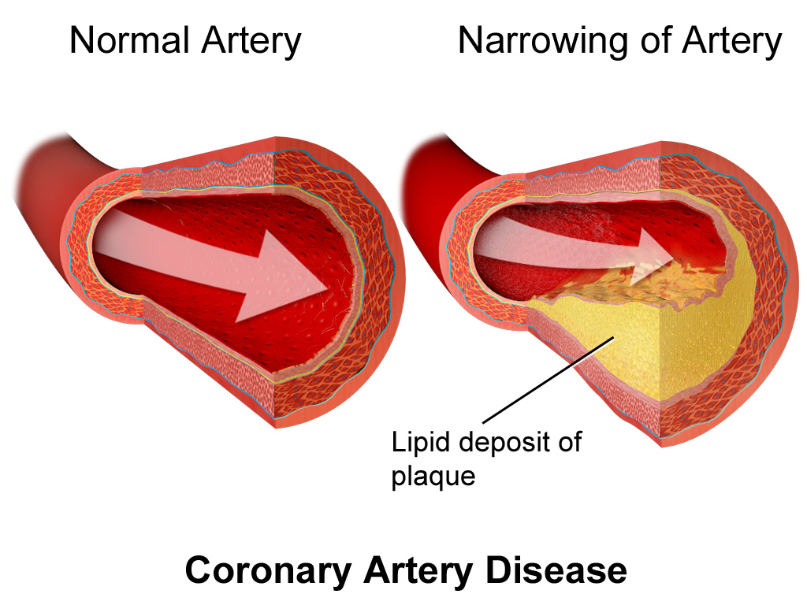
What is Coronary Heart Disease?
Buildup of plaque(s) in the coronary arteries
Leads to the narrowing of arteries
Restricts oxygenated blood from entering the heart
(National Heart, Lung, and Blood Institute, 2016)
Notes:
Coronary heart disease or ischemic heart disease is a disorder characterized by the buildup of plaques in the coronary arteries thus leading to the narrowing of the arteries
The buildup of plaques is known as atherosclerosis.
The plaques tend to accumulate throughout the years blocking circulation in the arteries and restricting the entrance of oxygenated blood into the heart

Slide 3
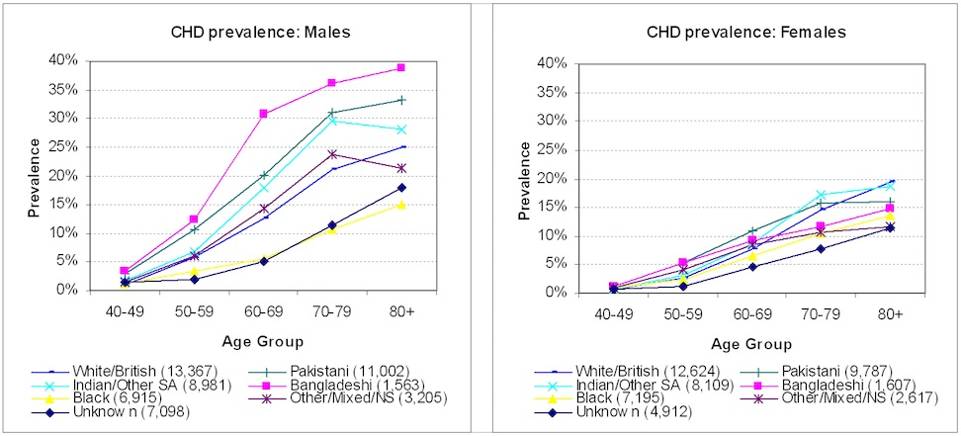
Epidemiology

Slide 4
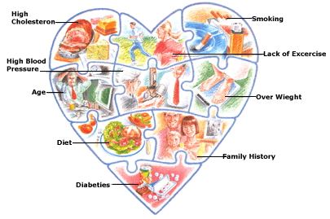
Etiology

Slide 5
Signs & Symptoms
Chest discomfort: Compression/fullness/pain that lasts more than a few minutes at the center of the chest; is intermittent; feels like GERD
Upper body discomfort: arms, back, neck, jaw or stomach
Shortness of breath: with or without chest discomfort
Other common symptoms: light-headedness, dizziness, nausea, vomiting, feeling unusually tired for no reason and breaking out in a cold sweat
(National Heart, Lung, and Blood Institute, 2016)
Notes:
Some of the most common symptoms include that of mild or severe chest pain, involving discomfort for a short (few minutes) period of time. This pain can be sharp, and feel very uncomfortable, similar to the pressure or compression felt of gastroesophageal reflux disease on the heart.
There may also be some upper body discomfort, ranging from the arms to the back, shoulders, neck, jaw and/or upper pat of the stomach and below the breasts.
In addition, shortness of breath can be a sign signalling discomfort to the heart, occurring either before or during the heart attack (NHLBI, 2015). Other common symptoms include light-headedness, dizziness, nausea, vomiting, feeling unusually tired for no reason and breaking out in a cold sweat (NHLBI, 2015).

Slide 6
PATHOPHYSIOLOGY

Slide 7
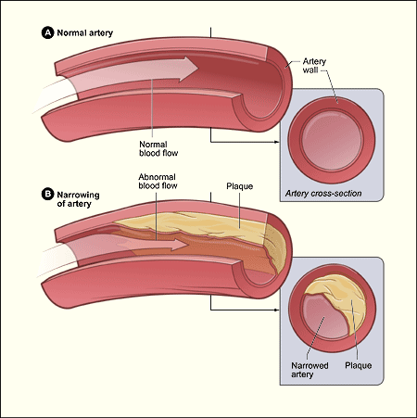
Atherosclerosis
Imbalanced lipid metabolism
Abnormal plaque build-up
Cholesterol
Fat
Calcium
Plaque hardens = narrowed arteries
(Libby & Theroux, 2005)
Notes:
Atherosclerosis is the buildup of plaques in the arteries restricting the flow of oxygen rich blood from moving inside the heart and body.
The plaque is made up of fat, cholesterol, calcium, and other components and continues to grow larger in the arteries.
As people age, the plaque narrows the arteries and hardens making it difficult for oxygenated blood to enter the muscles of the heart.
This can result in a heart attack or cardiac arrhythmia.
This is also what can cause angina, or chest pain

Slide 8
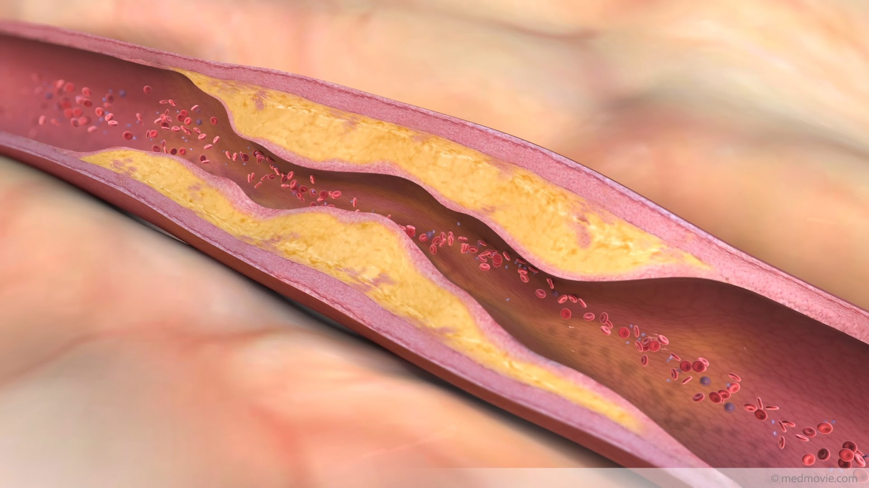
Atherosclerotic Lesions & Inflammation
Asymmetric focal thickenings of the artery
Recruitment of immune cells and inflammatory cytokines
Leads to cardiac infarctions, plaque rupturing or coronary thrombosis
(Libby & Theroux, 2005)
Notes:
Atheroscelortic lesions form due to the asymmetrical focal thickening of the arteries
The lesion continues to grow as immune cells such as effector cells are recruited to the arteries thus resulting in inflammation of the arteries
Along with these immune cells, the connective tissue and lipids further cement the formation of fatty streaks which contain macrophages and T cells
These macrophages and T cells recruit inflammatory cytokines producing a cytotoxic storm
Along with a heart attack, the formation of lesions can result in the plaque rupturing. This is dangerous because it releases thrombotic material into the bloodstream and can result in acute coronary syndrome

Slide 9
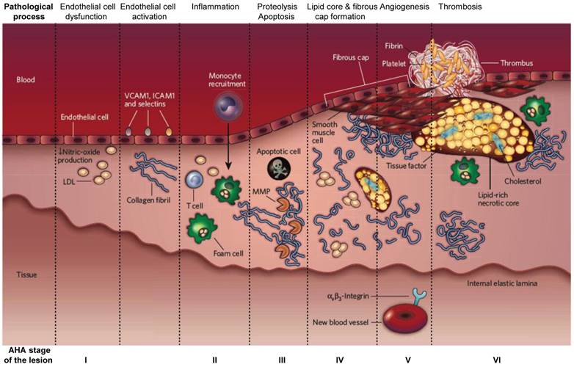
Notes:
http://www.thno.org/v03p0894.htm

Slide 10
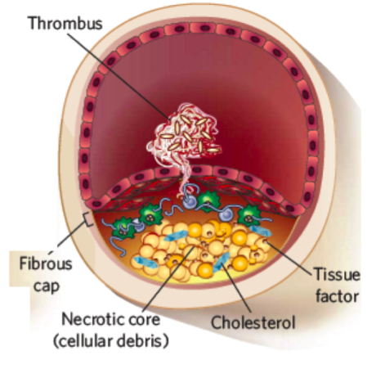
Thrombosis
Necrotic core forms within plaque
Rupturing of plaque
Erosion of endothelium
Formation of thrombus
(Radar & Daugherty, 2008)
Notes:
Foam cells die and this releases the cellular debris and crystalline cholesterol.
The smooth muscle cells form a fibrous cap beneath the endothelium layer which forms an “isolated space” for the plaque to grow.
This results in the formation of necrotic core eventually within the plaque, and this promotes recruitment of inflammatory cells.
Plaque can rupture as a result of this, or endothelium can erode which results in exposing thrombogenic material and formation of thrombus in the lumen.
If thrombus is large enough, it will block arteries and cause acute coronary syndrome or myocardial infarcation.
http://www.genomics.liv.ac.uk/tryps/Key_Papers/POM0208.pdf

Slide 11
DIAGNOSIS

Slide 12
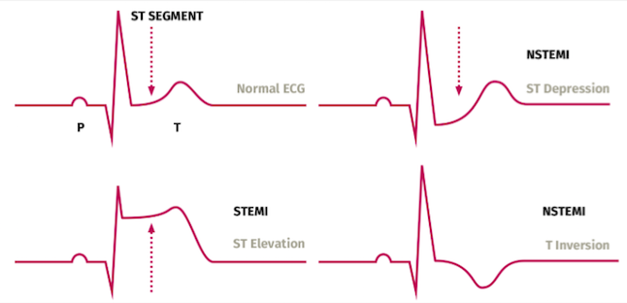
Electrocardiogram (ECG)
Complete Blockage results in STEMI
ST-Elevation
Epicardial Injury
NSTEMI is damage to subendocardial region
(Bonow et al., 2011)
Notes:
Normally, detection of coronary heart disease will result from a physician who has reviewed the patient’s medical and family history, as well as various test results (NHLBI, 2015).
The first diagnostic test that is used is called an Electrocardiogram or ECG (EKG), and is also considered a non-invasive diagnostic tool as it is an external measurement of the heart (AHA, 2016).
Complete blockage of the coronary artery results in STEMI or ST-elevation myocardial infarction, also known as a transmural or epicardial injury (AHA, 2016; Braunwald et al., 2002).
A partial blockage of the artery results in subendocardial ischemia, or ST-depression (Braunwald et al., 2002).
Both of these patterns can be tracked through ECG, and indeed the ECG patterns can change as the coronary occlusion changes. Due to damage in the epicardial tissue, a myocardial infarction patient with ST-elevation will have ventricles that take an extended period of time to repolarize, thus allowing a positive ion influx and observation of an elevated ST portion of the ECG (Braunwald et al., 2002). In contrast, a patient with an injury in the subendocardial region, would have too little positive ion influx (greater depolarization) and cause the ST vector directed toward the inner ventricular region, thus exhibiting an ST-depression in the ECG (Braunwald et al., 2002).

Slide 13
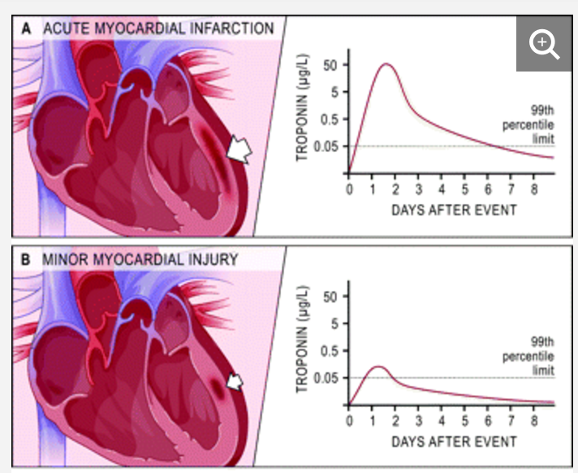
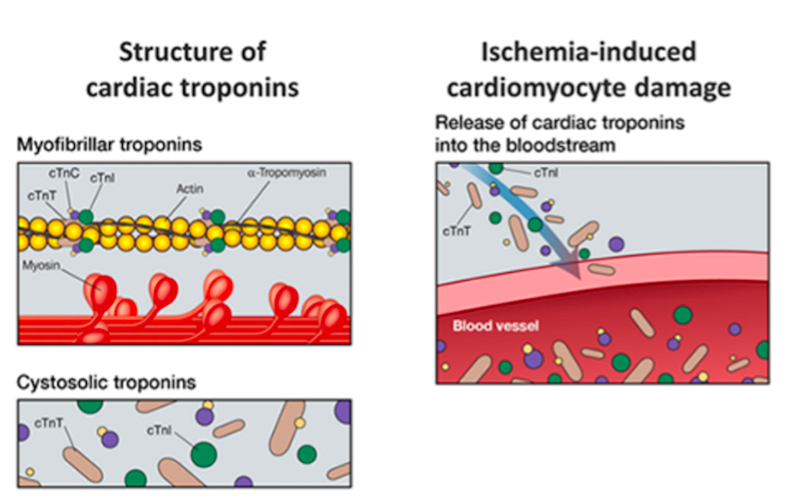
Troponin Blood Test
With minor myocardial injury & acute myocardial infarction:
Detectable levels of cardiac troponin for 5-7 hrs post injury with antibodies
Troponin-T is normally bound to Tropomyosin
Regulatory proteins control Ca²⁺ influx/outflow between actin & myosin
Released with cardiac cell necrosis
(Melanson et al., 2007)
Notes:
For pre-requisite knowledge, troponin-T is normally bound to tropomyosin along actin filaments in cardiac muscle; they are regulatory proteins which control the calcium influx/outflow between actin and myosin (Sharma et al., 2004).
The blood assay operates by making an antibody for cardiac troponin-T. This antibody then binds to any soluble troponin-T as a result of myocardial damage, thus allowing the physician to make a sensible diagnosis (Melanson et al., 2007).
Research showed that for acute myocardial infarction, there is more than 50 ug/L of soluble troponin in the blood 24-48 hours after the onset of chest pain (Melanson et al., 2007).
In contrast, minor myocardial injury may only show approximately a maximum of 0.05 ug/L of soluble troponin (Melanson et al., 2007). As seen in the image, troponin-T levels decrease severals days post-injury.

Slide 14
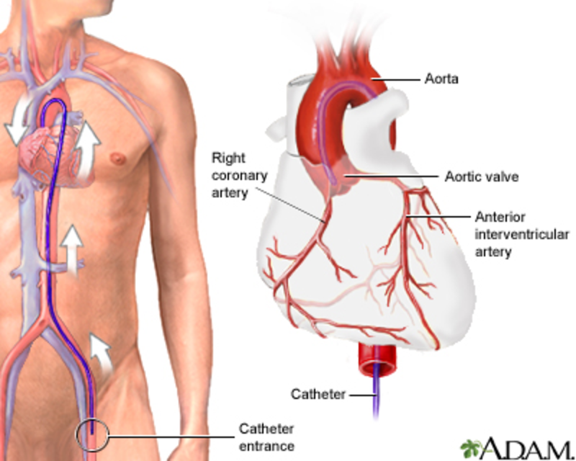
Cardiac Catheterization/Angiograms
Invasive
Insert catheter in femoral artery to locate blockage
X-ray dye for interior arterial illustrations
Detect pressure, oxygen content, and even produce small needle biopsy of heart
Notes:
using a narrow, rubber-like hollow tube, in which a catheter is inserted in an attempt to diagnose and clear out an arterial occlusion (Robinson, 2011).
The catheters are inserted through either the radial artery, brachial artery, or the most often used femoral artery, which provides ease of insertion and the least torturous path to the heart (Robinson, 2011).
By using a special X-ray contrast dye, catheterization can display exactly where the occlusion is located, a process called cardiac angiography (AHA, 2017).
In addition, catheterization can detect the pressure and oxygen content in the four chambers of the heart and also asses a small piece of heart tissue under a microscope (also called biopsy) (AHA, 2017).
https://www.youtube.com/watch?v=-DJiW1YADoE
https://ufhealth.org/coronary-angiography

Slide 15
TREATMENTS

Slide 16
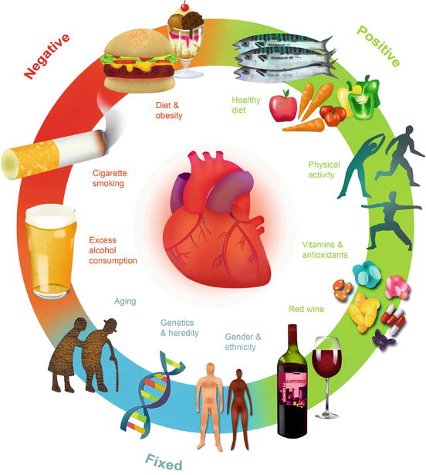
1. LIFESTYLE
Healthy Eating
Physical Activity
Quitting Smoking
Limiting Alcohol Consumption
(National Heart, Lung, and Blood Institute, 2016)
Notes:
Lifestyle modifications are important for preventing and treating CAD.
-Some of the lifestyle modifications include healthy eating. This requires that you avoid eating food that raise blood cholesterol levels such as red meat, and sugar foods high in saturated and trans fat as these are the precursors to LDL cholesterol, or “bad” cholesterol and can result in plaque buildup. A healthy diet should include more sources of monounsaturated and polyunsaturated fats to help lower cholesterol levels, and raise HDL cholesterol which is “good cholesterol”.
-Physical activity is another lifestyle modification that can lower blood pressure, and improve and boost heart health and function and can also reduce the amount of triglycerides levels.
-Smoking can worsen the risk factors of coronary artery disease over time, so it is very important to quit smoking.
-Limiting alcohol consumption is another lifestyle modifcation as too much alchol can raise blood pressure and triglyceride levels.

Slide 17
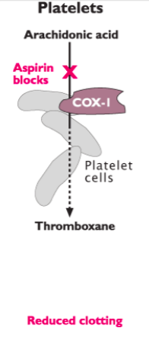
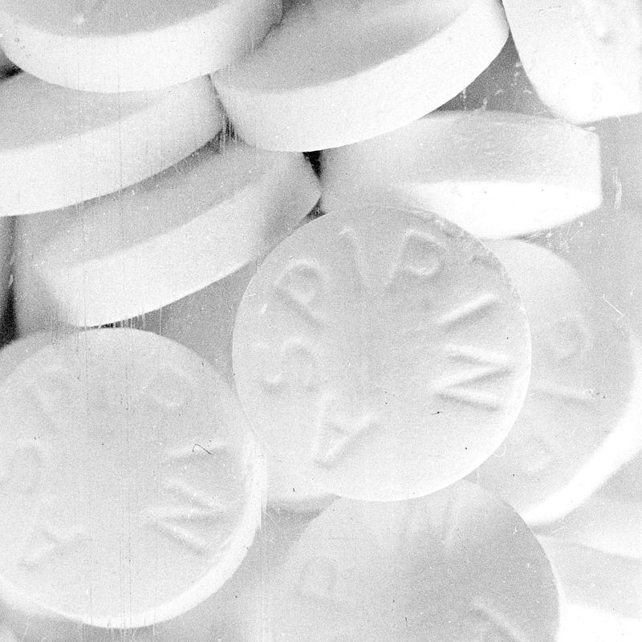
2. ASPIRIN
Prevents the formation of thromboxane
Inhibits COX-1
Prevents platelet aggregation and clotting
(Frishman et al., 2005)
Notes:
Aspirin is an antiplatelet medicine.
Prevents the conversion of arachidonic acid to proaggregatory molecule known as thromboxane.
Thromboxane is a vasoconstrictor, which facilitates platelet aggregation as it stimulates the activation of new platelets
Aspirin inhibits cyclooxygenase (COX-1) in platelets and prevents platelet aggregation, and thus reduces clotting.
Aspirin is an anti-prostaglandin which leads to reduced inflammation in blood vessels as well.

Slide 18
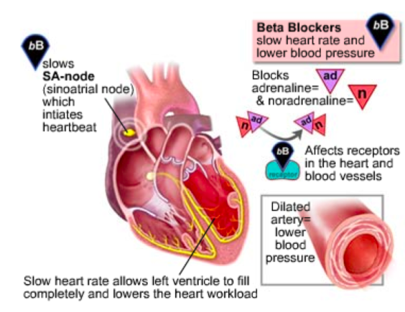
3. BETA-BLOCKERS
Block beta-adrenergic receptors
Prevent binding of adrenaline
(Frishman et al., 2005)
Notes:
Beta-blockers is a medication that is used to control abnormal heart rhythms, and treat high blood pressure.
Beta-blockers are antagonists that block the beta-adrenergic receptors for epinephrine and norepinephrine that mediates a flight or fight response. The beta receptors are found on cells of the heart muscles, smooth muscles, arteries, kidneys, and other tissues that are part of the sympathetic nervous system. The flight or fight response accelerates heart-rate and causes vasoconstriction increasing blood pressure as a result of stimulation of the beta-receptors by epinephrine and norepinephrine. However, exogenously administered beta-blockers bind preferentially and reversibly to the beta-receptor and competitively inhibits the epinephrine and norepinephrine, and weakens the effect. This results in slowing the heart rate, decreasing cardiac output, lessens the force with which heart muscle contracts, and dilates blood vessels. Examples of beta blockers include atenolol, metoprolol, nebivolol, and bisoprolol.

Slide 19
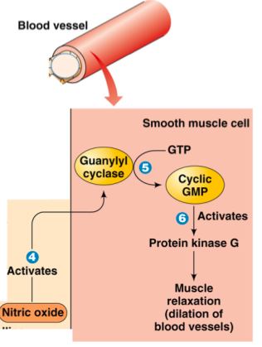
4. NITROGLYCERIN
Converted to nitric oxide = potent vasodilator
Activates guanylyl cyclase= formation of protein kinase G
Muscle Relaxation
(Kukovetz et al., 1987)
Notes:
Nitroglycerin is a medication used for high blood pressure.
Administered by mouth, under the tongue, applied to the skin, or by injection into a vein.
Nitroglycerin mode of action is not entirely clear, but it is an effective treatment that functions to dilate blood vessels as it is a precursor to nitric oxide, a potent vasodilator.
When converted to nitric oxide, it activates a molecule guanylyl cyclase which results in the formation of protein kinase G, and this dephosphorylates myosin heads, which results in muscle relaxation.

Slide 20
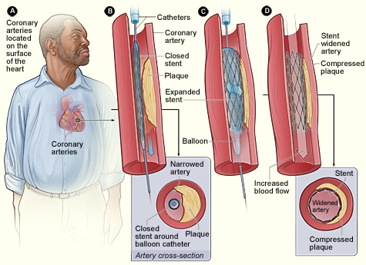
5. ANGIOPLASTY
Catheter inserted and threaded to heart
Dye injected and observed
Balloon & stent used to open up artery
(National Heart, Lung, and Blood Institute, 2016)
Notes:
Coronary Angioplasty is nonsurgical procedure that improves the overall blood flow to the heart by cardiac catheterization.
Insertion of a catheter tube, and injection of contrast dye that is iodine based into coronary arteries
This medicinal procedure is followed to open coronary arteries that are narrowed or blocked by the buildup of artherosclerotic plaque.
Insert the catheter into the blood vessel. The doctor uses live x-rays to guide the catheter to the heart to inject special contrast dye that will show the blockage
Another catheter is used over a guidewire, and a balloon is inflated at the tip of that catheter.
A small mest tube called a stent is placed in the artery to keep the artery open.
If a stent is implanted, anticlotting medicines are prescribed for three to 12 months.
The risk of complications is higher if the patient is older, and has extensive heart disease or multiple blockages in the coronary arteries.

Slide 21
FUTURE THERAPEUTICS & IMPLICATION

Slide 22
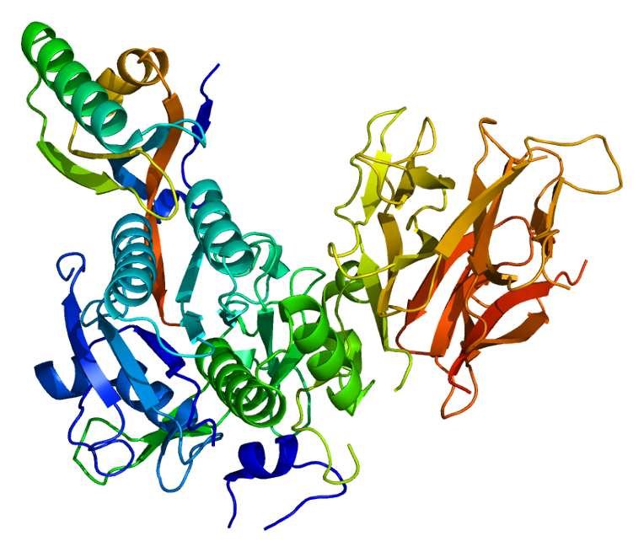
PCSK9-specific siRNA
Small interfering RNA (siRNA) as an alternative cardiovascular disease treatment
Prolonged reductions in LDL cholesterol
Direct-specific degradation messenger RNA
Encapsulated in lipid nanoparticle
Injection every 6-12 months
Side effects:
Potential hepatotoxicity
Notes:
-Currently, small interfering RNA (siRNA) has been investigated as an alternative method CDK treatment, as it has been associated with prolonged reductions in LDL cholesterol levels for over several months. SiRNA’s can direct-specific degradation messenger RNA for PCSK9, leading to suppression of PCSK9 protein synthesis.
- This PCSK9-specific siRNA is encapsulated in a lipid nanoparticle and delivered by a single injection every 6-12 months.
-Although this alternative method in lowering LDL plasma levels by utilizing PCSK9 mechanism shows promise; there has been concern due to its associated effects of hepatotoxicity. Therefore, ongoing studies are currently conducted to determine the safety and efficacy.

Slide 23
Anti-Inflammatory Therapy
Mechanism behind rupture of fibrous cap is unknown
Local or systemic inflammation
Studies:
Chronic low-level systemic inflammation; greater risk for cardiovascular disease
Anti-inflammatory therapeutics = benefits + reduction in cardiovascular disease patients
Agents: colchicine, canakinumab, methothrexate
Undergoing trials
Notes:
- The mechanisms behind the rupturing or erosion of the fibrous cap leading to unstable coronary atheromatous plaques have yet been elucidated.
-However, it can been believed that local or systemic inflammation can be an underlying etiology for such processes. Studies have evidently shown that chronic low-level system inflammation has been associated with greater risk for CDK.
-In addition, further studies have shown benefits, and a reduction of cardiovascular risk in CDK patients from anti-inflammatory therapeutics. These agents include colchicine, canakinumab, and methotrexate, which are currently in trials to assess its efficacy in reducing cardiovascular risks, and whether it plays a role in destabilizing atheroma plaques.

Slide 24
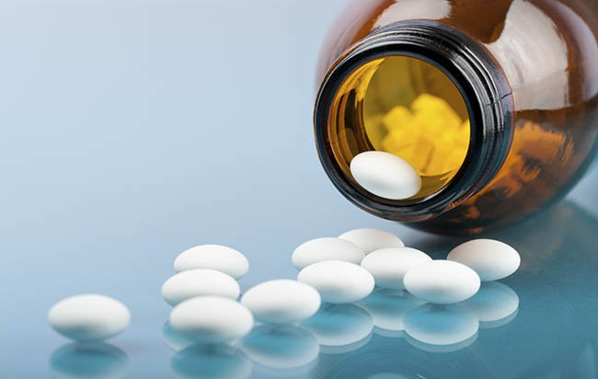
Personalized Antithrombotic Therapy
Treat patients at risk
Associated with increased risk of bleeding
Currently: low-dosage Aspirin as anticoagulation therapy
Future methods
Combinational antiplatelet & anticoagulants
Assessment of intensity
Notes:
-Atherothrombosis known as atherosclerotic plaque disruption with superimposed thrombosis is clinically manifested in coronary heart disease. In order to treat patients at risk for atherotrombosis, anti-thrombotic therapy can be provided to prevent ischemic events, however, it is often associated with an increased risk of bleeding.
- Currently, low-dose aspirin has been used for long-term prevention as anti-coagulation therapy.
- Though, future methods may consider combinational antiplatelet, anticoagulants, along with the assessment of intensity, and duration of therapy to achieve optimal benefits for each patient.

Slide 25
CONCLUSION

Slide 26
References
Bonow, R. O., Mann, D. L., Zipes, D. P., & Libby, P. (2011). Braunwald's Heart Disease E-Book: A Textbook of Cardiovascular Medicine. Elsevier Health Sciences.
Frishman, W. H., Cheng-Lai, A., & Nawarskas, J. (Eds.). (2005). Current cardiovascular drugs. Springer Science & Business Media.
Kukovetz, W. R., Holzmann, S., & Romanin, C. (1987). Mechanism of vasodilation by nitrates: role of cyclic GMP. Cardiology, 74(Suppl. 1), 12-19.
Libby, P., & Theroux, P. (2005). Pathophysiology of coronary artery disease. Circulation, 111(25), 3481-3488.
Melanson, S. E., Tanasijevic, M. J., & Jarolim, P. (2007). Cardiac troponin assays. Circulation, 116(18), e501-e504.
National Heart, Lung, and Blood Institute.(2016). How is Coronary Heart Disease Treated ?. Retrieved November 26, 2017, from https://www.nhlbi.nih.gov/health/health-topics/topics/cad/treatment#PhysicalActivity
Rader, D. J., & Daugherty, A. (2008). Translating molecular discoveries into new therapies for atherosclerosis. Nature, 451(7181), 904-913.

