Slide 1
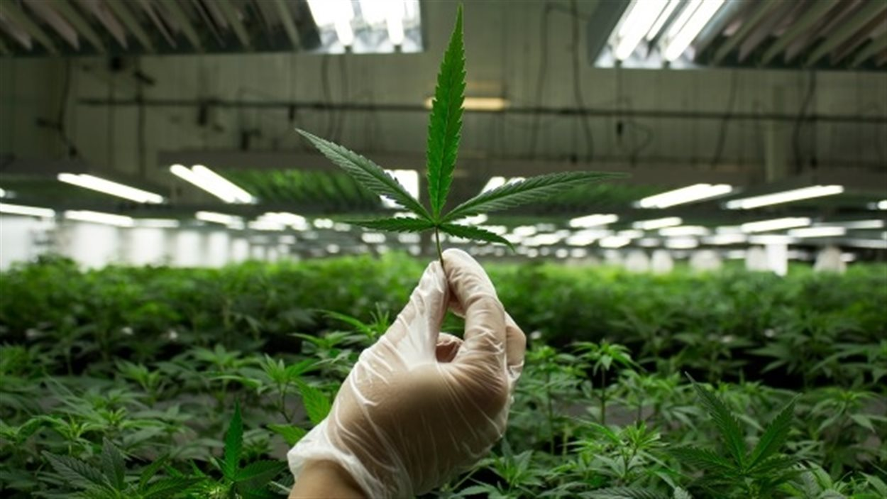
Effects of Cannabis
The Effects of Cannabis
Life Science 4M03
Group 5:
Jasmine, Henry, Sachin, Negar, Ebuka
Life Science 4M03
Group 5:
Jasmine, Henry, Sachin, Negar, Ebuka

Slide 2
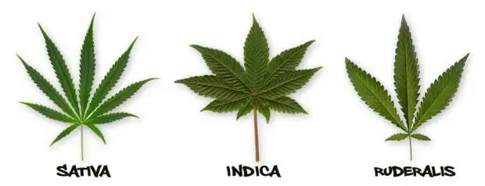
What is Cannabis?
Cannabis is a genus of flowering plants in the family Cannabaceae.
Other names: Marijuana, yarndi, pot, weed, hash, dope, ganja, joint, stick, chronic, cone, choof, dabs, dabbing, BHO.
Species: Sativa
Indica
Ruderalis
The psychoactive effects of cannabis are known to have a triphasic nature.
Notes:
There are three main species known as sativa, indica, and ruderalis. The species differ in their branches, growth and psychoactive properties.
The psychoactive effects of cannabis are known to have a triphasic nature. Primary, secondary and tertiary psychoactive effects from the main psychoactive compound, THC, range from a state of relaxation, to introspection, anxiety, paranoia, increase in heart rate and hunger.

Slide 3
How is it used?
Recreationally
Recreational cannabis use has spread globally to other developed countries and, recently, low- and middle income countries.
Medicinally
Chemotherapy, HIV/AIDS, Chronic pain
Commercially
Fibre ranging from paper, cordage, construction material and textiles in general, to clothing.
Religiously
Some religions used cannabis as an entheogenic
Notes:
During the past half-century, recreational cannabis use has become almost as common as tobacco use among adolescents and young adults. Since its use was first reported more than 40 years ago in the United States, recreational cannabis use has spread globally to other developed countries and, more recently, low- and middle income countries.
Medical cannabis (or medical marijuana) refers to the use of cannabis to treat disease or improve symptoms. Ex. Cannabis is used to reduce nausea and vomiting during chemotherapy
Cannabis for industrial uses is valuable in commercial products, especially as fibre ranging from paper, construction material and textiles in general, to clothing.
Different religions have varying stances on the use of cannabis, historically and presently, and we will discuss that in a bit more detail later on.

Slide 4
Forms of Cannabis
Marijuana (flowered buds)– the most common and least concentrated form.
Hashish – small blocks of dried cannabis resin.
Hash oil – a thick, oily liquid extracted from hashish
Concentrates – extracts (dabs, wax or shatter) typically using butane hash oil as a solvent
Cannabis can be smoked, eaten or vaporized and comes in different forms.
Notes:
There are several forms of cannabis, including marijuana which is the most common and least concentrated form. The flowers are the most potent forms of the plant. It is usually smoked in a bong, pipe or hand-rolled joint.
Other forms include Hashish, Hash oil, and concentrates. The concentration of THC in hashish is higher than in marijuana. Concentrates which are extracts are often vaporized in small quantities due to high THC content.
Cannabis can be smoked, eaten or vaporized and comes in different forms. People report that the subjective effects of cannabis vary significantly depending on the form consumed. Cannabis can be prepared into various foods generally called ‘edibles’.

Slide 5
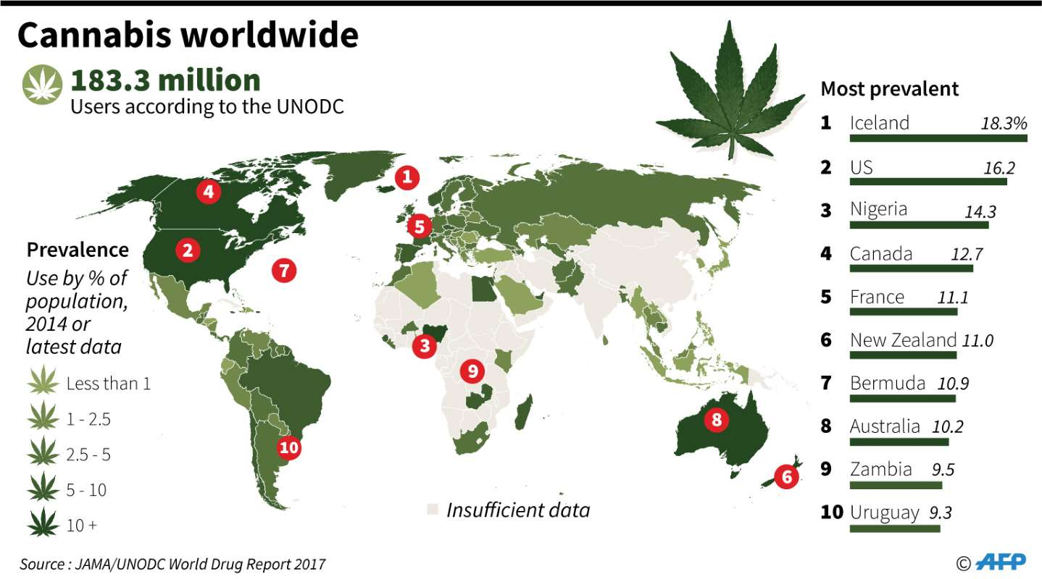
Demographics of Cannabis Use
Highest prevalence in North America, Western Central Africa, and Europe
General increase in the entire age population in Canada in recent years
https://www.msn.com/en-ca/news/cannabis/chart-cannabis-use-worldwide/ar-BBNv4hn
Notes:
The United Nations Office on Drugs and Crime (UNDOC) has reported that in 2015, the highest prevalence of cannabis use was in North America, Western Central Africa, as well Europe. Throughout the years, there are periods of an increase then decrease of cannabis use. For example, during the time of 1960s and early 1970s, an increase of consumption was seen in the ages of 15-24. This then started to decline in the 1990s, but gradually increased within the 2000s. Overall, there has been a general increase in the usage for the entire age population in Canada.

Slide 6
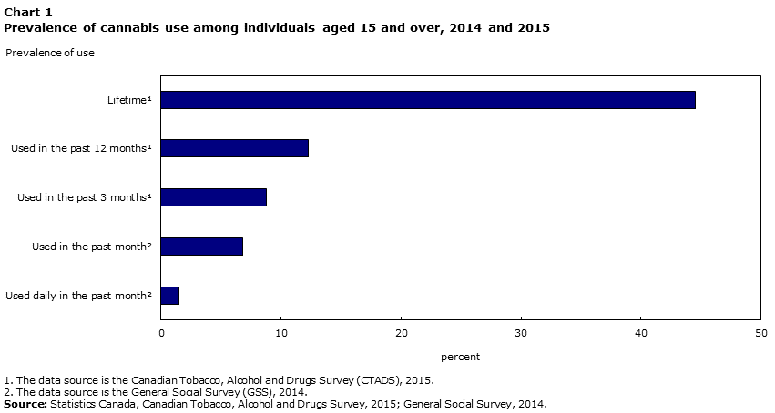
Prevalence of Cannabis Use
https://www150.statcan.gc.ca/n1/pub/75-006-x/2018001/article/54968-eng.htm
Notes:
A report has shown that in a sample of individuals of aged 15 and over, around 45% said that they had tried to use cannabis at least once in their lifetime. A survey was conducted within 10 provinces and was conducted over the year of 2015 from volunteers and shows the prevalent use from Canadians.

Slide 7
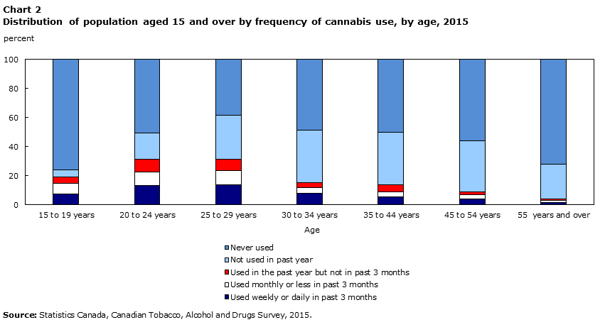
Distribution of Cannabis Use by Age
https://www150.statcan.gc.ca/n1/pub/75-006-x/2018001/article/54968-eng.htm
Notes:
From these individuals who have used cannabis in 2015, it is seen that the use is not equally distributed as majority of those who have used cannabis within the year were in their 20s and then decreases steadily as the age increases. In those who are over the age of 55, majority have not used cannabis within the past year.
It has been reported that 48% of men have used cannabis at least once in their life and 32% of women has used it once

Slide 8
Short-term Effects of Cannabis
Positive short-term effects:
· Relaxation
· A feeling of euphoria
· Sensory experiences (greater sense of sight, taste, smell, and sound)
Negative short-term effects:
· A feeling of fear or anxiety
· Inability to concentrate, remember certain tasks, or pay attention
· State of confusion
Notes:
The positive short-term effects of cannabis can include:
· Relaxation
· A feeling of euphoria
· Sensory experiences (greater sense of sight, taste, smell, and sound)
Negative short-term effects:
A feeling of fear or anxiety
Inability to concentrate, remember certain tasks, or pay attention
State of confusion
The smoke from cannabis can also cause a decrease in blood pressure and can damage blood vessels from the inhalation of smoke. Those who use cannabis can have delusions or hallucinations so it is advised to be aware of any of these effects on the body. It is not reported to overdose from marijuana, however, individuals may experience panic attacks as well as become paranoid which can lead to injury.

Slide 9
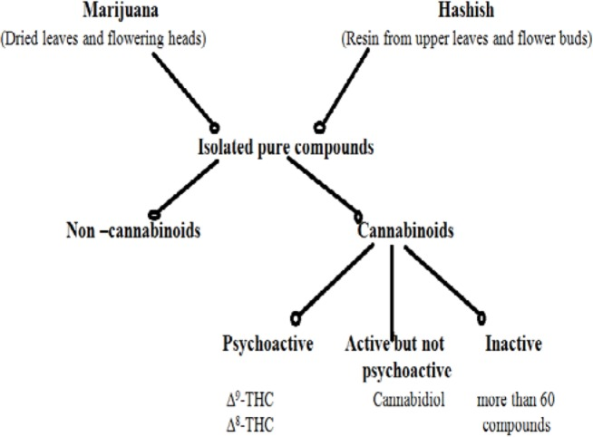
Mechanisms of Action - Overview
Delta 9-tetrahydrocannabinol (THC)
Cannabinoid receptor type 1
Cannabinoid receptor type 2
Cannabidiol (CBD)
Thought to cause paranoid and anxiety
Notes:
There are generally two sources of cannabis, one from dried leaves ( marijuana) and one from fresh leaves (Hashish). These sources are then isolated and purifies to be used. There are two major compounds that leads to the physiological effects of cannabis, the Delta 9-tetrahydrocannabinol aka (THC) and Cannabidiol (CBD).

Slide 10
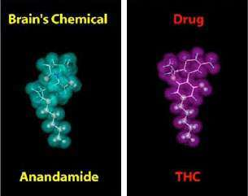
Mechanisms of Action - Overview
Delta 9-tetrahydrocannabinol
Cannabinoid receptor type 1
Cannabinoid receptor type 2
Cannabidiol
Thought to cause paranoid and anxiety
Notes:
THC is known to have the major effect on the brain as its structure is very similar to the neurotransmitter Anandamide and will bind to the Cannabinoid receptors (CB1 and CB2) and disturb the chemical neurotransmission.
And Cannabidiol is thought to be responsible for the experiences of paranoia and anxiety (lack of research for mechanisms)

Slide 11
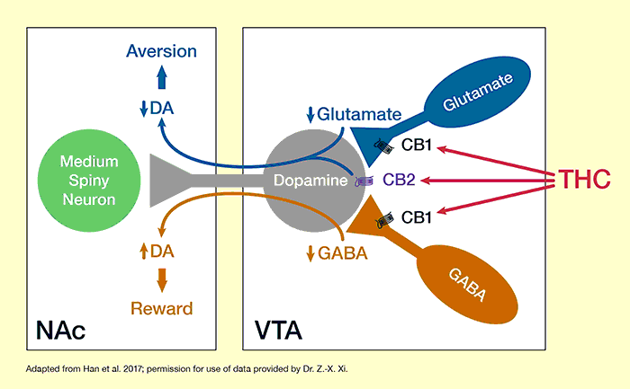
Mechanism of Action - THC
Notes:
As mentioned earlier THC will bind to the CB1 and CB2 receptors. But how does it give the “high” feeling?
The GABA and glutamate pathways are responsible for inhibiting and regulating dopamine,respectively. THC binds to the CB sites and inhibit these pathways thus increasing the overall dopamine levels in the brain.

Slide 12
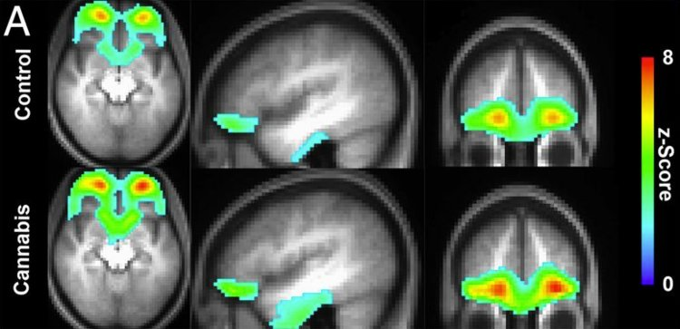
Mechanism of Action - Effect on the brain
Notes:
A PET scan of brain activity of a cannabis smoker vs non-smoker.
In the brain of the smoker, the prefrontal cortex (responsible for the reward feedback) is stimulated as well as the hippocampus which regulates emotions and form memories.

Slide 13
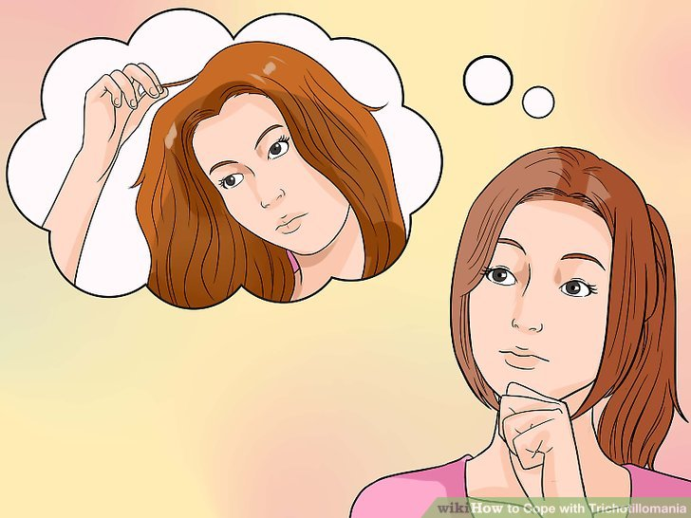
Medicinal Uses of Cannabis
Many uncontrolled and controlled studies regarding use of this substance
Uncontrolled → Treatment of Trichotillomania
Controlled Study → Crohn’s Disease
https://www.wikihow.com/Cope-with-Trichotillomania
Notes:
Many controlled and uncontrolled studies have been done in order to measure the therapeutic potential of THC on various medical conditions
Uncontrolled Study → Trichotillomania ( impulse control disorder → urge to pull out hair)
An example of an uncontrolled study was looking at the effect of THC on individuals diagnosed with trichotillomania.
Methods: 14 females (mean age of 33) diagnosed with disorder were administered anywhere between 2.5-15 mg of THC over a 12-week span
Results: This resulted in a significant reduction of hair pulling amongst all females in the study. In fact 9 of the women displayed a 35% reduction in symptoms following treatment.

Slide 14
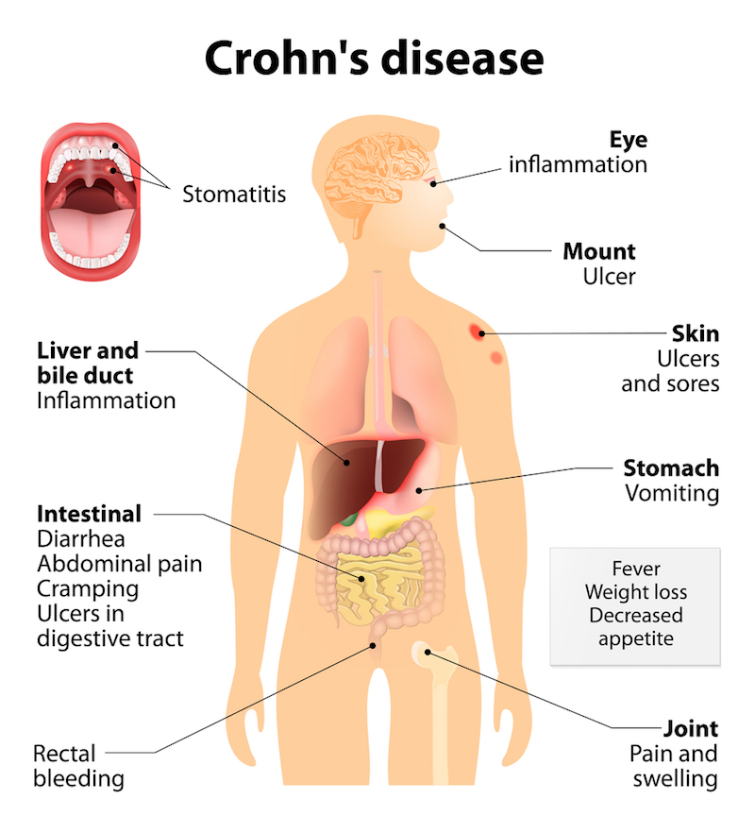
Crohn’s Disease (IBD)
This is categorized as inflammation occurring in any part of the gastrointestinal tract
Notes:
Controlled Study → Crohn’s Disease
Participants in this study are patients who previously did not respond well to other well accepted therapy strategies (steroids, immunomodulators, etc.)
One group was given cannabis cigarettes and other group was given placebo cigarettes for 8 weeks
Complete remission in 5 of 11 subjects in cannabis group and 1 of 10 in placebo group
THC-rich cannabis produced significant effects without side effects
Symptoms it relieved:
Regulating bowel movements
Inflammation (immune response)
Regulation of stomach acid
Visceral sensation (ability to perceive bodily organs)
Pain

Slide 15
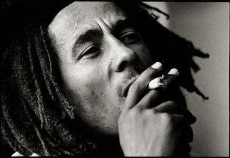
Spiritual Uses of Cannabis
Becoming closer to God
Chinese Taoism
Indian Hinduism
The Old Testament
Rastafari
https://www.thefix.com/content/bob-marley-headline-mainstream-marijuana-brand
Notes:
Chinese Taoism
Emperor Shen Nung was the father of chinese medicine and was well aware of the psychoactive properties of cannabis
His texts explained that when smoking weed for a long period of time it bettered communication skills with the spirits
Indian Hinduism
In sacred hindu texts, it is believed that cannabis is one of the 5 sacred plants
They believed marijuana was a gift from the gods, offering happiness and would help people gain liberation
The Old Testament
In this text there was a moment where there was a burning bush in which Moses heard the voice of God.
Many believe that this was a burning cannabis plant which was inspired to make anointing oil
This anointing oil was used for Jewish kings during crowning ceremonies
Rastafari
Many believe that the Tree of life mentioned in the bible is the marijuana plant and that several passages promote its use such as “thou shalt eat the herb of the field”
Rastas actually condemn the use of this substance for the sole purpose of getting high
Instead they believe it to be only used in religious ceremonies in order to enhance feelings of unity
A short prayer is often recited before the use of it

Slide 16
Recreational Uses of Cannabis
The act of intentionally altering one conscious state of mind
Legalization
Rules and regulations
Notes:
This is a short clip regarding the recent legalization of Cannabis in Canada
Recreational use is defined as the act of intentionally altering one conscious state of mind to feel happy or exhilarated
Just recently legalized in Canada under Justin Trudeau
Some Key Things to Note:
→ can grow in your household, only up to 4 plants
→ price will range anywhere from 10-12$ a gram in Ontario, this price is provincial specific
→ You can fly with up to 30 grams of weed within the country but not on international flights
→ In terms of work, this is regulated provincially (i.e in Calgary, officers are forbidden the right to use marijuana recreationally before they start working while in vancouver it is the discretion of the officers to self-evaluate whether or not they are sober enough for duty
→ In terms of driving, if 2-5 nanograms of thc is found in the blood you can face a fine of 1000$, if more than 5 nanograms are found or the use of marijuana mixed with the use of alcohol, there are larger consequences. People may be faced with up to 10 years in prison!

Slide 17
Long-term effects of Cannabis
The long-term effects of cannabis have not been studied extensively due to the substance being illegal in most countries
.
Positive | Negative
Pain management for numerous conditions | Increased risk of obtaining a lower level of education
Increase appetite, sleep aid, reduces stress/anxiety, reduces nausea | Increased risk of developing psychotic disorders
Notes:
Positive: the literature identifies use of cannabis as an effective management treatment for migraines, fibromyalgia, and irritable bowel syndrome. Furthermore, cannabis consumption can alleviate nausea in chemotherapy patients, chronic pain symptoms as well as tics and muscle spasms in patients with Multiple Sclerosis and Tourette’s syndrome.
Negative: the potential negative long-term effects that have been identified are primarily associated with early and regular consumption of cannabis in adolescents. A meta-analysis of over 6000 participants determined a correlation between early non-medicinal cannabis use in individuals under the age of 15 and an increased risk of dropping out of school and/or attaining a lower level of education
Furthermore, early heavy consumption of cannabis, in combination with other potential environmental and genetic stressors such as trauma and abuse in childhood or a predisposition to psychosis, has been associated with an increased risk of psychotic disorders such as schizophrenia

Slide 18
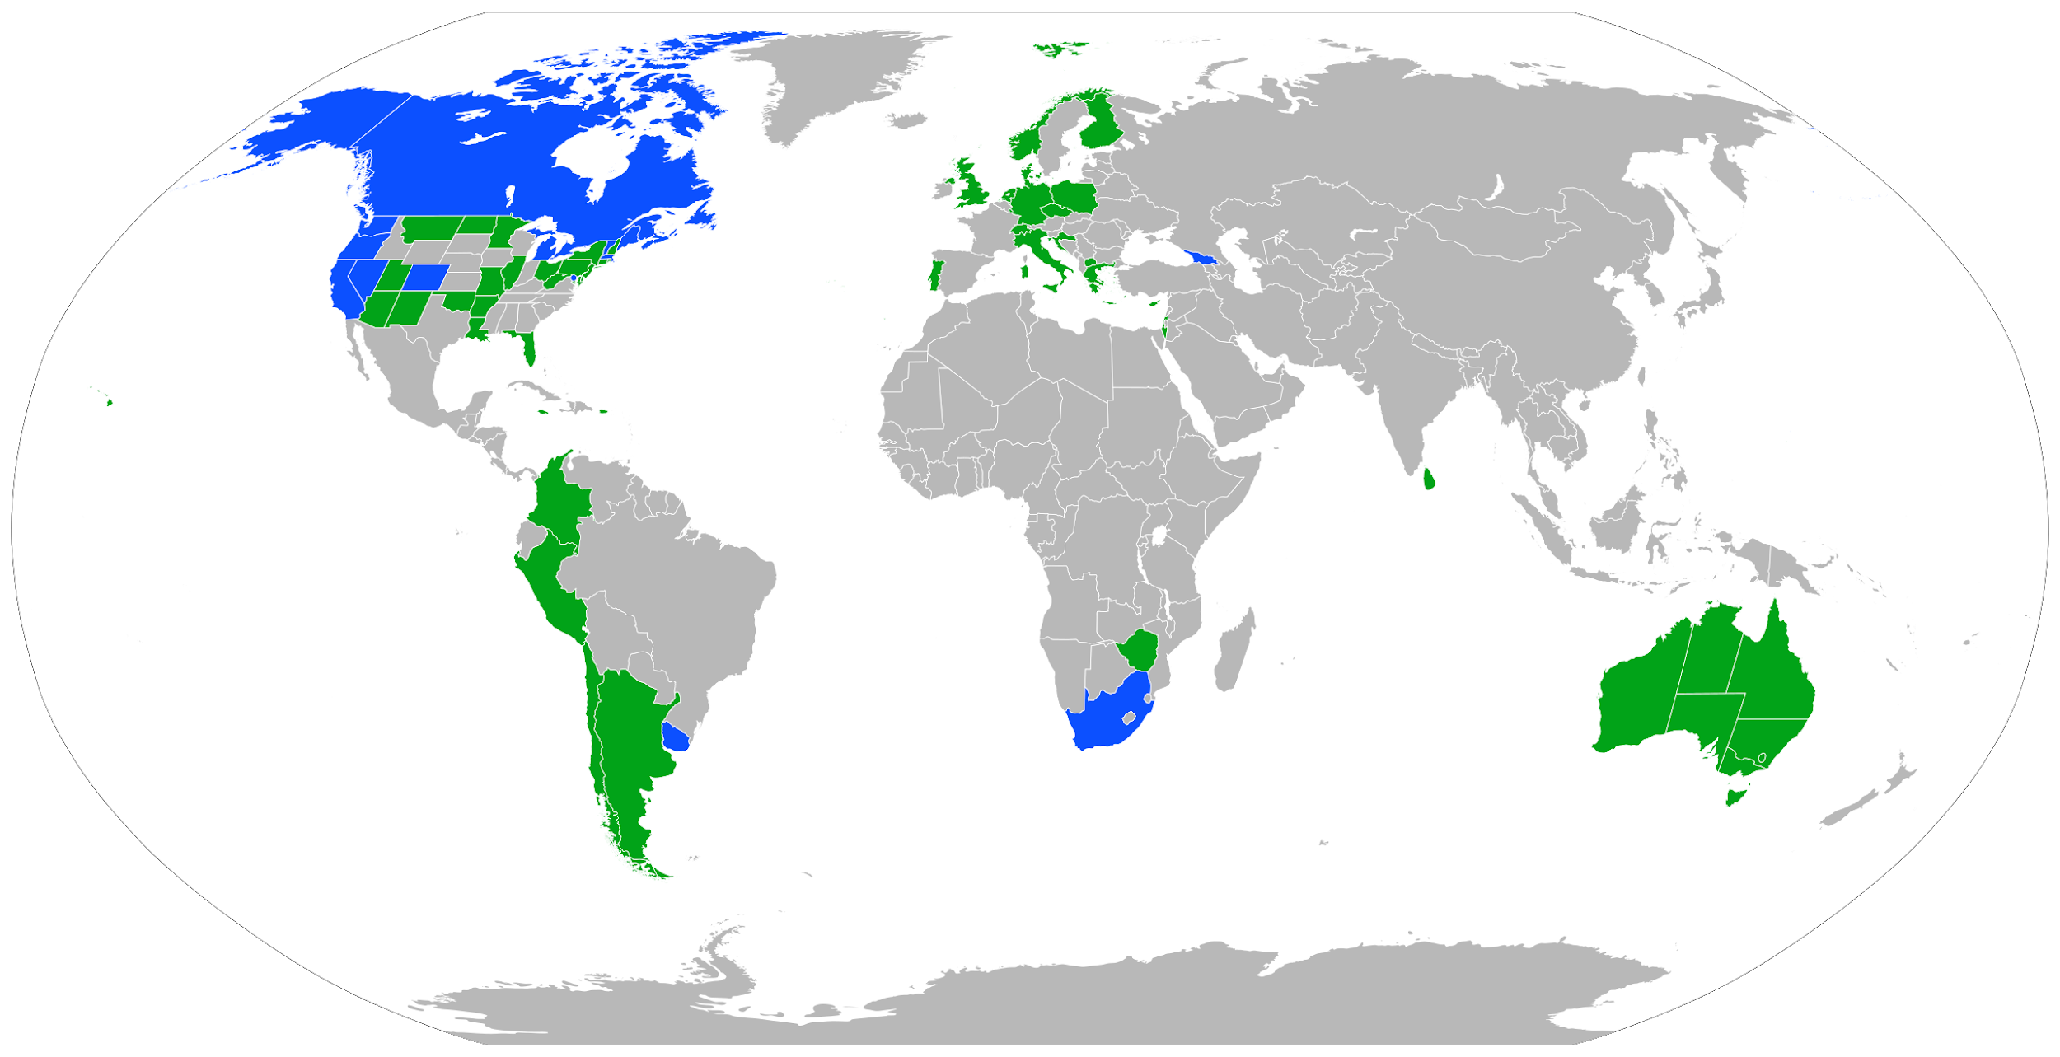
Legal Status
Legal as authorized by a physician Legal for any use (no prescription required)
Notes:
Map shows legality of cannabis around the world (mostly still illegal)
Blue → legal without any prescription ex. Canada, South Africa, Uruguay, some states
Green → Legal with prescription ex. Some states, european countries, Australia, Argentina, Chile

Slide 19
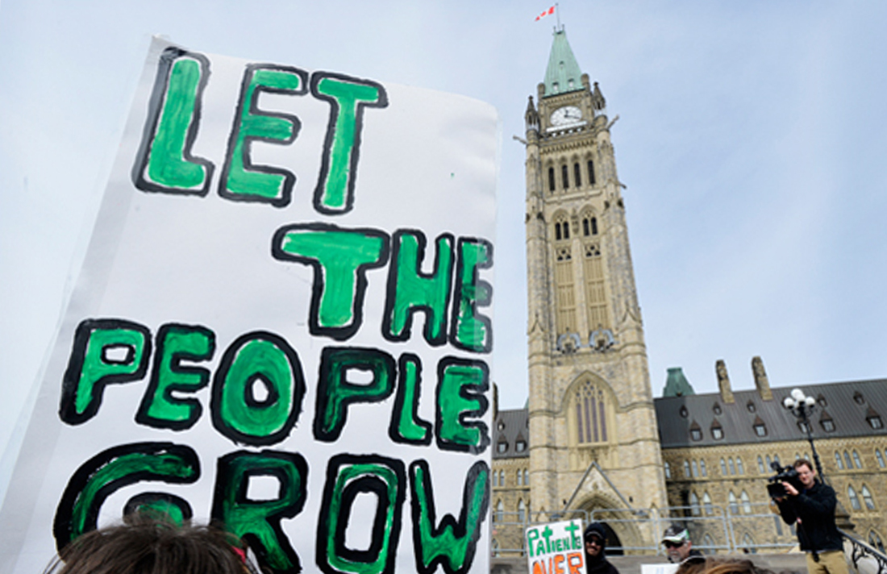
The Future of Cannabis
Increased opportunities for funding
More controlled studies
Discovering more uses for medical cannabis
Safer drugs on the market
Cultural shift in attitude
https://www.pot.tv/files/images/6/medicalmarijuanacanada_0.jpg
Notes:
Cannabis has been used for thousands of years as texts from Ancient Egypt and China illustrate the use of the cannabis plant for numerous purposes including the use of hemp seeds as sustenance and medicinal practices.
However, controlled studies on cannabis use as medicine in a clinical setting is low in prevalence.
With the legalization of cannabis in Canada, advocates of the substance hope that government regulations worldwide still become less strict regarding cannabis production, distribution and consumption. As cannabis becomes more widely accepted for medical purposes, this can lead to increased opportunities for research funding, more controlled studies, the discovery of novel uses for medical cannabis, safer drugs on the market and a cultural shift in attitude towards the substance.

Slide 20
References
Budhut. (2018). Crohn's Disease and Marijuana: Can Pot Heal Your Gut? Retrieved from https://www.budhut.net/crohns-disease-and-marijuana/
Butler, P. (2018, October 17). Legal pot is here: What you need to know | CBC News. Retrieved from https://www.cbc.ca/news/canada/marijuana-faq-legalization-need-to-know-1.4862207
Canada, H. (2018). Health effects of cannabis - Canada.ca. [online] Canada.ca. Available at: https://www.canada.ca/en/health-canada/services/drugs-medication/cannabis/health-effects/effects.html [Accessed 19 Nov. 2018].
Dufton, E. (2015). The Use of Marijuana in the Rastafari Religion. Retrieved from https://pointsadhsblog.wordpress.com/2015/06/11/the-use-of-marijuana-in-the-rastafari-religion/
Grotenhermen, F., & Müller-Vahl, K. (2016). Medicinal uses of marijuana and cannabinoids. Critical reviews in plant sciences, 35(5-6), 378-405.
Gruber, A. J., Pope, H. G., Hudson, J. I., & Yurgelun-Todd, D. (2003). Attributes of long-term heavy cannabis users: a case–control study. Psychological Medicine, 33(8), 1415-1422.
Hoch, E., Bonnet, U., Thomasius, R., Ganzer, F., Havemann-Reinecke, U., & Preuss, U. W. (2015). Risks associated with the non-medicinal use of cannabis. Deutsches Ärzteblatt International, 112(16), 271.

Slide 21
Kalvapalle, R. (2017, May 6). Weed around the world: What legal marijuana looks like in other countries. Global News. Retrieved from https://globalnews.ca/news/3378603/marijuana-laws-around-the-world/
NIDA for Teens. (2018). Drug Facts Chat Day: Marijuana. [online] Available at: https://teens.drugabuse.gov/national-drug-alcohol-facts-week/chat-with-scientists/popular-questions/marijuana [Accessed 19 Nov. 2018].
Ramirez, M. R. (2016). Potential Health Benefits of Cannabis Extracts: A Review. Journal of Chemical and Biomedical Science. Vol, 2(1), 1-8.
Smith, S. C., & Wagner, M. S. (2014). Clinical endocannabinoid deficiency (CECD) revisited. Neuroendocrinology Letters, 35(3).
Statistics Canada. (2018). Experimental Estimates of Cannabis Consumption in Canada, 1960 to 2015. [online] Available at: https://www150.statcan.gc.ca/n1/pub/11-626-x/11-626-x2017077-eng.htm [Accessed 19 Nov. 2018].
Webb, C. W., & Webb, S. M. (2014). Therapeutic benefits of cannabis: a patient survey. Hawai'i Journal of Medicine & Public Health, 73(4), 109.
World Health Organization. (2018). The health and social effects of nonmedical cannabis use. [online] Available at: http://www.who.int/substance_abuse/publications/cannabis_report/en/index5.html [Accessed 19 Nov. 2018].

