Slide 1
Global Burden of Disease: Coronary Artery Disease
Group 1: Kritika Badhan, Hannah Kearney, Muhammad Mateen, Vyshnavi Mahendran, and Wardha Wardha

Slide 2
Table of Contents
What is the Global Burden of Disease?
Overview of Coronary Artery Disease (CAD)
Epidemiology of CAD
Pathophysiology of CAD
Diagnosing CAD
Risk Factors associated with CAD
Treatment Options for CAD
Future Burden of CAD

Slide 3
What is the Global Burden of Disease?
Notes:
The global burden of disease measures the burden of a specific disease using the disability-adjusted-life-year (DALY) measurement. Coronary artery disease is the leading cause of mortality burden, morbidity and loss of quality of life.

Slide 4
Coronary Artery Disease (CAD)

Slide 5
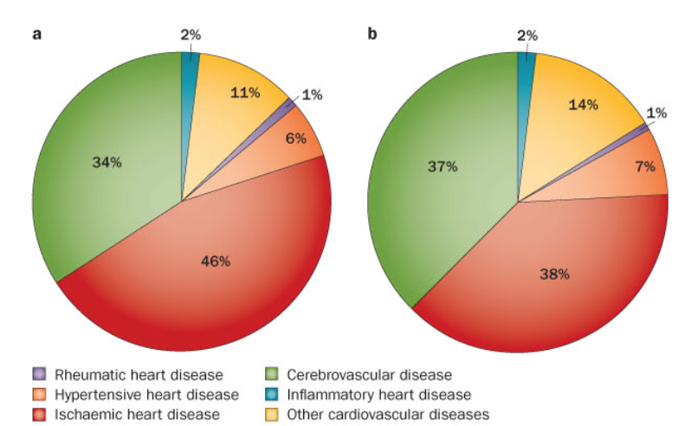
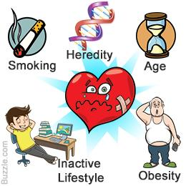
Overview
Ischemic Heart Disease has the largest global burden of disease
Also known as Coronary Artery Disease (CAD)
Symptoms: Angina, shortness of breath, heart attack
Risk Factors: High cholesterol, high blood pressure, high blood sugar, genetics, and obesity
Treatments: Lifestyle modifications, medications, and surgery
Retrieved from: http://www.nature.com/nrcardio/journal/v11/n5/full/nrcardio.2014.26.html, http://www.buzzle.com/articles/heart-disease-risk-factors.html

Slide 6
Epidemiology
Notes:
CAD is a major cause of death and disability in developed nations and is on the rise in developing nations.

Slide 7
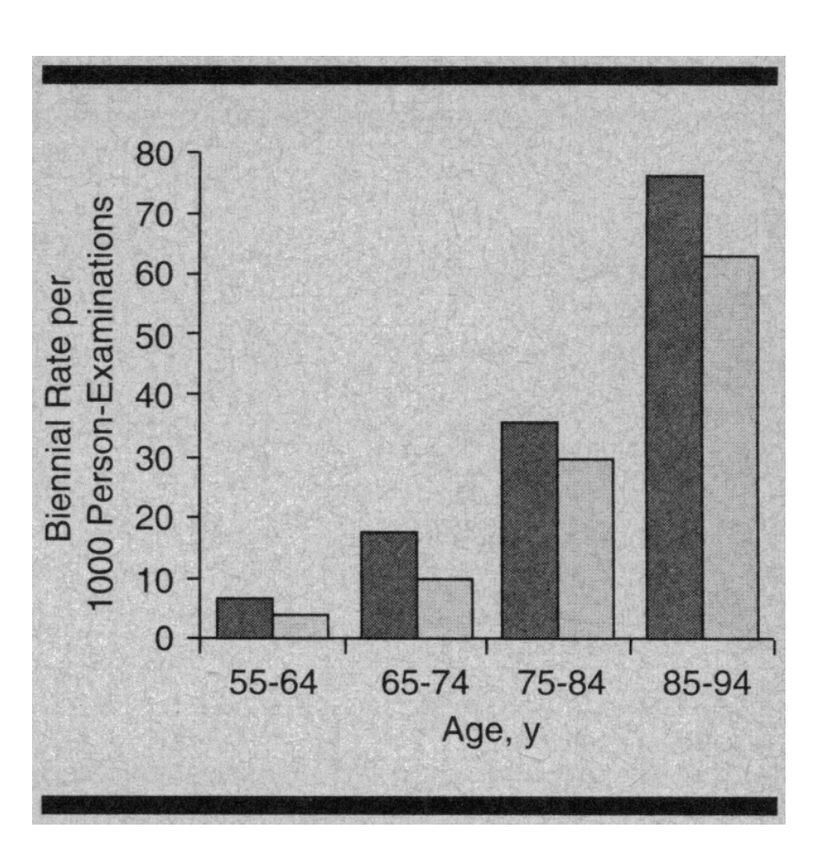
Framingham Heart Study
A comprehensive population-based cohort study done in the USA
Goal: Determine risk factors that contribute to CAD
Follow up study found for total coronary events, incidence rose steeply with age with women behind men by approximately 10 years
(Benjamin et al, 1994)
Notes:
An ongoing population-based cardiovascular cohort study conducted to assess the independent risk factors for atrial fibrillation. The study included thousands of men and women who had no symptoms of atrial fibrillation. One of the main goals was to determine the multiple risk factors which would contribute to atrial fibrillation
The study concluded that elderly men have a 1.5 times more chance of developing atrial fibrillation, which would contribute to further cardiovascular disease than women. This can be observed in the graph to the right with women indicate in lighter bars and men indicated in darker bars.

Slide 8
Prevalence and Mortality Rate
The 2016 Heart Disease and Stroke Statistics update of the American Heart Association reported that 15.5 million people over 20 years of age in the USA have CAD
(Sanchis-Gomar et al., 2016)
Retrieved from: http://atm.amegroups.com/article/view/10896/11530
Notes:
The 2016 Heart Disease and Stroke Statistics update of the American Heart Association reported that 15.5 million people over 20 years of age in the USA have CAD, with the prevalence increasing with age for both sexes.
Graph A indicates the prevalence of CHD and myocardial infarction (MI) and graph B indicates mortality rate in both sexes. The results indicate that while the prevalence increase for both sexes, men have been shown to have higher prevalence and mortality rate. Statistical studied states that approximately every 42 seconds, an american will experience a heart attack.

Slide 9
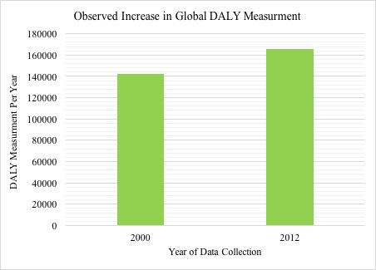
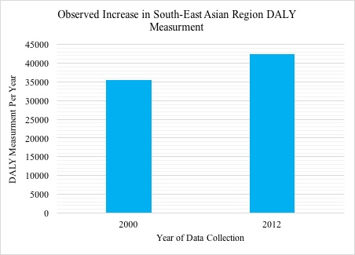
Global and Regional DALY
The World Health Organization released estimates of the global and regional burden of disease, which included 20 leading causes.
(World Health Organization, n.d.)
Notes:
The data was collected for 2000 and 2012, with a reported increase in DALY being observed both globally and in regions such as Southeast Asia, the Eastern Mediterranean and the western pacific region. The global rank of ischemic heart disease increased from being the third leading cause of death in 2000 to the first leading cause of death in 2012.

Slide 10
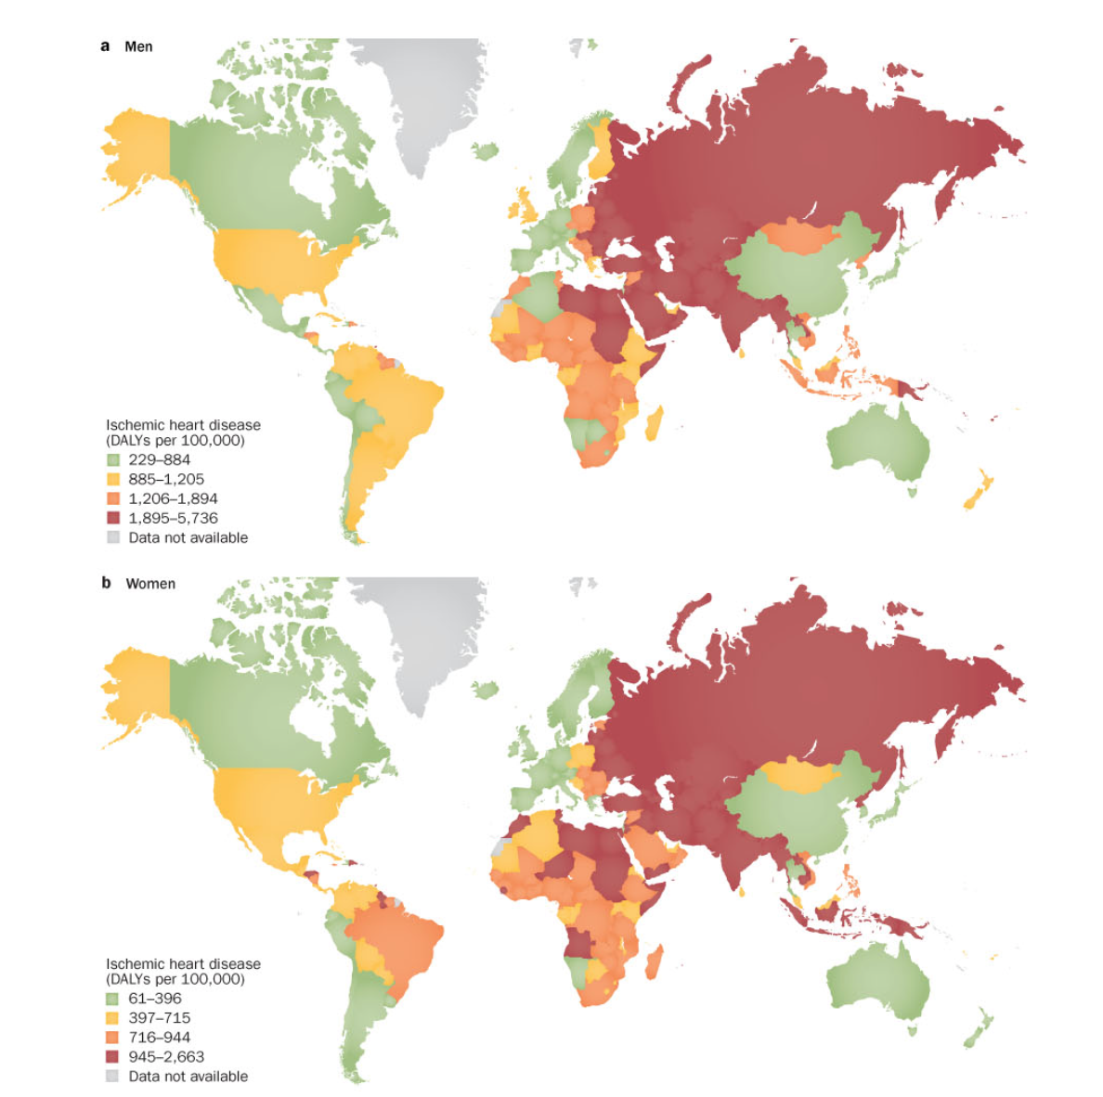
Shift in Global Burden
The bulk of the global burden of disease is shifting towards developing nations
(Wong, 2014)
Retrieved from: http://www.nature.com/nrcardio/journal/v11/n5/full/nrcardio.2014.26.html
Notes:
The global map indicates the DALYs per 100,000 individuals for CAD in men and women. As can be seen, the darker shading observed in Africa, the middle east and Russia is consistent with the current observations (shifting to developing nations). This will be discussed detail further on in the presentation. (Top is men, bottom is women)

Slide 11
Pathophysiology

Slide 12
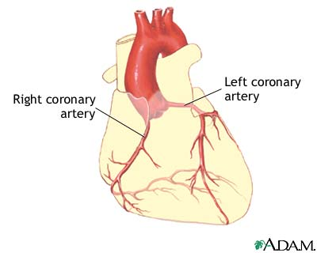
Coronary Artery Anatomy
Branch off of the Aorta
Supply blood to heart muscle
Hollow tubes
Muscular walls
Lined with epithelium
(Libby & Theroux, 2005), (Cleveland Clinic, 2017)
Retrieved from: https://medlineplus.gov/ency/images/ency/fullsize/19001.jpg
Notes:
Go over what is on slide, just introducing to idea of coronary artery

Slide 13
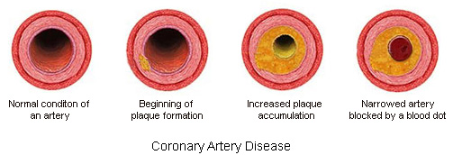
Atherosclerosis
Defined as the narrowing and hardening of vessels as plaque accumulates
Plaque = cellular debris, cholesterol, fat, waste, fibrin (clotting compound)
Retrieved from: https://medlineplus.gov/ency/images/ency/fullsize/19001.jpg, http://www.montcopa.org/ImageRepository/Document?documentID=12042, http://bme240.eng.uci.edu/students/07s/dkim/Coronary%20Artery%20Disease_files/droppedImage_4.jpg
(Libby & Theroux, 2005), (Cleveland Clinic, 2017)
Notes:
Main cause of CAD
2 causes of CAD
Chronic = slow narrowing over time and blood supply is slowly limited
Acute = clot breaks off and fully occludes artery
As an individual ages, cellular debris begins to stick to the vessel walls
Right image-- would be acute if breaks off

Slide 14
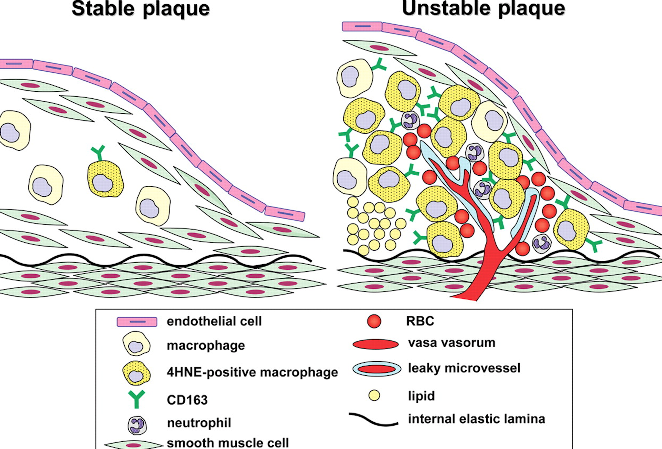
Atherosclerotic Lesions
Lesions enlarge into plaques
Plaques can be destabilized and cause ischemic events
Ischemic = blood flow to the heart is not adequate due to the narrowing or blockage of the coronary arteries
(Fuster et al., 1992)
Retrieved from: https://d1vzuwdl7rxiz0.cloudfront.net/content/ehj/30/15/1844/F6.large.jpg
Notes:
In individuals with coronary risk factors, lesions can rapidly enlarge into plaques
Having macrophages and lipids and neutrophils etc. can become activated and then destabilize the lesions from the inside out
Causes irritation of the endothelium, and can cause disruption in arterial function (artery contracts inappropriately and narrows artery even more)

Slide 15
Destabilizing Plaques
Lipid Rich Plaques
Small and soft because of high cholesterol and ester content
Changes in shear force can induce tearing
Macrophages
Enhance transport of cholesterol, release mitogenic factor that increases smooth-muscle cell proliferation, and release proteases which break down proteins
Vessel Wall Stress
Plaques that partially obstruct vessels change blood flow patterns can increase shear force
Bending and twisting of the artery during contractions
(Fuster et al., 1992)
Notes:
3 ways that an ischemic event can be induced
Lipid Rich Plaques - crescent-shape mass of lipids, sudden change in force can cause tearing
Macrophages - destabilize from the inside and also release proteases, which can digest extracellular matrix and release plaque
Vessel Wall Stress - basically what I have up there, plaques under tensile stress can rupture due to lack of collagen support
(Usually a combination of the three)
** I know I have a lot of writing on the slide but I don’t want to leave whoever is presenting without stuff to go off of especially bc this isn’t really common knowledge

Slide 16
Acute Conditions
Chest Pain (Angina)
Shortness of Breath
Heart Attack (Myocardial Infarction)
(Mayo Clinic Staff, 2015)
Notes:
Ischemic events most often translate into these 3 acute conditions
When plaques destabilize, the thrombus (clot) could either disintegrate into smaller components and restore normal patterns or they will block blood supply causing coronary occlusion

Slide 17
Symptoms
Shortness of Breath
If blood flow is obstructed or reduced, the heart is unable to pump enough blood to meet the needs of the body
Extreme fatigue
Myocardial Infarction
Occurs when coronary artery completely blocked
Crushing or squeezing pain in chest, pain in shoulder or arm
Angina
Tightness or pressure in the chest, typically the left side or center
Typically induced by stress, will subside within minutes of reducing exertion
(Mayo Clinic Staff, 2015)
Notes:
Basically just say what is on slide, women feel different symptoms than men
For Angina → women feel pain in neck, arm or back
MI → feel pain in neck or jaw
Also mention that these symptoms don’t all need to be present/some people may not experience any symptoms for heart attacks
Other symptoms can include sweating, nausea, denial,

Slide 18
Diagnosing CAD

Slide 19
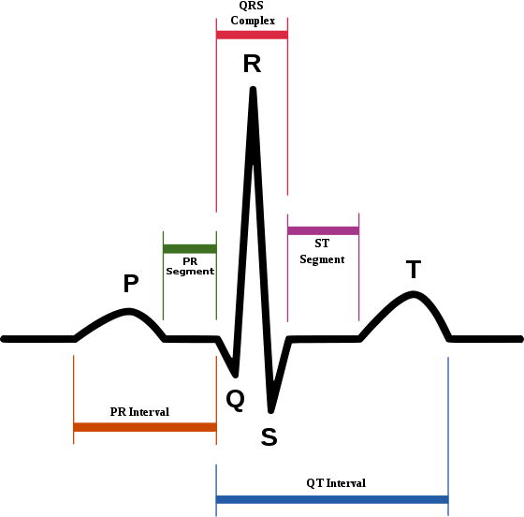
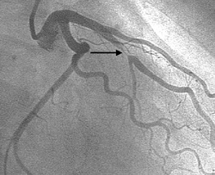
Diagnostic Tests
Electrocardiogram (ECG)
Echocardiogram
Exercise Stress Test
Coronary Angiogram (Gold Standard)
These tests are typically done in conjunction
(Bogle, n.d.) & (Mayo Clinic, n.d.)
Retrieved from:http://www.richardbogle.com/coronary-angiography.html, http://upload.wikimedia.org/wikipedia/commons/thumb/9/9e/SinusRhythmLabels.svg/560px-SinusRhythmLabels.svg.png
Notes:
Typically, if a patient displays symptoms (shortness of breath, angina, etc) they would be referred to do one of these diagnostic tests to determine the presence of CAD.
ECG, and Echos are both non-invasive techniques and simply image the heart at rest. If a patient displays symptoms during exercise, an exercise stress test may be ordered. All of these tests can determine if a patient has CAD but typically more testing needs to be done to be absolutely sure.
If either one of these tests is positive, a patient is referred for an Coronary Angiogram which is considered the GOLD STANDARD for diagnosing CAD.
In these photos, you can see that ECGs measure the electrical current of the heart (PQRST wave), and in the bottom you can see an coronary angiogram clearly detecting a severely restricted coronary artery.
(bottom picture is coronary angiogram)

Slide 20
Risk Factors

Slide 21
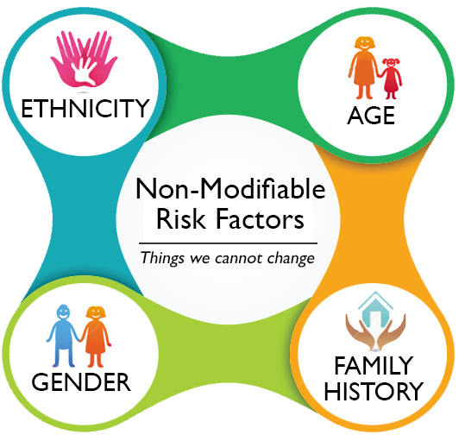
Non-Modifiable Risk Factors
Age
Sex
Genetics (Ethnicity)
These risk factors cannot be changed
(Coronary Artery Disease Risk Factors, 2016)
Retrieved from: http://www.sansar.org/uploads/content/4%20way%20cropped.jpg
Notes:
Inherent

Slide 22
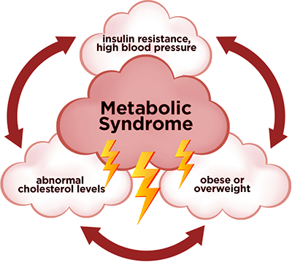
Physiological Risk Factors
High Cholesterol
High Blood Pressure
High Blood Sugar (Diabetes)
These risk factors can be
changed
(Coronary Artery Disease Risk Factors, 2016)
Retrieved from: http://drarien.co.za/wp-content/uploads/2014/06/Metabolic-Syndrome.png
Notes:
Modifiable - you can alter this, treat by medication etc.
The more risk factors you have, the higher your chance of developing CAD.
The combination of different factors is known as Metabolic Syndrome which can significantly increase your risk of developing CAD.

Slide 23
Lifestyle Factors
Lack of physical activity
Poor nutrition
These factors are extremely difficult to change and maintain for a long period of time
(Coronary Artery Disease Risk Factors, 2016)
Retrieved from:
http://1.bp.blogspot.com/-bJ4CdG_1brg/VkOxaNNMUiI/AAAAAAAAAjA/Riifqs1QmCI/s1600/healthy-lifestyle-diet-fitness-heart-sign-vector-shape-multiple-icons-depicting-various-sports-vegetables-44829978.jpg

Slide 24
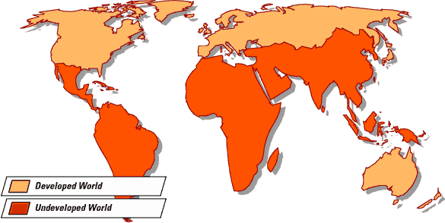
Healthcare Factors
Access to healthcare
Healthcare systems are reactionary
These factors further perpetuate the burden of disease in developing nations
(World Health Organization, n.d.)
Retrieved from: http://www.understandglobalization.com/wp-content/uploads/2013/05/economic-development-map.gif
Notes:
Healthcare systems around the world are reactionary in nature and tend to treat diseases only when the patient manifests symptoms rather than preventing the disease in the first place.
This approach to healthcare is especially problematic for chronic diseases such as CAD for which there appears to be no immediate cure but rather the only plausible medical solution is to manage the current conditions to not allow any advancement in the disease.
Unfortunately, this approach to disease is extremely expensive, and thus simply impractical for many living in developing nations.

Slide 25
Treatments

Slide 26
Treatment Options
Retrieved from: http://www.clipartpanda.com/categories/medication-clipart,
http://search.coolclips.com/m/vector/vc065197/doctors-in-surgery/,
http://www.clipartbest.com/clipart-dTrodpMpc
Notes:
CAD can be treated through pharmacological options (medications), medical procedures and lifestyle modifications.

Slide 27
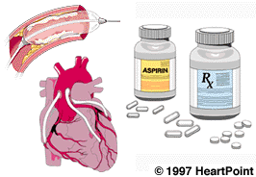
Pharmacological Options (Medication)
Beta blockers
Nitrates
Angiotensin converting enzyme (ACE)
Antiplatelets
Aspirin (Acetylsalicylic acid, ASA)
Retrieved from http://www.heartpoint.com/treatcoronaryartdis.html
(Brugts et al.,2012), (Hennekens,Dyken & Fuster, 1997)
Notes:
There are numerous medications available that are used to lower blood pressure and prevent blood clots from forming which ultimately reduces your chances of mortality from CAD. These medications include: beta blockers, nitrates, angiotensin converting enzyme (ACE) inhibitors, and antiplatelets.
Beta blockers are known to slow down the heartbeat and improve blood flow.
Nitrates are often used to widen blood vessels and control angina symptoms.
ACE are known to reduce the production of angiotensin, a chemical that causes arteries to narrow, and so are commonly used to lower blood pressure.
Antiplatelets such as aspirin are known to prevent formation of blood clots.

Slide 28
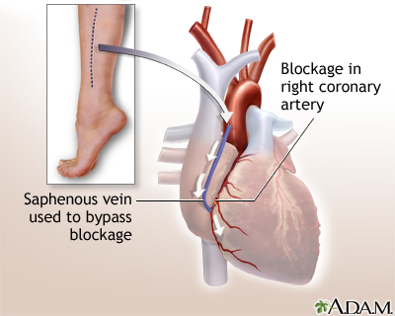
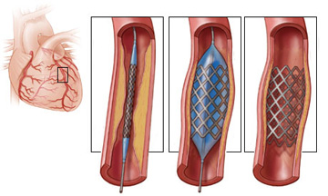
Medical Procedures and Surgery
Coronary Artery Bypass Graft Surgery (CABG)
Percutaneous Coronary Intervention (PCI)
Image retrieved from: http://umm.edu/health/medical/ency/presentations/heart-bypass-surgery-series
Image Retrieved from: http://www.premierheartcarett.com/coronary-angioplasty-pci/
(Llyod-Jones et al., 2010), (National Heart, Lung, and Blood Institute, 2016),
Notes:
Coronary Artery bypass graft surgery (CABG) is the most common type of heart surgery and is performed to improve blood flow into the heart. This surgery is performed by connecting a healthy artery or vein from another part of your body such as from the leg, chest, or arm to the blocked coronary artery. The healthy artery or vein bypasses the blocked or narrowed part of the artery, thus providing a new pathway for oxygen-rich blood to flow to the heart.
In the image shown, the surgery was performed using the saphenous vein from the leg, to bypass blockage in the right coronary artery.
Unlike the bypass surgery, the percutaneous coronary intervention (PCI) is a non-surgical procedure. It is often performed to widen blocked arteries often caused by atherosclerosis or “hardening of the arteries”. The procedure requires cardiac catheterization which involves the insertion of a hollow tube (catheter) with a small inflatable balloon at its tip, along with a stent. The stent then remains holding the artery open, as you can see in the image.

Slide 29
Lifestyle Modifications
Nutrition
Reducing cholesterol levels
Eating healthy fats
Quitting smoking
Limiting alcohol consumption
Regular physical activity
(Erbs,Linke & Hambrecht, 2006), (Jolliffe et al., 2001).
Retrieved from: https://fisyasam.wordpress.com/2014/04/15/powerhouse-benefits-of-avocado/
Notes:
Lifestyle modifications are important for preventing and treating CAD.
Some of the lifestyle modifications include nutrition,
This requires that you avoid eating food that raise your blood cholesterol levels ( so red meat and sugar foods) and consuming more sources of monounsaturated and polyunsaturated fats to help lower your cholesterol levels. Some examples include avocados, nuts ,tofu, etc.
It is also important that you limit the amount of alcohol you consume and quit smoking, as they can increase your risks of developing CAD.
Regular physical activity have been shown to improve symptoms and reduce mortality in patients with CAD.

Slide 30
Future Global Burden

Slide 31
Future Burden
Global burden expected to increase in developing countries
Large population
Low education level
Poor healthcare facilities
Developing countries accounted for 57% of total deaths due to CAD in 1990
Expected to increase to 70% by 2020
(Murray and Lopez, 1996)
Notes:
-The global burden of CAD is expected to increase, especially in developing countries due to a large population, low education level and poor healthcare facilities.
-According to the Global Burden of Disease Study, developing countries accounted for 57% of the total deaths due to CAD in 1990 and this percentage is expected to increase to 70% by 2020.

Slide 32
Multiple Choice
Which of the following is not a non-modifiable risk factor?
Nutrition
Age
Ethnicity
Sex
Family History
Which of the following are acute ischemic conditions?
Angina
Heart Attack
Shortness of Breath
A & B only
All of the Above

Slide 33
Multiple Choice
Which of the following is not a non-modifiable risk factor?
Nutrition (##)
Age
Ethnicity
Sex
Family History
Which of the following are acute ischemic conditions?
Angina
Heart Attack
Shortness of Breath
A & B only
All of the Above (##)

Slide 34
Questions?

Slide 35
References
Benjamin, E. J., Levy, D., Vaziri, S. M., D'Agostino, R. B., Belanger, A. J., & Wolf, P. A. (1994). Independent risk factors for atrial fibrillation in a population-based cohort: the Framingham Heart Study. Jama, 271(11), 840-844.
Bogle, Richard. (n.d.). Coronary Angiography. Retrieved from: http://www.richardbogle.com/coronary-angiography.html
Brugts, J. J., de Maat, M. P. M., Danser, A. H. J., Boersma, E., & Simoons, M. L. (2012). Individualised therapy of angiotensin converting enzyme (ACE) inhibitors in stable coronary artery disease: overview of the primary results of the PERindopril GENEtic association (PERGENE) study. Netherlands Heart Journal, 20(1), 24-32. doi:10.1007/s12471-011-0173-6
Cleveland Clinic (2017). Coronary Artery Disease. Retrieved January 15, 2017 from http://my.clevelandclinic.org/health/articles/coronary-artery-disease.
Coronary Artery Disease Risk Factors. (2016). National Heart, Lung, and Blood Institute. Retrieved from: https://www.nhlbi.nih.gov/health/health-topics/topics/hd
Eckel, R. H., & Krauss, R. M. (1998). American Heart Association Call to Action: Obesity as a Major Risk Factor for Coronary Heart Disease. Circulation, 97(21), 2099–2100. http://doi.org/10.1161/01.CIR.97.21.2099
Erbs, S., Linke, A., & Hambrecht, R. (2006). Effects of exercise training on mortality in patients with coronary heart disease. Coronary artery disease, 17(3), 219-225.
Fuster, V., Badimon, L., Badimon, J. J., & Chesebro, J. H. (1992). The pathogenesis of coronary artery disease and the acute coronary syndromes. New England journal of medicine, 326(4), 242-250.
Hennekens, C. H., Dyken, M. L., & Fuster, V. (1997). Aspirin as a Therapeutic Agent in Cardiovascular Disease A Statement for Healthcare Professionals From the American Heart Association. Circulation, 96(8), 2751-2753.
Jolliffe, J., Rees, K., Taylor, R. R., Thompson, D. R., Oldridge, N., & Ebrahim, S. (2001). Exercise‐based rehabilitation for coronary heart disease. The Cochrane Library. doi: 10.1002/14651858.CD001800.
Libby, P., & Theroux, P. (2005). Pathophysiology of coronary artery disease. Circulation, 111(25), 3481-3488.
Lloyd-Jones, D., Adams, R. J., Brown, T. M., Carnethon, M., Dai, S., De Simone, G., ... & Go, A. (2010). Heart disease and stroke statistics—2010 update. Circulation, 121(7), e46-e215.

Slide 36
References (2)
Mathers CD, Loncar D. Projections of global mortality and burden of disease from 2002 to 2030. PLoS Med. 2006 Nov;3:e442.
Mayo Clinic Staff (2015). Coronary artery disease. Retrieved January 15, 2016 from http://www.mayoclinic.org/diseases-conditions/coronary-artery-disease/symptoms-causes/dxc-20165314
Mayo Clinic. (n.d.). Coronary Artery Disease: Diagnosis. Retrieved from: http://www.mayoclinic.org/diseases-conditions/coronary-artery-disease/diagnosis-treatment/diagnosis/dxc-20165331
Murray CJL, Lopez AD. The Global Burden of Disease: A Comprehensive Assessment of Mortality and Disability from Disease, Injuries and Risk Factors in 1990 and Projected to 2020. Boston, Ma: Harvard University Press; 1996.
National Heart, Lung, and Blood Institute.(2016). How is Coronary Heart Disease Treated ?. Retrieved January 13,2017 from https://www.nhlbi.nih.gov/health/health-topics/topics/cad/treatment#HeartHealthyEating
National Heart, Lung, and Blood Institute.(2016). Percutaneous Coronary intervention.Retrieved January,13, 2017 from: https://www.nhlbi.nih.gov/health/health-topics/topics/angioplasty
Premier Heart Care TT. (n.d.). Coronary Angioplasty (PCI).Retrieved January 18 2017 from http://www.premierheartcarett.com/coronary-angioplasty-pci/
Sanchis-Gomar, F., Perez-Quilis, C., Leischik, R., & Lucia, A. (2016). Epidemiology of coronary heart disease and acute coronary syndrome. Annals of Translational Medicine, 4(13).
University of Maryland Medical Center. (2017). Heart Bypass surgery-series. Retrieved January 18 2017 from http://umm.edu/health/medical/ency/presentations/heart-bypass-surgery-series
Wong, N. D. (2014). Epidemiological studies of CHD and the evolution of preventive cardiology. Nature reviews. Cardiology, 11(5), 276.
Wing, R. R., & Phelan, S. (2005). Long-term weight loss maintenance. The American Journal of Clinical Nutrition. http://doi.org/82/1/222S [pii]
World Health Organization. (n.d.). Estimates for 2000-2012: Disease Burden. Retrieved from: http://www.who.int/healthinfo/global_burden_disease/estimates/en/index2.html
World Health Organization (n.d.). 50 Facts: Global health situation and trends 1955-2025. Retrieved from: http://www.who.int/whr/1998/media_centre/50facts/en/

