Slide 1
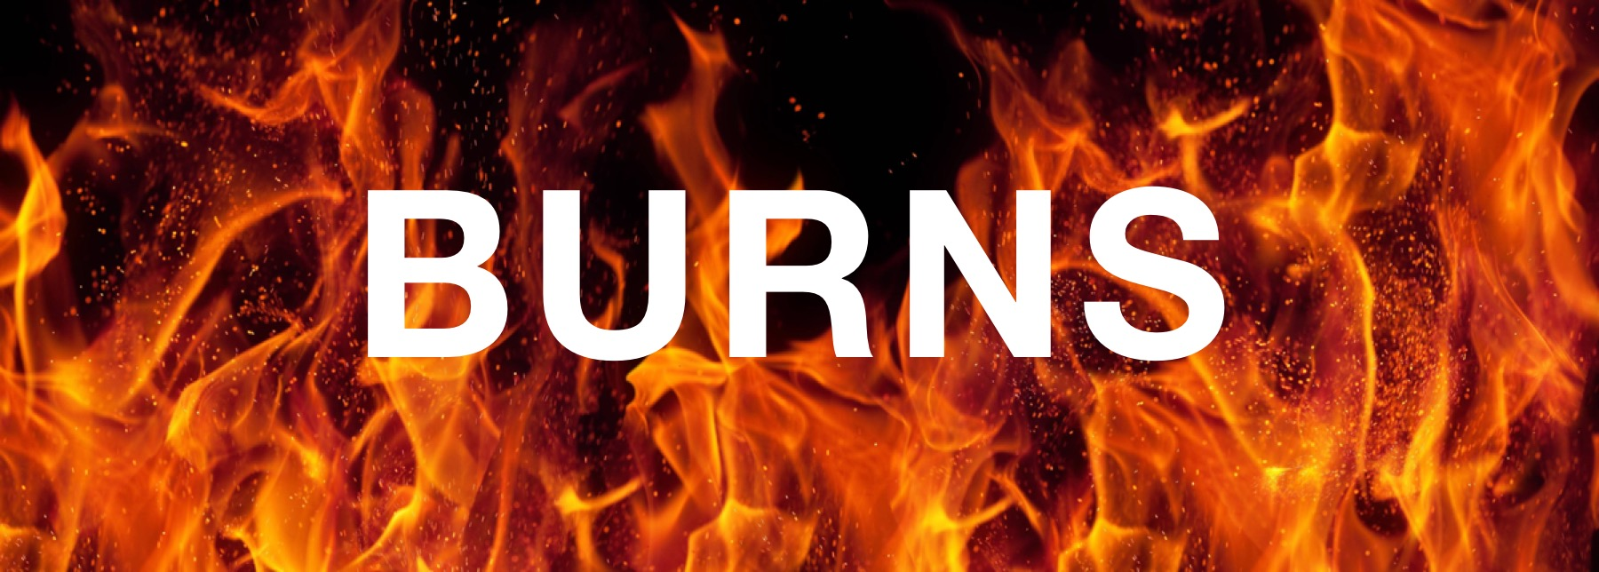
Created by: Anna, Melanie, Rebecca, Josh & Julia
Notes:
Anna

Slide 2
Disclaimer
Images may be sensitive to some viewers.
Notes:
Anna

Slide 3
Objectives
1.
2.
Introduction
Introduction to burns and associated risk factors
Classification
Discussion of the types of burns and their clinical manifestation
3.
4.
Mechanism
In-depth look into the pathophysiology of burns
Treatment
Examining treatment options available for burn patients
Notes:
Anna

Slide 4
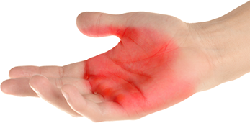
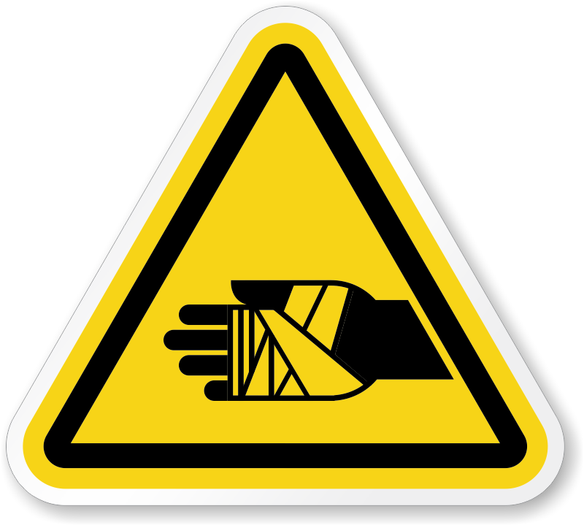
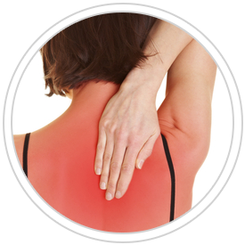
What are burns?
Severe skin damage: necrotic cells
Many sources of injury
Degrees of burns
Notes:
Julia
Not just named for the burning skin sensation characterized by injury, but severe skin damage that causes affected skin tissue cells to die - referred to as necrosis
Many sources: heat, chemicals, electricity, radiation
Most burns are recoverable without serious health consequences, some severe burns require immediate medical attention to prevent further injury/complication
3 main categories of burns - the degrees/types of burns are not based on the cause of the burn, but are based on the severity of the tissue cell death, and the length of exposure to the source causing the burn

Slide 5
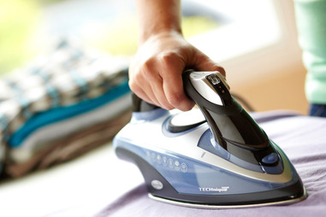
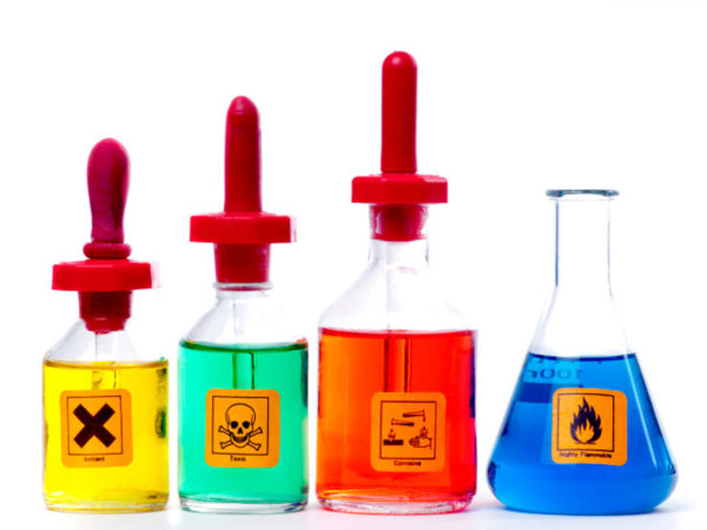
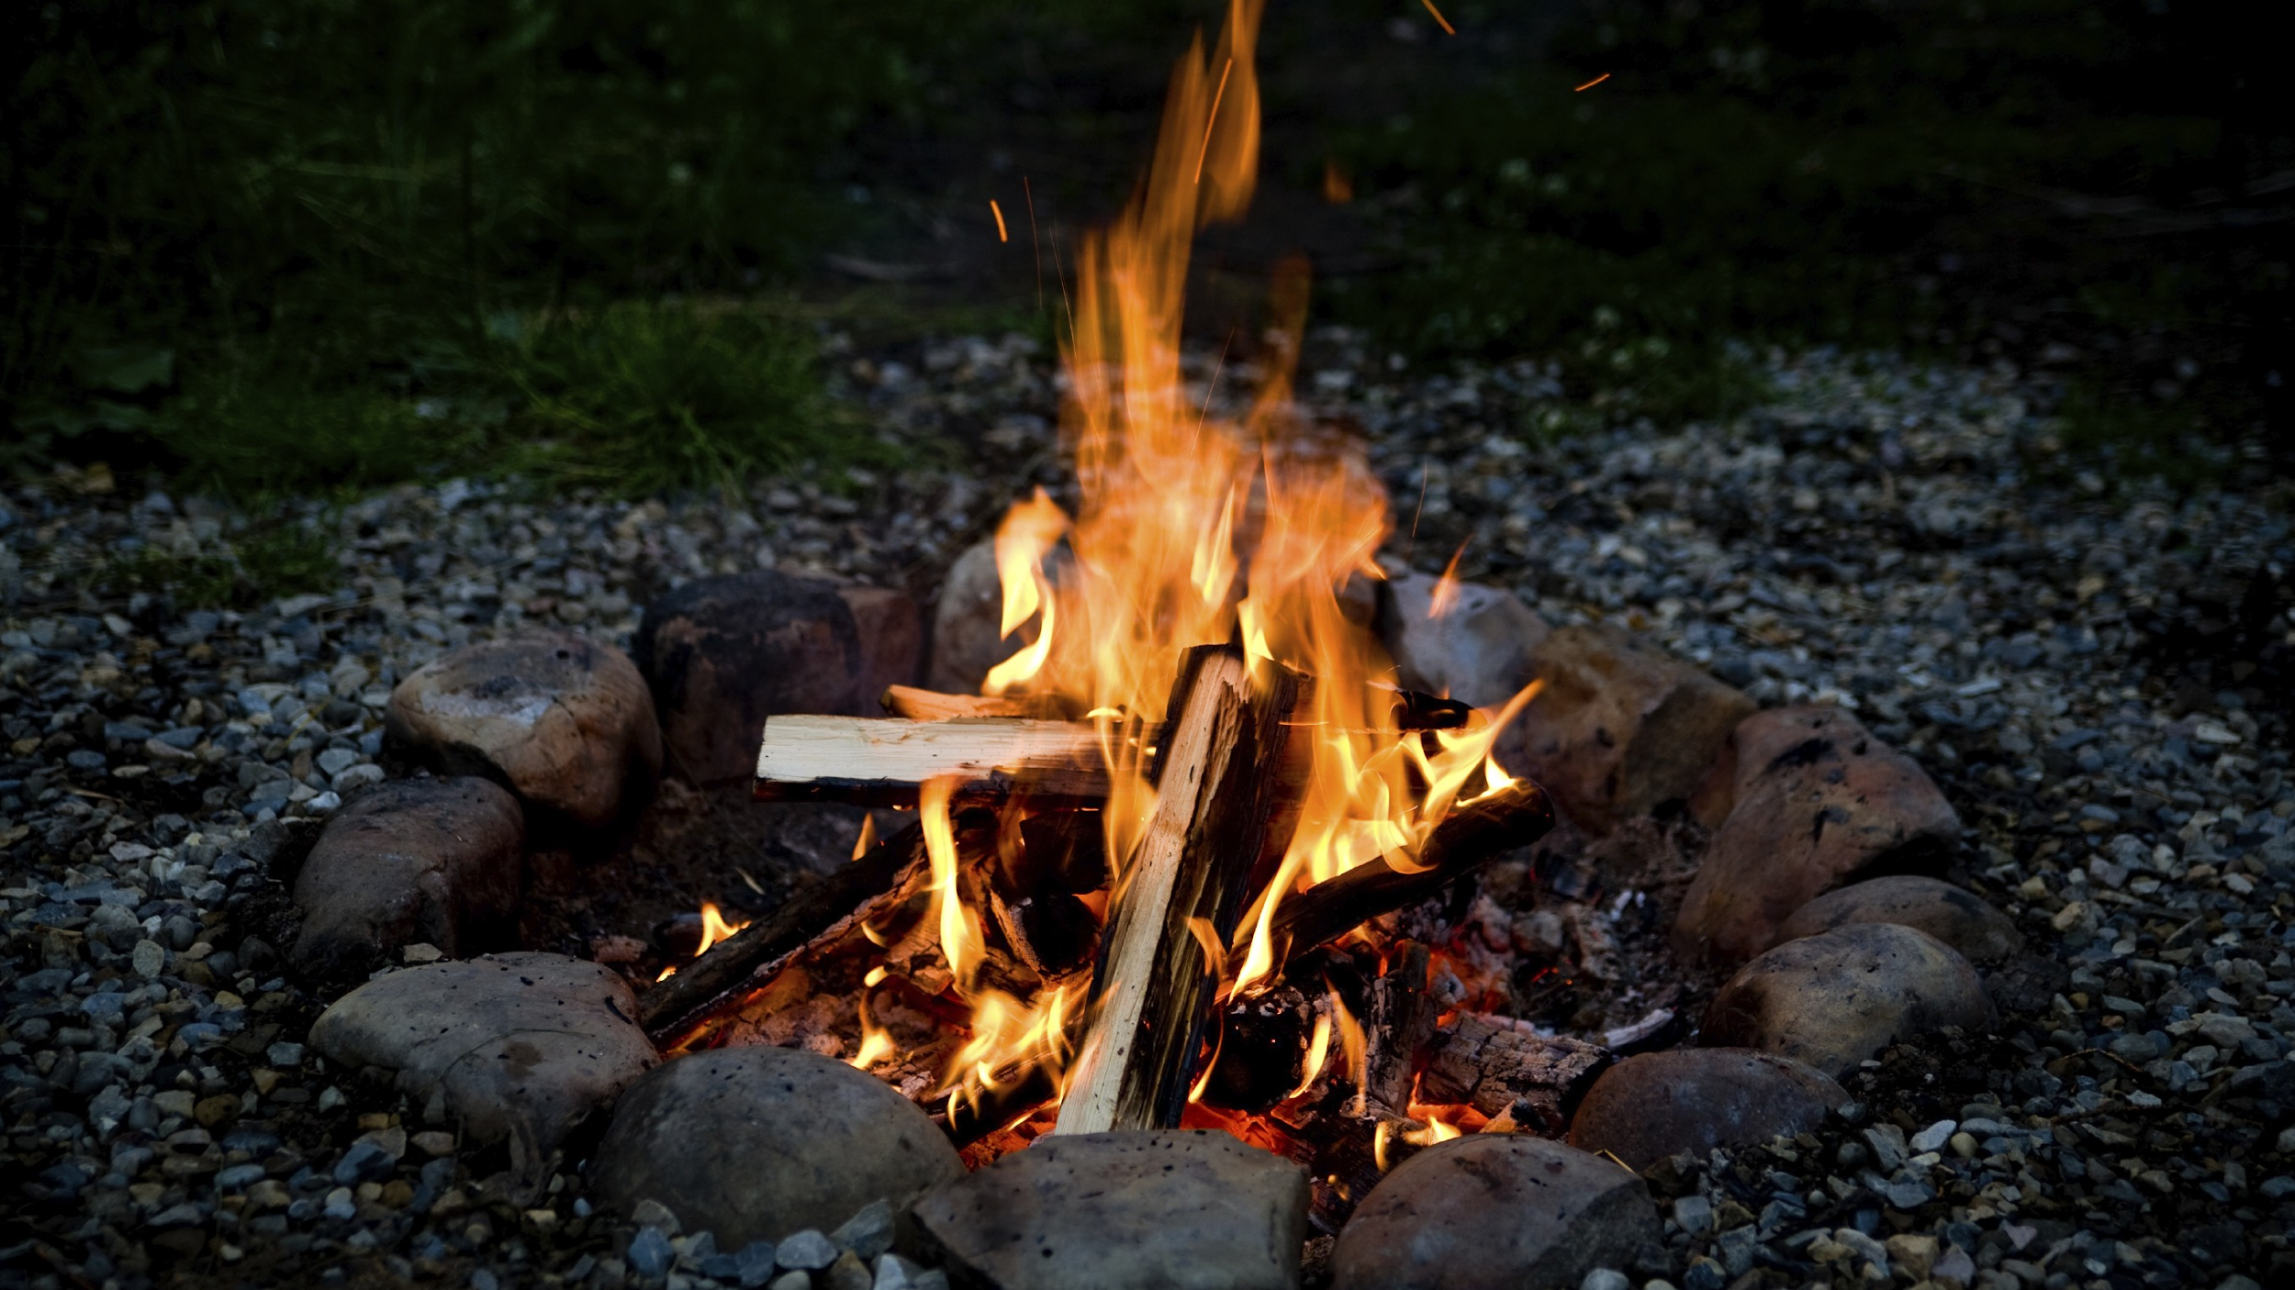
How are burns acquired?
Causes of Burns:
Heat
Radiation
Electricity
Chemicals
Forms of Heat:
Liquids
Solids
Flames
Notes:
Anna
Chemical burn - irritant - acid or a base
Bring up examples as you go
ex.flames - campfire
Ex. Radiation - sun
Ex. electricity - shock from outlet
A burn is acquired through contact with something that releases heat on the skin or other organs. Burn injuries often occur either in the home or at work and are the cause of the most non-life threatening morbidities to the body. Unlike uncontrollable life threatening injuries burns can be easily preventable through proper protection, knowledge and training. Knowing the forms and causes of heat you can potentially be exposed to is very important to limit the amount of burns people acquire.

Slide 6
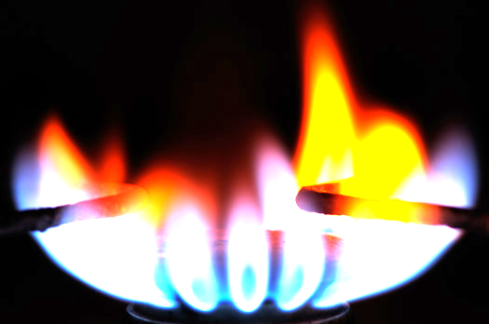
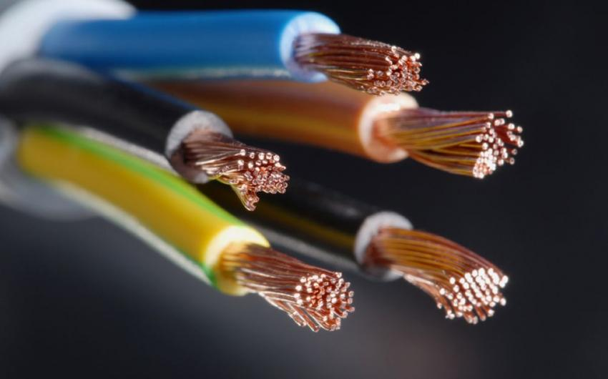
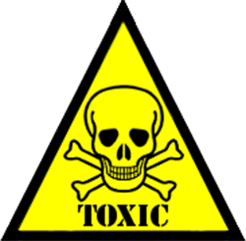
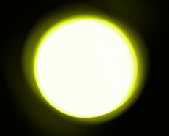
Mechanisms of Injury (Etiology)
Burns are caused by a variety of environmental factors.
Thermal
Electrical
Chemical
Sun
Ice
Notes:
Anna
Script:
The majority of burns are caused by a variety of environmental factors.
The first type of burn is a thermal Burns. There are three types of thermal burns: first is a flame burns, which is the most common type of burn and is sustained when the flame makes direct contact with the skin and tissue resulting in injury. A contact burn is damage to the skin caused by a hot object and include burns temperature from cigarettes, irons or cooking appliances. A scald is a wound to the skin caused by a hot liquid, where the scald becomes greater depending on the thickness of the liquid and its duration of contact with the skin.
Electrical Burns: Burns caused by exposure to low, intermediate and high voltage electric currents. Generally these burns tend to be deep and cause serious impairment to the skin and tissue.
Chemical Burns: Contact or exposure to industrial or household chemical products including flammable gases or liquids cause chemical burns. Breathing difficulties result from the inhalation of hot gases, as they could damage upper airways.
Sunburns: Damage to the skin caused by ultraviolet rays emitted from the sun, tanning beds or sunlamps.
Ice Burns: Ice burns result when skin makes contact with ice or cold for a long period of time. Ice burns cause the water in the cells of your skin to freeze, resulting in the development of sharp ice crystals that impair the composition of your skin cells causing blood vessels to constrict. Extended contact with snow, cold weather, or high-velocity winds can cause ice burns as well as the use of ice or cold packs when pressed directly onto bare skin.
Non-accidental Burns: Nearly 20% of burns in children are caused by abuse or neglect.

Slide 7
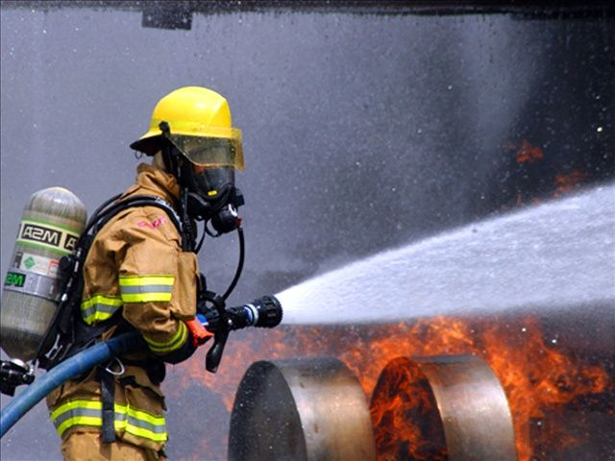
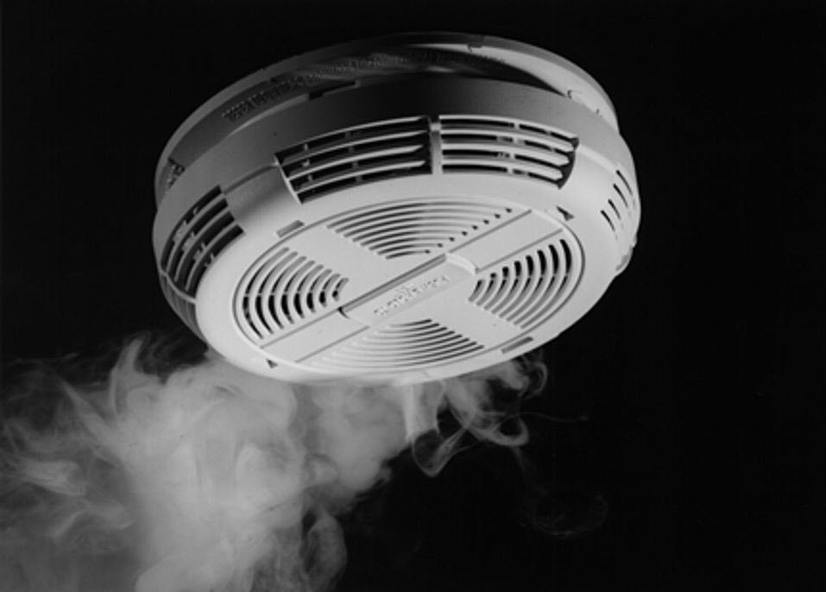
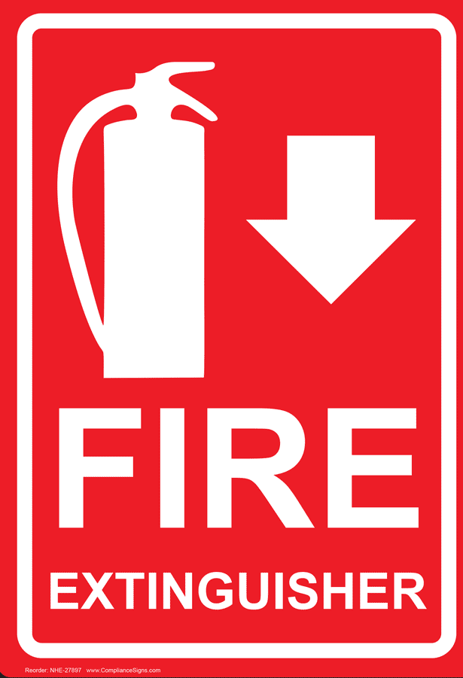
Epidemiology
20-25% of burns are work-related
20-29 year-olds= (highest) serious burn injuries
severe burn injury→ flame burns, scalds
decrease in deaths from burns:
firefighting techniques
emergency medical services
smoke detectors
90% of burn-related deaths occur in LMIC
Notes:
Julia
Script:
The incidence of burn injuries varies across age groups, gender, income and geographic location. Approximately 20-25% of burns are work-related and over 50% of these serious burn injuries occur in males.
20-29 year-olds have the highest prevalence of serious burn injuries, followed by children under 9 years of age
Flame burns and liquid scalds are the main causes of severe burn injury.
Most children under the age of 2 sustain severe burn injuries due to liquid scalds and hot surface burns
Older children above the age of 2 suffer from severe burn injuries due to flame burns.
In the past 20 years, deaths from burn-related injuries have declined . This decrease is a result of improved firefighting techniques, emergency medical services and the use of smoke detectors
This has attributed to an overall decrease in mortality and reduction in injuries
Worldwide, 90% of burn deaths occur in low and middle-income countries where prevention programs are not in place and the quality of acute care is not readily available

Slide 8
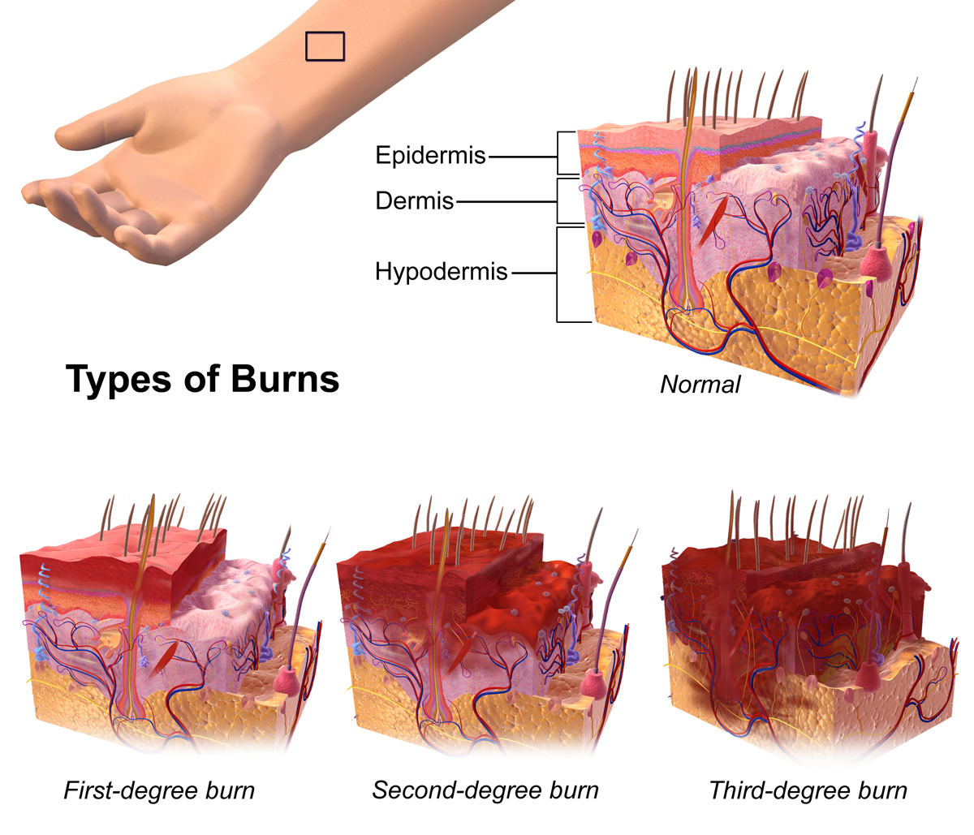
Types of Burns
First Degree
Second Degree
Third Degree
Fourth Degree
Notes:
Anna
At the very top of the image, we can see the normal layers of the skin. The first layer is called the epidermis, which protects the body from the environmental stressors. The second layer of the skin is called the dermis, which contains the blood vessels and hair follicles. Beneath the dermis is the hypodermis or the subcutaneous layer, which contains fat. In a first degree burn, the epidermis or the first layer of the skin is damaged. In a second degree burn, the damage extends to the dermal layer. In the third degree burn, the subcutaneous layer is aso damaged.
Maybe discuss the fourth in this context as well.

Slide 9
Clinical Presentation
Blisters & skin thickening
Scab-like tissue
Damage beyond top layer
Thickness & white
No pain?
Charred & leathery
*SHOCK*
Red & non-blistered
Minor inflammation
Pain
Notes:
Julia
First
Red, non-blistered skin, minor inflammation or swelling, pain, dry and peeling skin
If the burn affects a large area of the skin, still see a doctor! OR if it is a major joint on your face
Second
Blisters and some thickening of the skin, extremely red and sore
Some blisters may pop open - giving wet or weeping appearance
Scab-like tissue called fibrinous exudate may develop over the wound
Damage extends beyond the top layer
Third
Associated with other symptoms as well - such as SHOCK
Widespread thickness with a white, leathery appearance
Cause most damage and extend through every layer of skin
May not actually be in any pain because the burn has caused nerve damage (misconception that this burn is always the most painful type)
Waxy and white colour, char, dark brown colour, raised leathery texture and blisters that do not develop
Without surgery, wounds will heal with severe scarring and contracture

Slide 10
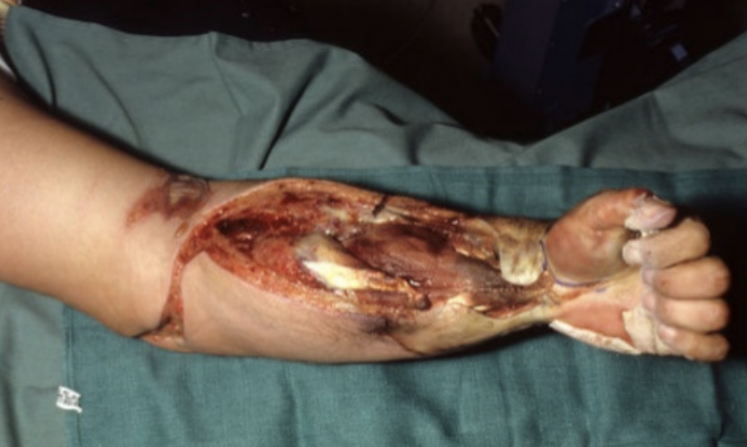
Fourth Degree Burn
May be fatal!
Symptoms of 3rd degree burns
Immediate medical attention & surgical interventions
Notes:
Julia
An additional category that is considered in the most severe cases
Includes all symptoms of third degree burns but also extends beyond the skin and into the tendons and bones
Not commonly seen clinically, but if it does occur, is very severe and can be life-threatening
Requires immediate medical attention and surgical interventions
Long recovery process

Slide 11
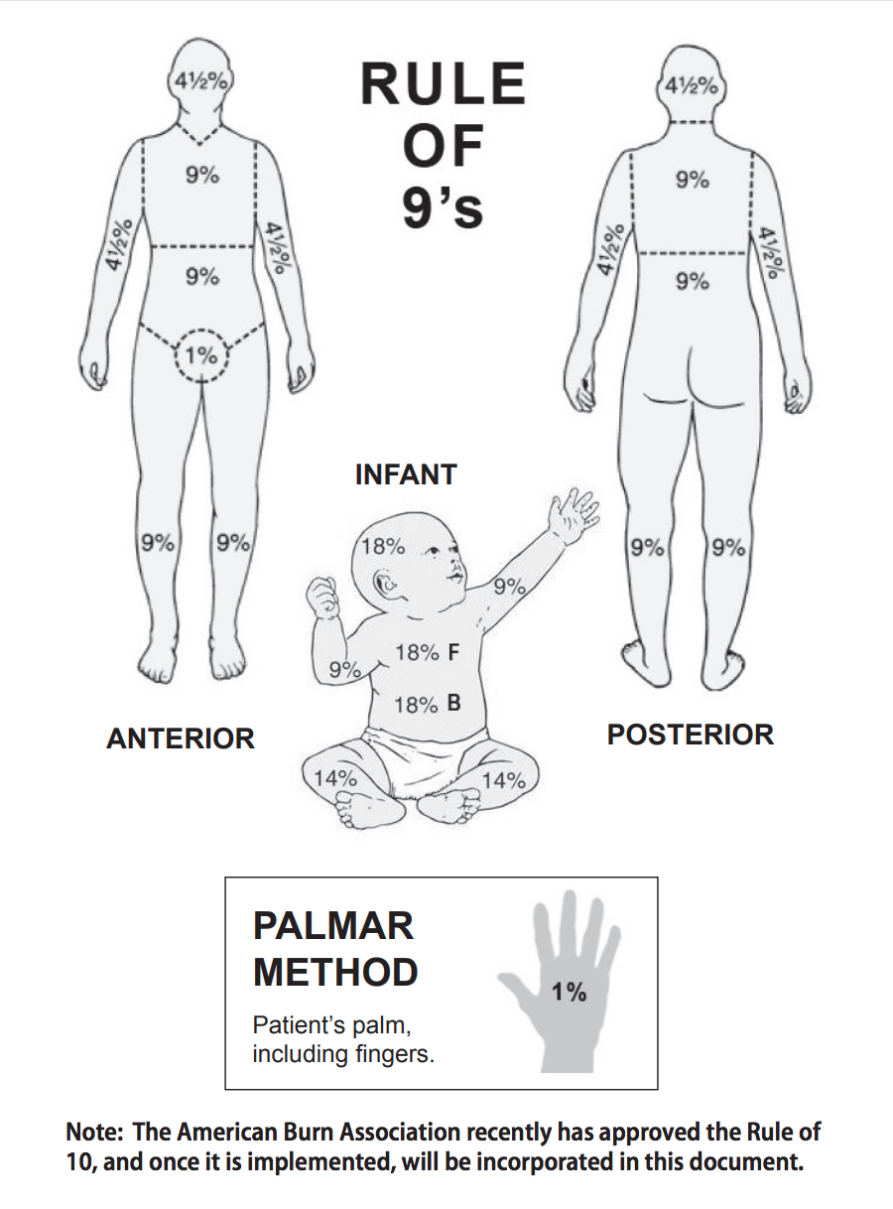
Total Body Surface Area Calculation
Rule of 9’s
Palmar Method
http://tetaf.org/wp-content/uploads/2016/01/Burn-Practice-Guideline.pdf
Notes:
Julia
Total body surface is estimated using the rule of 9 measure for adults and children. To supplement, the palmar method is also used for smaller/unique looking areas.

Slide 12
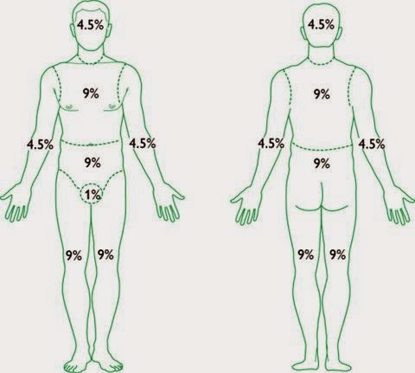
The Baux Scale - Chance of Mortality
+ 17?
http://bluecollarprepping.blogspot.ca/2015/04/burns-and-their-treatment.html
Notes:
Julia
Predict chance of mortality
Score over 140= unsurvivable
+17 score is added when there is inhalation burns present - decreasing chance of survival

Slide 13
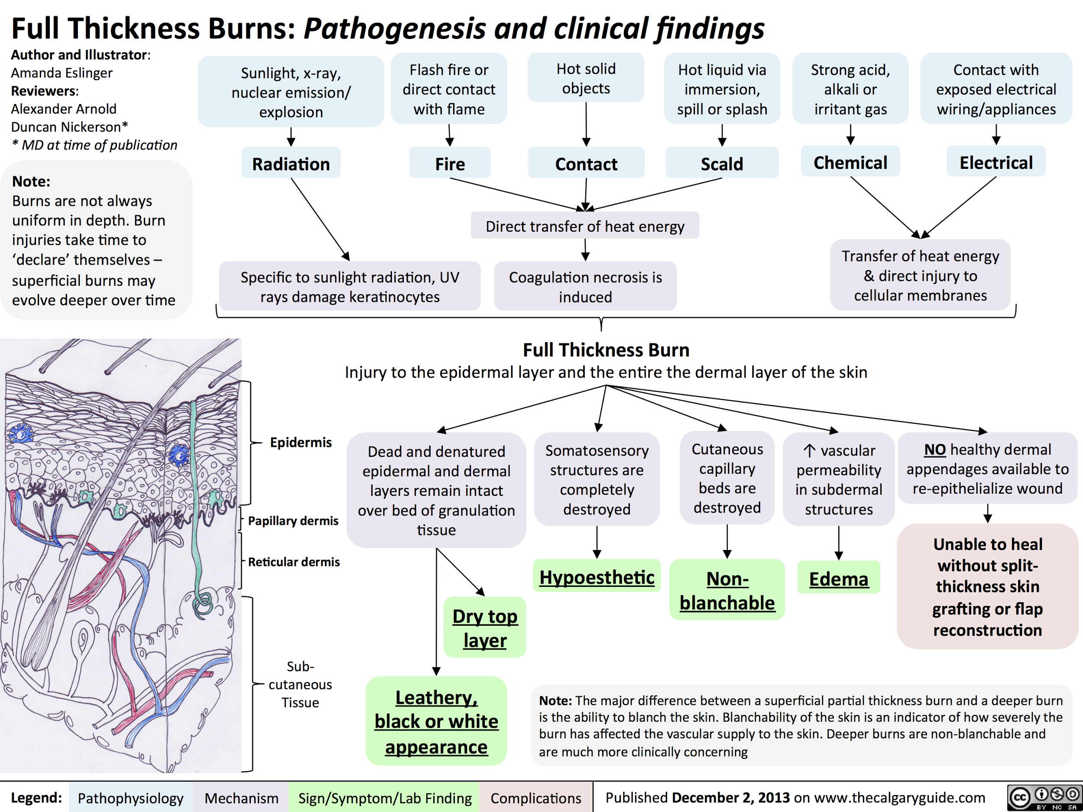
Pathophysiology
Notes:
Anna
The burn pathophysiology is characterized by an inflammatory reaction which leads to formation of oedema (Arturson, 1980). Oedema forms due to increased microvascular permeability, vasodilation and increased extravascular osmotic activity. These responses are caused by the chemical mediators of inflammation and the direct heat effect of a burn on the microvasculature. Vasodilation and increased vascular permeability is mostly initiated by histamine release (Arturson, 1980). Free radicals are released from polymorphonuclear leukocytes which cause damage to the cell membrane. This damage activates the enzymes that catalyze the hydrolysis of prostaglandin precursor causing rapid formation of prostaglandin. Prostaglandin inhibits the release of norepinephrine thus modulating the adrenergic nervous system which is activated in response to thermal injury (Arturson, 1980). The morphological changes of the blood lymph barrier are the increase in the number of vacuoles and many open endothelial intercellular junctions (Arturson, 1980). As well, the continuous loss of fluid from the blood circulation in the areas of damaged tissue results in an increase in haematocrit levels and a rapid fall in plasma volume as well as deceased cardiac output and hypoperfusion on cellular level. Burn shock will develop if the fluids are not restored. Also, burn wound provides a substantial area for entry of surface infection resulting in high risk of septic shock (Arturson, 1980).

Slide 14
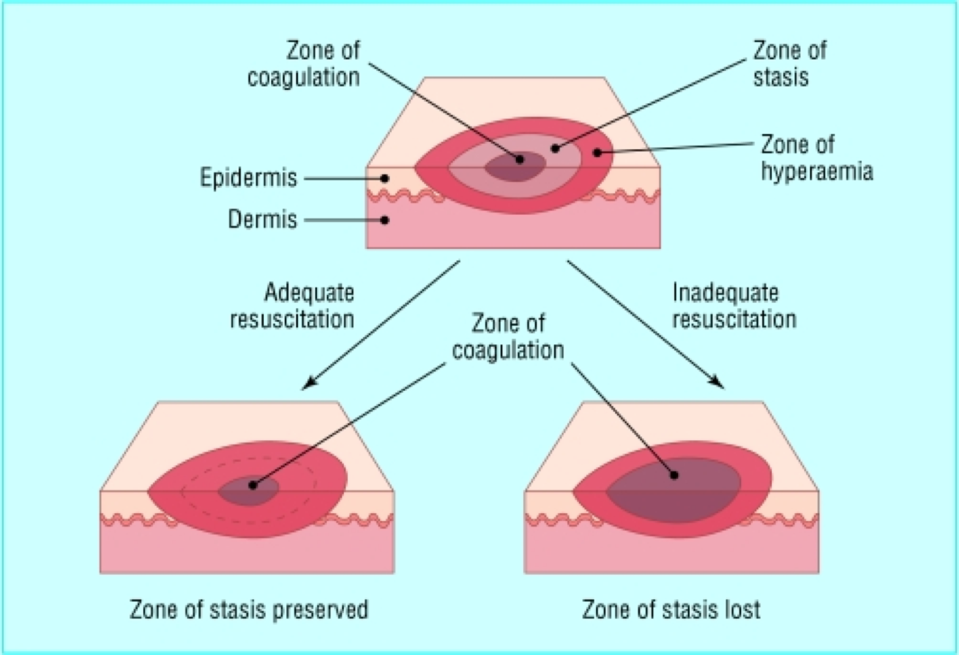
Pathophysiology
Local Response
Coagulation
Stasis
Hyperaemia
Artuson, G. (1980). Pathophysiology of the burn wound. Ann. Chir. Gynaecol. 69(5): 178-90.
Notes:
Anna
We will discuss twophysiology bodily responses to a burn: local and systemic.
The local response varies by zones (Shehan Hettiaratchy, 2004). The zone of coagulation is the zone that occurs at the point of maximum damage resulting in irreversible tissue loss. The zone surrounding the zone of coagulationThis zone is the surrounding zone of decreased tissue perfusion. This tissue could be potentially salvageable (Shehan Hettiaratchy, 2004). The aim of burn resuscitation is to increase tissue perfusion at this sight and prevent any damage becoming irreversible. The tissue in this area can be completely lost due to prolonged hypotension, infection or edema. The third zone of local response is the zone of hyperaemia (Shehan Hettiaratchy, 2004). This is the outermost zone in which tissue perfusion is increased. This tissue will recover unless undergoes severe sepsis or prolonged hypoperfusion (Shehan Hettiaratchy, 2004).

Slide 15
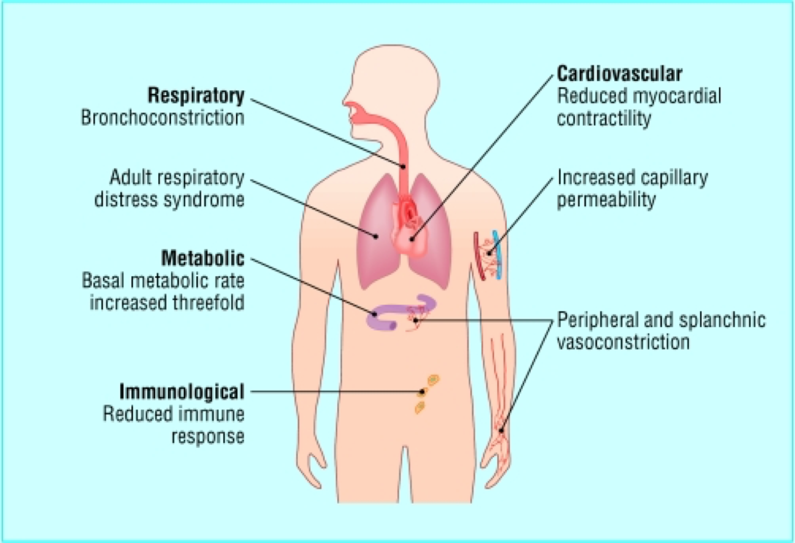
Pathophysiology
Systemic Response
Cardiovascular
Respiratory
Metabolic
Immunology
Artuson, G. (1980). Pathophysiology of the burn wound. Ann. Chir. Gynaecol. 69(5): 178-90.
Notes:
Anna
The systemic response is the effect of a burn on the whole body (Shehan Hettiaratchy, 2004). Once the burn reaches 30% of total body area, the release of cytokines and other inflammatory mediators at the site of injury results in a systemic response. Cardiovascular changes occur in severe cases as well (Shehan Hettiaratchy, 2004). The capillary permeability is increased which results in loss of intravascular proteins and fluids into the interstitial compartment. This leads to peripheral and splanchnic vasoconstriction. Contractility of the cardiac muscles increases, possibly due to release of tumour necrosis factor a. These changes along with the fluid loss lead to systemic hypotention and pypoperfusion. Respiratory changes also occur (Shehan Hettiaratchy, 2004). Inflammatory cells cause bronchoconstriction and in severe burns lead to adult respiratory distress syndrome. There are also metabolic changes that occur (Shehan Hettiaratchy, 2004). The basal metabolic rate increases up to three times its original rate. The increase in splanchnic metabolic rate and hypoperfusion requires the patient to undergo enteral feeding to prevent and decrease catabolism and gut integrity. Severe burns also result in immunological changes such as non-specific downregulation of immune response. This affects both the humoral and cell-mediated pathways (Shehan Hettiaratchy, 2004).

Slide 16
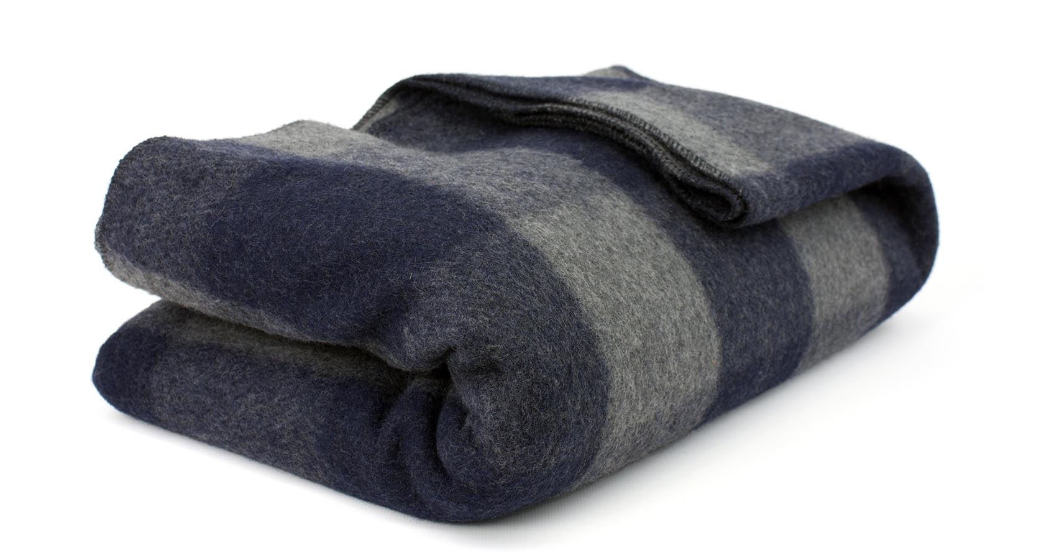
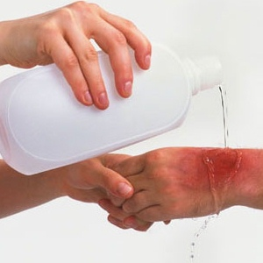
Treatment: Immediate
Heat Burns
Cold Temperature Burns
Liquid Scald Burns
Electrical Burns
Chemical Burns
Tar or Hot Plastic Burns
Notes:
Anna
Heat Burns: Heat burns (thermal burns): Smother any flames by covering them with a blanket or water. If your clothing catches fire, do not run: stop, drop, and roll on the ground to smother the flames.
Cold Temperature Burns: the small areas of your body (ears, face, nose, fingers, toes) that are really cold or frozen can be warmed by blowing warm air on them, tucking them inside your clothing or putting them in warm water.
Liquid Scald Burns: run cool tap water over the burn for 10 to 20 minutes. Do not use ice.
Electrical Burns: After the person has been separated from the electrical source, check for breathing and a heartbeat. If the person is not breathing or does not have a heartbeat, call .
Chemical Burns: Natural foods such as chili peppers, which contain a substance irritating to the skin, can cause a burning sensation. When a chemical burn occurs, find out what chemical caused the burn and call your local poison control center.
Tar or Hot Plastic Burns: Immediately run cold water over the hot tar or hot plastic to cool the tar or plastic.
http://www.natural-homeremedies-for-life.com/home-remedies-for-burns.html
http://www.everythingsummercamp.com/bunkhouse-plaid-wool-blanket

Slide 17
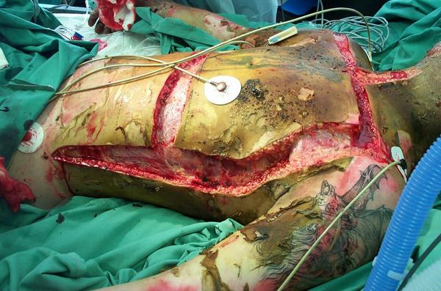
Treatment: Surgical Intervention: Escharotomy
https://twitter.com/4hremergencydoc/status/519853931682594816
Notes:
Burn eschar is essentially the dead tissue most damaged tissue. It has leathery consistency and is composed of denatured proteins and coagulated vessels. The incision made in the burn eshcar will release the pressure When the burn eschar circumferentially surrounds any body structure, the tissues within are subject to increasing interstitial pressures exacerbated by the tissue edema
Anna
Escharotomy is a surgical incision through the burn eschar (Kagan et al, 2009). Eschar, pronounced es-CAR, is dead tissue that sheds or falls off from healthy skin. This procedure is usually performed within the first 24 hours of burn injury. Burn eschar has an unyielding, leathery consistency and is characterized by denatured proteins and coagulated vessels in the skin (Kagan et al, 2009). When the burn eschar circumferentially surrounds any body structure, the tissues within are subject to increasing interstitial pressures exacerbated by the tissue edema that develops during the acute phase of burn resuscitation in the first 48 hours after burn injury (Kagan et al, 2009). This procedure releases the constriction caused by the burn eschar but do not remove the eschar. After approximately a week, the burn eschar is excised to the level of viable underlying tissue (Kagan et al, 2009).
Escharotomy
Debridement of Burn
Excision of Burn Wound
Excision & Grafting
http://www.burnsurvivorsttw.org/burns/grafts.html
http://www.medicalexhibits.com/medical_exhibits_image.php?exhibit=09157_01X
http://www.woundsresearch.com/article/evidence-intensive-autolytic-debridement-self-adaptive-wound-dressing
https://www.google.ca/search?biw=949&bih=662&tbm=isch&sa=1&ei=osMRWoj0EZisjwPatIqgDg&q=escharotomy&oq=escharotomy&gs_l=psy-ab.3..0l10.111510.113219.0.113437.11.11.0.0.0.0.155.1154.1j9.10.0....0...1.1.64.psy-ab..1.10.1152...0i67k1.0.kC_7vvrbAos#imgdii=osT8QFGi4dLv9M:&imgrc=tvu5tfofqDxcbM:
http://pedsinreview.aappublications.org/content/34/9/395

Slide 18
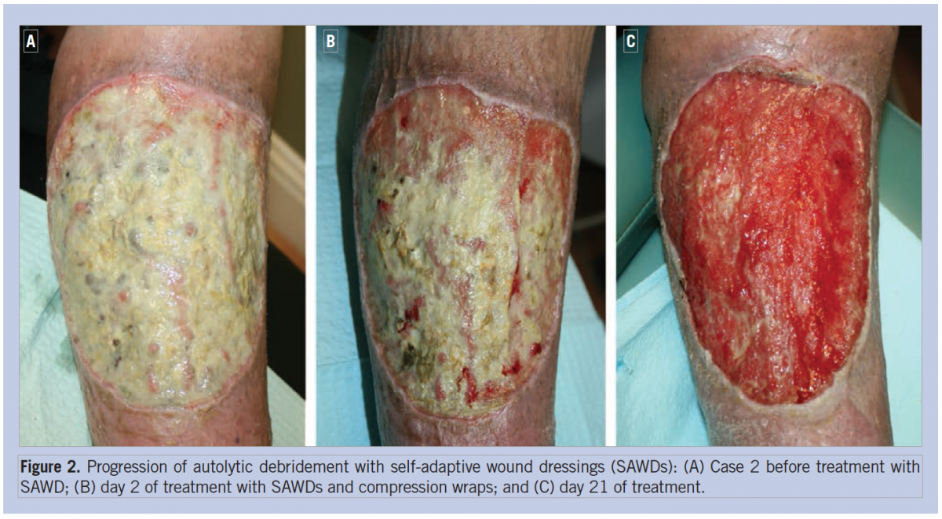
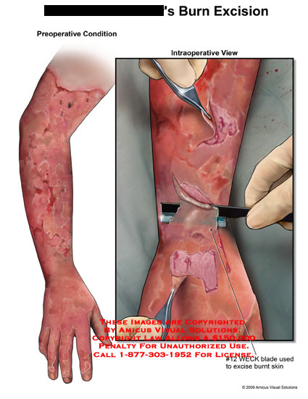
Treatment: Surgical Intervention: Burn Excision
http://www.woundsresearch.com/article/evidence-intensive-autolytic-debridement-self-adaptive-wound-dressing
Notes:
Anna
Debridement of burn wounds is another procedure which involves removal of loose, devitalized necrotic contaminated tissue, foreign bodies and other debris on the wound using mechanical and sharp techniques (Kagan et al, 2009). Wound healing is optimized when wound surfaces are clean with minimal microbial colonization and necrotic debris present (Kagan et al, 2009). Excision of burn wounds is a surgical procedure which requires incision through the deep dermis of open wounds, burn eschar and burn scars (Kagan et al, 2009). This involves surgical removal of all necrotic tissue. Excision of burn scars could also be performed on deep burn that would not heal on their own (Kagan et al, 2009). The goal is to remove all necrotic and non-viable tissue and to prepare the wound for immediate wound closure. (Kagan et al, 2009).
Escharotomy
Debridement of Burn
Excision of Burn Wound
Excision & Grafting
http://www.burnsurvivorsttw.org/burns/grafts.html
http://www.medicalexhibits.com/medical_exhibits_image.php?exhibit=09157_01X
http://www.woundsresearch.com/article/evidence-intensive-autolytic-debridement-self-adaptive-wound-dressing
https://www.google.ca/search?biw=949&bih=662&tbm=isch&sa=1&ei=osMRWoj0EZisjwPatIqgDg&q=escharotomy&oq=escharotomy&gs_l=psy-ab.3..0l10.111510.113219.0.113437.11.11.0.0.0.0.155.1154.1j9.10.0....0...1.1.64.psy-ab..1.10.1152...0i67k1.0.kC_7vvrbAos#imgdii=osT8QFGi4dLv9M:&imgrc=tvu5tfofqDxcbM:
http://pedsinreview.aappublications.org/content/34/9/395

Slide 19
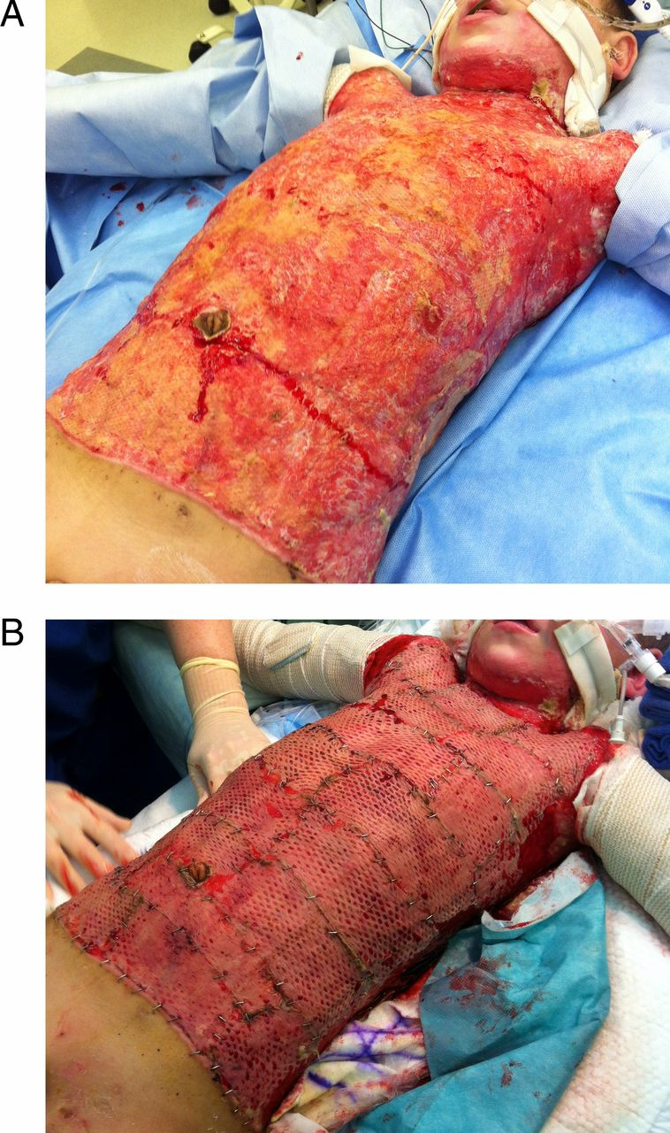
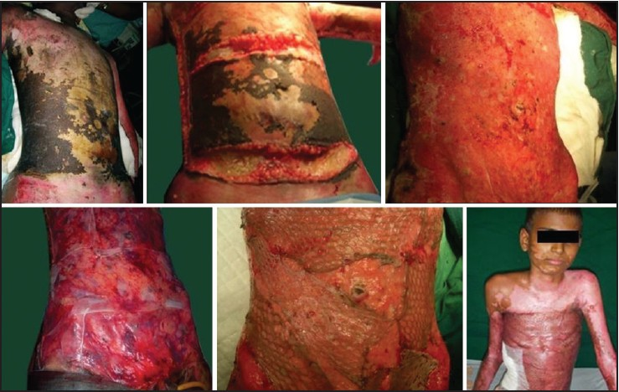
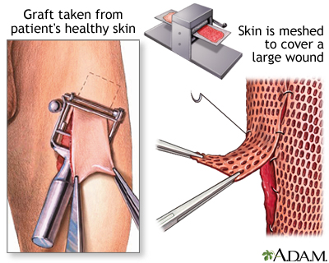
Treatment: Surgical Intervention: Grafting
http://www.burnsurvivorsttw.org/burns/grafts.html
Notes:
Anna
Script:
If the burn wound is very large, a burn grafting procedure will be performed
Skin grafting is a type of surgery used to treat burn patients. It is performed under anesthesia where healthy skin is taken from a section on your body defined as the donor site. Two types of skin graft procedures are available. Split-thickness grafts involve the transplant of only a few layers of the outer skin whereas full-thickness grafts encompass all of the dermis, resulting in permanent scarring. Most individuals have a split-thickness skin graft which involves taking the epidermis and dermis layers of the donor site. The donor site is taken from sections of the body that are usually covered, such as buttocks or inner thigh regions. The graft is spread on the bare region in need of covering and is held together by a dressing and a few stitches. A sterile dressing covers the donor site for 3 to 5 days to prevent any infections from arising. Split-thickness skin grafts tend to have a quick recovery period compared to full-thickness skin grafts which tend to require longer hospital stays.
Escharotomy
Debridement of Burn
Excision of Burn Wound
Excision & Grafting
http://www.burnsurvivorsttw.org/burns/grafts.html
http://www.medicalexhibits.com/medical_exhibits_image.php?exhibit=09157_01X
http://www.woundsresearch.com/article/evidence-intensive-autolytic-debridement-self-adaptive-wound-dressing
https://www.google.ca/search?biw=949&bih=662&tbm=isch&sa=1&ei=osMRWoj0EZisjwPatIqgDg&q=escharotomy&oq=escharotomy&gs_l=psy-ab.3..0l10.111510.113219.0.113437.11.11.0.0.0.0.155.1154.1j9.10.0....0...1.1.64.psy-ab..1.10.1152...0i67k1.0.kC_7vvrbAos#imgdii=osT8QFGi4dLv9M:&imgrc=tvu5tfofqDxcbM:
http://pedsinreview.aappublications.org/content/34/9/395
http://www.jcasonline.com/viewimage.asp?img=JCutanAesthetSurg_2011_4_3_176_91248_f2.jpg

Slide 20
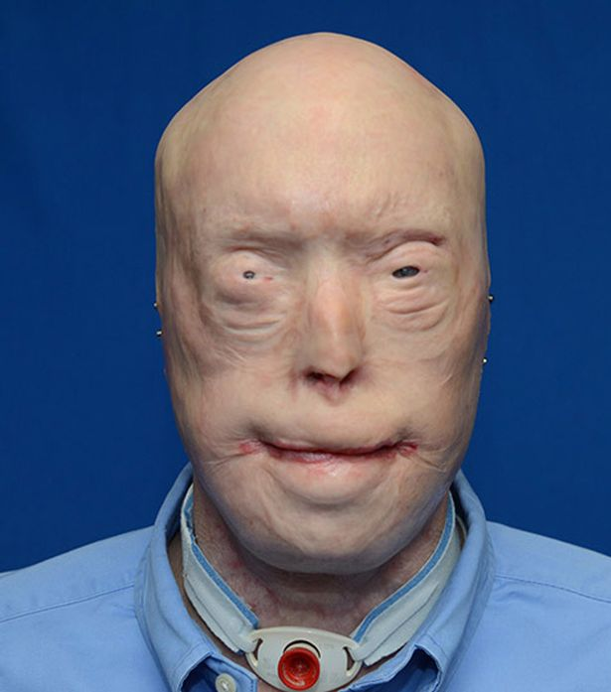
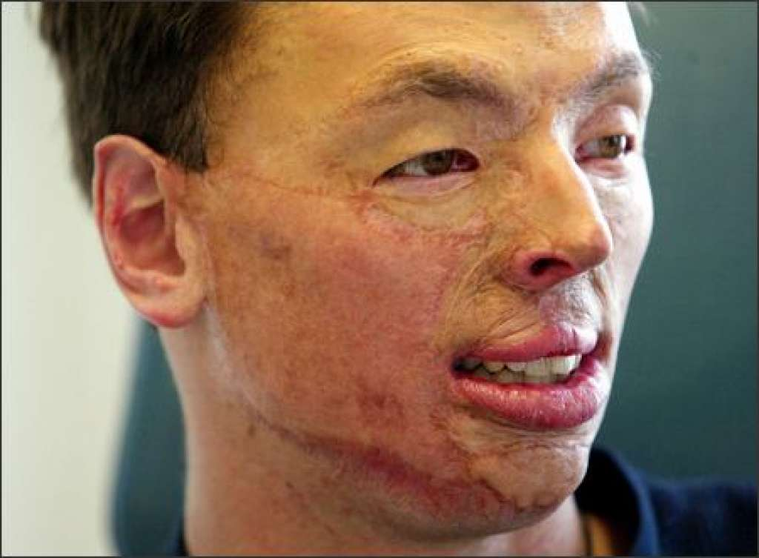
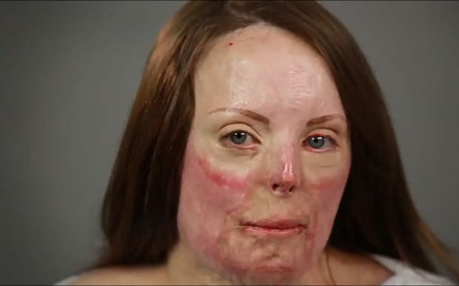
Psychosocial Outcome
Burn Wounds & Scars
Anxiety
Depression
Sleep Disturbance
Grief
http://www.huffingtonpost.ca/entry/new-face-transplant-photos-show-burn-patients-remarkable-rebirth_us_57869a92e4b03fc3ee4f124c
Notes:
Anna
Acute Phase
Patients with burns exhibit symptoms of anxiety and depression which begin to appear in the acute phase of recovery (Wiechman & Patterson, 2004). Acute stress disorder and post-traumatic stress disorder are more common after burns than other forms of injury. These symptoms are typically seen in patients that have larger burns and more severe pain and express more guilt about the precipitating event (Wiechman & Patterson, 2004). The severity of depression is correlated with a patient’s level of resting pain and level of social support. Sleep disturbance is central to both the anxiety and depression. Sleep can be affected by patient’s mood, agitation and nightmares (Wiechman & Patterson, 2004). Also, the patient is often awakened during the night for analgesia or for vital signs. At this stage, the patient may also begin the grieving process as they become more aware of the impact the burns might have on their life relating job, mobility, physical ability and appearance (Wiechman & Patterson, 2004).
Long Term Rehabilitation
High demands of long-term rehabilitation and social stressors such as family strains, return to work, sexual dysfunction, change in body image and disruption in daily may also cause negative psychosocial outcomes (Wiechman & Patterson, 2004). Patients could experience distress caused by vivid memories of the incident. However, adjustment to burn injuries improves over time and is believed to be independent of size of injury (Wiechman & Patterson, 2004). As well, burn scars are known to cause psychosocial outcomes (Lawrence et al, 2001). Multiple studies have reported that visibility, severity and location of scar have a strong relationship with the quality of life in the survivors of the major burns. Specifically, these burn characteristics are highly associated with psychosocial variables such as social comfort and perceived (Lawrence et al, 2001).
http://www.telegraph.co.uk/women/womens-life/11633973/Watch-timelapse-video-of-a-burn-survivors-scars-disappearing.html
http://www.seattlepi.com/local/article/Two-faces-burned-two-lives-changed-1146024.php

Slide 21
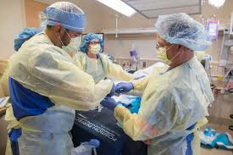
Burn Teams
Health Professionals:
Burn Surgeons
Nurses
Anesthesiologists
Respiratory Therapists
Occupational / Physical Therapists
Dietitian
Psychosocial (Al-Mousawi, Mecott-Rivera, Jeschke, & Herndon, 2009)
http://photobook.communitymedical.org/node/1079
Notes:
Julia
To accommodate severely burned victims, there are specialized burn centers. These burn centers are comprised of interdisciplinary burn teams. Each team consists of individuals from a variety of areas in the health field to create a multidisciplinary approach. One health professional on their own does not have the knowledge and experience to deal with the physical burn and the psychological affects that come with it. Without burn units and their teams, individuals that are inflicted with burns will go to a general hospital and receive care like any other patient where they are treated for the infliction, but not necessarily on an individual level
Burn Team Members
Burn Surgeons: The leaders of the team. Organize and implement the care of the patient. Since the locations of burns varies, different types of surgeons are needed depending on where the burn is located. They need to be able to lead and communicate with the team as well as know when to seek the expertise of another team member (Al-Mousawi, Mecott-Rivera, Jeschke, & Herndon, 2009).
Nurses: Are the largest portion of the members of the burn teams. Are involved with daily care for the patients. The nurses are constantly monitoring the patients to see if anything changes. Both practical and research nurses are a part of burn teams (Al-Mousawi et al., 2009).
Anesthesiologists: When the severity of burns is high, the burn team will look towards an anesthesiologist to assist with treating the patient. Issues with airways, ventilation, heat-loss, fluid and electrolyte balance, and circulatory instability will be addressed to help improve the treatment and recovery (Al-Mousawi et al., 2009).
Respiratory Therapists: Often when a severe burn injury inflicts the lungs, respiratory therapists get involved with the treatment. They help with the breathing injury, mechanics and sepsis, as well as the respiratory systems inflammatory response to the burn. While helping treat the patients they utilize a protocol-based approach (Al-Mousawi et al., 2009).
Occupational/Physical Therapists: Once the treatment is complete, depending on the extent of the burn the individual may need some form of rehabilitation. Occupational and physical therapists will give the patient a personalized program to follow to help improve recovery. If the program is followed through over the correct period of time the patient may get back to functioning the way he or she used to (Al-Mousawi et al., 2009).
Dietician: Major burns cause the body to use a lot of its energy stores in order to respond to the infliction. With this in mind, the patient may be lacking important nutrients. A dietician or nutritionist will be responsible for implementing and monitoring nutritional intake for the patients to get the nutrients they need as well as speed up recovery (Al-Mousawi et al., 2009).
Psychosocial Experts: Not only do burns have an impact on the physical body but also psychologically due to the trauma associated with the burn injury. Psychological experts like psychologists, psychiatrists and social workers will be consulted to help the patient and their loved ones response to the injury and the transition period. Making sure the patient has an improved mental state is needed to help with pain tolerance, anxiety, motivation

Slide 22
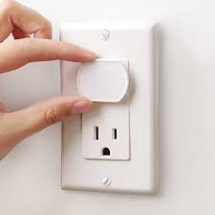
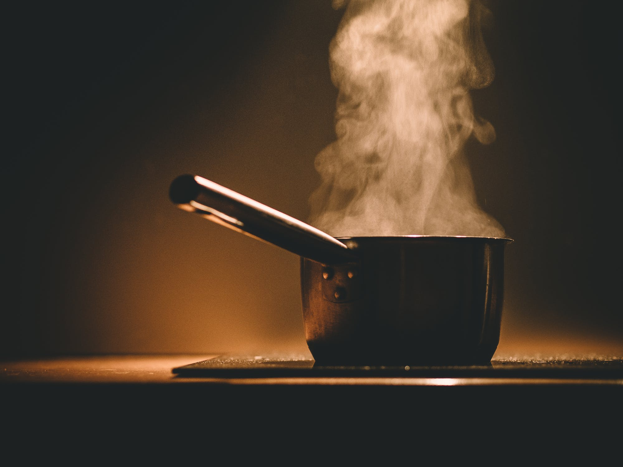
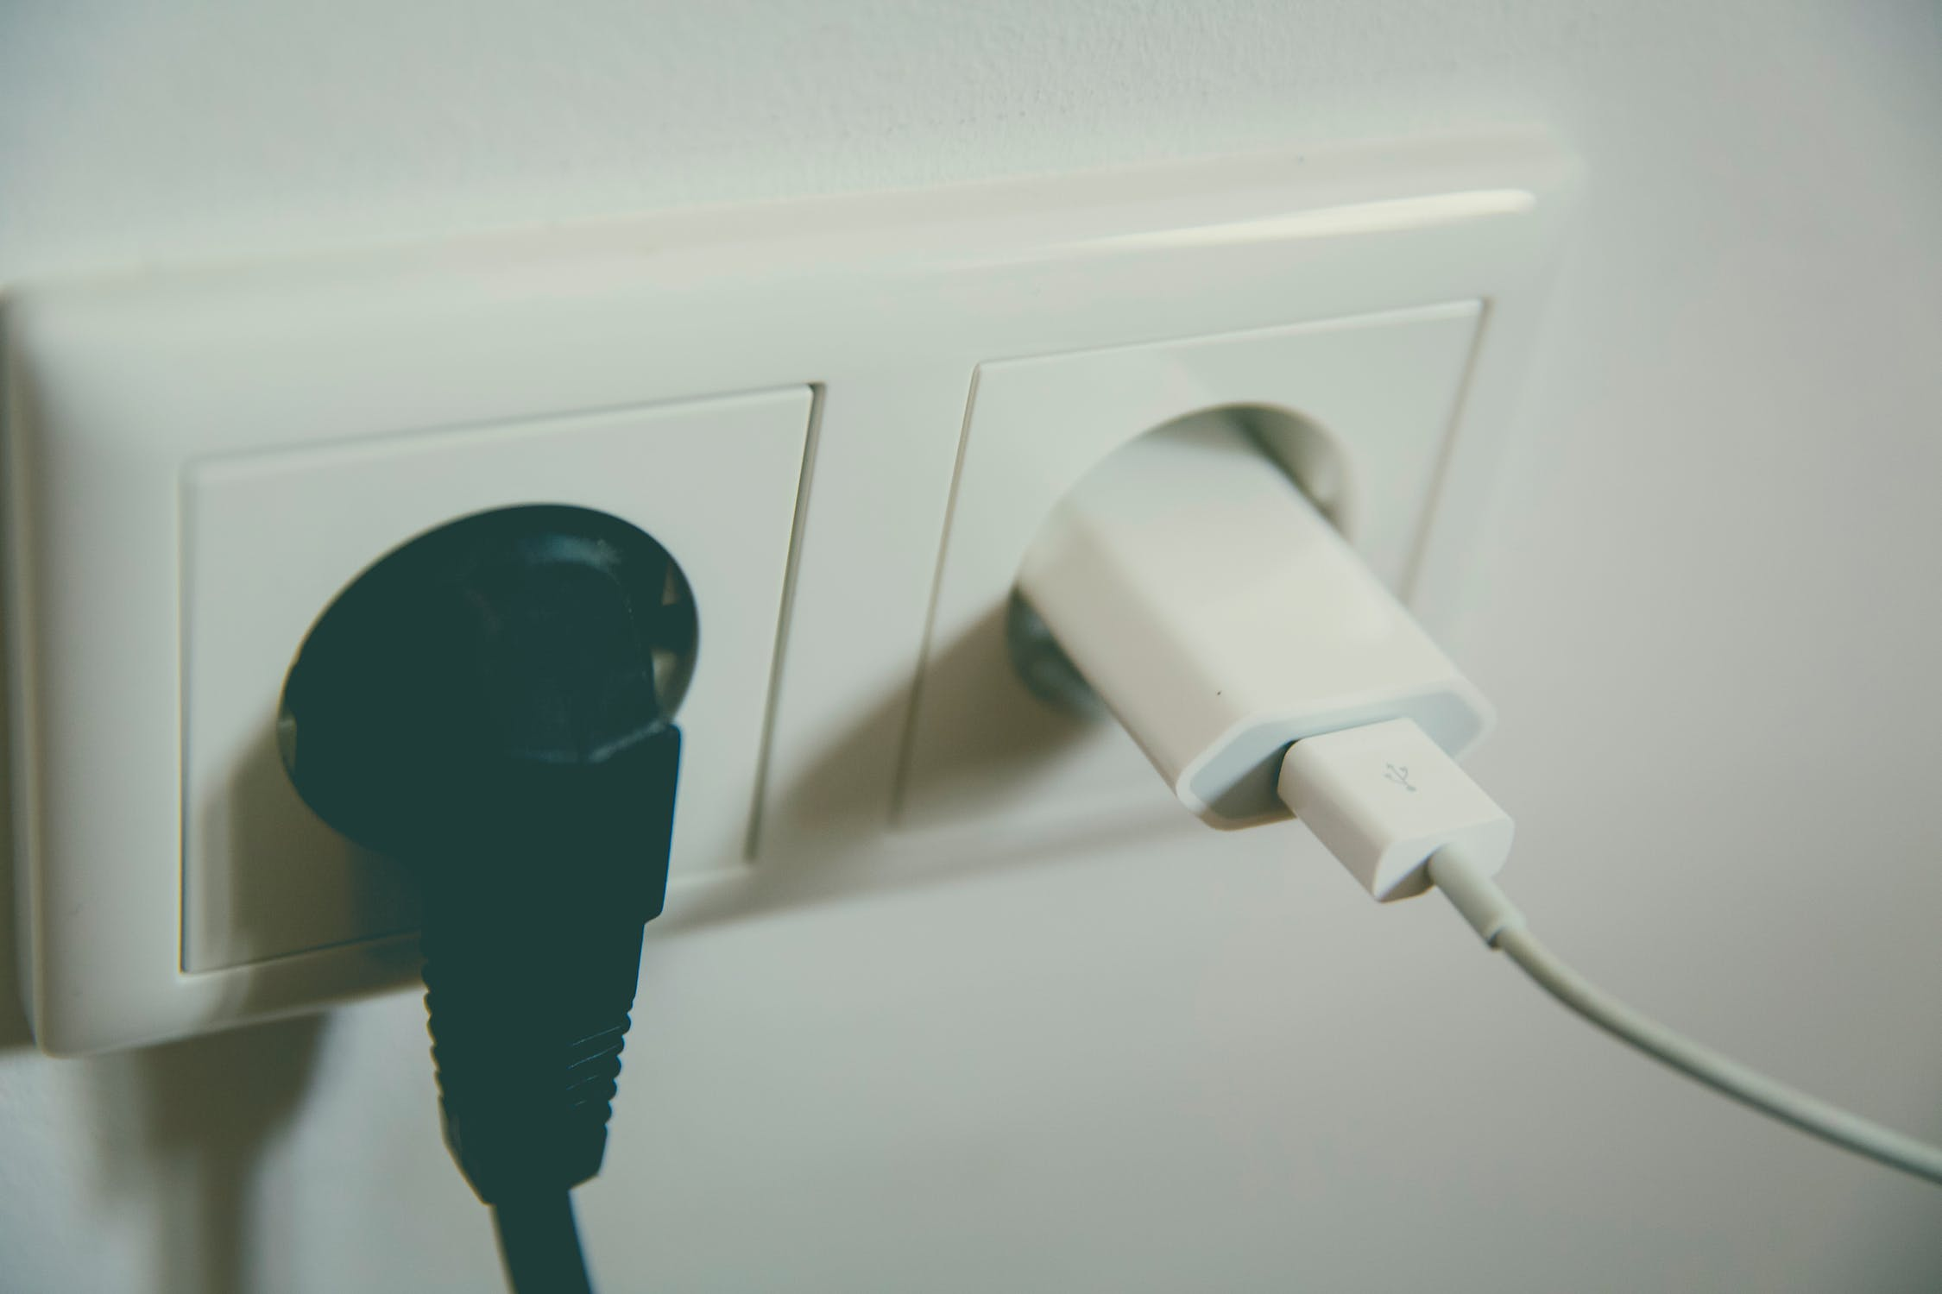
Home Prevention Strategies
Notes:
Julia
There are many tips that can be applied to help prevent home burns.
Turning off stoves or never leaving stove unattended if children are present
Turn pot handles inwards to prevent accident knocking over pots
Keep outlets and extension cords away from potentially flammable areas, use safety caps where possible on unused outlets
Always unplug electrical appliances if not being used
Images
Pot (https://www.pexels.com/photo/food-pot-kitchen-cooking-8717/)
Safety Caps https://www.proparentsupply.com/product/baby-mate-12-24-pcs-safety-electrical-outlet-covers-safety-caps-for-outlets-socket-covers-for-baby-safety-outlet-plugs-child-safety-outlet-covers-outlet-plug-cover-white-12-24-pcs/

Slide 23
Workplace Prevention Strategies
General Tips for the Workplace
Be aware of hazards that can cause burns
Do not attempt any tasks that you are uncomfortable with or feel that can harm you
Ask for assistance/further instructions when required
Notes:
Julia
When discussing workplace prevention strategies, it is heavily dependent on the workplace and work environment. People will have different workplace prevention strategies for burns that cater to their specific work environment.
Flammable solutions
Dress appropriately
Complete site-specific health and safety training before engaging in any work activity
Do not attempt any tasks that you are uncomfortable performing or you feel you are untrained for
Images
Server https://pixabay.com/en/waitress-the-waiter-restaurant-caf%C3%A9-2376728/
Construction https://pixabay.com/en/construction-worker-safety-2578410/

Slide 24
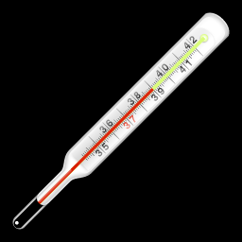
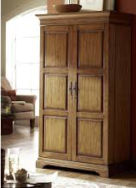
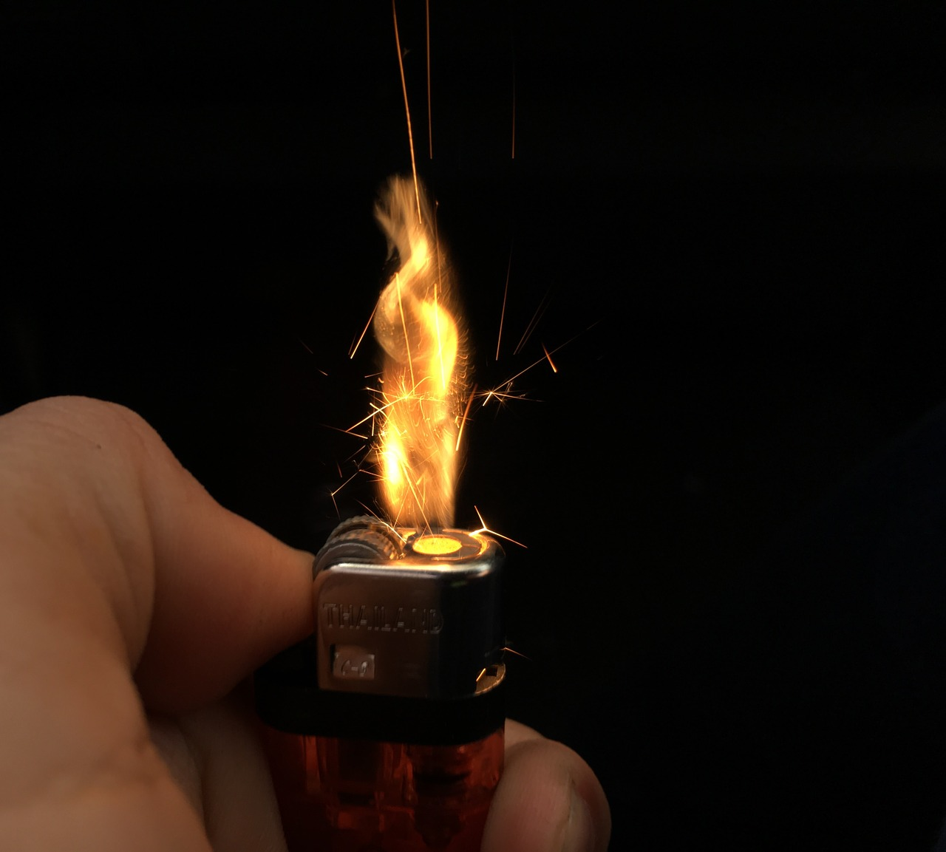
Prevention Strategies for Children
Check temperature of water before placing children inside
Place dangerous items such as lighters and matches out of reach
Notes:
Julia
It is important to take extra caution if you have children in your house.
Be mindful of water temperature
Keep children out of the kitchen while cooking as much as possible
Keep lighters and matches out of reach
Wide range or prevention strategies - burns ARE common injury, and can be very serious, however they are very preventable if the proper prevention strategies and precautions are put into place.
Images
Thermostats https://m.veryicon.com/icons/object/influenza/thermometer-1.html
Lighter: https://pixabay.com/en/use-the-lighter-fire-ignite-on-fire-2170198/
Top Shelves (high areas) http://customwritingink.com/small-cabinet-with-lock.html

Slide 25
References
Al-Mousawi, A. M., Mecott-Rivera, G. A., Jeschke, M. G., & Herndon, D. N. (2009). Burn teams and burn centers: the importance of a comprehensive team approach to burn care . Clinic Past Surgery , 36 (4), 547-554.
Artuson, G. (1980). Pathophysiology of the burn wound. Ann. Chir. Gynaecol. 69(5): 178-90.
Burn | First Degree Burn | Second Degree Burn | MedlinePlus. (n.d.). Retrieved November 15, 2017, from https://medlineplus.gov/burns.html
Burn Prevention and Fire Safety Tips. (2017). Barnabas Health. Retrieved 15 November 2017, from http://www.barnabashealth.org/Saint-Barnabas-Medical-Center/Our-Services/The-Burn-Center/Community-Outreach/Burn-Prevention-and-Fire-Safety-Tips.aspx
Burns - Causes, Symptoms, Treatment, Diagnosis - MedBroadcast.com. (2017). Medbroadcast.com. Retrieved 22 November 2017, from http://www.medbroadcast.com/condition/getcondition/burns
Burns Prevention. (2017). Mayo Clinic. Retrieved 15 November 2017, from https://www.mayoclinic.org/diseases-conditions/burns/basics/prevention/con-20035028
Cutaneous burns Etiology - Epocrates Online. (2017). Online.epocrates.com. Retrieved 22 November 2017, from https://online.epocrates.com/diseases/41224/Cutaneous-burns/Etiology
Edwards, D., Heard, J., Latenser, B. A., Quinn, K. Y., van Bruggen , J., & Jovic, G. (2011). Burn injuries in Eastern Zambia: Impact of Multidisciplinary Teaching Teams . Burn Care & Research , 32 (1), 31-38.
Epidemiology of burn injuries globally. (2017). Uptodate.com. Retrieved 22 November 2017, from http://www.uptodate.com/contents/epidemiology-of-burn-injuries-globally
Everything You Need to Know About Ice Burn. (2017). Healthline. Retrieved 22 November 2017, from https://www.healthline.com/health/ice-burn#overview1
Herndon, D. N., Lemaster, J., Beard, S., Bernstein, N., Lewis, S. R., Rutan, T. C., . . . Osten, T. V. (1986). The Quality of Life after Major Thermal Injury in Children. The Journal of Trauma:

