Slide 1
BIPOLAR DISORDER
Life Science 4M03: Group 2
https://dri6hp6j35hoh.cloudfront.net/blog/wp-content/uploads/2016/05/bigstock-Illustration-of-a-Pair-of-Mask-125654582-300x240.jpg

Slide 2
Introduction
Defining Bipolar Disorder
Symptoms & Diagnosis
Risk Factors & Epidemiology
Pathophysiology
Treatments
Societal Impact

Slide 3
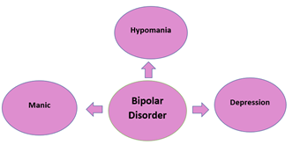
What is Bipolar Disorder?¹
“Bipolar disorder (BD), also known as manic depression, is a mental illness that expresses extreme high and low moods.”
Manic Phase: “High periods,” happy, energized, confident, impulsive, reckless, delusional, hallucinations may occur
Depression Phase: ”Low periods,” sad, hopeless
Hypomania: Mild symptoms of mania

Slide 4
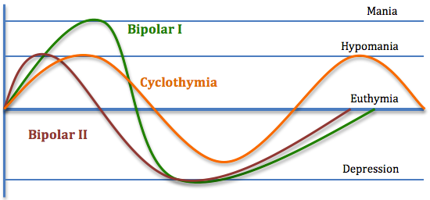
Bipolar Disorder: Type I & II, Cyclothymia¹
http://neurowiki2013.wdfiles.com/local--files/individual%3Acyclothymia/Cyclothymia%20graph.png

Slide 5
Symptoms & Diagnosis

Slide 6
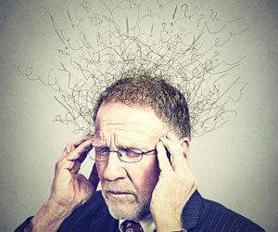
Symptoms²
Includes mania, hypomania and depression
Mania and hypomania include 3 or more of the following symptoms:
Abnormal upbeat, jumpy, or wired
Increased activity, energy or agitation
Exaggerated sense of well-being and confidence
Decreased need for sleep
Unusual talkativeness
Racing thoughts
Distractibility
Poor decision making
(Mayo Clinic Saff Print, 2017)
Notes:
.

Slide 7
Symptoms Cont’d
Major depressive episode includes 5 or more of the following symptoms:
Depressed mood
Marked loss of interest
Significant weight changes
Insomnia or sleeping too much
Restlessness
Fatigue
Feelings of worthlessness or excessive guilt
Decreased ability to concentrate
Indecisiveness
Planning or attempting suicide

Slide 8
Diagnosis: Bipolar Disorder Type I, Manic³
Extreme mood and increase in energy, lasting at least 1 week, most of the day, nearly every day
Three (or more) of the following symptom from the chart are present
The mood is severe enough to cause damage on social or occupational functioning
Not linked to the physiological effects of a substance or another medical condition

Slide 9
Diagnosis: Bipolar Disorder Type I, Depression³
Five or more of the following symptoms are present during the same 2-week period
The symptoms cause impairment in social and occupational situations
Not attributable to the physiological effects of a substance or another medical condition

Slide 10
Diagnosis: Bipolar Disorder Type II, Hypomanic³
A distinct period of abnormally irritable mood and increased energy, lasting at least 4 consecutive days
Three (or more) of the following symptoms in the chart have persisted
The disturbance in mood and the change in functioning are observable by others
Not severe enough to cause impairment in social or occupational functioning
The episode is not attributable to the physiological effects of a substance

Slide 11
Diagnosis: Bipolar Disorder Type II, Depression³
Five (or more) of the following symptoms in the chart have been present
The symptoms cause significant impairment in social, occupational, or other important areas of functioning.
The episode is not attributable to the physiological effects of a substance or another medical condition

Slide 12
Risk Factors & Epidemiology

Slide 13
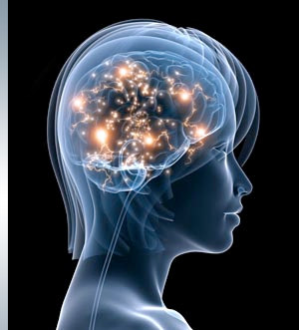
Causes and Risk Factors⁴
Biological differences
Physical changes of brain
Genetic differences
Greater susceptibility if one has an affected first-degree relative
Environment
Stressful, traumatic, or substance-induced
(Bipolar Disorder, n.d.)

Slide 14
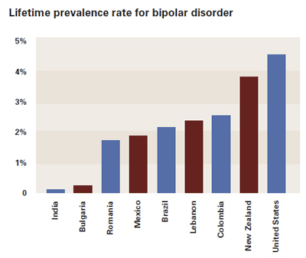
Epidemiology⁵
Highest= USA at 4.4%
Lowest= India at 0.1%
Columbia = low-income nation was high at 2.6%
http://www.apa.org/Images/2011-06-bipolar-chart_tcm7-116499.jpg

Slide 15
Pathophysiology

Slide 16
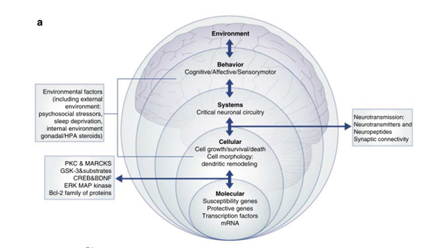
Abnormalities in Cellular Plasticity⁶
(Schloesser et al., 2008)

Slide 17
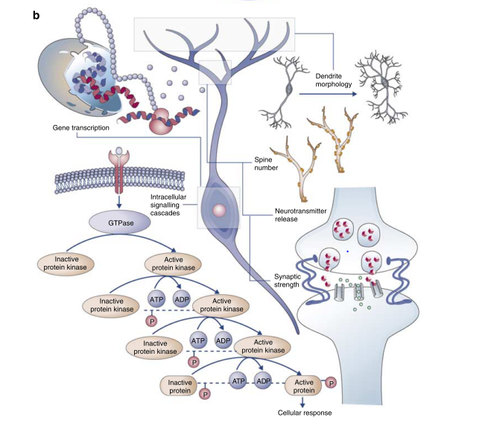
Cellular Signaling Cascades⁶
(Schloesser et al., 2008)

Slide 18
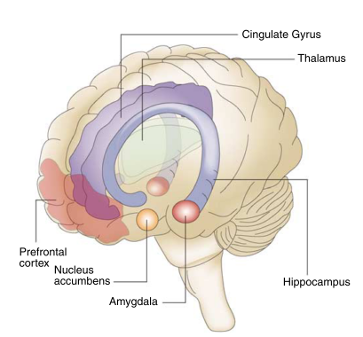
Affected Brain Regions⁶
(Schloesser et al., 2008)

Slide 19
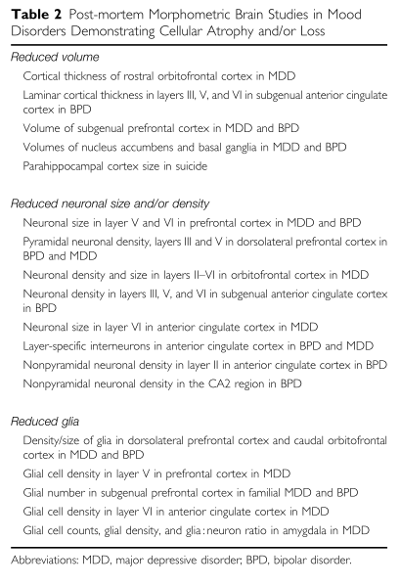
Post-Mortem Brain Studies⁶
Cellular brain atrophy / loss
Brain volume decreases
Reduced neuronal size and/ or density
Reduced glia
(Schloesser et al., 2008)

Slide 20
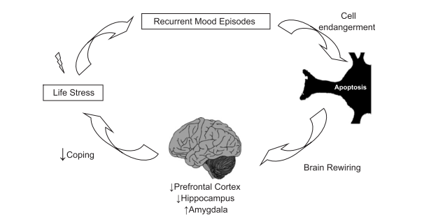
Cycle of Brain Rewiring in BD⁶
(Schloesser et al., 2008)

Slide 21
Treatments & Management

Slide 22
Types of Care⁷
75% of individuals with BD do not receive the optimal care.
Primary Care
Manage physical and mental health of patient and themselves
Misdiagnosis is common
Self Management
Long-term symptom management
Self monitoring (ie. diary, collaborative approach)
https://s.sharecare.com/img/video/stills/2538422639001_bipolar_treated.jpg

Slide 23
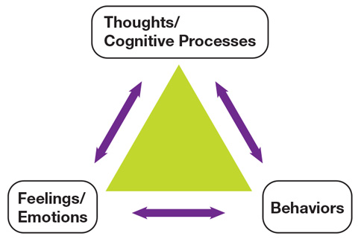
Psychological Therapy: Cognitive Behavioural Therapy^{7,8}
Short-term psychotherapy
Aims:
Collaborative approach
Self-awareness
Collaborative goal development
Psychoeducation
Delivers modes of intervention to patients and their families
RCT Analysis of Psychoeducation
Reduced relapses
Reduced recurring symptoms
Increased transition periods
http://www.camh.ca/en/hospital/health_information/a_z_mental_health_and_addiction_information/CBT/PublishingImages/cbtmodel.jpg

Slide 24
Group/Family Therapy⁹
Aims:
Uncover pre-existing issues
Educate family members
Develop coping mechanisms
Share common experiences
Provide support
http://www.eriemha.org/images/support-group.jpg

Slide 25
Pharmacotherapy¹⁰
Medications prescribed in conjunction with therapy (ex. CBT)
Generally 3 classes of medications:
Mood Stabilizers
Lithium
Lamotrigine
Atypical Antipsychotics
Benzodiazepines
Antidepressants
SSRIs (Selective Serotonin Reuptake Inhibitor)
https://www.choice.com.au/~/media/eec68689e4524ce29a75539b9f0ca9c1.ashx?jq=80&w=994&h=559

Slide 26
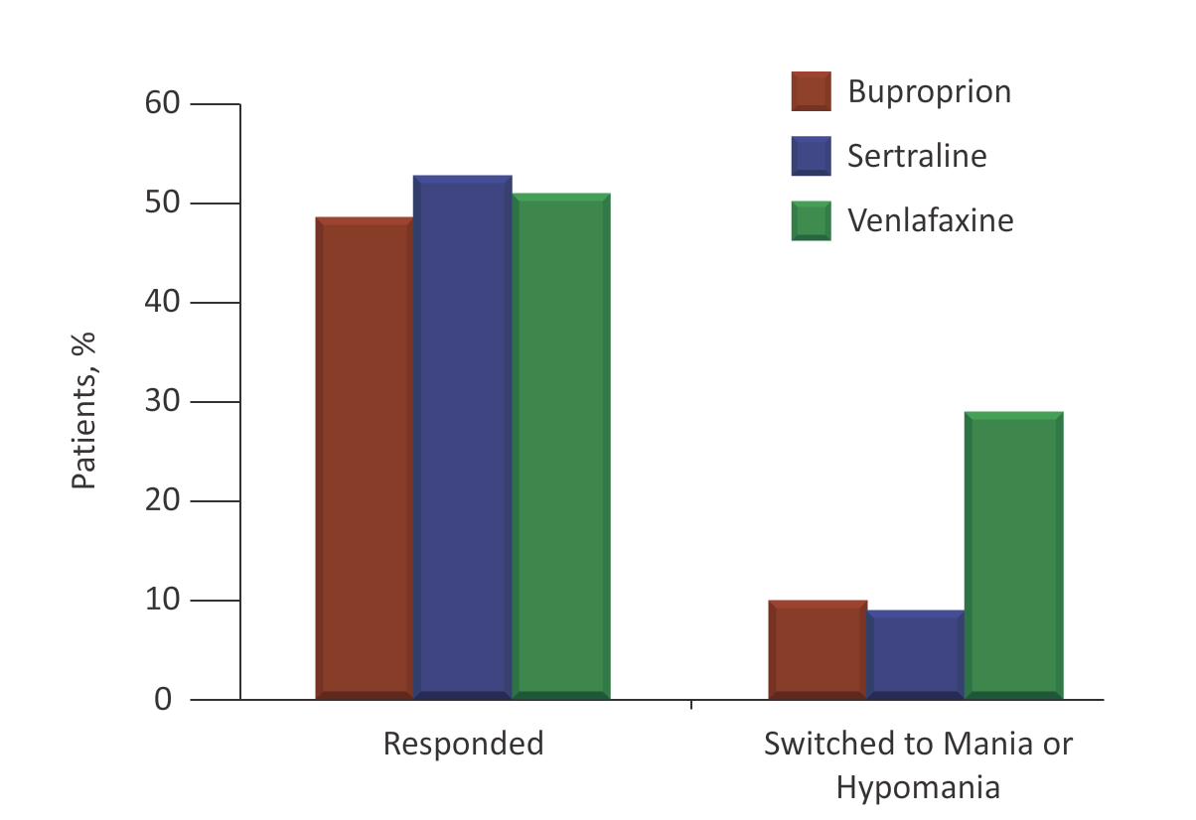
Antidepressant Use in Bipolar Disorder¹¹
Some studies suggest that SSRIs are more likely to induce mania
Study by Post et al.
Different antidepressants have have different propensities for triggering a switch
Venlafaxine confers the greatest risk

Slide 27
Societal Impact
Notes:
So now we have an understanding of how difficult this disease is to treat but what makes it worse is that stigma and impact it has on loved ones.

Slide 28
Impact on Families¹²

Slide 29
https://www.youtube.com/watch?v=7D-15Z9oE2g
Notes:
https://www.youtube.com/watch?v=7D-15Z9oE2g

Slide 30
References
Bipolar Disorder. (2005, September). Retrieved March 25, 2017, from http://www.webmd.com/bipolar-disorder/mental-health-bipolar-disorder#1
Mayo Clinic Staff Print. (2017, February 15). Symptoms and causes. Retrieved March 21, 2017, from http://www.mayoclinic.org/diseases-conditions/bipolar-disorder/symptoms-causes/dxc-20307970
Bipolar and Related Disorders. (n.a). Retrieved March 25, 2017, from http://dsm.psychiatryonline.org/doi/10.1176/appi.books.9780890425596.dsm03
Bipolar Disorder: Who's at Risk? (n.d.). Retrieved March 22, 2017, from http://www.webmd.com/bipolar-disorder/guide/bipolar-disorder-whos-at-risk#2
Prevalence of bipolar disorder. (2011, March 07). Retrieved March 25, 2017, from http://www.news-medical.net/news/20110307/Prevalence-of-bipolar-disorder.aspx
Schloesser, R. J., Huang, J., Klein, P. S., & Manji, H. K. (2008). Cellular Plasticity Cascades in the Pathophysiology and Treatment of Bipolar Disorder. Neuropsychopharmacology Reviews, 33, 110–133. https://doi.org/10.1038/sj.npp.1301575
National Collaborating Centre for Mental Health (UK). (2006). Bipolar disorder: The management of bipolar disorder in adults, children and adolescents, in primary and secondary care. Leicester, UK: British Psychological Society.
Colom, F., Vieta. E., Martinez-Aran, A., Reinares, M., Goikolea, JM., Benabarre, A., Torrent, C., Comes, M., Corbella, B., Parramon, G., & Corominas, J. (2003). A randomized trial on the efficacy of group psychoeducation in the prophylaxis of recurrences in bipolar patients whose disease is in remission. Archives of General Psychiatry, 60, (4), 402-4027. http://10.1001/archpsyc.60.4.402
Centre for Addiction and Mental Health. (n.d.). Treatments for bipolar disorder. Retrieved March 29, 2017, from http://www.camh.ca/en/education/about/camh_publications/info_guides/bipolar-info-guide/Pages/Treatments-for-bipolar-disorder.aspx#psych
Mayo Clinic. (2017). Bipolar Disorder. [online] Available at: http://www.mayoclinic.org/diseases-conditions/bipolar-disorder/diagnosis-treatment/treatment/txc-20308001 [Accessed 25 Mar. 2017].
Post, R., Altshuler, L., Leverich, G., Frye, M., Nolen, W., & Kupka, R. et al. (2006). Mood switch in bipolar depression: comparison of adjunctive venlafaxine, bupropion and sertraline. The British Journal Of Psychiatry, 189(2), 124-131. http://dx.doi.org/10.1192/bjp.bp.105.013045
Bipolar Disorder: Effects on the family. (n.d.). Retrieved March 26, 2017, from http://www.heretohelp.bc.ca/factsheet/bipolar-disorder-effects-on-the-family

