Slide 1
The Biological Basis of Sexuality
Gabrielle Retta, CJ Lindo, Franklin Duru, Angelica Dimita, Selina Casalino

Slide 2
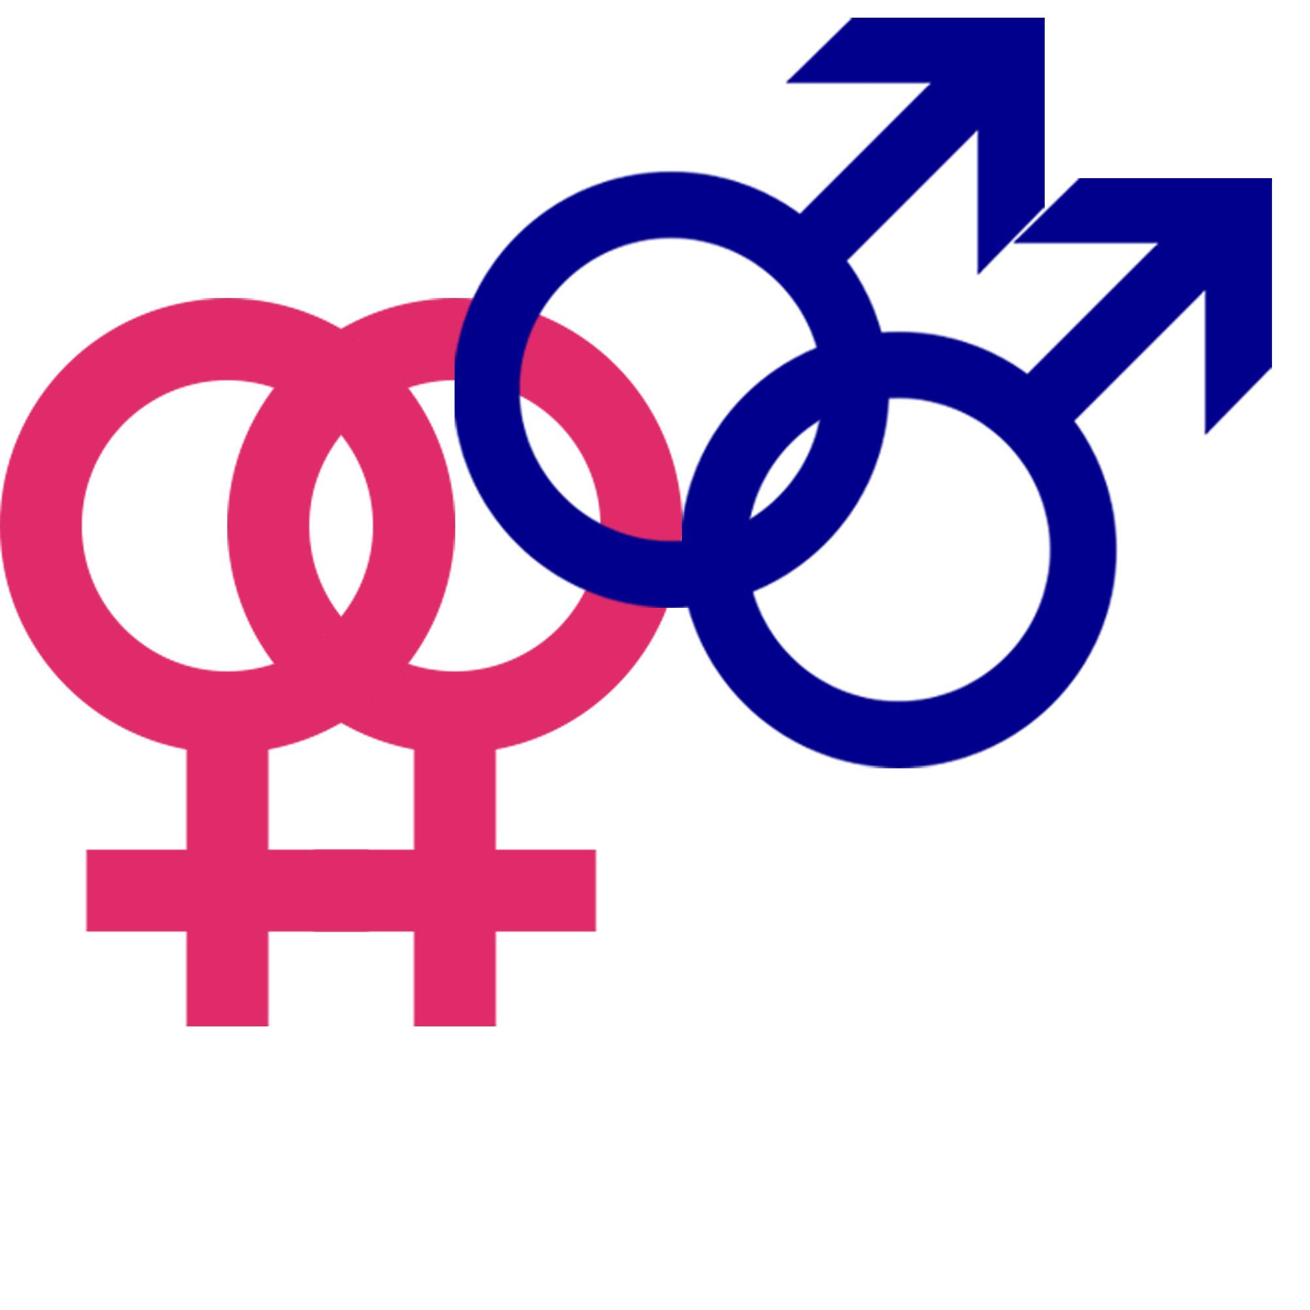
Introduction
Human Sexuality:
Expression as a sexual being
Studied by a variety of professionals
Experienced and Expressed
http://voxiitk.com/wp-content/uploads/2015/04/homosexuality-USE.svg_.jpg
Notes:
Text:
Human Sexuality refers to the way in which we experience and express ourselves as sexual beings. Your awareness of yourself as a female or male is a part of sexuality as well as the capacity to have erotic experiences and responses.
Human sexuality is studied by biologists, medical researchers, sociologists and psychologists and all fields make a contribution because sexuality is influenced by the interaction of biological, social, economic, cultural, and religious factors.
Sexuality is both experienced and expressed in thoughts, fantasies, desires, beliefs, attitudes, values, behaviours, practices, roles and relationships. Sexuality can include all of these dimensions, not all of them are always experienced or expressed

Slide 3
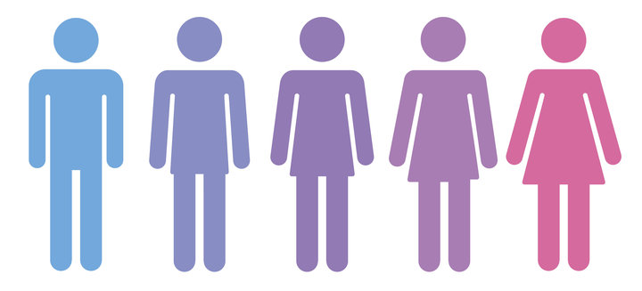
Key Terms
Gender Identity
Sexual Orientation
Monosexual
Plurisexual
https://www.huffingtonpost.ca/entry/gender-identity-respect_us_5a0daf8ee4b0b17e5e1483d4
Notes:
Gender Identity: person’s psychological identification with a particular gender, rather than their attraction to people
Sexual Orientation: Term describing a person’s sexual, emotional, or romantic attraction as well as the gender of people they are attracted to
Monosexual: Attracted to a single gender. This includes both heterosexual and homosexual people.
Heterosexual: one who is physically, emotionally and/or romantically attracted to individuals of a gender other than their own
Homosexual: one who is physically, romantically and/or emotionally attracted to individuals of the same gender with which they identify
Plurisexual: Attracted to multiple genders
Bisexual: attracted to people of their own and another gender (people attracted to men and women)
Some may have a preference
Pansexual: Attracted to others regardless of sex or gender. This includes attraction to people who identify as male, female, transgender, intersex, third gender, genderqueer, or anything in between
Queer: Term for all non-heterosexual identities. For example, a bisexual person who does not feel comfortable identifying as “bisexual” or a lesbian woman who does not wish to identify as “lesbian” can both identify as queer.

Slide 4
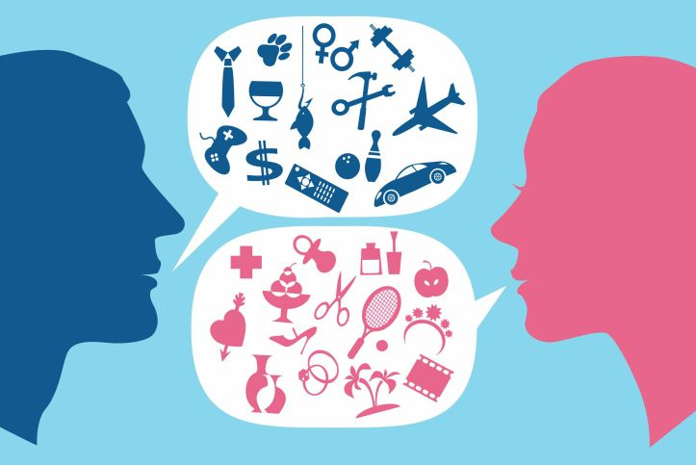
Key Terms Pt. 2
Demisexual
Androsexuality/Androphilia
LGBTQIAP
Asexual
Aromanticism
https://gendertrender.wordpress.com/2017/02/23/departments-of-education-and-justice-rescind-obamas-title-ix-gender-identity-guidance/
Notes:
LGBTQIAP: Lesbian, Gay, Bisexual, Transgender, Queer/Questioning, Intersex, Asexual, Pansexual
Used to describe the community of people who identify as something other than heterosexual and/or cisgender
More incluse term than LGBTQ
It is possible to identify with multiple orientations and gender identities
Androsexuality/Androphilia: attraction to men or masculinity
Includes heterosexual women and homosexual men
Aromanticism: People who do not feel a romantic desire
Not the same as asexual, as asexual identify does not rule out possible relationships
not interested in pursuing either sexual or romantic relationships with others
Asexual: does not experience sexual attraction or has little to no desire to engage in sexual activity
Derive no physical pleasure or emotional attachment with a sexual act
Still desire romantic relationships with people of same or other genders
Demisexuality: encompasses those who do not feel sexual attraction to others unless they feel emotionally connected to them
Relates most to the formation of committed romantic relationships, but does allow for other types of relationships like sexual relationships to form as well

Slide 5
Genes and Sexuality

Slide 6
Man-Loving Genes Hypothesis
“Evidence for maternally inherited factors favouring male homosexuality and promoting female fecundity.”
X-linked
Advantageous to mother
But, may be detrimental to son
Gene codes for sexual attractiveness towards men
(Camperio-Ciani, Corna, & Capiluppi, 2004)
Notes:
Studies suggest that 50% of gay men have some sort of genetic factor (Kunzig, 2008)
X-linked is suggested because study showed that gay sons had more gay men on their mother’s side of the family than on their father’s
Advantageous to mother → Camperio-Ciani study also found that gay men had more relatives in general -- this suggests that this “man-loving” gene is advantageous to the mother
This gene in particular is one that makes women more attracted to men -- allowing them to reproduce, having more offspring, and thus pass this gene onto their male children

Slide 7
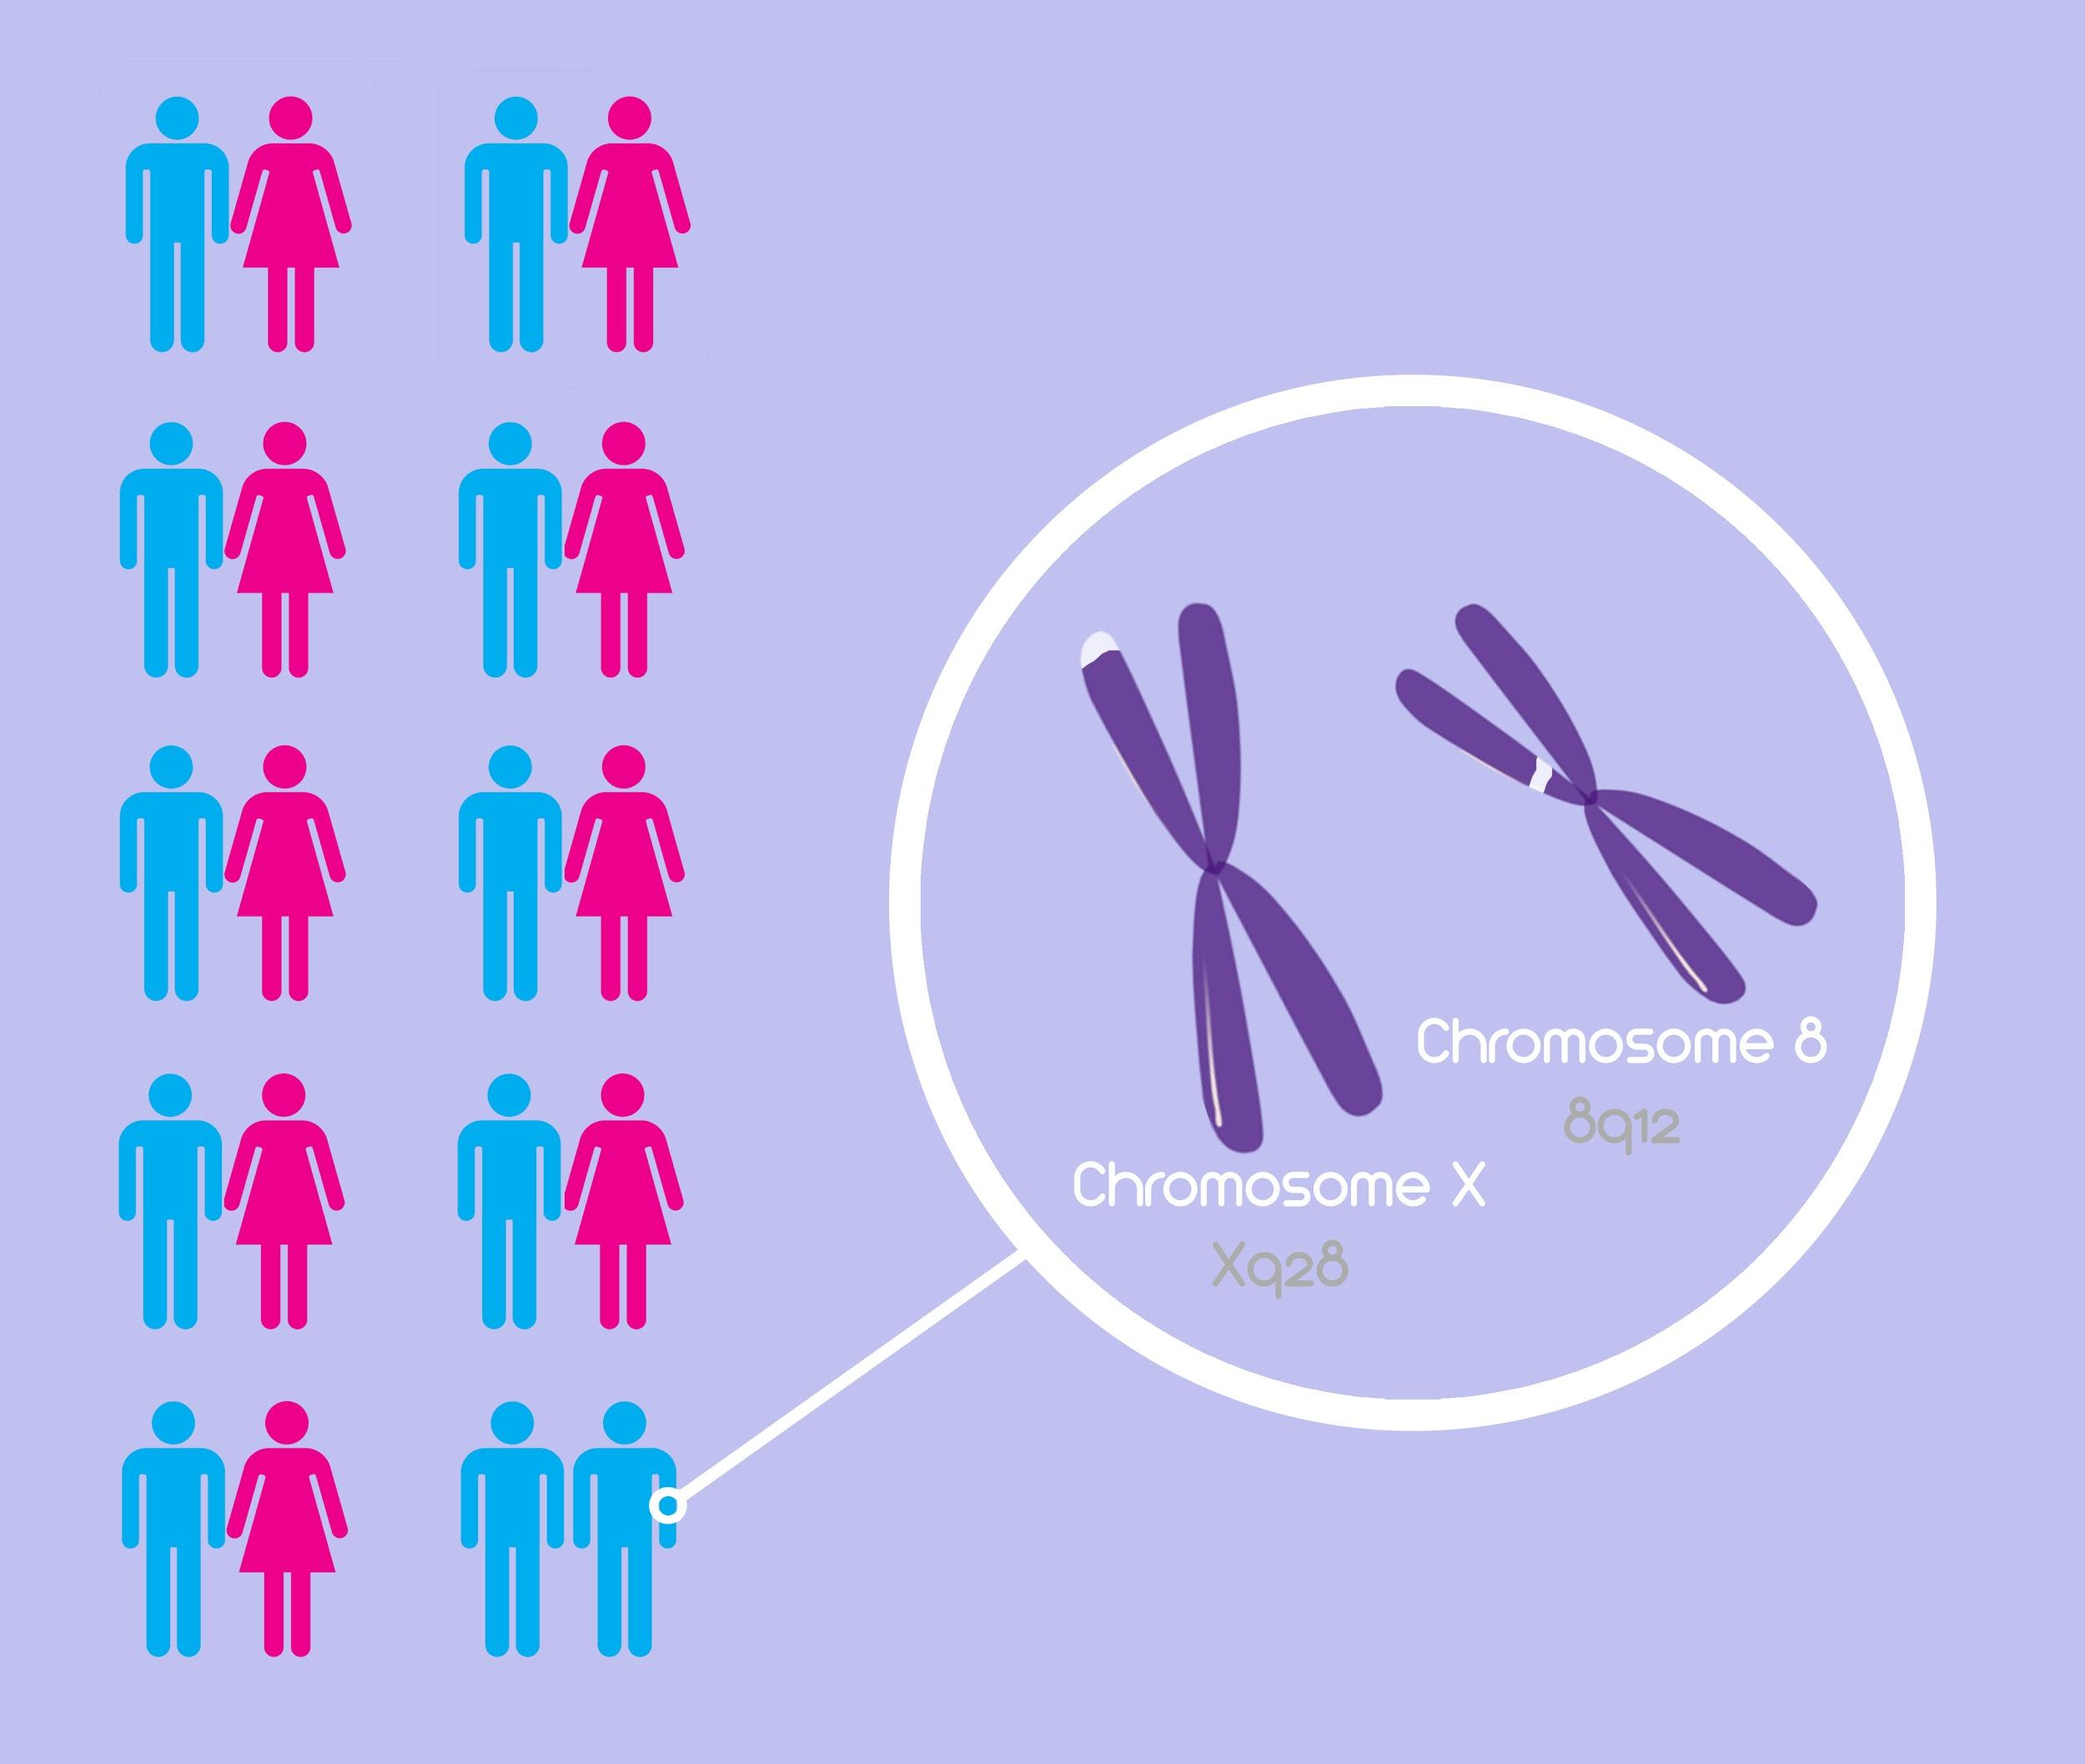
Chromosomes X and 8
(Suh, 2015)
Notes:
Study by Sanders et al focused their study on two different genes
Gene Xq28 on chromosome X
Gene 8q12 on chromosome 8

Slide 8
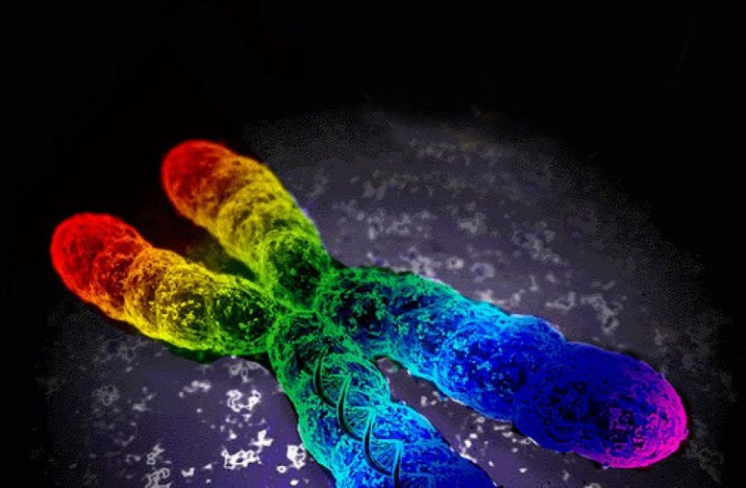
Sanders et al., 2015
Study consisted of:
351 families
908 genotyped family members
Of these 908 individuals:
793 were homosexual brothers
33 were heterosexual brothers
49 were mothers
33 were fathers
Calculated allele frequency estimates and used genetic mapping to discover common SNPs
https://geneticliteracyproject.org/2016/06/02/no-gay-gene-misconceptions-genetics/
Notes:
Among these individuals, sanders et al. calculated allele frequency estimates and used a deCODE genetic map
The reason they included mothers and fathers was to look at chromosome X in particular -- ties in with the “Man-loving genes hypothesis” and sanders et al. actually discuss this in their results (how Xq28 SNPs are more common within mothers than in fathers, which suggests another correlation between homosexality and chromosome X)

Slide 9
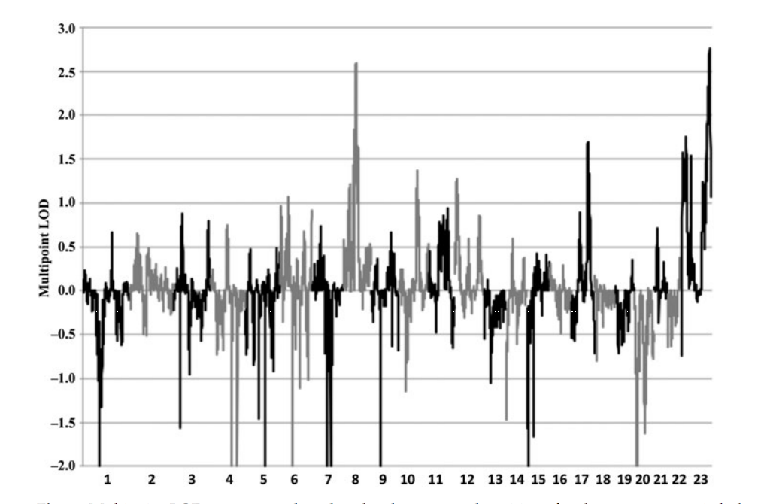
Sanders et al., 2015
Notes:
Results showed common SNPs throughout MOST homosexual men in the study in chromosomes 8 and X within these given regions (Xq28 and 8q12)
“It is likely that genes contributing to variation in male sexual orientation reside in these regions.”
This graph depicts the LODs of each chromosome -- this just tells us the likelihood of genes on a chromosome being inherited all together (instead of various parts of each gene not being inherited, etc.)
Can be seen that chromosomes 8 and 23 (X chromosome) have an extremely high LOD - meaning that SNPs on genes on these chromosomes are inherited together
Important to note that this study concluded that there are many other contributing factors to homosexuality, since NOT ALL gay men carried this gene

Slide 10
Sexuality and the Environment

Slide 11
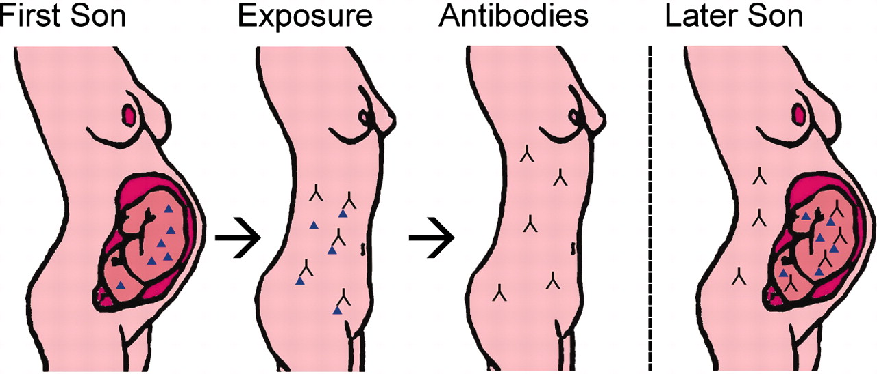
Fraternal Birth Order
(Blanchard, 2001)
http://www.pnas.org/content/103/28/10531/F1.large.jpg
Notes:
Fraternal Birth order
This theory is based on the mothers body changing during each pregnancy as her in-utero immune response changes
The Y chromosome in male fetuses creates H-Y antigens which are involved in sexual differentiation in vertebrates by aiding in the masculinization of the brain leading to sex-typical traits
During pregnancy with a male fetus, the mother’s immune system creates anti- H-Y antibodies to fight the H-Y antibodies as they are seen as invaders because of their link to the Y chromosome. With each subsequent pregnancy with a male fetus the mother’s body creates more and more anti- H-Y antibodies that inhibit the masculinization of the fetus and this is believed to be a factor in sexual orientation by interfering with sexual differentiation of the fetuses brain.
Graph: In men, sexual orientation correlates with an individual’s number of older brothers born from the same mother – each older brother increases the odds of homosexuality by close to 30% (3 of older sisters does not correlate with increasing probability of homosexuality)
This theory showcases a possible role of environment in sexual orientation in a developing fetus
· (Blanchard, 2001)
Wiki description:
Fraternal birth order, or the order in which male offspring are born to the same mother, has been studied for decades as a possible theory underlying differences in male sexuality. Blanchard (2011) describes that the fraternal birth order hypothesis is based upon the mother’s in-utero immune response changing during each subsequent pregnancy in response to presence of the fetus, specifically the Y chromosome. The Y chromosome in the male fetus produces Y-linked minor histocompatibility antigens (H-Y antigens). H-Y antigens are involved in sexual differentiation in vertebrates by aiding in the masculinization of certain brain structures and ultimately, sex-typical traits. During pregnancy with a male fetus, the mother’s immune system mounts a defense against the H-Y antigens because they are seen as foreign invaders, and therefore produces anti-H-Y antibodies. With each subsequent male pregnancy, the mother’s body will create increasing amounts of anti-H-Y antibodies. A visual representation of this process can be seen in Figure #. The effects H-Y antigens normally have on masculinization of male brain structures will be diminished, having an effect on sexual differentiation in the fetal brain and potentially, playing a role in sexual orientation. Based on his review of the literature, Blanchard (2011) summarizes that each older brother increases the odds of homosexuality by close to 30% (Figure #). Conversely, having three older sisters does not correlate with increasing probability of homosexuality.

Slide 12
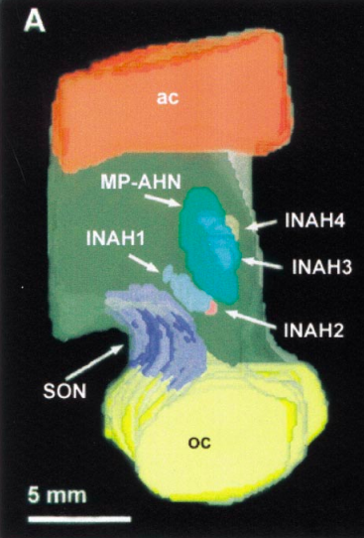
Neurohormonal or Neuroendocrine Theory
Exposure to atypical hormone levels during development results in sex-atypical neural differentiation
The interstitial nucleus of the human anterior hypothalamus (INAH-3) is smaller in homosexual vs heterosexual men
Resembles the size of INAH-3 in heterosexual women
(Modified from Byne et al., 2001)
Notes:
Neurohormonal or Neuroendocrine Theory
The Fraternal birth order phenomenon is evidence for neurohormonal or neuroendocrine theory, which examines the possibility that homosexual individuals have been exposed to atypical levels of hormones during development, thus causing sex-atypical neural differentiation
Byne et al. (2001) performed a brain autopsy on 34 presumed heterosexual men, 34 presumed heterosexual women, and 14 homosexual men and found that the INAH-3 area of the hypothalamus occupied a smaller volume in homosexual versus heterosexual men.
They also found that the INAH-3 contained more neurons and occupied a greater volume in heterosexual males versus females. The size of INAH-3 in homosexual males therefore showed a greater resemblance to the INAH-3 area of heterosexual females.
This difference in the hypothalamus points to a possible relationship between neural development and sexual orientation
While this study presents significant results, it is important to note that the homosexual men they studied were HIV positive, which may have affected brain tissue development and the validity of their conclusions. Sexual orientation was also presumed and not confirmed, as the autopsy had to be performed post-mortem.
(Byne et al., 2001; Bailey, Dunne & Martin, 2000; Avery et al., 2007)

Slide 13
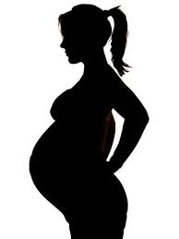
Maternal Stress Theory
A Test of the Maternal Stress Theory of Human Male Homosexuality (Bailey, Willerman, & Parks, 1991)
Does stress during development lead to male homosexuality?
Found that mothers of male non-heterosexuals reported no more stress during their pregnancies than did mothers of heterosexuals
Notes:
Maternal Stress Theory
Bailey, Willerman, and Parks (1991) collected stress-proneness data and retrospective reports of stress during pregnancy from mothers of male and female heterosexuals, bisexuals, and homosexuals. Each mother also rated pregnancy stress for a heterosexual sibling of the subject (as a control). There was no significant correlation between sexual orientation and maternal stress found for male offspring.
Research on maternal stress theory in males is ongoing and the literature is mixed on if maternal stress during pregnancy is significantly correlated with sexual orientation, particularly male homosexuality.

Slide 14
Physiology and Sexuality

Slide 15
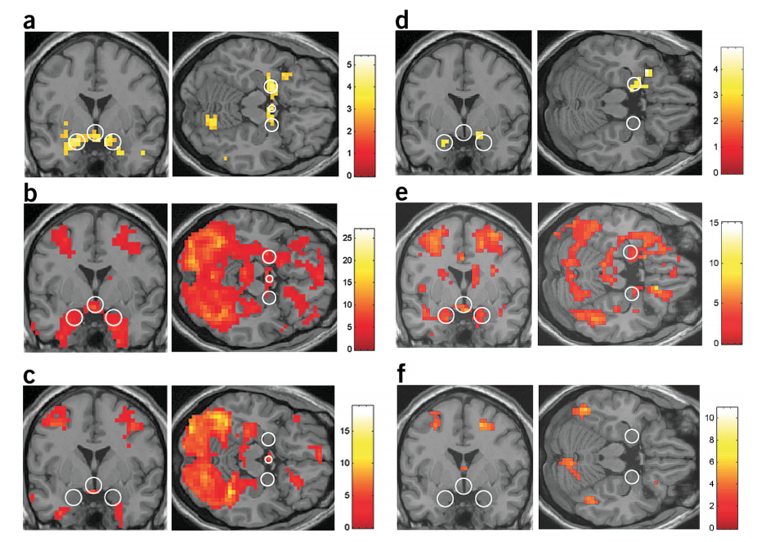
The Sexually Dimorphic Brain
Hamman et al, 2004
Notes:
Sex differences exist in every brain lobe, including in many ‘cognitive’ regions such as the hippocampus, amygdala and neocortex.
The amygdala is a structure in the temporal lobe that has long been known to play a key role in emotional responses and emotional memory in both humans and nonhuman animals.
Growing evidence from recent neuroimaging studies points to a new, expanded role for the amygdala as a critical structure that mediates sex differences in emotional memory and sexual responses.
Psychological studies have identified a variety of sex differences in emotion-related behavior in humans. For example, women on average retain stronger and more vivid memories for emotional events than men (Seidlitz and Diener 1998; Canli and others 2002).
Another prominent human sex difference is the substantially greater role that visual stimuli play in male sexual behaviour.
Recent neuroimaging studies using positron emission tomography (PET) and functional MRI (fMRI) have revealed that these and other sex differences in emotional responses are closely linked to differences in amygdala response.
In this article, we address these and other recent findings that highlight an emerging new role for the amygdala as a key structure that mediates differences in emotional and sexual responses between men and women
These sex differences in the amygdala’s function may be related to the structural and developmental sex differences that have been found previously, such as the high concentration of sex hormone receptors and the larger size of the amygdala in men than women
Numerous studies have demonstrated that men are more psychologically and physiologically responsive to visual sexually arousing stimuli and display a greater motivation to seek out and interact with such stimuli
This specific sex difference is predicted by evolutionary and sociobiological theories that postulate that it is adaptive for males to react rapidly to visual information that signals an opportunity to mate with a fertile female because this tends to increase their probability of passing on their genes. Because of the greater maternal investment in time and resources for childrearing, a similar rapid arousal response to visual stimuli is not adaptive for females.
The primary finding was that the amygdala and hypothalamus exhibited substantially more activation in men than in women when viewing the same sexually arousing visual stimuli. (Throw in a Figure to Illustrate this)
Another fMRI study, conducted by Karama and others (2002), also examined sex differences in brain responses to sexually arousing visual stimuli (films). Greater activity for men in the hypothalamus (which receives substantial amygdalar output) was observed with greater left amygdala activity in men

Slide 16
Clinical Implications
The differing response of Amygdala in both sexes leads to different disorders in both sexes
Males
Voyeurism
Autism
Females
Depression
Post Traumatic Stress Disorder
Notes:
Clinical implications:
Sex differences in the amygdala’s response have been cited by several authors as a potentially important factor that may explain why some psychological disorders are more common in men or women
Abnormal amygdala function has been observed in depression (Sheline and others 2001), and sex differences in the amygdala’s role in emotional memory have been linked to the greater prevalence of depression in women. Specifically, the prevalence of ruminative thinking associated with longer and more severe episodes of depression.
Because fear conditioning depends critically on the amygdala, sex differences in amygdala response may partly account for the greater prevalence of PTSD in women.
voyeurism are far more prevalent in men (Gomez 1991). The greater amygdala response to visual sexual stimuli and greater appetitive motivation elicited by visual sexual stimuli may contribute to the greater rate of such disorders in males.
autism, a developmental disability that is characterized by significant deficits in emotion, communication, and social interaction, is approximately four times as common in males than in females. The link between the amygdala and autism is further supported by neuroimaging evidence that the amygdala in children with autism undergoes abnormal development

Slide 17
Evolution and Sexuality
Notes:
There is considerable evidence that human sexual orientation is genetically influenced, with as many as 4% of the American population identifying as homosexual according to a 2016 poll (Gates, 2017). There’s a Darwinian paradox with regards to homosexuality in that selection, according to Darwin, should have eliminated alleles for homosexuality since they reduce individual fecundity and fitness. So why doesn’t this occur with homosexuality?

Slide 18
Homosexuality - Kin Selection
Homosexuality and Kin selection Bobrow & Bailey (2001) + Rahman & Hull (2003) studies
Both studies used questionnaire data to conduct a test for the kin selection hypothesis of male homosexuality in a sample of homosexual and heterosexual men
Both studies found no significant differences between heterosexual and homosexual men
Samoan Fa’afafine → real world example of kin selection and homosexuality
Vasey & VanderLaan (2010)
Compared money given to nieces and nephews from female, heterosexual male, and homosexual male relatives
Notes:
It was previously proposed that homosexuality was maintained through kin selection. Instead of reproducing directly, homosexual individuals would invest in the children of close relatives through resource provision and child care, thereby increase their kin's chance of survival and reproduction as a result. This would enable them to indirectly pass on their genes through their kin. However, when the kin selection hypothesis of homosexuality was tested by David Bobrow and Michael Bailey and once again by Rahman and Hull, it was not supported. They found no significant differences between heterosexual and homosexual men in familial affinity, willingness to provide financial and emotional resources, and benevolent tendencies (such as the willingness to babysit). These findings contradict the theory of homosexuality being maintained through kin selection.
However, research has demonstrated that Samoan homosexual men (known locally as fa'afafine) exhibit significantly higher altruistic tendencies toward nieces and nephews compared to Samoan women and heterosexual men. Vasey & VanderLaan (2010) used money given to, and received from, oldest and youngest siblings' sons and daughters as a behavioral assay of kin altruism. So they were able to measure the altruistic behaviour directed to nieces and nephews from their respective relatives. They then compared the results to women and heterosexual men, and found that the fa'afafine gave significantly more money, particularly to their youngest sibling’s daughters. (Vasey & VanderLaan, 2010)
So there is still some debate with regards to the validity of the kin selection hypothesis with regards to its role in the maintenance of homosexuality.

Slide 19
Impact of Pleiotropic Genes on Sexuality
Pleiotropic gene: a gene with more than one effect
Maintained throughout evolution → Increases desirable partner traits in heterosexual individuals
EMPATHY
DESIRABLE
PARTNER
TRAITS
FITNESS
SENSITIVITY
Heterosexual Men
Miller, 2000
Notes:
Another explanation for this Darwinian paradox has been proposed by Miller (2000). He argues that a mechanism (i.e., a gene for homosexuality) which produces only homosexuality would be strongly selected against and could not survive. However, a pleiotropic gene for which homosexuality was one of only several mechanisms could potentially survive selection. The survival of homosexuality in humans can be explained by sexual orientation being a trait that is influenced by a number of pleiotropic genes (Miller, 2000), which, simply put, are genes that have more than a single effect. Miller (2000) states that one effect could be contributing to homosexuality (with a negative effect on reproductive success), and the other effects could contribute to reproductive success in heterosexuals. For example, increasing desired traits in sexual partners. He explains in his study that, more often than not, these alleles are inherited along with other genes that make the male heterosexual, wherein the effect of the alleles would be increased sensitivity, empathy, tender-mindedness, and kindness (Miller, 2000), rather than outright homosexuality. Heterosexual individuals (particularly males, in this case) with these traits would make for better caregivers and fathers, and subsequently a more attractive prospective mate - thereby increasing their fitness.

Slide 20
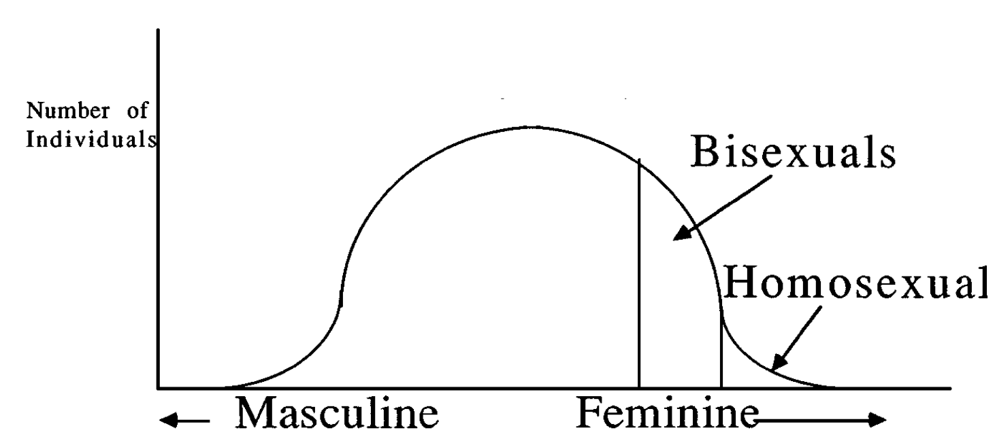
Pleiotropic Genes
Contributes to homosexual and bisexual phenotype prevalence
If pleiotropic genes all code for more ‘feminine’ traits, the individual will fall in bisexual or homosexual area of the Miller curve
Miller, 2000
Notes:
So to illustrate this, he created a normal curve with masculine and feminine traits on the x-axis and number of individuals on the y-axis. As you can see, most individuals would fall within the masculine, heterosexual range. According to Miller (2000), the aforementioned pleiotropic genes would shift male development, including that of the brain, in the female/feminine direction. Should he inherit multiple alleles that shift his development in the feminine direction, he becomes bisexual or homosexual. Males who inherit any such alleles, but still have fewer than five, are heterosexual and benefit from an increase in sensitivity. Additionally, males who inherit none of these alleles are hypermasculine and lacking in the sensitivity, kindness, empathy, and other traits that make them most attractive to females. So, it’s in this way that Miller postulates the alleles for homosexuality have been maintained: through a type of heterozygote advantage.

Slide 21
Female Sexuality and Evolution
Measured:
Sexual Attraction Scale Number (1-5)
Number of Sexual Partners
CGN
Results:
Low CGN → greater nonheterosexual attractions
Low CGN → more sexual partners in hetero- and nonheterosexual women
+
monozygotic female twins
dizygotic female twins
SEXUAL ATTRACTION SCALE
1
5
Only males, never females
Only females, never males
(Burri et al., 2015)
Notes:
In a twin study conducted by Burri et al. (2015), monozygotic and dizygotic female twins were asked to complete a survey regarding sexual behaviour and sexual orientation, as well as a follow-up survey assessing CGN (childhood gender nonconformity) – a measure for sex typicality. Zygosity of the twins was established using standardized questions about physical similarity and was confirmed by multiplex DNA genotyping in cases of uncertainty. In the first survey, a scale was used to score sexual attraction, ranging from 1 (only with males, never with females) to 5 (only with females, never males) with the option of “no sexual attraction” for asexual participants. As a measure of fitness, lifetime number of sexual partners was employed by the researchers. The results of the experiment showed low CGN (“masculine”) scores were associated with greater nonheterosexual attractions (score of 2-5 on the scale) and more sexual partners (Burri et al., 2015). Additionally, heterosexual women that scored “masculine” CGN were also associated with more sexual partners (Burri et al., 2015). Overall, the researchers concluded that CGN was associated with female homosexuality, more masculine heterosexual women had greater numbers of lifetime sexual partners, and that these relationships are influenced by common genetic factors via a single shared phenotype with a heritability of 40% (Burri et al., 2015). These results are consistent with the theory that the genetic variation underlying this fitness-reducing trait—female homosexuality—might be maintained through its reproductive benefits (higher number of lifetime partners) in heterosexual individuals.

Slide 22
References
Avery, A., Chase, J., Johansson, L., Litvak, S., Montero, D., & Wydra, M. (2007). America's Changing Attitudes toward Homosexuality, Civil Unions, and Same-Gender Marriage: 1977-2004. Social Work, 52(1), 71-79. http://dx.doi.org/10.1093/sw/52.1.71
Bailey, J., Dunne, M., & Martin, N. (2000). Genetic and environmental influences on sexual orientation and its correlates in an Australian twin sample. Journal Of Personality And Social Psychology, 78(3), 524-536. http://dx.doi.org/10.1037//0022-3514.78.3.524
Bailey, J. M., Willerman, L., & Parks, C. (1991). A test of the maternal stress theory of human male homosexuality. Archives of Sexual Behavior, 20(3), 277-293. Retrieved from https://www.researchgate.net/profile/J_Bailey2/publication/288653604_A_test_of_the_maternal_stress_theory_of_human_male_homosexuality/links/5694286f08ae425c68963693.pdf
Blanchard, R. (2001). Fraternal birth order and the maternal immune hypothesis of male homosexuality. Hormones and Behavior, 40,
105-114. https://doi.org/10.1006/hbeh.2001.1681
Bobrow, D., & Bailey, J. (2001). Is male homosexuality maintained via kin selection?. Evolution And Human Behavior, 22(5), 361-368. http://dx.doi.org/10.1016/s1090-5138(01)00074-5
Burri, A., Spector, T., & Rahman, Q. (2015). Common Genetic Factors among Sexual Orientation, Gender Nonconformity, and Number of Sex Partners in Female Twins: Implications for the Evolution of Homosexuality. The Journal of Sexual Medicine, 12(4), 1004–1011.
Byne, W., Mattice, L.A., Lasco, M.S., Kemether, E.K., Edgar, M.A., Morgello, S., Buchsbaum, M.S.,... Liesl, B. (2001). The Interstitial Nuclei of the Human Anterior Hypothalamus: An Investigation of Variation with Sex, Sexual Orientation, and HIV Status. Hormones and Behavior, 40, 86-92. doi:10.1006/hbeh.2001.1680
Camperio-Ciani, A., Corna, F., & Capiluppi, C. (2004). Evidence for maternally inherited factors favouring male homosexuality and promoting female fecundity. Proceedings of the Royal Society of London B: Biological Sciences, 271(1554), 2217-2221.

Slide 23
References
Gates, G. (2017). In U.S., More Adults Identifying as LGBT. Gallup.com. Retrieved 13 November 2017, from http://news.gallup.com/poll/201731/lgbt-identification-rises.aspx
Kunzig, R. (2008, May/June). Finding the switch: homosexuality may persist because the associated genes convey surprising advantages on homosexuals' family members. Psychology Today Magazine. Retrieved from https://www.psychologytoday.com/us/articles/ 200805/finding-the-switch
Miller, E. M. (2000). Homosexuality, birth order, and evolution: Toward an equilibrium reproductive economics of
homosexuality. Archives of sexual behavior, 29(1), 1-34.
Rahman, Q., & Hull, M. (2005). An Empirical Test of the Kin Selection Hypothesis for Male Homosexuality. Archives Of Sexual
Behavior, 34(4), 461-467. http://dx.doi.org/10.1007/s10508-005-4345-6
Sanders, A. R., Martin, E. R., Beecham, G. W., Guo, S., Dawood, K., Reiger, G., . . . Bailey, J. M. (2015). Genome-wide scan demonstrates significant linkage for male sexual orientation. Psychological Medicine, 45, 1379-1388. https://doi.org/10.1017/S0033291714002451
Suh, M. J. (2015, April 18). The truth about the “gay gene.” Innovation: Princeton Journal of Science and Technology. Retrieved from
http://princetoninnovation.org/magazine/2015/04/18/truth-gay-gene/
Vasey, P., & VanderLaan, D. (2010). Monetary exchanges with nieces and nephews: a comparison of Samoan men, women, and fa'afafine. Evolution And Human Behavior, 31(5), 373-380. http://dx.doi.org/10.1016/j.evolhumbehav.2010.04.001

