Slide 1
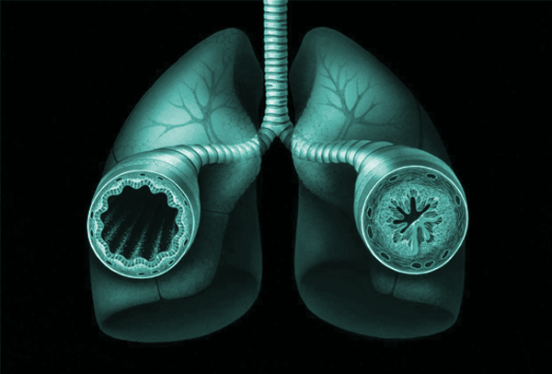
Asthma
Nerissa D’Mello, Ahmed Khan, Fadi Hana, Rohan Minhas & Mathushan Sukumar

Slide 2
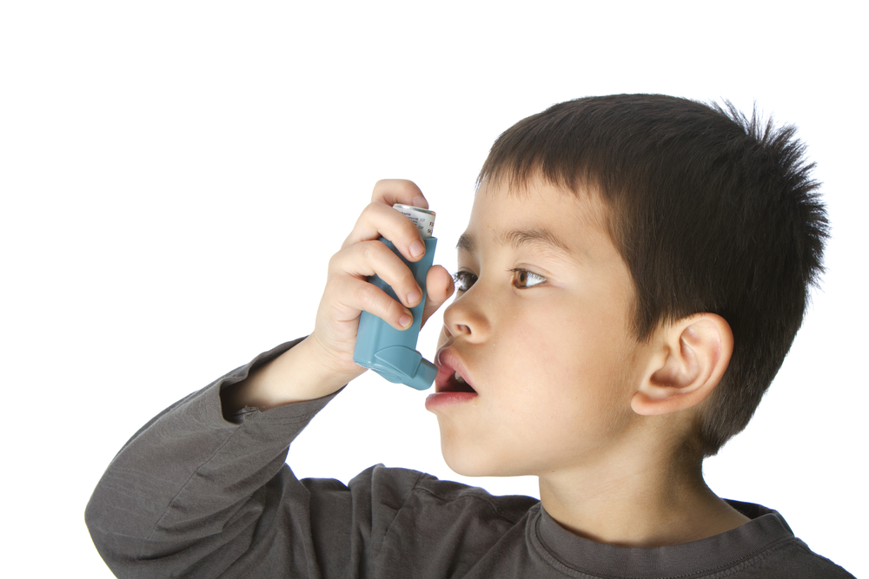
Table of Contents
Introduction
Signs and Symptoms
Diagnosis
Pathogenesis
Pathophysiology
Treatments
Conclusion

Slide 3
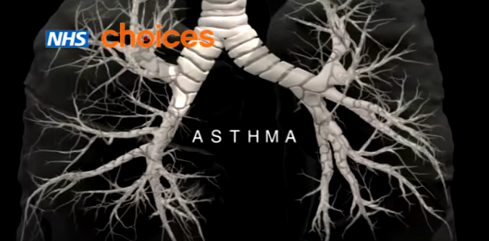
Video: Asthma
https://www.youtube.com/watch?v=7EDo9pUYvPE

Slide 4
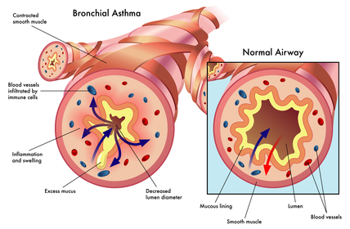
Introduction
Asthma is a chronic inflammatory disease that leads to airway constriction and airway hyperresponsiveness
About 300 million people affected worldwide
250, 000 deaths annually
Asthma can be divided into two forms:
Allergic asthma:
Most commonly found in children
An allergic sensitization causes progression of asthma
Interaction between the IgE antibody in the body and the inhaled/ingested allergen
Non - allergic Asthma:
Most commonly found in women
This form is hard to treat and requires a more long-term intervention

Slide 5
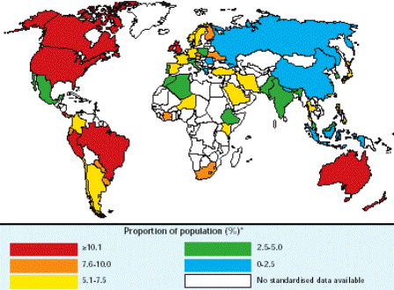
Epidemiology
Prevalence of Asthma varies around the world
Mostly prevalent in developed countries (US, Canada, Australia)
Factors like increased industrialization, lifestyle and environmental factors
Increased prevalence of this disease is leading to increased mortality over time
75% increase in prevalence observed between 1980 and 1994
Greatest increase in children and young adults
Might be due to greater awareness from the public and earlier detection times

Slide 6
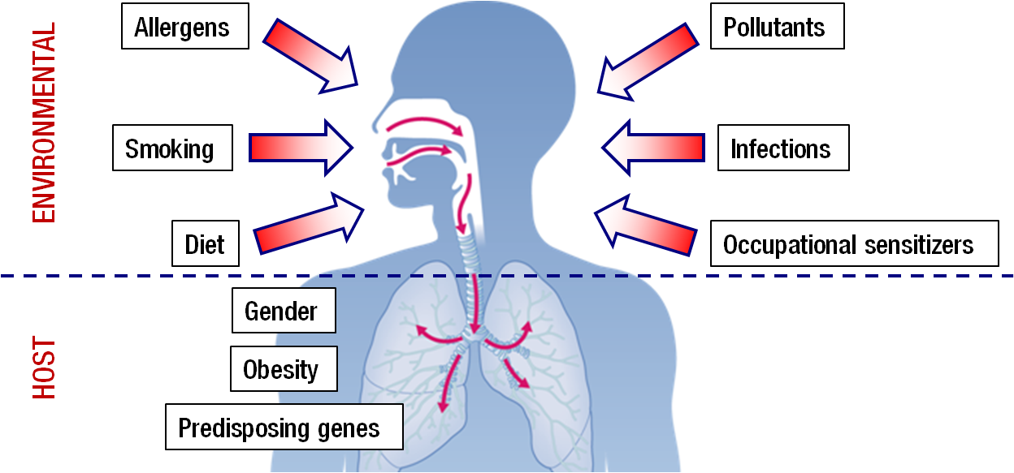
Risk Factors
Heredity
Two asthmatic parents → 80 - 90% chance of developing asthma; one asthmatic parent → 30 - 40% chance of developing asthma; Family history of asthma → four time increase of developing asthma
Environment of the Fetus
Mother’s exposure to allergens in the first 22 weeks of gestation
Bronchial hyperresponsiveness mostly found in infants with lower birthweight as opposed to infants with a higher birthweight
Mothers younger than 20 years and those who smoke
Environmental factors
Environmental exposures to allergen early in life
Urban environments - indoor/sedentary lifestyle
Overuse and misuse of Antibiotics
Vitamin C deficiency and diets low in Omega 3’s
Exposure to infections
Family size

Slide 7
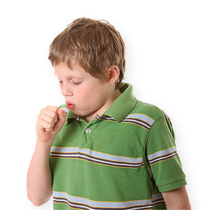
Signs and Symptoms
Mostly physiological abnormalities affecting lung function; sometimes cardiac performance
Checklist:
Ability to sleep in the night
Coughing associated with tachycardia
Wheezing
Dyspnea- difficulty breathing
Triggers can be attributed to emotional stress faced by children→ Anxiety attacks

Slide 8
Signs and Symptoms
Combination of factors exacerbate activity and the overall inflammation in the airway
May just have one of the symptoms, or all at once
Can be mistaken for other diseases due to range of common symptoms
Highly dependent on each person: asthma attacks, long periods without asthma, symptoms once a day, or only during fitness activity.

Slide 9
Diagnosis
Studies indicate 50-80% children develop asthma-like symptoms < 5 years old
Misdiagnosis is common as these symptoms are representative of most respiratory malfunction: chronic bronchitis, pneumonia, infection etc.
Prognosis directed towards family history of asthma as an allergy, or prenatal exposure to secondhand smoke and allergens
In children→ hard to obtain qualitative measurements indicating impairment of lung function
In adults→ more easier since physicals are conducted more frequently, assess quality of life as adult ages, annual checkups

Slide 10
Pathogenesis
What initiates the inflammatory process in the first place is still being investigated
New observations suggest that the origins of asthma occurs early in life
Asthma is a complex and interactive process that depends on the interplay between
Host factors: particularly snips and gene markers that are hereditary
Environmental exposures such as: allergens, chemical irritants, cold air, exercise, medications

Slide 11
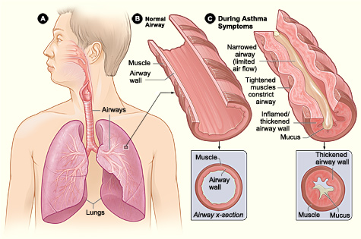
Pathophysiology
Chronic disease of the respiratory system involving:
Bronchoconstriction- narrowing of airway
overdeveloped mucous glands
airway thickening/bronchial inflammation
obstruction of the air flow
wheezing and shortness of breath
Involves interplay and combined effect of many cells and signals

Slide 12
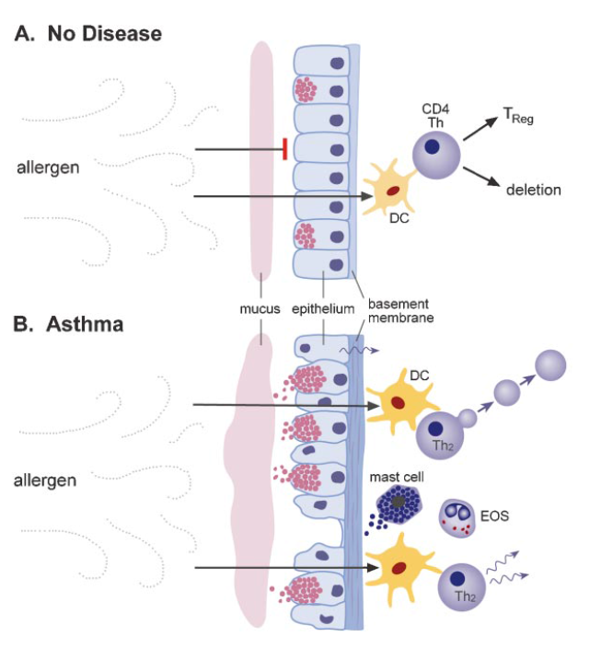
Pathophysiology: Normal Response
Normally airborne antigens are sampled by antigen presenting cells (i.e. dendritic cells) at the bronchial mucosa
The barrier function of the mucosa remains intact via tight junctions and ensures mucociliary clearance
Treg cells induce self tolerance and suppress allergy and immune response
Treg cells are non-inflammatory regulatory T cells which help mediate immunological tolerance
Treg cells secrete IL-10 or TGF-beta signals

Slide 13
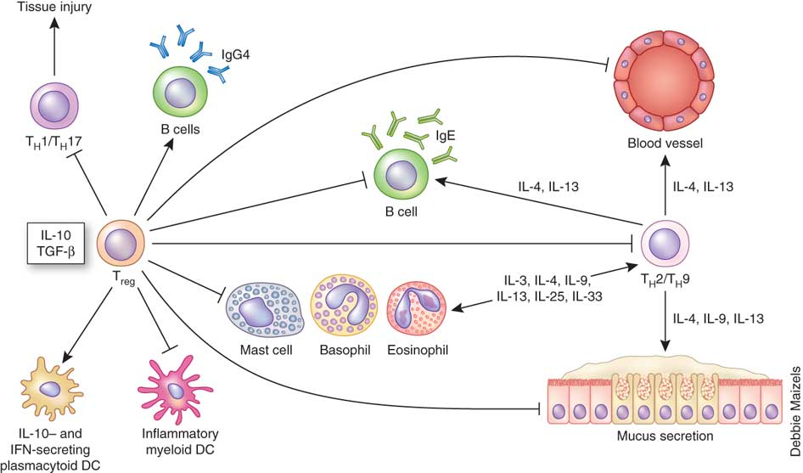
Pathophysiology: Normal Response Con’t
T reg cells:
inhibit dendritic cells
inhibit T cells which promote inflammation of airway and bronchoconstriction
inhibit B cells from producing IgE which leads to inflammation caused by histamine production
inhibit mast cells, eosinophils and basophils which cause inflammation and mucous via histamine and prostaglandin release

Slide 14
Pathophysiology: Asthmatic Response
The barrier is disrupted causing leaky basement membrane and no mucociliary clearance
Number of dendritic cells increase
Gives rise to T helper 2 cells (Th2) cells which activate inflammatory cells
Causes inflamed airways, release of inflammatory mediators, and epithelial damage
I.e. IgE dependent release of mediators from mast cells such as histamines and prostaglandins that directly contract smooth muscle
I.e. T helper 2 cells induces eosinophilic inflammation

Slide 15
Treatments - Management
•No permanent cure
•Management techniques implemented to alleviate symptoms of disease
•Avoid irritants that lead to inflammation of the airway
•Symptom relief from short-term medication
•i.e. Inhalers such as Ventolin
•Symptom relief from long-term medication
•Daily supplements that aid in the control to help prevent future aggravation of symptoms

Slide 16
Treatments - Therapeutics
•Inhalers – Bronchodilation
•Classified as beta-agonists
•Ventolin / Albuterol
•Bind to beta-adrenergic G-protein coupled receptors (GPCRs) of bronchial smooth muscle
•Leads to production of cyclic AMP (cAMP)
•cAMP pathway signals relaxation of smooth muscle cells
•Formoterol
•Similar mechanism to Ventolin
•Long-term solution as therapeutant remains at level of the
cell-membrane for larger periods of time
•Also binds to beta2-adrenergic receptors on mast cell membrane
•Reduction in histamine release (inflammatory agent)

Slide 17
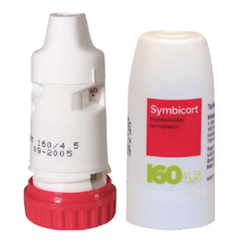
Treatments - Therapeutics
•Inhalers – Anti-inflammatory corticosteroids
•Pathway
•Minute 1 – Drug reaches target cells
•1-30 Minutes – Bronchial vasoconstriction resulting in closure of vascular microleaks
•Few Hours – Transcription factor activation post-binding to glucocorticoid receptor
•Relaxation of bronchial smooth muscle
•Combination drug therapy
•i.e. Symbicort
•Commonly used inhaler combining bronchodilators and anti-inflammatory
medication
•Results in synergistic effect
•Anti-inflammatory efficiency increased in presence of
bronchodilators such as Formoterol

Slide 18
References
Bacharier, L. B., Boner, A., Carlsen, K. H., Eigenmann, P. A., Frischer, T., Götz, M., ... & Platts‐Mills, T. (2008). Diagnosis and treatment of asthma in childhood: a PRACTALL consensus report. Allergy, 63(1), 5-34.
Bryan, S. A., Leckie, M. J., Hansel, T. T., & Barnes, P. J. (2000). Novel therapy for asthma. Expert opinion on investigational drugs, 9(1), 25-42.
Chiang, L. C., Ma, W. F., Huang, J. L., Tseng, L. F., & Hsueh, K. C. (2009). Effect of relaxation-breathing training on anxiety and asthma signs/symptoms of children with moderate-to-severe asthma: a randomized controlled trial.International Journal of Nursing Studies, 46(8), 1061-1070.
Cohn L, Elias JA, Chupp GL. Asthma: mechanisms of disease persistence and progression. Annu Rev Immunol. 2004; 22: 789-815. Review
Keller, M., Lowenstein, S. (2002). Epidemiology of Asthma. Seminars in Respiratory and Critical Care Medicine, 23(4). 317-329.
Kuna, P., & Kuprys, I. (2002). Symbicort Turbuhaler: a new concept in asthma management. International journal of clinical practice, 56(10), 797-803.
Lambrecht, B., Hammad, H. (2015). The Immunology of Asthma. Nature Immunology, 16(1), 45-56.
National Asthma Education, Prevention Program (National Heart, & Blood Institute). Second Expert Panel on the Management of Asthma. (1997).Expert panel report 2: guidelines for the diagnosis and management of asthma. DIANE Publishing.
National Asthma Education and Prevention Program, Third Expert Panel on the Diagnosis and Management of Asthma. Expert Panel (Report 3): Guidelines for the Diagnosis and Management of Asthma, Bethesda (MD): National Heart, Lung, and Blood Institute (US); 2007 Aug. Section 2, Definition, Pathophysiology and Pathogenesis of Asthma and Natural History of Asthma. Available from: http://www.ncbi.nlm.nih.gov/books/NBK7223/
Pauwels, R. A., Löfdahl, C. G., Postma, D. S., Tattersfield, A. E., O'Byrne, P., Barnes, P. J., & Ullman, A. (1997). Effect of inhaled formoterol and budesonide on exacerbations of asthma. New England Journal of Medicine, 337(20), 1405-1411.
Pawankar. (2014). Allergic diseases and asthma: a global public health concern and a call to action. World Allergy Organ J., 7(1), 12.

