Slide 1
Autonomous Sensory Meridian Response
Group 5 Presentation 3
March, 19th, 2020

Slide 2
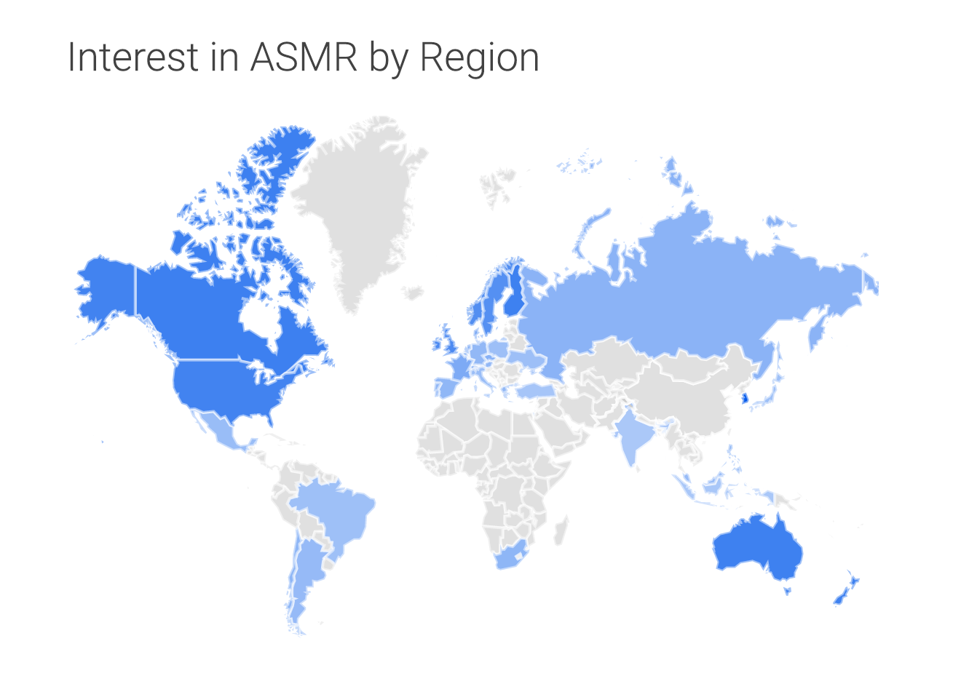
World wide
Phenomenon
(Mooney & Klein, 2016)

Slide 3
What is ASMR?
Media
Response
Brain
Notes:
john

Slide 4
What is ASMR?
Known as the “brain tingle” or
“brain orgasm”
Feeling Relaxed or “Tingle” with certain media content
Folding towel, flipping page
Tingle starts from the...
Scalp Body Arms/ Legs
(The ASMR, n.d.)

Slide 5
Science of
ASMR
Unclear of how the media trigger these responses
ASMR is closely related to Default Mode Network (DMN)
Decreased activities around some regions
Parts of sensory and attentional regions (sensory cortex, thalamus)
Increased activities around some regions
Executive control and visual resting-state regions (frontal lobe, occipital lobe)
(The ASMR, n.d.)
Notes:
john

Slide 6
Science of
ASMR
Decreased brain activities in the highlighted regions due to ASMR (Smith et.,2017)
Notes:
john

Slide 7
Science of
ASMR
Increased brain activities in the highlighted regions due to ASMR (Smith et.,2017)
Notes:
john

Slide 8
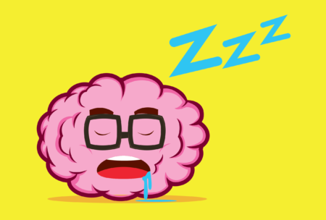
ASMR & Sleep
In a study conducted by Barratt and Davis
98% of the participants agree that ASMR helps with relaxation
82% of the participants agree that ASMR helps with sleeping
81% of the participants reported that the most common time for engagement with ASMR is before going to sleep at night.
(Barratt & Davis, 2015)
(The ASMR, n.d.)
Notes:
john

Slide 9
ASMR & Babies
There is little research identifying whether babies experience ASMR, however…
...ASMR is often used to help babies and toddlers fall asleep
Hushed whispers
Repetitive toy sounds
Soft touches
Caring glances
(“Breastfeeding a Sleepy Baby,” 2019)
Notes:
andrew

Slide 10
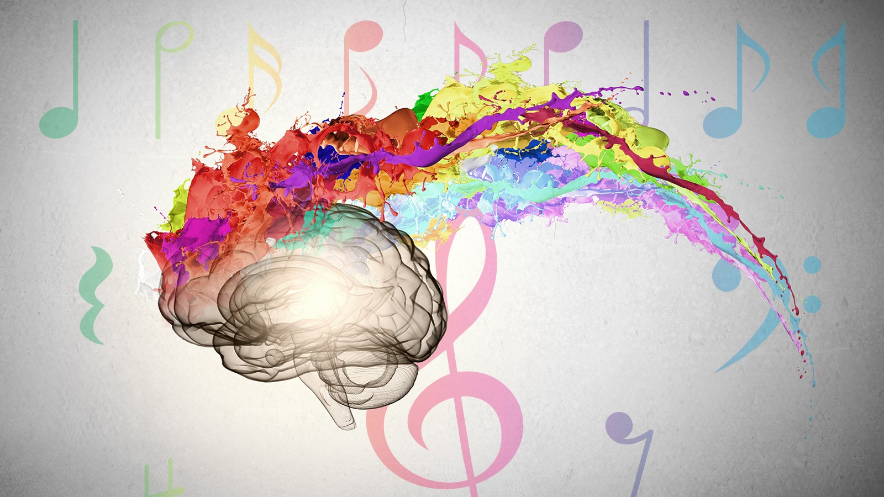
ASMR & Synesthesia
Synesthesia is the perceptual condition characterized by consistent sensory associations and atypical blending of the senses
Eg. When hearing a particular sound leads to a specific taste in the mouth
In ASMR
Secondary sensations are automatic and uncontrollable
In synesthesia
Secondary sensations are autonomous
(ASMR and other sensory phenomena, n.d.)
Notes:
Andrew

Slide 11
Does EVERYONE respond to ASMR?
Notes:
Andrew

Slide 12
The answer is …
NO

Slide 13
81%
Out of 800 participants claimed to experience ASMR
Notes:
andrew

Slide 14
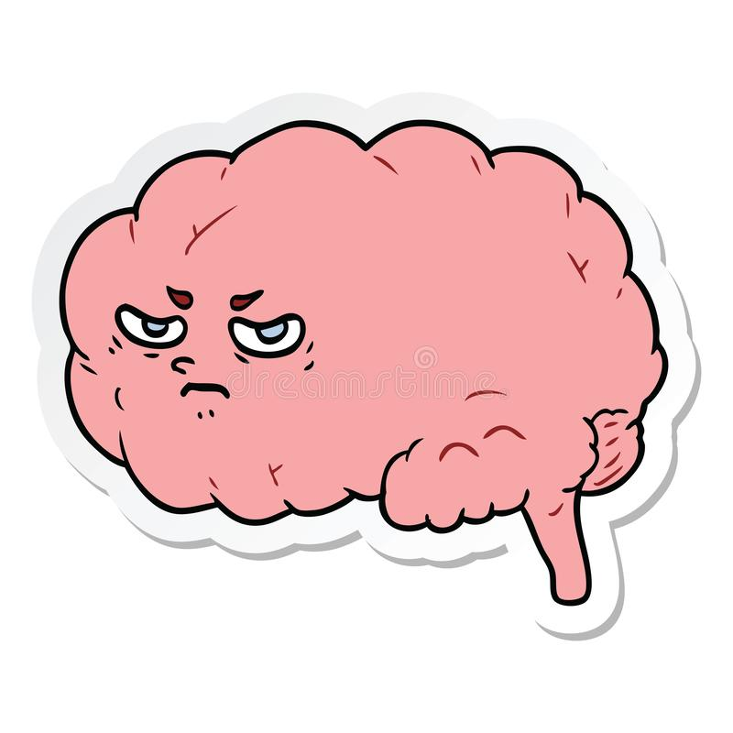
Some people find it very annoying...
Depends on the individuals
Brain activities differs
Different firing rate of the brain with a particular input
Believed people with no ASMR experience have less brain activities related to:
Rewarding
Emotional Arousal
(Dreamtime, n.d.)
Notes:
John

Slide 15
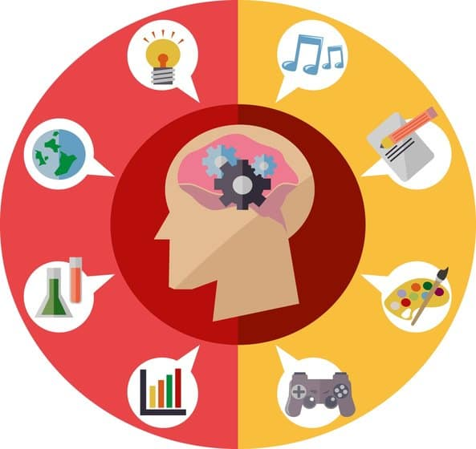
Misophonia of ASMR
ASMR is related to Misophonia
Misophonia is a disorder triggered by sound and causes anger and disgust
50% of who suffer from misophonia also report experiencing ASMR
ASMR and misophonia represent the opposite ends of a spectrum of experience.
the sound of chewing is highly relaxing for some people, while for others it is highly aversive.
(Fredborg, Clark, & Smith, 2018)
(The ASMR, n.d.)
Notes:
john

Slide 16
ASMR & Disorders
ASMR can offer therapeutic benefits for those who seek short-term relief from depression, stress and chronic pain
BUT…
ASMR can also lead to heightened sensitivity and aversion to sounds that elicit intense feelings of anger, anxiety and disgust
(The Physical Evolution of Consciousness, n.d.)
Notes:
andrew

Slide 17
ASMR & Anxiety
Many individuals watch ASMR videos to combat stress and anxiety
ASMR could be a new digital therapy for mental health
Promote relaxation and sleep
Some studies suggests that ASMR is associated with reduced heart rate and increased skin conductance
(Finkel, 2018)
Notes:
andrew

Slide 18
So… is ASMR safe?
So...is ASMR Safe?
OF COURSE IT IS!
It is no different than listening to music or nature sounds in order to relax the mind
Notes:
andrew

Slide 19
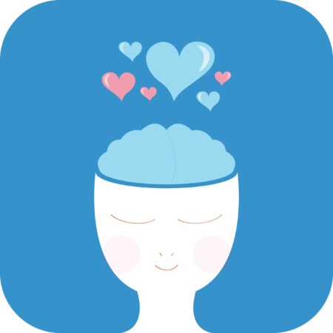
Conclusion
The topic of ASMR has recently become well-known
Mechanism of ASMR still requires further research
Not everyone experiences ASMR
Overall ASMR is safe and can be used for therapeutic purposes with further research
If you experience ASMR, relax at home away from Covid-19
(The ASMR, n.d.)
Notes:
john

Slide 20
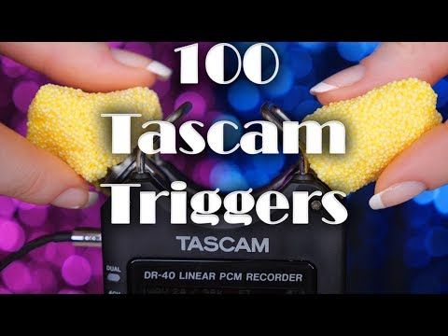
Example of ASMR

Slide 21
Reference
ASMR and Kids: What is It, and What are the Pros and Cons? - Detroit and Ann Arbor Metro
Parent. (2020). Retrieved 21 March 2020, from
https://www.metroparent.com/daily/health-fitness/mental-health-self-care/asmr-and-kids-
what-is-it-and-what-are-the-pros-and-cons/
Barratt, E. L., & Davis, N. (2015). Autonomous Sensory Meridian Response (ASMR): a
flow-like mental state. Peerj, 3, e851. doi: 10.7717/peerj.851
Brain tingles: First study of its kind reveals physiological benefits of ASMR. (2018, June 21). Retrieved from https://www.sciencedaily.com/releases/2018/06/180621101334.htm
Dovern, A., Fink, G. R., Fromme, A. C. B., Wohlschläger, A. M., Weiss, P. H., & Riedl, V. (2012). Intrinsic network connectivity reflects consistency of synesthetic experiences. Journal of Neuroscience, 32(22), 7614-7621.
Etchells, P. (2016, January 8). ASMR and 'head orgasms': what's the science behind it? | Pete Etchells. Retrieved from https://www.theguardian.com/science/head-quarters/2016/jan/08/asmr-and-head-orgasms-whats-the-science-behind-it

Slide 22
Reference
Fredborg, B., Clark, J., & Smith, S. D. (2017). An examination of personality traits associated with autonomous sensory meridian response (ASMR).
Fredborg, B. K., Clark, J. M., & Smith, S. D. (2018). Mindfulness and autonomous sensory meridian response (ASMR). PeerJ, 6. doi: 10.7717/peerj.5414
Frontiers in psychology, 8, 247.
Hubbard, E. M., & Ramachandran, V. S. (2005). Neurocognitive mechanisms of synesthesia. Neuron, 48(3), 509-520.
Is ASMR Dangerous? Hearing Is Believing—Hooke Audio. (2018). Retrieved March 19, 2020,
from https://hookeaudio.com/blog/asmr/is-asmr-dangerous-hearing-is-believing/
If You Love ASMR Videos, It Could Give You A Mental Health Boost. (2018). Bustle. Retrieved March 19, 2020, from https://www.bustle.com/p/is-asmr-good-for-you-a-new-study-shows-it-could-have-mental-health-benefits-9689870

Slide 23
Reference
ohnson, J. E. (2003). The Use of Music to Promote Sleep in Older Women. Journal of Community Health Nursing, 20(1), 27–35. doi: 10.1207/s15327655jchn2001_03
Poerio, G., Blakey, E., Hostler, T., & Veltri, T. (2018). More than a feeling: Autonomous sensory meridian response (ASMR) is characterized by reliable changes in affect and physiology. PLOS ONE, 13(6), e0196645. doi: 10.1371/journal.pone.0196645
Science Is Finding Out Why Some Love ASMR Videos and Others Hate Them. (2019, February 12). HowStuffWorks. https://science.howstuffworks.com/life/inside-the-mind/human-brain/science-is-finding-out-why-some-love-asmr-videos-and-others-hate-them.htm
Smith, S. D., Katherine Fredborg, B., & Kornelsen, J. (2017, August). An examination of the default mode network in individuals with autonomous sensory meridian response (ASMR). Retrieved from https://www.ncbi.nlm.nih.gov/pubmed/27196787
Scofield, E., Hostler, T. (2019). A Quantitative Study Investigating the Relationship between Autonomous Sensory Meridian Response (ASMR), Misophonia and Mindfulness.

