Slide 1
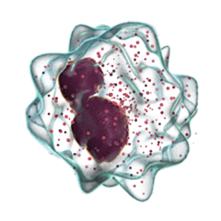
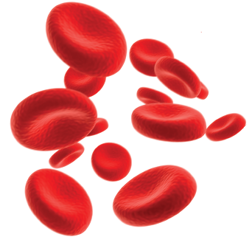
Aplastic Anemia
Created by: Julia, Melanie, Rebecca, Anna & Josh

Slide 2
Agenda
1.
2.
Introduction
Introduction to Aplastic Anemia, its risk factors and epidemiology
Mechanism
Look at the pathophysiology and the diagnosis of the disease
3.
4.
Treatment
Examine the multiple treatment options available
Next Steps
Take a closer look at research that is being done

Slide 3
What is Aplastic Anemia?
https://www.dkms.org/en/aplasticanemia

Slide 4
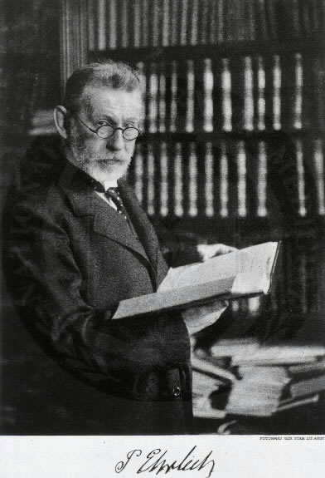
Origin
Dr. Paul Ehrlich
First treated disease in 1888
Patient & symptoms
Dr. Anatole Chauffard
Introduced the official name “Aplastic Anemia”
Red blood cells only
https://www.uab.edu/reynolds/histfigs/ehrlich
(Cuglievan, DePombo, & De Angulo , 2017)

Slide 5
Epidemiology
severe form, lower survival rate
SURVIVAL RATE
> 3 months | 73%
> 2 years | 57%
> 15 years | 51%
Most affected:
older individuals over the age of 60 years
(Montane et al., 2008)

Slide 6
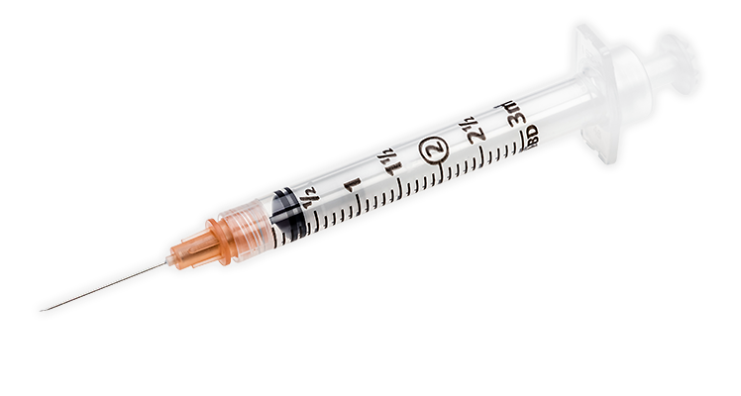
Acquired Aplastic Anemia
Environmental Factors:
Toxins
Radiation
Chemotherapy
Infectious diseases
Medications
Pregnancy

Slide 7
Hereditary Aplastic Anemia
Inherited conditions contribute to AA:
Fanconi anemia
Shwachman-Diamond syndrome
Dyskeratosis
Diamond-Blackfan anemia
PARENT CHILD

Slide 8
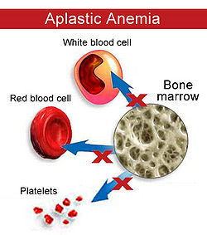
Pathophysiology
Damage to bone marrow → shuts down blood cell production
Stem cell damage renders cells unable to regenerate
Few blood cells are released into bloodstream

Slide 9
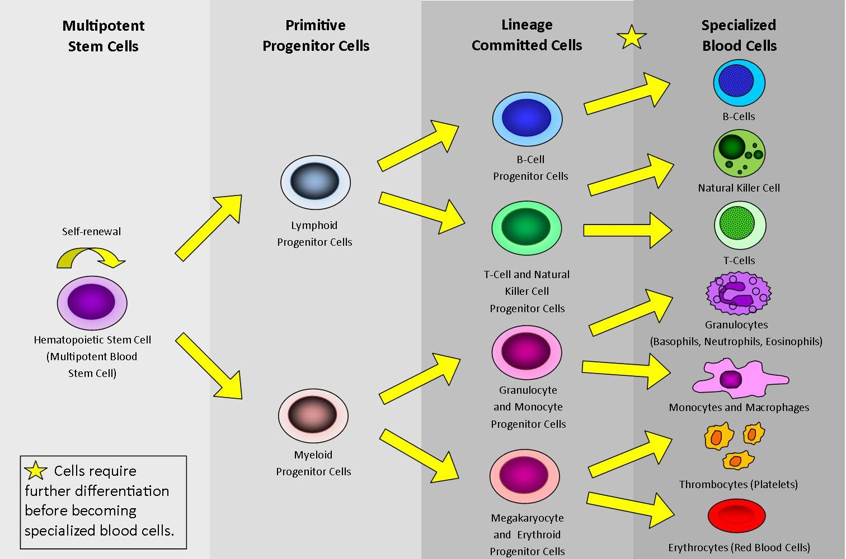
Stem Cell Development
https://www.frontiersin.org/articles/10.3389/fphys.2012.00107/full

Slide 10
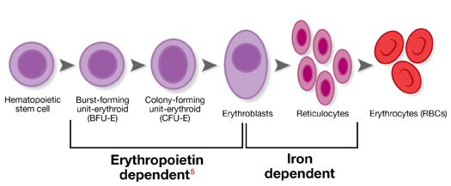
Red Blood Cells
Transport oxygen and carbon dioxide
Iron-rich hemoglobin protein
Result:
Not enough oxygen to tissues
Low iron

Slide 11
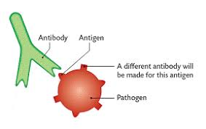
White Blood Cells
Mediate immune defense in the body
Decrease white blood cells → more susceptible to infection

Slide 12
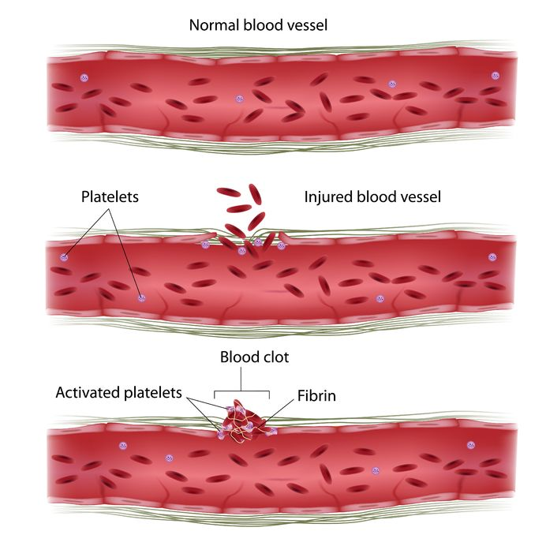
Platelets
Functions with coagulation factors to clot injured vessels
Decreased platelets cause excessive, uncontrolled bleeding
Impaired clotting mechanism → dangerous!

Slide 13
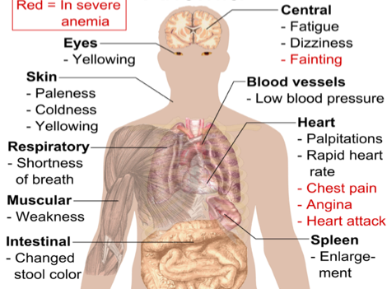
What does it look like?

Slide 14
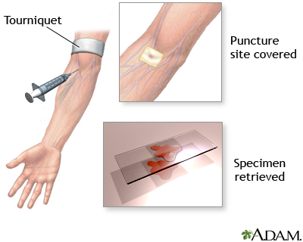
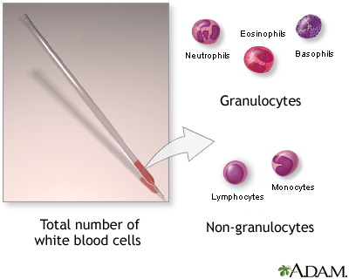
Screening Tests
Complete blood count | Leukocyte differential | Reticulocyte count
https://medlineplus.gov/ency/presentations/100152_2.htm

Slide 15
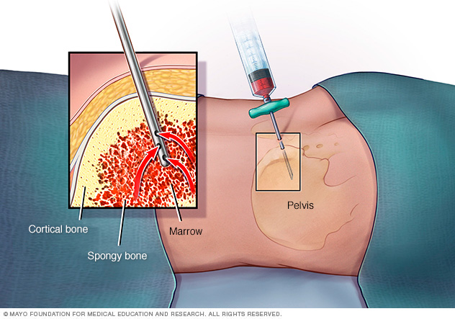
Screening Test
Bone Marrow Aspirate and Biopsy
https://www.mayoclinic.org/tests-procedures/bone-marrow-biopsy/multimedia/bone-marrow-biopsy/img-20007021

Slide 16
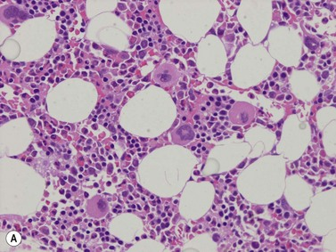
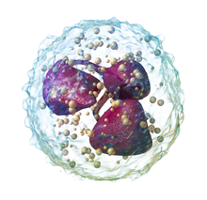
Diagnosis
 | Bone Marrow Cellularity | Absolute Neutrophil Count (ANC) | Absolute Reticulocyte Count (ARC) | Platelet Count
Normal Levels | 50% | 1000 - 500/microL | 20,000 - 105,000/microL | 150,000 - 450,000/microL
Severe Aplastic Anemia | < 30% | < 500/microL | < 20,000/microL | < 20,000/microL
Very Severe Aplastic anemia | ____ | <200/microL | _____ | ______

Slide 17
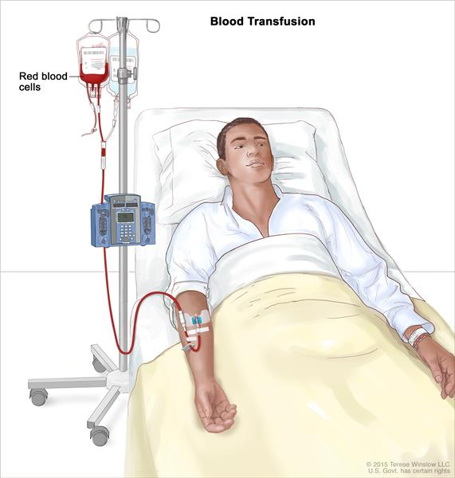
Immediate Treatment: Blood Transfusion
https://www.cancer.gov/publications/dictionaries/cancer-terms?cdrid=45991

Slide 18
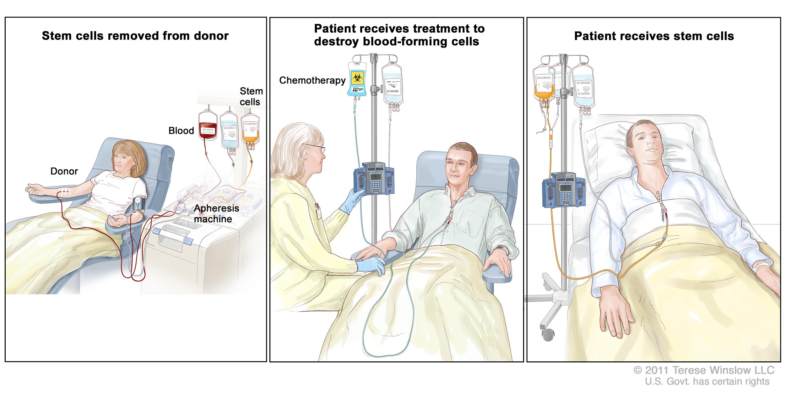
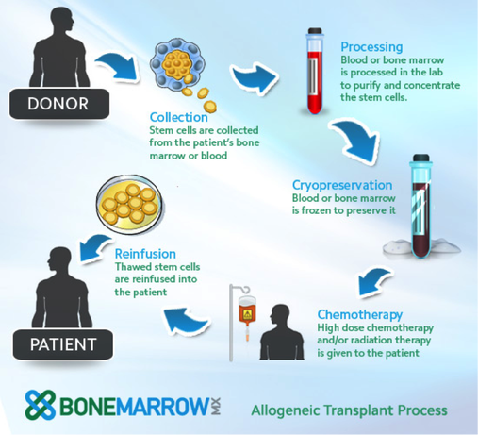
Definitive Treatment: Bone Marrow Transplant
http://www.bonemarrowmx.com/allogeneic-bone-marrow-transplant/
https://www.foxchase.org/blog/2014-02-09-too-old-stem-cell

Slide 19
Treatment: Medications
Immunosuppressants
Cyclosporine anti-thymocyte globulin and methylprednisolone
Bone marrow stimulants
Sargramostim, filgrastim and pegfilgrastim
Antibiotics and antiviral medicines
Antibiotics
Ciprofloxacin, neomycin and colistin
Antivirals
Acyclovir and valaciclovir

Slide 20
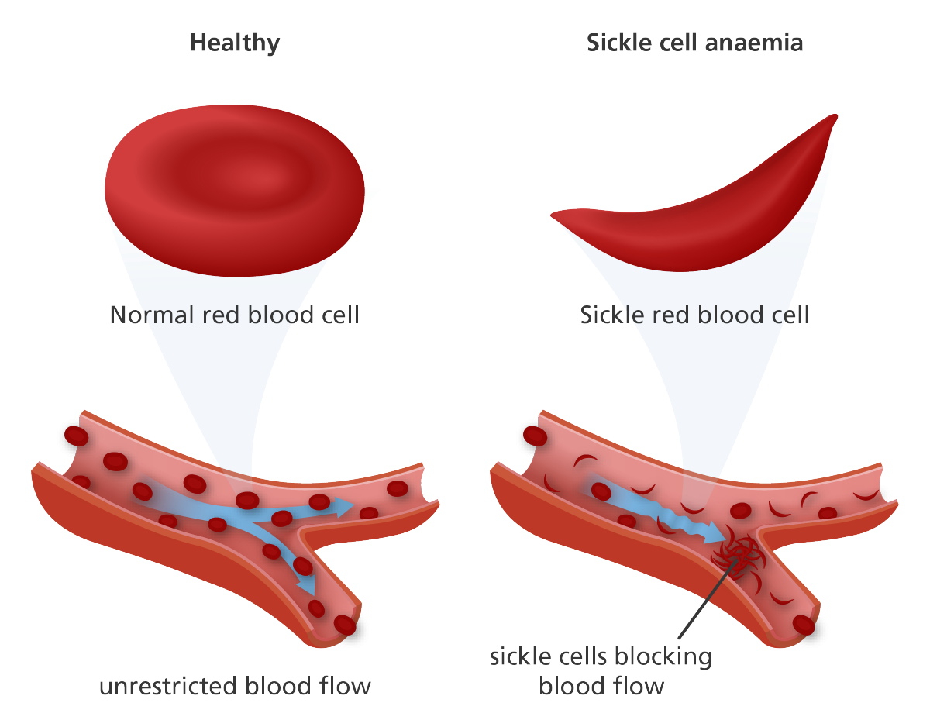
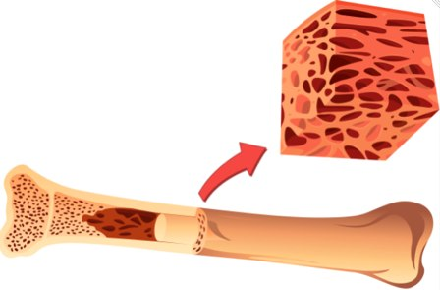
Myelodysplastic Syndrome

Slide 21
Quality of Life
Fatigue most significantly impacts daily lifestyle
Management strategies
(Escalante et al., 2015)
http://a1.ro/lifestyle/te-simti-mereu-obosit-vezi-care-sunt-motivele-id690468.html

Slide 22
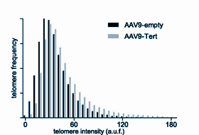
Current Research:
Telomerase-based Treatment:
Targets the bone marrow and provides increased telomerase expression
Telomerase expression→telomere elongation
reverses aplastic anemia phenotypes
(Bar, et al., 2015)

Slide 23
Conclusion
What is it?
disease where the bone marrow stops making blood cells
Who does it affect?
older individuals, people of East-Asian descent
How to treat it?
bone marrow transplant, blood transfusion, medications
Novel Approaches?
telomerase-based treatment

Slide 24
QUESTIONS

Slide 25
Question 1
Which of the following is not a possible symptom of Aplastic Anemia?
Frequent or prolonged infections
Increased clotting mechanism leading to blood clots
Skin rash or unexplained bruising
Fatigue
Rapid or irregular heart rate

Slide 26
Question 1
Which of the following is not a possible symptom of Aplastic Anemia?
Frequent or prolonged infections
Increased clotting mechanism leading to blood clots##
Skin rash or unexplained bruising
Fatigue
Rapid or irregular heart rate

Slide 27
Question 2
Acquired Aplastic Anemia can be caused by which set of environmental factors?
Diet, Pregnancy, Medications
Radiation, Chemotherapy, Diet
Infectious diseases, Medications, Weather
Toxins, Radiation, Pregnancy
Pregnancy, Altitude, Diet

Slide 28
Question 2
Acquired Aplastic Anemia can be caused by which set of environmental factors?
Diet, Pregnancy, Medications
Radiation, Chemotherapy, Diet
Infectious diseases, Medications, Weather
Toxins, Radiation, Pregnancy##
Pregnancy, Altitude, Diet

Slide 29
References
Aplastic Anemia and MDS International Foundation. Causes. (2016). Retrieved October 25, 2017, from http://www.aamds.org/diseases/aplastic-anemia/causes
Aplastic Anemia and MDS International Foundation. Types. (2016). Retrieved October 25, 2017, from http://www.aamds.org/diseases/aplastic-anemia/types
Bar, C., Povedano, J., Serrano, R., Benitez-Buelga, C., Popkes, M., & Formentini, I. et al. (2016). Telomerase gene therapy rescues telomere length, bone marrow
aplasia, and survival in mice with aplastic anemia. Blood, 127(14), 1770-1779. http://dx.doi.org/10.1182/blood-2015-08-667485
Braunstein, M.E. (2016) Aplastic Anemia. Retrieved 28 October 2017, from
https://www.merckmanuals.com/en-ca/professional/hematology-and-oncology/anemias-caused-by-deficient-erythropoiesis/aplastic-anemia
Cuglievan, B., DePombo, A., & De Angulo , G. (2017). Aplastic anemia: the correct nomenclature matters. The Hematology Journal , 101 (9).
DeZern, A. E., & Brodsky, R. A. (2011). Clinical management of aplastic anemia. Expert Review of Hematology, 4(2), 221–230. http://doi.org/10.1586/ehm.11.11
DeZern, A., Zahurak, M., Symons, H., Cooke, K., Jones, R., & Brodsky, R. (2017). Alternative Donor Transplantation with High-Dose Post-Transplantation
Cyclophosphamide for Refractory Severe Aplastic Anemia. Biology Of Blood And Marrow Transplantation, 23(3), 498-504.
http://dx.doi.org/10.1016/j.bbmt.2016.12.628
Escalante, C. P., Chisolm, S., Song, J., Richardson, M., Ellen, S., Lam, T., et al. (2015). Fatigue, quality of life and related symptoms: patient reported outcomes in
myeloplastic syndrome, aplastic anemia and paroxysmal nocturnal hemoglobinuria. Blood , 126 (23).
Health 24 . (n.d.). The seven types of anemia. Retrieved October 25, 2017, from Health 24: http://www.health24.com/Lifestyle/Your-Blood/Anaemia-20130216-2

Slide 30
References
How Is Aplastic Anemia Treated? - NHLBI, NIH. (2017). Nhlbi.nih.gov. Retrieved 28 October 2017, from
https://www.nhlbi.nih.gov/health/health-topics/topics/aplastic/treatment
Killick SB, Win N, Marsh JC, et al. (1997) Pilot study of HLA alloimmunization after transfusion with pre-storage leucodepleted blood products in aplastic anaemia. Br. J.
Haematol. 97(3), 677–684.
Kojima, S. (2016). Why is the incidence of aplastic anemia higher in Asia? Retrieved October 24, 2017, from
http://www.tandfonline.com/doi/full/10.1080/17474086.2017.1302797
Laundy GJ, Bradley BA, Rees BM, Younie M, Hows JM. (2004) Incidence and specificity of HLA antibodies in multitransfused patients with acquired aplastic anemia.
Transfusion. 44(6), 814–825.
Mandal, A. (2013). What is hematology? Retrieved October 25, 2017, from News Medical Life Sciences : https://www.news-medical.net/health/What-is-Hematology.aspx
Marsh J, Socie G, Tichelli A, et al. (2010) Should irradiated blood products be given routinely to all patients with aplastic anaemia undergoing immunosuppressive
therapy with anti-thymocyte globulin (ATG)? A survey from the European Group for Blood and Marrow Transplantation Severe Aplastic Anaemia Working Party.
Br. J. Haematol. 150(3), 377–379.
Montané, E., Ibáñez, L., Vidal, X., Ballarín, E., Puig, R., García, N., . . . Catalan, A. N. (2008). Epidemiology of aplastic anemia: a prospective multicenter study. Retrieved
October 24, 2017, from https://www.ncbi.nlm.nih.gov/pubmed/18322256
National Heart, Lung and Blood Institute. (2012). What is aplastic anemia? Retrieved October 24, 2017, from National Heart, Lung and Blood Institute:
https://www.nhlbi.nih.gov/health/health-topics/topics/aplastic

