Slide 1
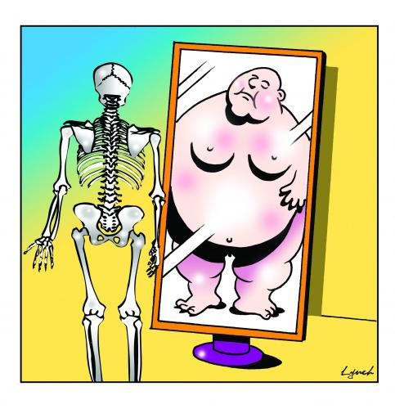
ANOREXIA NERVOSA
Tiffane Anandarajan
Vaidehi Bhatt
Giulia Coletta
Michael Kwok
Kulsum Saeed
Notes:
Persistent behaviours that interfere with maintaining an adequate weight for health. Typically, these behaviours include: restricting food, compensating for food intake through intense exercise, and/or purging through self-induced vomiting or misuse of medications like laxatives, diuretics, enemas, or insulin. Anorexia was previously associated specifically with weight loss, making it difficult to recognize in children and adolescents. Children and adolescents need to gain weight in order to support healthy growth and development; therefore failing to gain weight or grow is just as concerning as weight loss;
A powerful fear of gaining weight or becoming fat. The individual may feel this way even if they are maintaining a weight that is too low for their health. Their fear may translate into the use of a variety of techniques to evaluate their body size or weight – behaviour known as body checking. These techniques can include frequent weighing, obsessive measuring of body parts and the persistent use of mirrors to check for “fat.” It is important to note that weight loss or a lack of weight gain rarely calms body anxieties;
Disturbance in how the person experiences their weight and shape. The person overestimates their body size, usually evaluates it negatively, and feels their weight and shape matter more than most anything else about them; and
The person does not fully appreciate the seriousness of their condition. Anorexia is linked with cardiac arrest, suicidality, and other causes of death.
Anorexia was previously associated with the loss of menstrual periods which made it difficult or impossible to identify in males or in pre-pubescent children or teens – this aspect is no longer necessary for diagnosis.

Slide 2
“We clean our plates, yet we’re still famished - starving for something other than food.”
Kate Wicker

Slide 3
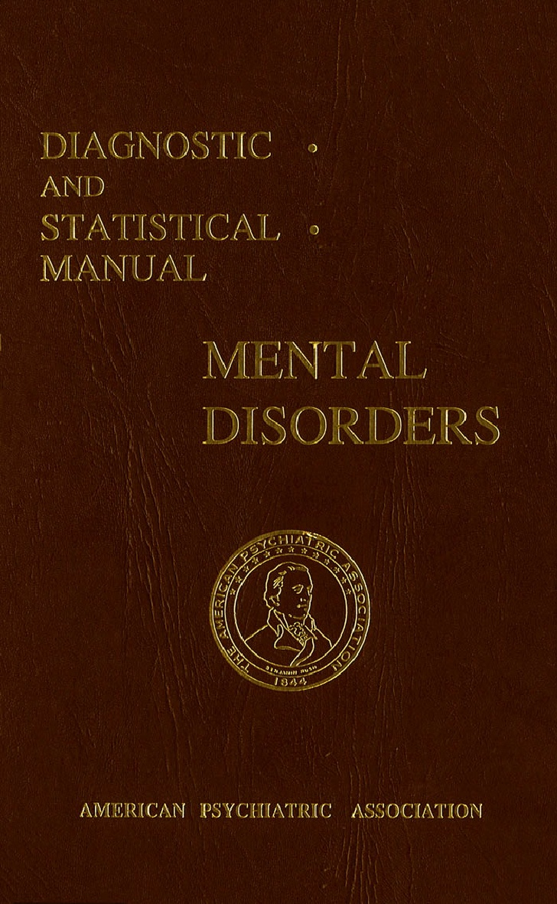
History
DSM 1
First eating disorder listed
Religious fasting, spiritual purity and self- sacrifice
Ernest - Charles Lasègue
1873
2013
Hellenistic Era
1980
Sir William Gull
DSM 5
“other specified feeding or eating disorder”
Notes:
Has been seen since the Hellenistic era and has continued through the Middle Ages
In earlier history, it was focused on religious fasting, spiritual purity and self- sacrifice
The term, anorexia nervosa was first established by Sir William Gull in 1873
Sir William Gull made observations of this condition and presented it to the British Medical Association in Oxford
French physician, Ernest- Charles Lasègue also published details of cases the same year that the term was created, his work concentrated more on the psychological symptoms and examined the role of parental and family interactions
AN was the first eating disorder to be placed into the first DSM edition
It was not until 1980 that the body image disturbance criteria was a diagnostic criterion
In DSM 5, it is now under the “other specified feeding or eating disorder” along with bulimia nervosa (BN), binge eating disorder (BED), avoidant/restrictive food intake disorder (ARFID), rumination disorder and pica

Slide 4
Epidemiology
85%
0.9%
0.3%
of
body weight
9 out of 10 are female.
270 per 100,000
Notes:
Nine out of 10 people with anorexia are female and about 1 percent of U.S. females between ages 10 and 25 is anorexic.
Lifetime prevalence, incidence rates and 5 year recovery rates were calculated from data from 2882 women from 1975-1979 birth cohorts of Finnish twins:
Incidence in women aged 15 to 19 years was 270 per 100,000 person- years
5 year clinical recovery rate was 66.8% at which complete or nearly complete psychological recovery was seen
Average prevalence in Western Europe and North America is 0.3%
Lifetime prevalence in females is 0.9% and in males is 0.3%; note lifetime prevalence is defined as the proportion of individuals in a population that at some point in their life have experienced the disease
Western countries have a higher prevalence than non- Western countries
Affected countries include not only the United States but Austria, France, Turkey, Poland
Individuals with AN are unable to maintain a normal healthy body weight, often dropping well below 85% of their ideal weight. Youth who are still growing fail to make expected increases in weight (and often height).

Slide 5
Etiology
Notes:
Biological. Although it's not yet clear which genes are involved, there may be genetic changes that make some people at higher risk of developing anorexia. Some people may have a genetic tendency toward perfectionism, sensitivity and perseverance — all traits associated with anorexia.
Psychological. Some people with anorexia may have obsessive-compulsive personality traits that make it easier to stick to strict diets and forgo food despite being hungry. They may have an extreme drive for perfectionism, which causes them to think they're never thin enough. And they may have high levels of anxiety and engage in restrictive eating to reduce it.
Environmental. Modern Western culture emphasizes thinness. Success and worth are often equated with being thin. Peer pressure may help fuel the desire to be thin, particularly among young girls.

Slide 6
Distorted Body Image
Notes:
Previous research has demonstrated that women with AN and BN seem to overestimate their own body dimensions to a similar degree, whereas healthy women show a tendency to underestimate them.5,6 The cognitive–affective component of a disturbed body image comprises negative body-related attitudes and emotions. Although in Western cultures, discontent with one’s shape and weight seems to be widespread in the general female population,7women with eating disorders exceed healthy women in terms of body dissatisfaction. Individuals have a distorted body image and, even when emaciated, tend to see themselves as ‘fat’, express denial of being underweight and compulsively over-exercise. They are often resistant to treatment and lack insight regarding the seriousness of the medical consequences of the disorder. Two types of
Although AN is characterized as an eating disorder, it remains unknown whether there is a primary disturbance of appetitive pathways

Slide 7
Risk Factors
Perfectionisms
Negative Self-Evaluation
Obesity
Obsessive Compulsive Disorder
Stress/trigger
Notes:
It has been found that there are several risk factors for developing anorexia. These include: perfectionism, negative self-evaluation, obesity, family history of anorexia, affective disorder, substance abuse, obsessive-compulsive disorder and a stress/trigger. It was also found that a lot of these risk factors were correlated to being risk factors of other psychological conditions (Fairburn, Cooper, Doll & Welch, 1999). It should also be mentioned that all of the aforementioned risk factors are not known in detail - their significance is unknown at this point. Social determinants, culture and family also play a role, and vary significantly

Slide 8
PATHOPHYSIOLOGY

Slide 9
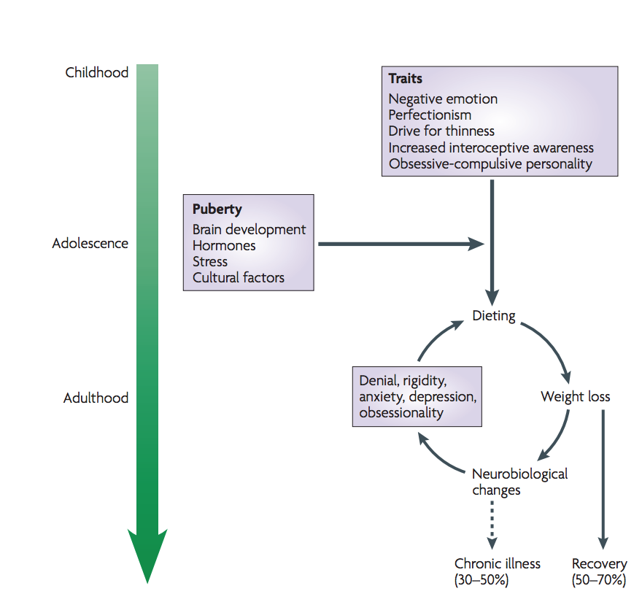
Notes:
If they have a personality or temperament predesposition trait it can contribute to one’ vulnerability of developing anorexia. It is usually seen that it becomes intensified during adolescence.

Slide 10
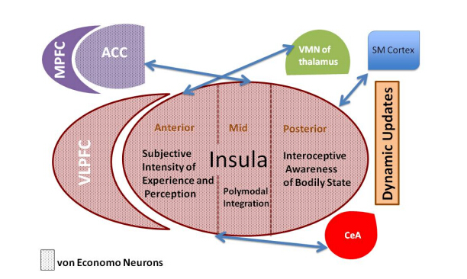
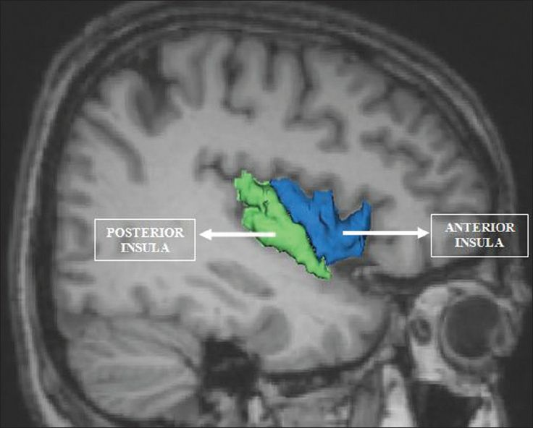
Notes:
The insula is a small region of the cerebral cortex - it is seperated into the anterior, mid and prosterior. We will be focusing on the anterior insula where the focus is the intensity of the experience and perception

Slide 11
Anterior Insula
Integration of interceptive information
Altered sense of self because of an altered insula activity
Strong conflict between the biological need for food and acquired aversive association with food
A failure to appropriately respond to hunger and diminished motivation to change

Slide 12
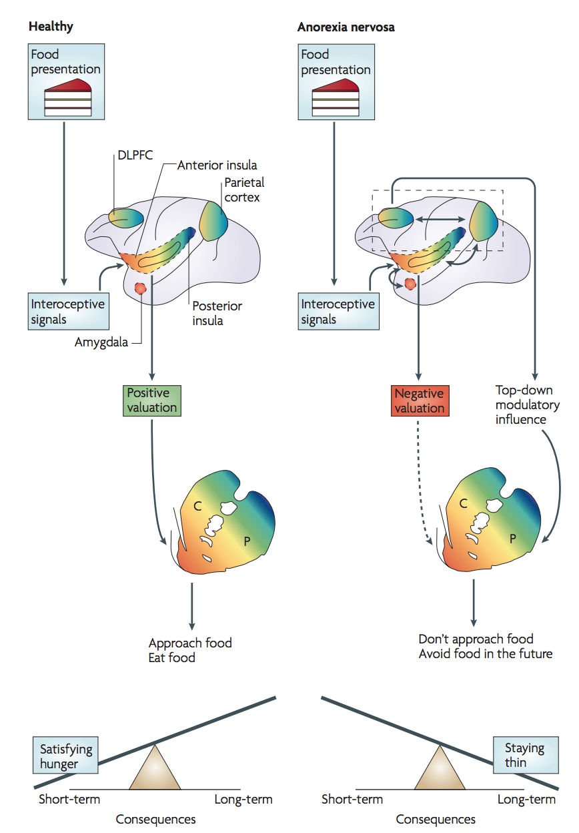
Anterior Insula
Notes:
In healthy individuals, the presentation of food‑related stimuli is associated with ascending interoceptive afferents that converge on the anterior insula, which processes state‑related positive or negative valuation of these signals.
In individuals with AN this interoceptive information is biased towards the negative or aversive properties of food
Individuals who have AN will usually experience an aversive visceral sensation when they are exposed to food or a form of food-related stimuli. This creates a bias towards the reward-related properties of food and creates a more negative emotion. This minimizes the exposure to food stimuli

Slide 13
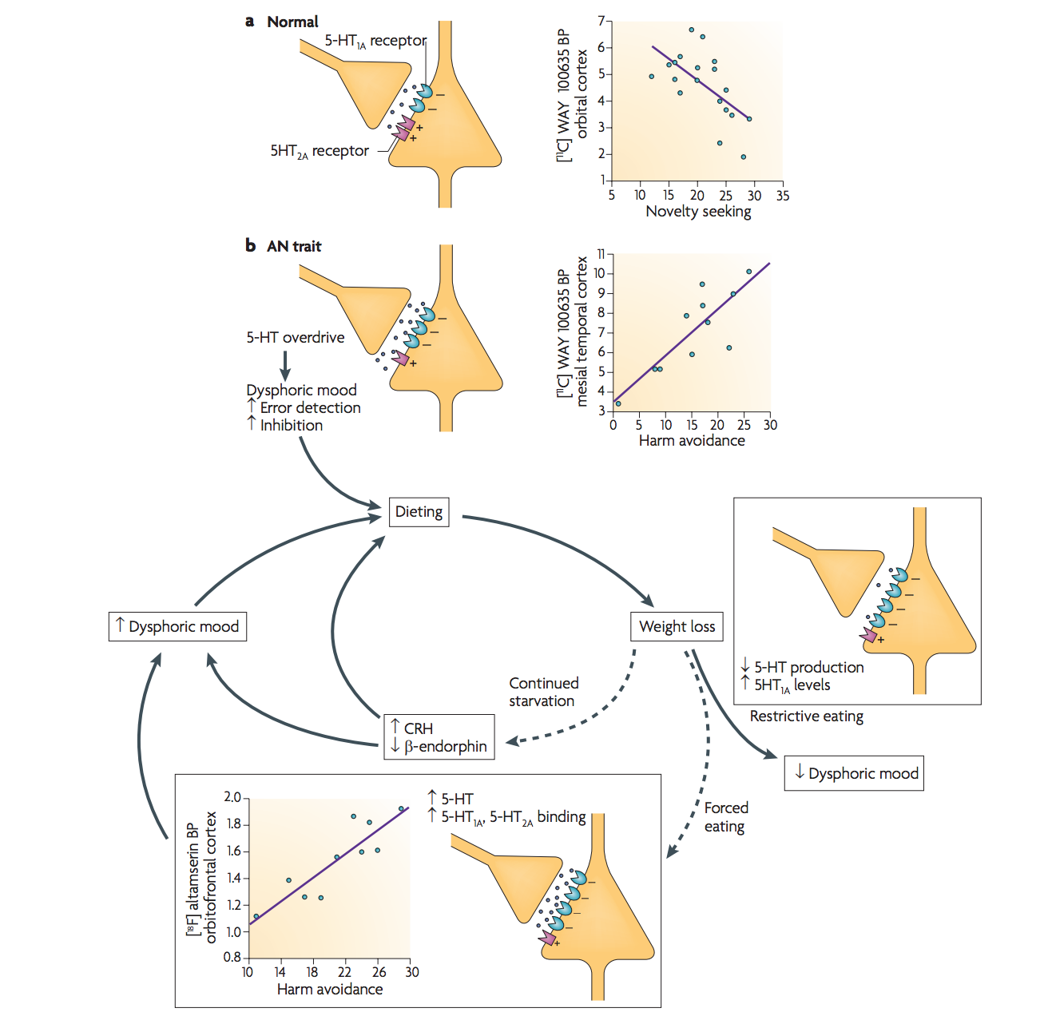
Serotonin Pathway
Notes:
increase in postsynaptic 5-HT1A receptor binding potential. Moreover, 5-HT2A receptor binding is positively related to harm avoidance in subjects suffering from AN. Therefore, when individuals with AN are forced to eat (FIG. 2), it is likely that they have a relative increase in extracellular 5-HT concentrations in the brain, leading to an exaggeration of dysphoric mood.

Slide 14
DIAGNOSIS
Confirmation that weight loss is not attributed to any other factor
A Physical Exam:
BMI, electrolytes, protein
Thryoid, liver and kidney function
Refer to Mental Health Professionals
Notes:
Anorexia is not a straightforward disease to diagnose. It can all be agreed however that a low body weight is the main component for diagnosis. Following such, an individual may also possess fear for gaining weight, as well as have an altered interpretation of healthy weight (Rothenberg, 1988).
The first step for diagnosis by the physician is to confirm that the weight loss is not attributed by any other factor. He or she may run several tests to confirm this: a physical exam to determine if the patient’s BMI is under 17.5, and blood tests to measure electrolytes, protein, and thyroid, liver and kidney function. If the tests reveal no abnormalities and the physician believes it is mental, a referral to a mental health professional is commonly seen ("Diagnosis of anorexia nervosa", 2018).
The second step for diagnosis is conducted by a mental health professional, who utilizes the Diagnostic & Statistics of Mental Disorders Manual 5 (DSM-5) as an aid. The professional determines through questionnaires, and evaluations if the patient has fears of gaining weight or has restrictive eating patterns ("Diagnosis of anorexia nervosa", 2018).
Some common symptoms for patients with anorexia are: extreme weight loss, fatigue, insomnia, dizziness or insomnia, constipation and abdominal pain, low blood pressure, and dehydration. Lastly, some patients present with bulimic symptoms - binging and purging ("Anorexia nervosa - Symptoms and causes", 2018).

Slide 15
DIAGNOSIS
DSM-5
Questionnaires and Evaluations
Fear of Gaining Weight
Common Symptoms:
Extreme weight loss, fatigue, insomnia, dizziness, abdominal pain, low blood pressure and dehydration

Slide 16
Treatments
Familial Assistance
Nutritional Guidance
Behavioural Therapy
Medication
Notes:
Where to start
A mental health professional, such as a psychologist to provide psychological therapy. If you need medication prescription and management, you may see a psychiatrist. Some psychiatrists also provide psychological therapy.
A registered dietitian to provide education on nutrition and meal planning.
Medical or dental specialists to treat health or dental problems that result from your eating disorder.
Your partner, parents or other family members. For young people still living at home, parents should be actively involved in treatment and may supervise meals.
It's best if everyone involved in your treatment communicates about your progress so that adjustments can be made to treatment as needed.
Managing an eating disorder can be a long-term challenge. You may need to continue to see members of your treatment team on a regular basis, even if your eating disorder and related health problems are under control.
Setting up a treatment plan
You and your treatment team determine what your needs are and come up with goals and guidelines. Your treatment team works with you to:
Develop a treatment plan. This includes a plan for treating your eating disorder and setting treatment goals. It also makes it clear what to do if you're not able to stick with your plan.
Treat physical complications. Your treatment team monitors and addresses any health and medical issues that are a result of your eating disorder.
Identify resources. Your treatment team can help you discover what resources are available in your area to help you meet your goals.
Work to identify affordable treatment options.Hospitalization and outpatient programs for treating eating disorders can be expensive, and insurance may not cover all the costs of your care. Talk with your treatment team about financial issues and any concerns — don't avoid treatment because of the potential cost.
Psychological therapy
Psychological therapy is the most important component of eating disorder treatment. It involves seeing a psychologist or another mental health professional on a regular basis.
Therapy may last from a few months to years. It can help you to:
Normalize your eating patterns and achieve a healthy weight
Exchange unhealthy habits for healthy ones
Learn how to monitor your eating and your moods
Develop problem-solving skills
Explore healthy ways to cope with stressful situations
Improve your relationships
Improve your mood
Treatment may involve a combination of different types of therapy, such as:
Cognitive behavioral therapy. This type of psychotherapy focuses on behaviors, thoughts and feelings related to your eating disorder. After helping you gain healthy eating behaviors, it helps you learn to recognize and change distorted thoughts that lead to eating disorder behaviors.
Family-based therapy. During this therapy, family members learn to help you restore healthy eating patterns and achieve a healthy weight until you can do it on your own. This type of therapy can be especially useful for parents learning how to help a teen with an eating disorder.
Group cognitive behavioral therapy. This type of therapy involves meeting with a psychologist or other mental health professional along with others who are diagnosed with an eating disorder. It can help you address thoughts, feelings and behaviors related to your eating disorder, learn skills to manage symptoms, and regain healthy eating patterns.
Your psychologist or other mental health professional may ask you to do homework, such as keep a food journal to review in therapy sessions and identify triggers that cause you to binge, purge or do other unhealthy eating behaviors.
Nutrition education
Registered dietitians and other professionals involved in your treatment can help you better understand your eating disorder and help you develop a plan to achieve and maintain healthy eating habits. Goals of nutrition education may be to:
Work toward a healthy weight
Understand how nutrition affects your body, including recognizing how your eating disorder causes nutrition issues and physical problems
Practice meal planning
Establish regular eating patterns — generally, three meals a day with regular snacks
Take steps to avoid dieting or bingeing
Correct health problems that are a result of malnutrition or obesity
Medications for eating disorders
Medications can't cure an eating disorder. They're most effective when combined with psychological therapy.
Antidepressants are the most common medications used to treat eating disorders that involve binge-eating or purging behaviors, but depending on the situation, other medications are sometimes prescribed.
Taking an antidepressant may be especially helpful if you have bulimia or binge-eating disorder. Antidepressants can also help reduce symptoms of depression or anxiety, which frequently occur along with eating disorders.
You may also need to take medications for physical health problems caused by your eating disorder.

Slide 17
References
Anorexia nervosa - Symptoms and causes. (2018). Mayo Clinic. Retrieved 26 March 2018, from https://www.mayoclinic.org/diseases-conditions/anorexia/symptoms-causes/syc-20353591
Diagnosis of anorexia nervosa. (2018). Healthdirect.gov.au. Retrieved 26 March 2018, from https://www.healthdirect.gov.au/diagnosis-of-anorexia-nervosa
Kaye, W. H., Fudge, J. L., & Paulus, M. (2009). New insights into symptoms and neurocircuit function of anorexia nervosa. Nature Reviews Neuroscience, 10(8), 573.
Rothenberg, A. (1988). Differential diagnosis of anorexia nervosa and depressive illness: A review of 11 studies. Comprehensive Psychiatry, 29(4), 427-432. http://dx.doi.org/10.1016/0010-440x(88)90024-7
Støving, R. K., Chen, J. W., Glintborg, D., Brixen, K., Flyvbjerg, A., Hørder, K., & Frystyk, J. (2007). Bioactive insulin-like growth factor (IGF) I and IGF-binding protein-1 in anorexia nervosa. The Journal of Clinical Endocrinology & Metabolism, 92(6), 2323-2329.
Vocks, S., Busch, M., Grönemeyer, D., Schulte, D., Herpertz, S., & Suchan, B. (2010). Neural correlates of viewing photographs of one’s own body and another woman’s body in anorexia and bulimia nervosa: an fMRI study. Journal of Psychiatry & Neuroscience : JPN, 35(3), 163–176. http://doi.org/10.1503/jpn.090048

