Slide 1
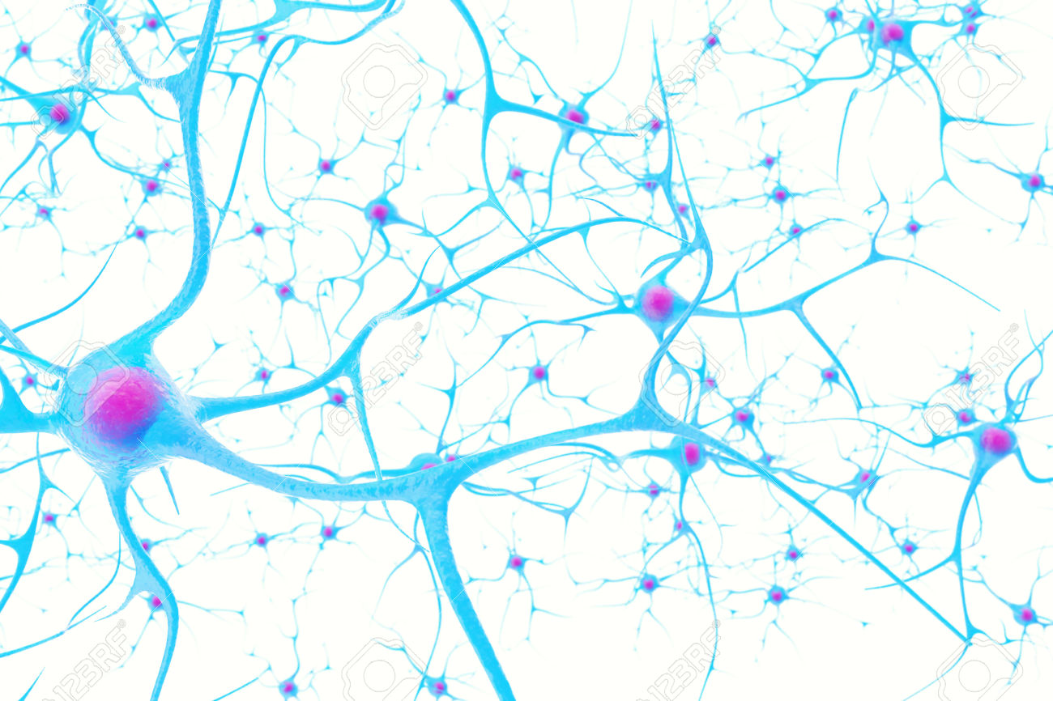
Alzheimer's Disease
Aman, Harris, Isha, Sarah, Vandevi

Slide 2
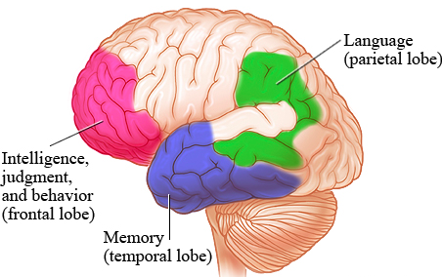
Introduction
Target areas: memory, behaviour, language
Causes neuronal death
Progressive disease
Greatest risk factor is aging
(Healthwise, 2015)
Notes:
Alzheimer’s disease is a type of dementia specifically targeting areas of the brain responsible for memory, behaviour and language. Individuals with this disease have weakened connections between neurons, causing cell death in these particular regions. Alzheimer’s is a progressive disease where its symptoms accumulate very slowly, and worsen over time. Beginning stages are typically very mild, however eventually individual’s are no longer able to engage in meaningful conversation and respond to environmental cues. Though Alzheimer’s is not a normal side effect of aging, its greatest risk factor is age. However, approximately five percent of people between the ages of 40-50 develop early-onset Alzheimer’s.

Slide 3
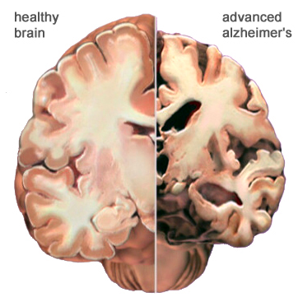
Introduction cont’d
Most common neurodegenerative disease
Eight year life span after diagnosis
Disease causes:
Nerve cell death
Tissue loss
(Alzheimer’s Association, 2011)
Notes:
Alzheimer’s is the most common neurodegenerative disease. Individuals diagnosed with this disease live approximately eight years after symptoms become noticeable. This is because this disease causes nerve cell death and tissue loss within the brain. As an individual continues to age the size of the brain drastically shrinks, causing loss of function to almost all areas.
(Image shows reduced size of Alzheimer’s brain)

Slide 4
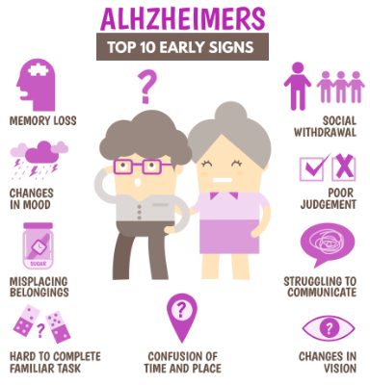
Introduction cont’d
Early Symptoms:
Memory loss
Difficulty with familiar tasks
Confusion of time or place
Issues with speaking or writing
Changes in mood and personality
(Alzheimer’s Association, 2011)
Notes:
A few of the major early symptoms of Alzheimer’s are:
Memory loss affecting daily life (important dates, asking the same questions)
Difficulty with familiar tasks (driving to familiar locations, remembering how to play a game)
Confusion with time or place (losing track of dates/seasons, not remembering where they are or how they got there)
New issues with speaking or writing (trouble following/ joining a conversation, repeating themselves)
Changes in mood and personality (may become confused, depressed, anxious)

Slide 5
Case Study
Subject: 59 year old male
Occupation: Physician
Later stages revealing the inability to identify everyday objects as sufficiently as before
Orientation of the object was a factor
Patient complained about bright objects
preferred light to appear from behind him rather than looking at the lit object or bright object
Began making puzzling mistakes in everyday activities
Mistakes had to do with vision and inattentiveness
Visual passiveness
Uninterested in surroundings
Loss in right peripheral vision
Inability to perceive depth and distance
Trouble with hand eye coordination
http://www.picturesof.net/pages/100718-194482-954053.html
(Levine, 1995)
Notes:
We will introduce a case study now before we get into more of the disease just so you can refer back to this subject’s symptoms while you learn about the diagnosis, symptoms and treatments of Alzheimer’s disease.
The subject we will focus on is a 59 year old male, his occupation as a physician.
The symptoms we will be focusing on are:
The man making puzzling mistakes in everyday activities
Most of these mistakes having to do with vision and inattentiveness
Like visual passiveness
He was not aware but others were about his behaviour. The patient blamed it on fatigue
These behavours appeared gradually, therefore hard to distinguish the onset of the disease and when it it began
There was loss in his right peripheral vision - inability to perceive depth and distance
Complained when reading, the print was smaller
Didn’t realize while driving that he drove into a curb and ripped the bottom right part of the car
His depth perception was very off- he mistook a poster being a postcard
After being diagnosed, the patient came back for tests
One particular test being identification test where the patient is told to identify everyday objects
The subject was shown a toothbrush and was not able to identify it at a certain orientation. When he was given the object to hold, he was able to identify it.
The subject also preferred having light come from behind him and not directly towards his eyes because he had a hard time seeing. Therefore any bright objects were a difficulty.
Although perseverance, social aspects and manners stayed normal
In his late stage there was deterioration of memory and social skills
We will return to this subject after learning more about the disease

Slide 6
Epidemiology
Worldwide, nearly 44 million people have Alzheimer’s or a related dementia (Alzheimer’s Disease International)
Only 1-in-4 people with Alzheimer’s disease have been diagnosed (Alzheimer’s Disease International)
Alzheimer’s and dementia is most common in Western Europe (North America is close behind)
Alzheimer’s is least prevalent in Sub-Saharan Africa. (Alzheimer’s Disease International)
Alzheimer’s and other dementias are the top cause for disabilities in later life (Alzheimer’s Disease International)
Notes:
Read slide

Slide 7
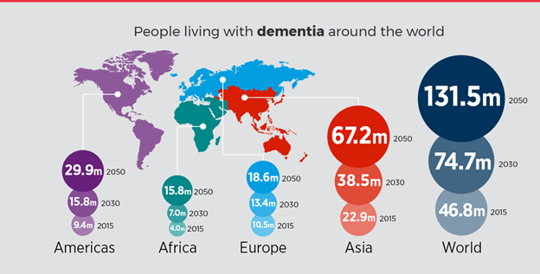
Epidemiology Cont’d
Expected growth of dementia
(Alzheimer's Disease International, 2015)
Notes:
As you can see the rapid increase of dementia, individuals would also be at increased risk of AD due to the fact that AD composes 50-70% of all forms of dementia, making it the leading cause of this neurodegenerative disease

Slide 8
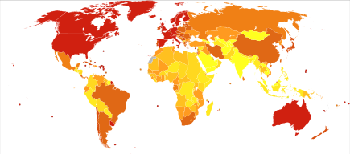
Epidemiology Cont’d
Number of deaths due to Alzheimer's in 2012
(Wikipedia, 2017)
Notes:
the world map just indicates the number of deaths in 2012. so almost basically you can see that there are more deaths in developed countries, maybe due to the fact there is more of an aging population

Slide 9
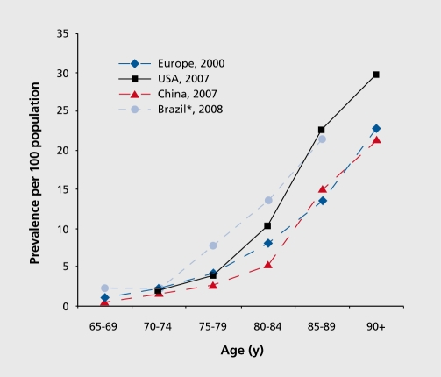
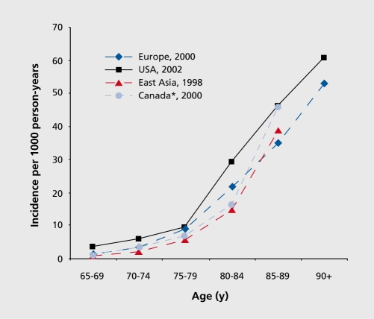
Epidemiology Cont’d
(Qiu, Kivipelto & Strauss, 2009)
Notes:
The incidence rate is the number of new cases per population at risk in a given time period, whereas the prevalence rate the number of people in a population who have a disease at a given time
One of the primary risk factor for AD, where there is a correlation of the incidence rate of every five years after the age of 65, the risk of acquiring AD approximately doubles (2). Furthermore, there is also higher incidence rates in women compared to men of developing AD particularly in the population older than 85 (3).

Slide 10
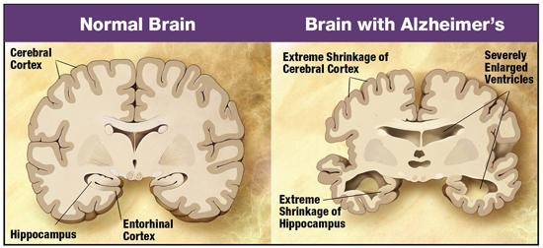
Pathophysiology: Stages of Alzheimer’s
Early Onset
Starts in entorhinal cortex and hippocampus
Shrinking of Amygdala, leading to mood and emotional changes
Mid Onset
Cortical and hippocampal shrinkage, widening of ventricles
Memory loss, mood changes, inability to accomplish daily tasks, language impairment, confusion with location of familiar environments
Late Onset
Plaques and tangles spread
Extreme atrophies of cerebral cortex and hippocampus
Severe dementia, loss of autonomic functions and complete dependence on others for care
(Whole Health Insider, 2013)
Notes:
Stages of Alzheimer's
Early Onset
Starts in entorhinal cortex and hippocampus (regions associated with memory. Thus, pathology in these regions would affect memory)
Shrinking of Amygdala, leading to mood and emotional changes
Mid Onset
Continuation of memory loss, mood changes, inability to accomplish daily tasks, language impairment, confusion with location of familiar environments
Cortical shrinkage, shrinkage of hippocampus, widening of ventricles within the brain
Late Onset
Plaques and tangles spread throughout brain
Extreme atrophies of cerebral cortex and hippocampus and more widening of ventricles
Severe dementia, loss of autonomic functions and complete dependence on others for care

Slide 11
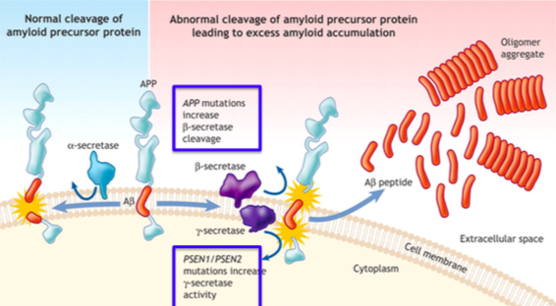
Pathophysiology: Extracellular Amyloid Plaques
(da Silva, 2015)
Notes:
This picture explains the plaques found throughout the brain of AD patients.
It starts off with the Amyloid Precursor Protein (APP) but little is known about the function of this protein.
If APP is cleaved by alpha secretase, there is no buildup of amyloid plaque (seen in the left of the picture)
If APP is cleaved by beta and/or gamma secretase, alpha beta peptide fragments are released due to an abnormal cleavage of the protein by these enzymes (seen in right of pic)
These fragments aggregate and form plaque in the extracellular space.
Huge component of the amyloid plaques are found throughout the brain in AD patients
PSEN1 and PSEN2 (blue box) play a role in regulating APP processing through gamma secretase
Mutations in these increase gamma secretase activity leading to more plaque formation

Slide 12
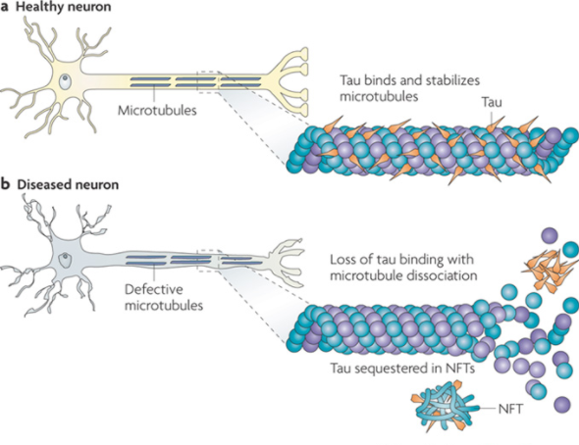
Pathophysiology: Intracellular Neurofibrillary Tangles
(Brunden, 2009)
Notes:
In this picture:
Microtubules run along the length of the axon acting like tracks for transportation of motor proteins kinesin and dynein carrying neuro signals
The Tau protein prevents depolymerization of these microtubules by binding to them
in normal physiology (healthy neuron), protein kinases phosphorylate Tau lifting them off the microtubule, allowing passage of motor proteins kinesin and dynein to move along the microtubule; and then tau reattaches after its dephosphorylation
in pathology (diseased neuron), there’s hyperphosphorylation of tau proteins which causes tau to aggregate with other taus, and form tangles
Thus, neuro signals cannot be transported if this occurs

Slide 13
Diagnosis
Definitive diagnosis of Alzheimer’s can only be made post-mortem by examining brain tissues
Clinical diagnosis made during the mild-to-severe stage
Using factors: medical history, history from relatives, behaviour observations, presence of characteristic neurological and neuropsychological features
Clinicians often use brain imaging and clinical assessments and focus on declining mental ability
(Ladenson, Laterza, & Modur, 2013)
Notes:
Definitive diagnosis of Alzheimer’s can only be made post-mortem by examining brain tissues!
Alzheimer’s disease can be categorized into three stages; Early, Mild-to-severe, and Advanced. The clinical diagnosis is most often made during the mild-to-severe stage.
Clinicians can diagnose the presence of Alzheimer’s disease with an adequate amount of certainty using several factors. These factors include the individual’s medical history, history from relatives, behaviour observations, presence of characteristic neurological and neuropsychological features
Clinicians focus heavily on a combination of both brain imaging and clinical assessments for diagnosis and focus on declining mental ability

Slide 14
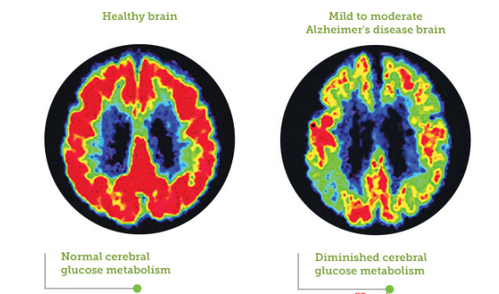
Diagnosis (Brain Imaging/MMSE)
Identifying Neurological features
Computed tomography (CT)
Magnetic resonance imaging (MRI),
Single-photon emission computed tomography (SPECT)
Positron emission tomography (PET)
Individual's intellectual functioning
Mini-Mental State Examination (MMSE)
Interview with family members/caregivers
(Ladenson, Laterza, & Modur, 2013)
Notes:
In order to identify the presence of neurological features, a number of brain imaging techniques are used, such as,
computed tomography (CT), magnetic resonance imaging (MRI), single-photon emission computed tomography (SPECT), and positron emission tomography (PET).
Figure shows a PET scan in which we can compare a healthy brain to a mild-to-moderate Alzheimer’s Disease brain. Not only is there a shrinkage in mass of the Alzheimer’s Disease brain (ATROPHY), but glucose metabolism, indicated by the red probe, seems to be significantly decreased in the Alzheimer’s Disease brain relative to the healthy brain.
In addition, assessment of the individual’s intellectual functioning can further help support a diagnosis. The Mini-Mental State Examination (MMSE) (Contains a series of questions and tests) is the most common administered test to evaluate cognitive impairments such as problems with memory, attention and language. Further examinations are crucial to diagnose Alzheimer’s with sufficient certainty, including, interviews with family members and caregivers, who can provide important information about daily living abilities.

Slide 15
Diagnosis (Biomarkers in research)
No specific biomarker that can confirm Alzheimer’s Disease with 100% certainty
Possible to use CSF measurements of
B-amyloid (1-42) (Reduced)
Total Tau (Enhanced)
Phosphorylated-tau-181(Enhanced)
Still being studied and not used in diagnosis due to lack of scientific support/validation
(Humpel, 2011)
Notes:
Biomarkers can provide valuable indications of health and disease, and contain high sensitivity and specificity that defines their diagnostic utility. Biomarkers can help distinguish between different types of dementias that may appear very similar to Alzheimer’s Disease.
However...
There are no specific biomarkers that can confirm Alzheimer’s Disease with 100% certainty.
However, it is possible to use measurements of B-amyloid (1-42), total tau, and phosphorylated-tau—181 in the cerebrospinal fluid as biomarkers for Alzheimer’s Disease. The combination of all three can significantly increase the diagnosis of Alzheimer’s Disease. In patients with Alzheimer’s, due to aggregation of B-Amyloid (1-42) in the brain, B-amyloid (1-42) would essentially be reduced in the cerebrospinal fluid, whereas total tau and phosphorylated tau would be enhanced.
Could possibly lead to early diagnosis
Note: B-amyloid is increased probably because it is deposited in the plaques in the brain and not available in diffusible form in the CSF

Slide 16
Diagnosis - A clip for the Grey’s Anatomy fans...
Notes:
Just a random video lol

Slide 17
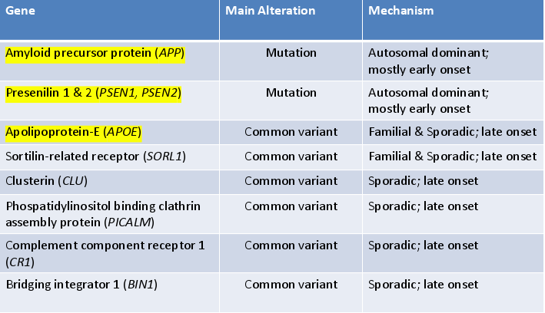
Diagnosis - Genome Studies?
(daSilva, 2015)
Notes:
Candidate gene studies for Alzheimer’s Disease do not allow conclusive evidence for the presence of disease beyond a simple hypothesis. The Genome-wide association studies (GWAS) test many genetic markers to detect the presence of diseases related to Alzheimer’s Disease. This form of study is most often used in clinical trials rather than clinical diagnosis.
Image shows a chart of Genes associated with Alzheimer’s Disease. Reiterate that mutations of any does not mean you will definitely get Alzheimer’s!

Slide 18
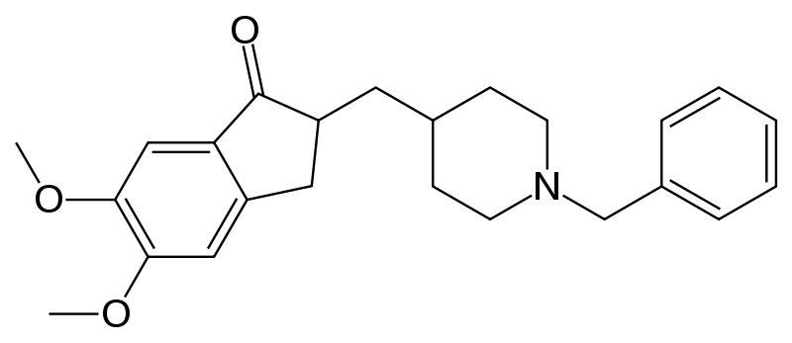
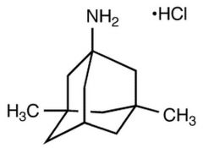
Treatments (Pharmaceutical)
Name | Stage | Type of pharmaceutical
Donzepil | Mild-to-moderate/Moderate-to-severe | Acetylcholinesterase inhibitors
Rivastigmine | Mild-to-moderate | Acetylcholinesterase inhibitors
Galantime | Mild-to-moderate | Acetylcholinesterase inhibitors
Memantine | Moderate-to-severe | NMDA receptor antagonist
Memantine
Donzepil
(Tan et al., 2014)
Notes:
Similar to the diagnosis of the disease, there has yet to be an effective cure for Alzheimer’s Disease. Although there are several treatments available that help treat the symptoms of the disease, they provide relatively few benefits. They have not shown to delay the onset of AD or halt the progression of the disease.
Pharmaceutical treatments include acetylcholinesterase inhibitors and as well as a NMDA receptor antagonist.
Donzepil, Rivastigmine, and Galantime are acetylcholinesterase inhibitors most often used in the mild-to-moderate stage of the disease.
Alzheimer’s Disease is correlated with a decrease in the activity cholinergic neurons, and these drugs inhibit the activity acetylcholinesterase (breakdown of acetylcholine), therefore increasing the concentration of acetylcholine in the brain to make up for the decrease in cholinergic neurons from the disease.
Approximately 20% of patients taking one of these three drugs may show common side effects associated with cholinergic access such as, nausea and vomiting.
Memantine is a NMDA receptor antagonist, which is most used in the moderate-to-severe stages of the disease.
In Alzheimer’s Disease the excitatory neurotransmitter Glutamate is overstimulated, ultimately causing cell death through a process known as excitotoxicity. Memantine acts on the glutamatergic system by inhibiting the overstimulation of glutamate.
Common side effects of this drug include, hallucinations, confusion, fatigue, headache, and dizziness.

Slide 19
Treatments (Psychosocial/Caregiving)
Psychosocial
Cognition
Behaviour
Emotion
Stimulation-oriented
Example: Reminiscence Therapy
Caregiving
Help carry out day-to-day activities
Helps patients adjust to the illness
(Schmid, 2017)
Notes:
In addition to pharmaceutical treatments, many Alzheimer's patients will undergo psychosocial and caregiving treatments. Psychosocial treatments specifically target the cognition, emotion, behaviour, and stimulation-oriented aspects of the disease.
A common example of a psychosocial intervention is known as Reminiscence Therapy, in which patients are involved in a discussion of past experiences with photographs, music, and other familiar items. This type of intervention tends to show minor improvements in the cognition and mood of the patients.
Caregiving is essential to help patients who are incapable of carrying out common day-to-day activities. Both have received minimal scientific support but seem to be significant in helping patients adjust to the illness.

Slide 20
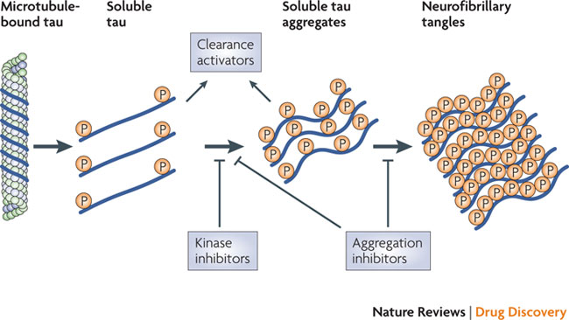
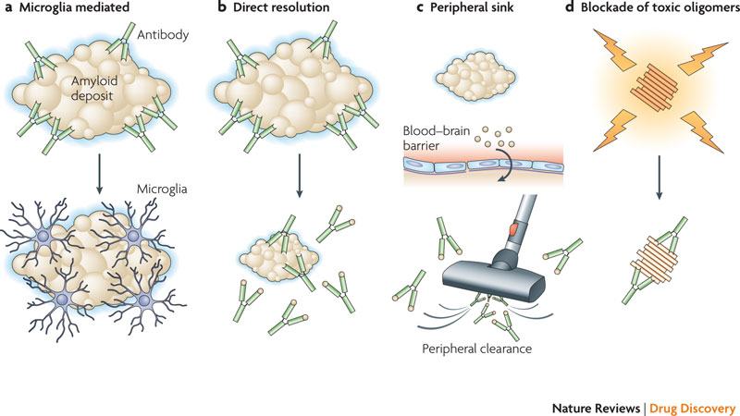
Future Advances
Tau aggregates (Kinase inhibitors)
B-amyloid plaques (antibodies)
(Citron, 2010)
Notes:
Researchers are continually looking at possible ways to delay and halt the progression of Alzheimer’s Disease. Current treatments only provide minimal relief to the symptoms of the disease and not the underlying disease itself.
Some possible therapeutics include drugs that decrease the production of B-amyloid plaques and tau, removing the toxic aggregates, or preventing the aggregation.
Figure 1 depicts therapeutics that target Tau aggregates through kinase inhibitors, which block the formation of the tau aggregates.
Figure 2 shows four distinct ways amyloid specific antibodies may be able to degenerate the B-amyloid plaques.
In addition to future treatments, it is important to focus on advancing research and development in biomarkers that can help assess risk and monitor the underlying disease.

Slide 21
Returning to Case study
There was loss in peripheral vision and depth perception, which parts of the brain were targeted by the disease?
ANS: occipitopareital areas
Colour identification was preserved, what can we say about this? (what was not damaged, related to the occipital lobe)
ANS: Cones (bipolar cells located in the retina)
What distinguishes that the frontal lobe was least affected by the plaques and tangles?
ANS: Social manners and perseverance were still in tact
Memory and language skills failed during the last stages of the disease, what part of the brain was affected?
ANS: Frontal lobe and hippocampus amygdala
Notes:
On slide

Slide 22
References
Alzheimer's Association. (2011). Healthy Brain Versus Alzheimer's Brain. Retrieved March 03, 2017, from http://www.alz.org/braintour/healthy_vs_alzheimers.asp
Citron, M. (2010). Alzheimer's disease: strategies for disease modification. Nature reviews Drug discovery, 9(5), 387-398.
Healthwise. (2015, November). Areas of the Brain Affected by Alzheimer's and Other Dementias. Retrieved March 03, 2017, from http://www.webmd.com/alzheimers/areas-of-the-brain-affected-by-alzheimers-and-other-dementias
Humpel, C. (2011). Identifying and validating biomarkers for Alzheimer's disease. Trends in biotechnology, 29(1), 26-32.
Ladenson, J. H., Laterza, O., & Modur, V. (2013). U.S. Patent No. 8,481,277. Washington, DC: U.S. Patent and Trademark Office.
Schmid, J. (2017, February 02). Reminiscence and Alzheimer's Disease. Retrieved March 05, 2017, from http://www.best-alzheimers-products.com/reminiscence-and-alzheimers-disease.html
Tan, C. C., Yu, J. T., Wang, H. F., Tan, M. S., Meng, X. F., Wang, C., ... & Tan, L. (2014). Efficacy and safety of donepezil, galantamine, rivastigmine, and memantine for the treatment of Alzheimer's disease: a systematic review and meta-analysis. Journal of Alzheimer's Disease, 41(2), 615-631.
Levine, D. N. "The Visual Variant Of Alzheimer's Disease: A Clinicopathologic Case Study". Neurocase 1.4 (1995): 345f-348. Web.

Slide 23
References Cont’d
Brookmeyer, R., Johnson, E., Ziegler-Graham, K., & Arrighi, H. M. (2007). Forecasting the global burden of Alzheimer’s disease. Alzheimer's & dementia, 3(3), 186-191.
Qiu, C., Kivipelto, M., & von Strauss, E. (2009). Epidemiology of Alzheimer’s disease: occurrence, determinants, and strategies toward intervention. Dialogues Clin Neurosci, 11(2), 111-128.

