Slide 1
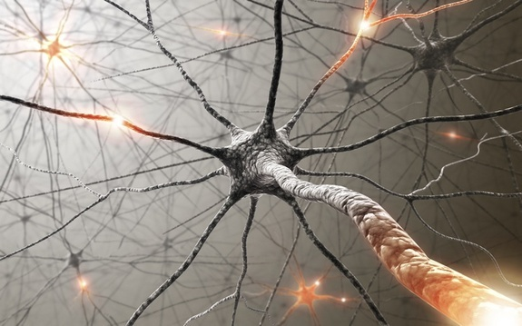
ALS
Group 1: Abhishek Achunair, Susanna Chen,
Sandeep Ghotra, Olivia Kohlmaier, Jayson Subaskaran
Notes:
Presenters: Olivia & Susanna
Photo from https://www.livescience.com/39583-als-lou-gehrigs-disease.html

Slide 2
What is Amyotrophic Lateral Sclerosis (ALS)?
Also known as
Lou Gehrig’s disease
Motor Neuron disease
Brain cannot communicate with muscles => paralysis
Progressive
Lose the ability to: Walk, Talk, Eat, Swallow, Breathe
No cure
Few treatment options
Notes:
Olivia
A-myo-trophic Lateral Sclerosis:
Is also known as ALS, Lou Gehrig’s disease, or motor neuron disease
Gradually paralyzes people as the brain is no longer able to communicate with the muscles of the body
It is progressive, meaning it gets worse over time
And people with this disease eventually lose the ability to walk, talk, eat, swallow, and breathe as their muscles break down
There is no cure
There are few treatment options available

Slide 3
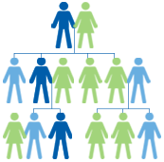
Two types of ALS
Sporadic ALS
Can affect anyone
Most common form
95% of cases
Familial ALS
Heritable
5 to 10% of cases
Notes:
Olivia
Two types of ALS:
Sporadic ALS
A type the disease can affect anyone regardless of gender, age or ethnicity
it is the most common form, presented in approximately 95% of ALS cases
In contrast, Familial ALS
Heritable, meaning it can be passed on from parent to child
Seen in approx. 5-10% of ALS cases

Slide 4
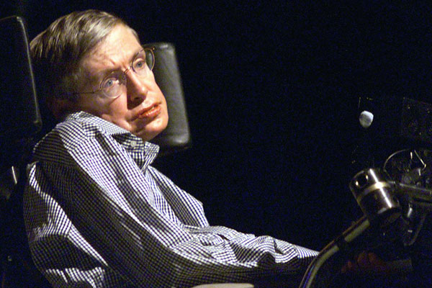
Signs & Symptoms
Reduced strength in the arms and/or legs
Difficulty speaking
Difficulty swallowing
Difficulty breathing
Muscles atrophy
Paralysis
Most common cause of death: respiratory failure
Notes:
Olivia
First symptoms of ALS are reduced strength in the arms and/or legs, or difficulty speaking, swallowing, and even breathing
As the nerve cells begin to die, they send fewer and fewer signals, causing the muscles to atrophy, meaning that they get smaller and thinner
After the nerve cells completely die, the patient is effectively paralyzed
Respiratory failure is the most common cause of death

Slide 5
Relevant Statistics
Ages of 40-60
More than 200,000 globally
About 3,000 Canadians
In Canada 2-3 people die of ALS each day
Over 5,000 people in the U.S. diagnosed each year
15 new cases each day
80% of people with ALS die within 2-5 years of diagnosis
Notes:
Olivia
It most often affects people between the ages of 40 and 60 (prevalence)
More than 200,000 people around the world are living with ALS currently (prevalence)
With an estimated 3,000 Canadians (prevalence)
Every day about 2-3 people in Canada die of ALS (mortality rate)
And a little over 5,000 people in the U.S. are diagnosed with ALS each year (15 new cases a day) (incidence) http://www.alsa.org/about-als/facts-you-should-know.html
And lastly, 80% of people with ALS die within 2-5 years of diagnosis (prognosis)

Slide 6
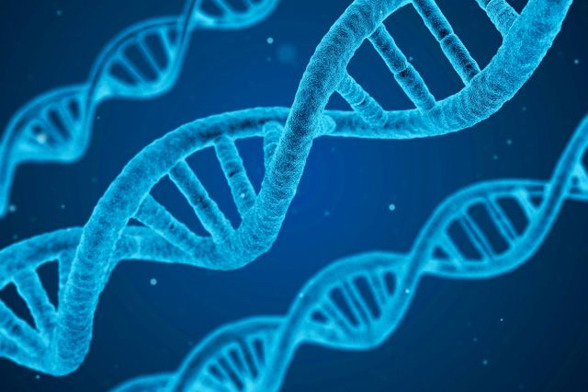
Etiology
http://newsroom.ucla.edu/releases/study-reveals-white-nationalists-reactions-when-genetics-test-results-challenge-their-identity0
Genetics
Gene mutations
Chemical imbalances
Altered immune system
Environment
Toxins/infectious agents
Physical trauma
Increased physical activity
https://www.healthlinkbc.ca/health-topics/aa165656
Notes:
Susanna
No clear answer
Gene mutations - SOD1
Chemical imbalances - glutamate
Altered immune system - attacks nerve cells
Toxins - smoke & lead
Physical trauma - earlier = higher risk
Increased PA - higher association

Slide 7
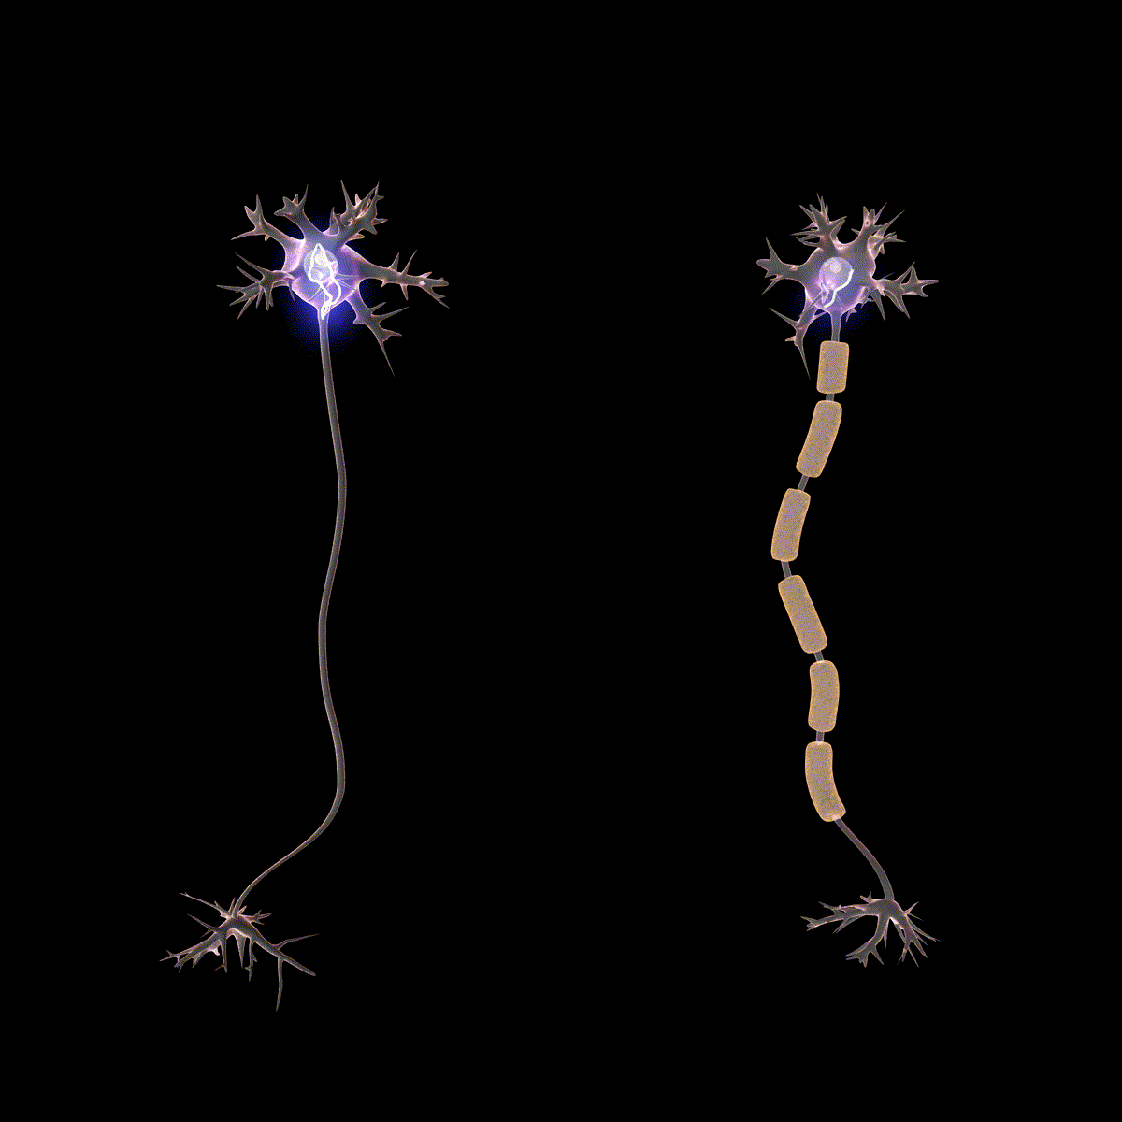
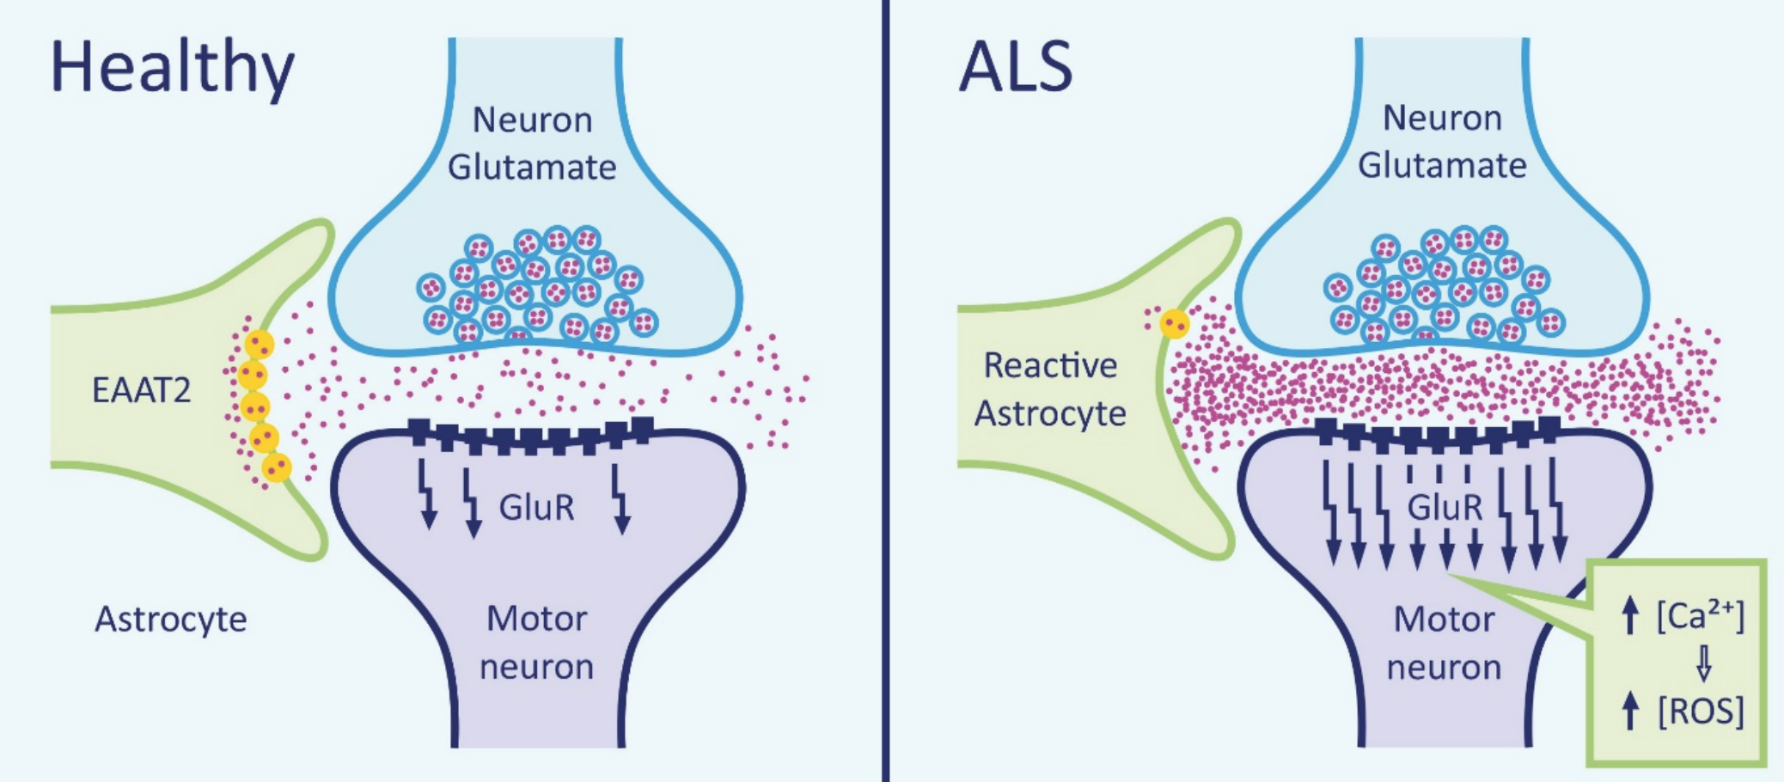
Pathophysiology
https://commons.wikimedia.org/wiki/File:Saltatory_Conduction.gif
Free radical-mediated Oxidative stress
Functional Abnormalities of Mitochondria
Glutamate Excitotoxicity
Impairment of Axonal Structure & Transport
http://diglib.tugraz.at/download.php?id=582ed2225ac7d&location=browse
Notes:
Susanna
Pathophysiology
Mutant SOD1 -> aggregation
Free radical-mediated oxidative stress
Mutant SOD1 can’t bind Zn & Cu to break down radicals/toxins
Functional Abnormalities of Mitochondria
Mutant SOD1 accumulates in intermembrane space & matrix of mitochondria
Leads to ATP deficits
Bcl-2 regulates apoptosis - cannot function properly with mutant SOD1
Glutamate Excitotoxicity
For neurotransmission
Removed by excitatory amino acid transporters (EAATS) after postsynaptic receptors are activated
Increased EAATs in ALS patients → over-stimulation of receptors
Impairment of Axonal Structure or Transport Defects
Due to many pathways caused by mutant SOD1
Build up of mitochondria, autophagosomes, and neurofilaments in the damaged motor neurons → death of the neurons.

Slide 8
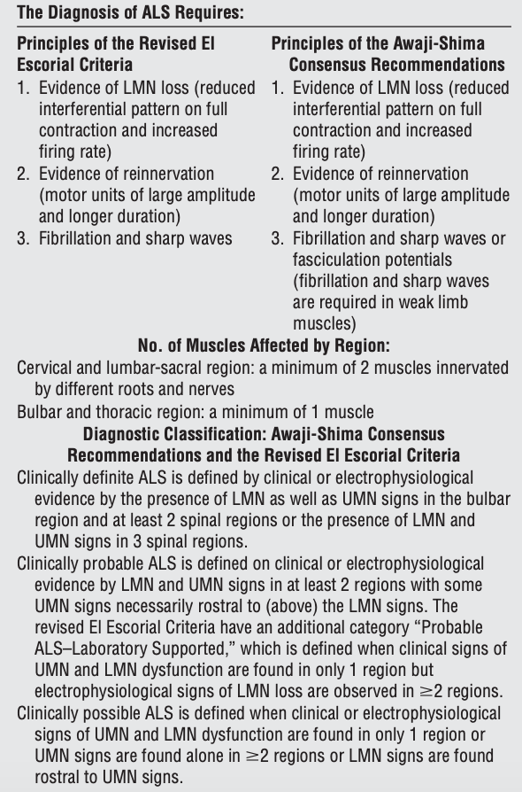
Diagnosis: Formal Criteria
El Escorial Criteria (1994)
El Escorial/Airlie House Criteria (1998)
Awaji-Shima Criteria (2008)
Source: Costa et al., 2012
Notes:
Olivia
Diagnosis
There is no distinct biological marker available for study in the diagnosis of ALS.
Due to this, various medical and lab tests need to be completed to rule out other diseases that exhibit identical or similar symptoms
The El Escorial criteria was typically used as the international standard of guidelines for diagnosis
However, a conference held in April 1998 by the World Federation of Neurology Research Committee on Motor Neuron Diseases developed a consensus document with new requirements
After this revision of the El Escorial criteria, it was re-named as the Airlie House criteria
These set of guidelines went under further revision to produce the Awaji-Shima criteria (which you can see in the image displayed here)
This criteria was introduced in 2008, and they key difference is that a diagnosis of ALS now requires:
clinical or electrophysiological evidence with more regional specifications to ensure that an accurate ALS diagnosis
for example looking for signs in bulbar, spinal regions etc.

Slide 9
Tests, Examinations, & Potential Biomarkers
Potential Biomarkers | 8OH2’dG, adipsin, MIP-1b, IL-8
EMG | Lower motor neuron
Neuroimaging | Upper motor neuron, tumors & lesions
Muscle & Nerve Biopsy | Differential diagnosis
Laboratory Tests | Blood test Urine test
Notes:
Olivia
Seeing as there is no unique biomarker to ALS and its cause is undetermined, much research has gone into searching for potential biomarkers
For example
Potential Biomarkers
a 2000 study by Bogdanov et al. discusses how damage to neurons could be attributed to oxidation
A biomarker in cerebrospinal fluid, urine, and plasma that indicates DNA damage is 8-hydroxy-2’-deoxyguanosine (8OH2’dG).
The study, involving 165 subjects, examined this marker in ALS patients against a control group for almost a year.
The results indicated that as the neurodegenerative properties worsened in ALS subjects over the course of the study, the levels of this biomarker increased.
These results are coherent with the hypothesis that “oxidative pathology accompanies…ALS and [suggests] that [this biomarker] may provide a useful tool for monitoring therapeutic interventions” across the progression of the disease.
Another study by Gonzalez-Garza and colleagues in 2018, studied adipsin, MIP-1b, and IL-8 as potential biomarkers for diagnosis of ALS.
ALS could be an autoimmune disease as there is evidence that an immune-mediated inflammatory process parallels the progression of ALS
In their study, the researchers “analyzed 19 different cytokines and growth factors in the cerebrospinal fluid of 77 ALS patients and 13 controls…”
Their results showed an increase of adipsin, MIP-1b, and IL-6, and a decrease of IL-8 thresholds, related with ALS patients”
Diagnosis and Progression of ALS
No single test can give an explicit ALS diagnosis.
Neurological tests can assist in an initial visual-based diagnosis; however, further examinations, such as EMG, blood and urine tests, and muscle and nerve biopsies can be used to confirm or refute the diagnosis
EMG
is a helpful test in the beginning stages of ALS as it detects lower motor neuron degeneration in specific regions and will help rule out other potential illnesses.
EMGs involve nerve conduction studies and examinations that use needle electrodes on the tongue and lower face.
These tests measure a regular or decreased amplitude of compound motor action potentials and other factors to support a diagnosis of ALS
Neuroimaging
Includes tests such as radiography, myelography, CT scans, and MRIs
However, in recent times, MRIs have effectively been deemed to replace the role played by myelography and CT scans.
MRIs are especially useful in recognizing whether any tumours or lesions can cause upper motor neuron symptoms.
Muscle and Nerve Biopsy
Are optional tests performed for the “differential diagnosis of ALS”.
Particular cases of inclusion body myo-sitis appear nearly identical to the lower motor neuron symptoms of ALS.
As such, biopsies may be performed to rule out such conditions.
Laboratory Tests
Such as blood and urine tests are taken for blood counts, and measures of certain electrolytes and proteins (antibodies).
These tests can rule out conditions such as hyper-para-thyroid-ism and my-as-thenia.

Slide 10
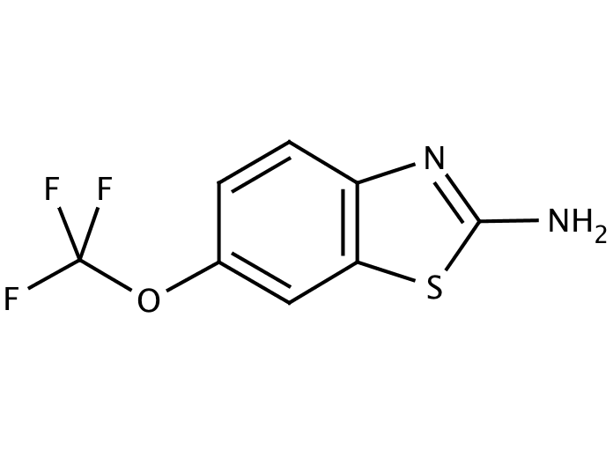
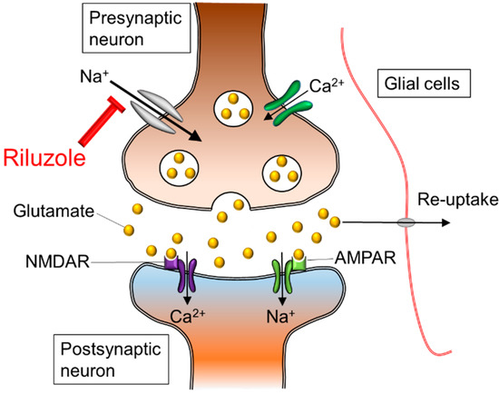
Current Treatments - Riluzole
https://www.researchgate.net/figure/The-chemical-structure-of-riluzole-RilutekR_fig1_267557809
Reduction in levels of glutamate in the brain
Available through pill and liquid form
Side effects include
Dizziness
GI conditions
Liver function alterations
https://www.mdpi.com/1420-3049/20/5/7775/htm
Notes:
Susanna
Main drug
Blocks glutamate release
For excitatory functions
Stops calcium influx & stops neuron death

Slide 11
New Treatments
hiPSCs (Mice)
Stem cell therapy
Transplantation of glial-rich neural progenitors of hiPSCs into lumbar spinal cord
Post transplantation → astrocytes → increased life span
Notes:
Susanna
Stem cells
glial-rich neural progenitors from hiPSCs into the lumbar spinal cord of mice
Had ALS, mutant SOD1
Differentiated to astrocytes
Restored mutated astrocytes
Longer life span due to AKT pathway being activated

Slide 12
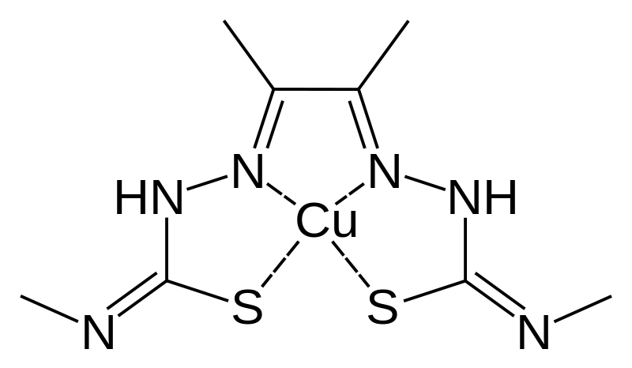
New Treatments
CuATSM
CuATSM (Humans)
Delivers copper to copper-deficient cells
Prevents misfolding of proteins
Phase 1 Clinical Trials
Improved lung and cognitive functions
https://commons.wikimedia.org/wiki/File:Cu-ATSM_skeletal.svg
Notes:
Susanna
CuATSM
reduce/slows symptoms
Delivers Cu to prevent misfolding of SOD1
Improved cognitive functions and breathing
Higher doses have more effects
2019 - phase 2 clinical trials

Slide 13
Conclusion
Notes:
Olivia
In conclusion,
ALS is a motor neuron disease
Affects many people worldwide
There is still no clear cause for it but the origin is seen as multifactorial, as the onset of the disease can be due to many disturbances in the molecular pathways.
No cure
Few treatment options
Most common treatment: Riluzole
New treatments still under study: Stem cells & CuATSM which offer a promising future
Thank you for listening and we’d be happy to take your questions now

Slide 14
References (1)
About - Project MinE. (n.d.). Retrieved from https://www.projectmine.com/about/
Amyotrophic lateral sclerosis (ALS). (2018). Retrieved from https://www.mayoclinic.org/diseases-conditions/amyotrophic-lateral-sclerosis/symptoms-causes/syc-20354022
Amyotrophic Lateral Sclerosis (ALS) Fact Sheet | National Institute of Neurological Disorders and Stroke. (2018, August 9). Retrieved from
https://www.ninds.nih.gov/Disorders/Patient-Caregiver-Education/Fact-Sheets/Amyotrophic-Lateral-Sclerosis-ALS-Fact-Sheet
Amyotrophic lateral sclerosis (ALS) - Symptoms and causes. (2018). Retrieved from
https://www.mayoclinic.org/diseases-conditions/amyotrophic-lateral-sclerosis/symptoms-causes/syc-20354022
Carvalho, J. (2019). ALS Progression May Be Slowed With CuATSM Treatment, Trial Shows. Retrieved from
https://alsnewstoday.com/2019/01/10/cuatsm-may-slow-als-progression-improve-cognition-respiration-phase-1-trial/
Copper Compound (CuATSM) Shows Promise in ALS Lab Studies. (n.d.). Retrieved from
https://www.als.net/news/copper-compound-cuatsm-shows-promise-in-als-laboratory-results/
Costa, J., Swash, M., & de Carvalho, M. (2012). Awaji criteria for the diagnosis of amyotrophic lateral sclerosis: a systematic review. Archives of neurology, 69(11), 1410-1416.
Notes:
Doble, A. (1996). The pharmacology and mechanism of action of riluzole. Neurology, 47(6 Suppl 4), S233-241.
Riluzole Oral : Uses, Side Effects, Interactions, Pictures, Warnings &amp; Dosing - WebMD. (n.d.). Retrieved January 30, 2019, from https://www.webmd.com/drugs/2/drug-12138/riluzole-oral/details

Slide 15
References (2)
Doble, A. (1996). The pharmacology and mechanism of action of riluzole. Neurology, 47(6 Suppl 4), S233-241.
Facts You Should Know. (n.d.). Retrieved from http://www.alsa.org/about-als/facts-you-should-know.html
Fischer, L. R., Igoudjil, A., Magrane, J., Li, Y., Hansen, J. M., Manfredi, G., & Glass, J. D. (2010). SOD1 targeted to the mitochondrial intermembrane space
prevents motor neuropathy in the Sod1 knockout mouse. Brain, 134(1), 196-209.
Irving, M. (2019). New ALS drug slows disease progression in groundbreaking clinical trial. Retrieved from
https://newatlas.com/als-mnd-drug-clinical-trial-success/58026/?fbclid=IwAR2b0PRNHR7mmPCO0UVCq6KSHvwAQonjQtZgvQDgsbUrE
C2Unrw7k0qROzU
Kamel, F., Umbach, D., Hu, H., Munsat, T., Shefner, J., Taylor, J., & Sandler, D. (2005). Lead Exposure as a Risk Factor for Amyotrophic Lateral Sclerosis.
Neurodegenerative Diseases,2(3-4), 195-201. doi:10.1159/000089625 (https://www.ncbi.nlm.nih.gov/pubmed/16909025)

Slide 16
References (3)
Kiernan, M. C., Vucic, S., Cheah, B. C., Turner, M. R., Eisen, A., Hardiman, O., ... & Zoing, M. C. (2011). Amyotrophic lateral sclerosis. The lancet, 377(9769), 942-955.
Kondo, T., Funayama, M., Tsukita, K., Hotta, A., Yasuda, A., Nori, S., . . . Inoue, H. (2014). Focal Transplantation of Human iPSC-Derived Glial-Rich Neural
Progenitors Improves Lifespan of ALS Mice. Stem Cell Reports,3(2), 242-249. doi:10.1016/j.stemcr.2014.05.017
(https://www.ncbi.nlm.nih.gov/pmc/articles/PMC4175543/pdf/main.pdf)
Learning, L. (n.d.). Biology for Majors I. Retrieved January 25th, 2019, from https://courses.lumenlearning.com/wm-biology1/chapter/reading-electron-transport-chain/
Pehar, M., Harlan, B. A., Killoy, K. M., & Vargas, M. R. (2018). Role and Therapeutic Potential of Astrocytes in Amyotrophic Lateral Sclerosis. Current Pharmaceutical
Design,23(33). doi:10.2174/1381612823666170622095802
Riluzole Oral : Uses, Side Effects, Interactions, Pictures, Warnings &amp; Dosing - WebMD. (n.d.). Retrieved January 30, 2019, from
https://www.webmd.com/drugs/2/drug-12138/riluzole-oral/details
Seals, R. M., Hansen, J., Gredal, O., & Weisskopf, M. G. (2016). Physical Trauma and Amyotrophic Lateral Sclerosis: A Population-Based Study Using Danish National Registries.
American Journal of Epidemiology,183(4), 294-301. doi:10.1093/aje/kwv169 (https://academic.oup.com/aje/article/183/4/294/2195444)

Slide 17
References (4)
SOD1 gene - Genetics Home Reference - NIH. (2016, March). Retrieved January 26th, 2019, from https://ghr.nlm.nih.gov/gene/SOD1
Swash, M. (2018). Physical activity as a risk factor in ALS. Journal of Neurology, Neurosurgery & Psychiatry,89(8), 793-793. doi:10.1136/jnnp-2018-318147
(https://jnnp.bmj.com/content/89/8/793)
What is ALS? - ALS Society of Canada. (n.d.). Retrieved from https://www.als.ca/about-als/what-is-als/
What is ALS? What Are the Types and Causes? (2016). Retrieved from https://www.webmd.com/brain/understanding-als-basics#1
Xia, M. (n.d.). Investigating the role of PICK1 in regulating mutant SOD1 in amyotrophic lateral sclerosis. Nature Education, 8(3),4. doi:10.14711/thesis-991012588267103412
Zarei, S., Carr, K., Reiley, L., Diaz, K., Guerra, O., Altamirano, P. F., . . . Chinea, A. (2015). Surgical Neurology International, 6, 171st ser.
doi:https://dx.doi.org/10.4103/2152-7806.169561

Slide 18
Thank you for listening!
Questions?

