Slide 1
Addison’s Disease
Adrenal Insufficiency
Sabrina Fisico, Ayesha Javed, Yumna Makda, Kritika Seth, Reda Siddiqui

Slide 2
OVERVIEW
Case Study
Introduction
Epidemiology
Signs and Symptoms
Aetiology
Pathophysiology
Diagnosis
Treatment
Prognosis and Management
Notes:
Extreme weakness, confusion, the chills, dizziness and low blood pressure - Addisonian crisis.

Slide 3
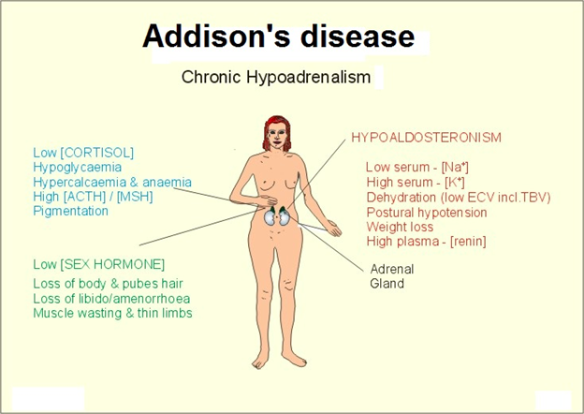
What is Addison’s Disease (AD) ?
Notes:
Endocrine disorder - the adrenal glands do not produce enough of the hormones cortisol and in some cases aldosterone, due to the destruction or dysfunction of the adrenal cortex.

Slide 4
CASE STUDY
“It is a story of iron-willed fortitude in mastering the difficulties of chronic illness … [his] collective health problems were not enough to deter him from running for president.”
Notes:
https://www.theatlantic.com/magazine/archive/2013/08/the-medical-ordeals-of-jfk/309469/

Slide 5
EPIDEMIOLOGY
The frequency rate of Addison's disease is roughly one in 100,000.
40–144 cases per million population (1/25,000–1/7,000)
This disease can can affect persons of any age, sex, or ethnicity
It typically presents in adults between 30 and 50 years of age.
More common in females and children

Slide 6
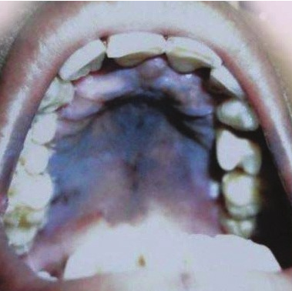
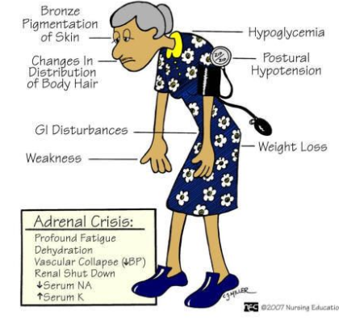
SYMPTOMS
Hyperpigmentation
Chronic fatigue
Loss of appetite
Generalized weakness
Hypotension
Weight loss
Gastrointestinal upset
Dehydration and craving for salt
Hyponatremia
Hyperkalemia
Notes:
https://www.ncbi.nlm.nih.gov/pmc/articles/PMC3636818/
http://slideplayer.com/slide/7053912/

Slide 7
ADDISONIAN CRISIS
Severe dehydration
Pale, cold, clammy skin
Sweating
Rapid, shallow breathing
Dizziness
Severe vomiting and diarrhea
Severe muscle weakness
Headache
Severe drowsiness
Loss of consciousness
Notes:
http://www.umerfinancials.com/7-quickest-reactions-every-homeowner-must-have-in-an-emergency/
http://www.animationartwork.com/artwork/taz_art.sku14122

Slide 8
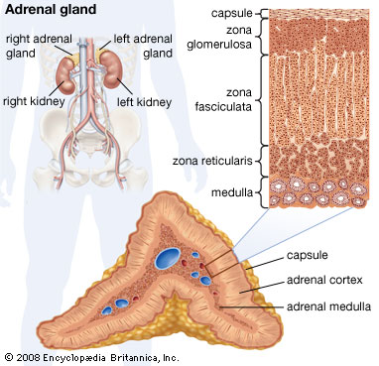
ADRENAL GLANDS
Located above the kidneys
Outer adrenal cortex produces steroid hormones:
Mineralocorticoids
Glucocorticoids
Androgens
3 zones including: zona glomerulosa, the zona fasciculata and zona reticularis.
Notes:
https://www.britannica.com/science/adrenal-gland

Slide 9
AD ASSOCIATED HORMONES
MINERALOCORTICOIDS
Aldosterone
Produced in zona glomerulosa
Regulates blood pressure and electrolyte balance
GLUCOCORTICOIDS
Cortisol, Corticosterone
Synthesized in zona fasciculata
Metabolism and immune system suppression
Cortisol released in response to stress
ANDROGEN
Zona reticularis
Sex hormones

Slide 10
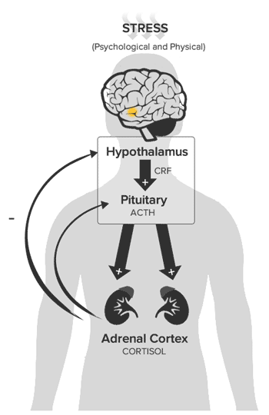
HYPOTHALAMIC-PITUITARY-ADRENAL AXIS (HPA)
Corticotrophin-releasing hormone (CRH) is a released from the hypothalamus.
Stimulates the release of adrenocorticotropic hormone (ACTH) from the anterior pituitary gland.
Production and release of cortisol from the adrenal cortex.
Systemic levels of cortisol act in a negative feedback system throughout the HPA axis.
Notes:
http://www.integrativepro.com/Resources/Integrative-Blog/2016/The-HPA-Axis

Slide 11
AETIOLOGY
Genetic & Environmental Causes
Adrenal Dysgenesis:
Inadequate development of adrenal gland (genetic causes)
DAX1 mutations
Impaired Steroidogenesis
Impaired biochemical production
Adrenal Destruction:
Pathological glandular damage
Autoimmune response
Infections (environmental)
Metastatic Malignancy

Slide 12
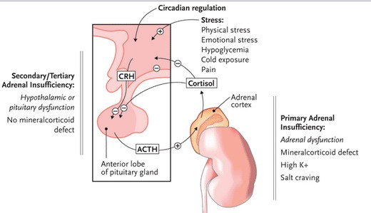
PATHOPHYSIOLOGY
Notes:
http://www.prn.org/index.php/complications/article/hiv_osteoporosis_adrenal_insufficiency_85
Addison’s disease can manifest in one of two ways, either as primary adrenal insufficiency, or secondary adrenal insufficiency

Slide 13
Primary Adrenal Insufficiency
Most common presentation of AD
Destruction of adrenal glands by the production of antibodies against cells in the adrenal cortex
Human leukocyte antigen (HLA) complex: self vs. foreign antigens
Variant of the HLA-DRB1 gene called HLA-DRB1*04:04.
Circulating antibodies against 21-hydroxylase can be detected in around 85% of patients
Steroidogenic enzyme 21-hydroxylase
Damaged adrenal glands

Slide 14
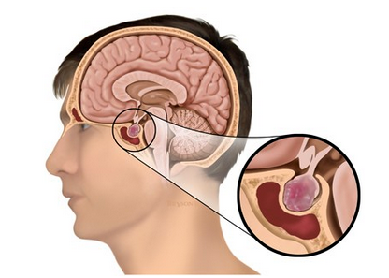
Secondary/Tertiary Adrenal Insufficiency
Hypothalamic or pituitary dysfunction
Tumors
Head injuries
Sudden withdrawal of steroid therapy
Lack of ACTH
Decreased stimulation of adrenal cortex
Notes:
http://blog.medillsb.com/10-medicall-illustrations-that-shed-light-on-tumors/

Slide 15
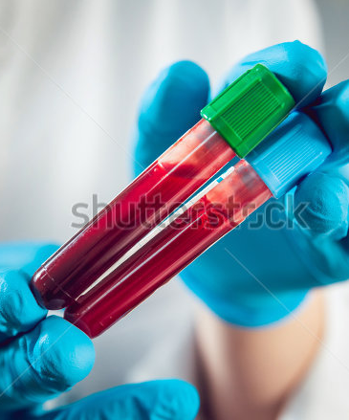
DIAGNOSIS
Cosyntropin Stimulation Test
Test levels of plasma cortisol after synthetic ACTH injection
Low levels indicate Addison’s
Immunologic test
21-hydroxylase antibody test
CT scan of adrenal glands
Supporting test
Notes:
https://www.shutterstock.com/search/blood+vial
presentation of all symptoms relate to the levels of cortisol, mineralocorticoid, and adrenal androgen deficiency at the time.

Slide 16
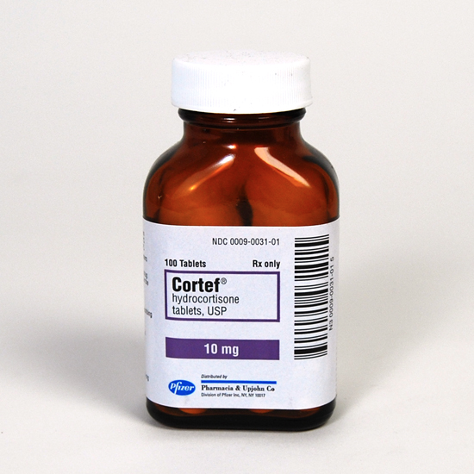
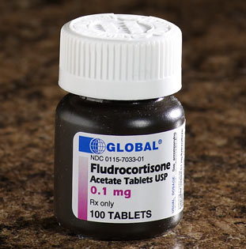
TREATMENT
Oral Medications
Cortisol Replacement
Hydrocortisone
2-3 times daily; 2.5, 10 & 20mg tablets
Cortisone Acetate
2-3 times daily; 5 & 25mg tablets
Prednisone
1-2 times daily; 1-5mg tablets
Aldosterone Replacement
Fludrocortisone
1 daily dose; 0.05 or 0.1mg tablet
Notes:
Image: https://www.mcguffmedical.com/content/images/thumbs/0002255_cortefreg-10mg-100-tabl.jpeg
Image: http://www.drsfostersmith.com/images/Categoryimages/normal/p-50023-45490-fludrocortiso.jpg

Slide 17
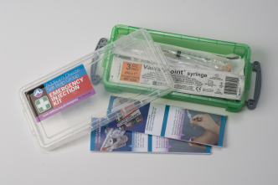
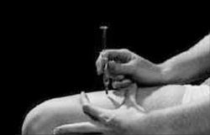
TREATMENT
Injection Alternatives
Intravenous
Intramuscular
Injection Kit
Addisonian Crisis
Notes:
Image: http://www.addisons.org.uk/index.php/articles.html/_/articles-for/emergencies/obtaining-your-emergency-injection-kit-r36
Image: http://www.addisonsociety.ca/injection-kit.html
Image: https://s-media-cache-ak0.pinimg.com/736x/6a/da/2b/6ada2bd89bf21d62e0c99c6c0d12d22a.jpg

Slide 18
TREATMENT
Considerations…
Androgen Replacement
Dehydroepiandrosterone (DHEA) for women
Medical Procedures
Surgery
Increase cortisol and aldosterone doses
Exercise
Loss of fluids and electrolytes
Increase in hydrocortisone, fluid and salt intake
Notes:
Image: http://www.blackwell.ge/res/images/images/2015071418392830770.jpg
Image: http://ichef-1.bbci.co.uk/news/660/media/images/80748000/jpg/_80748739_jog464584343.jpg
androgens also deficient

Slide 19
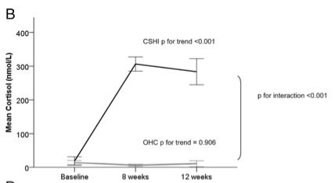
TREATMENT
Oksnes et al.: A randomized clinical trial comparing Continuous Subcutaneous Hydrocortisone Infusion (CSHI) versus Oral Hydrocortisone Replacement (OHC)
CSHI shown to be more effective than OHC
Reestablished circadian cortisol rhythm
Notes:
Image: https://academic-oup-com.libaccess.lib.mcmaster.ca/jcem/article-lookup/doi/10.1210/jc.2013-4253

Slide 20
PROGNOSIS
When Addison’s Disease is well-treated and managed...
Expect a good outcome and quality of life!
(NHS Choices, 2017)
Notes:
In terms of prognosis, the average Addison’s patient can anticipate a fairly good outcome, if the disease is treated adequately.
A relatively normal quality of life can be expected for these patients.
It is important for these patients, who are typically free of other disease, to maintain upkeep of their medication and self-care.

Slide 21
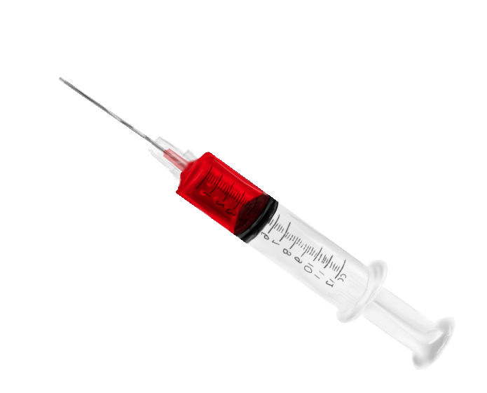
MANAGEMENT
Self-maintenance is key! (NHS Choices, 2017)
1. Managing medication
Prescriptions
Spare or extra medication
Correct daily treatment
2. Injectable forms of medication
In case of emergency or adrenal shock

Slide 22
MANAGEMENT
3. Relationship with healthcare professionals
Regular visits
Open line of communication
4. Providing information to others
Family, friends and colleagues
Medical bracelets or information booklets
Notes:
Michels and Michels, 2014, MayoClinic, 2017)

Slide 23
Case Study Reveal
“It is a story of iron-willed fortitude in mastering the difficulties of chronic illness … [his] collective health problems were not enough to deter him from running for president.”
President John F. Kennedy
Notes:
Can you guess who the case study was referring to? If you didn’t know, the case study is about John F Kennedy. He was the 35th president of the United States. He stayed silent about this condition, and suffered with it a for a majority of his life. However, with the proper treatment and management, individuals with Addison’s disease do not have to suffer in the same way. Thank you for listening to our presentation.

Slide 24
References
Adrenal Insufficiency & Addison's Disease | NIDDK. (n.d.). Retrieved March 01, 2017, from https://www.niddk.nih.gov/health-information/endocrine-diseases/adrenal-insufficiency-addisons-disease#prepare
Dallek, R. (2013, November 05). The Medical Ordeals of JFK. Retrieved Feb 20th 2017, from https://www.theatlantic.com/magazine/archive/2013/08/the-medical-ordeals-of-jfk/309469/
Odeke, S., & Nagelberg, S. (2001). Addison disease. eMedicine Journal, 2, 5.
Volpé, R. (1990). Autoimmune diseases of the endocrine system. Boca Raton: CRC Press.
Sarkar, S. B., Sarkar, S., Ghosh, S., & Bandyopadhyay, S. (2012). Addison’s disease. Contemporary Clinical Dentistry, 3(4), 484–486. http://doi.org/10.4103/0976-237X.107450
Chernecky CC, Berger BJ. ACTH stimulation test - diagnostic. In: Chernecky CC, Berger BJ, eds. Laboratory Tests and Diagnostic Procedures. 6th ed. Philadelphia, PA: Elsevier Saunders; 2013:98.
Michels, A., & Michels, N. (2014). Addison disease: early detection and treatment principles. Indian Journal of Clinical Practice, 25(6).
Ten, S., New, M., & Maclaren, N. (2001). Addison’s disease 2001. The Journal of Clinical Endocrinology & Metabolism, 86(7), 2909-2922.
Brooke, A. M., & Monson, J. P. (2009). Addison's disease. Medicine, 37(8), 416-419.
Fujieda, K., & Tajima, T. (2005). Molecular basis of adrenal insufficiency. Pediatric research, 57, 62R-69R.
Charmandari, E., Nicolaides, N. C., & Chrousos, G. P. (2014). Adrenal insufficiency. The Lancet, 383(9935), 2152-2167.
Mitchell, A. L., & Pearce, S. H. (2012). Autoimmune Addison disease: pathophysiology and genetic complexity. Nature reviews Endocrinology, 8(5), 306-316.
Addison’s Disease. (2015). Mayo Clinic. Retrieved February 28, 2017 from, http://www.mayoclinic.org/diseases-conditions/addisons-disease/diagnosis-treatment/treatment/txc-20156064
Oksnes, M. (2014). Continuous Subcutaneous Hydrocortisone Infusion versus Oral Hydrocortisone Replacement for Treatment of Addison's Disease: A Randomized Clinical Trial. The Journal of Clinical Endocrinology & Metabolism, 99 (5): 1665-1674.
Husebye, E. S. (2013). Consensus statement on the diagnosis, treatment and follow-up of patients with primary adrenal insufficiency. The Journal of Internal Medicine, 275 (2): 104-115.
Injection Kit. (2017). Canadian Addison Society. Retrieved February 28, 2017 from http://www.addisonsociety.ca/injection-kit.html
Michels, A., Michels, N. (2014). Addison Disease: Early Detection and Treatment Principles. Am Fam Physician. 89 (7): 563-568.
“Addison's disease - Treatment". NHS Choices. Retrieved 2017-02-25
“Overview: Addison’s disease”. Mayo Clinic. Retrieved from http://www.mayoclinic.org/diseases-conditions/addisons-disease/manage/ptc-20156068.
mature mortality in patients with Addison’s disease: a population-based study. The Journal of Clinical Endocrinology & Metabolism, 91(12), 4849-4853.
Chantzichristos, D., Persson, A., Eliasson, B., Miftaraj, M., Franzén, S., Bergthorsdottir, R., ... & Johannsson, G. (2016). Patients with Diabetes Mellitus Diagnosed with Addison´ s Disease Have a Markedly Increased Additional Risk of Death. In Cushing Syndrome and Primary Adrenal Disorders (pp. OR25-4). Endocrine Society.

Slide 25
Questions?

Slide 26
Multiple Choice Questions
What is the characteristic early symptom of Addison’s Disease?
Low BP
Craving for salt ##
Hyperpigmentation
Generalised muscle weakness
More than one of the above
2. What is the most common cause of Addison’s Disease?
Autoimmune response ##
Infection
Withdrawal of steroid therapy
Cardiovascular disease
None of the above

