Slide 1
A Look Inside Breast Cancer
Zil Nasir, Allan Tran, Kunal Mehta, Noor Tariq, Arani Muthurajah
Notes:
Names, representing group one
Today we are going to be doing a presentation on breast cancer which ties well into this month as it is breast cancer awareness month

Slide 2
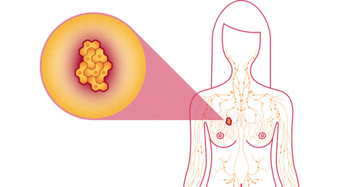
Outline:
Introduction
Etiology and Epidemiology
Global distribution
Predisposition
Screening and Symptoms
Anatomy and Physiology
Stages of breast cancer
Pathophysiology
Therapies and treatment
Image from: National breast cancer association
Notes:
ZIL
These are the topics we are going to be covering.

Slide 3
Introduction
Uncontrollable division of cells in the breast tissue
Second leading cancer in the world
1 in 8 women will be diagnosed in their lifetime
Most often associated with developed countries
(Canadian Cancer Society, 2017)
Notes:
Breast cancer is characterized by an uncontrollable division of cells in the breast tissue. It is the second leading cancer in the world affecting 1 in 8 women during their lifetime. Although found globally, the prevalence is highest in developing countries.

Slide 4
Etiology
Modifiable Risks | Non-modifiable Risks
Diet | Age
Alcohol Consumption | Ethnicity
Obesity | Age at Menarche/Menopause
Age at First Birth/ Breastfeed | Endogenous Hormones

Slide 5
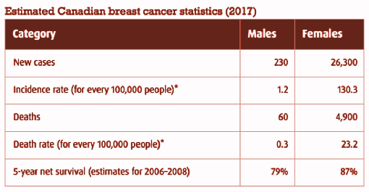
Epidemiology: Canada
The incidence and death rates of males and females in Canada for the year of 2017
(Canadian Cancer Society, 2017)
Notes:
Although breast cancer affects both women and men, women are diagnosed on a much larger scale.
Looking at rates in Canada:
The incidence for females is about 130.0 cases for every 100 000 people and only 1.2 cases in men per 100 000 people
The death rate for females is about 23.2 cases per 100 000 in females and only 0.3 cases per 100 000 in males

Slide 6
Epidemiology: World
Incidence varies greatly:
89.7 per 100 000 in Western Europe
19.3 per 100 000 in East Africa
40 per 100 000 in developing regions
(WHO, 2017)
Notes:
The world wide statistics are not as updated as the Canadian statistics however they provide a good understanding of incidence and death rates.
Highest rates are found in Western European countries, America, and Canada. Rates are significantly lower in African countries.

Slide 7
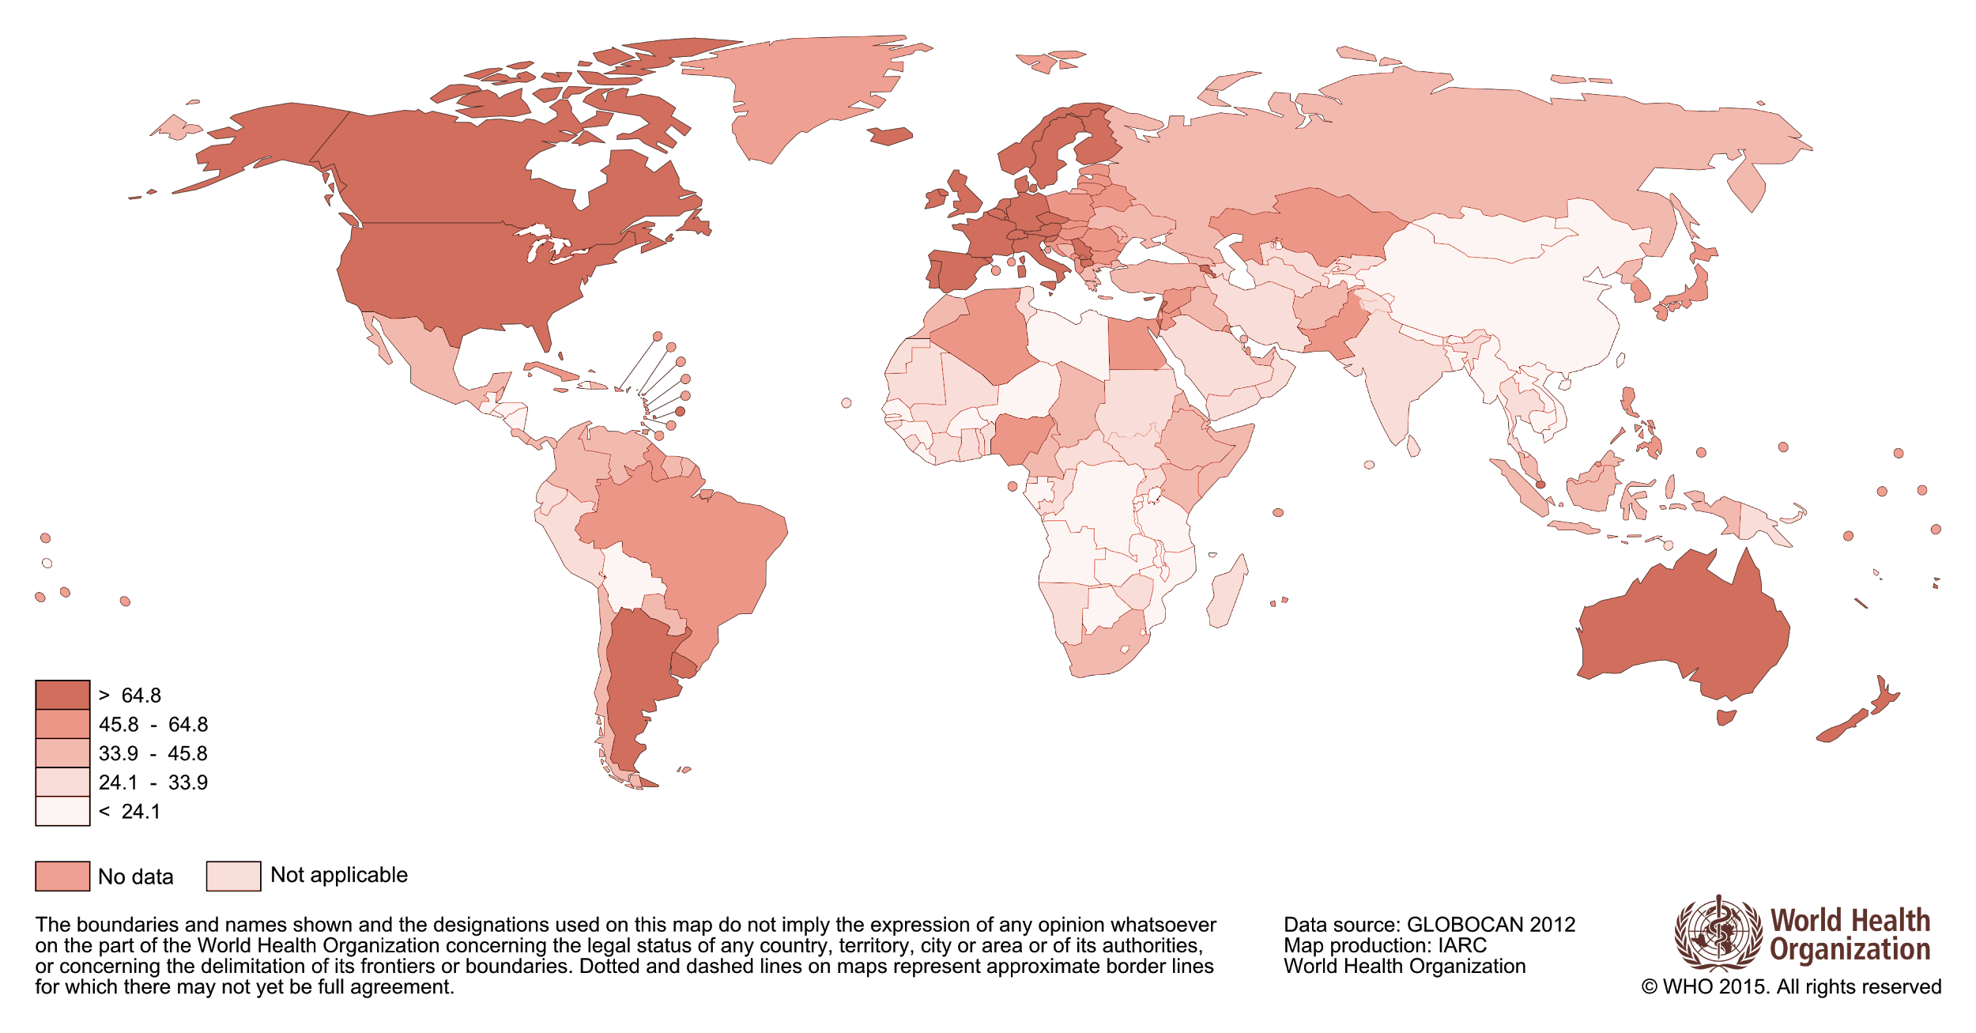
Global Incidence and Distribution
Survival rate in low income countries: 40%
Survival rate in high income countries: 80%
Estimated over 500 000 women died in 2011
(WHO, 2017)
Image from Globocan
Notes:
From there we can conclude that the highest rates of breast cancer are found in developed countries such as Western European countries and the US whereas the lowest rates are found in African countries, particularly East Africa. Although the incident rates
The reason for low rates was due to a lack of intervention and treatment opportunities. Women are greater diagnosed in much later stages, where chances of survival are low Even for the treatment options that are available, they tend to be expensive

Slide 8
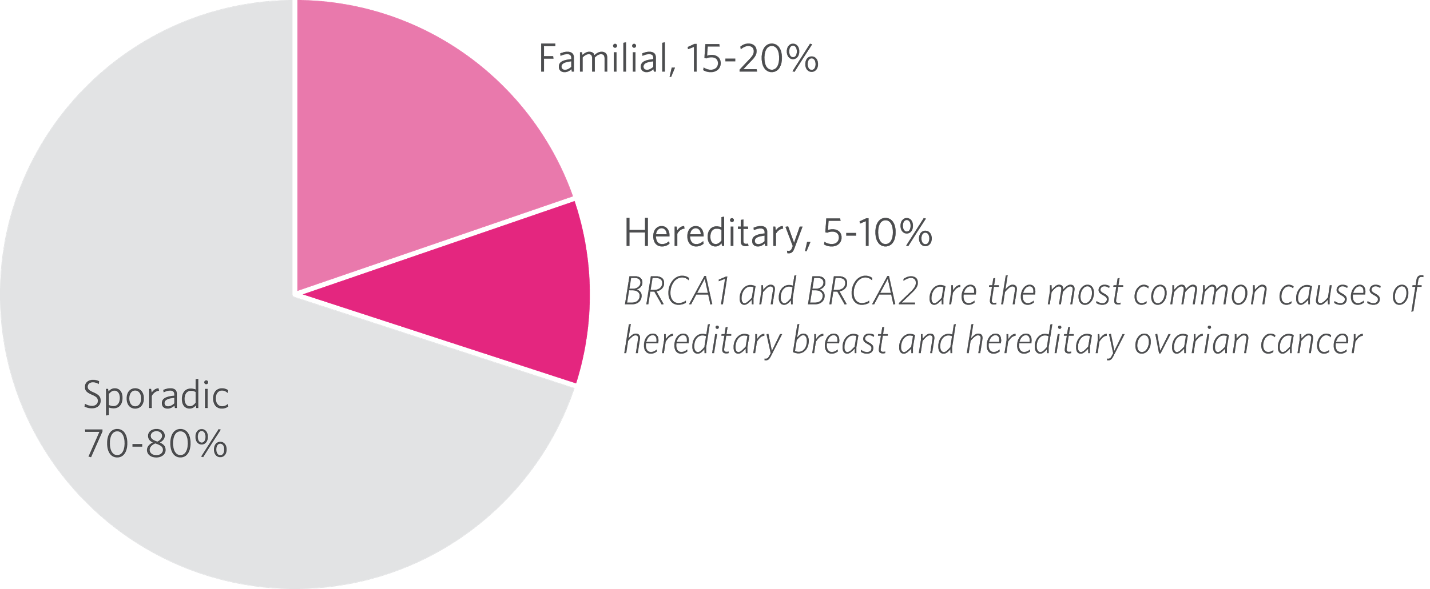
Predisposition
Image from: http://patients.ambrygen.com/cancer/breast-cancer/new-diagnosis/what-do-I-need-to-know-about-breast-cancer-genetics
Notes:
There are 3 types of genetic predisposition to breast cancer: familial, hereditary and sporadic, with sporadic accounting for a majority of cases. However, inherited or hereditary predisposition is of great interest to us. The genetic predisposition to breast cancer is commonly caused by the abnormalities in the BRCA1 and BRCA2 genes Despite it being quite rare, once the mutation has been inherited and activated, there is a 65-85% chance of developing breast cancer by age 70.

Slide 9
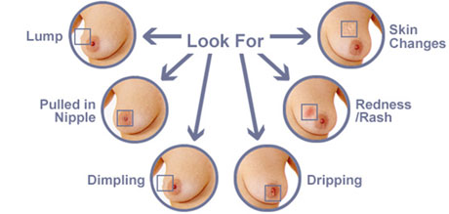
Symptoms
Image from: http://www.breastcancerinindia.com/breast-cancer-symptoms.html
Notes:
The most common symptoms of breast cancer include:
Formation of a new lump
Change in nipple shape
Change in breast and surrounding skin size, shape and colour
Fluid discharge from the nipple(s)

Slide 10
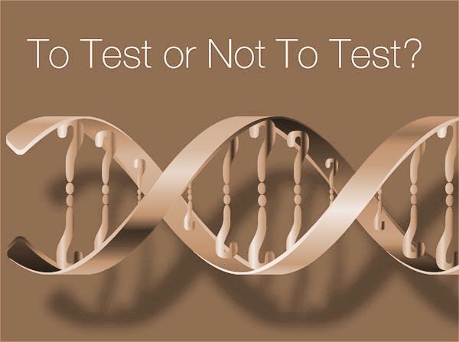
Screening
Genetic Screening Type 1
Genetic Screening Type 2
Mammography
Fine Needle Aspiration
Core Needle Biopsy
Excisional Biopsy
(Warner et al., 2001)
Notes:
Screening for breast cancer involves testing healthy women for the presence of abnormalities to achieve an early diagnosis and result in lower mortality rates. Some detected cancers are benign and may not progress at all. At the same time, not all cancers found by screening can be cured.
Genetic screening involves searching through an individual’s DNA for cancerous mutations. Type 1 looks through all mutations linked to cancer development while Type 2 compares an individual’s DNA to at least 4 family members that possess the BRCA mutation.
Mammography produces images of the breast to allow for visual examination. This allows for early detection of cancerous cells before physical manifestation.
Fine needle aspiration involves using a fine needle to extract and examine fluid from abnormal lumps in the breast.
Core needle biopsies use a slightly larger, hollow needle to remove layers of tissue and determine the progression of the cancer in breast tissue.
Excisional biopsy involves removing part of or all of the abnormal mass in the breast. This form of screening helps determine the best and most efficient course of treatment for breast cancer.

Slide 11
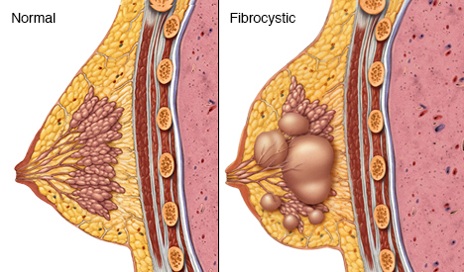
Abnormalities with Screening
Fibrocystic Breast Disease
Non-proliferative lesion (~1)
Proliferative lesion without atypia (1.3-1.9)
Proliferative lesion with atypia (2.9-12.0)
(Dupont, 1993)
Image from: http://www.mayoclinic.org/diseases-conditions/fibrocystic-breasts/home/ovc-20194898
Notes:
Follow ups to abnormal screening results may be required to determine whether abnormal masses are cancerous or not. Abnormal cell growth is commonly categorized as Fibrocystic breast disease (FBD) and result from non-proliferative and proliferative lesions in the breast. Non-proliferative lesions are lesions that occur due to trauma, irregularities in secretion, and clogging of ducts. This may form cysts, ductal ectasia (clogging of lactiferous duct), periductal fibrosis and columnar cell change.
Proliferative lesions are a result of rapid growth of cells.
A proliferative lesion without atypia is the growth of normal cells. In this case, ducts and lobules are growing quickly but appear to be normal. This includes the formation of ductal hyperplasia (overgrowth of cells), radial scars, and intraductal papilloma (tumor found in milk duct).
Proliferative lesions with atypia refer to the excessive growth of ducts and lobules that are growing rapidly and appear to be abnormal. Possible conditions include atypical ductal and lobular hyperplasia.

Slide 12
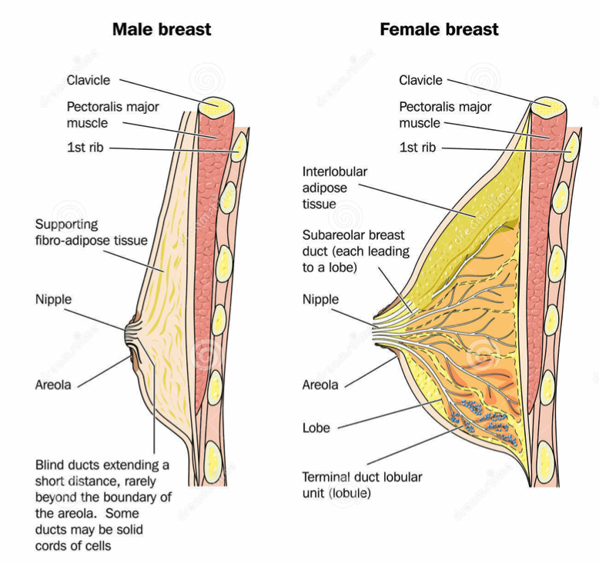
Anatomy and Physiology
Specialized function - production of milk for lactation
Sit atop pectoralis muscle
Female breasts - lobes and ducts
Male breasts - ducts with blunt ends
Figure : Compares the male breast anatomy and the female breast anatomy.
(National Cancer Institute, 2015)
Image from: http://www.cancer.ca/en/cancer-information/cancer-type/breast/breast-cancer/the-breasts/?region=on
Notes:
-Breasts are organs that have a specialized function which is the production of milk for lactation. The breast is made up of lobes, ducts, connective tissues, fats, and glands.
-Female breasts have specialization as both the lobes and ducts are connected to allow for secretion of nutrients.
-Male breasts however only have the ducts that have a blunt end and do not connect to the lobes.
-Both the male and female breasts sit atop of the pectoralis muscle.

Slide 13
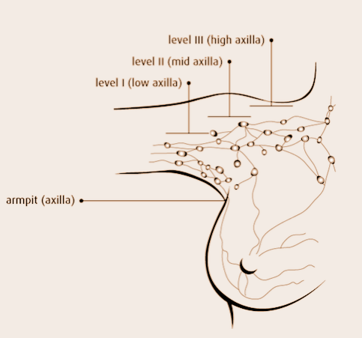
Connected to blood and lymph vessels
Lymph vessels move lymph fluid into lymph nodes
Axillary lymph nodes
Level I - low axilla
Level II - mid axilla
Level III - high axilla
Figure : Illustrates the axillary lymph nodes : level I, level II, and level III.
(Canadian Cancer Society, 2017)
Image from: http://www.cancer.ca/en/cancer-information/cancer-type/breast/breast-cancer/the-breasts/?region=on
Notes:
The breasts are connected to the blood and lymph vessels. The lymph vessels collect and move the lymph fluid away from the breast into lymphatic tissue (lymph nodes) around the breast.
The lymph vessels and lymph nodes compose the lymphatic system of the breast. The axillary lymph nodes are under the arm, and are divided into three levels:
· Level I is low axilla, which is along the outer border of the pectoralis minor
· Level II is mid axilla, beneath the pectoralis minor
· Level III is high axilla, along the inner border of pectoralis minor
When breast cancer spreads, it spreads to level I lymph nodes first, followed by level II, and level III

Slide 14
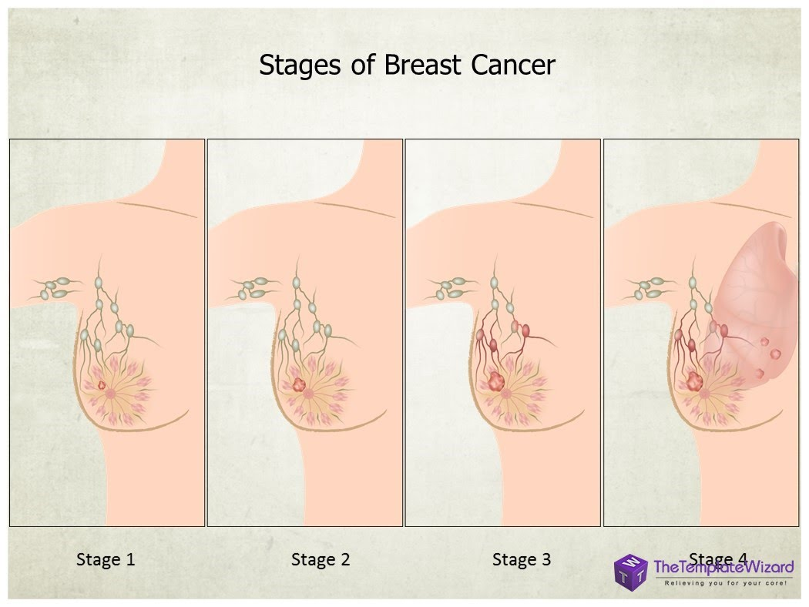
Stages of breast cancer
TNM system is used to diagnose the stage of the breast cancer
Stage 0: Carcinoma in situ stage
Stage 1: Cancer contained in regions of abnormal cell growth
1a: tumour is less than 2 cm
1b: tumour is 0.2-2mm and has moved to lymph nodes
Stage 2: Cancer either remains in the same spot and grows in size or has extended to the lymph nodes
2a: tumour is less than 2 cm and crossed lymph nodes
2b: tumour is between 2-5cm
Image from worldbreastcancer.org
(National Cancer Institute, 2015)
Notes:
TNM System
The Tumour, Lymph Node, and Metastasis (TNM) system is widely recognized when labeling the stages of breast cancer.
Stage 0: carcinoma In situ stage:
There is abnormal but non-invasive cellular growth in the ducts, lobule, or nipple region. Generally clinical breast exams or mammograms are recommended followed by a tamoxifen hormone therapy
Stage 1:
The cancer is found and contained in the regions where abnormal cells began to grow. If the cancer is stage 1a, the tumour is less than 2cm in size and has not spread to lymph nodes. If the cancer is in stage 1b, the cancer has moved to the lymph nodes but is less than 0.2-2mm in size.
Stage 2:
The cancer continues to grow but remains either in the breast or has extended a little beyond the lymph nodes. Stage 2a means the tumour is either less than 2cm but has crossed less than 4 auxiliary lymph nodes or the tumour is between 2-5cm in size but has not spread towards the lymph nodes. Stage 2b can be characterized by the size of the cancer being between 2-5cm in size spreading into the lymph nodes or the tumour being about 5cm but has remaining stationary.

Slide 15
Stages of Breast cancer (continued)
Stage 3: Cancer has now spread beyond the region of the original tumour such as the skin near the breast and chest walls
3a: tumour is growing beyond 5 cm and has spread to lymph nodes beyond the original site
3b: tumour has grown to any size, spreading nearby tissue and muscle
Stage 4: Cancer has metastasized to other organs and regions of the body
Image from worldbreastcancer.org
(National Cancer Institute, 2015)
Notes:
Stage 3:
The breast cancer has now spread beyond the region of the original tumour growth and is beginning to affect muscles and lymph nodes beyond the original site. In stage 3a the tumour is growing beyond 5cm in size. There are also small clusters of cancerous cells found in the lymph node region. Otherwise, the tumour is larger than 5cm and spreading to lymph nodes and nearby regions like the breastbone or under the arm. In stage 3b, the tumour can grow to any size as it spreads and invades of the skin near the breast and chest walls.
Stage 4:
This is considered the most dangerous stage, as there is no treatment to cure the cancer. The cancer has spread to other regions around the body and has metastasized into regions of the brain, bones, liver, and lungs. Treatment can only prolong the individual’s lifespan.

Slide 16
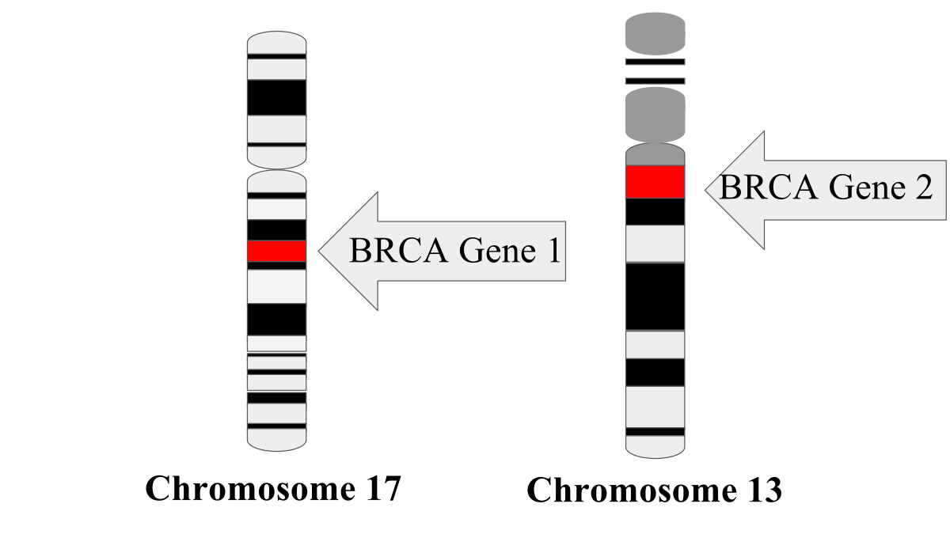
Pathophysiology
Breast Cancer Susceptibility Gene (BRCA)
BRCA1 and BRCA2
Tumour suppressor genes
Chromosome 13 and 17
Function:
Repair of double DNA breakages
Homologous recombination DNA repair
Non-homologous end-joining
Cellular responses to DNA damage
Block cell proliferation
Induction of apoptosis
(Lee Moffitt Cancer Centre and Research Institute, 2004 )
(Miki, 1994; Rosen, 2014; Wooster, 1995)
Notes:
The breast cancer susceptibility gene 1 (BRCA1) and breast cancer susceptibility gene 2 (BRCA2) are tumour suppressor genes, and translational protein products expressed in all humans.
When the BRCA gene is translated into its BRCA protein product, it plays a role in repairing double DNA breaks such as non-homologous end-joining and homologous recombination DNA repair
nucleotide sequences are exchanged between two similar or identical molecules of DNA.
It also functions to facilitates cellular responses to DNA damage through blockage of cell proliferation and induction of apoptosis
Therefore, a genetic mutation in BRCA1 and BRCA2 could affect function of its protein products, impairing the ability to repair damaged DNA, and as a result lead to the susceptibility to breast cancer
(Lee Moffitt Cancer Centre and Research Institute, 2004 )
Reference: http://www.medscape.org/content/2004/00/48/73/487390/487390_fig.html

Slide 17
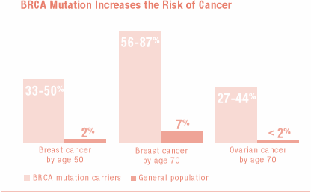
Pathophysiology (Cont.)
Lifetime risk of Mutant-BRCA Carriers
Image from jacobsintl.org
(Kuchenbaecker, 2017)
Notes:
The significance of such genes are predominantly due to the associated lifetime risk for breast cancer (BC) when mutations are present
This is shown through a prospective cohort study by Kuchenbaecker et al. which revealed the cumulative BC risk to age 80 years to be 72% for BRCA1 and 69% for BRCA2
The study also shows that a rapid increase in BC incidence from adulthood until ages 30-40 for BRCA1, and until ages 40-50 for BRCA2
However, past the range of highest incidence of both BRCA, the frequency of BC presentation remains constant at 20-30 per 1000 persons until age 80
(Kuchenbaecker, 2017)
http://jamanetwork.com/journals/jama/article-abstract/2632503
Associated lifetime risk of breast cancer
BRCA1
Lifetime risk to age 80: 72%
High incidence to ages 30-40
BRCA2:
Lifetime risk to age 80: 69%
High incidence to ages 40-50
Past the peak incidence until age 80
Constant at 20-30/1000 mutant-BRCA carriers

Slide 18
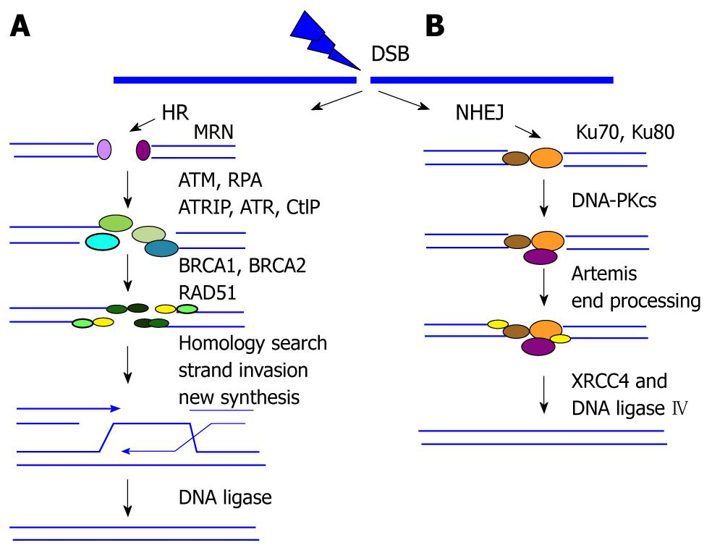
Pathophysiology (Cont.)
BRCA Involved in DNA Repair
Study by Moynahan et al.
BRCA1 and BRCA2 mutant cell-lines
Impairment of chromosome-break repair
BRCA coupled with Rad51
Chen et al.
DNA breakage via hydroxyurea or UV radiation
BRCA1 and BRCA colocalization; DNA replication sites
Image from world journal of clinical oncology
(Chen, 1998; Foray, 1999; Moynahan, 2001; Moynahan 1999; Scully, 1997)
Notes:
There are several studies which validate the role of BRCA1 and BRCA2 in DNA repair
Firstly, a study conducted by Foray et al. reveals the inability of irradiated cells to repair DNA double-strand breaks due dysfunctional BRCA1 and BRCA2
Secondly, additional studies have demonstrated the impairment of homologous recombination repair on chromosomal-breaks in BRCA1- and BRCA2-mutant cell-lines
This study further explained how BRCA proteins conjugate with Rad51 recombinase to effectively repair DNA damage, and thus allowing for chromosomal stability
Lastly, Chen et al. reveals the colocalization of BRCA1 and BRCA2 at the DNA replication sites after the applying hydroxyurea or UV radiation to cause double DNA breaks in cells
These studies evidently concludes that BRCA1 and BRCA2 are protein compounds that have a role in proper DNA repair

Slide 19
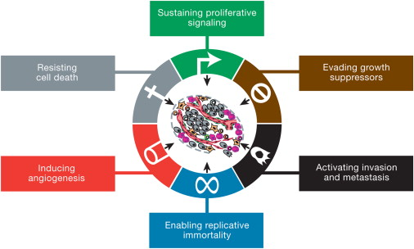
Pathophysiology (Cont.)
Additional Genes involved in Cell-cycle Misregulation
Genes vital for:
Normal cell growth, survivability, replication
Disruption → Sustained proliferation, evasion of growth suppressors, replicative immortality, activation of invasion and metastasis, induction of angiogenesis, resistance to cell death
Genes involved in Breast Cancer:
Overexpression of Cyclin D1 or E
Downregulation of cyclin dependent kinase inhibitors
Activation of retinoblastoma or p55
(Hanahan, 2011)
(Ahmad, 2012; Landberg, 1997)
Notes:
There are additional genes, when unregulated, results in cancerous-cell phenotypes of the breast tissue
These genes are primarily responsible for regulation of the cell cycle which is an important mechanism for normal cell growth, survivability and replication
Therefore, mutations in these genes may lead to sustained proliferative signaling, evasion of growth suppressors, replicative immortality, activation of invasion and metastasis, induction of angiogenesis, and resistance to cell death
In breast cancer, there is either an overexpression of cyclin D1 and E, down-regulation of cyclin-dependent kinase inhibitors, or the activation of tumour suppressor proteins, retinoblastoma and p55
This will ultimately lead to misregulation in cell-cycle resulting in the development of cell-malignancy
Image reference
Hanahan, 2011 - http://www.sciencedirect.com/science/article/pii/S0092867411001279

Slide 20
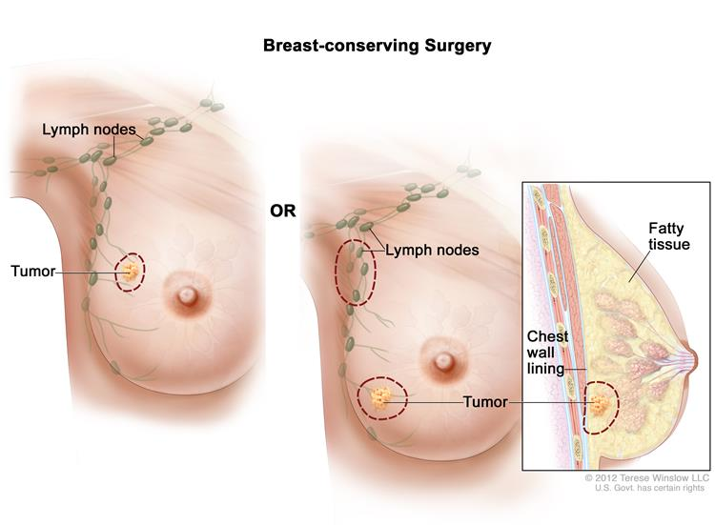
Treatment: Surgical Interventions
LUMPECTOMY
Breast-conserving surgery (BCS)
Least invasive
Removal of a small tumour without removing entire breast tissue
Effective at early stages of breast cancer
(Fisher et al., 2002)
Image from: https://www.cancer.gov/images/cdr/live/CDR415521.jpg
Notes:
Surgery depends on the size and location of tumour, and if the cancer has spread to the lymph nodes. Before surgery, neoadjuvant chemotherapy is commonly used to shrink the tumour so it is relatively easier to remove.
Lumpectomy is one of the surgical interventions that is the least invasive and is also referred to breast-conserving surgery (BCS), and is always followed up by radiation therapy.
This involves the removal of a tumour that is small without removing the entire breast tissue.
The surgeon makes small incision near the abnormal area, and removes the abnormal mass along with a margin of healthy tissue.
BCS is very effective at the early stages of breast cancer when the tumours are locally invasive.

Slide 21
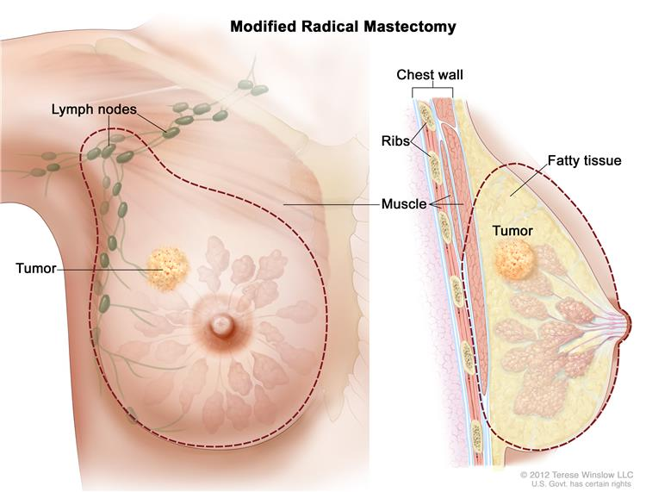
Treatment: Surgical Interventions
MASTECTOMY
Treatment of large tumours that have spread
Complete removal of the breast tissue
Removal of fascia over pectoralis muscle
Image from oncology nurse advisor
(Fisher et al., 2002)
Image from: https://www.cancer.gov/images/cdr/live/CDR415523.jpg
Notes:
Mastectomy is another surgical intervention that is used to treat large tumours that have spread to more than one area in the breast.
Mastectomy involves the complete removal of the breast tissue, and the removal of the fascia over the pectoralis muscle. After the removal, the surgeon places tubes where removal has occurred, and these tubes function to remove blood and lymph fluid that collect during the healing process

Slide 22
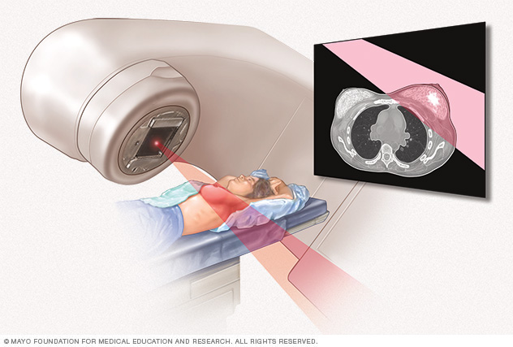
Treatment: Radiation Therapy
Uses high-energy rays to destroy cells
Damages genetic material to stop growth
Used before surgery to shrink tumour size
(National Cancer Institute, 2015)
Notes:
Radiation therapy uses high-energy rays (like X rays and gamma rays) to destroy cancer cells, and prevent cancer cells from recurring after surgery.
It is also used to shrink tumour size before surgery.
The therapy damages the genetic material of the cancer cells and stops growth.
The high-energy rays can also damage the normal cells, however the normal cells have the ability to repair themselves after the radiation therapy is applied.

Slide 23
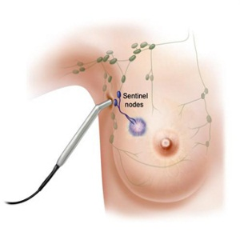
Treatment: Chemotherapy
Highly invasive
Neoadjuvant vs. Adjuvant
Taxol Chemotherapy
Stabilizes microtubules
Cells remain in metaphase-anaphase stage → leads to apoptosis
Image from oncology nurse advisor
(National Cancer Institute, 2015)
Notes:
This one is probably the most popular. Chemotherapy is a highly invasive treatment that kills rapidly dividing cells. There are two forms: Neoadjuvant and adjuvant. Neoadjuvant therapy is used before surgery to reduce the size of the tumor. It also increases the chance for the patient to have breast conserving surgery. Adjuvant therapy is used after the surgery to destroy any lingering cancer cells that were either left behind or have metastasized.
One form of chemotherapy is taxol therapy. In this, Taxol binds to tubulin subunits to stabilize MT against depolymerization. This causes the cells to remain in the metaphase-anaphase stage leading any cancer cells to engage in apoptosis.
Although productive, chemotherapy also has side effects such as low blood cell count, hair loss and infection.
Chemotherapy is a treatment that is used to kill rapidly diving cells, and is highly invasive
There are two types of chemotherapy: neoadjuvant and adjuvant therapy.
Neoadjuvant therapy is used before surgery, and targets to shrink the large tumour to increase the chance of patient to have a breast-conserving surgery. The patient is treated with high risk of metastasis without delay, and the therapy can also show if the tumour is responding to the treatment, making the removal of the tumour safer.
Adjuvant therapy is used after surgery for patients who have no evidence of cancer. The therapy targets to destroy any cancer cells that may be left behind or cells that have metastasized.
Taxol chemotherapy is another specific branch of chemotherapy where taxol binds to the tubulin subunits and stabilizes the microtubules against depolymerisation. This results in the cell to remain in metaphase-anaphase stage, and leads to cell apoptosis than cell replication. Chemotherapy is usually offered to treat early stage breast cancer with a high risk of recurrence or locally advanced breast cancer.
Chemotherapy can also cause side effects depending on the type of drug used, the dosage, and overall health. Some common side effects include low blood cell count, hair loss, infection, nausea and vomiting, nervous system damage, and loss of appetite.

Slide 24
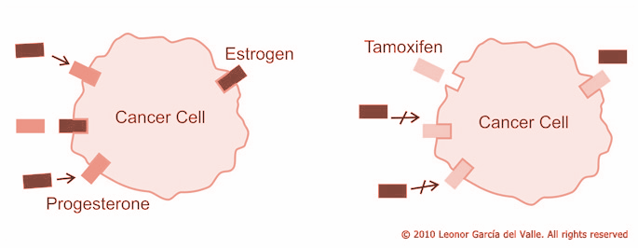
Treatment: Hormonal Therapy
Used to treat hormone receptor-positive breast cancer
Anti-estrogen drugs
Tamoxifen
Aromatase inhibitors
Inhibits aromatase enzyme
Decrease levels of estrogen or block production of estrogen to minimize growth of tumour cell
Image from Surgical oncologist Breast surgeon
(Johnston & Dowsett, 2003)
Notes:
Hormone therapy is used to treat breast cancer by adding, blocking or removing hormones. Basically some breast cancer tissue can be hormone receptor positive meaning the cells have receptors for estrogen, progesterone, or both. Tamoxifen is most commonly used as anti-estrogen drug, which blocks the estrogen receptors on cancer cells so cancer cells are not able to use estrogen. Aromatase is an enzyme that the body uses to make estrogen in areas of the body other than the ovaries, such as fat tissues and adrenal glands. Aromatase inhibitors block the action of aromatase enzyme, which decreases levels of estrogen in the body. A decrease in estrogen levels is beneficial because very little estrogen can be used by the cancer cells, minimizing growth of the tumour cell.
Hormonal therapy is used to treat breast cancer by adding, blocking, or removing hormones.
Hormone therapy is used for breast cancer tissue tested for hormone receptor positive, which means that the cancer cells have receptors for estrogen, progesterone, or both. With these receptors present on the cancer cell, the hormones can attach to the receptors, and help these cells to grow
The two common therapies to treat hormone receptor-positive breast cancer are anti-estrogen drugs, and aromatase inhibitors.
Tamoxifen is most commonly used as anti-estrogen drug, which blocks the estrogen receptors on cancer cells so cancer cells are not able to use estrogen.
Aromatase is an enzyme that the body uses to make estrogen in areas of the body other than the ovaries, such as fat tissues and adrenal glands. Aromatase inhibitors block the action of aromatase enzyme, which decreases levels of estrogen in the body. A decrease in estrogen levels is beneficial because very little estrogen can be used by the cancer cells, minimizing growth of the tumour cell.
The figure explains the mechanism of action of aromatase inhibitor and tamoxifen. Estrogen binds to the estrogen receptor, and Tamoxifen competes with with estrogen for ER binding, and aromatase inhibitor reduce synthesis of estrogen from their androgenic precursor.

Slide 25
Immunotherapy (Current Study)
Natural killer cells
Role in immunosurveillance, potential of cancer eradication
Study by Shenouda et al.
Ex-vivo expansion of NK-cells → High cytotoxicity to breast cancer cells
Enabling patients to restore or boost NK-cell levels
Notes:
This study looked at natural killer cells and their role in breast cancer treatment. For example a study found that expanding NK cells in vivo provide highly effective cytotoxicity in breast cancer cell lines leading to their destruction. From this, we can now look into accumulating personalized activated NK cells in patients to restore of boost their NK levels to fight against cancer.

Slide 26
References
1. Ahmad, A. (2013). Breast Cancer Metastasis and Drug Resistance. In Breast Cancer Metastasis and Drug Resistance(pp. 143–159). https://doi.org/10.1007/978-1-4614-5647-6
2. Bau, D. T., Mau, Y. C., & Shen, C. Y. (2006, August 18). The role of BRCA1 in non-homologous end-joining. Cancer Letters. https://doi.org/10.1016/j.canlet.2005.08.003
3. Bernstein, L. (2002). Epidemiology of endocrine-related risk factors for breast cancer. J Mammary Gland Biol Neoplasia. 7, 3–15.
4. Breast cancer: prevention and control. (n.d.). Retrieved October 03, 2017, from http://www.who.int/cancer/detection/breastcancer/en/
5. Breast Cancer. (2017, June 07). Retrieved October 03, 2017, from https://www.cdc.gov/cancer/breast/statistics/index.htm
6. Canadian Cancer Society. (2017). Retrieved September 30, 2017, from
7. Cerullo, V., Diaconu, I., Kangasniemi, L., Rajecki, M., Escutenaire, S., Koski, A., … Hemminki, A. (2011). Immunological Effects of Low-dose Cyclophosphamide in Cancer Patients Treated With Oncolytic Adenovirus. Molecular Therapy, 19(9), 1737–1746. https://doi.org/10.1038/mt.2011.113
8. Chen, J., Silver, D. P., Walpita, D., Cantor, S. B., Gazdar, A. F., Tomlinson, G., … Scully, R. (1998). Stable Interaction between the Products of the BRCA1 and BRCA2 Tumor Suppressor Genes in Mitotic and Meiotic Cells. Molecular Cell, 2(3), 317–328. https://doi.org/10.1016/S1097-2765(00)80276-2
9. Cohen, I., Pappo, O., Elkin, M., San, T., Bar-Shavit, R., Hazan, R., Peretz, T., Vlodavsky, I, and Abramovitch, R. (2006). Heparanase promotes growth, angiogenesis and survival of primary breast tumors. Int J Cancer. 118, 1609-1617.
10. Collaborative Group on Hormonal Factors in Breast Cancer. (2002). Alcohol, tobacco and breast cancer – collaborative reanalysis of individual data from 53 epidemiological studies, including 58 515 women with breast cancer and 95 067 women without the disease. British J Cancer. 11, 1234–1245. http://doi.org/10.1038/sj.bjc.6600596
11. Deng, C. X. (2006). BRCA1: Cell cycle checkpoint, genetic instability, DNA damage response and cancer evolution. Nucleic Acids Research, 34(5), 1416–1426. https://doi.org/10.1093/nar/gkl010
12. Diederichs, S., & Gutschner, T. (2012). The hallmarks of cancer A long non-coding RNA point of view. RNA Biology, 96, 703–719.
13. Dupont, W. D., Parl, F. F., Hartmann, W. H., Brinton, L. A., Winfield, A. C., Worrell, J. A., ... & Plummer, W. D. (1993). Breast cancer risk associated with proliferative breast disease and atypical hyperplasia. CANCER-PHILADELPHIA-, 71, 1258-1258.
14. Ewertz, M., Duffy, S.W., Adami, H.O., Kvale, G., Lund E, Meirik O, Mellemgaard A, Soini I, Tulinius H. (1990). Age at first birth, parity and risk of breast cancer: a meta-analysis of 8 studies from the Nordic countries. Int J Cancer. 46, 597–603.
15. Ferlay, J., Bray, F., Pisani, P., and Parkin, D.M. (2002). Globocan: cancer incidence, mortality and prevalence worldwide. IARC CancerBase No 5, version 2.0. Lyon: IARC Press; 2004.

Slide 27
16. Fisher, B., Anderson, S., Bryant, J., Margolese, R. G., Deutsch, M., Fisher, E. R., ... & Wolmark, N. (2002). Twenty-year follow-up of a randomized trial comparing total mastectomy, lumpectomy, and lumpectomy plus irradiation for the treatment of invasive breast cancer. New England Journal of Medicine, 347(16), 1233-1241.
17. Foray, N., Randrianarison, V., Marot, D., Perricaudet, M., Lenoir, G., & Feunteun, J. (1999). Gamma-rays-induced death of human cells carrying mutations of BRCA1 or BRCA2. Oncogene, 18(51), 7334–7342. https://doi.org/10.1038/sj.onc.1203165 from the laboratory. Nature reviews. Cancer, 3(11), 821.
18. Gagnon, J., Lévesque, E., The Clinical Advisory Committee on Breast Cancer Screening and Prevention, Borduas, F., Chiquette, J., Diorio, C., … Simard, J. (2016). Recommendations on breast cancer screening and prevention in the context of implementing risk stratification: impending changes to current policies. Current Oncology, 23(6), e615–e625. http://doi.org/10.3747/co.23.2961
19. Gupta, G. P., and Massagué. (2006). Cancer metastasis: building a framework. Cell. 127, 679-695.
20. Guray, M., & Sahin, A. A. (2006). Benign breast diseases: classification, diagnosis, and management. The oncologist, 11(5), 435-449.
21. He, Y., Rajantie, I., Pajusola, K., Jeltsch, M., Holopainen, T., Yla-Herttuala, S.,… Alitalo, K. (2005). Vascular endothelial cell growth factor receptor 3–mediated activation of lymphatic endothelium is crucial for tumour cell entry and spread via lymphatic vessels. Cancer Res. 65, 4739-4746.
22. Hemminki, O., Parviainen, S., Juhila, J., Turkki, R., Linder, N., Lundin, J., … Hemminki, A. (2015). Immunological data from cancer patients treated with Ad5/3-E2F-Δ24-GMCSF suggests utility for tumor immunotherapy. Oncotarget, 6(6), 4467. https://doi.org/10.18632/oncotarget.2901 http://www.cancer.ca/en/?region=on
23. Johnston, S. R., & Dowsett, M. (2003). Aromatase inhibitors for breast cancer: lessons
24. Key, T. J., Verkasalo, P. K., & Banks, E. (2001). Epidemiology of breast cancer. The Lancet Oncology, 2(3), 133-140. doi:10.1016/s1470-2045(00)00254-0
25. Kluttig, A., & Schmidt-Pokrzywniak, A. (2009). Established and suspected risk factors in breast cancer aetiology. Breast Care, 4(2), 82–87. http://doi.org/10.1159/000211368
26. Kotb, A. M., Hierholzer, A., and Kemler, R. (2011). Replacement of E-cadherin by N-cadherin in the mammary gland leads to fibrocystic changes and tumor formation. Breast Cancer Res. 13,104, 2011.
27. Kuchenbaecker, K. B., Hopper, J. L., Barnes, D. R., Phillips, K.-A., Mooij, T. M., Roos-Blom, M.-J., … Olsson, H. (2017). Risks of Breast, Ovarian, and Contralateral Breast Cancer for BRCA1 and BRCA2 Mutation Carriers. Jama, 317(23), 2402–2416. https://doi.org/10.1001/jama.2017.7112
28. LANDBERG, G., & ROOS, G. (1997). The cell cycle in breast cancer. APMIS, 105(7–12), 575–589. https://doi.org/10.1111/j.1699-0463.1997.tb05056.x
29. Marcu, A., Black, G., Vedsted, P., Lyratzopoulos, G., & Whitaker, K. L. (2017). Educational differences in responses to breast cancer symptoms: A qualitative comparative study. British journal of health psychology, 22(1), 26-41
30. Martin, T.A., Ye, L., Sanders, A.J., Lane, J., and Jiang, W. G. (2013). Cancer invasion and metastasis: Molecular and cellular perspective. Austin (TX): Landes Bioscience.
31. Masuda, H., Zhang, D., Bartholomeusz, C., Doihara, H., Hortobagyi, G. N., & Ueno, N. T. (2012). Role of Epidermal Growth Factor Receptor in Breast Cancer. Breast Cancer Research and Treatment, 136(2), 10.1007/s10549–012–2289–9. http://doi.org/10.1007/s10549-012-2289-9
32. Miki, Y., Swensen, J., Shattuck-eidens, D., Futreal, P. A., Harshman, K., Tavtigian, S., … Skolnick, M. H. (1994). Strong Candidate for the Breast and Ovarian Cancer Susceptibility Gene BRCA1. Science, 266, 66–71. https://doi.org/10.1126/science.7545954

Slide 28
33. Moynahan, M. E., Pierce, A. J., & Jasin, M. (2001). BRCA2 is required for homology-directed repair of chromosomal breaks. Molecular Cell, 7(2), 263–272. https://doi.org/10.1016/S1097-2765(01)00174-5
34. National Cancer Institute. (2015, July 8). Breast Cancer Treatment for Health
35. Patsialou, A., Wang, Y., Lin, J., Whitney, K., Goswami, S., Kenny, P. A., and Condeelis, J. S. (2012). Selective gene-expression profiling of migratory tumor cells in vivo predicts clinical outcome in breast cancer patients. Breast Cancer Research. 14, 1-19.
36. Powell, S., & Kachnic, L. (2003). Roles of BRCA1 and BRCA2 in homologous recombination, DNA replication fidelity and the cellular response to ionizing radiation. Oncogene, 22(37), 5784–5791. https://doi.org/doi: 10.1038/sj.onc.1206678
Professionals (PDQ).
37. Radford, D. M., & Zehnbauer, B. A. (1996). Inherited breast cancer. Surgical Clinics of North America, 76(2), 205-220
38. Rolli, M., Fransvea, E., Pilch, J., Saven, A., and Felding-Habermann, B. (2003). Activated integrin αvβ3 cooperates with metalloproteinase MMP-9 in regulating migration of metastatic breast cancer cells. Proc. Natl. Acad. Sci. U.S.A. 100, 9482-9487.
39. Rosen, E. M., & Pishvaian, M. J. (2014). Targeting the BRCA1/2 tumor suppressors. Current Drug Targets, 15(1), 17–31. https://doi.org/10.2174/1389450114666140106095432
40. Salgado, J., Aramendía, J. M., Gutierrez, C., Gil, C., Robles, M., & García-Foncillas, J. (1995). Identification of the breast cancer susceptibility gene BRCA2. Nature, 378(6559), 789–792. https://doi.org/10.1038/378789a0
41. Scully, O. J., Bay, B., Yip, G., and Yu, Y. (2012). Breast cancer metastasis. Cancer Genomics Proteomics. 9, 311-320.
42. Scully, R., Chen, J., Plug, A., Xiao, Y., Weaver, D., Feunteun, J., … Livingston, D. M. (1997). Association of BRCA1 with Rad51 in mitotic and meiotic cells. Cell, 88(2), 265–275. https://doi.org/10.1016/S0092-8674(00)81847-4
43. Seitz, H.K., & Becker, P. Alcohol metabolism and cancer risk. (2007). Alcohol Res Health. 30, 38–41, 44-47.
44. Shenouda, M. M., Gillgrass, A., Nham, T., Hogg, R., Lee, A. J., Chew, M. V., … Ashkar, A. A. (2017). Ex vivo expanded natural killer cells from breast cancer patients and healthy donors are highly cytotoxic against breast cancer cell lines and patient-derived tumours. Breast Cancer Research, 19(1), 76. https://doi.org/10.1186/s13058-017-0867-9
45. Sölétormos, G., Nielsen, D., Schiøler, V., Mouridsen, H., & Dombernowsky, P. (2004). Monitoring different stages of breast cancer using tumour markers CA 15-3, CEA and TPA. European Journal of Cancer, 40(4), 481-486. doi:10.1016/j.ejca.2003.10.015
46. Thigpen, J. (2012). Comparisons between different polychemotherapy regimens for early breast cancer: meta-analyses of long-term outcome among 100 000 women in 123 randomised trials. Yearbook of Medicine,2012, 111-112. doi:10.1016/s0084-3873(12)00182-4

Slide 29
47. Turnbull, C., & Rahman, N. (2008). Genetic predisposition to breast cancer: past, present, and future. Annu Rev Genomics Hum Genet. 9, 321–345.
48. Warner, E., Plewes, D. B., Shumak, R. S., Catzavelos, G. C., Di Prospero, L. S., Yaffe, M. J., ... & Taylor, G. A. (2001). Comparison of breast magnetic resonance imaging, mammography, and ultrasound for surveillance of women at high risk for hereditary breast cancer. Journal of Clinical Oncology, 19(15), 3524-3531
49. Wendt, M. K., Taylor, M. A., Schiemann, B. J., and Schiemann, W. P. (2011). Down-regulation of epithelial cadherin is required to initiate metastatic outgrowth of breast cancer. Mol Biol Cell. 22, 2423-2235.
50. Yilmaz, M., and Christofori, G. (2010). Mechanisms of motility in metastasizing cells. Mol Cancer Res. 8, 629-642.

Slide 30
Questions
What is/are the genetic predisposition(s) for developing breast cancer?
Familial
Hereditary
Sporadic
All of the above
What happens during the the third stage of breast cancer?
Non-invasive cell growth
Cancer cells begins to invade and metastasize in nearby tissue, muscle, and lymph nodes
The cancer metastasizes to other organs such as the heart and lungs
None of the above
Notes:
D
B

