Slide 1

CRISPR-Cas12-Based Detection of SARS-CoV-2
By: Adnan, Syed, Tristen, Leena

Slide 2
Introduction
Issue
02
Last 40 Years
01
SARS-CoV-2
03
Lack of access to rapid and accurate diagnostics
Many large-scale epidemics
Increased need for diagnostics
(Broughton et al., 2020)

Slide 3

Limitations of Previous Diagnostics
qRT-PCR
Serological Tests
4-6 hours to detect virus
Expensive equipment
Training required
Time needed for detectable immune response
(Broughton et al., 2020)
(CDC., 2020)

Slide 4
DETECTR Advantages Over Current Diagnostics
DETECTR
Detection takes 30-40 min
Comparable accuracy to qRT-PCR
Isothermal signal amplification
Single nucleotide target specificity
Use of lateral flow strips for easy readouts (Point of Care Testing)
(Broughton et al., 2020)

Slide 5
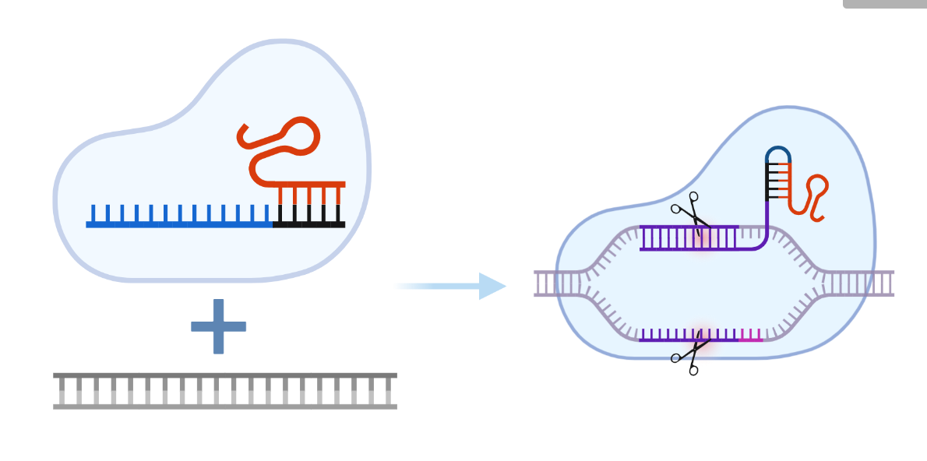
Use of CRISPR/Cas Technology in Diagnostics
Guide RNA
Cas Protein
Target DNA
Figure created in BioRender.com
(Srivastava et al., 2020)

Slide 6
Timeline of Assays Using CRISPR/Cas Technology
SHERLOCK
2016
2018
NASBACC
HOLMES ASSAY
2017
Cas13: Zika and Dengue Virus
(Gootenberg et al., 2017)
Cas9: Zika Virus
Cas12
(Li et al., 2018)
(Pardee et al., 2016)

Slide 7
Timeline of Assays Using CRISPR/Cas Technology
SHERLOCK v2
March 2020
DETECTR
AIOD CRISPR
2018
April 2020
Multiplexing Cas13 and Cas12
Cas12
(Gootenberg et al., 2018)
(Broughton et al., 2020)
Cas12
(Ding et al., 2020)

Slide 8
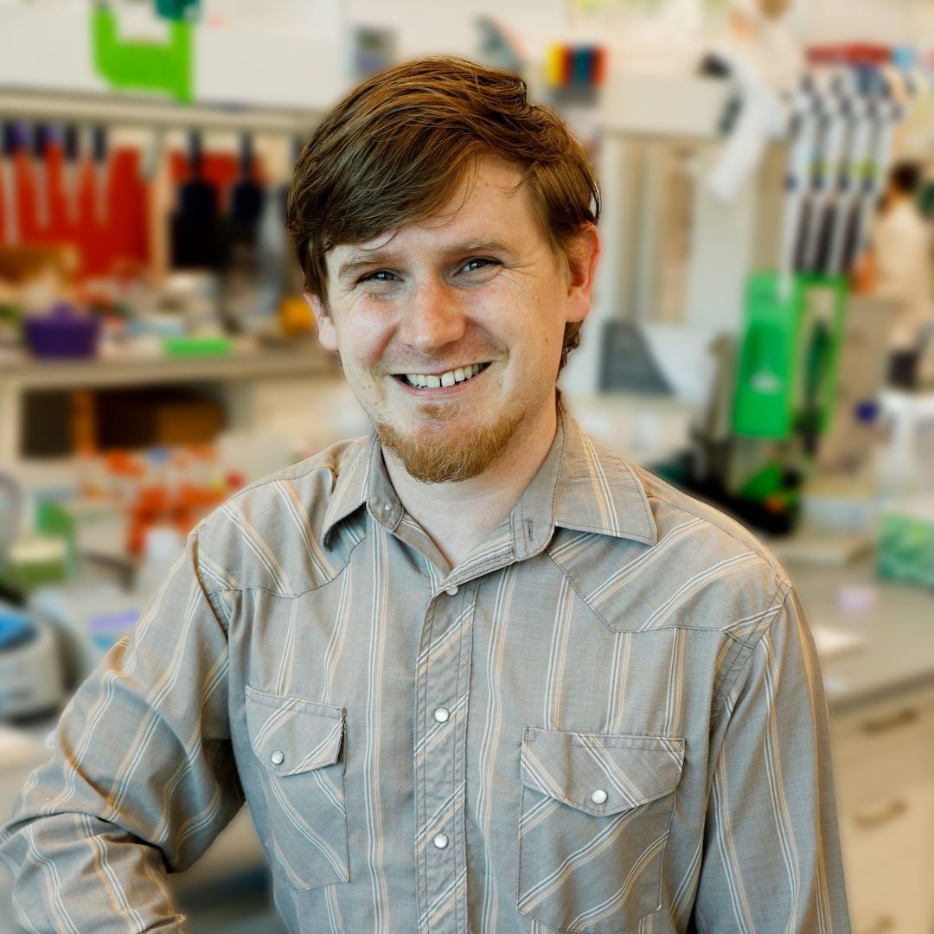

Lead Authors
Xianding Deng
James P Broughton
Doctor of Philosophy
24 publications
Research interests: Next generation sequencing
Senior Manager Mammoth Biosciences
12 publications
POC using CRISPR Technology
(Broughton et al., 2020)
(ResearchGate, n.d.)
(Mammoth Biosciences, Inc., 2021)

Slide 9
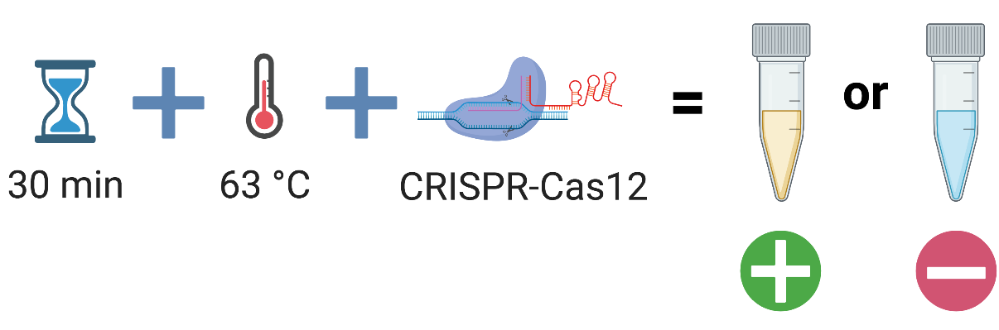
DETECTR - How does it work?
Figure created in BioRender.com

Slide 10
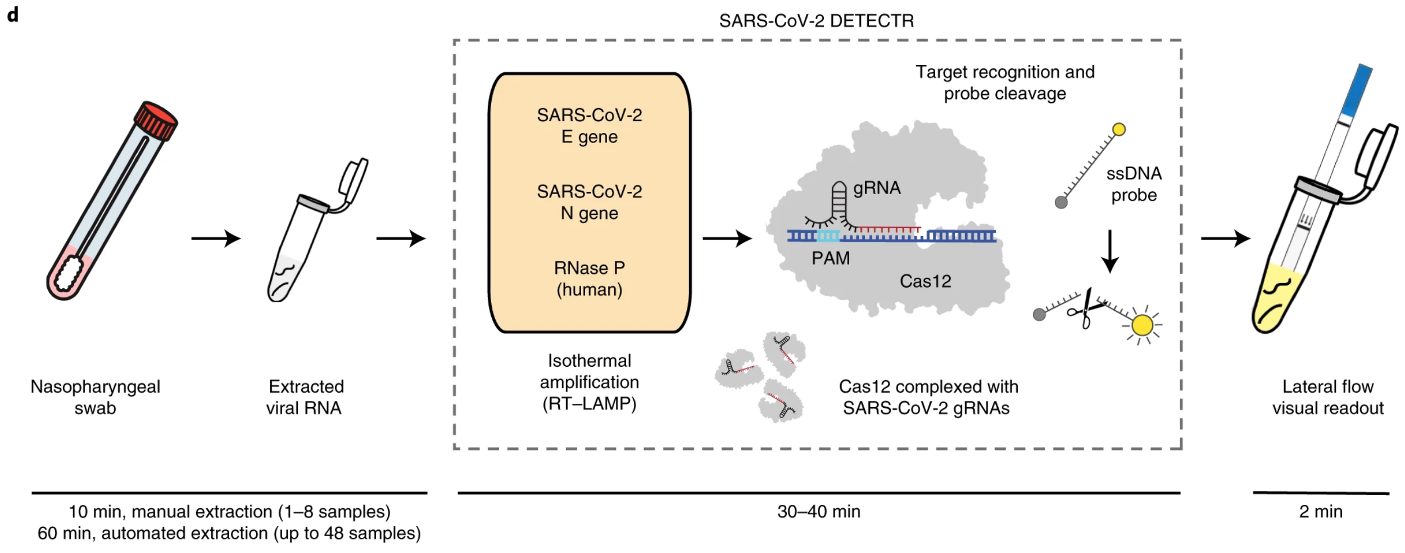
DETECTR - How does it work?
(Broughton et al., 2020)

Slide 11
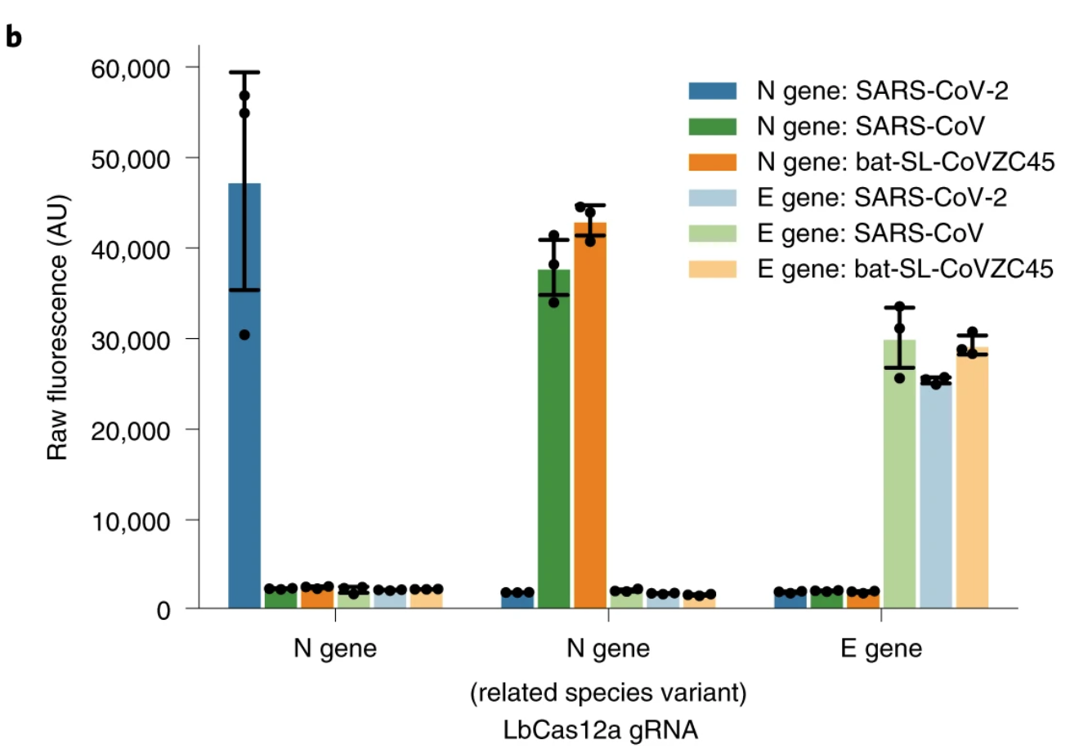
DETECTR Design
Cas12 guide RNA (gRNA) specificity.
The nucleoprotein gene (N) gRNA is specific for SARS-CoV-2, whereas the envelope gene (E) gRNA is able to detect three SARS-like coronavirus strains.
gRNAs specifically target SARS-CoV-2 or broadly detect related coronavirus strains.
(Broughton et al., 2020)

Slide 12
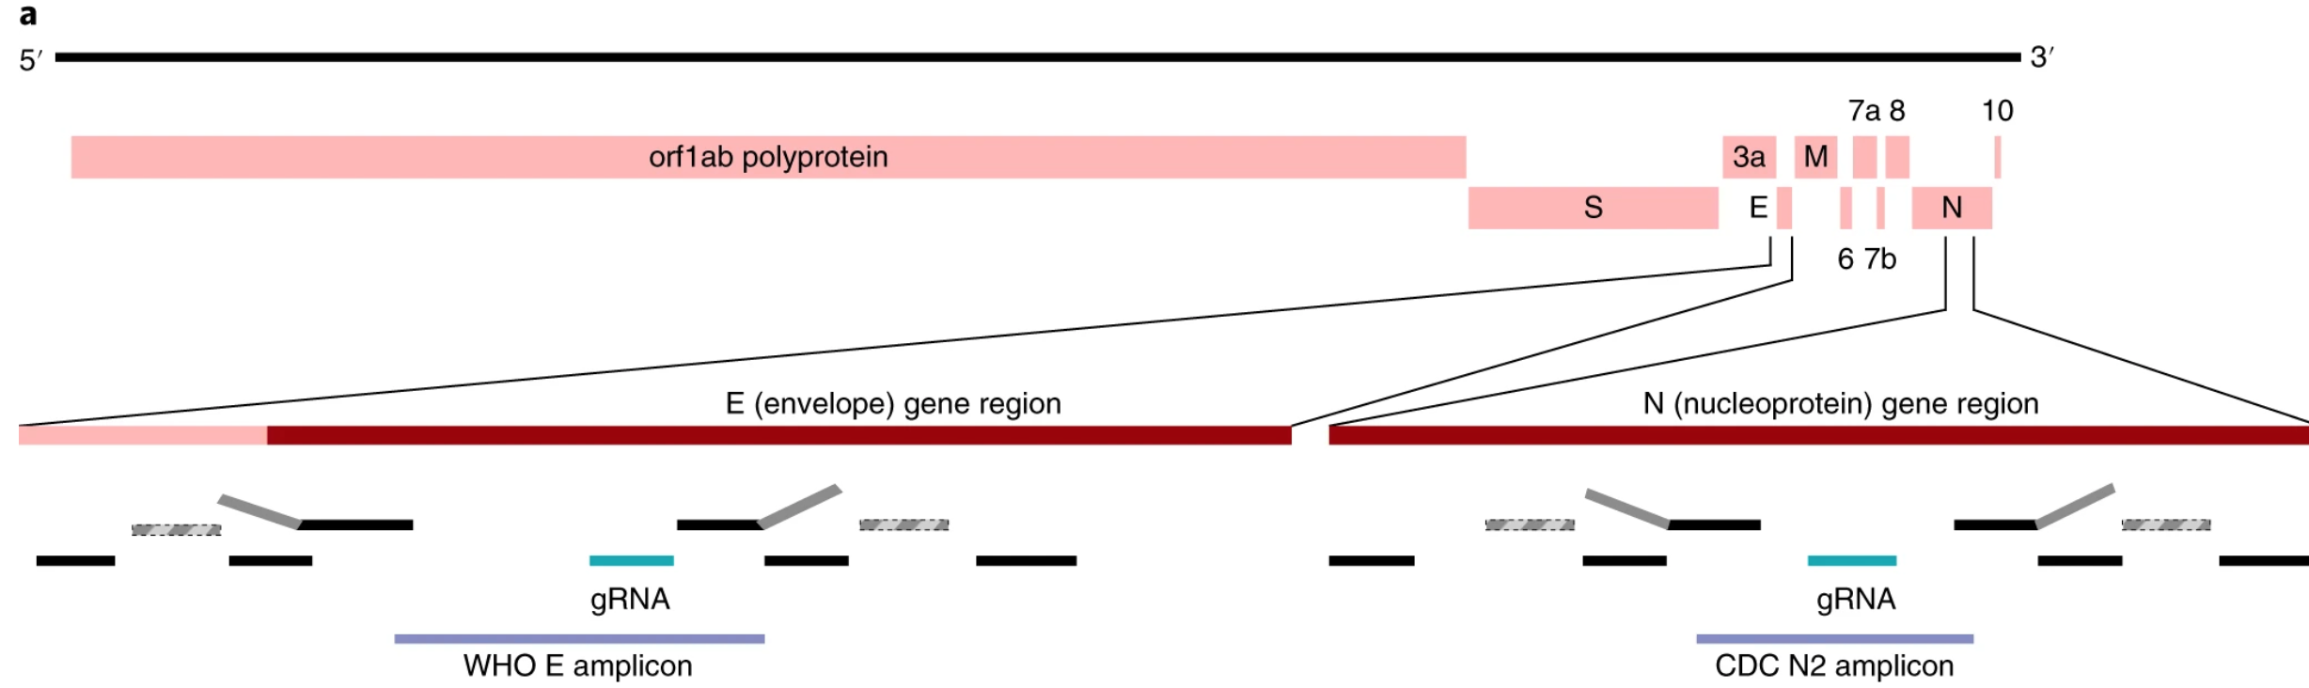
(Broughton et al., 2020)

Slide 13
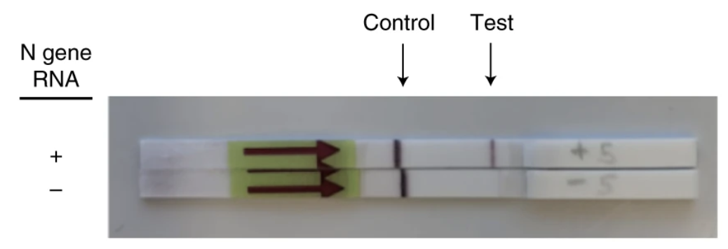
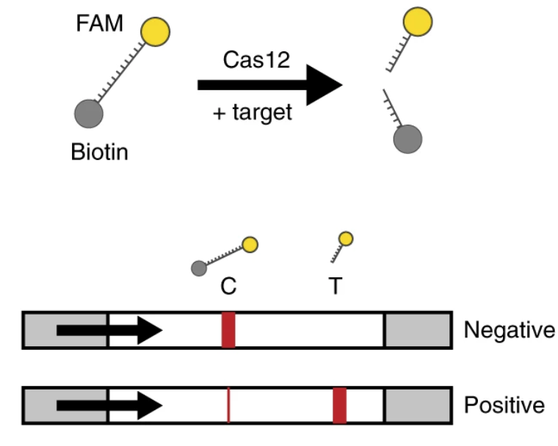
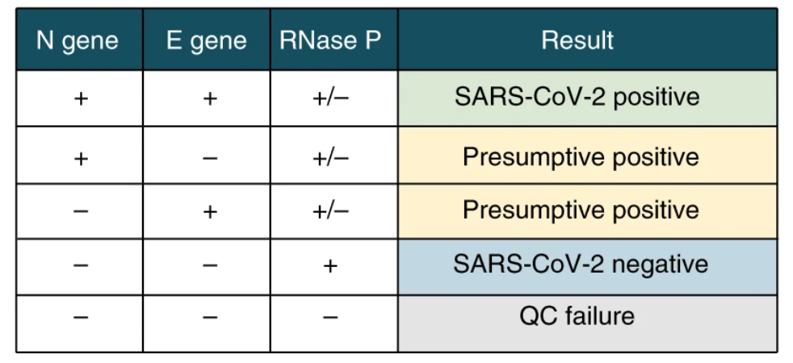
DETECTR Visualization
(Broughton et al., 2020)

Slide 14
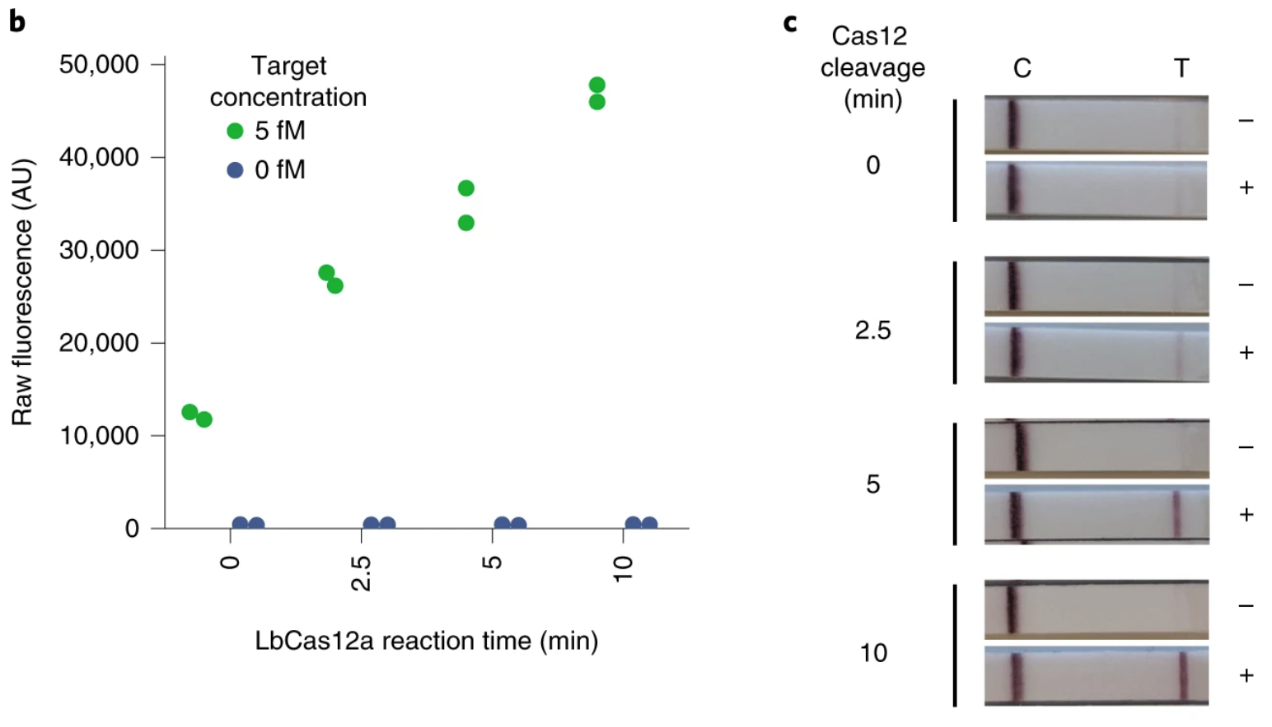
DETECTR Visualization
(Broughton et al., 2020)

Slide 15
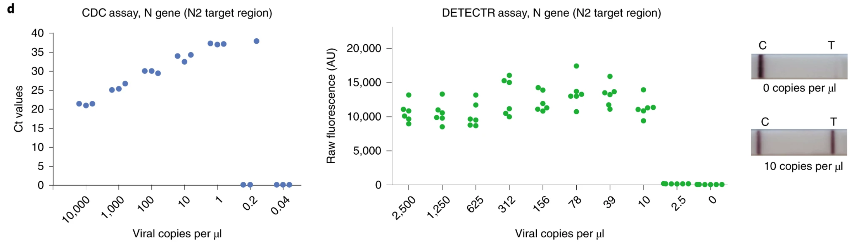
DETECTR Limit of Detection
(Broughton et al., 2020)

Slide 16
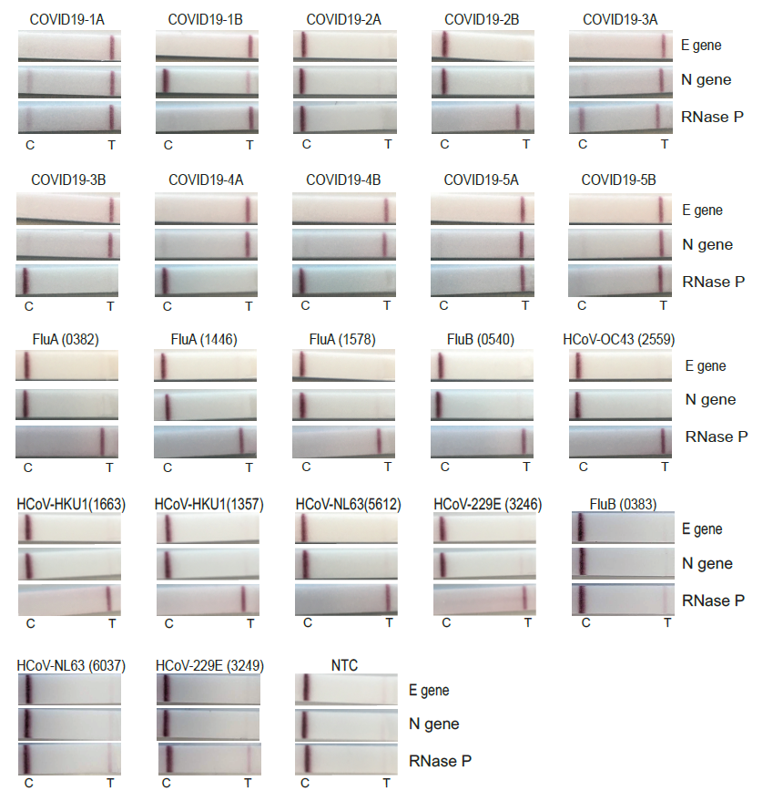
DETECTR Cross Reactivity
No Cross Reactivity when tested experimentally
95% positive predictive agreement
100% negative predictive agreement
(Broughton et al., 2020)

Slide 17
Summary of Paper
Uses RT–LAMP followed by CRISPR–Cas12-based detection to distinguish SARS-CoV-2 specifically
Can run in approximately 30–40 min
Easily visualized on a lateral flow strip
Higher limit of detection
No Cross Reactivity
(Broughton et al., 2020)

Slide 18
Limitations
Lack of PAM sequence for N1 and N3 gene
Use of only one Cas protein (further multiplexing capability)
Limited reagent availability
Higher Limit of Detection (Clinical presence)
Less sensitive compared to RT-PCR
(Cebrian-Serrano et al., 2017)
(Srivastava et al., 2020)
(Serrano, et al. 2020)
(University of Oxford Medical Sciences Division, n.d.)
(MammothBioscience, 2019)

Slide 19
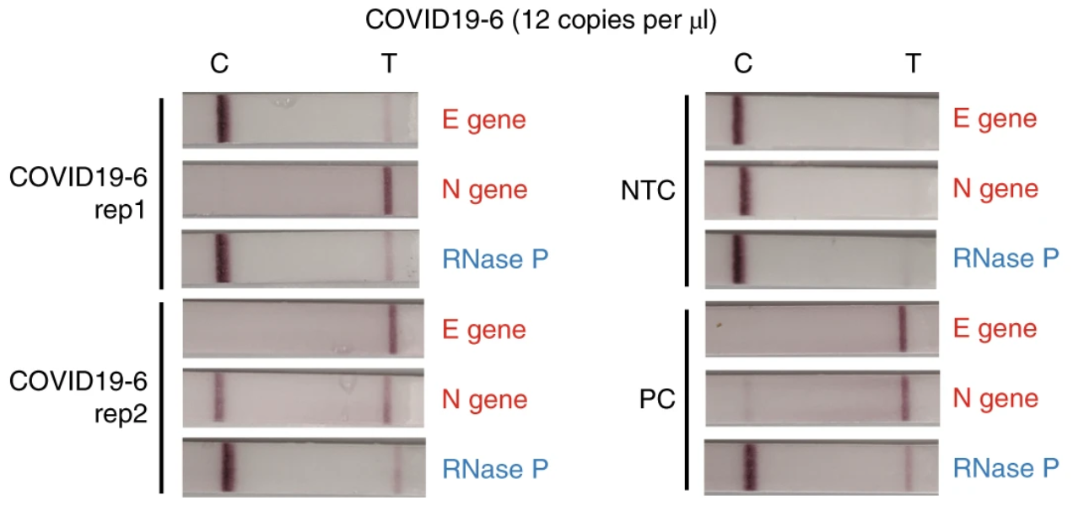
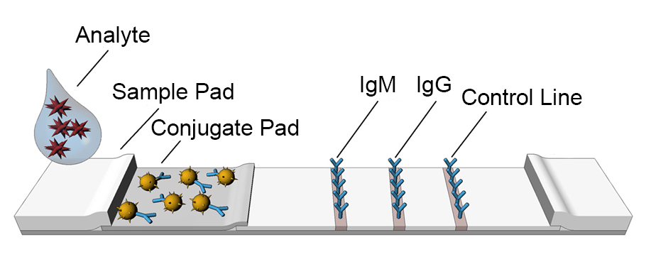
Further Research Questions: Merging Testing Strips
Fewer reagents used
More cost effective
Lateral flow testing strips required for testing of each gene
Lateral flow testing strip for antibody detection
(JOYSBIO Biotechnology et al., 2020)

Slide 20
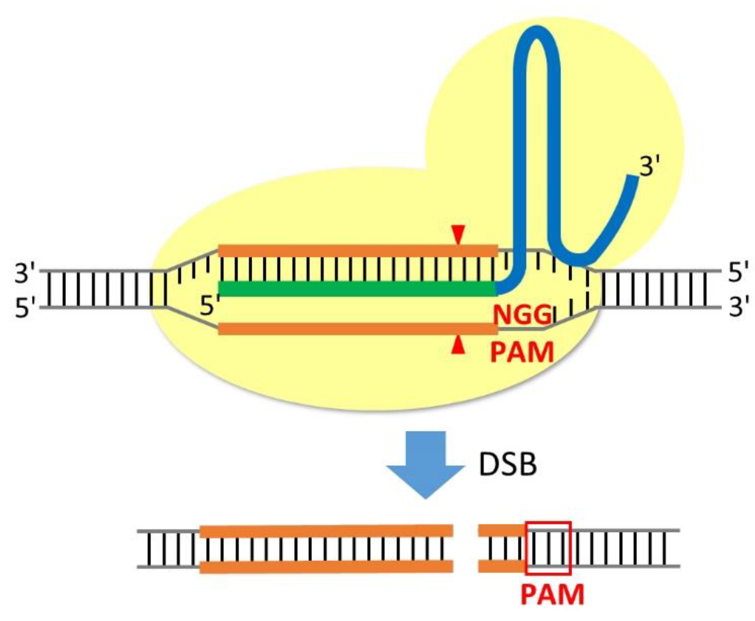
Further Research Questions: PAM Sequences
Amplification region
Increase accuracy of test
Conserved Regions
Multiplexing
(MammothBioscience, 2019)

Slide 21
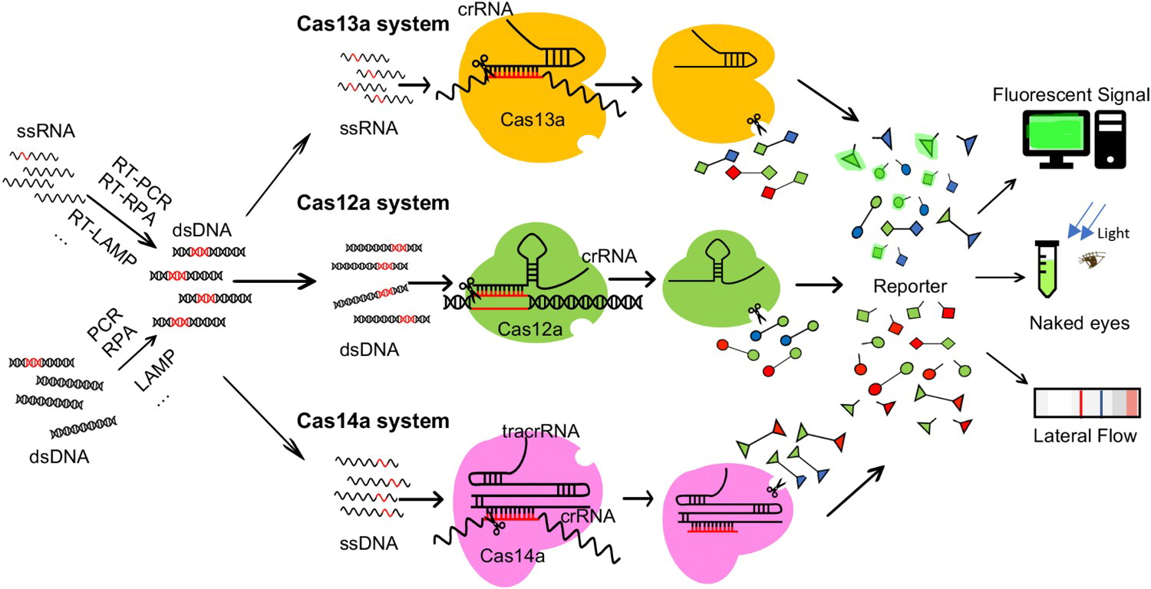
Further Research Questions: Other Cas Proteins
PAM Sequence
Single or Double Stranded DNA
DNA or RNA
Workflow of using different Cas proteins, depending on their preferred nucleic acid substrate and potential read out methods
(MammothBioscience, 2019) (Wang et al., 2020)

Slide 22
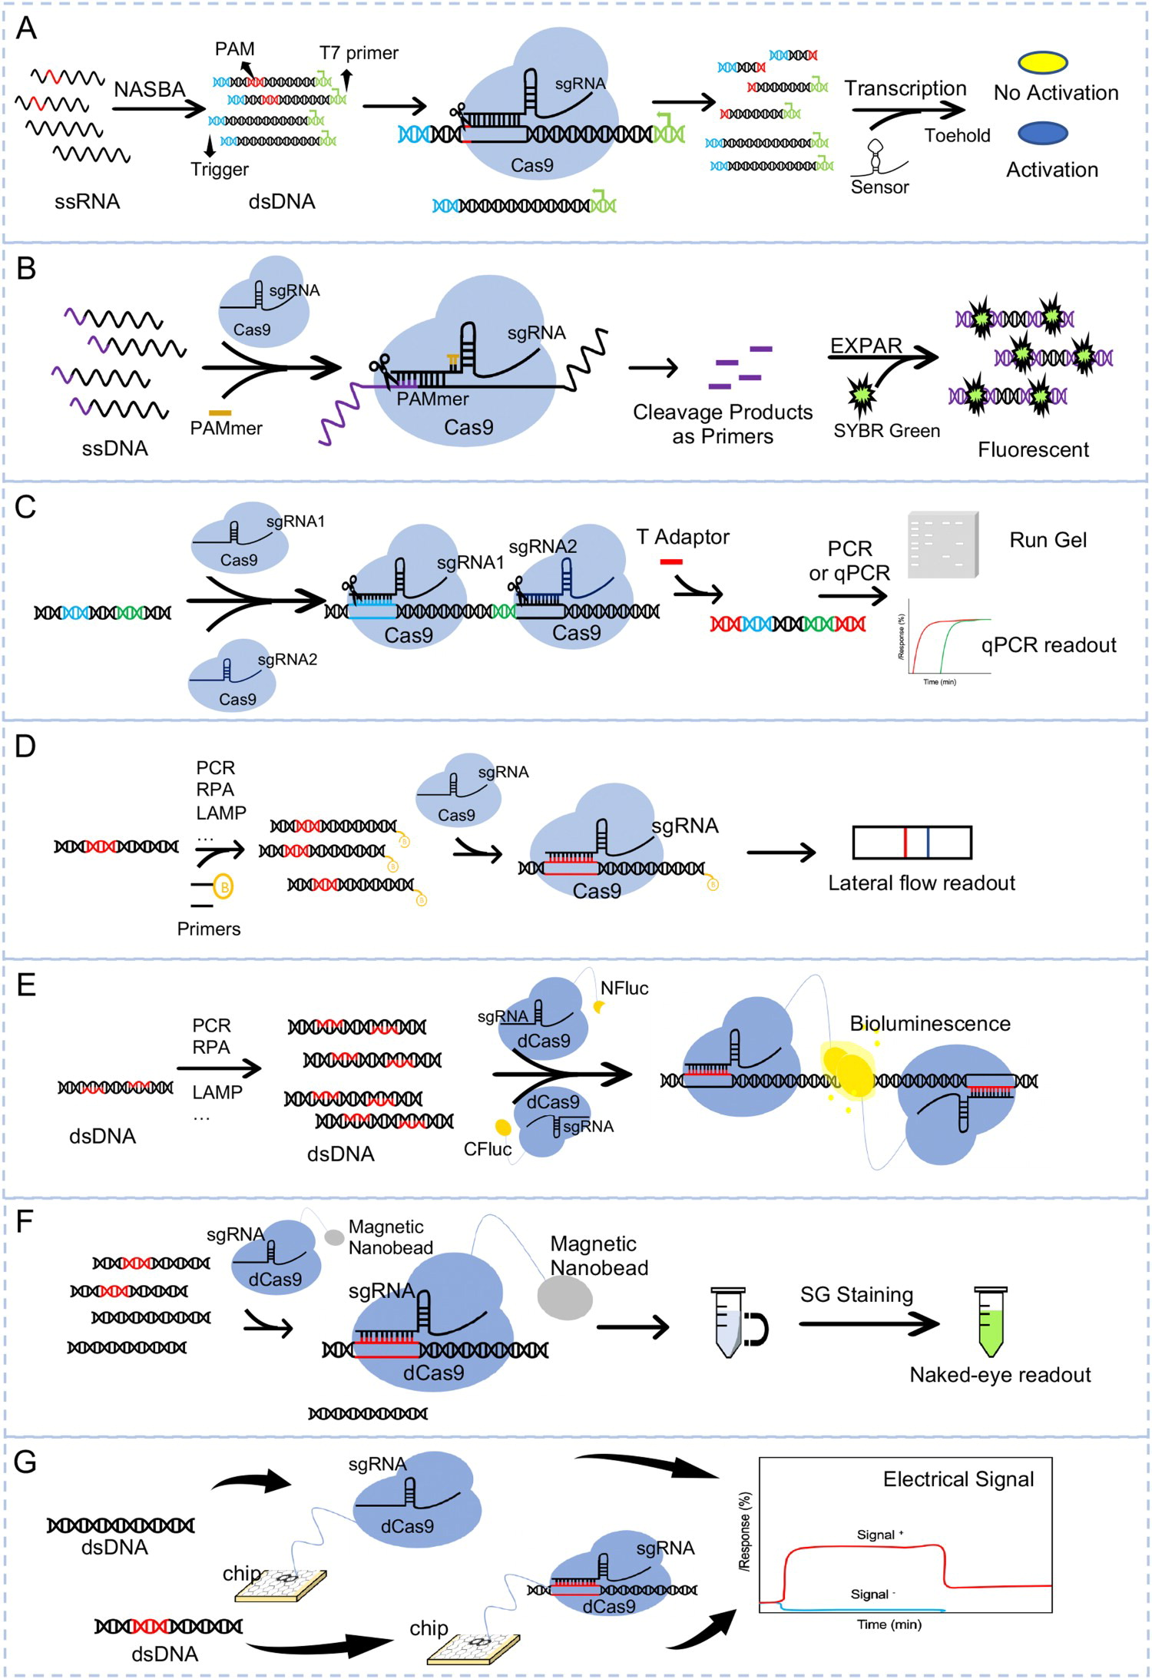
Different CRISPR assay protocols using different equipment, reagents and readout methods.
(Wang et al., 2020)

Slide 23
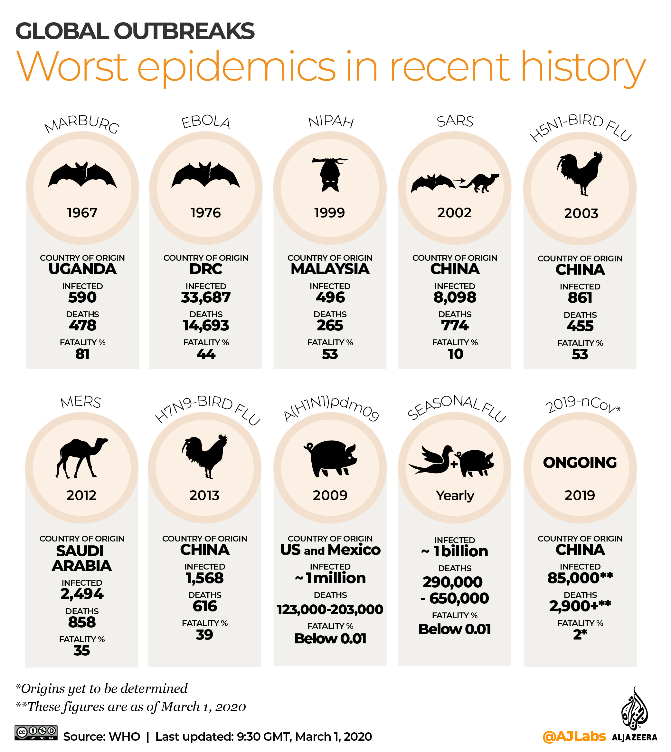
Further Implications: Beyond COVID-19
Other zoonotic viruses
Bacterial diagnosis
Cancer
(Vangah et al., 2020) (Huang et al., 2018)

Slide 24
THANKS For Listening

Slide 25
References
Broughton, J. P., Deng, X., Yu, G., Fasching, C. L., Servellita, V., Singh, J., Miao, X., Streithorst, J. A., Granados, A., Sotomayor-Gonzalez, A., Zorn, K., Gopez, A., Hsu, E., Gu, W., Miller, S., Pan, C., Guevara, H., Wadford, D. A., Chen, J. S., & Chiu, C. Y. (2020). CRISPR-Cas12-based detection of SARS-CoV-2. Nature Biotechnology, 38(7), 870-874.
Centers for Disease Control and Prevention. (2020, January 24). Real-time RT–PCR Panel for Detection 2019-nCoV. https://stacks.cdc.gov/view/cdc/84526
Ding, X., Yin, K., Li, Z., & Liu, C. (2020). All-in-One Dual CRISPR-Cas12a (AIOD-CRISPR) Assay: A Case for Rapid, Ultrasensitive and Visual Detection of Novel Coronavirus SARS-CoV-2 and HIV virus. bioRxiv : the preprint server for biology, 2020.03.19.998724.
Gootenberg, J. S., Abudayyeh, O. O., Kellner, M. J., Joung, J., Collins, J. J., & Zhang, F. (2018). Multiplexed and portable nucleic acid detection platform with Cas13, Cas12a, and Csm6. Science, 360(6387), 439–444.
Gootenberg, J. S., Abudayyeh, O. O., Lee, J. W., Essletzbichler, P., Dy, A. J., Joung, J., Verdine, V., Donghia, N., Daringer, N. M., Freije, C. A., Myhrvold, C., Bhattacharyya, R. P., Livny, J., Regev, A., Koonin, E. V., Hung, D. T., Sabeti, P. C., Collins, J. J., & Zhang, F. (2017). Nucleic acid detection with CRISPR-Cas13a/C2c2. Science, 356(6336), 438–442.
Huang, C., Lee, K., & Doudna, J. (2018). Applications of CRISPR-Cas Enzymes in Cancer Therapeutics and Detection. Trends In Cancer, 4(7), 499-512. doi: 10.1016/j.trecan.2018.05.006
Jolany vangah, S., Katalani, C., Boone, H., Hajizade, A., Sijercic, A. and Ahmadian, G., 2020. CRISPR-Based Diagnosis of Infectious and Noninfectious Diseases. Biological Procedures Online, 22(1).

Slide 26
References
Li, S. Y., Cheng, Q. X., Liu, J. K., Nie, X. Q., Zhao, G. P., & Wang, J. (2018). CRISPR-Cas12a has both cis- and trans-cleavage activities on single-stranded DNA. Cell research, 28(4), 491–493.
MammothBioscience. (2019). The Cas proteins behind CRISPR Diagnostics. https://mammoth.bio/2019/06/10/the-cas-proteins-behind-crispr-diagnostics/
Mammoth Biosciences, Inc. (2021). Reading and writing the code of life. Retrieved February 25, 2021 from https://mammoth.bio/
Pardee, K., Green, A. A., Takahashi, M. K., Braff, D., Lambert, G., Lee, J. W., Ferrante, T., Ma, D., Donghia, N., Fan, M., Daringer, N. M., Bosch, I., Dudley, D. M., O, C. D. H., Gehrke, L., & Collins, J. J. (2016). Rapid, Low-Cost Detection of Zika Virus Using Programmable Biomolecular Components. Cell, 165(5), 1255–1266.
ResearchGate. (n.d.). Xianding Deng. Retrieved February 26, 2021 from https://www.researchgate.net/profile/Xianding-Deng
Srivastava, S., Upadhyay, D. J., & Srivastava, A. (2020). Next-Generation Molecular Diagnostics Development by CRISPR/Cas Tool: Rapid Detection and Surveillance of Viral Disease Outbreaks. Frontiers in molecular biosciences, 7, 582499.
Wang, X., Shang, X. and Huang, X., 2020. Next-generation pathogen diagnosis with CRISPR/Cas-based detection methods. Emerging Microbes & Infections, 9(1), pp.1682-1691.

Slide 27
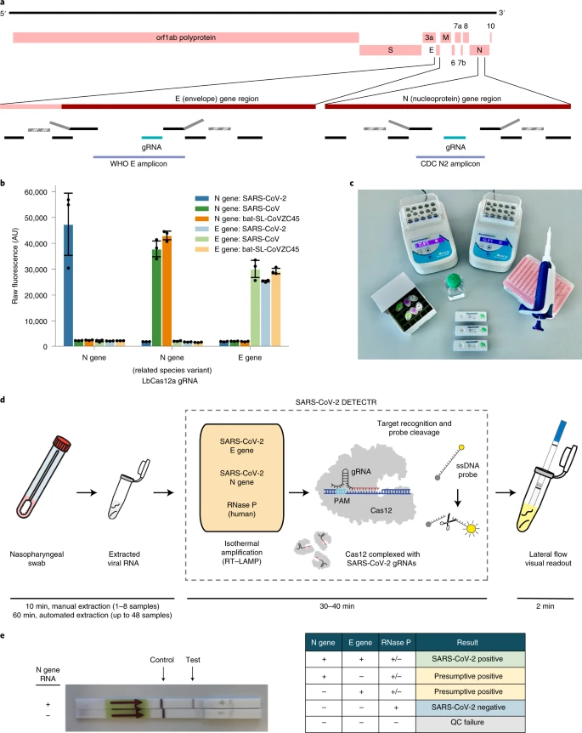
Point of Care Testing
Affordability
Speed of detection
Lack of specialized machinery and technicians
Minimum reagents required for detection by DETECTR CRISPR-Cas12 SARS-COV-2
Lateral Flow testing strip for DETECTR CRISPR-Cas12 SARS-COV-2

