Slide 1
Diagnostics of SARS-CoV-2
By: Adnan, Syed, Tristen, Leena

Slide 2
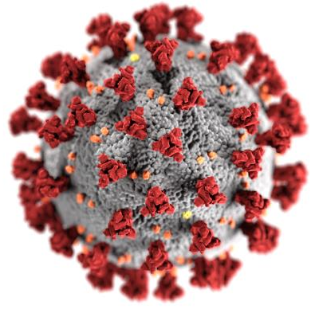
Introduction - What is SARS-CoV-2?
Outbreak originated in China in late 2019
Disease caused by this virus is called: coronavirus disease 2019 (a.k.a. COVID-19)
Global pandemic declared March 11, 2020
Symptoms include:
Fever
Dry cough
Shortness of breath
Fatigue
Loss of smell and/or taste
Illustration of SARS-CoV-2. Adapted from Eckert & Higgins, 2020.
(Sheposh, 2021)(WHO, 2021)

Slide 3
Diagnostic Overview
CT-Scan
rRT-PCR/RT-LAMP
Serological Testing
Antigen Based Testing
Future Directions
Clinical Performance
Analytical sensitivity: reliably detect minimum amount of target substance within sample (limit of detection)
Analytical specificity: ability of test to detect only the analyte being measured
Clinical sensitivity: True positive rate
Clinical specificity: True negative rate
ACRONYMS TO KNOW
RT-PCR: Reverse transcription polymerase chain reaction
RT-LAMP: Reverse transcription loop-mediated isothermal amplification
ELISA: Enzyme-linked immunoassay
LFA: Lateral flow assay
CRISPR: Clustered Regularly Interspaced Short Palindromic Repeats
AI: Artificial Intelligence
(Chau et al., 2020)
Notes:
This is timeline for diagnostic testing during the covid 19 pandemic, starting with with advent of ct scans and moving into more gold standard testing such as rt pcr rt lamp serological and antigen based testing and finally we will talk about new novel techniques arising and future directions that diagnostics can take

Slide 4
Importance of Diagnostic Testing
Epidemiological information for Public Health
COVID-19 +ve
COVID-19 -ve
Prevent spread of COVID-19

Slide 5
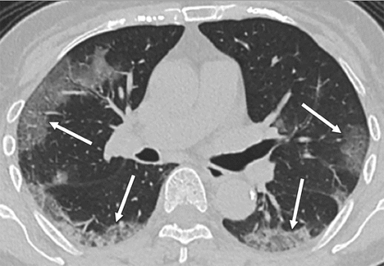
CT-Scans
Series of X-rays of lungs
Earliest Diagnostic test
Lower specificity and sensitivity (even lower)
Expensive and specialist reliant
Quick results
Presence of bilateral ground-glass opacities in upper lobe
(Bernheim et al, 2020)(Bai et al, 2020)
Notes:
CT scans are a series of x-rays taken from different angles and with the use of computer, can produce highly detailed cross sectional images. CT scans were the earliest diagnostic test used for COVID-19 as RT-PCR and ELISA specific to the disease had not yet been developed at the advent of the pandemic in Wuhan China. However, compared to these gold standard tests, CT scans are less specific and sensitive due to the test being qualitative and physician reliant. Especially less sensitive as studies have shown physicians are more likely to give false negatives using CT scans due to most cases being mild. The advantage of using this test is that the results are presented right away, however taking the test is time consuming and expensive.

Slide 6
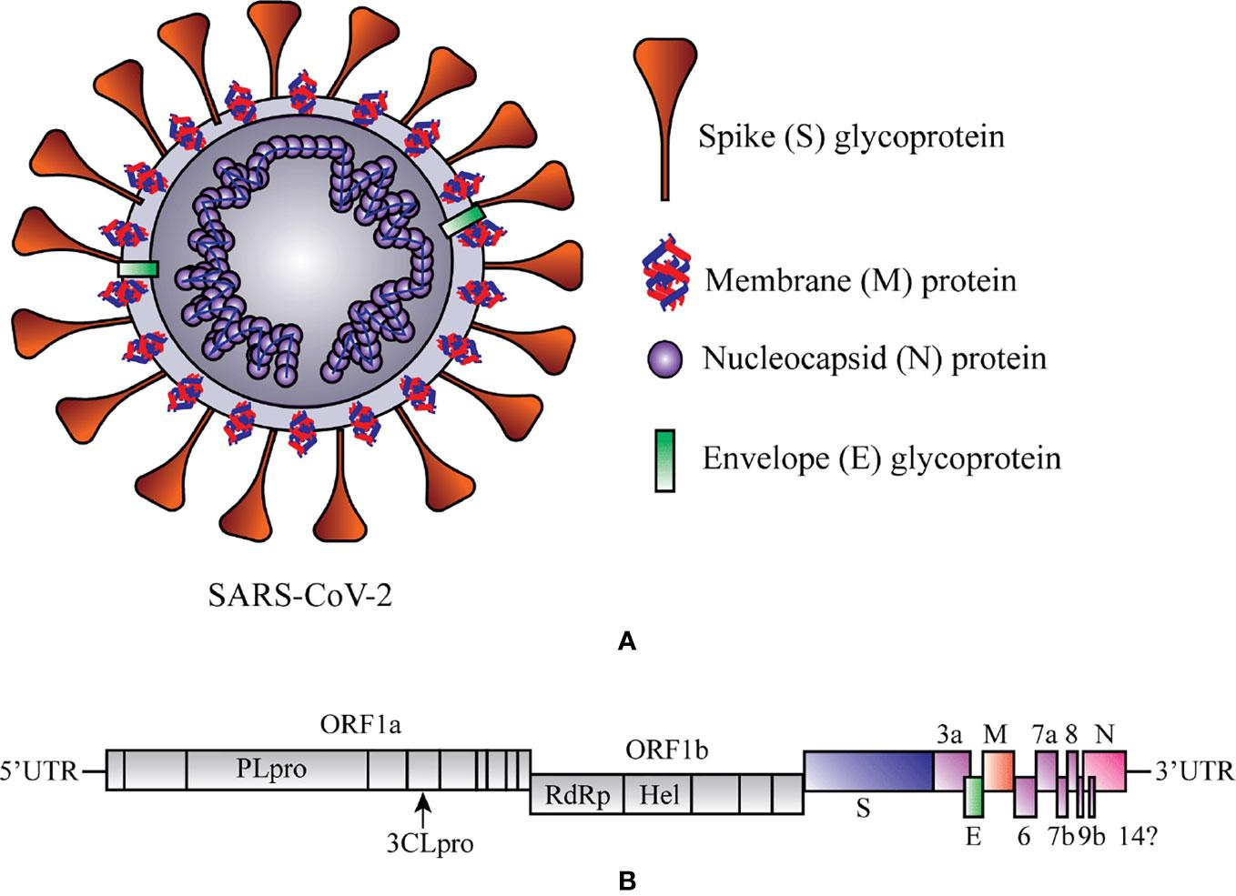
rRT-PCR
Initially tested for the presence of SARS-CoV-2 RdRp, N or E genes
Later narrowed down testing to the RdRp Helicase gene alone due to lower cross-reactivity with other viruses
Figure adapted from Sarkar et al. 2020 Potential Therapeutic Options for COVID-19: Current Status, Challenges, and Future Perspectives
(Sarkar et al. 2020)

Slide 7
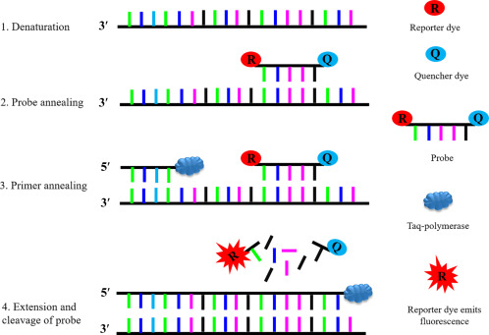
rRT-PCR
Samples are retrieved and treated
Marker DNA sequences complementary to the viral gene are added
Standard PCR testing begins with updates occurring in real time
Figure adapted from Roy et al. 2019. Chapter 5 - Small RNA proteome as disease biomarker: An incognito treasure of clinical utility
(Roy et al 2019)

Slide 8
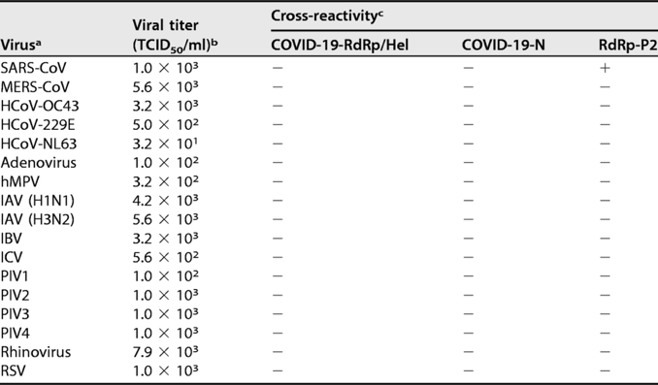
rRT-PCR
Advantages:
Little time between sample collection and test results
No cross-reactivity with other respiratory viruses or other coronavirus strains
Disadvantages:
Fairly expensive
Unable to retroactively diagnose COVID-19 infections
Figure Adapted from Chan et al. 2020. Improved Molecular Diagnosis of COVID-19 by the Novel, Highly Sensitive and Specific COVID-19-RdRp/Hel Real-Time Reverse Transcription-PCR Assay
(Chan et al. 2020) (ThermoFisher, 2020)

Slide 9
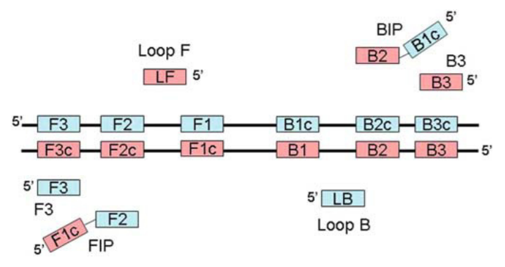
RT-LAMP
One-step nucleic acid amplification method
Advantages:
Faster and less expensive alternative to RT-PCR
High sensitivity and specificity
Special training or equipment not required
Disadvantages:
Designing compatible LAMP primers to target sequence
Figure Adapted from Mori & Notomi 2009. Schematic illustrating the loop-mediated isothermal amplification (LAMP) primers
(Lamb et al., 2020) (Mori & Notomi, 2009)(Schilling, 2015)
Notes:
RT- LAMP
Another nucleic acid test is RT-LAMP which offers a faster and less expensive alternative to RT-PCR. RT-LAMP is a one-step nucleic acid amplification method that can be completed in less than an hour, uses relatively inexpensive stable reagents, and offers high sensitivity and specificity (Lamb et al., 2020). High specificity of LAMP is due to the fact that amplification will not occur unless all six primers are bound to the target DNA sequence. This diagram illustrates the amplification process involving the primers. Furthermore, this assay does not require special training or equipment to be performed. One disadvantage of this RT-LAMP as researchers oftentime have difficulty designing LAMP primers that are compatible with the target DNA sequence.

Slide 10
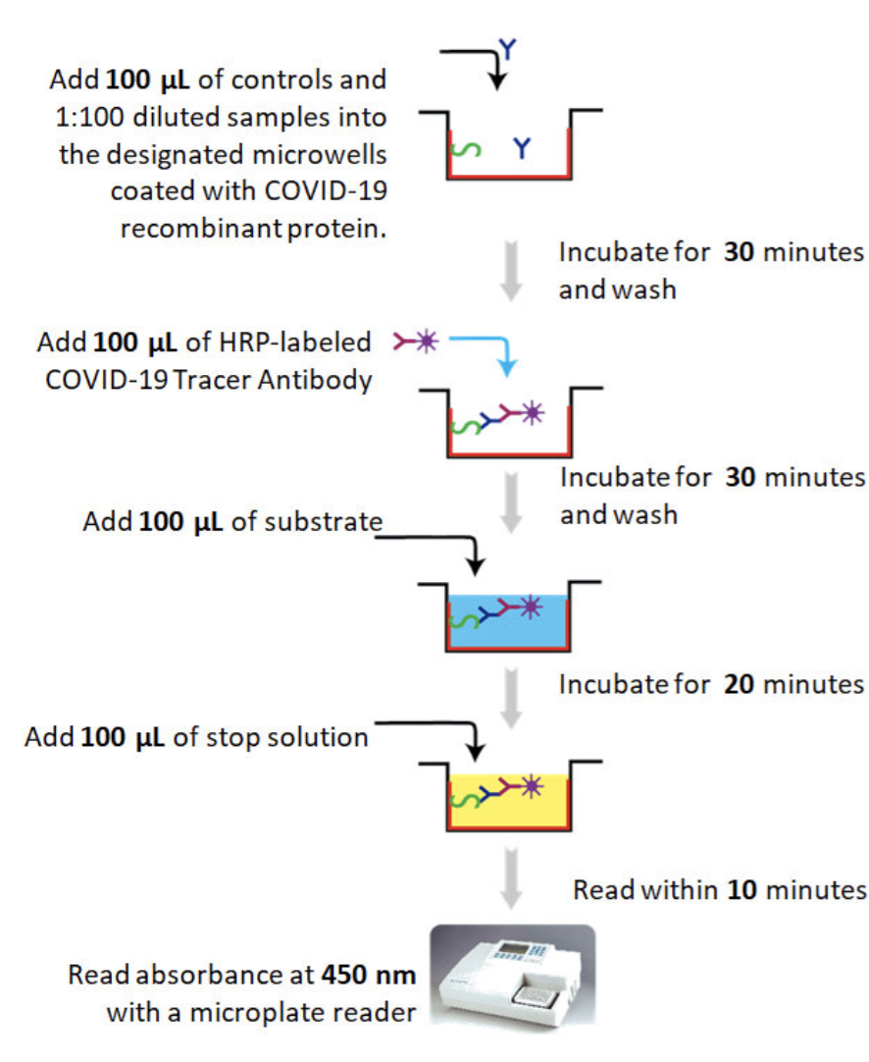
Serological Testing: ELISA
ELISA:
High specificity and sensitivity after seroconversion
Contained purified SARS-COV-2 protein to bind human antibody
Indirect: Presence of secondary antibody
Added Substrate and fluorescence indicator
Retrospective Testing
COVID-19 ELISA test Protocol
(Epitope Diagnostics Inc., 2020) (Serrano et al, 2020) (Gibbs et al, 2020) (Michigan Diagnostics, 2020) (Choe et al 2021)

Slide 11
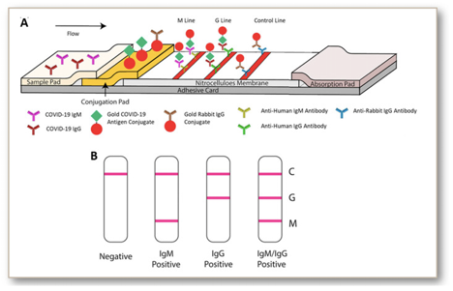
Serological Testing: Rapid Lateral Flow Assay
Rapid Lateral Flow Assay:
Use of Anti-Human IgG and IgM to capture potential SARS-COV-2 specific antibodies
Easy to read results based on coloured bands
Quick Processing Time
Point of Care Testing
Inexpensive
Lowered Specificity and Sensitivity
Steps in COVID-19 specific Lateral Flow Assay
(Augustine et al, 2020) (Hackner et al, 2020) (Serrano et al, 2020)

Slide 12
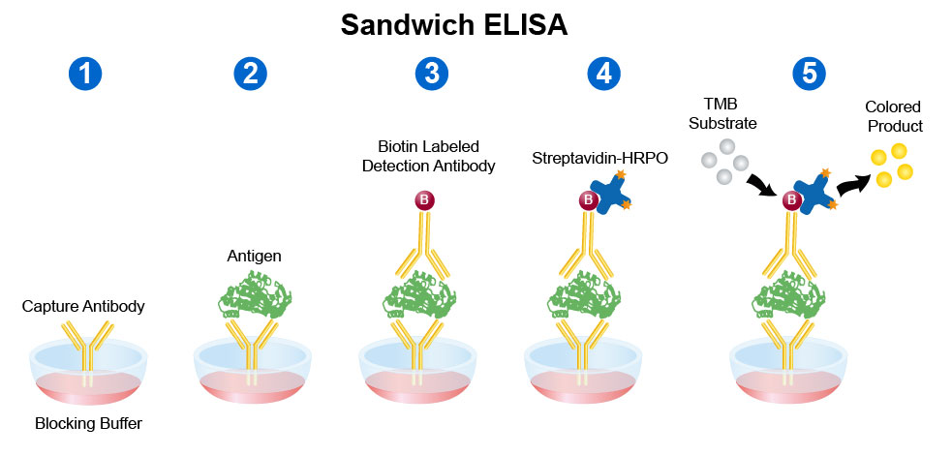
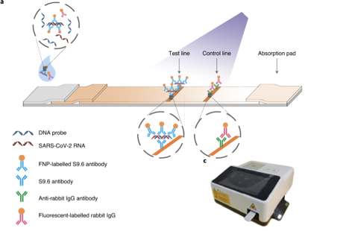
Antigen Based Testing
Lateral Flow Assay:
Adapted technique
Use of DNA probes
Easy to read results based on fluorescence cut off value
Sandwich ELISA:
Use of lab made Capture, primary and secondary antibody
Potential results of lateral flow strip
Figure adapted from Leinco Technologies inc. Sandwich ELISA protocol
Steps in COVID-19 specific antigen Lateral Flow fluorescence immunoassay
(Wang et al, 2020) (FIND, 2020) (Augustine et al, 2020)

Slide 13
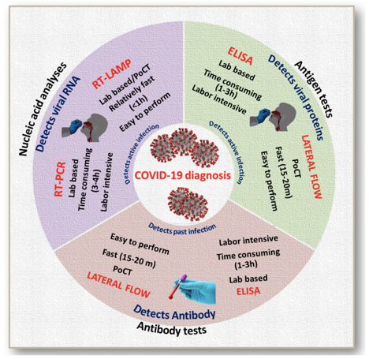
Gold standard: Overview of Current Methods
(Augustine et al, 2020)

Slide 14
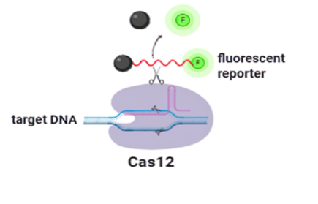
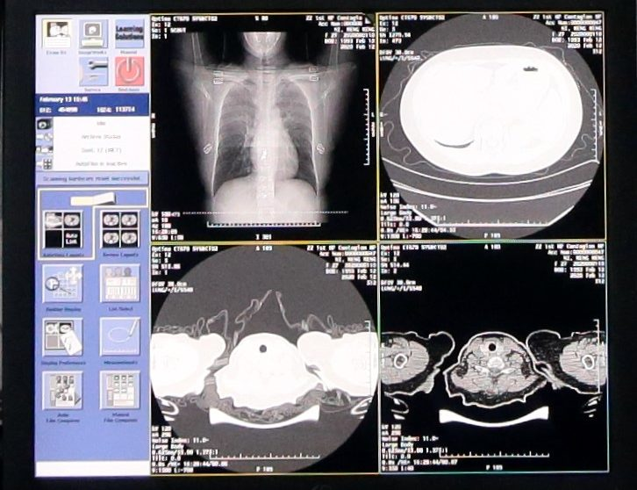
Novel methods summary
Artificial Intelligence
CRISPR-Cas12
P-BEST
(Jolany Vangah et al., 2020; Shental et al., 2020)

Slide 15
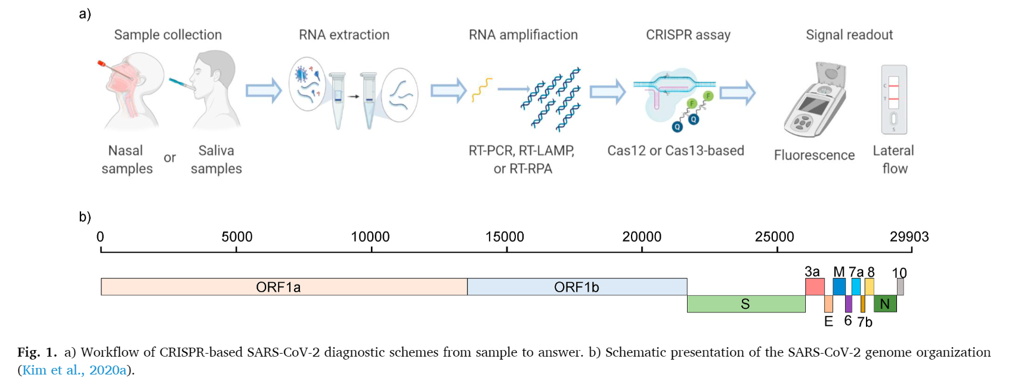
Crispr-Based Detection
(Broughton et al., 2020)
Notes:
One of the novel methods of covid detection is Crispr-Cas12 based detection. In the first step, the samples are collected from the patients. The most general forms of the SARS- CoV-2 samples are nasopharyngeal and oropharyngeal swabs. After sample collection, viral RNAs need to be extracted from the raw sample.
RNA isolation procedures typically involve three general steps: lysis, separation of RNA from other macromolecules such as DNA, proteins, and lipids, followed by RNA elution. This isolation can be performed by magnetic bead purification, spin column isolation, or organic extraction which is considered the best method for this situation. Once isolation is completed, the isolated sample is amplified using methods such as RT-PCR or RT-LAMP to boost the amount of RNA past the limit of detection. After that, the sample is placed in a CRISPR assay such as the SARS-CoV-2 DNA Endonuclease-Targeted CRISPR Trans Reporter system also known as the DETECTR system where a specific region of SARS-CoV-2 would be recognized by the Cas12-CRISPR guide RNA complex and cleaved, which creates probes that can then visualized by a fluorescent lateral flow readout.

Slide 16
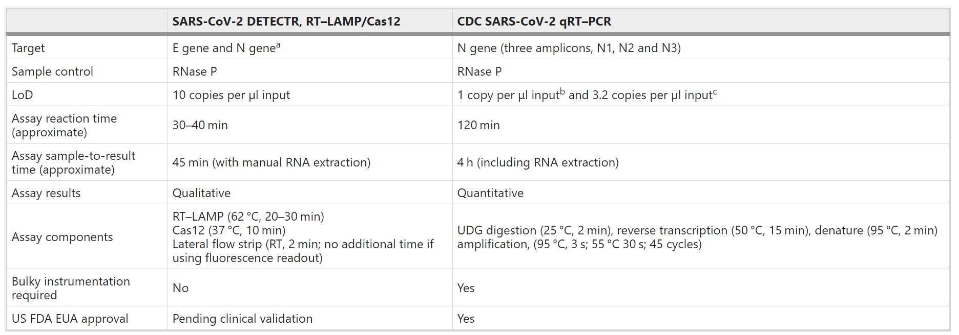
Overview of Paper
CRISPR–Cas12-based detection of SARS-CoV-2 Broughton et al.
(Broughton et al., 2020)
Notes:
Our main paper is a report on the development of a CRISPR–Cas12-based assay for the detection of SARS-CoV-2 from extracted patient sample RNA. This method is called SARS-CoV-2 DNA Endonuclease-Targeted CRISPR Trans Reporter (DETECTR) which I have explained in the previous slide. Using synthetic, in vitro-transcribed SARS-CoV-2 RNA gene targets in nuclease-free water, we demonstrated that CRISPR–Cas12-based detection can distinguish SARS-CoV-2 with no cross-reactivity for related coronavirus strains using N gene gRNA and with expected cross-reactivity for E gene gRNA. The DETECTR assay can be run in approximately 30–40 min and then visualized immediately on a lateral flow strip. The SARS-CoV-2 DETECTR assay is considered positive if there is detection of both the E and N genes or presumptive positive if there is detection of either the E or N gene. When compared to other testing such as the CDC qRT–PCR assay, the DETECTR system was able to provide a more easily comprehensive result compared to the CDC assay and provided results much quicker as well. However, a disadvantage found in comparison to the CDC assay was that the DETECTR system had a higher limit of detection and therefore required more viral RNA in a sample for the system to be able to detect it. Other key advantages over other methods include not needing thermocycling, rapid turnaround time, single nucleotide target specificity, integration with accessible and easy-to-use reporting formats such as lateral flow strips and no requirement for complex laboratory infrastructure

Slide 17
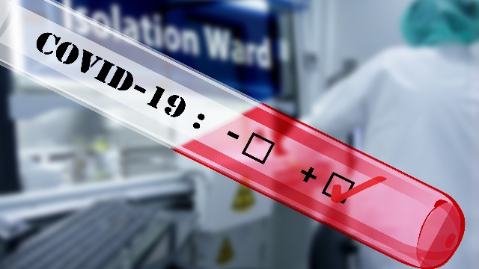
Future Direction
Point of Care Testing
Notes:
Point of care testing is a test that can be done during a consultation with a patient at that same healthcare facility, leading to near instant results. This allows the treating physician to quickly make informed decisions to diagnose and treat a patient as quickly as possible. Current treatment methods, while effective, require too much time and materials which slow down a healthcare facility’s ability to treat the accumulating number of coronavirus cases that are appearing. Current limitations with this type of testing are the production and cost of materials for these tests such as rapid Lateral flow tests.

Slide 18
Mass Screening: P-BEST
Single step group testing method to test multiple people for SARS-CoV-2
Much faster rate than testing individually
Each individual’s sample is a part of multiple groups in a combinatorial grouping method
Helps determine the specific positive individual from a positive group test result without the need for additional testing
(Shental et al., 2020)
Notes:
P-Best uses a single step group testing method to test multiple people for SARS-CoV-2 at a much faster rate. Instead of testing each sample separately, samples are pooled into groups in the P-Best system, and each pool is tested for SARS-CoV-2 using a PCR-based diagnostic assay. Each individual’s sample is a part of multiple groups in a combinatorial grouping method to determine the specific positive individual from a positive group test result without the need for additional testing. At peak efficiency this system can correctly diagnose patients with SARS-CoV-2 at an 800% decrease in number of tests compared to individual testing.

Slide 19
AI-Based Testing
Machine learning by previous RT-PCR verified CT scans
Quick diagnosis
Enhances physician diagnosis
Improves sensitivity
Predicts progression of illness
Still in infancy
(Bernheim et al, 2020) (Chen and See 2020) (Zhang et al 2020)
Notes:
With the advancement of technology, artificial intelligence has been a highly looked upon field in aiding the medical field in the fight against covid 19. Computers are taught through previously confirmed CT scans as the ai learn to differentiate and diagnosis COVID19. It allows for quick diagnosis, especially in the current state of over admissions in a hospital setting. As mentioned earlier, COVID 19 diagnosis based off CT scans has lowered sensitivity and AI is able to enhance physician diagnosis and increase the sensitivity of the CT test. Additionally, the ai is able to predict the progression of illness and determine which patients make require greater assistance. While given these potential benefits, meta analyses of shown that ai is still ways away from being reliable in a clinical setting and more research needs to be conducted to increase accuracy in order for physicians to depend on ai.

Slide 20
QUESTIONS?

Slide 21
References
Broughton, J. P., Deng, X., Yu, G., Fasching, C. L., Servellita, V., Singh, J., … Chiu, C. Y. (2020). CRISPR–Cas12-based detection of SARS-CoV-2. Nature Biotechnology, 38(7), 870–874. https://doi.org/10.1038/s41587-020-0513-4
Chan, J. F.-W., Yip, C. C.-Y., To, K. K.-W., Tang, T. H.-C., Wong, S. C.-Y., Leung, K.-H., … Yuen, K.-Y. (2020). Improved Molecular Diagnosis of COVID-19 by the Novel, Highly Sensitive and Specific COVID-19-RdRp/Hel Real-Time Reverse Transcription-PCR Assay Validated &lt;em&gt;In Vitro&lt;/em&gt; and with Clinical Specimens. Journal of Clinical Microbiology, 58(5), e00310-20. https://doi.org/10.1128/JCM.00310-20
Chau, C. H., Strope, J. D., & Figg, W. D. (2020). COVID-19 Clinical Diagnostics and Testing Technology. The Journal of Human Pharmacology and Drug Therapy, 40(8), 857-868.
Eckert, A., & Higgins, D. (2020). [Illustration of SARS-CoV-2] [Photograph] CDC. https://phil.cdc.gov/Details.aspx?pid=23312
Lamb, L. E., Bartolone, S. N., Ward, E., & Chancellor, M. B. (2020). Rapid detection of novel coronavirus/Severe Acute Respiratory Syndrome Coronavirus 2 (SARS-CoV-2) by reverse transcription-loop-mediated isothermal amplification. PLoS ONE, 15(6), 1–15.
Mori, Y., & Notomi, T. (2009). Loop-mediated isothermal amplification (LAMP): a rapid, accurate, and cost-effective diagnostic method for infectious diseases. J. Infect. Chemother, 15 (2), 62–69.
Roy, J., Jain, N., Singh, G., Das, B., & Mallick, B. (2019). Chapter 5 - Small RNA proteome as disease biomarker: An incognito treasure of clinical utility. In B. Mallick (Ed.), AGO-Driven Non-Coding RNAs (pp. 101–136). Academic Press. https://doi.org/https://doi.org/10.1016/B978-0-12-815669-8.00005-1
Sheposh, R. (2021). Coronavirus Disease 2019 (COVID-19). Salem Press Encyclopedia of Health.
Shental, N., Levy, S., Wuvshet, V., Skorniakov, S., Shalem, B., Ottolenghi, A., … Hertz, T. (2020). Efficient high-throughput SARS-CoV-2 testing to detect asymptomatic carriers. Science Advances, 6(37), 5961–5972. https://doi.org/10.1126/sciadv.abc5961
Schilling, M. (2015). The economic benefits of point-of-care testing. Abbott. https://www.pointofcare.abbott/shared/static-assets/other/2697.1_HHE2015ArticleMartinSchilling.pdf
ThermoFisher (2020). Basic Principles of RT-qPCR. https://www.thermofisher.com/ca/en/home/brands/thermo-scientific/molecular-biology/molecular-biology-learning-center/molecular-biology-resource-library/spotlight-articles/basic-principles-rt-qpcr.html
World Health Organization. (2021). WHO coronavirus disease (COVID-19) dashboard. Retrieved January 27, 2020 from https://covid19.who.int/
Shental, N., Levy, S., Wuvshet, V., Skorniakov, S., Shalem, B., Ottolenghi, A., … Hertz, T. (2020). Efficient high-throughput SARS-CoV-2 testing to detect asymptomatic carriers. Science Advances, 6(37), 5961–5972. https://doi.org/10.1126/sciadv.abc5961

