Slide 1
Case Study
Chagas Disease
Jose
46 years old
California, USA
Admitted to hospital with chest pain, shortness of breath
Diagnosed with advanced heart failure
Notes:
M

Slide 2
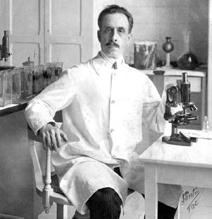
History
Trypanosoma cruzi (T. cruzi) was first discovered in a Chinchorro mummy (9000 years old)
Miguel Diaz Pimenta recorded symptoms similar to Chagas disease in his book in 1707
Carlos Chagas discovered Chagas disease in 1909
Steverding, D. (2014). The history of Chagas disease. Parasites & vectors, 7(1), 317.
Notes:
Chagas disease is an infectious disease which is caused by the protozoan flagellate Trypanosoma cruzi (T.cruzi) (1). The earliest that T. cruzi was detected was 9000 years ago from a Chinchorro mummy. The Chinchorro people were the first settlers of South America’s coastal region.
Miguel Diaz pimenta has also recorded symptoms that were similar to what we know as Chagas disease in several travellers in his book in 1707
Decades later, a physician by the name of Carlos Chagas was informed about an insect that bit people by a railroad engineer worker. He then dissected the insects and found large number of trypanosomes in their hindgut, which he then names T. cruzi. Dr. Chagas was able to link the insect to the trypanosomes and then to people’s symptoms (1). Through his research, he discovered Chagas disease in 1909 (2).
JENNA

Slide 3
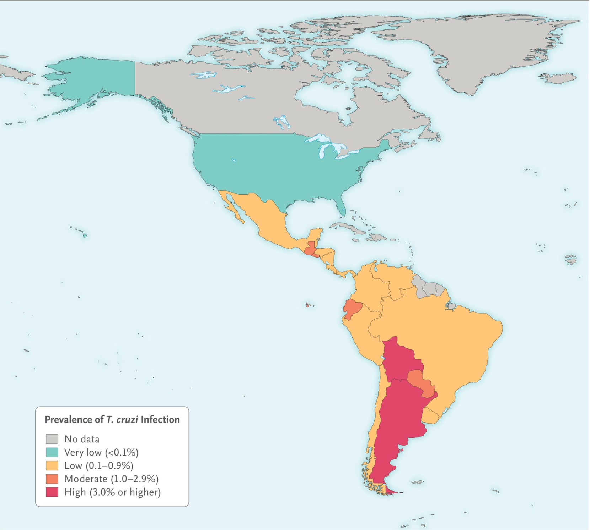
Epidemiology
Predominant in the continental part of Latin America
Vectors prefer inhabiting the mud structures of villages and huts
Infection rate: less than 1% per year
Occurance rate has decreased: 18 million in 1991 vs 5.7 million in 2010
Bern, C. (2015). Chagas’ disease. New England Journal of Medicine, 373(5), 456-466.
Notes:
Chagas disease is predominantly in continental part of Latin America as can be seen in this diagram(4). It has recently also been detected in the United States, Canada and many European countries due to travelling between these regions.
The vectors prefer inhabiting the mud structures of villages and huts in latin america and are nocturnal. They come out at night to feed on human’s blood when they are sleeping.
Chagas disease is getting more attention as it is starting to become a global health concern since WHO recognized it to be the world’s 13th most neglected tropical disease in 2010 (19).
T. cruzi infection rate is less than 1% per year, with the highest being 4% per year in hyperendemic Bolivian Chaco (20).
It is encouraging for the scientific community to know that their efforts to decrease the occurrence rate has paid off since T. cruzi infection rate has decreased from 18 million in 1991 to 5.7 million in 2010(20).
JENNA

Slide 4
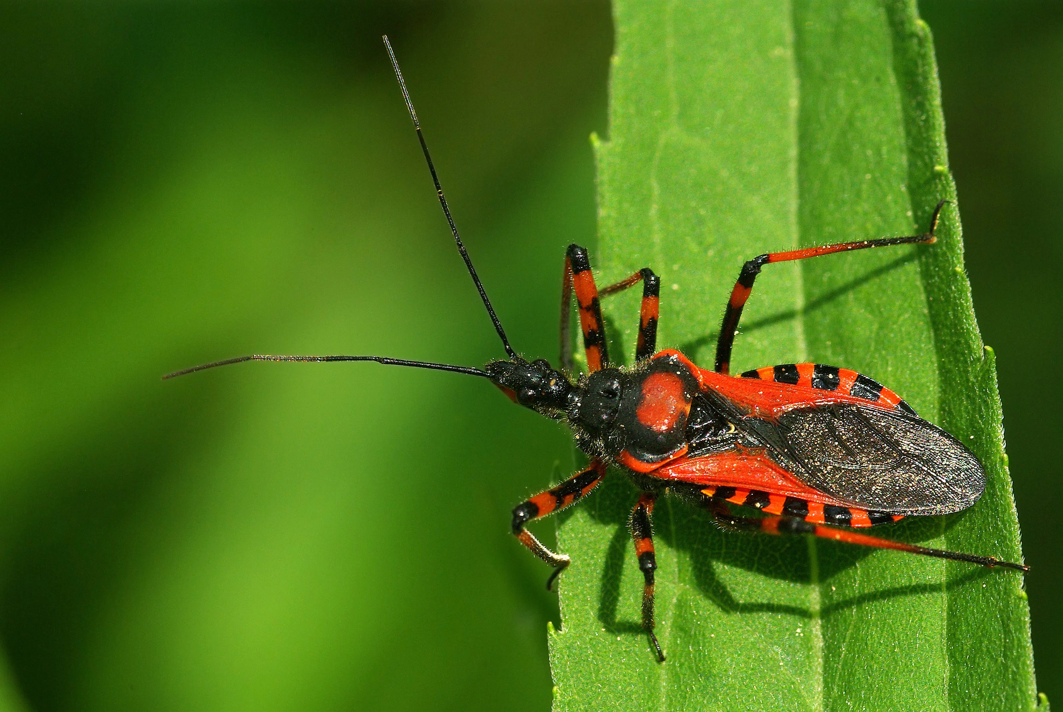

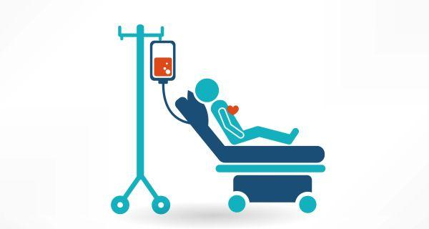
Transmission
Contact through feces of infected vector (Triatoma infestans → “kissing bugs”)
Congenital contraction
Contact with contaminated blood transfusions or donated organs
Rarely with contaminated food/drink
Triatoma definition/meaning. (n.d.). Retrieved January 31, 2018, from http://imagict.com/en/words/triatoma
World Thalassemia Day: 10 facts you must know about blood transfusion. (2015, May 08). Retrieved January 31, 2018, from http://www.thehealthsite.com/diseases-conditions/ten-facts-you-need-to-know-about-blood-transfusion/
Nadeau, M. (2016, August 03). Healthy Alternatives for Junk Food. Retrieved January 31, 2018, from https://www.nautilusplus.com/healthy-alternatives-junk-food/
Notes:
T.Cruzi is transmitted through contact of faeces of infected insects of the Triatominae (kissing bugs or conenose bugs) subfamily. They are often called “kissing bugs” because they have the tendency to bite individual’s faces. When they bite, they also defecate, leaving their feces free to enter the bite site to transmit the parasite. Some of the most well known vectors of the disease include Triatoma infestans (kissing bugs), as well as Rhodnius proxlius and Panstrongylus megistus (1).
The baby can also get Chagas if the mother is infected and is delivering through natural birth
Coming in contact with contaminated blood during a transfusion or an organ during donation is another way of transmission
Lastly, it could also be transmitted through contaminated food/drinks but it’s rare because the stomach pH is low enough to destroy the trypomastigote
JENNA

Slide 5
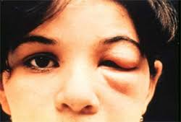
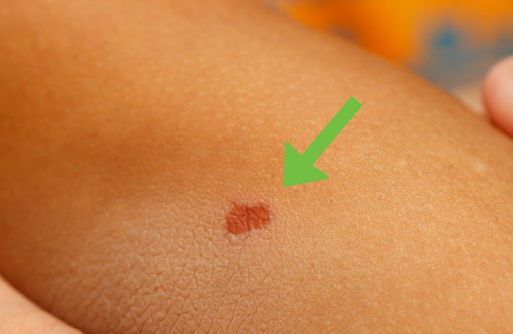
Symptoms of Chagas Disease
Acute Phase
After infection
  Lasts first few weeks to months
Swelling/redness at infection site
Swollen lymph nodes
Skin rash
Fever
  95% of cases do not show symptoms
Romana’s sign: Swelling of the eyelid
Swelling at the bite site
Davis C.P. (2018). Chagas Disease (American Trypanosomiasis or Kissing Bug Disease). MedicineNet.

Slide 6
Symptoms of Chagas Disease Cont’d...
Indeterminate Phase
No symptoms
Lasts 10-20 years in patient’s lifetime
Chronic Phase
Palpitations
Cardiomyopathy
Congestive Heart Failure (CHF)
Chronic constipation
Shortness of breath
Emphysema
Fainting
Notes:
M

Slide 7
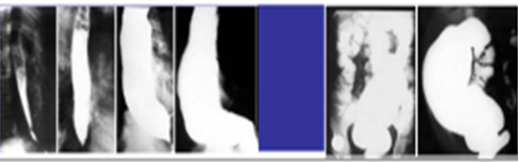
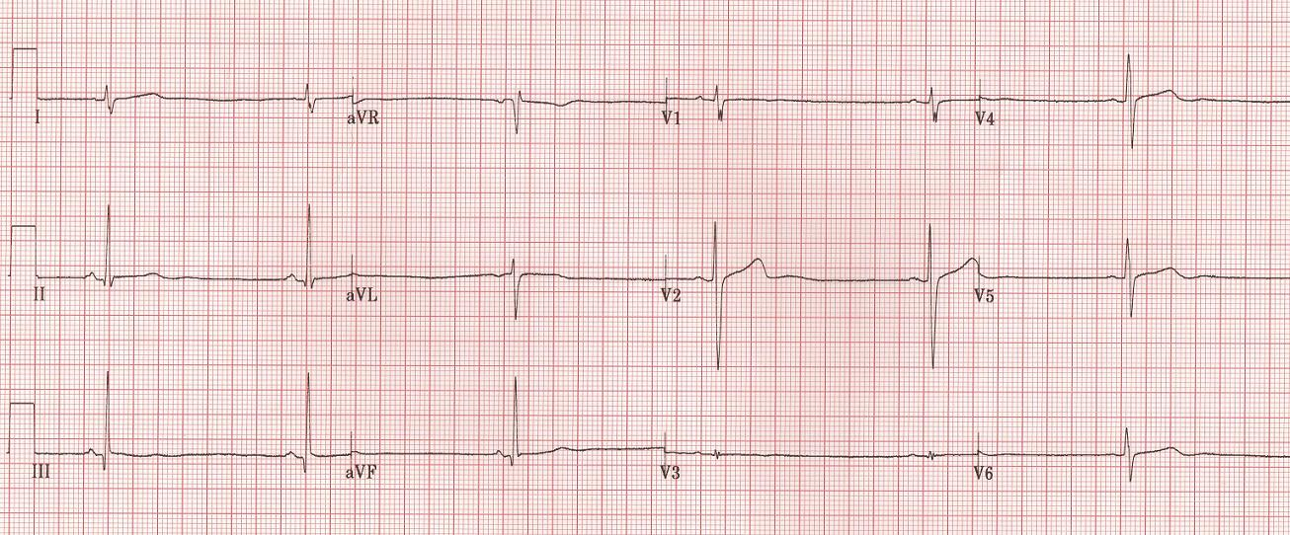
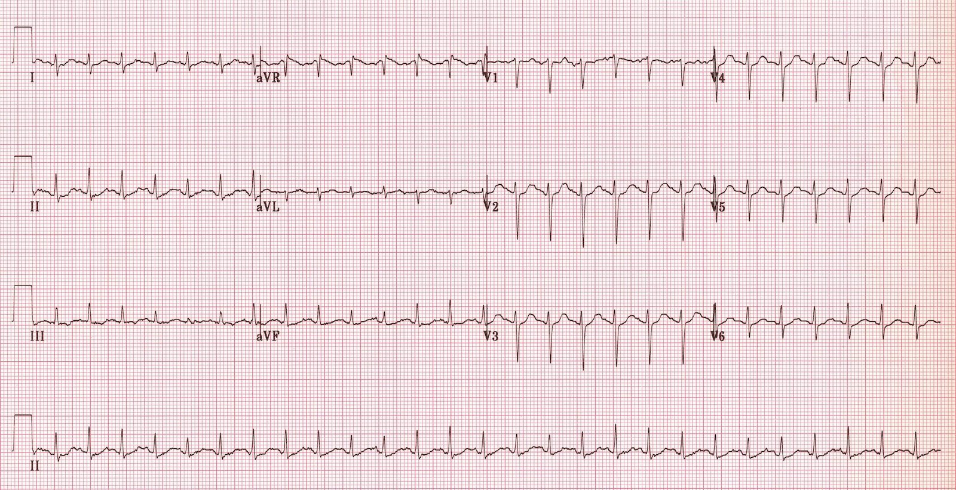
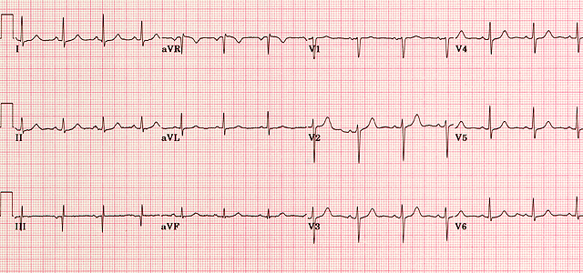
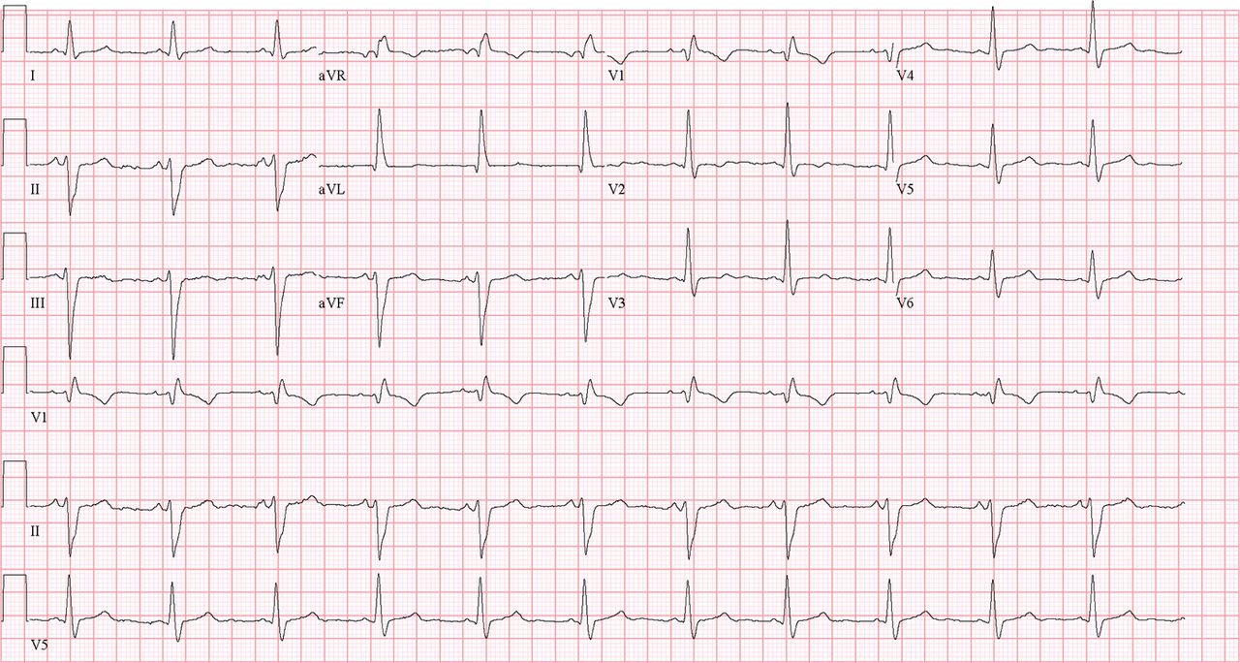
Chronic Phase Signs
Rassi, A., (2014, July) Chagas’ Heart Disease. World Congress of Cardiology Scientific Sessions, Australia.
Bradyarrhythmia
Associated megaesophagus and megacolon
Abnormal Q waves, AV blocks, a low QRS voltage, Sick Sinus Syndrome
Tachycardia
Normal ECG
Notes:
http://rasmussen.libanswers.com/faq/32689

Slide 8
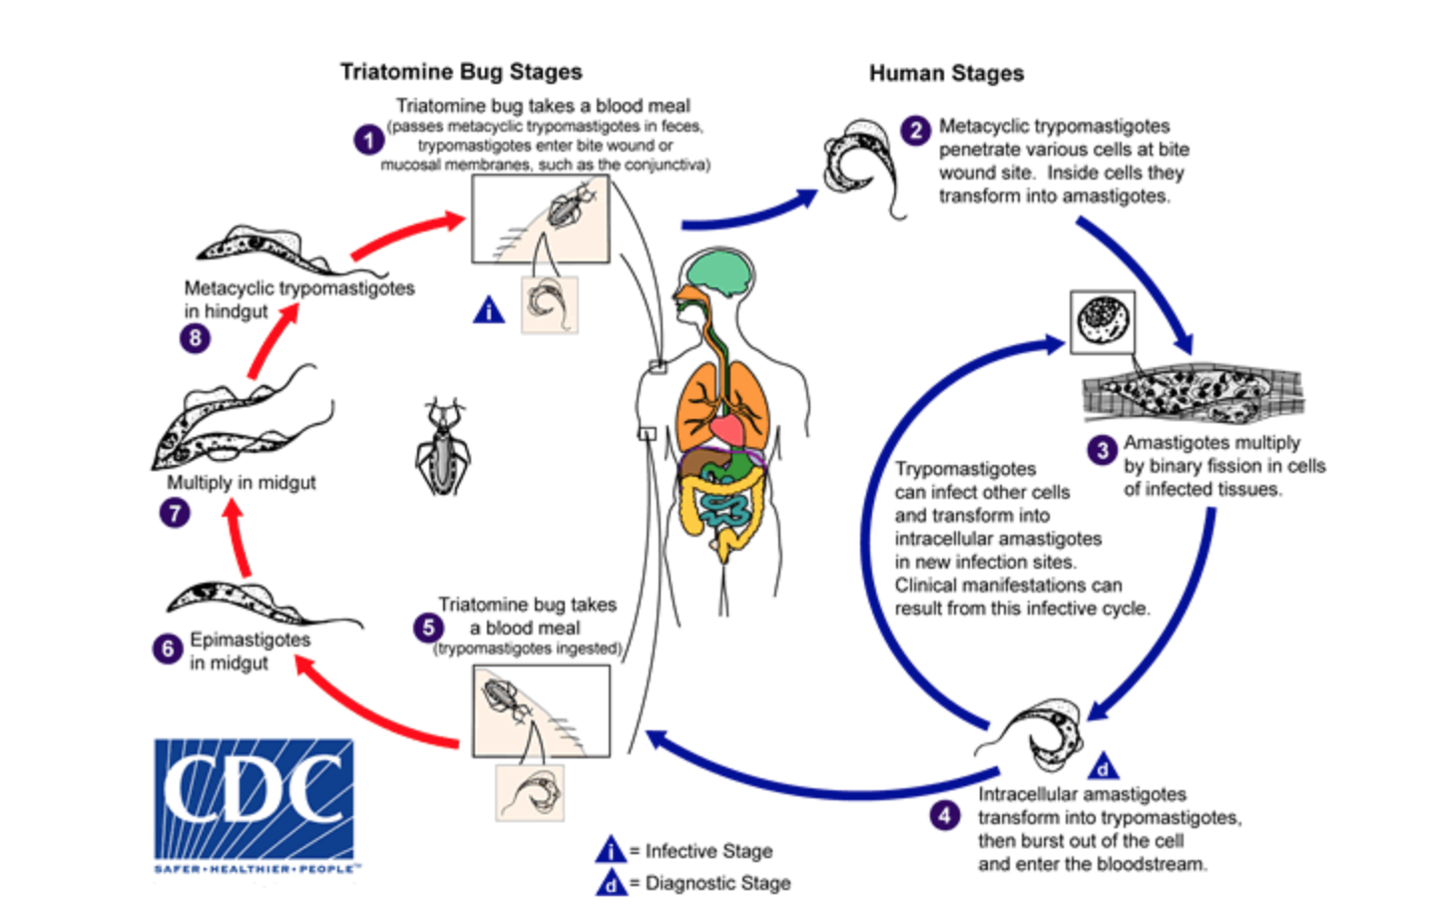
Life Cycle of T. cruzi
Amastigotes = no flagella
Trypomastigotes = has flagella
Replicate inside the cells as amastigotes
Burst out of the cells as trypomastigotes
Centers for Disease Control and Prevention. (2012). Life cycle. Retrieved from https://www.cdc.gov/parasites/chagas/biology.html
Notes:
An infected T. cruzi is one that has trypomastigotes in their hindgut. Upon taking a blood meal from humans, they leave their feces on the skin and this is how trypomastigotes enter from kissing bugs to humans. Once they are in the human body, they lose their flagella and transform into amastigotes. This is the most ideal life cycle for them to reproduce exponentially within the cells. Once they have fully infected the cell, they transform back into trypomastigotes and burst out of the cell and enter the bloodstream. Once in the bloodstream, they can access other organs and once again transform into amastigotes inside the cell to replicate and infect the organ. Keep in mind that if a non-infected T.cruzi takes a blood meal from an infected human, they will become infected as well.
M

Slide 9
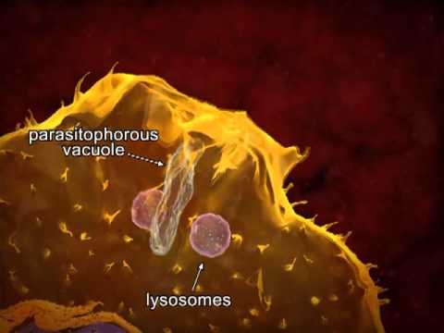
Mechanisms - Step 1
Recognition and recruitment of the immune system’s macrophages
Internalization of the trypomastigote and amastigote at the site of insect bite via phagocytosis
https://www.youtube.com/watch?v=1ais69H0li8
Notes:
JENNA
http://blog.apastyle.org/apastyle/2011/10/how-to-create-a-reference-for-a-youtube-video.html

Slide 10
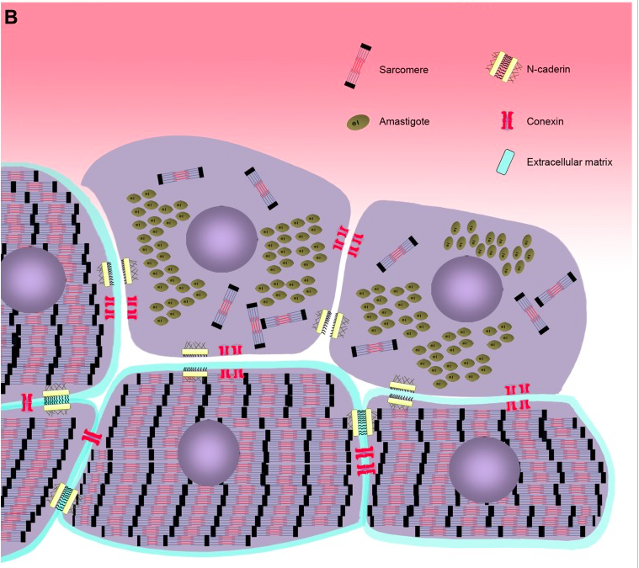
Mechanisms - Step 2
Internalization mechanism of cardiomyocytes
  Microfilament rearrangement
Result: Cardiac Arrhythmias
Calvet, C. M., Melo, T. G., Garzoni, L. R., Oliveira Jr, F. O., Neto, D. T. S., NSL, M., ... & Pereira, M. C. (2012). Current understanding of the Trypanosoma cruzi-cardiomyocyte interaction. Frontiers in immunology, 3.
Notes:
JENNA

Slide 11
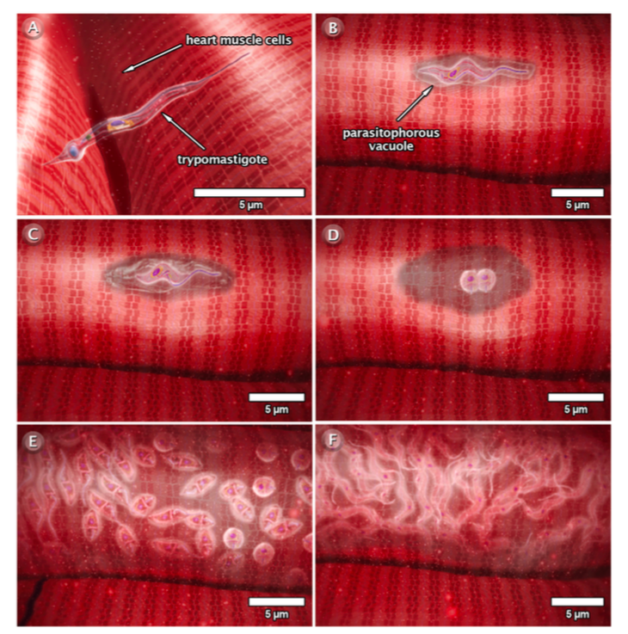
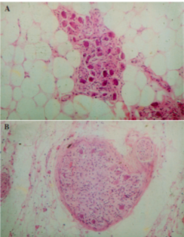
Pathophysiology
Accumulation of immune response cells
Cytokines, chemokines, nitric oxide
Necrosis of myofibrils
Results in cardiac fibrosis, hypertrophy and cardiac denervation (below)
Normal neuronal
population
Degenerative neuronal population
Calvet, C. M., Melo, T. G., Garzoni, L. R., Oliveira Jr, F. O., Neto, D. T. S., NSL, M., ... & Pereira, M. C. (2012). Current understanding of the Trypanosoma cruzi-cardiomyocyte interaction. Frontiers in immunology, 3.
Notes:
Left side - normal neuronal population
Right side - less dense neuronal population
Note: amastigotes start to accumulate and damage the nerve cells and overall structure, immune cells are recruited to the site of damage but also end up accumulating and causes the enlargement of the cardiomyocytes.
Autonomic nervous system neuronal depopulation due to:
-direct parasitism
-inflammation
JENNA

Slide 12
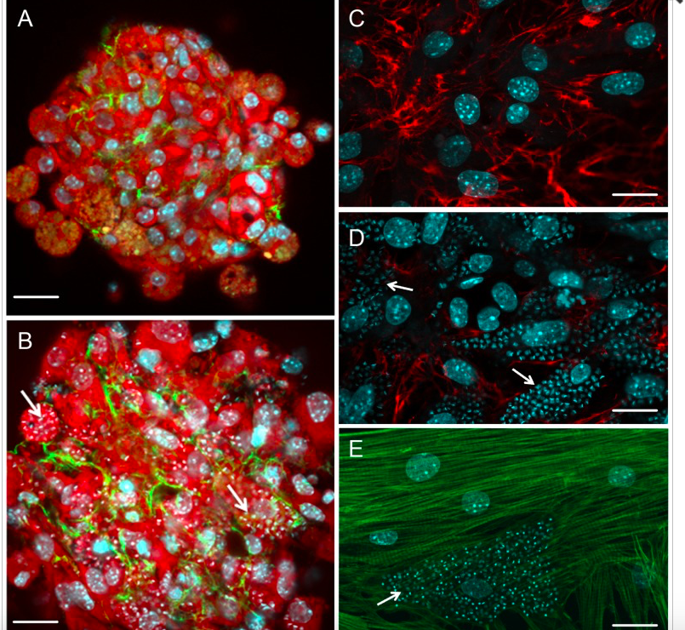
Pathophysiology
A → uninfected cardiomyocyte
B → infected cardiomyocyte
C → normal distribution of fibronectin
D → abnormal distribution of fibronectin
E → disorganization of myofibrils
Calvet, C. M., Melo, T. G., Garzoni, L. R., Oliveira Jr, F. O., Neto, D. T. S., NSL, M., ... & Pereira, M. C. (2012). Current understanding of the Trypanosoma cruzi-cardiomyocyte interaction. Frontiers in immunology, 3.
Notes:
JENNA

Slide 13
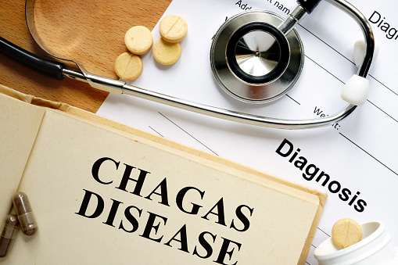
But Can You Be Cured Of Chagas Disease?
Marchione, V. (2016). Chagas diagnosis. Retrieved from https://www.belmarrahealth.com/chagas-disease-vaccine-potential-after-study-identifies-how-it-evades-immune-system/
Notes:
Script: Unfortunately you cant cure Chagas disease however you can definitely prevent it.
Melika

Slide 14
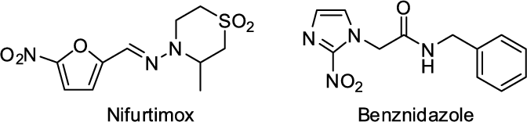
Treatment: Benznidazole
Released in 1972 at La Roche Laboratories
Approved by FDA in August 2017
  Only for ages 2-12
Nitroimidazole antiparasitic
  Acute infection
Unable to treat chronic cases
Severe side effects
  Harmful for pregnant women
Silve Junior, E.N.D. (2014). Chemical structure of benznidazole and nifurtimox . Retrieved from https://www.researchgate.net/publication/273691638_Anti-_Trypanosoma_cruzi_Compounds_
Our_Contribution_for_the_Evaluation_and_Insights_on_the_Mode_of_Action_of_Naphthoquinones_and_Derivatives
(
Chemical structure of Benznidazole
Notes:
Please refer to the figure when explaining the mechanism/
Melika

Slide 15
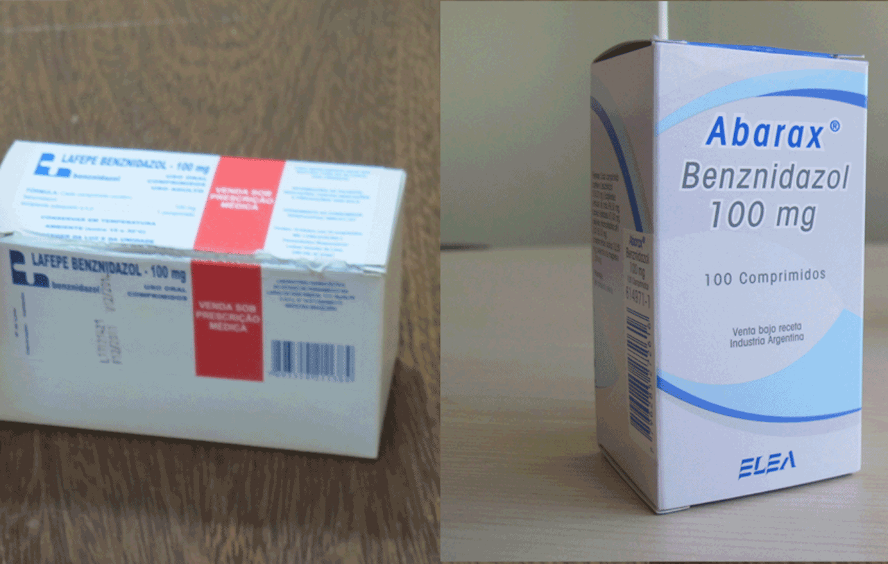
Side effects: Benznidazole
Allergic dermatitis
Peripheral neuropathy
Anorexia and weight loss
Insomnia
Popular drug for Benznidazole
Barcelona Institute for Global Healt, 2018. Chagas disease treatment. Retrieved from http://www.infochagas.org/en/tratamiento
Notes:
Melika

Slide 16
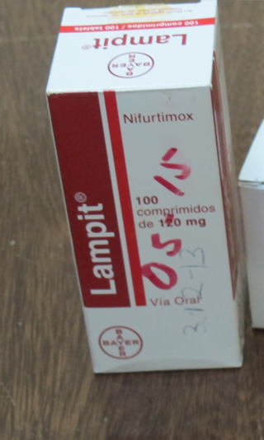
Treatment: Nifurtimox
Alternative to Benznidazole
Not approved by FDA
Mechanism: intracellular nitro reduction with the generation of the nitro radical, followed by redox cycling against T.cruzi
Not recommended for pregnant women or patients with kidney problems
Popular drug for Nifurtimox
Barcelona Institute for Global Healt, 2018. Chagas disease treatment. Retrieved from http://www.infochagas.org/en/tratamiento
Notes:
Lampit is a common drug name for Nifurtimox
JENNA

Slide 17
Side effects: Nifurtimox
Anorexia and weight loss
Polyneuropathy
Nausea
Vomiting
Headache
Dizziness or vertigo
Chemical structure of Nifurtimox
Silve Junior, E.N.D. (2014). Chemical structure of benznidazole and nifurtimox . Retrieved from https://www.researchgate.net/publication/273691638_Anti-_Trypanosoma_cruzi_Compounds_Our_Contribution_
for_the_Evaluation_and_Insights_on_the_Mode_of_Action_of_Naphthoquinones_and_Derivatives.
Notes:
Please refer to the figure when explaining the mechanism/
JENNA

Slide 18
Back to the Case Study
Put on donor list
Doctor contacted Centers for Disease Control and Prevention (CDC) when she remembered learning about Chagas Disease in med school
  CDC physician hotline
Blood tests
Complicated treatment plan
  Waited 2 months post-surgery for treatment medications
Notes:
JENNA

Slide 19
References
Steverding, D. (2014). The history of Chagas disease. Parasites & vectors, 7(1), 317.
Moncayo, Á. (2010). Carlos Chagas: biographical sketch. Acta tropica, 115(1), 1-4.
https://www.medicinenet.com/chagas_disease/article.htm
http://www.who.int/mediacentre/factsheets/fs340/en/
Rassi, A., & Marin-Neto, J. A. (2010). Chagas disease. The Lancet, 375(9723), 1388-1402.
Kierszenbaum, F. (2007). Mechanisms of pathogenesis in Chagas disease. Acta Parasitologica, 52(1), 1-12.
Bonney, K. M., & Engman, D. M. (2008). Chagas heart disease pathogenesis: one mechanism or many?. Current molecular medicine, 8(6), 510-518.*
Chaves, A. T., Estanislau, J. D. A. S. G., Fiuza, J. A., Carvalho, A. T., Ferreira, K. S., Fares, R. C. G., ... & da Costa Rocha, M. O. (2016). Immunoregulatory mechanisms in Chagas disease: modulation of apoptosis in T-cell mediated immune responses. BMC infectious diseases, 16(1), 191.
Ribeiro, A. L., Nunes, M. P., Teixeira, M. M., & Rocha, M. O. (2012). Diagnosis and management of Chagas disease and cardiomyopathy. Nature Reviews Cardiology, 9(10), 576-589.
Jannin, J., & Villa, L. (2007). An overview of Chagas disease treatment. Memórias do Instituto Oswaldo Cruz, 102, 95-98. http://www.scielo.br.libaccess.lib.mcmaster.ca/scielo.php?pid=S0074-02762007005000106&script=sci_arttext
Bern, C. (2011). Antitrypanosomal therapy for chronic Chagas' disease. New England Journal of Medicine, 364(26), 2527-2534.http://www.nejm.org.libaccess.lib.mcmaster.ca/doi/full/10.1056/NEJMct1014204
Urbina, J. A., & Docampo, R. (2003). Specific chemotherapy of Chagas disease: controversies and advances. Trends in parasitology, 19(11), 495-501. http://www.sciencedirect.com.libaccess.lib.mcmaster.ca/science/article/pii/S1471492203002411
Calvet, C. M., Melo, T. G., Garzoni, L. R., Oliveira Jr, F. O., Neto, D. T. S., NSL, M., ... & Pereira, M. C. (2012). Current understanding of the Trypanosoma cruzi-cardiomyocyte interaction. Frontiers in immunology, 3.
Teixeira, D. E., Benchimol, M., Crepaldi, P. H., & de Souza, W. (2012). Interactive multimedia to teach the life cycle of Trypanosoma cruzi, the causative agent of Chagas disease. PLoS neglected tropical diseases, 6(8).
Rassi Jr, A., Rassi, A., & Marin-Neto, J. A. (2009). Chagas heart disease: pathophysiologic mechanisms, prognostic factors and risk stratification. Memorias do Instituto Oswaldo Cruz, 104, 152-158.
Teixeira, A.R.L., Nitz, N., Guimaro, M.C., Gomes, C., & Santos-Buch, C.A. (2006). Chagas disease. Postgrad Med J, 82 (974): 788-798.
Rassi, A., (2014) Chagas’ Heart Disease. World Congress of Cardiology Scientific Sessions.
Rassi, A., & Marin-Neto, J. A. (2010). Chagas disease. The Lancet, 375(9723), 1388-1402.
Bern, C. (2015). Chagas’ disease. New England Journal of Medicine, 373(5), 456-466.
Centers for Disease Control and Prevention. (2012). Retrieved from https://www.cdc.gov/parasites/chagas/biology.html

Slide 20
Question 1
Which one of the following methods of transmission is the LEAST likely to occur for Chagas disease?
Contact through feces of infected vector
Congenital contract from mother to baby
Contact with contaminated blood transfusions or contaminated organs from donors
Contaminated food/drink

Slide 21
Question 1
Which one of the following methods of transmission is the LEAST likely to occur for Chagas disease?
Contact through feces of infected vector
Congenital contract from mother to baby
Contact with contaminated blood transfusions or contaminated organs from donors
D. Contaminated food/drink

Slide 22
Question 2
How can amastigotes bind to macrophages at the site of infection without transforming into trypomastigote?
Amastigotes have a flagella so they travel to the macrophages
Macrophages are recruited to the site due to an immune response
Amastigotes send signals to recruit macrophages
They do not bind

Slide 23
Question 2
How can amastigotes bind to macrophages at the site of infection without transforming into trypomastigote?
Amastigotes have a flagella so they travel to the macrophages
Macrophages are recruited to the site due to an immune response
Amastigotes send signals to recruit macrophages
They do not bind

